Slide 1
Linear Methods for Classification, Part 2
BMTRY 790: Machine Learning

Slide 2
Last Time
We’ve discussed several methods for developing a linear classifier
Linear regression
Logistic and Multinomial Regression (categorical)
Proportional Odds regression (ordinal)
Linear and Quadratic Discriminant Analysis
Let’s look at a real example

Slide 3
Multinomial Example
Localized breast cancer can be treated by excising tumor tissue in the affected breast
In order to ensure removal of as little tissue as possible, it is important to determine different tissue types to discriminate tumor from other tissue.
Study goal: Determine if impedance measures in human breast tissue can discriminate
Connective tissue
Benign tumor
Carcinoma
(Adipose tissue- I excluded this in the example)

Slide 4
Multinomial Example
Features:
I0 = Impedivity (ohm) at zero frequency
PA500 = Phase angle at 500 KHz
HFS = High-frequency slope of phase angle
normArea = Area under the spectrum by impedance distance
between spectral ends
Max IP = Maximum of the spectrum
DR = Distance between I0 and the real part of the maximum
frequency point
P = Length of the spectral curve

Slide 5
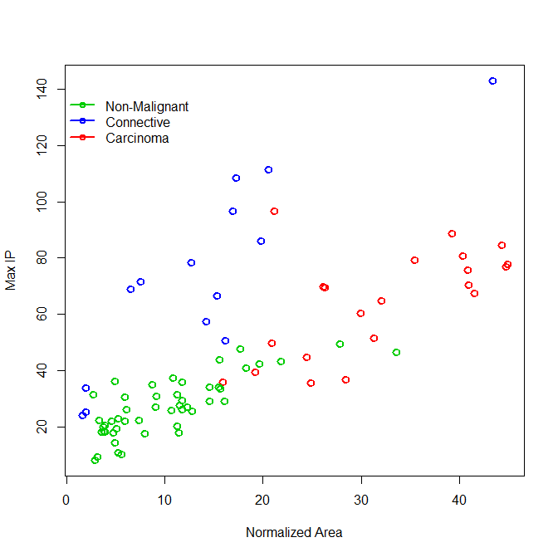
Our Groups

Slide 6
Linear Classification Using OLS in R
We can fit this using the lm function in the base package
We just need to generate the appropriate Y matrix to go with X of indicator variables

Slide 7
Breast Tissue Example
### Generating our matrix of indicators ###
btis<-read.csv("H:\\public_html\\BMTRY790_Spring2023\\Datasets\\BreastTissue.csv")
table(btis$Class)
adipose carcinoma connective nonmalig
22 21 14 49
btis<-btis[-which(btis$Class=="adipose"),]
btis$Iclass<-ifelse(btis$Class=="nonmalig", 1, ifelse(btis$Class=="connective", 2, 3))
y1<-ifelse(btis$Class=="nonmalig", 1, 0)
y2<-ifelse(btis$Class=="connective", 1, 0)
y3<-ifelse(btis$Class=="carcinoma", 1, 0)
Y<-cbind(y1,y2,y3)
Y
y1 y2 y3
[1,] 0 0 1
[2,] 0 0 1
[3,] 0 0 1
…
[82,] 0 1 0
[83,] 0 1 0
[84,] 0 1 0

Slide 8
Recall- What Does the OLS Model Look Like?

Slide 9
Breast Tissue Example
### Fitting our model using the predictors “normArea” and “maxIP” ###
colnames(btis)
[1] "CaseID" "Class" "I0" "PA500" "HFS" "normArea“ "MaxIP" "DR" "P" "Iclass"
X<-btis[,6:7]
mvmod<-lm(Y ~ X)
bhat<-coef(mvmod)
round(bhat, 4)
y1 y2 y3
(Intercept) 1.1893 -0.0625 -0.1268
XnormArea -0.0053 -0.0264 0.0317
XMaxIP -0.0118 0.0149 -0.0032

Slide 10
Breast Tissue Example
### More detail about the model ###
summary(mvmod)
Response y1 : ### Recall y1 was the indicator of non-malignant tissue
Call: lm(formula = y1 ~ X)
Residuals:
Min 1Q Median 3Q Max
-0.8990 -0.1522 0.0633 0.2051 0.7236
Coefficients:
Estimate Std. Error t value Pr(>|t|)
(Intercept) 1.189253 0.070399 16.893 < 2e-16 ***
XnormArea -0.005326 0.004279 -1.245 0.217
XMaxIP -0.011753 0.001917 -6.131 3.01e-08 ***
---
Signif. codes: 0 ‘***’ 0.001 ‘**’ 0.01 ‘*’ 0.05 ‘.’ 0.1 ‘ ’ 1
Residual standard error: 0.3345 on 81 degrees of freedom. Multiple R-squared: 0.556, Adjusted R-squared: 0.5451
F-statistic: 50.72 on 2 and 81 DF, p-value: 5.222e-15

Slide 11
Breast Tissue Example
### More detail about the model ###
summary(mvmod)
Response y2 : ### Recall y2 was the indicator of connective tissue
Call: lm(formula = y2 ~ X)
Residuals:
Min 1Q Median 3Q Max
-0.82311 -0.11796 -0.04127 0.06243 0.74646
Coefficients:
Estimate Std. Error t value Pr(>|t|)
(Intercept) -0.062502 0.051153 -1.222 0.225
XnormArea -0.026368 0.003109 -8.481 8.44e-13 ***
XMaxIP 0.014937 0.001393 10.725 < 2e-16 ***
---
Signif. codes: 0 ‘***’ 0.001 ‘**’ 0.01 ‘*’ 0.05 ‘.’ 0.1 ‘ ’ 1
Residual standard error: 0.2431 on 81 degrees of freedom. Multiple R-squared: 0.5898, Adjusted R-squared: 0.5797
F-statistic: 58.23 on 2 and 81 DF, p-value: < 2.2e-16

Slide 12
Breast Tissue Example
### More detail about the model ###
summary(mvmod)
Response y3 : ### Recall y3 was the indicator of carcinoma
Call: lm(formula = y3 ~ X)
Residuals:
Min 1Q Median 3Q Max
-0.79275 -0.16455 -0.00716 0.09627 0.76502
Coefficients:
Estimate Std. Error t value Pr(>|t|)
(Intercept) -0.126751 0.060286 -2.102 0.0386 *
XnormArea 0.031695 0.003664 8.650 3.92e-13 ***
XMaxIP -0.003184 0.001641 -1.940 0.0559 .
---
Signif. codes: 0 ‘***’ 0.001 ‘**’ 0.01 ‘*’ 0.05 ‘.’ 0.1 ‘ ’ 1
Residual standard error: 0.2865 on 81 degrees of freedom. Multiple R-squared: 0.578, Adjusted R-squared: 0.5675
F-statistic: 55.46 on 2 and 81 DF, p-value: 6.717e-16

Slide 13
Recall- How Do We Predict From OLS?

Slide 14
Breast Tissue Example
### Look at the predicted “posterior probabilities” and verify they sum to 1###
round(predict(mvmod), 3)
y1 y2 y3
1 0.322 0.048 0.630
2 0.231 0.290 0.479
3 0.036 -0.084 1.048
…
82 0.346 0.793 -0.140
83 -0.230 1.060 0.170
84 -0.037 0.933 0.103
rowSums(predict(mvmod))
1 2 3 … 82 83 84
1 1 1 … 1 1 1

Slide 15
What About Our Decision Boundaries?

Slide 16
What About Our Decision Boundaries?

Slide 17
What About Our Decision Boundaries?

Slide 18
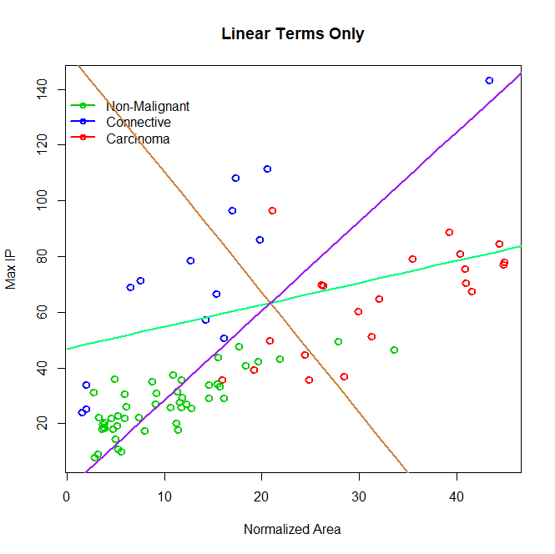
Boundaries

Slide 19
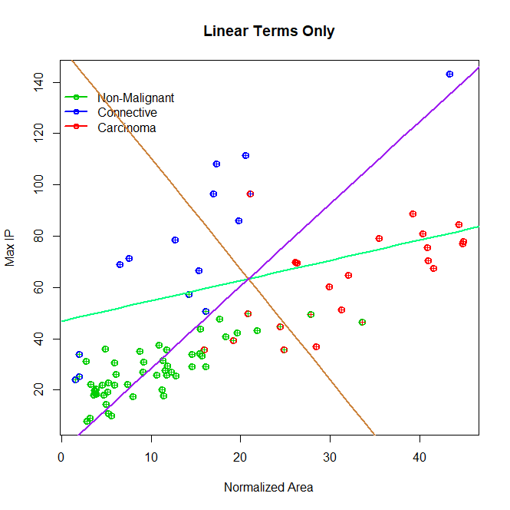
Prediction vs. Observed?

Slide 20
Breast Tissue Example
### What happens if we include a square term? ###
X<-as.matrix(cbind(btis[,6:7], btis[,6]*btis[,7]))
colnames(X)<-c("Intercept","normArea","MaxIP","CrossProd")
mvmod<-lm(Y ~ X)
bhat<-coef(mvmod)
round(bhat, 4)
y1 y2 y3
(Intercept) 1.3352 -0.1102 -0.2250
XnormArea -0.0158 -0.0229 0.0387
XMaxIP -0.0152 0.0161 -0.0009
XCrossProd 0.0002 -0.0001 -0.0001

Slide 21
Breast Tissue Example
### More detail on one of the models ###
summary(mvmod)
Response y1 : ### Recall y1 was the indicator of non-malignant tissue
Call: lm(formula = y1 ~ X)
Residuals:
Min 1Q Median 3Q Max
-0.95267 -0.15834 0.02606 0.22856 0.61158
Coefficients:
Estimate Std. Error t value Pr(>|t|)
(Intercept) 1.3352053 0.1120653 11.915 < 2e-16 ***
XnormArea -0.0157959 0.0075883 -2.082 0.0406 *
XMaxIP -0.0151997 0.0028099 -5.409 6.41e-07 ***
XCrossProd 0.0001854 0.0001115 1.662 0.1003
---
Signif. codes: 0 ‘***’ 0.001 ‘**’ 0.01 ‘*’ 0.05 ‘.’ 0.1 ‘ ’ 1
Residual standard error: 0.3309 on 80 degrees of freedom. Multiple R-squared: 0.5709, Adjusted R-squared: 0.5548
F-statistic: 35.47 on 3 and 80 DF, p-value: 1.106e-14

Slide 22
How Do We Predict From This OLS Fit?

Slide 23
What About Our Decision Boundaries Now?

Slide 24
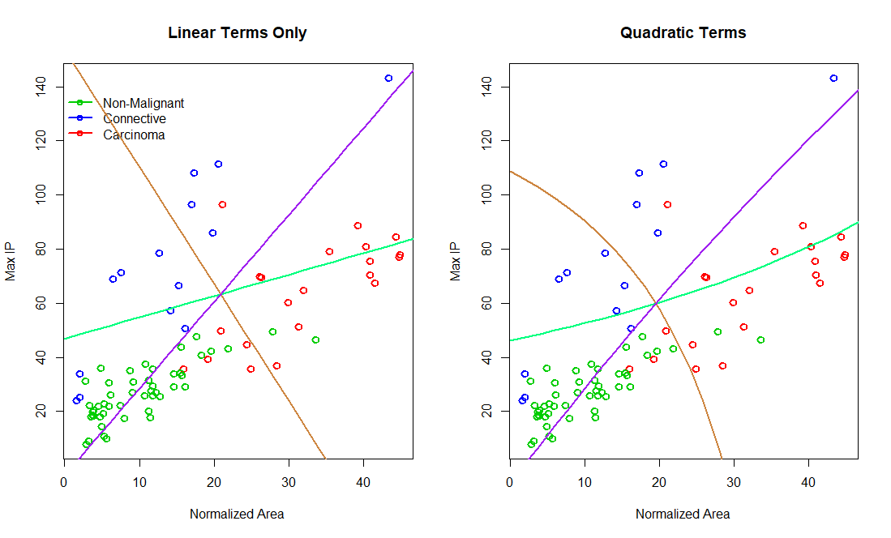
Boundaries For Linear and Quadratic Models

Slide 25
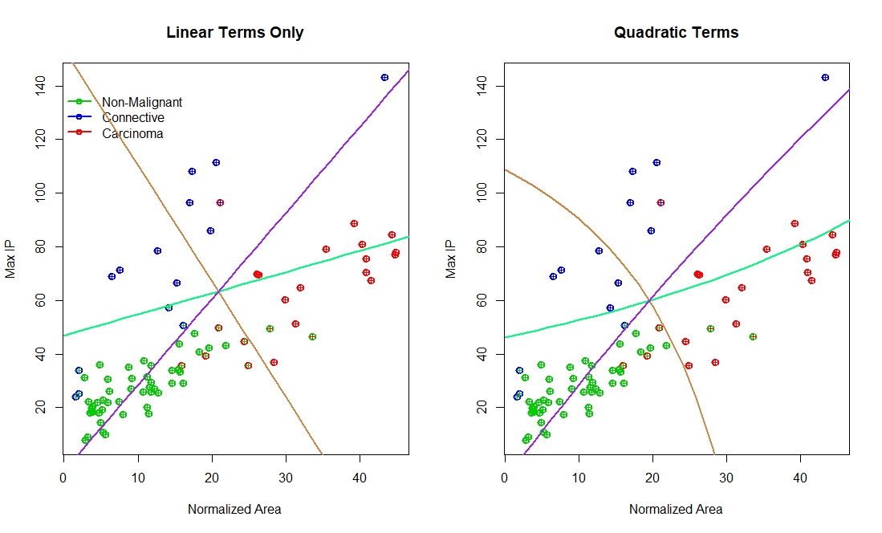
Prediction vs. Observed?

Slide 26
Linear Classification Using Multinomial Logistic Regression in R
There are several packages in R that can fit multinomial logistic regression models:
nnet
mlogit
The nnet package is also used to fit neural network models (which we will discuss later).
The mlogit package was developed by an econometrician and is not as easy to use

Slide 27
Recall- What Does the Multinomial Logistic Model Look Like?

Slide 28
Breast Tissue Example
### Let’s fit a multinomial logistic regression ###
library(nnet)
mnlogit<-multinom(Iclass~normArea + MaxIP, data=btis)
# weights: 12 (6 variable)
initial value 92.283432
iter 10 value 27.405225
iter 20 value 26.910655
final value 26.910551
converged
bhat<-coef(mnlogit)
round(bhat, 4)
(Intercept) normArea MaxIP
2 -6.9510 -0.3761 0.2486
3 -7.4091 0.1189 0.1025

Slide 29
Breast Tissue Example
### The model in a little more detail ###
summary(mnlogit)
Call:
multinom(formula = Iclass ~ normArea + MaxIP, data = btis)
Coefficients:
(Intercept) normArea MaxIP
2 -6.950988 -0.3760546 0.2486397
3 -7.409075 0.1189195 0.1025015
Std. Errors:
(Intercept) normArea MaxIP
2 1.65974 0.13830884 0.06526318
3 1.68603 0.07977037 0.05226703
Residual Deviance: 53.8211
AIC: 65.8211

Slide 30
How Do We Predict From Multinom Logit?

Slide 31
Breast Tissue Example
### Prediction with the nnet package is easy ###
predict(mnlogit)
[1] 3 3 3 3 3 3 1 1 3 3 3 3 3 3 3 3 3 3 1 1 2 1 1 1 1 1 1 1 1 1 1 1 1 1 1 1 1 1
[39] 1 1 1 2 1 1 1 1 1 1 1 1 3 1 3 1 1 1 1 1 1 1 1 1 1 1 1 1 1 1 1 1 2 3 2 1 2 1
[77] 2 1 2 2 2 2 2 2
Levels: 1 2 3
round(predict(mnlogit, type="probs"), 3)
1 2 3
1 0.089 0.004 0.907
2 0.050 0.088 0.861
3 0.003 0.000 0.997
4 0.002 0.002 0.996
…
83 0.000 0.999 0.001
84 0.000 0.998 0.002

Slide 32
What About Our Decision Boundaries?

Slide 33
What About Our Decision Boundaries?

Slide 34
What About Our Decision Boundaries?

Slide 35
What About Our Decision Boundaries?

Slide 36
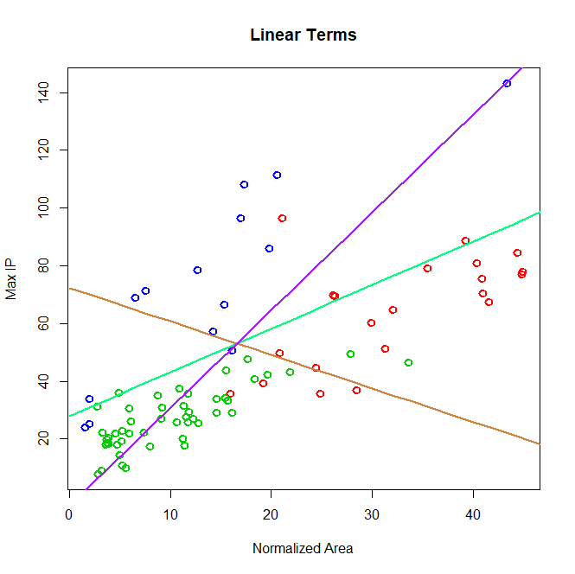
Boundaries

Slide 37
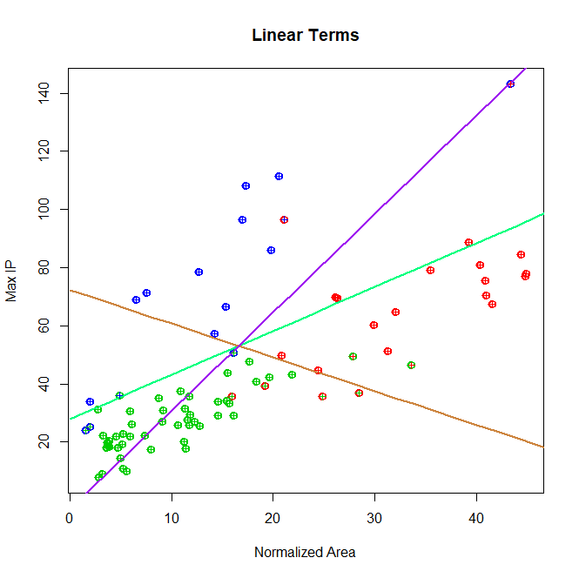
Prediction vs. Observed?

Slide 38
Breast Tissue Example
### What happens if we include a square term? ###
mnlogit<-multinom(Iclass~normArea + MaxIP + normArea*MaxIP, data=btis)
# weights: 15 (8 variable)
initial value 92.283432
iter 10 value 26.501180
iter 20 value 24.418754
iter 30 value 24.353278
final value 24.350348
converged
bhat<-coef(mnlogit)
round(bhat, 4)
(Intercept) normArea MaxIP normArea:MaxIP
2 -5.9982 -0.4503 0.2391 0.0002
3 -13.4033 0.3557 0.2141 -0.0042

Slide 39
Breast Tissue Example
### The model in a little more detail ###
summary(mnlogit)
Call:
multinom(formula = Iclass ~ normArea + MaxIP + normArea * MaxIP, data = btis)
Coefficients:
(Intercept) normArea MaxIP normArea:MaxIP
2 -5.9982 -0.4502771 0.2390874 0.0001683211
3 -13.4033 0.3557169 0.2141333 -0.0041586005
Std. Errors:
(Intercept) normArea MaxIP normArea:MaxIP
2 1.8124995 0.1910363 0.06301215 0.002586209
3 0.6066884 0.1155966 0.03582469 0.001893630
Residual Deviance: 48.7007
AIC: 64.7007

Slide 40
What About Our Decision Boundaries Now?

Slide 41
What About Our Decision Boundaries Now?

Slide 42
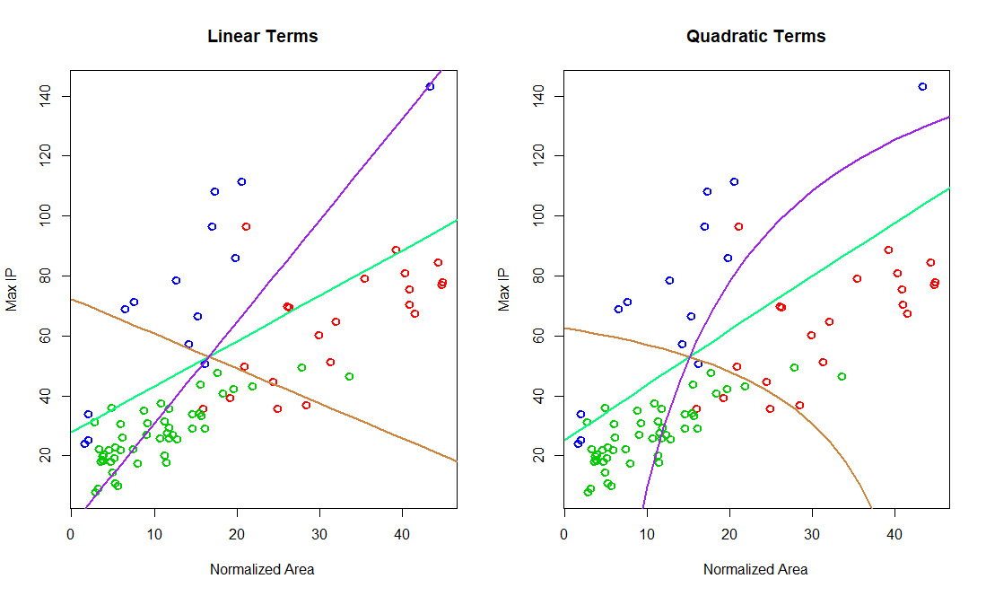
Boundaries For Linear and Quadratic Models

Slide 43
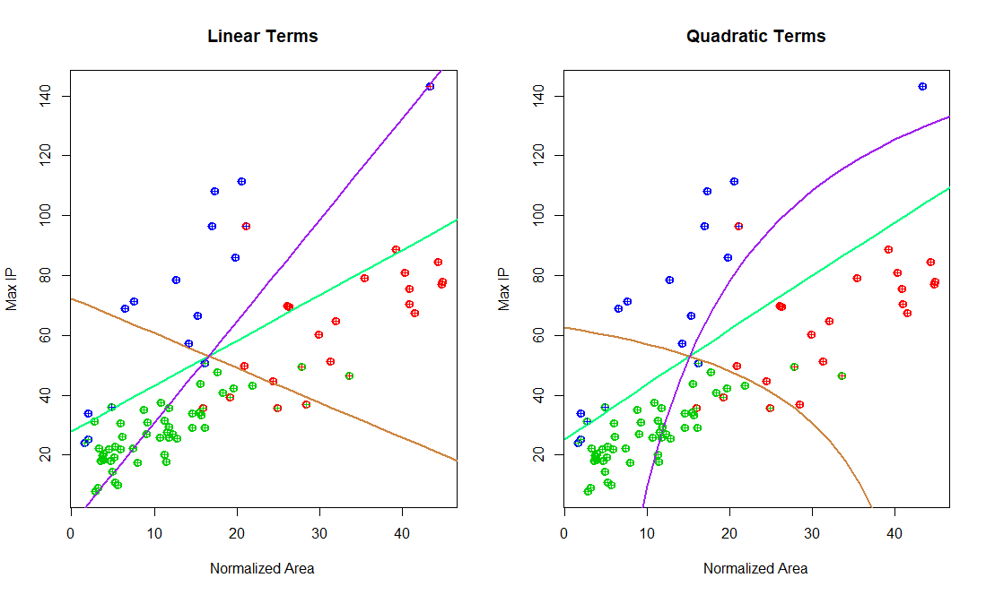
Prediction vs. Observed?

Slide 44
Linear Classification Using LDA in R
Both linear and quadratic discriminant analysis can be conducted in R using the MASS package

Slide 45
Breast Tissue Example
### Let’s fit an LDA model ###
library(MASS)
mnlda<-lda(Iclass ~ normArea + MaxIP, data=btis, CV=FALSE)
print(mnlda)
Call: lda(Iclass ~ normArea + MaxIP, data = btis, CV = FALSE)
Prior probabilities of groups:
1 2 3
0.5833333 0.1666667 0.2500000
Group means:
normArea MaxIP
1 10.24920 27.19797
2 13.99781 72.95797
3 32.04633 64.53152

Slide 46
Breast Tissue Example
### Let’s fit an LDA model ###
Coefficients of linear discriminants:
LD1 LD2
normArea 0.17963820 -0.02874489
MaxIP -0.06683251 -0.04441188
Proportion of trace:
LD1 LD2
0.5458 0.4542

Slide 47
Breast Tissue Example
### Let’s fit an LDA model ###
names(predict(mnlda))
[1] "class" "posterior" "x"
predict(mnlda)$class
[1] 3 3 3 3 3 1 1 1 3 3 3 3 3 3 3 3 3 3 3 3 2 1 1 1 1 1 1 1 1 1 1 1 1 1 1 1 1 1
[39] 1 1 1 1 1 1 1 1 1 1 1 1 3 1 3 1 1 1 1 1 1 1 1 1 1 1 1 1 1 1 1 1 2 2 2 1 2 1
[77] 1 1 1 2 2 2 2 2
Levels: 1 2 3

Slide 48
Breast Tissue Example
round(predict(mnlda)$posterior, 3)
1 2 3
1 0.113 0.001 0.886
2 0.270 0.067 0.663
…
82 0.004 0.996 0.000
83 0.000 1.000 0.000
84 0.000 1.000 0.000
round(predict(mnlda)$x, 3)
LD1 LD2
1 1.368 -1.103
2 0.050 -1.416
…
82 -3.409 -0.811
83 -3.737 -3.109
84 -3.390 -2.348

Slide 49
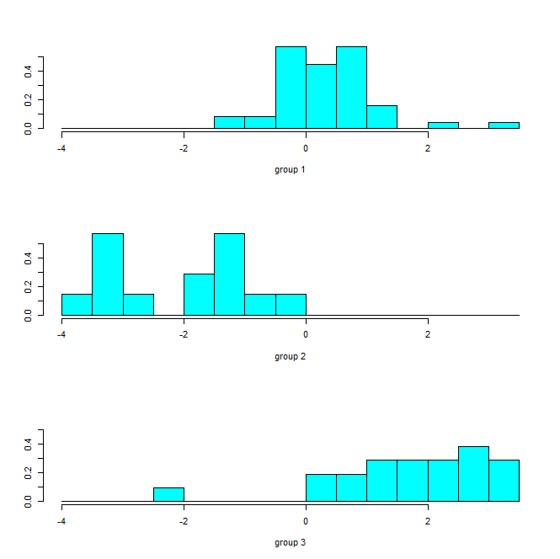
Breast Tissue Example
plot(mnlda, dimen=1)

Slide 50
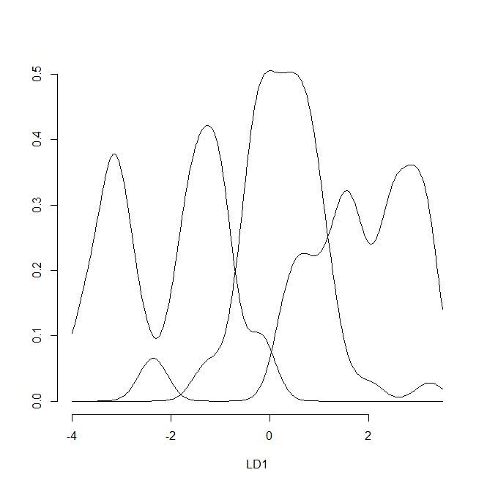
Breast Tissue Example
plot(mnlda, type=“density”, dimen=1)

Slide 51
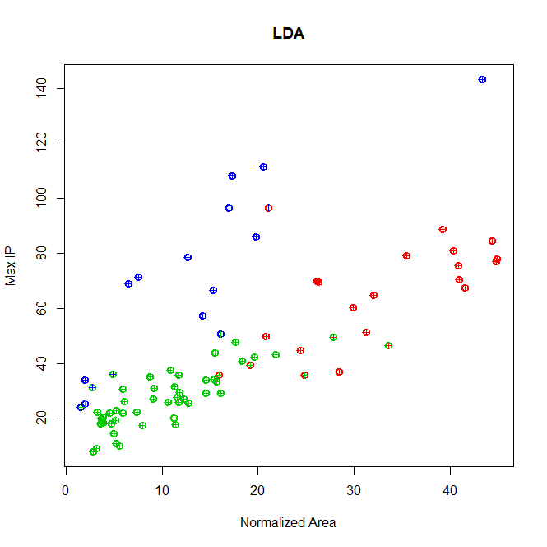
Prediction vs. Observed?

Slide 52
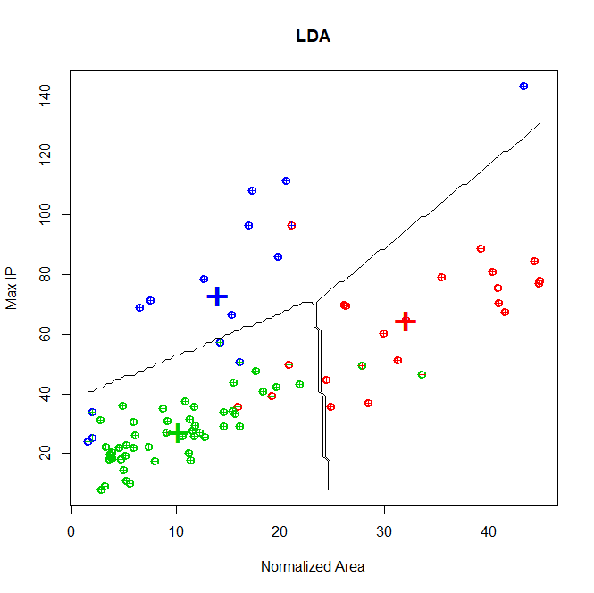
Decision Boundaries?

Slide 53
Any Issues LDA?
LDA assumes equal variance of the features for each group…
var(btis[nonm,6:7]) ### Variance for non-malignant tissue
normArea MaxIP
normArea 43.56911 52.80027
MaxIP 52.80027 104.52057
var(btis[conn,6:7]) ### Variance for connective tissue
normArea MaxIP
normArea 116.0438 323.2375
MaxIP 323.2375 1187.0811
var(btis[carc,6:7]) ### Variance for carcinoma tissue
normArea MaxIP
normArea 86.12503 106.5995
MaxIP 106.59945 345.3887

Slide 54
Any Issues LDA?
There is a formal test for homogeneity of the variance matrices between groups
Bartlett’s test:
Null: H₀: Σ₁ = Σ₂ = Σ₃
Alternative: at least one is not equivalent
bartlett.test(btis[,6:7], btis$Iclass)
Bartlett test of homogeneity of variances
data: btis[, 6:7]
Bartlett's K-squared = 48.31, df = 1, p-value = 3.638e-12

Slide 55
Breast Tissue Example
### Let’s fit an QDA model ###
mnqda<-qda(Iclass ~ normArea + MaxIP, data=btis, CV=FALSE)
mnqda
Call: qda(Iclass ~ normArea + MaxIP, data = btis, CV = FALSE)
Prior probabilities of groups:
1 2 3
0.5833333 0.1666667 0.2500000
Group means:
normArea MaxIP
1 10.24920 27.19797
2 13.99781 72.95797
3 32.04633 64.53152

Slide 56
Breast Tissue Example
### QDA model ###
names(predict(mnqda))
[1] "class" "posterior"
predict(mnqda)$class
[1] 3 3 3 3 3 1 1 1 3 3 3 3 3 3 3 3 1 3 3 3 2 1 1 1 1 1 1 1 1 1 1 1 1 1 1 1 1 1 1 1 1 1 1 1 1 1 1 1 1 1 3 1
[53] 3 1 1 1 1 1 1 1 1 1 1 1 1 1 1 1 1 1 2 2 2 3 2 1 2 1 2 2 2 2 2 2
Levels: 1 2 3

Slide 57
Breast Tissue Example
round(predict(mnlda)$posterior, 3)
1 2 3
1 0.032 0.001 0.968
2 0.001 0.041 0.958
3 0.000 0.000 1.000
4 0.000 0.000 1.000
5 0.001 0.034 0.965
…
82 0.000 0.995 0.005
83 0.000 1.000 0.000
84 0.000 0.998 0.002

Slide 58
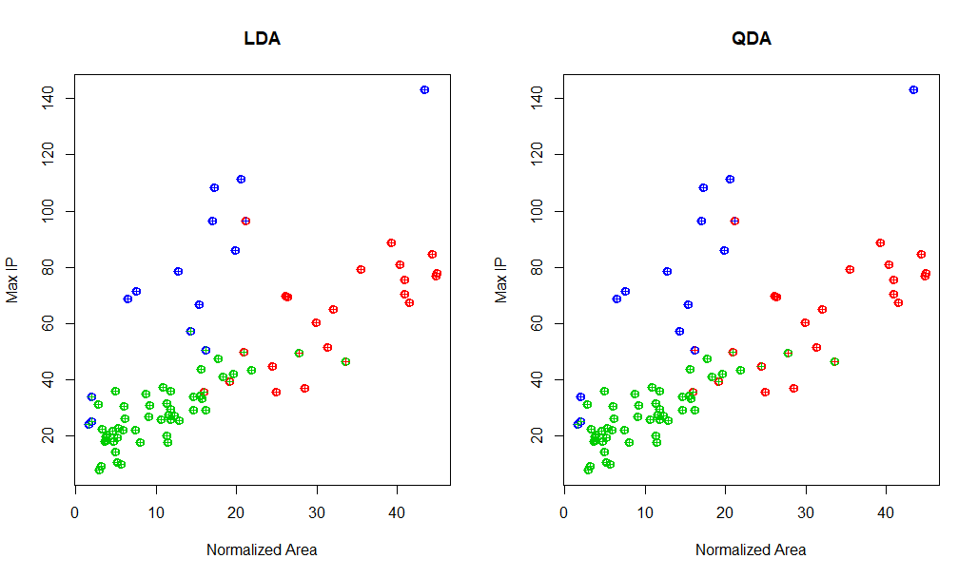
Prediction vs. Observed?

Slide 59
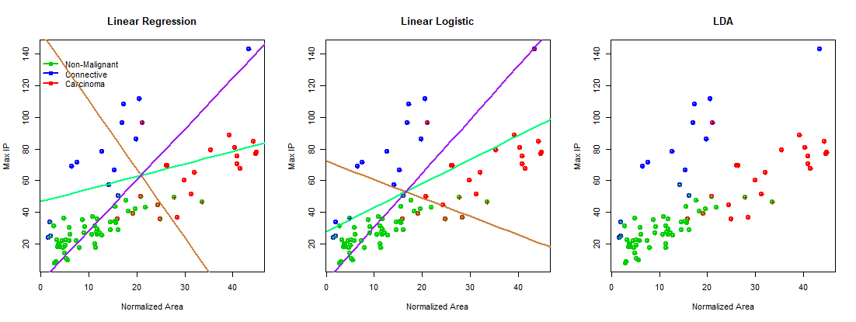
Predictions from the 3 Linear Models

Slide 60
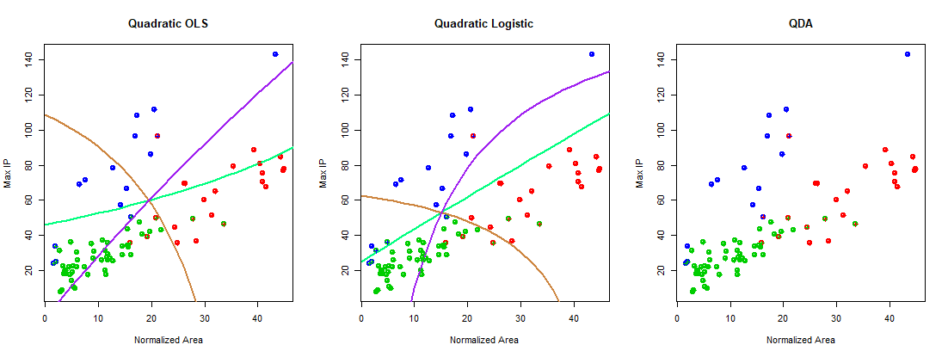
Predictions from the 3 “Quadratic” Models

Slide 61
Getting R Source Code..
>library(nnet)
> multinom
function (formula, data, weights, subset, na.action, contrasts = NULL,
Hess = FALSE, summ = 0, censored = FALSE, model = FALSE, ...)
{
class.ind <- function(cl) {
n <- length(cl)
x <- matrix(0, n, length(levels(cl)))
x[(1L:n) + n * (as.integer(cl) - 1L)] <- 1
dimnames(x) <- list(names(cl), levels(cl))
x
}
summ2 <- function(X, Y) {
X <- as.matrix(X)
…
if (model)
fit$model <- m
class(fit) <- c("multinom", "nnet")
if (Hess)
fit$Hessian <- multinomHess(fit, X)
fit
}
<bytecode: 0x00000000066b7b68>
<environment: namespace:nnet>

Slide 62
Getting R Source Code..
> library(MASS)
> lda
function (x, ...)
UseMethod("lda")
<bytecode: 0x0000000006e7bf50>
<environment: namespace:MASS>

Slide 63
Getting R Source Code..
> getAnywhere(lda)
A single object matching ‘lda’ was found
It was found in the following places
package:MASS
namespace:MASS
with value
function (x, ...)
UseMethod("lda")
<bytecode: 0x0000000006e7bf50>
<environment: namespace:MASS>
> methods(lda)
[1] lda.data.frame* lda.default* lda.formula* lda.matrix*
see '?methods' for accessing help and source code

Slide 64
Getting R Source Code..
> MASS:::lda.default
function (x, grouping, prior = proportions, tol = 1e-04, method = c("moment",
"mle", "mve", "t"), CV = FALSE, nu = 5, ...)
{
if (is.null(dim(x)))
stop("'x' is not a matrix")
x <- as.matrix(x)
if (any(!is.finite(x)))
stop("infinite, NA or NaN values in 'x'")
n <- nrow(x)
p <- ncol(x)
…
cl[[1L]] <- as.name("lda")
structure(list(prior = prior, counts = counts, means = group.means,
scaling = scaling, lev = lev, svd = X.s$d[1L:rank], N = n,
call = cl), class = "lda")
}
<bytecode: 0x00000000154975c8>
<environment: namespace:MASS>

