Slide 1
Linear Methods for Classification, Part 1
BMTRY 790

Slide 2
Classification
Assuming we have data with 2 or more groups, we may want to determine which group an observation belongs too
Thus the goal of classification analysis is to find a “good” rule to assign observations to an appropriate group…
But how do we do that?

Slide 3
How does probability play a role in decision making?
Example: we want determine if a patient has lung cancer or not based on a CT-scan.
inputs x: set of pixel intensities for our image
outcome y: lung cancer (Y/N)
Consider probability of a subject’s class given their image using Bayes’ theorem
Intuitively we choose the class with the higher posterior probability

Slide 4
Definitions in Classification
We are looking for classification rules that minimize our total expected misclassification cost/loss

Slide 5
Minimizing Misclassification Rate
A simple cost function minimizes the number of observations we misclassify
Develop a rule that assigns classes to each observation
Rule divides feature space X into regions R_{k} (decision regions). Boundaries between these regions are called decision boundaries.
Calculate the probability of a misclassification.
Consider a 2 class example, a mistake occurs when an input vector belonging to G₁ is assigned to G₂
The probability of a mistake is:

Slide 6
The minimum probability of making a mistake occurs if x assigned to class with the largest posterior probability
Generalized to K classes, it is often easier to maximize the probability of being correct
which is maximized when regions R_{k} chosen such that each x assigned to class with largest posterior probability

Slide 7
Linear Regression Approach, 2 Classes
Recall out discussion in the first class where we considered K = 2 classes.
We can fit a linear regression model to our response y using the predictors in X just as we would with a continuous outcome
The resulting regression model takes the familiar form
We then determine the class according to

Slide 8
Linear Regression Approach
Recall we can think of a regression model as an estimate of a conditional expectation
We can also think of this as an estimate of the posterior probability given our feature vector x
Question: is how good is this approximation
Since the regression estimate is not bounded on (0, 1), there are clearly some issued with the idea that the model is estimating a posterior probability
However…

Slide 9
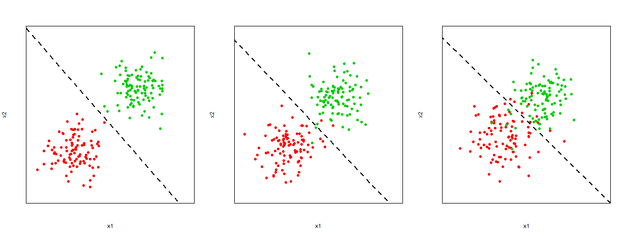
Linear Regression Approach, 2 Classes
For some classification problems with 2 classes, this approach works fairly well.
In general, for the 2-class case it often works as well as other linear classifiers. But what if K > 2?

Slide 10
Linear Regression Approach, >2 Classes

Slide 11
K > 2
Example:
Goal is to distinguish between several different types of lung tumors (both malignant and non-malignant):
Small cell lung cancer
Non-small cell lung cancer
Granulomatosis
Sarcoidosis
In this case features may be pixels from CT scan image

Slide 12
Linear Regression Approach, K > 3
What about the case where we have K > 3 classes:
We can still use a linear regression approach, however we now consider the fact that we have K possible values
An indicator variable y as our response is no longer sufficient
Instead, we consider our response as a matrix of K indicators, Y_{n x K}

Slide 13
Linear Regression Approach, K > 3
So how can we write this model?
Consider the case where K = 3

Slide 14
Linear Regression Approach, K > 3
So what does the beta matrix look like in this case?

Slide 15
Linear Regression Approach, K > 3
And what about the linear model?

Slide 16
Linear Regression Approach, K > 3
This is easily extended to more than three cases
We can simultaneously fit a linear regression model to each indicator in our n x K response matrix Y

Slide 17
Linear Regression Approach, K > 3
We can see that our model is a series of linear regression models
Similarly, our predictions for any observation represent a vector of K predicted responses for each of the models in our overall model
Prediction of class in this case is estimated by
For 2 features, the decision boundary between classes j and k is

Slide 18
Linear Regression Approach, K > 3
Even when K > 2, we still view the regression model as an estimate of a conditional expectation
We can also continue to think of this as an estimate of the posterior probability given our feature vector x
Question: is how good is this approximation
we can verify the sum to be true
but there are some additional issues beyond the 2-class case…

Slide 19
Linear Regression Approach
Positive aspects of this approach:
Closed form solution for discriminant function parameters
Familiarity among clinicians and basic scientists
Some obvious problems with this approach:
Model output should represent probability but not constrained on (0,1) interval
Lacks robustness to outliers (even worse for classification problems)
Poor separation of classes if a region assigned only a small posterior probability
Potential for “masking” when K > 3

Slide 20
Outliers…
Small “posterior probability”…

Slide 21
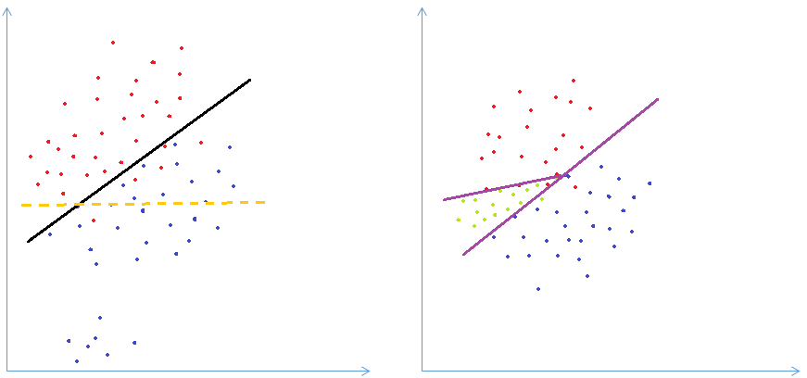
Outliers…
Small “posterior probability”…

Slide 22
Outliers…
Small “posterior probability”…

Slide 23
Outliers…
Small “posterior probability”…

Slide 24
Outliers…
Small “posterior probability”…

Slide 25
Masking Issue

Slide 26
Masking Issue
The masking issue is even more common when K is large (and when p is small)
In the case of masking with 3 classes, this issue can often be addressed by adding quadratic terms
For example consider these two models
vs.

Slide 27
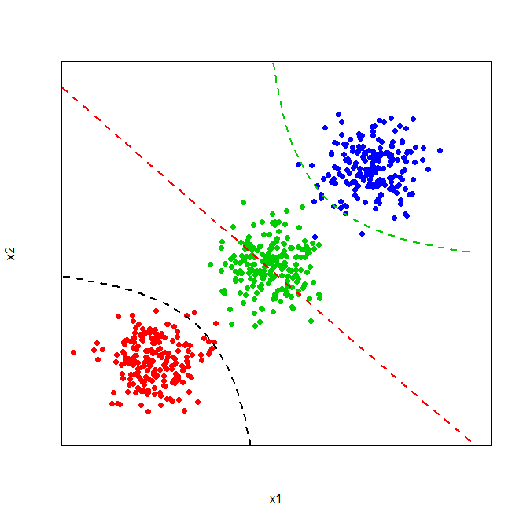
Adding Quadratic Terms to Address Masking

Slide 28
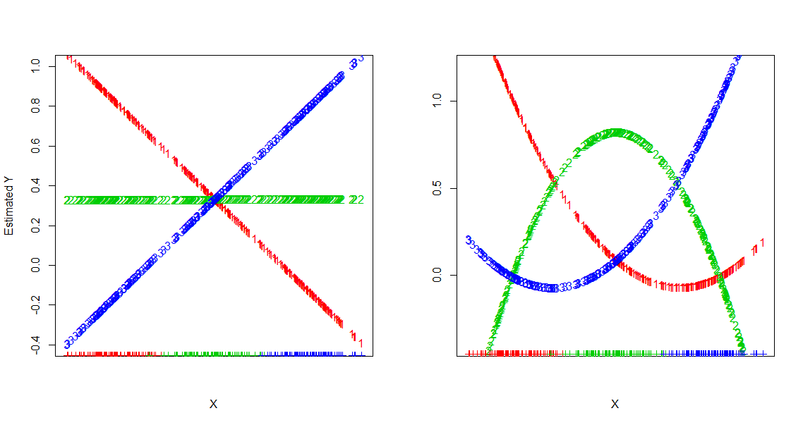
Adding Quadratic Terms to Address Masking

Slide 29
Masking Issue
As shown, we can address the masking issue by adding a quadratic term to the model for K = 3
However, if K > 3 adding a quadratic term is often not sufficient to address masking
General rule of thumb:
Need polynomial terms and cross-product terms of total degree K-1 for the worst cases
This yields O(p^{K-1}) terms total
There are alternative approaches based on linear functions of X that can avoid this problem

Slide 30
Logistic Regression
Probably the most commonly used linear classifier (certainly one we all know)
If the outcome is binary, we can describe the relationship between our features X and the probability of our outcomes as a linear relationship:
Using this we define the posterior probability of being in either of the two classes as

Slide 31
Estimating Logistic Regression Parameters
The goal is to find the MLE for the regression parameters
Recall we are considering the logit transformation for binary response y
We can use this to write the conditional likelihood for beta given the data
$$\text{For} g=1,y=1,\text{and} \text{for} g=2,y=0$$ logit[$P\left(Y=1\left|X=x\right.\right)]=\log\left(\frac{p\left(x;β\right)}{1−p\left(x;β\right)}\right)=xβ$ $$p_{g=1}\left(x;β\right)=p\left(x;β\right) \& p_{g=2}\left(x;β\right)=1−p\left(x;β\right)$$

Slide 32
Estimating Logistic Regression Parameters
Likelihood

Slide 33
Estimating Logistic Regression Parameters
Likelihood

Slide 34
Estimating Logistic Regression Parameters
We can take the derivative w.r.t. each component
Consider the jth component
In this case, we end up with p+1 score equations for each coefficient
But they are non-linear in β and so we can’t solve directly
However, we can solve numerically (Newton-Raphson)

Slide 35
Newton-Raphson Approach
“Newton-Raphson” is one possible method for numeric optimization
Common approach for logistic regression
Referred to as iteratively reweighted least squares
Consider the case where we want to minimize a function f(β) of a variable, β.
We want to find the location of the global minimum, β *.
Assume that f(β ) is smooth, and that β * is a regular interior minimum
derivative at β * is zero
2nd derivative is positive

Slide 36
Newton-Raphson Approach
Near the minimum we could make a Taylor expansion:
Note Second derivative has to be positive to ensure f(β ) > f(β ∗)
f(β ) is close to quadratic near the minimum
NR uses this fact to minimize a quadratic approximation of the function we really want to estimate

Slide 37
Newton-Raphson Approach
Start with a guess β ⁽⁰⁾, and we can take a 2nd order Taylor expansion around
Take the derivative of the RHS wrt β, and set it equal to zero at a point β ⁽¹⁾ and solve for β ⁽¹⁾
This process is iterate to update the estimate for β until convergence is reached

Slide 38
Newton-Raphson for Logistic Regression
At any iteration we have β ^{(old)}, and by NR we can update this estimate as

Slide 39
Logistic Regression for K > 2
Again, what happens if we have more than two classes?
Examples:
Goal is to distinguish between several different types of lung tumors (both malignant and non-malignant):
Small cell lung cancer
Non-small cell lung cancer
Granulomatosis
Sarcoidosis
In this case features may be pixels from CT scan image
Ordinal outcome (i.e. Likert scale) defining attitudes towards safety of epidurals during labor
Features include age, ethnicity, education level, socio-economic status, parity, etc.

Slide 40
Logistic Regression for K > 2
Classes in the first example do not have a natural ordering
We can fit a multinomial logit model
The model includes K – 1 logit models
Constrained such that the K probabilities sum to 1

Slide 41
Logistic Regression for K > 2
We can estimate the posterior probabilities of each of our K classes from the multinomial logit model

Slide 42
Logistic Regression for K > 2
When K = 2, this reduces down to a single linear function (i.e. a single logistic regression).
Though we’ve referenced the last category, since the data have no natural ordering we could reference any category we choose.
Note since all parameters vary in these models, changing the reference categories will change the estimated betas.

Slide 43
Logistic Regression for K > 2
It makes sense to fit these models simultaneously
As a result, there are some assumptions and constraints we must impose
The different classes in the data represent a multinomial distribution
Constraint: all posterior probabilities must sum to 1
In order to achieve this all models fit simultaneously
Independence of Irrelevant Alternatives:
Relative odds between any two outcomes independent of number and nature of other outcomes being simultaneously considered
Notes:
Example of violation of the IIA assumption:
-The clearest case of a violation of this property is when certain outcomes serve as substitutes for others.
-Let's say we were interested in individual's transportation choices for commuting. -What if we broke our transportation categories into four: red bus, blue bus, car, and train.
-Now let's suppose that everyone is equally distributed among these categories, so that: Choice Red Bus Blue Bus Car Train (Proportion 0.25 0.25 0.25 0.25 )
-Let's say we removed blue buses as an option by repainting all of our blue buses red.
-If these are truly distinct categories, then the blue bus group should distribute evenly among the remaining categories: Choice Red Bus Car Train (Proportion 0.33 0.33 0.33 )
-It’s more likely however that blue bus and red bus are perfect substitutes for one another so that individuals who did use the blue bus will now use the red bus: Choice Red Bus Car Train Proportion 0.50 0.25 0.25
-Multinomial logistic regression assumes that none of the categories can serve as substitutes. If they can serve as substitutes, then the results of multinomial logistic regression might not be very realistic.

Slide 44
Logistic Regression for K > 2
Ordinal: maternal attitude towards epidurals (Likert scale)
One possible option is to fit a cumulative logit model
The model for P(G < k|X = x) is just a logit model for a binary response
In this case, the response takes value 1 if y < k and the takes value 0 if y > k + 1

Slide 45
Logistic Regression for K > 2
It is of greater interest however to model all K – 1 cumulative logits in a single model.
This leads us to the proportional odds model
Notice the intercept is allowed to vary as j increases
However, the other model parameters remain constant
Does this make sense given the name of the model?

Slide 46
Logistic Regression for K > 2
Assumptions for the proportional odds model
Intercepts are increasing with increasing j
Models share the same rate of increase with increasing j
Odds ratios proportional to distance between x₁ and x₂ and the proportionality constant is same for each logit
For j < k, the curve for P(G < k| X = x) is equivalent to curve for P(G < j| X = x) shifted (β_{0k} – β_{0j})/β units in the x direction
Odds ratios to interpret the model are cumulative odds ratios

Slide 47
So far we have made no assumptions about the distribution of the data
Decision theory suggests that we need to know the posterior class probability for optimal classification
This brings us back to Bayes…
We can see that having f_{k}(x) can help us classify observations
Many techniques are based on models for the class densities
Linear (and quadratic) discriminant analysis assumes MVN

Slide 48
Discriminant Functions
Takes input vector x and assigns it to one of K classes (G_{K})
linear discriminant function means function is linear
Simplest linear discriminant function:
1st consider 2 class case:
Input vector x assigned to class G₁ if y(x) > 0 and class G₂ otherwise
Decision boundary defined by y(x) > 0
β₀ determines boundary location

Slide 49
Linear Discriminant Functions
In order to generalize this to K > 2 classes, we define one discriminant comprised of K linear functions:
Decision boundary between j and k is a (D-1)-dimensional hyperplane defined by:
Properties:
Singly connected
Convex

Slide 50
Linear Discriminant Analysis: 2 Class Case
First assume our features are MVN with equal covariances
Our f_{k}(x)’s are:
In normal theory, we often resort to a likelihood ratio test… what if we consider something like that here?

Slide 51
2 Class Case
Assume covariances are equal

Slide 52
2 Class Case
The problem is we are interested in posterior class probabilities rather than f_{k}(x)…
Instead of the ratio of f₁(x) to f₂(x) , consider the ratio of the conditional probabilities

Slide 53
2 Class Case
We can think of this as the log odds of being in class 1 versus class 2 given observed data X
Therefore we make our decision about class assignment based on whether this ratio is larger or smaller than 0
Our decision boundary between the two classes occurs where
This boundary represents a hyperplane in p dimensions (based on the p features defined in x)

Slide 54
Linear Discriminant Analysis, K > 2
We can generalize this to more than 2 classes
The more general form of the linear discriminant function for LDA is:
In general we don’t know μ_{k}, Σ, or π_{k} so we need to estimate these values.

Slide 55
Linear Discriminant Analysis, K > 2
We can estimate the unknown quantities as
Then the decision boundary between classes is defined by multiple hyperplanes defined by each line where

Slide 56
LDA and Least Squares
In the 2 class case there is a correspondence between our least squares classifier and LDA
LDA classifies an observed x to class 2 if
It can be shown that the coefficients vector from LS is proportional to the LDA direction shown above
Decision rules only the same if N₁ = N₂
However for more than 2 classes, LDA and linear regression loose this correspondence

Slide 57
From a least squares standpoint, we can also think about classification via LDA as a dimensionality reduction problem
For 2 class case, we use p inputs (vector x) and project into one direction represented by:
Thresholding so that y > 0 classifies G₁ same as least squares
Problem is loss of information… what may have been well separated in p-dimensional space isn’t in 1-D space
Instead adjust weights β to select a projection that maximizes separation

Slide 58
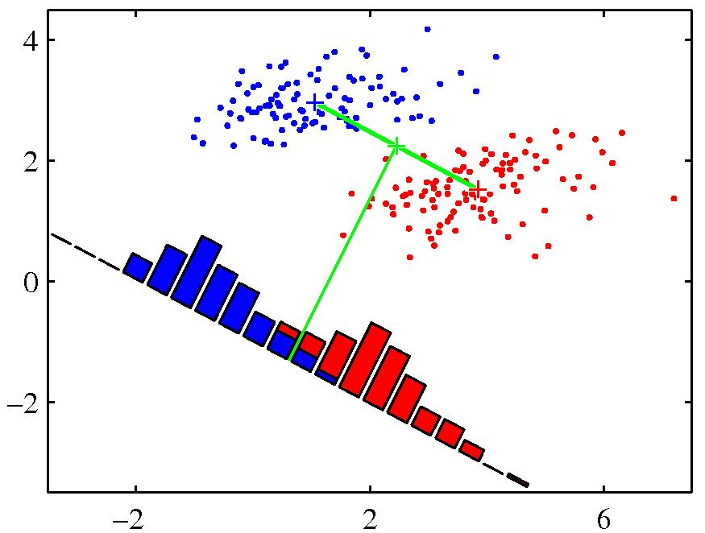

Slide 59
Logistic Regression vs. LDA
Both LDA and logistic regression represent models of the log-posterior odds between classes k and K that are linear functions of x
LDA:
Logistic regression:

Slide 60
Logistic Regression vs. LDA
The posterior conditional density of class k for both LDA and logistic regression can be written in the linear logit form
The joint density for both can be written in the same way
Both methods represent linear decision boundaries that classify observations
So what’s the difference?

Slide 61
Logistic Regression vs. LDA
The difference lies in how the linear coefficients are estimated
LDA: Parameters are fit by maximizing the full log likelihood based on the joint density
-recall here φ is the Gaussian density function
Logistic regression: In this case the marginal density P(G = k) is arbitrary and parameters are estimated by maximizing the conditional multinomial likelihood
-although ignored, we can think of this marginal density as being estimated in a
nonparametric unrestricted fashion

Slide 62
Logistic Regression vs. LDA
So this means…
(1) LR makes fewer assumptions about distribution of the data (more general approach)
(2) But LR “ignores” the marginal distribution P(G= k)
-Including additional distributional assumptions provides more information about
parameters allowing for more efficient estimation (i.e. lower variance)
-if Gaussian assumption correct, could lose up to 30% efficiency
-OR need 30% more data for conditional likelihood to do as well as full likelihood

Slide 63
Logistic Regression vs. LDA
(3) If observations far from decision boundary (i.e. probably NOT Gaussian), they influence estimation of common covariance matrix
-i.e. LDA is not robust to outliers
(4) data in a two class model can be perfectly separated by a hyperplane, LR parameters are undefined. But LDA coefficients still well defined (marginal likelihood avoids this degeneracy)
-e.g. one particular feature has all of its density in one class
-Advantages/disadvantages to both methods
-LR thought of as more robust because makes fewer assumptions
-In practice they tend to perform similarly

Slide 64
Quadratic Discriminant Analysis
One very strong assumption we’ve sort of glossed over in LDA is the assumption that all covariance matrices are equal
If this assumption does not hold, we can’t simplify our log ratio quite as easily
The first term can’t be dropped…

Slide 65
Quadratic Discriminant Analysis
We can simplify this a little bit…
Our final discriminant function in this case becomes

Slide 66
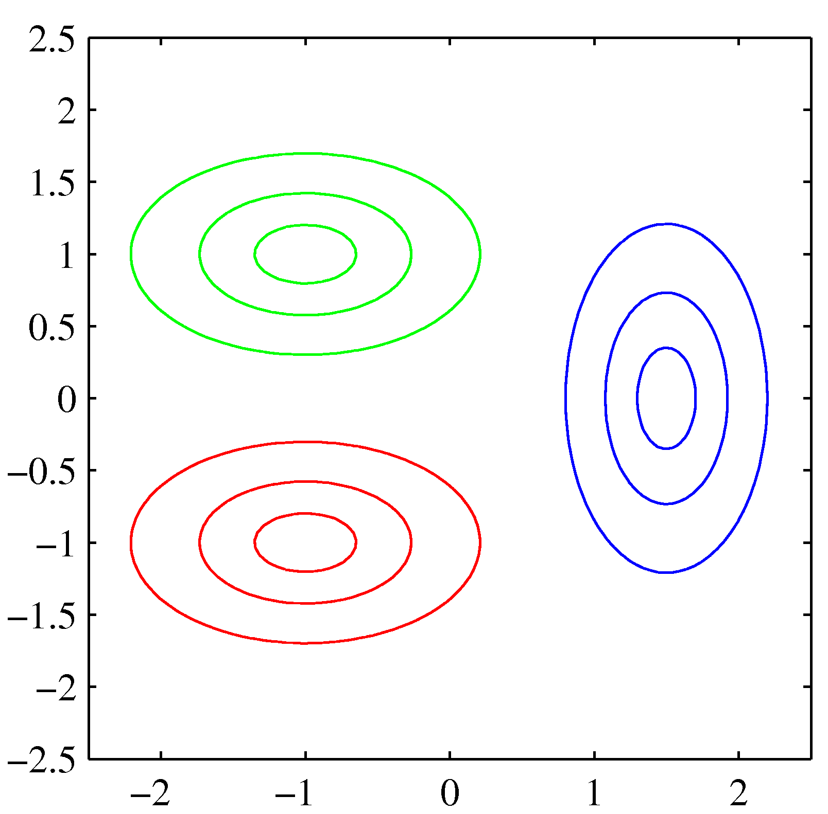
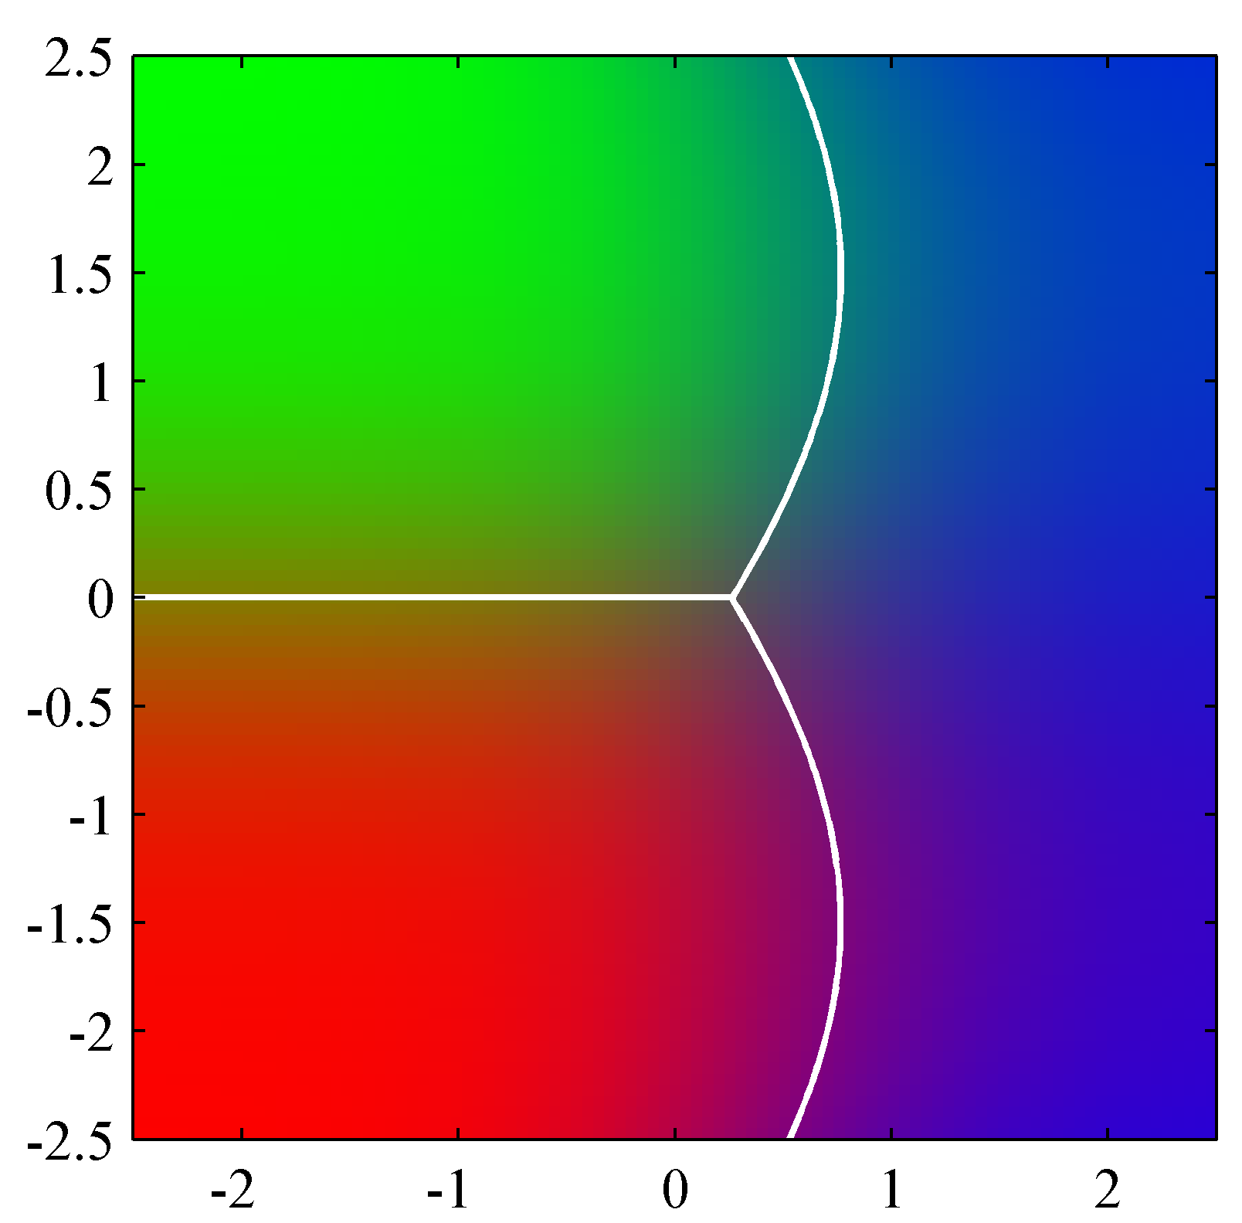
Quadratic Discriminant Analysis
Our discriminant function is no longer linear
Hence we refer to this as quadratic discriminant analysis

Slide 67
General Notes
So how do we decide between linear and quadratic discriminant analysis?
We need to check if our covariances for our two (or more) populations are the same
Bartlett’s test is a formal test to check for equality of covariance
But, should be interpreted with caution

Slide 68
Problems with These Methods
There are a few problems with the methods we’ve discussed…
As with regression, we have a hard time including a large number of covariates especially if n is small
A linear boundary may not really be an appropriate choice for separating our classes
So what can we do?

Slide 69
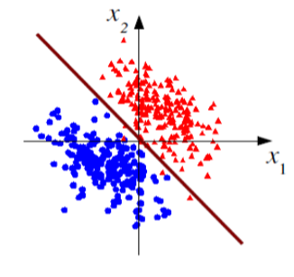
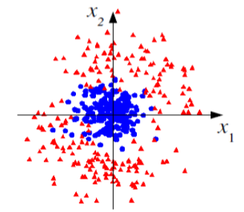
LDA and logistic regression (and often linear regression) work well
if classes are linear separable…
But what if they aren’t?
Linear boundaries may be almost useless

Slide 70
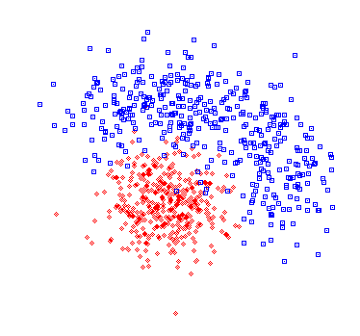
Nonlinear Test Statistics
The optimal decision boundary may not be a hyperplane
→ nonlinear test statistic
H₁
H₀
accept
Multivariate statistical methods are a Big Industry:
Neural Networks
Support Vector Machines
Kernel density methods

Slide 71
Next Time
How to fit these models
Other linear classification methods

