Slide 1
Linear Regression Methods for Collinearity
BMTRY 790: Machine Learning

Slide 2
Regression Analysis
Recall our early discussion…
Given a set of predictors/features, x, and an outcome of interest, y
Main goal is to identify a function f(x) that predicts y well
Linear regression assumes a structural relationship between x and y
Used so often because models are simple and interpretable

Slide 3
Problems with Linear Regression
OLS models fit to all predictors may inhibit interpretability
Consider model selection approaches
OLS model fit to all predictors may “over-fit” the data
Results in poor generalizability
Not able to predict new data well
In data with many predictors, there may also be issues of collinearity
That is, one or more predictors in X may be described by a linear combination of other predictors in X
Certainly happens if p > n (then X is not full column rank).

Slide 4
Collinearity
If the feature matric X is not full rank, a linear combination aX of columns in X =0
In such a case the columns are co-linear in which case the inverse of X’X doesn’t exist
It is rare that aX == 0, but if a combination exists that is nearly zero, (X’X)⁻¹ is numerically unstable
Results in very large estimated variance of the model parameters making it difficult to identify significant regression coefficients

Slide 5
Penalized Regression
Penalized regression model take the general form
Some of these approaches designed to handle collinear predictors
Ridge:
Elastic Net:
However, there are other alternatives (that require less “tuning”) available

Slide 6
Derive Input Approaches for Collinearity
Principal Components Regression (PCR)
Define a set of p principal components
Linear combinations of the original predictors in X
Fit a linear regression model to these derived components
Partial Least Squares Regression (PLSR)
Define a set of derived inputs (latent variables)
Also a linear combination of X but also accounts for y
The latent variables are estimated iteratively
Note, these methods are also helpful if p is large as they typically use a subset of size m < p of components

Slide 7
Defining “Genetic” Race by PCA
Zakharia F, et al. (2009). Characterizing the admixed African Ancestry of African Americans.
Genome Biology, 10(12): R141

Slide 8
Principal Component Regression (PCR)
Use of PCR can serve two objectives
Eliminate collinearity by developing p orthogonal derived components, z₁, z₂, …, z_{p}, as alternative for the original correlated p features, x₁, x₂, …, x_{p}, in X
Reduce number of “features” need to fit the regression model for y by including only m < p (# of original predictors)
Choose the m components that capture a majority of the variability in X
So how do we come up with these derived orthogonal components?

Slide 9
“Exact” Principal Components
Our components, Z, are represented for data X_{nxp} as linear combinations of p random measurements on j = 1,2,…,n subjects

Slide 10
“Exact” Principal Components
We can also find the moments for these p linear combinations of our data X
Notes:
-Given that we assume X is MVN_p(mu_x, Sigma_x) we can find the moments for the ith principal component (show)

Slide 11
“Exact” Principal Components
We can also find the moments for these p linear combinations of our data X
Notes:
-Given that we assume X is MVN_p(mu_x, Sigma_x) we can find the moments for the ith principal component (show)

Slide 12
“Exact” Principal Components
Principal components are those combinations that are:
(1) Uncorrelated (linear combinations Z₁, Z₂,…, Z_{p})
(2) Variance as large as possible
(3) Subject to:

Slide 13
Finding PC’s Under Constraints
So how do we find PC’s that meet the constraints we just discussed?
We want to maximize subject to the constraint that
This constrained maximization problem can be done using the method of Lagrange multipliers
Thus, for the first PC we want to maximize

Slide 14
Finding 1st PC Under Constraints
Differentiate w.r.t a₁ and set equal to 0 :

Slide 15
Recall Eigenvalues and Eigenvectors
The eigenvalues of an A_{nxn} matrix
are scalar values that are the solutions to
for a set of eigenvectors, . Typically normalized so that

Slide 16
Finding 2nd PC Under Constraints
We can think about this in the same way, but we now have an additional constraint
We want to maximize but subject to
So now we need to maximize

Slide 17
Finding 2nd PC Under Constraints
Differentiate w.r.t a₂ and set equal to 0:

Slide 18
Finding 2nd PC Under Constraints
Differentiate w.r.t a₂ and set equal to 0:

Slide 19
Finding PC’s Under Constraints
But how do we choose our eigenvector (i.e. which eigenvector corresponds to which PC?)
We can see that what we want to maximize is
So we choose λ_{i} to be as large as possible
If λ₁ is our largest eigenvalue with corresponding eigenvector e_{i} then the solution for our max is
Notes:
-We’ve already noted that these expressions for finding the ai’s that are a good solution for finding the linear combos of our X’s to generate our derived Z’s look like the ai’s are eigne vectors and the Lagrange multipliers are eigen values but how do we choose our eigenvectors?
-We can use singular value decomposition (SVD) to calculate our eigenvalues and vectors, we get a set of p eigenvalues and eigenvectors
-So how do we choose which eigenvector corresponds to which PC?
-We note that we want to maximize a1’*Sigma*a1 = a1’*lambda*a1=lambda*a1’a1=lambda
-Thus if we choose lambda1 as the largest eigenvalue we get the maximum for the first component
-If lambda1 is our largest eigenvalue with corresponding eigenvector e1 then our solution is Sigma*a1=lambda1*e1

Slide 20
“Exact” Principal Components
So we can compute the PCs from the variance matrix of X, Σ:

Slide 21
Properties
We can update our moments using the proposed solution

Slide 22
Properties
We can update our moments using the proposed solution

Slide 23
Properties
We can update our moments using the proposed solution

Slide 24
Properties
Normality assumption not required to find PC’s
If X ~ N_{p}(μ,Σ) then:
Total Variance:

Slide 25
Principal Components
Consider data with p random measures on i = 1,2,…,n subjects
For the i^{th} subject we then have the random vector
X₂
μ₂
μ₁
X₁

Slide 26
Graphic Representation
Now suppose X₁, X₂ ~ N₂(μ, Σ)
Z₁ axis selected to maximize variation in the scores
Z₂ axis must be orthogonal to Z₁ and maximize variation in the scores
X₂
Z₁
Z₂
X₁

Slide 27
How Much Variance is Captured
Proportion of total variance accounted for by the first k components is
If the proportion of variance accounted for by the first k principal
components is large, we might want to restrict our attention to only these
first k components
Keep in mind, components are simply linear combinations of the original
p measurements

Slide 28
PC’s from Standardized Variables
As was the case with penalized regression, PC’s are not scale invariant. Thus we want to standardize our variables before finding PCs

Slide 29
Compare Standardized/Non-standardized PCs
$$\text{Non}\text{−}\text{standardized} \text{Standardized} \\ Σ=\left[\begin{matrix}1 & 4 \\ 4 & 100\end{matrix}\right] ρ=\left[\begin{matrix}1 & 0.4 \\ 0.4 & 1\end{matrix}\right] \\ λ_{1}=100.16 { e}_{1}^{′}=\left[\begin{matrix}0.04 & 0.999\end{matrix}\right] λ_{1}=1.4 { e}_{1}^{′}=\left[\begin{matrix}0.707 & 0.707\end{matrix}\right] \\ λ_{2}=0.84 { e}_{2}^{′}=\left[\begin{matrix}0.999 & −0.04\end{matrix}\right] { λ}_{2}=0.6 { e}_{2}^{′}=\left[\begin{matrix}0.707 & −0.707\end{matrix}\right]$$

Slide 30
Estimation
In general we do not know what Σ is- we must estimate if from the sample
So what are our estimated principal components?

Slide 31
Back to PCR
Once we have our estimated PCs, z₁, z₂, …, z_{p}, we want to fit a regression model for our response y using our PC as the features
We can calculate the values for our new derived components for each of our n observations
Based on the linear combination of our original x’s described by z₁, z₂, …, z_{p}
Note this still doesn’t reduce the number of features used in our regression model
If we let m = p, our estimate will be the same as OLS
However, if we want to reduce the number of features in our model, we can again use a cross-validation approach

Slide 32
Software
The pls package in R can fit both PCR and PLSR models
The pls package has reasonable functionality for fitting models
Has built in cross-validation
Also has many available plotting features
Loading on each x_{j} for the derived features
(a) fraction of L₁-norm
(b) maximum number of steps
There is also a nice tutorial for the package available in the Journal of Statistical Soft

Slide 33
Body Fat Example
library(pls)
### Fitting a Principal Component Model ###
bf.pcr <- pcr(PBF ~ ., data=bodyfat2, validation = "CV")
summary(bf.pcr)
Data: X dimension: 252 13
Y dimension: 252 1
Fit method: svdpc
Number of components considered: 13
VALIDATION: RMSEP
Cross-validated using 10 random segments.
(Intercept) 1 comps 2 comps 3 comps 4 comps 5 comps 6 comps 7 comps 8 comps 9 comps 10 comps 11 comps 12 comps 13 comps
CV 1.002 0.7897 0.6888 0.6402 0.6401 0.6693 0.6410 0.6201 0.6045 0.6069 0.6080 0.6133 0.5328 0.5314
adjCV 1.002 0.7893 0.6902 0.6375 0.6392 0.6684 0.6401 0.6126 0.6023 0.6046 0.6056 0.6103 0.5309 0.5296
TRAINING: % variance explained
1 comps 2 comps 3 comps 4 comps 5 comps 6 comps 7 comps 8 comps 9 comps 10 comps 11 comps 12 comps 13 comps
X 61.85 72.27 79.98 85.12 89.72 92.14 94.34 96.34 97.75 98.78 99.38 99.82 100.0
PBF 38.55 54.12 58.36 58.66 60.64 62.83 67.36 67.41 67.58 67.99 68.30 74.78 74.9

Slide 34
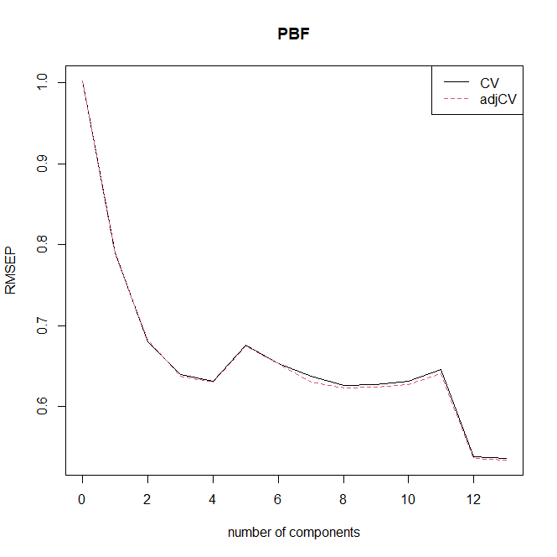
Examining the Model Graphically
plot(bf.pcr, plottype="validation”, legendpos=“topright”)

Slide 35
Body Fat Example
names(bf.pcr)
[1] "coefficients" "scores" "loadings" "Yloadings" "projection" "Xmeans"
[7] "Ymeans" "fitted.values" "residuals" "Xvar" "Xtotvar" "fit.time"
[13] "ncomp" "method" "validation" "call" "terms" "model“
round(bf.pcr$coefficients[,,1:3], 4) ### OR use coef(bf.pcr, 1:3) (Note, this returns these coefficients as an array)
1 comps 2 comps 3 comps
Age 0.0022 0.2566 0.1702
Wt 0.0754 0.0693 0.0774
Ht 0.0221 -0.1367 -0.2761
Neck 0.0669 0.0973 0.0274
Chest 0.0692 0.1401 0.1527
Abd 0.0683 0.1580 0.1831
Hip 0.0714 0.0724 0.1178
Thigh 0.0679 0.0261 0.0923
Knee 0.0675 0.0507 0.0505
Ankle 0.0505 -0.0255 -0.0518
Bicep 0.0655 0.0489 0.0644
Arm 0.0547 0.0092 -0.0053
Wrist 0.0611 0.0885 0.0087

Slide 36
Body Fat Example
round(bf.pcr$scores, 3) ### OR use scores(bf.pcr)
Comp1 Comp2 Comp3 Comp4 Comp5 Comp6 Comp7 Comp8 Comp9 Comp10 Comp11 Comp12 Comp13
1 -2.220 1.237 -1.496 -0.285 0.163 -0.236 -0.226 0.263 -0.076 -0.292 0.153 -0.364 -0.037
2 -0.886 2.010 -0.038 -0.228 -0.168 -0.745 -0.050 -0.609 -0.192 0.165 -0.220 0.030 0.039
3 -2.361 1.220 -2.194 1.914 -0.181 0.264 0.166 -0.129 0.073 -0.438 0.114 -0.153 -0.291
…
249 2.640 -2.313 1.304 0.073 -0.045 -0.379 -0.787 0.211 0.244 -0.211 -0.203 -0.148 -0.046
250 0.451 -3.206 -0.472 0.288 1.008 -0.179 0.713 -0.061 0.086 0.345 0.334 -0.263 0.046
251 1.235 -2.183 1.811 0.154 -0.122 0.557 -0.447 -0.989 0.263 -0.735 0.204 -0.188 0.166
252 3.693 -2.370 1.799 0.406 -0.773 -0.025 -0.604 -0.633 0.584 -0.310 -0.234 -0.127 -0.186

Slide 37
Body Fat Example
bf.pcr$loadings ### OR use loadings(bf.pcr)
Loadings:
Comp1 Comp2 Comp3 Comp4 Comp5 Comp6 Comp7 Comp8 Comp9 Comp10 Comp11 Comp12 Comp13
Age -0.751 0.420 0.294 0.207 -0.152 0.262 0.166
Wt 0.345 0.142 -0.206 0.190 0.872
Ht 0.101 0.469 0.678 0.485 0.115 0.134 0.102 0.124
Neck 0.306 0.121 -0.206 -0.561 -0.115 -0.703
Chest 0.316 -0.209 0.152 0.450 0.248 -0.431 0.398 0.409 -0.214
Abd 0.312 -0.265 -0.122 0.120 0.229 0.295 0.140 -0.791
Hip 0.326 -0.221 0.178 0.163 -0.101 0.134 0.323 -0.609 0.343 -0.403
Thigh 0.310 0.123 -0.322 -0.273 -0.115 0.522 0.631
Knee 0.308 0.247 0.497 -0.443 -0.137 -0.272 -0.540
Ankle 0.231 0.224 0.128 0.500 -0.679 0.347 0.167 -0.106
Bicep 0.299 -0.322 -0.150 0.845 0.129 -0.147 -0.110
Arm 0.250 0.134 -0.683 -0.310 0.446 0.228 -0.273 0.153
Wrist 0.279 0.388 -0.265 -0.352 -0.467 -0.272 0.513

Slide 38
Body Fat Example
round(bf.pcr$loadings[,1:13], 3)
Loadings:
Comp1 Comp2 Comp3 Comp4 Comp5 Comp6 Comp7 Comp8 Comp9 Comp10 Comp11 Comp12 Comp13
Age 0.010 -0.751 0.420 0.079 -0.040 0.294 -0.034 0.207 -0.152 0.262 0.031 0.166 0.041
Wt 0.345 0.018 -0.039 0.087 0.142 -0.031 0.076 -0.047 0.061 -0.019 -0.206 0.190 0.872
Ht 0.101 0.469 0.678 0.082 0.485 0.115 0.134 0.102 0.005 0.124 0.062 -0.008 -0.090
Neck 0.306 -0.090 0.121 -0.206 0.055 -0.561 0.007 -0.115 -0.703 -0.048 -0.073 -0.013 -0.095
Chest 0.316 -0.209 -0.061 -0.009 0.152 -0.070 0.450 -0.061 0.248 -0.431 0.398 0.409 -0.214
Abd 0.312 -0.265 -0.122 0.120 0.229 0.033 0.295 -0.086 0.140 0.086 -0.037 -0.791 -0.046
Hip 0.326 -0.003 -0.221 0.178 0.163 0.045 -0.049 -0.101 0.134 0.323 -0.609 0.343 -0.403
Thigh 0.310 0.123 -0.322 0.077 0.096 0.062 -0.273 0.041 -0.115 0.522 0.631 0.073 0.018
Knee 0.308 0.050 0.001 0.247 0.005 0.497 -0.443 -0.137 -0.272 -0.540 -0.013 -0.088 -0.076
Ankle 0.231 0.224 0.128 0.500 -0.679 -0.032 0.347 0.167 -0.106 0.080 0.011 -0.024 -0.035
Bicep 0.299 0.049 -0.076 -0.322 -0.035 -0.045 -0.150 0.845 0.129 -0.147 -0.110 -0.081 -0.049
Arm 0.250 0.134 0.071 -0.683 -0.310 0.446 0.228 -0.273 -0.035 0.153 -0.043 -0.005 -0.002
Wrist 0.279 -0.081 0.388 -0.059 -0.265 -0.352 -0.467 -0.272 0.513 0.007 0.071 -0.077 -0.030

Slide 39
Body Fat Example
bf.pcr$Yloadings
Loadings:
Comp1 Comp2 Comp3 Comp4 Comp5 Comp6 Comp7 Comp8 Comp9 Comp10 Comp11 Comp12 Comp13
PBF 0.219 -0.339 -0.206 0.181 0.264 0.398 0.176 0.197 -1.067 -0.227
Comp1 Comp2 Comp3 Comp4 Comp5 Comp6 Comp7 Comp8 Comp9 Comp10 Comp11
SS loadings 0.048 0.115 0.042 0.005 0.033 0.070 0.158 0.002 0.009 0.031 0.039
Proportion Var 0.048 0.115 0.042 0.005 0.033 0.070 0.158 0.002 0.009 0.031 0.039
Cumulative Var 0.048 0.163 0.205 0.210 0.243 0.313 0.471 0.473 0.482 0.513 0.552
Comp12 Comp13
SS loadings 1.139 0.052
Proportion Var 1.139 0.052
Cumulative Var 1.691 1.743
round(as.vector(bf.pcr$Yloadings), 4)
[1] 0.2190 -0.3389 -0.2057 0.0675 0.1815 0.2643 0.3978 0.0458 0.0954 0.1758 0.1973 -1.0672 -0.2275

Slide 40
Body Fat Example
So what exactly are the coefficients in a pcr R object?

Slide 41
Body Fat Example
So what exactly are the coefficients in a pcr R object?

Slide 42
Body Fat Example
So what exactly are the coefficients in a pcr R object?

Slide 43
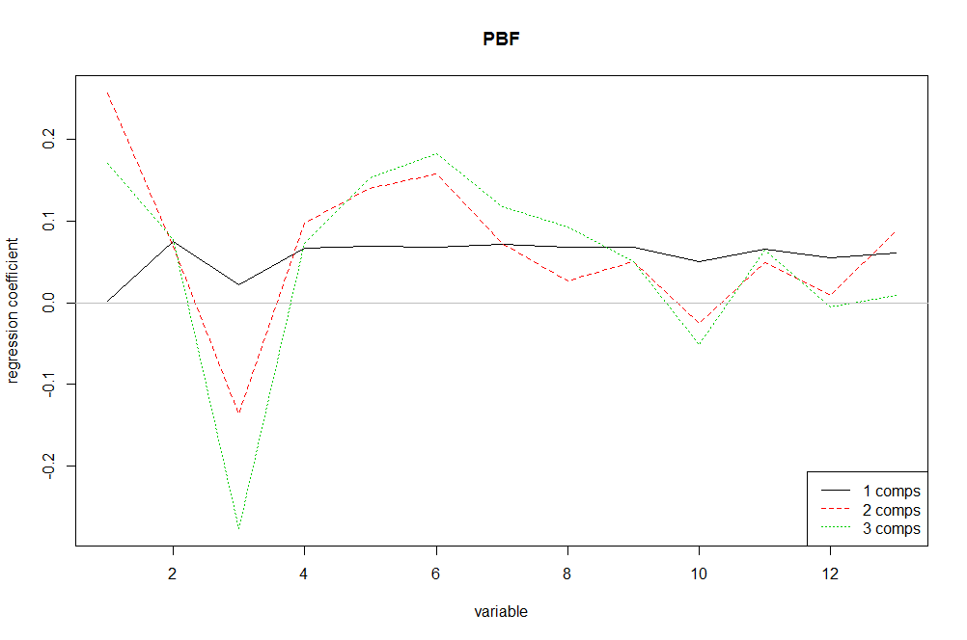
Examining the Model Graphically
plot(bf.pcr, plottype=“coef“, 1:3, legendpos=“bottomright”)

Slide 44
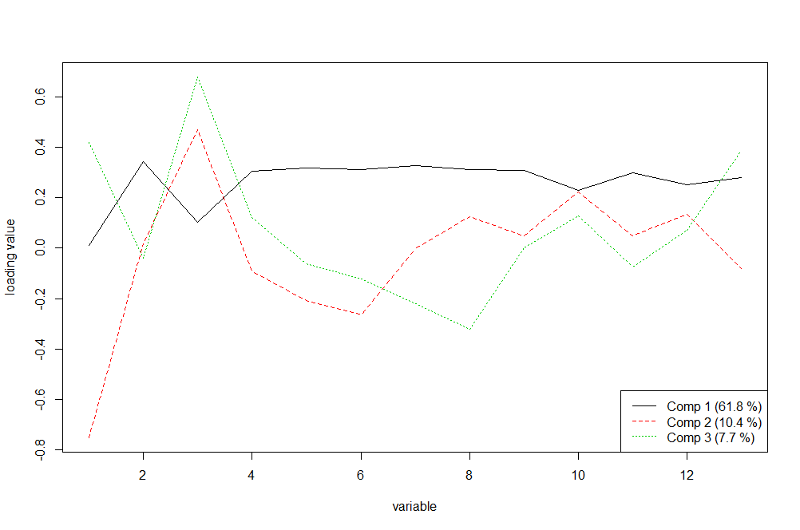
Examining the Model Graphically
plot(bf.pcr, plottype=“loadings“, 1:3, legendpos=“bottomright”)
loadingplot(bf.pcr, 1:3)

Slide 45
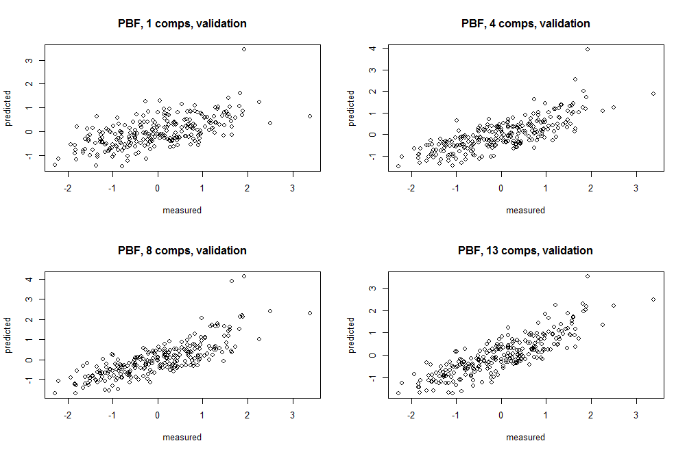
Examining the Model Graphically
par(mfrow=c(2,2))
plot(bf.pcr, "prediction", ncomp=1); plot(bf.pcr, "prediction", ncomp=4)
plot(bf.pcr, "prediction", ncomp=8); plot(bf.pcr, "prediction", ncomp=13)

Slide 46
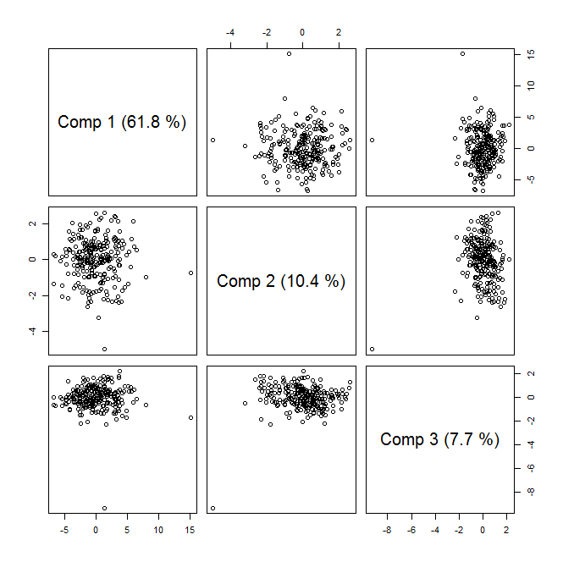
Examining the Model Graphically
plot(bf.pcr, “score”, 1:3)

Slide 47
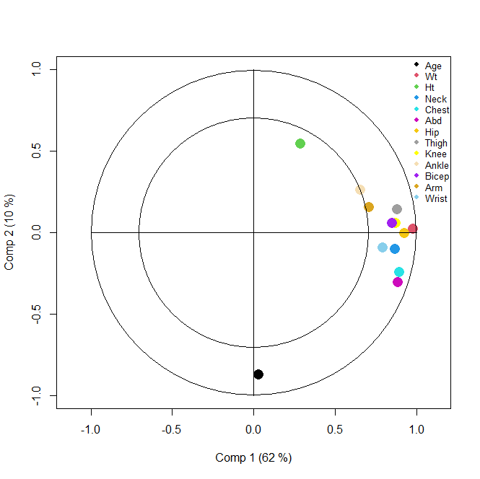
Examining the Model Graphically
plot(bf.pcr, plottype="correlation", pch=16,
col=c(1:8,"yellow","wheat","purple","goldenrod","skyblue"),
cex=2)
legend(x=0.95, y=1.10, legend=colnames(bodyfat[,2:14]),
col=c(1:8,"yellow","wheat","purple","goldenrod","skyblue"),
cex=0.8, pch=16, bty="n")

Slide 48
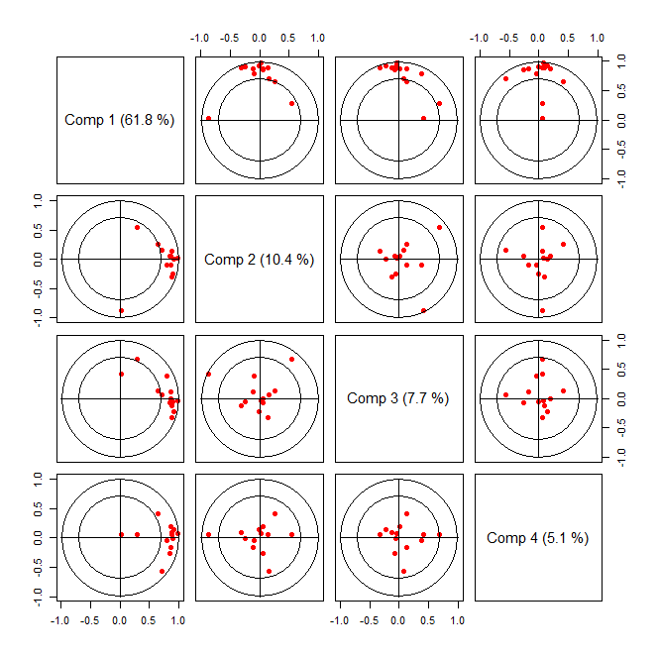
Examining the Model Graphically
plot(bf.pcr, plottype="correlation", 1:4, pch=16, col=2)

Slide 49
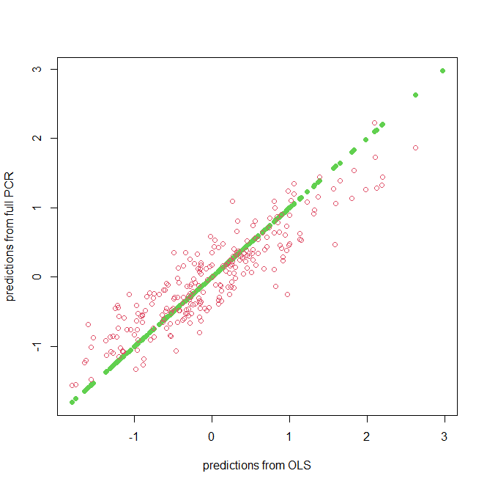
Comparison to OLS?
### Comparison to OLS fit
bf.ols<-lm(PBF ~ ., data=bodyfat2)
pbf.ols<-predict(bf.ols)
bf.pcr <- pcr(PBF ~ ., data=bodyfat2, validation = "CV")
pbf3<-fitted(bf.pcr, ncomp=3)[,,3]
pbf.fullpcr<-fitted(bf.pcr, ncomp=13)[,,13]
plot(pbf.ols, pbf.fullpcr, xlab="predictions from OLS",
ylab="predictions from full PCR", pch=16, col=3)
points(pbf.ols, pbf3, pch=1, col=2)

Slide 50
Partial Least Square Regression (PLSR)
Similar to PCR with some important differences
Also eliminates collinearity using a derived set of orthoganol components, z₁, z₂, …, z_{m},
BUT, PLSR used both the original correlated p features, x₁, x₂, …, x_{p}, in X and response vector y
Thus components include information on the variability in X
But also include information on the correlation between X and y
As in PCR, reduce the number of “features” need to fit the regression model for y by including only m< p of the original predictors
These components that depend on both X and y are estimated iteratively

Slide 51
PLSR Algorithm
Standardize x_{j}’s so and set
For m = 1, 2, …, p
(a)
(b)
(c)
(d)
Output the sequence of fitted vectors . Since the are linear in the original x_{j}’s, so is

Slide 52
Body Fat Example
### Fitting a Principal Component Model ###
bf.plsr <- plsr(PBF ~ ., method="simpls“, data=bodyfat2, validation = "CV")
summary(bf.plsr)
Data: X dimension: 252 13
Y dimension: 252 1
Fit method: simpls
Number of components considered: 13
VALIDATION: RMSEP
Cross-validated using 10 random segments.
(Intercept) 1 comps 2 comps 3 comps 4 comps 5 comps 6 comps 7 comps 8 comps 9 comps 10 comps 11 comps 12 comps 13 comps
CV 1.002 0.7472 0.6144 0.6003 0.5746 0.5480 0.5346 0.5314 0.5311 0.5320 0.5321 0.5323 0.5325 0.5326
adjCV 1.002 0.7469 0.6134 0.5979 0.5717 0.5465 0.5324 0.5298 0.5295 0.5303 0.5303 0.5305 0.5307 0.5308
TRAINING: % variance explained
1 comps 2 comps 3 comps 4 comps 5 comps 6 comps 7 comps 8 comps 9 comps 10 comps 11 comps 12 comps 13 comps
X 61.14 71.54 76.43 81.82 85.6 87.49 91.19 93.81 95.68 96.56 97.48 98.68 100.0
PBF 45.53 64.02 69.29 71.46 73.1 74.74 74.83 74.88 74.89 74.90 74.90 74.90 74.9

Slide 53
Body Fat Example
names(bf.plsr)
[1] "coefficients" "scores" "loadings" "Yloadings" "projection" "Xmeans"
[7] "Ymeans" "fitted.values" "residuals" "Xvar" "Xtotvar" "fit.time"
[13] "ncomp" "method" "validation" "call" "terms" "model“
….
Pretty much the same as the pcr model but fit in a different way

Slide 54
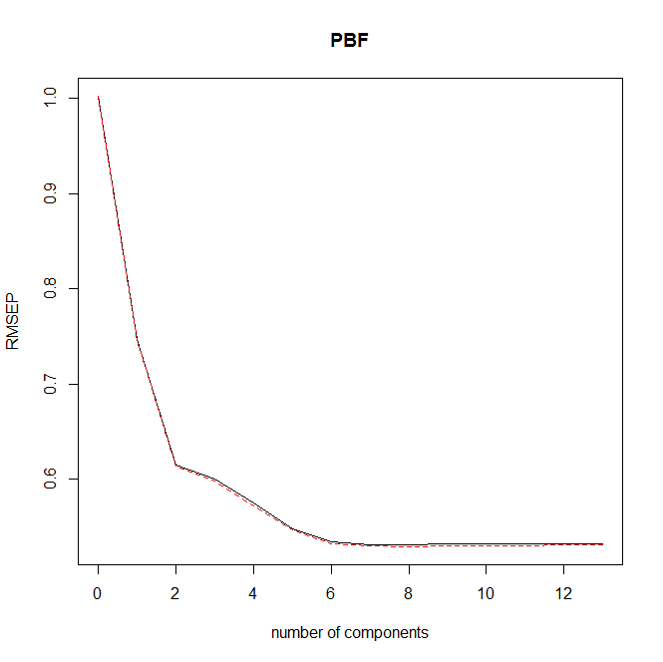
Examining the Model Graphically
plot(bf.plsr, plottype="validation")

Slide 55
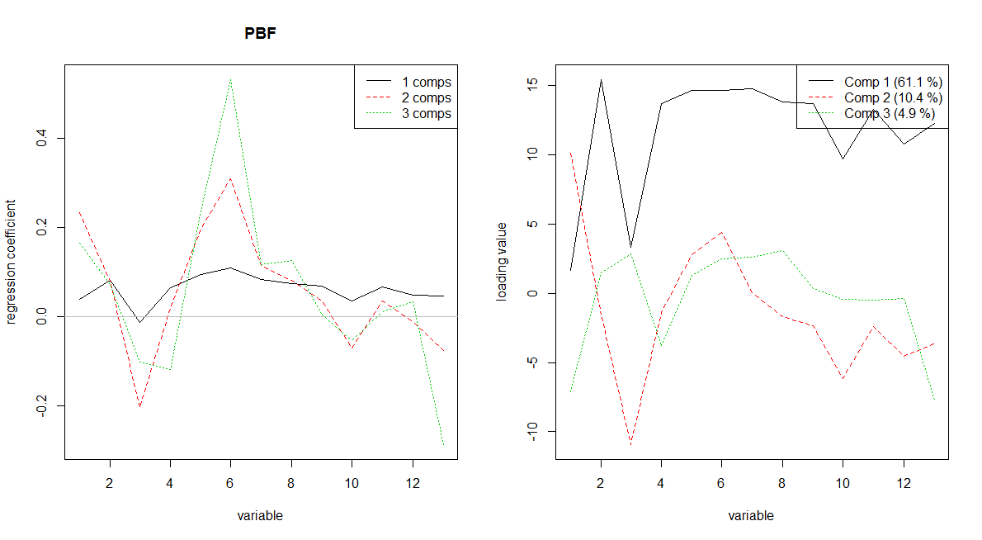
Examining the Model Graphically
par(mfrow=c(1,2))
plot(bf.plsr, plottype="coefficients", 1:3, legendpos="topright")
plot(bf.plsr, plottype="loadings", 1:3, legendpos="topright")

Slide 56
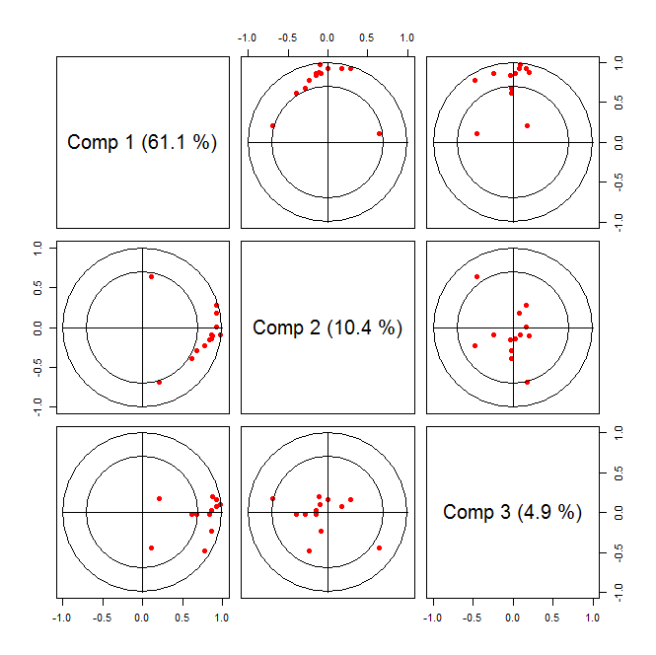
Examining the Model Graphically
plot(bf.plsr, plottype="correlation", 1:3, pch=16, col=2)

Slide 57
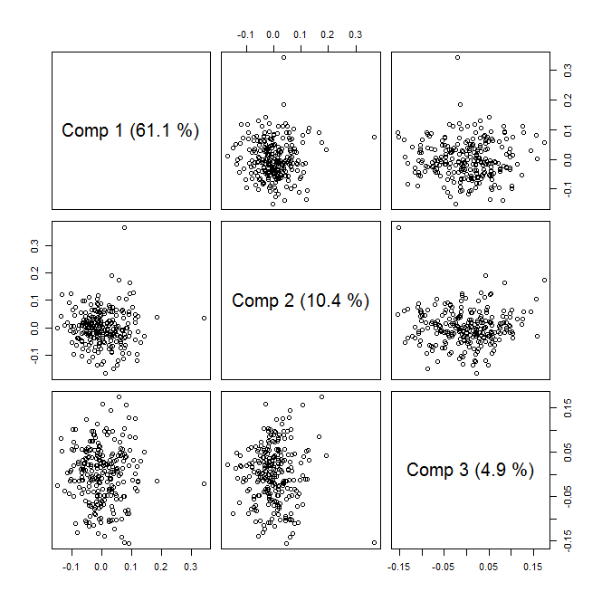
Examining the Model Graphically
plot(bf.plsr, “score”, 1:3)

Slide 58
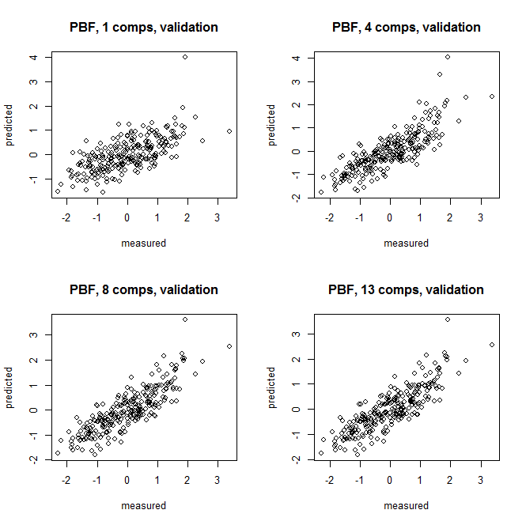
Examining the Model Graphically
par(mfrow=c(2,2))
plot(bf.plsr, "prediction", ncomp=1); plot(bf.plsr, "prediction", ncomp=4)
plot(bf.plsr, "prediction", ncomp=8); plot(bf.plsr, "prediction", ncomp=13)

Slide 59
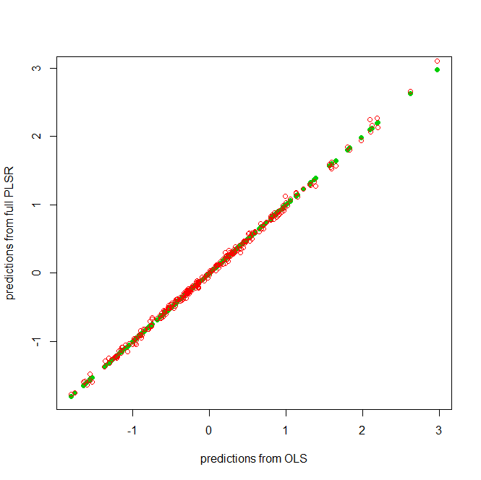
Comparison to OLS?
### Comparison to OLS fit
bf.ols<-lm(PBF ~ ., data=bodyfat2)
pbf.ols<-predict(bf.ols)
bf.plsr <- plsr(PBF ~ ., data=bodyfat2, validation = "CV")
pbf8<-fitted(bf.plsr, ncomp=6)[,,6]
pbf.fullplsr<-fitted(bf.plsr, ncomp=13)[,,13]
plot(pbf.ols, pbf.fullplsr, xlab="predictions from OLS",
ylab="predictions from full PLSR", pch=16, col=3)
points(pbf.ols, pbf6, pch=1, col=2)

Slide 60
Summary Basic PCR and PLSR
Both PCR and PLSR are designed predominantly to address issues of collinearity
Both do this by developing a set of orthogonal derived features
PCR bases these on X only
PLSR derives them both on the original X and on y
A secondary function of these approaches is to reduce the number of features included in the fitted model
Use m < p derived features in the final model
NOTE: the m derived features are still based on all p original predictors in X

Slide 61
PCR vs. PLSR
In theory PLSR should have a prediction advantage over PCR
PCR seeks those derived components that explain the most variability in X
PLSR seeks components that not only account for the variability in X but simultaneously accounts for correlation with y
However, in empirical evaluation they perform similarly for prediction
PLSR does tend to require fewer components than PCR

Slide 62
Some Issues with PCR and PLSR
As we’ve noted, PCR and PLSR are useful for
Addressing multicollinearity
Dimension reduction
Using a reduced number of components does in theory provide dimension reduction
Components generally have non-zero weights on all variables in X
So there is no dimension reduction in X

Slide 63
SCoTLASS
Approach to obtain sparse loadings by imposing L₁ (lasso) penalty on PCA
Successively maximize the variance

Slide 64
SCoTLASS
Here, t, is a tuning parameter that must be defined by the user
If t is selected to be sufficiently small, some loadings in PC will be exactly 0
Limited guidance for selecting t and computational inefficiency of SCoTLASS makes tuning difficult
Additionally, loadings not very sparse if one must account for a high proportion of variability in X

Slide 65
Sparse PCA
Goal: implement penalty in determining loadings
Recall, penalized approaches used in a regression setting.
So consider PCA in this context
1st place PCA in context of singular value decomposition (SVD)

Slide 66
Sparse PCA
Thm 1: For i = 1,…, p, let Z_{i} = U_{i}D_{ii} is the i^{th} PC. For any λ > 0, the ridge estimates, , is:
We could find a solution using LARS-EN
But… this theorem depends on the original PCA solution

Slide 67
Sparse PCA
Thm 2: For any λ > 0, let
Thm 3 (extend to k PCs): Consider the first k PCs.
Let . For any λ > 0, let

Slide 68
Sparse PCA
Theorems 2 and 3 address issues of non-unique solutions if p > n.
However, this approach doesn’t yield sparsity. So we can rewrite the expression from Thm 3 as:
Requires an alternating algorithm that alternates between optimizing B|A and A|B

Slide 69
Sparse PCA algorithm
Initialize A = V[1,k]; loadings 1st k components
For fixed A = [α₁,…,α_{k}], solve the elastic net problem for j =1,2,…,k
For fixed B = [β₁,…,β_{k}], compute the SVD of X’XB = UDV’, then update A = UV’
Repeat steps 2-3 until convergence.
Normalize:

Slide 70
Implementation
Sparse PCA is implemented in the elasticnet package in R
Function to fit an SPCA model is spca and takes arguments
x = predictor or covariance/correlation matrix
K = number of components desired
para = vector positive elements of length k (used for λ_{1,j})
type = “predictor” or “Gram”
sparse = “penalty” or “varnum”
lambda = value for ridge penalty (default = 1e-6)
And a few others
Limited guidance provided for selecting K, para, or lambda.

