Slide 1
Review of Linear Regression
BMTRY 790: Machine Learning

Slide 2
Regression Analysis
Consider a set of predictors/features, x, and an outcome of interest, y
Main goal in supervised learning to identify a function f(x) that predicts y well
We can consider a model based approach, e.g. linear regression, in which we assume a structural relationship between x and y

Slide 3
Why Use Such Models
There are many reasons to consider regression approaches
  Models are simple and interpretable
  Linear models can outperform non-linear methods when:
    There are a limited number of training observations
    Low signal to noise ratio
  Such models can be have can be made more flexible (i.e. non-linear) by applying transformations to the data
    As we saw with the polynomial example

Slide 4
f(x) for Linear Regression
Given our features, x, the regression function takes the following form:
Recall we then want to identify the estimate of f(x) that minimizes the prediction error for output
  We need to define a loss function L(Y, f(x))
The most common choice of loss function for regression is L₂ = squared error loss

Slide 5
Notation & Data Organization
Consider a set of j = 1, 2,…, p variables (or features) collected in a study and an outcome y
And i = 1, 2,…, n is the number of samples

Slide 6
Least Squares Estimation
Using the squared error loss function, we can develop an estimate of f(x) by finding value that minimizes the loss

Slide 7
Least Squares Estimation
Goal: minimize the sum of squared error (i.e. minimize our loss function)
  Take the derivative w.r.t. β

Slide 8
Least Squares Estimation
We can use this to predicted the outcome

Slide 9
Residuals
We can also estimate the error in our prediction to find our residuals (i.e. the “amount” of y we missed)

Slide 10
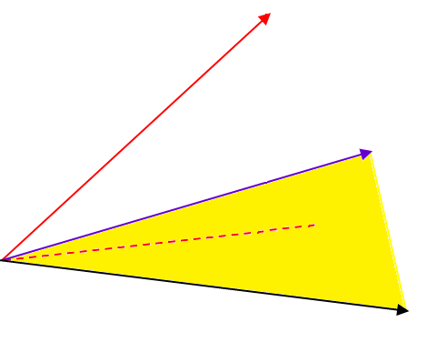
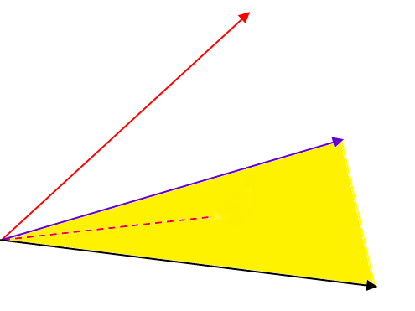


Graphical Representation
y
y
x₂
x₂
$$\hat{y}$$
$$\hat{y}$$
x₁
x₁

Slide 11
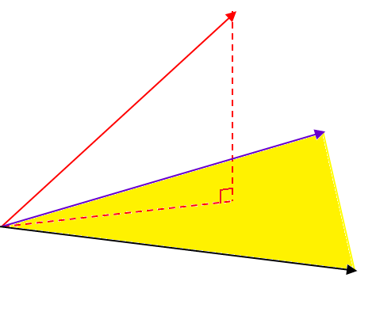


Graphical Representation
y
$$y−\hat{y}$$
x₂
$$\hat{y}$$
x₁

Slide 12
Least Squares Properties

Slide 13

Unbiasedness
We can easily show that is unbiased
$$\hat{β}$$

Slide 14
Covariance of the Residuals
First find the variance of the error term in

Slide 15
Covariance of Beta
We use this to estimate the variance of

Slide 16
Likelihood Ratio Test for individual β_{i}’s
First we may test if any predictors effect the response:
The LRT is based on the difference in sums of square between the full and null models…

Slide 17
LRT for individual β_{i}’s
Difference in RSS between the full and null models…

Slide 18
LRT for individual β_{i}’s
Difference in RSS between the full and null models…

Slide 20
Percent Body Fat Example
Data collected to develop a predictive model to estimate percent body fat
These data include complete information 150 participants and examples of features include.
  Age (years)
  Weight (lbs)
  Height (inches)
  Chest circumference (cm)
  Abdomen 2 circumference (cm)
  Hip circumference (cm)
  Forearm circumference (cm)
  Wrist circumference (cm)

Slide 21
Percent Body Fat
Our full model is:
Call: lm(formula = PBF ~ ., data = SSbodyfat)
Residuals:
Min 1Q Median 3Q Max
-7.8552 -2.9788 -0.4227 3.1428 8.9839
Coefficients:
Estimate Std. Error t value Pr(>|t|)
(Intercept) -14.35633 20.47786 -0.701 0.48446
Age 0.10101 0.04093 2.468 0.01483 *
Wt -0.09551 0.06158 -1.551 0.12322
Ht -0.09893 0.10132 -0.976 0.33059
Neck -0.48190 0.26795 -1.798 0.07432 .
Chest 0.04548 0.12286 0.370 0.71181
Abd 0.92004 0.10794 8.523 2.62e-14 ***
Hip -0.29165 0.17616 -1.656 0.10011
Thigh 0.30453 0.18764 1.623 0.10691
Knee -0.06456 0.31475 -0.205 0.83780
Ankle 0.38060 0.23671 1.608 0.11018
Bicep 0.01274 0.20298 0.063 0.95006
Arm 1.01042 0.34759 2.907 0.00426 **
Wrist -2.34001 0.71395 -3.278 0.00133 **
Residual standard error: 4.12, 136 degrees of freedom Multiple R-squared: 0.759, Adjusted R-squared: 0.736
F-statistic: 33.02 on 13 and 136 DF, p-value: < 2.2e-16

Slide 22
LRT
What if we want to test whether or not the 4 most non-significant predictors in the model can be removed

Slide 23
Model Building Process
In RTCs, a model is specified a priori
Not generally the case with other study designs
  Confirmatory observational studies
    Intended to test hypotheses derived from earlier studies
    Covariates used to account for known influences on a response
    Potentially consider a larger number of predictors that might be in the model
  Exploratory observational studies
    Case where there aren’t necessarily any specific hypotheses
    Goal to determine potentially useful explanatory variables
    Screen out some of these variables

Slide 24
Exploratory Studies
Challenges
  Identify “good” subset of explanatory variables
  Functional form of the regression model
  Identifying interactions
Considerations
  Omission of important variables increases bias
  Inclusion of unimportant variables increases variance
Different “best” subsets may have different purposes
  Descriptive vs. predictive?

Slide 25
Model Building
If we have a large number of predictors, we may want to identify the “best” subset
There are many methods of selecting the “best”
Some of the most common choices include
  Examine all possible subsets of predictors
  Forward stepwise selection
  Backwards stepwise selection

Slide 26
Best Subset Selection
First consider the null model M₀ containing no predictors (predicts mean of y for each sample)
For k = 1, 2, …, p:
  Fit all models containing k predictors
  Select the best model, M_{k}, from these models where best is defined by the model with the smallest RSS
Finally select the best model from among models M₀, M₁, …, M_{p} using some measure of model fit

Slide 27
Step-Wise Selection
Best subset selection is computationally expensive when p is large
Large feature space also increases the chance of overfitting
  Poor prediction in new data
  Higher variance of parameter estimates
Step-wise selection approaches consider a restricted set of models
  offer an attractive alternative

Slide 28
Forward Step-Wise Selection
Start with the null model M₀
For k = 0, 1, 2, …, p-1:
  Consider all p - k models that augment the predictors in model M_{k} with one additional predictor.
  Choose the model from the p - k models and updated to model M_{k+1}
Choose the best model from the models M₀ to M_{p} based on a measure of goodness of fit

Slide 29
Backward Step-Wise Selection
Start with the null model M₀
For k = p, p-1, p-2, …, 1:
  Consider the k models that include all but one of the predictors in model M_{k} for a total of k -1 predictors.
  Choose the model from the k models and updated to model M_{k-1}
Choose the best model from the models M₀ to M_{p} based on a measure of goodness of fit

Slide 30
Concerns with Step-Wise Selection
Clearly offers a computational advantage over the best subset approach
  Searches through only 1+p(p+1)/2 models
This approach not guaranteed to find the best possible model from among the 2^{p} possible models
Note backward selection requires that p < n which does not need to be true for forward selection
Step-wise approaches also yield biased estimates
  Upwardly biased so effect of covariates appear to larger than they actually are

Slide 31
Model Building
Though we can consider predictors that are significant, this may not yield the “best” subset (some models may yield similar results)
The “best” choice is made by examining some criterion
  R²
  RSS
  Mallow’s C_{p}
  AIC (or other information criterion)
Since R² increases as predictors are added, Mallow’s C_{p} and AIC are better choices for selecting the “best” predictor subset

Slide 32
Model Building
The R² and RSS related to error in the training set
  Result: largest model always have the largest values
Given that generalizability is one possible goal (in particular if we are seeking good prediction), larger R² may seem desirable
However, training error rate is generally a poor estimate of test error rate

Slide 33
Model Building
Mallow’s C_{p}:
  Plot the pairs ( p, C_{p}).
  Good models have coordinates near the 45º line
Akaike’s Information Criterion
  Smaller is better

Slide 34
Back to Our Body Fat Example
Call: lm(formula = PBF ~ ., data = SSbodyfat)
Residuals:
Min 1Q Median 3Q Max
-7.8552 -2.9788 -0.4227 3.1428 8.9839
Coefficients:
Estimate Std. Error t value Pr(>|t|)
(Intercept) -14.35633 20.47786 -0.701 0.48446
Age 0.10101 0.04093 2.468 0.01483 *
Wt -0.09551 0.06158 -1.551 0.12322
Ht -0.09893 0.10132 -0.976 0.33059
Neck -0.48190 0.26795 -1.798 0.07432 .
Chest 0.04548 0.12286 0.370 0.71181
Abd 0.92004 0.10794 8.523 2.62e-14 ***
Hip -0.29165 0.17616 -1.656 0.10011
Thigh 0.30453 0.18764 1.623 0.10691
Knee -0.06456 0.31475 -0.205 0.83780
Ankle 0.38060 0.23671 1.608 0.11018
Bicep 0.01274 0.20298 0.063 0.95006
Arm 1.01042 0.34759 2.907 0.00426 **
Wrist -2.34001 0.71395 -3.278 0.00133 **

Slide 35
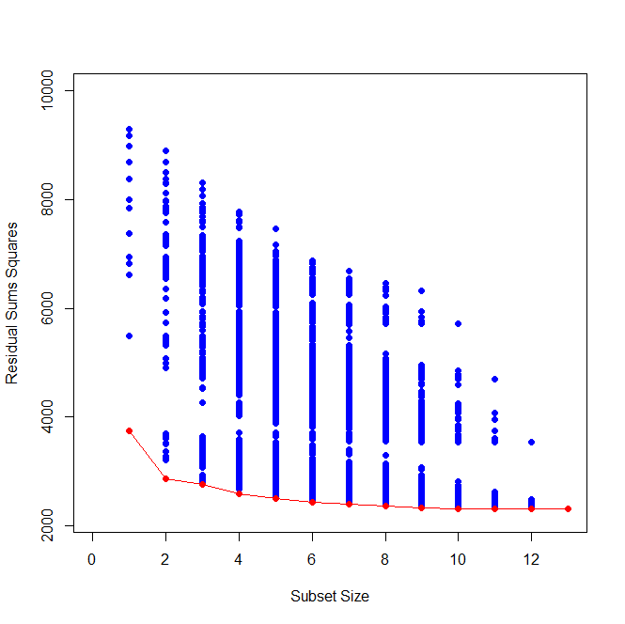
Best Subset Selection
First consider the plot of SS_{res} for all possible subsets of the eight predictors

Slide 36
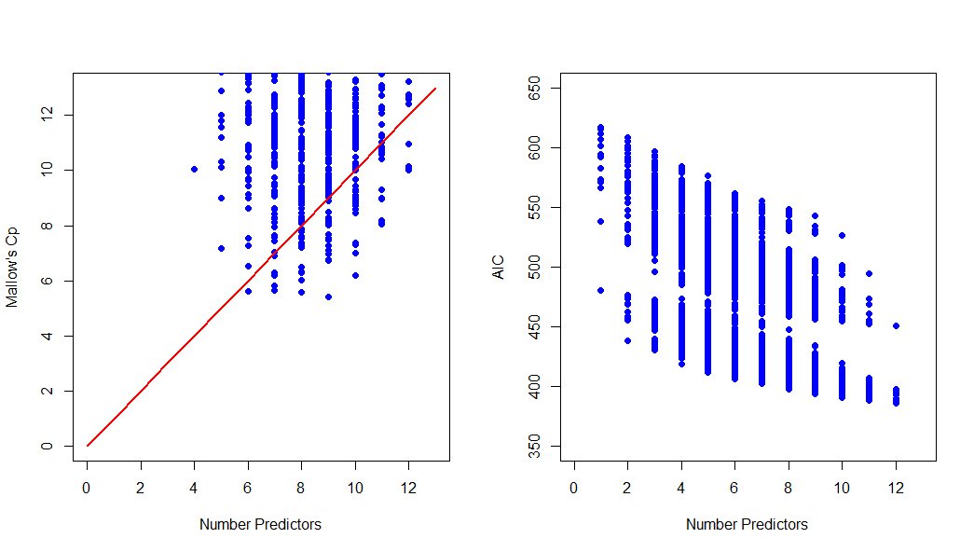
Model Subset Selection
What about Mallow’s C_{p} and AIC?

Slide 37
Best Subset Model
Say we choose the model with the 9 parameters.
> summary(mod9)
Call:
lm(formula = PBF ~ Age + Wt + Neck + Abd + Hip + Thigh + Ankle + Arm + Wrist, data = bodyfat)
Coefficients:
Estimate Std. Error t value Pr(>|t|)
(Intercept) -24.32529 15.08393 -1.613 0.109070
Age 0.10657 0.03886 2.742 0.006897 **
Wt -0.11609 0.05120 -2.267 0.024893 *
Neck -0.46267 0.26066 -1.775 0.078073 .
Abd 0.95407 0.09041 10.553 < 2e-16 ***
Hip -0.24975 0.16783 -1.488 0.138970
Thigh 0.32318 0.16325 1.980 0.049700 *
Ankle 0.37835 0.23102 1.638 0.103714
Arm 1.07448 0.31063 3.459 0.000719 ***
Wrist -2.44983 0.69932 -3.503 0.000618 ***
---
Signif. codes: 0 ‘***’ 0.001 ‘**’ 0.01 ‘*’ 0.05 ‘.’ 0.1 ‘ ’ 1
Residual standard error: 4.084 on 140 degrees of freedom Multiple R-squared: 0.7569, Adjusted R-squared: 0.7413
F-statistic: 48.44 on 9 and 140 DF, p-value: < 2.2e-16

Slide 38
Best Forward Stepwise Model
Chooses the model with the all 13 parameters!
> summary(fwmod)
Call: lm(formula = PBF ~ ., data = SSbodyfat)
Residuals:
Min 1Q Median 3Q Max
-7.8552 -2.9788 -0.4227 3.1428 8.9839
Coefficients:
Estimate Std. Error t value Pr(>|t|)
(Intercept) -14.35633 20.47786 -0.701 0.48446
Age 0.10101 0.04093 2.468 0.01483 *
Wt -0.09551 0.06158 -1.551 0.12322
Ht -0.09893 0.10132 -0.976 0.33059
Neck -0.48190 0.26795 -1.798 0.07432 .
Chest 0.04548 0.12286 0.370 0.71181
Abd 0.92004 0.10794 8.523 2.62e-14 ***
Hip -0.29165 0.17616 -1.656 0.10011
Thigh 0.30453 0.18764 1.623 0.10691
Knee -0.06456 0.31475 -0.205 0.83780
Ankle 0.38060 0.23671 1.608 0.11018
Bicep 0.01274 0.20298 0.063 0.95006
Arm 1.01042 0.34759 2.907 0.00426 **
Wrist -2.34001 0.71395 -3.278 0.00133 **
Residual standard error: 4.12, 136 degrees of freedom Multiple R-squared: 0.759, Adjusted R-squared: 0.736
F-statistic: 33.02 on 13 and 136 DF, p-value: < 2.2e-16

Slide 39
Best Backward Stepwise Model
Chooses the model with the 9 parameters.
> summary(bwmod)
Call:
lm(formula = PBF ~ Age + Wt + Neck + Abd + Hip + Thigh + Ankle + Arm + Wrist, data = bodyfat)
Coefficients:
Estimate Std. Error t value Pr(>|t|)
(Intercept) -24.32529 15.08393 -1.613 0.109070
Age 0.10657 0.03886 2.742 0.006897 **
Wt -0.11609 0.05120 -2.267 0.024893 *
Neck -0.46267 0.26066 -1.775 0.078073 .
Abd 0.95407 0.09041 10.553 < 2e-16 ***
Hip -0.24975 0.16783 -1.488 0.138970
Thigh 0.32318 0.16325 1.980 0.049700 *
Ankle 0.37835 0.23102 1.638 0.103714
Arm 1.07448 0.31063 3.459 0.000719 ***
Wrist -2.44983 0.69932 -3.503 0.000618 ***
---
Signif. codes: 0 ‘***’ 0.001 ‘**’ 0.01 ‘*’ 0.05 ‘.’ 0.1 ‘ ’ 1
Residual standard error: 4.084 on 140 degrees of freedom Multiple R-squared: 0.7569, Adjusted R-squared: 0.7413
F-statistic: 48.44 on 9 and 140 DF, p-value: < 2.2e-16

Slide 40
Model Checking
Always good to check if the model is “correct” before using it to make decisions…
Information about fit is contained in the residuals
If the model fits well the estimated error terms should mimic N(0, σ ²).
So how can we check?

Slide 41
Model Checking
Studentized residuals plot
Plot residuals versus predicted values
-Ideally points should be scattered (i.e. no pattern)
-If a pattern exists, can show something about the problem

Slide 42
Model Checking
Plot residuals versus predictors
QQ plot of studentized residuals plot

Slide 43
Model Checking
While residuals analysis is useful, it may miss outliers- i.e. observations that are influential on predictions
Leverage:
  how far is the j^{th} observation from the others?
  How much pull does j exert on the fit
Observations that affect inferences are influential

Slide 44
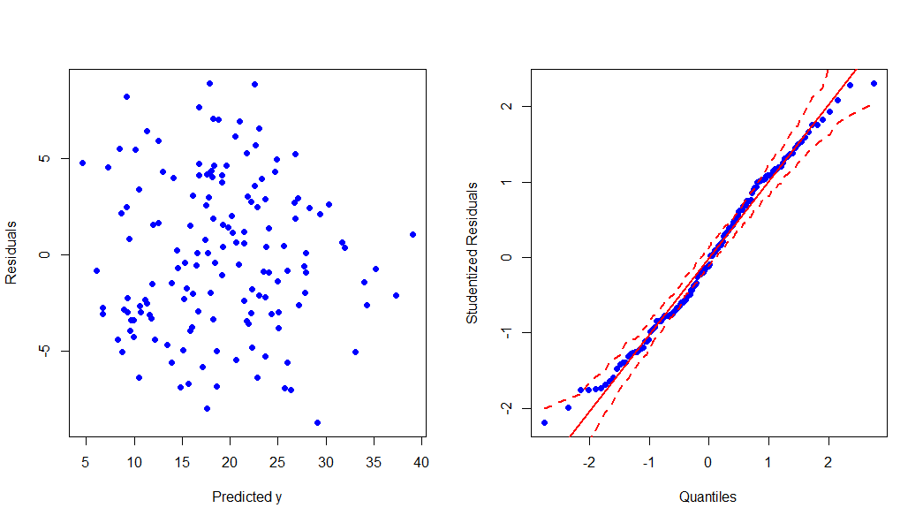
% Body Fat Model Check
Consider the model with 9 parameters.
Let’s look at the residual diagnostics

Slide 45
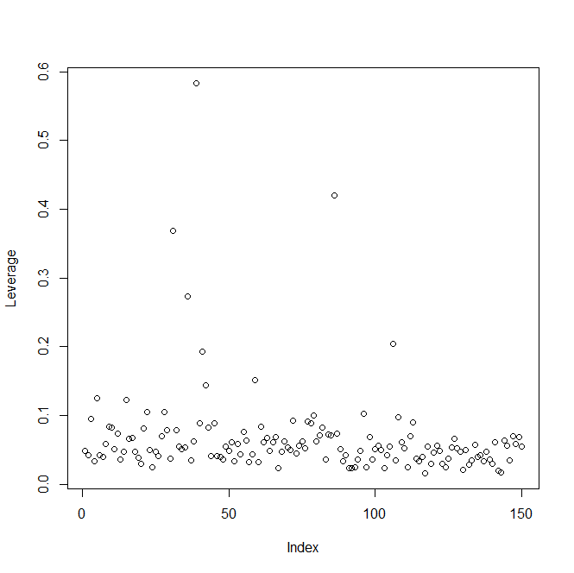
% Body Fat Model Check
What about leverage

Slide 46
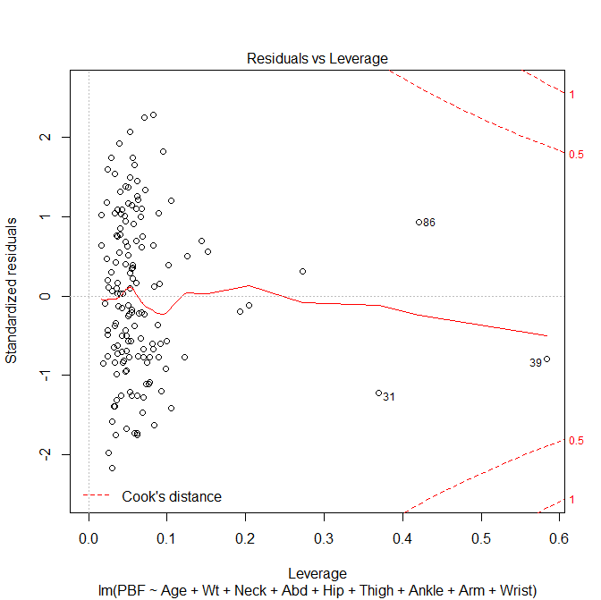

Slide 47
Outliers & Influential Points
> SSbodyfat[which(lev>0.2),c(2,3,5,7,8,9,11,13,14)]
Age Wt Neck Abd Hip Thigh Ankle Arm Wrist (Leverage)
31 32 182.00 38.7 88.7 99.8 57.5 33.9 27.7 18.4 (0.369)
36 49 191.75 38.4 113.1 113.8 61.9 21.9 29.8 17.0 (0.273)
39 46 363.15 51.2 148.1 147.7 87.3 29.6 29.0 21.4 (0.583)
86 67 167.00 36.5 89.7 96.2 54.7 33.7 27.7 18.2 (0.421)
43 165.50 31.1 87.3 96.6 54.7 24.8 29.4 18.8 (0.204)
> colMeans(SSbodyfat[,c(2,3,5,7,8,9,11,13,14)])
Age Wt Neck Abd Hip Thigh Ankle Arm Wrist
43.8 177.4 37.8 91. 7 99.8 59.4 23.1 28.7 18.2

Slide 48
Co-linearity
If the feature matrix X is not full rank, a linear combination aX of columns in X =0
In such a case the columns are co-linear in which case the inverse of X’X doesn’t exist
It is rare that aX == 0, but if a combination exists that is nearly zero, (X’X)⁻¹ is numerically unstable
Results in very large estimated variance of the model parameters making it difficult to identify significant regression coefficients

Slide 49
Collinearity
We can check for severity of multicollinearity using the variance inflation factor (VIF)

Slide 50
Mis-specified Model
If important predictors are omitted, the vector of regression coefficients my be biased
Biased unless columns of x₁ and x₂ are independent.

Slide 51
Impact of Misspecification
Consider the following example
Simulation:
  Impact of correlation of on regression estimates if we exclude X₅

Slide 52
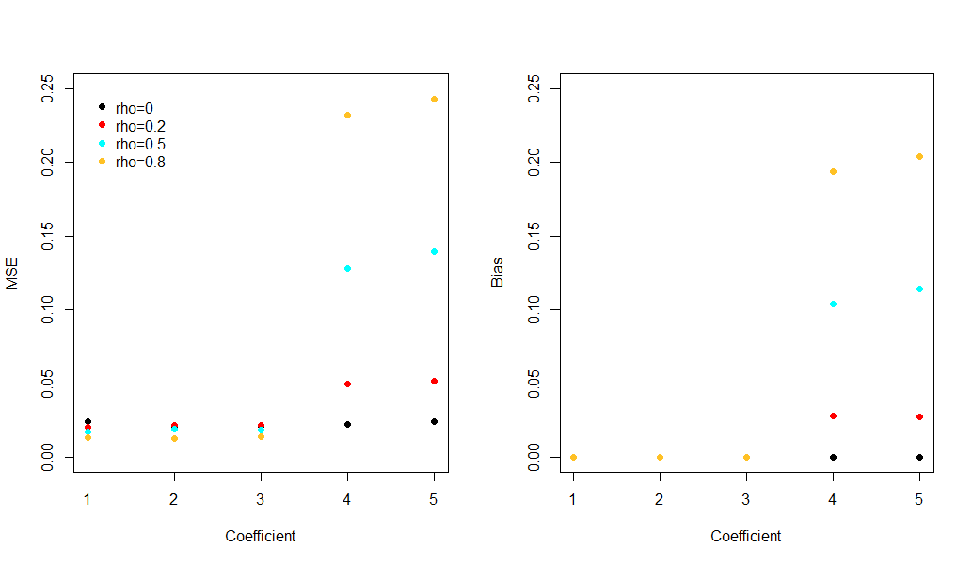
Simulation Results

Slide 53
Model Check
What about collinearity?
> round(cor(SSbodyfat[,c(2,3,5,7,8,9,11,13,14)]), digits=3)
Age Wt Neck Abd Hip Thigh Ankle Arm Wrist
Age 1.000 -0.052 0.083 0.201 -0.091 -0.226 -0.093 -0.106 0.202
Wt -0.052 1.000 0.810 0.876 0.934 0.857 0.560 0.689 0.703
Neck 0.083 0.810 1.000 0.719 0.705 0.682 0.415 0.663 0.718
Abd 0.201 0.876 0.719 1.000 0.867 0.770 0.399 0.538 0.571
Hip -0.091 0.934 0.705 0.867 1.000 0.891 0.502 0.581 0.576
Thigh -0.226 0.857 0.682 0.770 0.891 1.000 0.458 0.632 0.502
Ankle -0.093 0.560 0.415 0.399 0.502 0.458 1.000 0.380 0.503
Arm -0.106 0.689 0.663 0.538 0.581 0.632 0.380 1.000 0.677
Wrist 0.202 0.703 0.718 0.571 0.576 0.502 0.503 0.677 1.000
>vif(mod9)
Age Wt Neck Abd Hip Thigh Ankle
2.134783 19.015548 3.679822 7.928140 13.127375 6.407491 1.634879
Arm Wrist
2.688906 3.502969

Slide 54
What if our investigator really felt all 13 predictors really would give the best model?
> summary(mod13)
Call:
lm(formula = PBF ~ Age + Wt + Ht + Neck + Chest + Abd + Hip + Thigh + Knee + Ankle + Bicep + Arm + Wrist, data = bodyfat, x = T)
Coefficients:
Estimate Std. Error t value Pr(>|t|)
(Intercept) -18.18849 17.34857 -1.048 0.29551
Age 0.06208 0.03235 1.919 0.05618 .
Wt -0.08844 0.05353 -1.652 0.09978 .
Ht -0.06959 0.09601 -0.725 0.46925
Neck -0.47060 0.23247 -2.024 0.04405 *
Chest -0.02386 0.09915 -0.241 0.81000
Abd 0.95477 0.08645 11.044 < 2e-16 ***
Hip -0.20754 0.14591 -1.422 0.15622
Thigh 0.23610 0.14436 1.636 0.10326
Knee 0.01528 0.24198 0.063 0.94970
Ankle 0.17400 0.22147 0.786 0.43285
Bicep 0.18160 0.17113 1.061 0.28966
Arm 0.45202 0.19913 2.270 0.02410 *
Wrist -1.62064 0.53495 -3.030 0.00272 **
Residual standard error: 4.305 on 238 degrees of freedom. Multiple R-squared: 0.749, Adjusted R-squared: 0.7353 . F-statistic: 54.65 on 13 and 238 DF, p-value: < 2.2e-16

Slide 55
Is collinrearity problematic?
> vif(mod13)
Age Wt Ht Neck Chest Abd Hip
2.250450 33.509320 1.674591 4.324463 9.460877 11.767073 14.796520
Thigh Knee Ankle Bicep Arm Wrist
7.777865 4.612147 1.907961 3.619744 2.192492 3.377515

