Slide 1
Neural Networks II
BMTRY 790: Machine Learning

Slide 2
Tuning ANNs
There are several considerations when fitting an ANN model
Models tend to be over-parameterized
Optimization is non-convex and unstable
However, there is some guidance on how to address these issues
Choosing starting weights
Avoiding overfitting
Choosing number of hidden units and layers

Slide 3
Impact of Starting Values
Recall, in fitting a feed-forward ANN, we must initialize the weights we will consider in the model
Have weights α_{mj} for each predictor X_{j} for hidden unit Z_{m}
Also have weights β_{km} for hidden unit Z_{m} on outcome Y_{k}
If weights are initialized near 0 and the sigmoidal function is used
Operative part of sigmoid function is approximately linear
Thus ANN is initially approximately linear
Note becomes less linear as weights increase (i.e. algorithm proceeds)
Thus common choice is to randomly initialize starting weights near 0

Slide 4
Likelihood of Over-fitting
ANNs are particularly prone to over-fitting
Use of many weights allows algorithm to achieve a global minimum
However this results in model that is not generalizable
Early ANNs employed an early stopping rule to avoid this issue
Starting weights already represent a highly regularized solution (all near 0)
Use validation set to determine when to stop
Weight decay is a more formalized method of regularization
Add a penalty term to the error function (think ridge and lasso)

Slide 5
Weight Decay
As I mentioned, weight decay formalized the idea of regularization by including a “penalty” in the error function.
Several J(θ) have been proposed
λ is a shrinkage parameter and needs to be chosen when tuning the models

Slide 6
Scaling Inputs
When using a regularization approach, scale of the inputs impacts the scaling of the weights in the bottom layer (i.e. X_{j}’s)
Just as with ridge or lasso regression, it is a good idea to center and scale all continuous predictors
Ensures inputs treated equally in regularization
Also provides a more informed choice of starting weights
Note with standardized inputs, input weights typically initialized between -0.7 and 0.7.

Slide 7
Number of Hidden Units and Layers
The hidden units can be thought of as latent variables
Estimated as a non-linear function applied to a weighted linear combination of original inputs X_{j}
We don’t know up front how many hidden units to use
Too few yields a model that isn’t necessarily sufficiently flexible
Too many can overfit (but this can be addressed by regularization)
Typical “good” choice ranges between 5 to 100
We can also have multiple hidden layers
Allows for construction of hierarchical features with different levels resolution
Generally chosen by background knowledge and/or experimentation

Slide 8
Bagged ANNs
Because the error function is non-convex, there are often many local minima
As a results, the final solution is often very dependent on the choice of starting weights
Could try different starting weights to choose ones that yields the smallest error
Alternatively, average prediction over a collection of neural networks
Popular fix is to build a bagged ANN and make predictions much as we would from a bagged set of decision trees

Slide 9
Fitting ANNs in R
As with many of the methods we’ve discussed, there are several packages to fit ANN models in R
nnet: can fit ANN for regression and binary or multi-class outcomes but can only consider a single hidden later
neuralnet: fits ANNs for regression or binary outcomes (not multi-class), can consider multiple hidden layers
RSNNS: Implements the “Stuttgart Neural Network Simulator” to fit mulit-layer perceptrons
Others with differing functionality
FCNN4R, brnn, elm
Let’s look at some examples…

Slide 10
Lupus Nephritis
Example: Treatment response in patients with treatment response
Data include 213 observations examining treatment response at 1 year in patient with lupus nephritis
Data includes
Demographics: age, race
Treatment response: Yes/No
Clinical Markers: c4c, dsDNA, EGFR, UrPrCr
Urine markers: IL2ra, IL6, IL8, IL12

Slide 11
nnet Package
#########################################################
### 2-CLASS CLASSIFICATION EXAMPLE ###
### TREATMENT RESPONSE IN LUPUS NEPHRITIS ###
#########################################################
LN<-read.csv("H:/public_html/BMTRY790_Spring2023/Datasets/LupusNephritis.csv")
ids1<-which(LN$CR90==1)
ids0<-which(LN$CR90==0)
LN[,c(2,3,5:10)]<-scale(LN[,c(2,3,5:10)])
set.seed(1234)
trn1<-sample(ids1, .67*length(ids1), replace=F)
trn0<-sample(ids0, .67*length(ids0), replace=F)
sub<-sort(c(trn1, trn0))

Slide 12
nnet Package
#### Fitting an ANN using nnet (as always, train the model first)
tngrid<-expand.grid(size=c(5,10,20,30,40,50), decay=c(0.05,0.1,0.5))
trnnet<-train(as.factor(CR90) ~ ., data=LN, method="nnet", trControl=trainControl(method="cv", number=10), tuneGrid=tngrid)
trnnet
Neural Network
280 samples
10 predictor
2 classes: '0', '1'
No pre-processing
Resampling: Cross-Validated (10 fold)
Summary of sample sizes: 253, 252, 251, 252, 252, 252, ...
Resampling results across tuning parameters:
size decay Accuracy Kappa
5 0.05 0.7362114578 0.2484269312
…
50 0.50 0.7396871009 0.1741686209
Accuracy was used to select the optimal model using the largest value.
The final values used for the model were size = 30 and decay = 0.5.

Slide 13
nnet Package
nnmod1<-nnet(as.factor(CR90)~., data=LN[sub,], size=30, decay=0.5, maxit=100)
# weights: 361
initial value 145.618573
iter 10 value 102.555621
iter 20 value 100.058072
…
iter 100 value 99.704650
final value 99.704650
stopped after 100 iterations
name(nnmod1)
[1] "n" "nunits" "nconn" "conn" "nsunits" "decay" "entropy" "softmax"
[9] "censored" "value" "wts" "convergence" "fitted.values" "residuals" "lev"
[16] "call" "terms" "coefnames" "xlevels“

Slide 14
nnet Package
nnmod1$n
[1] 10 30 1
nnmod1$conn
[1] 0 1 2 3 4 5 6 7 8 9 10 0 1 2 3 4 5 6 7 8 9 10 0 1 2 3 4 5 6
….
[320] 0 1 2 3 4 5 6 7 8 9 10 0 11 12 13 14 15 16 17 18 19 20 21 22 23 24
[346] 25 26 27 28 29 30 31 32 33 34 35 36 37 38 39 40
nnmod1$nconn
[1] 0 0 0 0 0 0 0 0 0 0 0 0 11 22 33 44 55 66 77 88 99 110 121 132
[25] 143 154 165 176 187 198 209 220 231 242 253 264 275 286 297 308 319 330 361

Slide 15
nnet Package
nnmod1$conn
[1] 0 1 2 3 4 5 6 7 8 9 10 0 1 2 3 4 5 6 7 8 9 10 0 1 2 3 4 5 6
….
[346] 25 26 2728 29 30 31 32 33 34 35 36 37 38 39 40
round(nnmod1$wts, 3)
[1] 0.0005 0.0593 -0.0274 0.1914 0.0048 0.0126 -0.0672 -0.1933 0.0043 0.1039
[11] 0.0475 0.0007 0.0596 -0.0272 0.1915 0.0050 0.0127 -0.0675 -0.1934 0.0043
[21] 0.1039 0.0475 -0.0011 -0.0449 0.0198 -0.1538 -0.0062 -0.0050 0.0527 0.1567
…
[331] -0.0108 -0.3221 -0.3223 0.2515 -0.3220 0.2513 0.2533 -0.3222 -0.3218 -0.3222
[341] 0.2534 -0.3218 -0.3219 -0.3221 -0.3222 0.2508 -0.3223 -0.3220 -0.3220 0.2520
[351] 0.2521 -0.3221 -0.3221 -0.3222 0.2517 -0.3223 1.2524 0.2509 -0.3222 0.2518
[361] -0.3220

Slide 16
nnet Package
as.vector(round(nnmod1$fitted.values, 4) )
[1] 0.0969 0.0278 0.2560 0.2994 0.5586 0.4812 0.5789 0.0705 0.1871 0.1420 0.2554 0.3335
[13] 0.1053 0.2074 0.3109 0.2626 0.0865 0.1295 0.1657 0.1888 0.6342 0.3201 0.3520 0.2059
…
[181] 0.1471 0.1609 0.3060 0.3666 0.1803 0.2321 0.5551
table(ifelse(nnmod1$fitted.values<0.5, 0, 1), LN$CR90[sub])
0 1
0 136 42
1 2 7
table(ifelse(predict(nnmod1, newdata=LN[-sub,])>0.5, 1, 0), LN$CR90[-sub])
0 1
0 68 23
1 0 2

Slide 17
nnet Package
### Another way to look at it…
library(pROC)
trroc<-roc(LN$CR90[sub], as.vector(nnmod1$fitted.values))
trroc
Call:
roc.default(response = LN$CR90[sub], predictor = as.vector(nnmod1$fitted.values))
Data: as.vector(nnmod1$fitted.values) in 138 controls (LN$CR90[sub] 0) < 49 cases (LN$CR90[sub] 1).
Area under the curve: 0.7333629
tsroc<-roc(LN$CR90[-sub], as.vector(predict(nnmod1, newdata=LN[-sub,])))
tsroc
Call:
roc.default(response = LN$CR90[-sub], predictor = as.vector(predict(nnmod1, newdata = LN[-sub, ])))
Data: as.vector(predict(nnmod1, newdata = LN[-sub, ])) in 68 controls (LN$CR90[-sub] 0) < 25 cases (LN$CR90[-sub] 1).
Area under the curve: 0.7523529

Slide 18
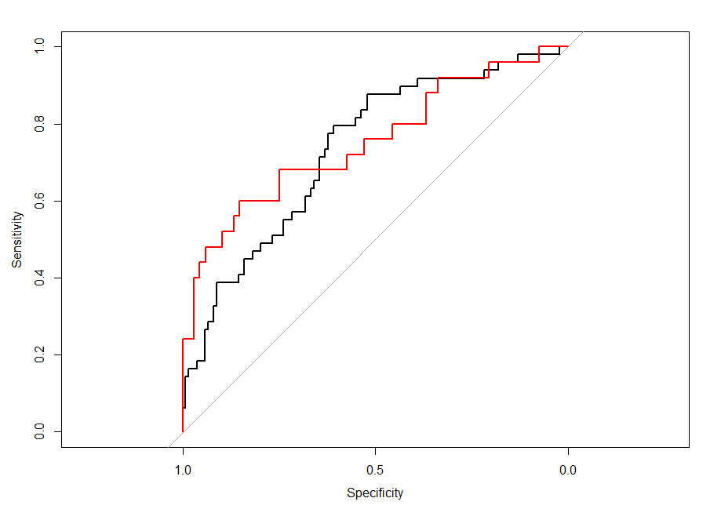

Slide 19
Now the RSNNS package..

Slide 20
RSNNS Package
#### Using the RSNNS package (first train the model)
library(RSNNS)
tngrid<-expand.grid(layer1=3:5, layer2=1:4, layer3=0:3, decay=c(0.1, 0.2))
trnnet<-train(as.factor(CR90) ~ ., data=LN, maxit=200, method="mlpWeightDecayML", trControl=trainControl(method="cv", number=10), tuneGrid=tngrid)
Multi-Layer Perceptron, multiple layers
280 samples; 10 predictor; 2 classes: '0', '1'
No pre-processing
Resampling: Cross-Validated (10 fold)
Summary of sample sizes: 251, 251, 252, 252, 253, 251, ...
Resampling results across tuning parameters:
layer1 layer2 layer3 decay Accuracy Kappa
3 0 0 0.1 0.7358921730 0
3 0 0 0.2 0.5895958767 0
…
5 4 4 0.1 0.7358921730 0
5 4 4 0.2 0.6429164386 0
Accuracy was used to select the optimal model using the largest value.
The final values used for the model were layer1 = 3, layer2 = 1, layer3 = 0 and decay = 0.1.

Slide 21
RSNNS Package
#### Using the RSNNS package (first train the model)
nnmod2<-mlp(x=LN[sub,-11], LN$CR90[sub], size=c(3,1), learnFuncParams=c(0.1), maxit=500, linOut=FALSE,
inputsTest=LN[-sub,-11], targetsTest=LN[-sub,11])
par(mfrow=c(2,2))
plotIterativeError(nnmod2)
predictions <- predict(nnmod2,LN[-sub,-11])
plotRegressionError(predictions[,1], LN[-sub,11])
plotROC(fitted.values(nnmod2), LN[sub,11])
plotROC(predictions, LN[-sub,11])

Slide 22
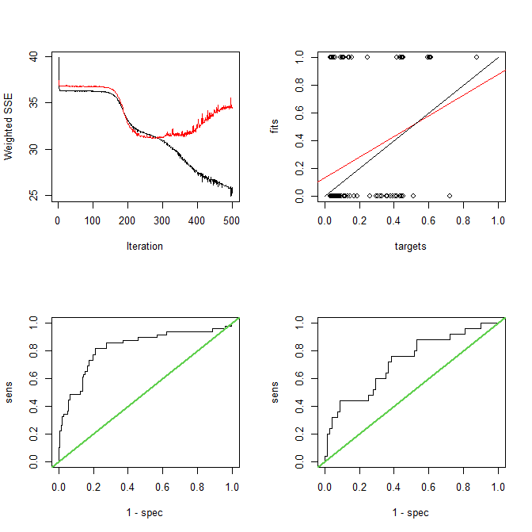

Slide 23
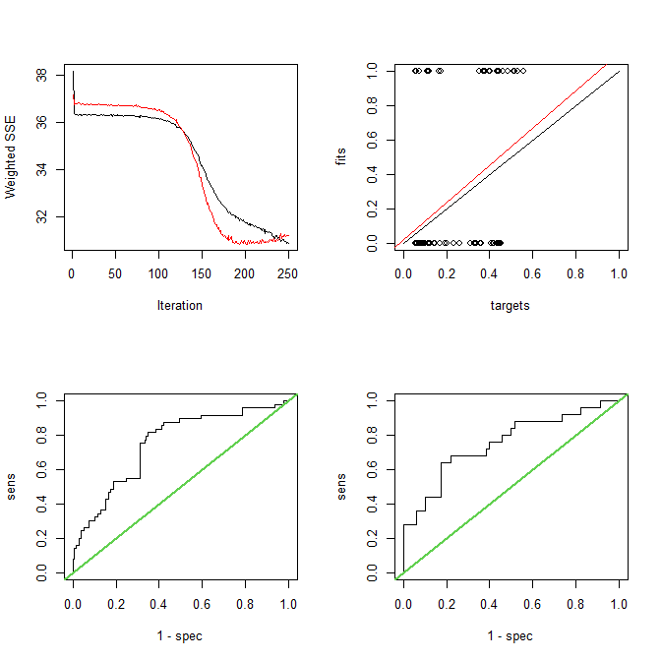
nnmod2a<-mlp(x=LN[sub,-11], LN$CR90[sub], size=c(3,1), learnFuncParams=c(0.1), maxit=250, linOut=FALSE,
inputsTest=LN[-sub,-11], targetsTest=LN[-sub,11])

Slide 24
RSNNS Package
> roc(LN$CR90[sub], as.vector(predict(nnmod2a)))
Setting levels: control = 0, case = 1
Setting direction: controls < cases
Call: roc.default(response = LN$CR90[sub], predictor = as.vector(predict(nnmod2a)))
Data: as.vector(predict(nnmod2a)) in 138 controls (LN$CR90[sub] 0) < 49 cases (LN$CR90[sub] 1).
Area under the curve: 0.7786
> roc(LN$CR90[-sub], as.vector(predict(nnmod2a, newdata=LN[-sub,-11])))
Setting levels: control = 0, case = 1
Setting direction: controls < cases
Call: roc.default(response = LN$CR90[-sub], predictor = as.vector(predict(nnmod2a, newdata = LN[-sub, -11])))
Data: as.vector(predict(nnmod2a, newdata = LN[-sub, -11])) in 68 controls (LN$CR90[-sub] 0) < 25 cases (LN$CR90[-sub] 1).
Area under the curve: 0.7182
table(ifelse(nnmod1$fitted.values<0.5, 0, 1), LN$CR90[sub])
0 1
0 124 32
1 14 17
table(ifelse(predict(nnmod1, newdata=LN[-sub,])>0.5, 1, 0), LN$CR90[-sub])
0 1
0 63 19
1 5 6

Slide 25
RSNNS Package
unit definition section :
no. | typeName | unitName | act | bias | st | position | act func | out func | sites
----|----------|---------------------|-------------|-------------|----|---------- |-----------------|----------|-------
1 | | Input_race | 1.00000 | 0.14227 | i | 1, 0, 0 | Act_Identity | |
2 | | Input_age | -0.29287 | 0.02396 | i | 2, 0, 0 | Act_Identity | |
3 | | Input_urprcr | -0.70644 | -0.14502 | i | 3, 0, 0 | Act_Identity | |
4 | | Input_dsdnapn | 1.00000 | 0.24410 | i | 4, 0, 0 | Act_Identity | |
5 | | Input_c4c | -0.45356 | 0.21352 | i | 5, 0, 0 | Act_Identity | |
6 | | Input_egfr | -0.02096 | -0.12572 | i | 6, 0, 0 | Act_Identity | |
7 | | Input_il2ra | 1.88319 | -0.19338 | i | 7, 0, 0 | Act_Identity | |
8 | | Input_il6 | 0.54756 | -0.22156 | i | 8, 0, 0 | Act_Identity | |
9 | | Input_il8 | -0.06250 | -0.23556 | i | 9, 0, 0 | Act_Identity | |
10 | | Input_il12 | -0.48901 | -0.15669 | i | 10, 0, 0 | Act_Identity | |
11 | | Hidden_2_1 | 0.99061 | 0.25627 | h | 1, 2, 0 |||
12 | | Hidden_2_2 | 0.68652 | 0.00629 | h | 2, 2, 0 |||
13 | | Hidden_2_3 | 0.02644 | -0.34849 | h | 3, 2, 0 |||
14 | | Hidden_3_1 | 0.33832 | 0.42794 | h | 1, 4, 0 |||
15 | | Output_1 | 0.39277 | 0.87233 | o | 1, 6, 0 |||
----|----------|---------------------|-------------|-------------|----|------------|-------------------|----------|-------

Slide 26
RSNNS Package
> extractNetInfo(nnmod2a)$unitDefinitions
unitNo unitName unitAct unitBias type posX posY posZ actFunc outFunc sites
1 1 Input_race 1.00000000 0.142274946 UNIT_INPUT 1 0 0 Act_Identity Out_Identity
2 2 Input_age -0.29286540 0.023958683 UNIT_INPUT 2 0 0 Act_Identity Out_Identity
3 3 Input_urprcr -0.70644116 -0.145024896 UNIT_INPUT 3 0 0 Act_Identity Out_Identity
4 4 Input_dsdnapn 1.00000000 0.244095743 UNIT_INPUT 4 0 0 Act_Identity Out_Identity
5 5 Input_c4c -0.45356163 0.213524163 UNIT_INPUT 5 0 0 Act_Identity Out_Identity
6 6 Input_egfr -0.02096219 -0.125717014 UNIT_INPUT 6 0 0 Act_Identity Out_Identity
7 7 Input_il2ra 1.88318801 -0.193376452 UNIT_INPUT 7 0 0 Act_Identity Out_Identity
8 8 Input_il6 0.54756421 -0.221560270 UNIT_INPUT 8 0 0 Act_Identity Out_Identity
9 9 Input_il8 -0.06250137 -0.235559404 UNIT_INPUT 9 0 0 Act_Identity Out_Identity
10 10 Input_il12 -0.48900744 -0.156690210 UNIT_INPUT 10 0 0 Act_Identity Out_Identity
11 11 Hidden_2_1 0.99060601 0.256269306 UNIT_HIDDEN 1 2 0 Act_Logistic Out_Identity
12 12 Hidden_2_2 0.68652302 0.006293331 UNIT_HIDDEN 2 2 0 Act_Logistic Out_Identity
13 13 Hidden_2_3 0.02643615 -0.348486125 UNIT_HIDDEN 3 2 0 Act_Logistic Out_Identity
14 14 Hidden_3_1 0.33832175 0.427941352 UNIT_HIDDEN 1 4 0 Act_Logistic Out_Identity
15 15 Output_1 0.39276898 0.872330725 UNIT_OUTPUT 1 6 0 Act_Logistic Out_Identity

Slide 27
RSNNS Package
> round(weightMatrix(nnmod2a)[,c(1,10:15)], 3)
Input_race Input_il12 Hidden_2_1 Hidden_2_2 Hidden_2_3 Hidden_3_1 Output_1
Input_race 0 0 -0.093 0.423 0.106 0.000 0.000
Input_age 0 0 -0.585 -0.288 0.166 0.000 0.000
Input_urprcr 0 0 -2.672 1.171 1.419 0.000 0.000
Input_dsdnapn 0 0 0.203 -0.212 -0.917 0.000 0.000
Input_c4c 0 0 -0.558 -0.922 0.378 0.000 0.000
Input_egfr 0 0 -0.534 -1.799 -1.008 0.000 0.000
Input_il2ra 0 0 0.978 0.303 -0.656 0.000 0.000
Input_il6 0 0 0.014 0.691 -0.184 0.000 0.000
Input_il8 0 0 -0.626 -1.304 -0.088 0.000 0.000
Input_il12 0 0 -0.165 0.364 -0.175 0.000 0.000
Hidden_2_1 0 0 0.000 0.000 0.000 -2.801 0.000
Hidden_2_2 0 0 0.000 0.000 0.000 2.371 0.000
Hidden_2_3 0 0 0.000 0.000 0.000 1.812 0.000
Hidden_3_1 0 0 0.000 0.000 0.000 0.000 -3.866
Output_1 0 0 0.000 0.000 0.000 0.000 0.000

Slide 28
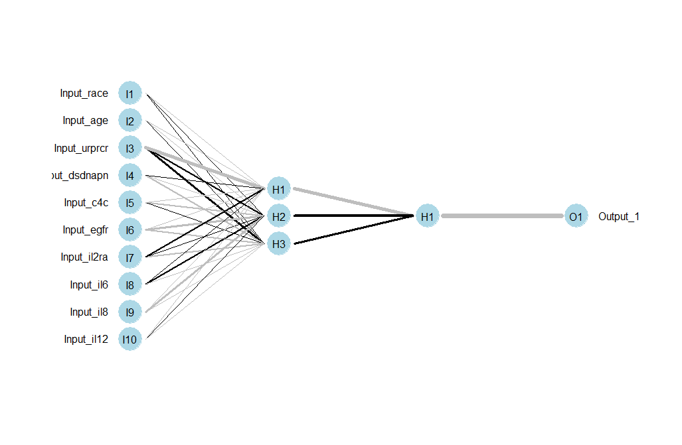
Plotting and ANN form RSNNS
### NICE plots of ANN model from RSNNS
library(NeuralNetTools)
plotnet(nnmod2a)

Slide 29
Bagged ANN
We already know bagging is one approach to improve prediction performance of weak learners
The caret package has functionality to fit a bagged ANN model using models from the nnet package as the base models
We can train this model using the train function in caret
We could also easily develop a function to fit a bagged ANN using the RSNNS package which has greater functionality.

Slide 30
Bagged ANN
### Using the avNNet function from caret to fit a bagged neural net
tngrid<-expand.grid(size=c(5,25,50), decay=c(0.1,0.5), bag=c(100,150,200,250))
trnnet<-train(as.factor(CR90) ~ ., data=LN, method="avNNet", trControl=trainControl(method="cv", number=10), tuneGrid=tngrid)
trnnet
Model Averaged Neural Network
280 samples
10 predictor
..
Resampling results across tuning parameters:
size decay bag Accuracy Kappa
5 0.1 100 0.7538405400 0.2397554221
…
50 0.5 250 0.7498722861 0.1826383057
Accuracy was used to select the optimal model using the largest value.
The final values used for the model were size = 25, decay = 0.5 and bag = 150.

Slide 31
Bagged ANN
### Using the avNNet function from caret to fit a bagged neural net
nnmod3<-avNNet(as.factor(CR90)~., data=LN[sub,], size=25, decay=0.5, repeats=250, bag=TRUE)
round(predict(nnmod3),3)
0 1
220 0.648 0.352
178 0.603 0.397
2 0.600 0.400
225 0.617 0.383
27 0.608 0.392
0.622 0.378
…
56 0.605 0.395
233 0.640 0.360
231 0.595 0.405
209 0.567 0.433
75 0.615 0.385

Slide 32
Bagged ANN
### Using the avNNet function from caret to fit a bagged neural net
table(predict(nnmod3, newdata=LN[sub,-11], type="class"), LN$CR90[sub])
0 1
0 137 44
1 1 5
table(predict(nnmod3, newdata=LN[-sub,-11], type="class"), LN$CR90[-sub])
0 1
0 68 23
1 0 2

Slide 33
Bagged ANN
trroc<-roc(LN$CR90[sub], predict(nnmod3, newdata=LN[sub,-11], type="prob")[,2])
trroc
Call:
roc.default(response = LN$CR90[sub], predictor = predict(nnmod3, newdata = LN[sub, -11], type = "prob")[, 2])
Data: predict(nnmod3, newdata = LN[sub, -11], type = "prob")[, 2] in 138 controls (LN$CR90[sub] 0) < 49 cases (LN$CR90[sub] 1).
Area under the curve: 0.7248
tsroc<-roc(LN$CR90[-sub], predict(nnmod3, newdata=LN[-sub,-11], type="prob")[,2])
tsroc
Call:
roc.default(response = LN$CR90[-sub], predictor = predict(nnmod3, newdata = LN[-sub, -11], type = "prob")[, 2])
Data: predict(nnmod3, newdata = LN[-sub, -11], type = "prob")[, 2] in 68 controls (LN$CR90[-sub] 0) < 25 cases (LN$CR90[-sub] 1).
Area under the curve: 0.7565

Slide 34
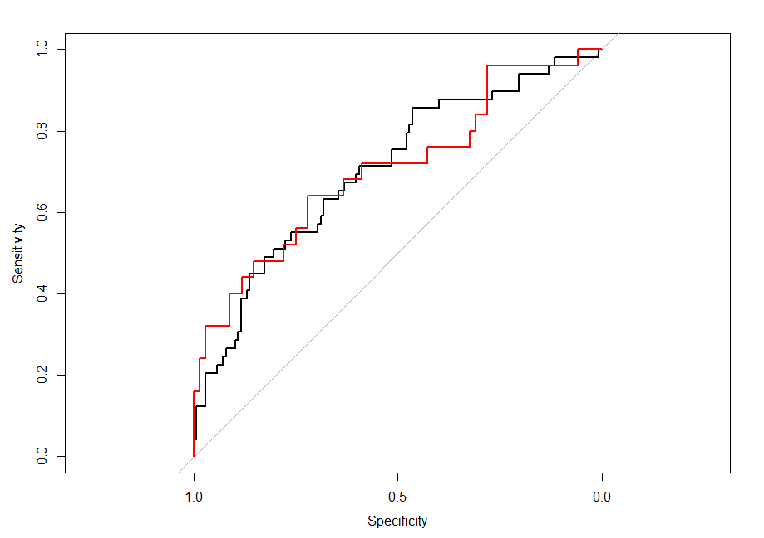

Slide 35
Multinomial Example
Localized breast cancer can be treated by excising tumor tissue in the affected breast
In order to ensure removal of as little tissue as possible, it is important to determine different tissue types to discriminate tumor from other tissue.
Study goal: Determine if impedence measures in human breast tissue can discriminate
Connective
Benign tumor
Carcinoma
Adipose

Slide 36
Multinomial Example
Features:
I0 = Impedivity (ohm) at zero frequency
PA500 = Phase angle at 500 KHz
HFS = High-frequency slope of phase angle
normArea = Area under the spectrum by impedance distance
between spectral ends
Max IP = Maximum of the spectrum
DR = Distance between I0 and the real part of the maximum
frequency point
P = Length of the spectral curve

Slide 37
RSNNS Package
######################################################
### Example of Multi-Class ANN model ###
### ###
### MULTI-CLASS CLASSIFICATION EXAMPLE ###
### DIFFERENTIATING BREAST TISSUE TYPES ###
######################################################
#### Using the RSNNS package (first train the model)
btis<-read.csv("H:\\public_html\\BMTRY790_Spring2023\\Datasets\\BreastTissue.csv")
btis<-btis[,-1]
set.seed(1234)
sub<-sort(sample(1:nrow(btis), 0.67*nrow(btis), replace=F))
tngrid<-expand.grid(layer1=0:5, layer2=0:5, layer3=0:5, decay=c(0.1, 0.2))
trnnet<-train(Class ~ ., data=btis, maxit=500, method="mlpWeightDecayML", trControl=trainControl(method="cv",
number=10), tuneGrid=tngrid)

Slide 38
RSNNS Package
#### Using the RSNNS package (first train the model)
trnnet
Multi-Layer Perceptron, multiple layers
106 samples
7 predictor
4 classes: 'adipose', 'carcinoma', 'connective', 'nonmalig'
No pre-processing
Resampling: Cross-Validated (10 fold)
Resampling results across tuning parameters:
layer1 layer2 layer3 decay Accuracy Kappa
0 0 0 0.1 0.4034848485 0
0 0 0 0.2 0.3880303030 0
…
5 5 5 0.2 0.4062121212 0
Accuracy was used to select the optimal model using the largest value.
The final values used for the model were layer1 = 2, layer2 = 1, layer3 = 0 and decay = 0.1.

Slide 39
RSNNS Package
#### Special coding for multi-class model in RSNNS
btisClass<-decodeClassLabels(btis[,1])
btisIn<-btis[,-1]
btis<-splitForTrainingAndTest(btisIn, btisClass, ratio=.333)
names(btis)
[1] "inputsTrain" "targetsTrain" "inputsTest" "targetsTest"
round(head(btis$inputsTrain), 3)
I0 PA500 HFS normArea MaxIP DR P
[1,] 524.794 0.187 0.032 29.911 60.205 220.737 556.828
[2,] 330.000 0.227 0.265 26.109 69.717 99.085 400.226
[3,] 551.879 0.232 0.064 44.895 77.793 253.785 656.769
[4,] 380.000 0.241 0.286 39.249 88.758 105.199 493.702
[5,] 362.831 0.201 0.244 26.342 69.389 103.867 424.797
[6,] 389.873 0.150 0.098 20.869 49.757 107.686 429.386

Slide 40
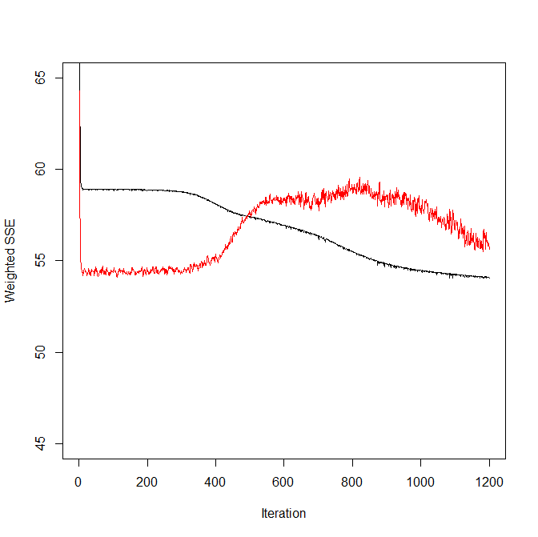
RSNNS Package
#### Now we can fit our model
nnmod4<-mlp(x=btis$inputsTrain, btis$targetsTrain, size=c(2,1), learnFuncParams=c(0.1), maxit=1200, linOut=F,
inputsTest=btis$inputsTest, targetsTest=btis$targetsTest)
plotIterativeError(nnmod4)

Slide 41
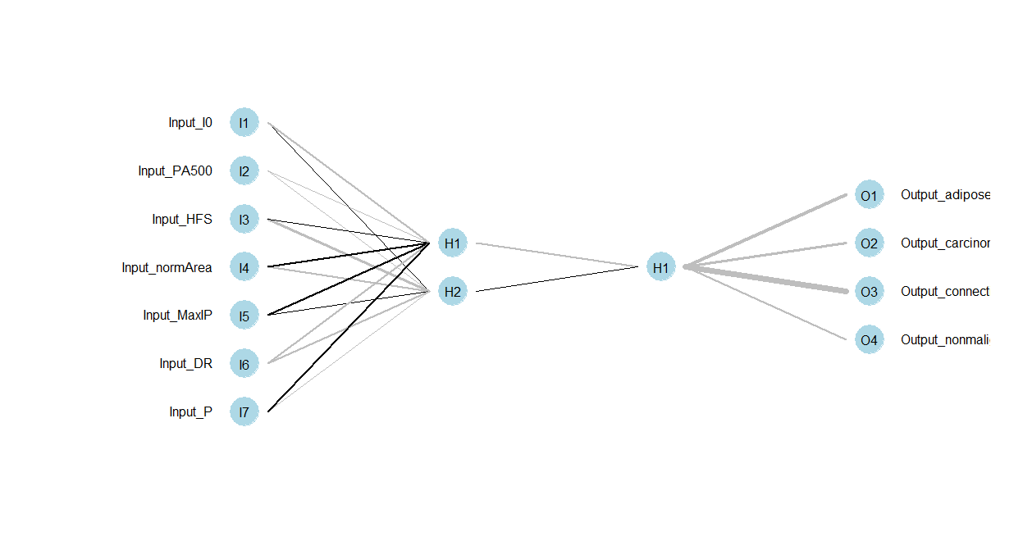

Slide 42
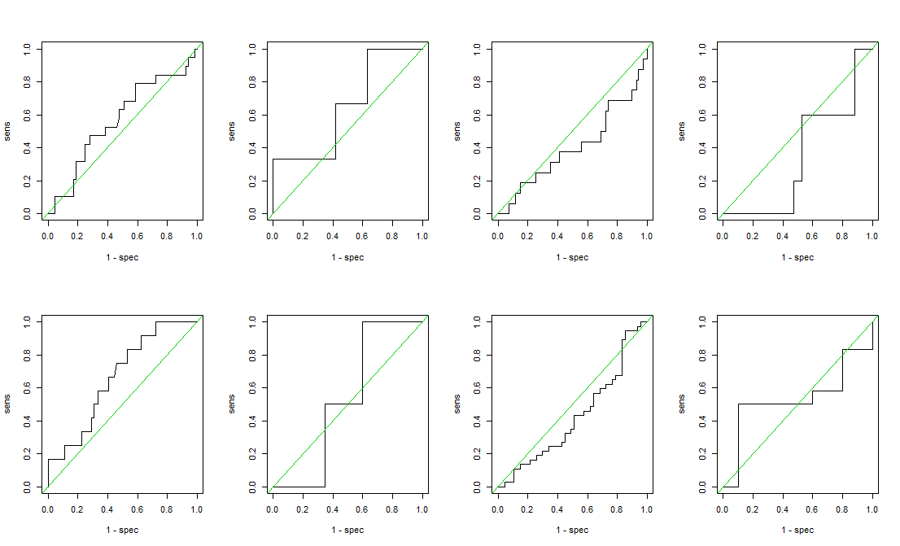

Slide 43
Final Notes
ANNs can be tricky to fit…
Careful consideration should be made to select appropriate tuning parameters
Too few hidden features or layers may results in insufficient flexibility
Too many can overfit
Additionally, number of iterations is an important consideration
In the models fit here, if too few iterations were considered predicted values tended to be the same across all observations
Thus it is often necessary to go back and forth between number of hidden features/layers and number of iterations
Models presented in class likely needed more training to choose the best set of parameters but this can be time consuming

