Slide 1
Lecture 1: Overview of Machine Learning
BMTRY 790: Machine Learning

Slide 2
General Information
Website:
http://people.musc.edu/~wolfb/BMTRY790_Spring2023/BMTRY790_2023.htm
Office: 302B, 135 Cannon Place
Phone: (843)876-1940
Email: wolfb@musc.edu
Office Hours: By appointment

Slide 3
Homework
4-5 homework assignments worth 60% of your grade.
Include some theory, application of software, as well as writing your own code.
Should be submitted electronically. Scan hand-written homework send electronic copy.
Due 1 week after it is assigned unless otherwise noted.
One day late will receive a 25% reduction, two days late will receive a 50% reduction, more than two days late will not be accepted.

Slide 4
Exam
There will also be one mid-term exam that constitutes 20% of your grade.
The exam will consist of:
Theory of statistical learning algorithms
Writing pseudo code for programming statistical algorithms
Comparison of different statistical learning algorithms.

Slide 5
Project
Designed to simulate a real problem you may face once you’ve graduate- how to choose from among different modeling techniques.
The goal will be to use the methods learned throughout the class to develop a prediction model for real-world data.

Slide 6
What is Machine Learning
Making computers adapt or modify their actions to lead to a more accurate actions…
Examples of actions
Predicting a patient’s response
Identifying subsets of similar observations
Extraction of features relevant to an outcome

Slide 7
Types of Machine Learning
Supervised
Have a set of training of observations with both predictors and response(s)
Unsupervised
Have a set of features but no response is provided
Goal is to identify similar observations

Slide 8
Types of Machine Learning
Reinforcement
Between supervised and unsupervised
Algorithm told when it is right or wrong
“Rewarded” for correct action
“Penalized” for mistakes
Examples include things like teaching a computer to play a game
i.e. what is the best move to make at this time?

Slide 9
Vocabulary: Statistics vs. ML
Dependent Variable (Y, G, t)
Response
Outcome
Target
Output
Independent Variables (X)
Predictors
Features
Inputs

Slide 10
Goal In Machine Learning
General goal
discover patterns in data through the use of algorithms
use these patterns to take some action
Examples?

Slide 11
Goal In Machine Learning
In a more mathematical/statistical context
Given input features x
Find a function f (x) that does a good job of predicting/estimating an outcome y
Linear regression is an example of this
Ideally we want the results from our learner to be generalizable

Slide 12
Simple Example
We want to understand bioavailability of iron in rainwater to phytoplankton
Iron is a limiting nutrient and certain “forms” of iron are more available for phytoplankton to use
Ionic iron (Fe²⁺ or Fe³⁺) are more available than colloidal iron (e.g. Fe₂O₃ = rust).
Major source of iron in the open ocean is from rainwater
We want to evaluate if there is a relationship between time of day with Fe³⁺

Slide 13
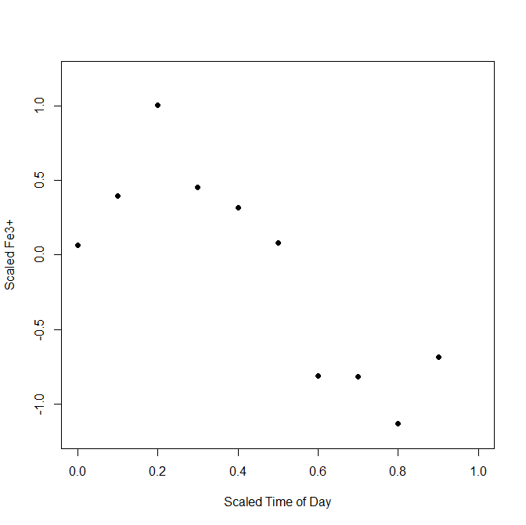
Simple Example
We observe some real-valued input variable x = time for 10 rain events and we want to predict y = Fe³⁺
This is a problem we are familiar with… What is one approach we might take?

Slide 14
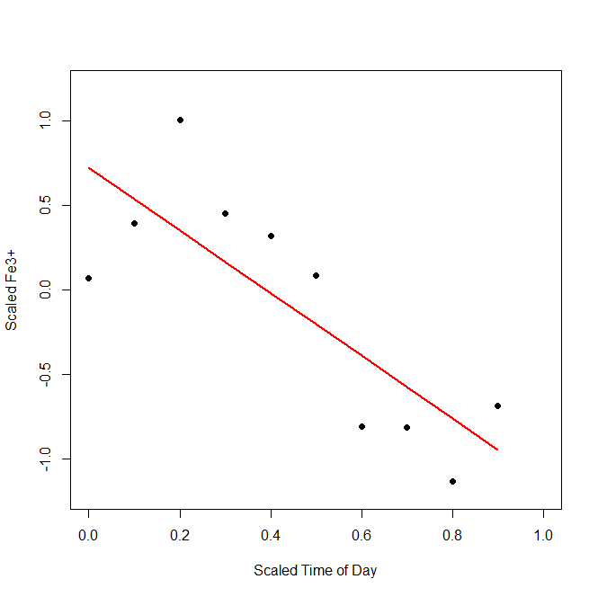
Simple Example
Let’s say we run a regression model

Slide 15
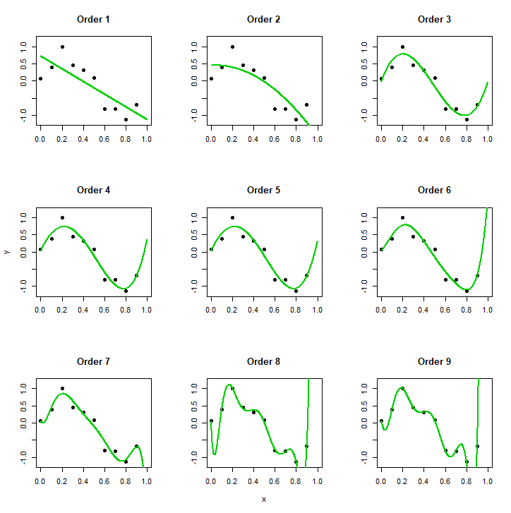
Polynomial Fits

Slide 16
Coefficients with Increasing Order
 | M=0 | M=1 | M=3 | M=6 | M=9
b0 | -0.112 | 0.721 | -0.014 | 0.052 | 0.068
b1 |  | -1.852 | 8.692 | 2.564 | -16.590
b2 |  |  | -27.218 | 38.797 | 244.86
b3 |  |  | 18.504 | -258.484 | 693.33
b4 |  |  |  | 555.678 | -19609.9
b5 |  |  |  | -533.186 | 102882.1
b6 |  |  |  | 196.115 | -257122.5
b7 |  |  |  |  | 343211.3
b8 |  |  |  |  | -235721.8
b9 |  |  |  |  | 65522.27

Slide 17
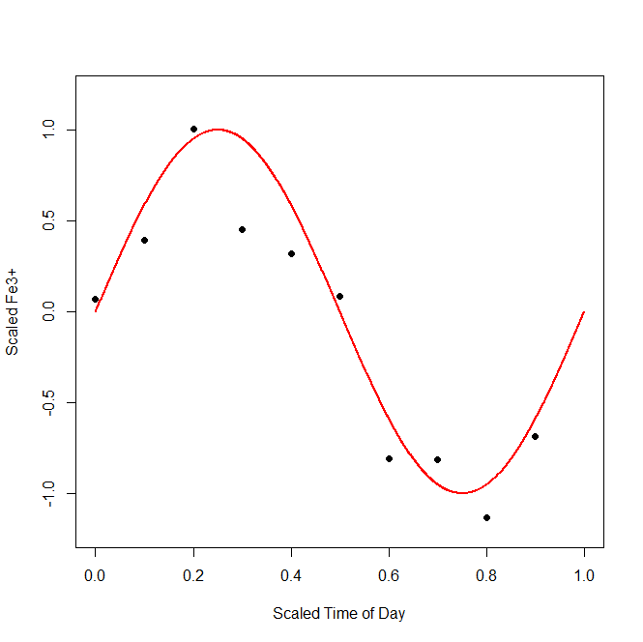
y = f(x) = sin(2πx) + ε

Slide 18
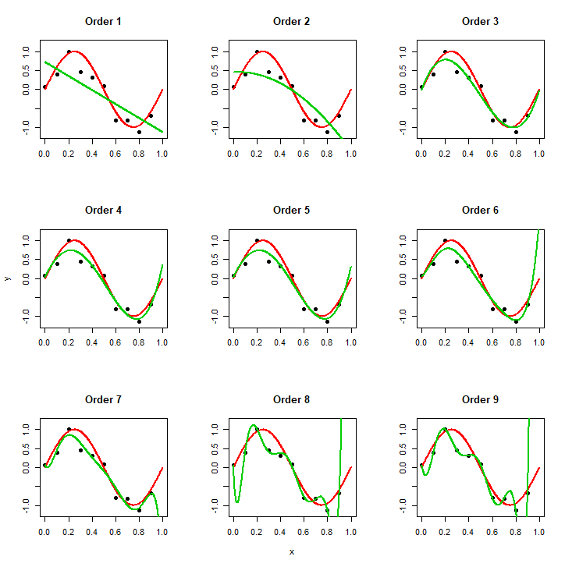
Polynomial Fits

Slide 19
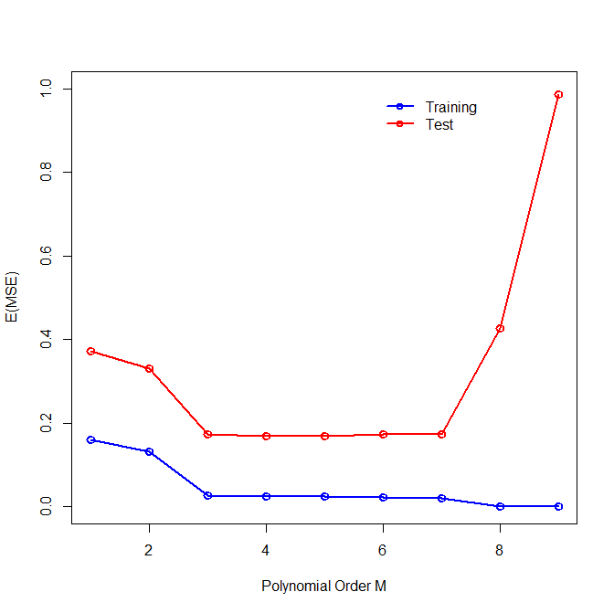
Examining Overfitting

Slide 20
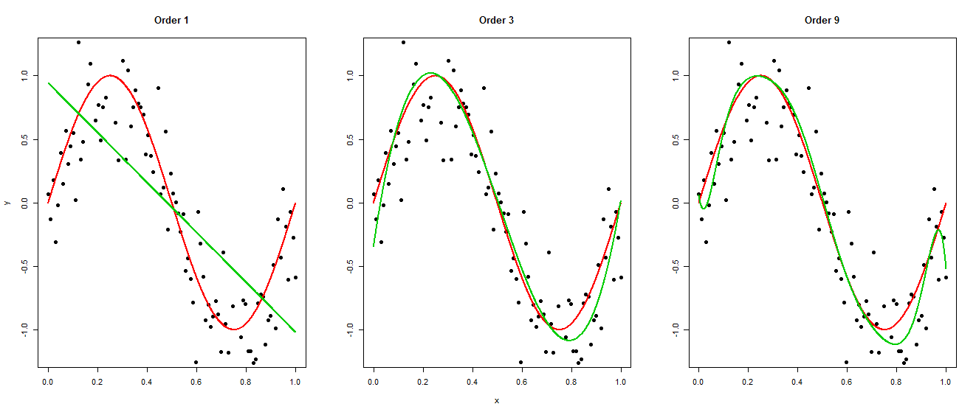
What about with more data?

Slide 21
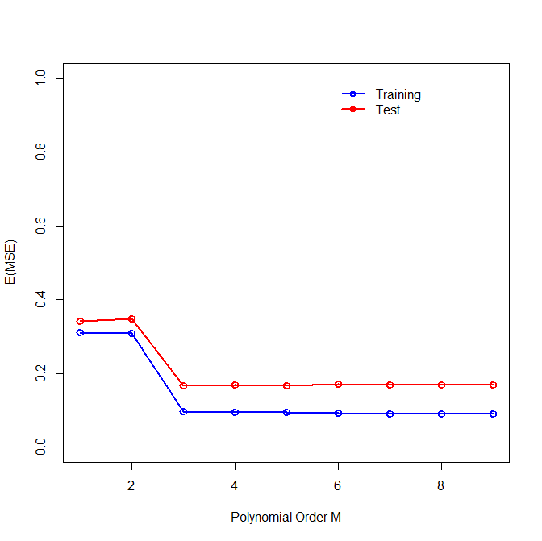
Impact of Larger N on Overfitting

Slide 22
Another Simple Example
Consider an example where we have a data set with 2 features x₁ and x₂ and an output variable, y, with two classes
e.g. classify Cooper River Bridge run participants as runners/walkers based on chip time and age
We want to develop a prediction rule for determining the class of y based on x₁ and x₂
i.e. find some yields a good prediction
What methods might we use that we know already?

Slide 23
“Linear” Regression Approaches
We could simply develop a linear model
How can we use the output to classify y and develop a decision boundary?

Slide 24
“Linear” Regression Approaches
Decision boundary from linear regression model

Slide 25
“Linear” Regression Approaches
Alternatively we could use a link function
i.e. logistic regression
How can this type of mode be used to develop a decision boundary

Slide 26
“Linear” Regression Approaches
Decision boundary from logistic regression model

Slide 27
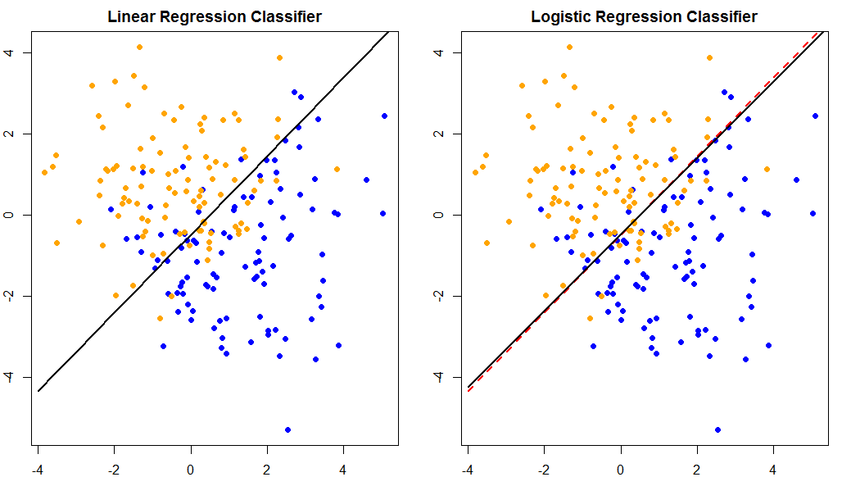
Linear Classifiers

Slide 28
Caveats
Linear classifiers yield relatively stable predictions
However, we make relatively large assumptions about the association between y and our features x
Classes are linearly separable
Inputs/predictors are independent
Independence of errors
There are (many?) times when these assumptions are unreasonable

Slide 29
Alternatives
The regression approaches are model based and assume a specific relationship between X and Y
There are many alternatives to traditional linear regression classifiers
Here we briefly examine 1… nearest neighbors

Slide 30
Nearest Neighbors
Idea: use the k observations closest to point x_{i} to develop a decision boundary to determine the predicted class
Mathematically we can express this as follows
There are certainly fewer assumptions but what assumption does this still make?

Slide 31
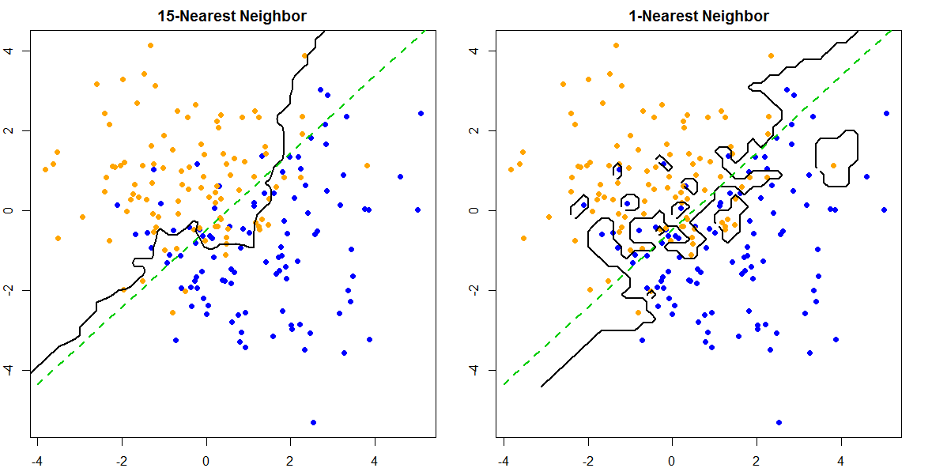
K-Nearest Neighbors

Slide 32
Caveats for kNN
Requires fewer assumptions and can adapt to any scenario
However, sub-regions of the decision boundary are determined by only a small subset of the training observations
Results is that kNN often produced unstable estimates

Slide 33
Loss Functions
In trying to define f (X) to predict Y given our values of X, we need to choose a loss function to penalize prediction errors.
Familiar loss functions
$$\text{squared} \text{error} \text{loss}\text{:}$$
$$\text{absolute} \text{error} \text{loss}\text{:}$$
$$\text{zero}\text{−}\text{one} \text{loss}$$

Slide 34
Loss Functions
Selecting the loss function leads us to a criterion for choosing
Goal is to minimize the expected loss

Slide 35
Least Squares Example

Slide 36
In Context of LR and kNN?
Thus for regression our best estimation of Y when X=x is the conditional mean of Y at X=x.
The NN approach directly implements this idea in local regions in the training data
Expectation approximated by average all y_{i}’s in the neighborhood of X=x
Conditioning on relaxed region close to observation X=x

Slide 37
Curse of Dimensionality
Refers to problems with analyzing high-dimensional data that do not occur in low-dimensional settings.
As the number of features increases, the feature space volume increases so fast that the data become sparse.
Result is that our intuition breaks down as dimensions increase.

Slide 38
Curse of Dimensionality
If evaluating statistical significance, the amount of data needed to support the result often grows exponentially with the dimensionality
For discovery (i.e. discover patterns), organizing and searching the data relies on detecting areas where objects form groups with similar properties
In high dimensional data, all objects may appear to be sparse, which prevents common data organization strategies from being efficient

Slide 39
Consider Our Examples
Polynomial fit
We considered a case with only a single variable
But what happens if we consider D variables?

Slide 40
Consider Our Examples
k-NN:
We considered a case with two variables
Consider two classed based on D inputs uniformly dispersed in a D-dimensional hypercube of unit volume
Want capture hypercubical neighborhood around a target point to capture a fraction r of the unit volume
Expected edge length is e_{D}(r) = r^{1/D}
In 10 dimensions for r = 0.1 this means e₁₀(0.1) = 0.80
However, the range of each input is only 1.0

Slide 41
More on Supervised Learning
Start with assumptions that data come from a model Y = f(x) + ε where E(ε) = 0 and is independent of X
Here f(x) = E(Y|X = x)
Goal of supervised learning is to learn f by example
Learning algorithm can modify the input/output relationship based on

Slide 42
Function Approximation
Data {x_{i}, y_{i}} considered (p+1)-dim Euclidean space
f(x) has domain of p-dim input space and is related to data via a model like y_{i} = f(x_{i}) + ε
Goal to obtain useful approximation for f(x) based on all x
Many approximations include estimated set of parameters θ
Linear regression: f(x) = x’β → θ = β
More general: (linear basis expansion)

Slide 43
On Writing R Functions…
Idea:
Objects created within a function are local to the environment of the function
They don’t exist outside of the function.
But you can “return” a value(s) of the object from the function
Can be used in other functions
Can summarize results of task the function completed

Slide 44
Why Write Your Own Functions?
Easy way to conduct simulations for method evaluation
Standardize code you use often
Once function written, need one line of code to run your analysis
e.g. plotting functions to summarize results
Developing and disseminating new methods

Slide 45
Basic Function Format
Need a function name
Arguments (generally at least)
Body of code that does some task
Final object the function returns (not necessary)

Slide 46
Pseudo Code- Simple Example
What do we need to generate our data sin(x) example

Slide 47
y = f(x) = sin(2πx) + ε

Slide 48
Pseudo Code- Simple Example
What do we need to generate our data sin(x) example

Slide 49
Code for Simple Example

Slide 50
More Complex Example
polyfit<-function(dat, maxpol)
{
models<-vector("list", maxpol+1)
prd<-matrix(0, nrow=nrow(nxs), ncol=maxpol)
tst<-myfunc(100)
prdtrn<-errtrn<-matrix(0, nrow=nrow(dat), ncol=maxpol)
prdnew<-errnew<-matrix(0, nrow=100, ncol=maxpol)
model.basis<-lm(y ~ 1, dat)
models[[1]]<-model.basis$coef
for (i in 1:maxpol)
{
modi<-lm(y ~ poly(x, i, raw=TRUE), data=dat)
models[[i+1]]<-modi$coef
prdtrn[,i]<-predict(modi)
errtrn[,i]<-(prdtrn[,i]-dat$y)^2
prdnew[,i]<-predict(modi, newdata=tst[,2])
errnew[,i]<-(prdnew[,i]-tst$y[1:94])^2
}
ans<-list(models=models, ptrn=prdtrn, etrn=errtrn, pnew=prdnew, enew=errnew)
return(ans)
}

Slide 51
Troubleshooting
R and Rstudio do have a debug() function
Use print statements to determine when code breaks
Use toy examples for which you know how the output should look and can compare what your function returns with what it should return
Comment code to help yourself as well!

Slide 52
Examples of Trouble Shooting
Using print statements to understand an error
Goal: Develop a function to calculate the odds ratios for all possible cut-points for a single continuous variable x and a categorical variable y

Slide 53
Understanding Error Message
calcOR_allX<-function (x, y) {
ORs<-c()
for (i in 1:length(x))
{
cp<-sort(x)[i]
Ix<-ifelse(x>cp, 1, 0)
tab<-table(Ix, y)
ORs<-append(ORs, (tab[1,1]*tab[2,2])/(tab[1,2]*tab[2,1]))
}
return(ORs)
}
> calcOR_allX(x=x, y=y)
Error in tab[2, 2] : subscript out of bounds

Slide 54
Understanding Error Message
calcOR_allX<-function (x, y) {
ORs<-c()
for (i in 1:length(x))
{
cp<-sort(x)[i]
Ix<-ifelse(x>cp, 1, 0)
tab<-table(Ix, y)
print(paste("Table for cut-point", i,sep=" "))
print(tab)
ORs<-append(ORs, (tab[1,1]*tab[2,2])/(tab[1,2]*tab[2,1]))
}
return(ORs)
}
calcOR_allX(x=x, y=y)
…
[1] "Table for cut-point 100"
y
Ix 0 1
0 50 50
Error in tab[2, 2] : subscript out of bounds

Slide 55
Understanding Error Message
calcOR_allX<-function (x, y) {
ORs<-c()
for (i in 1:length(x))
{
cp<-sort(x)[i]
Ix<-ifelse(x>cp, 1, 0)
tab<-table(Ix, y)
if (dim(tab)[1]==dim(tab)[2])
{ORs<-append(ORs, (tab[1,1]*tab[2,2])/(tab[1,2]*tab[2,1]))}
}
return(ORs)
}
>tst<- calcOR_allX(x=x, y=y)
>tst
[1] Inf ...
[97] 2.041667 1.000000 Inf

Slide 56
Examples of Trouble Shooting
Using toy examples to check your code
Goal: Develop a function to calculate the relative risk for a binary variable x and a categorical variable y

Slide 57
Test Examples
calcRR<-function (x, y) {
tab<-table(x, y)
if (dim(tab)[1]==dim(tab)[2])
{ RR<-(tab[1,1]/sum(tab[,1]))/(tab[2,1]/sum(tab[2,])) }
return(RR)
}
>dat
x y
[1,] 1 0
[2,] 1 0
[3,] 0 1
[4,] 1 0
[5,] 1 0
[6,] 0 1
[7,] 1 1
[8,] 0 0
[9,] 1 0
[10,] 1 0

Slide 58
Test Examples
calcRR<-function (x, y) {
tab<-table(x, y)
if (dim(tab)[1]==dim(tab)[2])
{ RR<-(tab[1,1]/sum(tab[,1]))/(tab[2,1]/sum(tab[2,])) }
return(RR)
}
>dat
x y
[1,] 1 0
[2,] 1 0
[3,] 0 1
[4,] 1 0
[5,] 1 0
[6,] 0 1
[7,] 1 1
[8,] 0 0
[9,] 1 0
[10,] 1 0
>calcRR(x=dat$x, y=dat$y)
[1] 0.1667

Slide 59
Test Examples
calcRR<-function (x, y) {
tab<-table(x, y)
print("This is the 2x2 table")
print(tab)
if (dim(tab)[1]==dim(tab)[2])
{ RR<-(tab[1,1]/sum(tab[,1]))/(tab[2,1]/sum(tab[2,])) }
return(RR)
}
>calcRR(x=dat$x, y=dat$y)
[1] "This is the 2x2 table"
y
x 0 1
0 1 2
1 6 1
[1] 0.1666667

Slide 60
Test Examples
calcRR<-function (x, y) {
tab<-table(x, y)
print("This is the 2x2 table")
print(tab)
if (dim(tab)[1]==dim(tab)[2])
{ RR<-(tab[2,2]/sum(tab[,2]))/(tab[1,2]/sum(tab[1,])) }
return(RR)
}
>calcRR(x=dat$x, y=dat$y)
[1] "This is the 2x2 table"
y
x 0 1
0 1 2
1 6 1
[1] 0.5

Slide 61
Test Examples
calcRR<-function (x, y) {
tab<-table(x, y)
print("This is the 2x2 table")
print(tab)
if (dim(tab)[1]==dim(tab)[2])
{ RR<-(tab[2,2]/sum(tab[2,]))/(tab[1,2]/sum(tab[1,])) }
return(RR)
}
>calcRR(x=dat$x, y=dat$y)
[1] "This is the 2x2 table"
y
x 0 1
0 1 2
1 6 1
[1] 0.2143

Slide 62
Next Time
Review simple and multiple regression (this is a lead into variable selection techniques and adaptations to linear regression models)

