Slide 1
Support Vector Machines
BMTRY 790

Slide 2
Recall Our Discussion of Optimal Hyperplanes
We’ve already touched on the topic of linear optimal separating hyperplanes
We defined optimal as
  Separation of the two classes and maximize the distance from the closest points of either class
Such a definition provides a unique solution
Also tends to lead to better classification performance on test data

Slide 3
What are SVMs?
The original SVMs were decision machines, and did not provide posterior probabilities
  There have been attempts to elicit posterior probabilities
    Fit logistic distribution using maximum likelihood to the decision values
Relevance Vector Machine (RVM) is a Bayesian formulation and has posterior outputs, much sparser solutions than SVMs
  Beyond the scope of this lecture (and class)

Slide 4
Examples of Uses of SVMs
Automatic classification of gene expression profiles or mass spectroscopy data
Classify DNA or Protein sequences
Identifying hand written digits, image processing
Identifying fraudulent and real credit card transactions
Determination of SPAM email

Slide 5
Basic components of a SVM
Separating hyperplane
Maximum-margin of the hyperplane
Soft margin
Kernel function

Slide 6
Simple Example
Microarray expression data from patients with acute leukemia
  Both acute lymphoblastic (ALL) and acute myeloid (AML) leukemias
We want to identify type of leukemia based on expression data from patients
From a much larger data set by Golub et al.

Slide 7
Example Data
Start by considering two genes for each patient.
Each gene is represented as an RNA expression level of the given gene
The training data can be described, where x is our data and y is the class of that data point

Slide 8
2-Gene Example
If there truly were only 2 genes, coming up with a classification rule might be easy
Consider the graph below…
  But what about 4+ dimensions
  Or more likely (in gene expression) thousands of dimensions

Slide 9
The Separating Hyperplane
The hyperplane is the decision boundary an SVM uses to distinguish one object from another
It is a flat n-1 dimension subspace of an n dimensional space, separating the original space into 2 parts
  A dot on a line
  A line on a 2-D space
  A plane in a 3-D volume…

Slide 10
The Separating Hyperplane
Regardless of original dimension, the hyperplane is the separating linear boundary between ALL and AML
Sometimes a 1 or 2-D hyperplane is sufficient
But what about increasing the number of genes to 5 or 6 or the whole 6,817 genes of the original data set
This can be extrapolated mathematically

Slide 11
Which Hyperplane
There are many hyperplanes and a subset of these separate the two categories
The job of SVM is to distinguish the “best” hyperplane from among those that separate the data
  i.e. which provides the best classifier?

Slide 12
Linear Support Vector Machines
In the binary classification problem, the construct a function such that
The separating function then classifies a new point depending on whether or not the classifier is positive

Slide 13
Linearly Separable Data
Recall the case where data are linearly separable implying the data can be separated by a hyperplane:
To choose the “best” hyperplane, define:
  d₋ = shortest distance from the hyperplane and the nearest negative data point
  d₊ = shortest distance from the hyperplane and the nearest positive data point
Thus the margin can be defined as : d = d₋ + d₊
The “best” hyperplane maximizes this margin and is defined as the maximum marginal classifier.

Slide 14
The Maximal Margin Hyperplane
This hyperplane is defined by a middle line (i.e. the margin) which separates the classes but keeps a max distance from any one point.
Model parameters are a convex optimization problem, thus a local solution is a global optimum
The end result is that the hyperplane is dominated by nearby data points
The points that fall on the hyperplane defined by d₋ and d₊ are called the support vectors (hence SVMs)

Slide 15
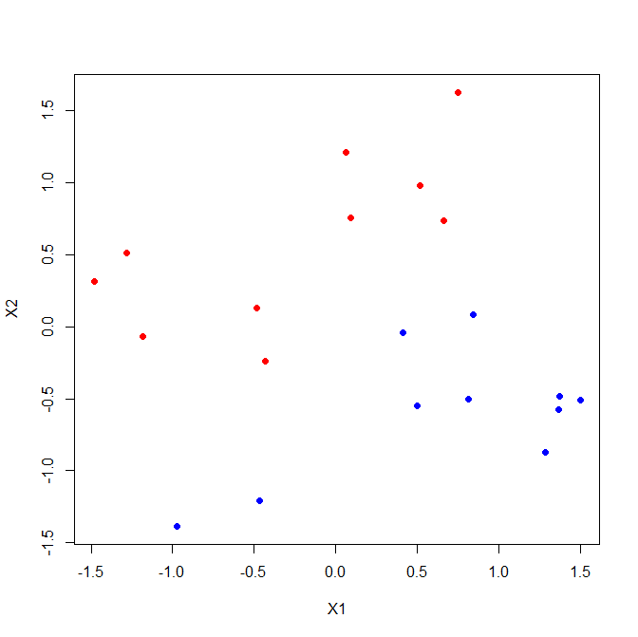

Slide 16
Linear Support Vector Machines
If the data are linearly separable, then there are β₀ and β for which:
We can combine these inequalities:
To find the optimal hyperplane we want to find the β₀ and β
This is a convex (constrained) optimization problem that is solved using Lagrangian multipliers

Slide 17
Interpretation of
Consider 1 point x₁ from f (x₁) = +1 and one point x₂ from f (x₂) = -1
We project the vector (x₁ - x₂) onto the normal vector of our hyperplane.
is the width of the margin between two hyperplanes f (x₁) = +1 and f (x₂) = -1.

Slide 18
Solve Optimal Boundary by Quadratic Programming
Need to solve a convex optimization problem:
  Quadratic objective function
  Linear inequality constraints
Lagrange function: Introduce Lagrange multipliers α_{i} > 0.
L_{P} has to be minimized with respect to the primal variables (β, β₀) and maximized with respect to the dual variables α_{i} .
In other words, we need to find the saddle point for L_{P} .

Slide 19
Wolfe Dual Problem
At the saddle point we have
i.e.
By substituting both into L_{P} to get the dual problem:
subject to

Slide 20
Linear SVM Solution
First solve the dual problem for α
  subject to α_{i} > 0, i = 1,2,…, n and
  Denote the solution as
The SVM slope is obtained by
The SVM intercept is solved using the KKT condition
  with any of the points with (support vectors)
The SVM boundary is given by

Slide 21
Karush-Kuhn-Tucker (KKT) Optimality Condition
The optimal solution should satisfy

Slide 22
Support Vectors
Support Vectors (SVs) are all points with α_{i} > 0.
Thus we can define an index set
The solution and decision boundary can be expressed only in terms of the SVs
However, identification of the SV points requires the use of all the data.

Slide 23
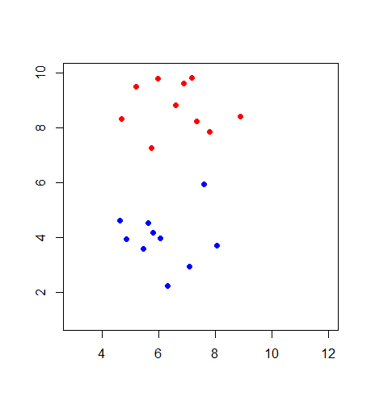
Margin
H₋₁=(β₀+1)+x’β
d₋
β₀+x’β
d₊
H₊₁=(β₀-1)+x’β

Slide 24
How Can We Extend This
The linear SVMs we discussed earlier in class have a few limitations
  Based on separating hyperplanes linear in our original features in X
  Also assumed classes were perfectly linearly separable, which isn’t often the case
SVMs are generalized to address these issues thus:
  They do not have to be linear planes in our original features in X
  Also, they don’t require the data to be perfectly separable
    important since this is not often possible without over-fitting

Slide 25
More About SVMs in General
Non-probabilistic (sort of) binary linear classifier, allowing identification of 2 groups
Generalization of linear decision boundaries
  though clearly we can use a linear hyperplane
Basic SVM is an algorithm for optimizing a convex loss function with respect to a given binary outcome
  Scalable for multi dimensional data
  Unaffected by local minima

Slide 26
Linearly Non-Separable Data
Up to now we had been assuming the data are perfectly linearly separable
In reality, data are rarely linearly separable (i.e. we expect some overlap)
As a result, one or more of the constraints placed in solving the optimization problem will be violated
We can deal with this problem by introducing two concepts:
  A soft-margin allows a few data points to cross into the margin or over the hyperplane, allowing misclassification
  A slack variable, ξ, that defines the distance from a point on the wrong side of d₊ or d₋

Slide 27
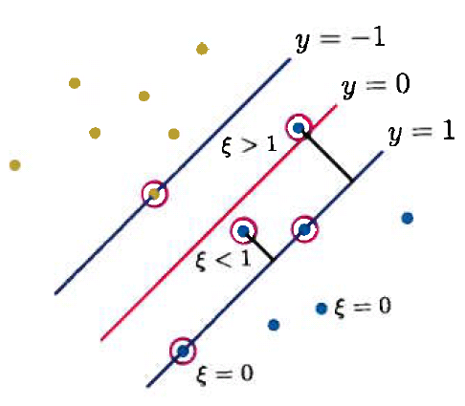
The Soft Margin
Penalizes crossover by looking at the number and distance of the misclassifications
Trade off between the hyperplane violations and the margin size
The slack variables are bounded by some set cost
The farther they are from the soft margin, the less influence they have on the prediction

Slide 28
More on the Soft Margin
All observations have an associated slack variable
  ξ = 0 for all points on the margin (or correct side of the margin)
  0 < ξ < 1 for a point in the margin or the right side of the hyperplane
  ξ > 1 for all points on the wrong side of the hyperpane
  Constant C is trade off between the slack variable penalty and the margin
When allowing error, we optimize our hyperplane by:

Slide 29
Nonlinear Support Vector Machines
As we’ve discussed previously, a linear classifier is often always appropriate
We could consider non-linear transformations (i.e. basis expansions) of our x’s using some nonlinear mapping:
The transformed sample is:
We can substitute for x_{i} when developing our SVM and the optimization depends on:

Slide 30
Kernel Trick
The “new” feature space defined by h may be very large and as such it is difficult to calculate
However, this is not a problem as in practice, SVMs use the kernel trick to find the optimal hyperplane
The basic idea to avoid directly computing
  The kernel trick is an algorithm for computing this inner product
  Compute it using a non-linear kernel function:
  Then compute a linear SVM using this

Slide 31
Example of the Kernel Trick
Consider data with 2 input features X₁ and X₂
Let’s look at a polynomial kernel of degree 2:

Slide 32
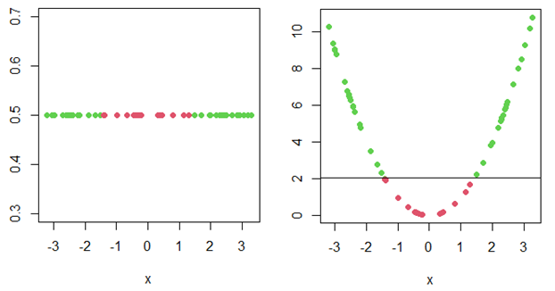
Nonlinear Support Vector Machines
Data with a one predictor, X, and a 2 classes outcome (red/green)
  We cannot separate these with a single point hyperplane…

Slide 33
Nonlinear Support Vector Machines
Data with a one predictor, X, and a 2 classes outcome (red/green)
  We cannot separate these with a hyperplane…
  But if we consider X² instead (i.e. project from 1 dimension into 2)…

Slide 34
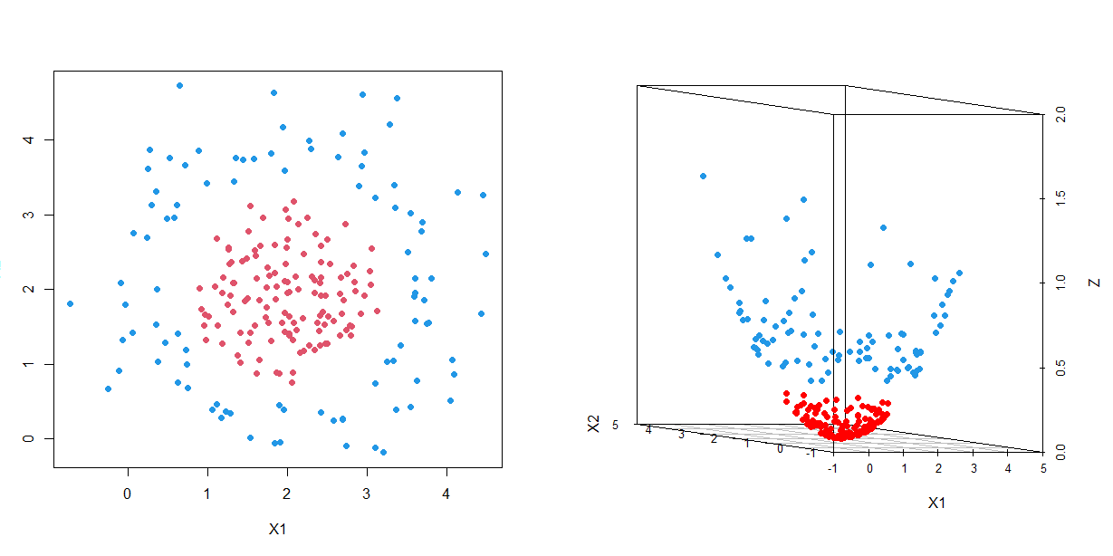
Nonlinear Support Vector Machines
What about a slightly more complicated example?
  The classes are clearly different but they aren’t separable using a linear plane
X2

Slide 35
Nonlinear Support Vector Machines
What about a slightly more complicated example?
  The classes are clearly different but they aren’t separable using a linear plane
  We can used something called a “radial basis” projection…
X2

Slide 36
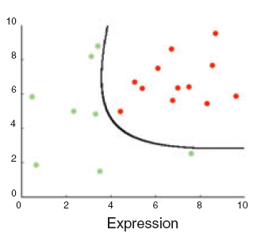
Higher Dimension Projection
We can project into even higher dimensions, then project the hyperplane back into a visual dimension
There is a kernel to allow linear separation of any consistent data set
The curse of dimensionality, use of too high a dimension will lead to over fitting the data
Projected from 2-D into 4-D to find the hyperplane,
then projecting that hyperplane back into 2-D space
Over fitting by projecting into to high of a dimensional space

Slide 37
The “Right” Kernel
A matter of trial, error, and experience
Types of simple Kernels
  Polynomial:
    Non-linear, good for normalized training data
  Gaussian/Radial Basis:
    The feature space is infinite dimensional function space( results in non-parametric classifier)
    Sigma (gamma) plays the role of determining how sensitive the hyperplane is to noise in the training data
  Neural Network:

Slide 38
Optimizing the Kernel
We need to determine a few things when optimizing a kernel
  Optimize C, the cost of being on the wrong side of the margin
  For different kernels, we can optimize all parameters that are not included in the feature space
Optimization can be done using a grid search

Slide 39
Optimizing the Kernel
Grid search:
  Select several starting values for the cost
    10, 100, 1000, 10000
  Select several values for the kernel parameters
    e.g. for the Gaussian kernel we must find γ = 1/σ
    Choose values such as 10⁻⁶-10⁻¹
  Conduct a k-fold cross-validation with each combination of parameters and estimate error rate
  Choose those values that provide the two best error rate ranges and repeat the grid search with more refined values

Slide 40
Multiple Classes Problem
Our focus has been on binary classification but what is k > 2?
Common approaches:
  One vs. all SVMs for a classes
  One vs. one SVMs
    each point classified by multiple SVMs and the choice with the highest count determines classification.
There is some indication in the literature that the one vs. one approach is better (and oddly not more computationally difficult)

Slide 41
Fitting SVMs in R
As with many of the methods we’ve discussed, there are several packages in R but the two most commonly used are
  e1071: included functions to fit and tune an SVM as well as several other types of classifiers.
    Kernels include linear, polynomial, radial basis, and neural net (sigmoid)
    Default kernel is the radial basis kernel
  kernlab: fits SVMs but also useful for other kernel based methods (including relevance vector machines and kernel PCA)
    Provides more possible kernel functions and different types of svm implementation
    It does not have a built in tuning function
Let’s look at an example…

Slide 42
Lupus Nephritis
Example: Treatment response in patients with treatment response
Data include 280 observations examining treatment response at 1 year in patient with lupus nephritis
Data includes
  Demographics: age, race
  Treatment response: Yes/No
  Clinical Markers: c4c, dsDNA, EGFR, UrPrCr
  Urine markers: IL2ra, IL6, IL8, IL12

Slide 43
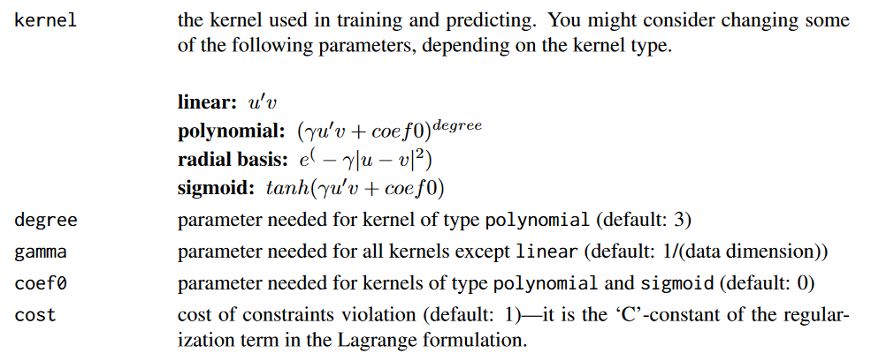
e1071 Tuning Parameters

Slide 44
e1071
#### Fitting an SVM using e1071 package
library(e1071)
cwts<-187/table(LN$CR90[sub])
tune.fit<-tune.svm(as.factor(CR90)~., data=LN[sub,], type="C", gamma=10^(-6:-1), cost=10^(1:3), class.weights=cwts[2])
summary(tune.fit)
Parameter tuning of ‘svm’:
- sampling method: 10-fold cross validation
- best parameters:
gamma cost class.weights
0.1 100 3.816327
- best performance: 0.2880117
- Detailed performance results:
gamma cost class.weigths error dispersion
1 1e-06 10 3.816327 0.7383041 0.09071399
2 1e-05 10 3.816327 0.7383041 0.09071399
…
17 1e-02 1000 3.816327 0.3798246 0.08166746
18 1e-01 1000 3.816327 0.2935673 0.12139258

Slide 45
e1071
#### Fitting an SVM using e1071 package
names(tune.fit)
[1] "best.parameters" "best.performance" "method" "nparcomb" "train.ind" "sampling" "performances" "best.model"
tune.fit$best.parameters
gamma cost class.weights
0.1 100 3.816327
tune.fit$best.performance
[1] 0.2880117
tune.fit$best.model
Call:
best.svm(x = as.factor(CR90) ~ ., data = LN[sub, ], gamma = 10^(-6:-1), cost = 10^(1:3), class.weights = cwts[2], type = "C")
Parameters:
SVM-Type: C-classification
SVM-Kernel: radial
cost: 100
gamma: 0.1
Number of Support Vectors: 102

Slide 46
e1071
#### Fitting an SVM using e1071 package
model<-svm(as.factor(CR90)~., data=LN[sub,], type="C", class.weights=cwts[2],
cost=tune.fit$best.parameters[[2]], gamma=tune.fit$best.parameters[[1]], cross=10)
names(model)
[1] "call" "type" "kernel" "cost"
[5] "degree" "gamma" "coef0" "nu"
[9] "epsilon" "sparse" "scaled" "x.scale"
[13] "y.scale" "nclasses" "levels" "tot.nSV"
[17] "nSV" "labels" "SV" "index"
[21] "rho" "compprob" "probA" "probB"
[25] "sigma" "coefs" "na.action" "accuracies"
[29] "tot.accuracy" "fitted" "decision.values" "terms"

Slide 47
e1071
#### Fitting an SVM using e1071 package
model$decision.values
0/1
2 1.4189344
4 1.1883675
0.9997150
…
277 -0.9999401
279 -1.0002299
model$tot.accuracy
[1] 67.91444
table(model$fitted, LN$CR90[sub])
0 1
0 138 0
1 0 49

Slide 48
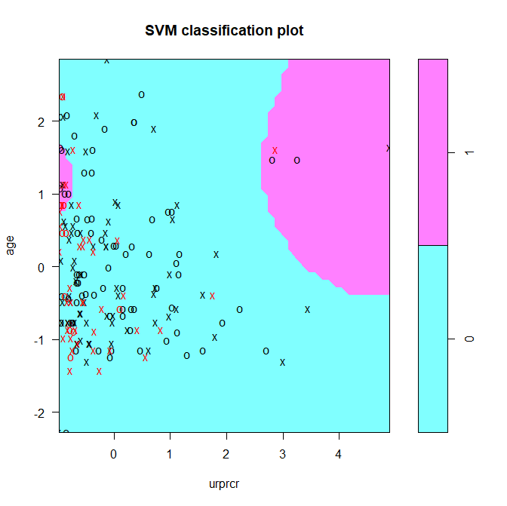
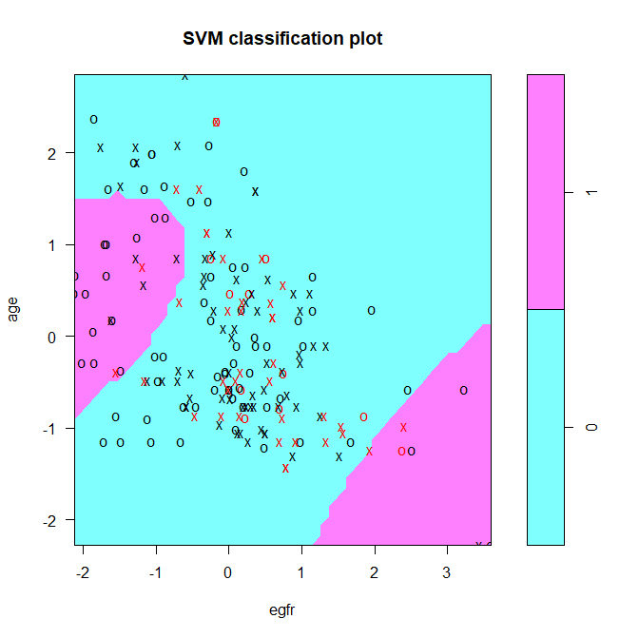
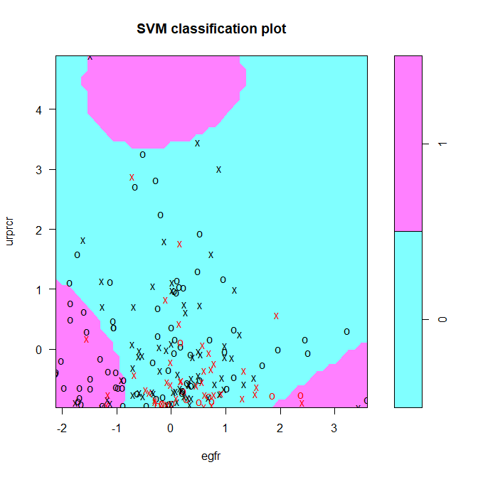
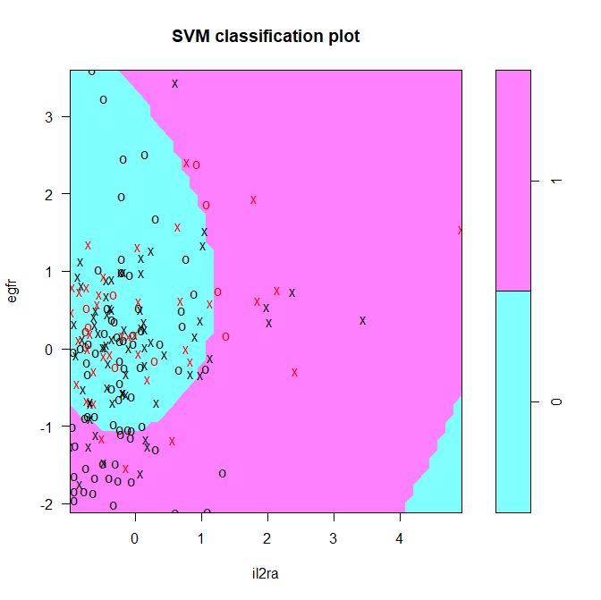
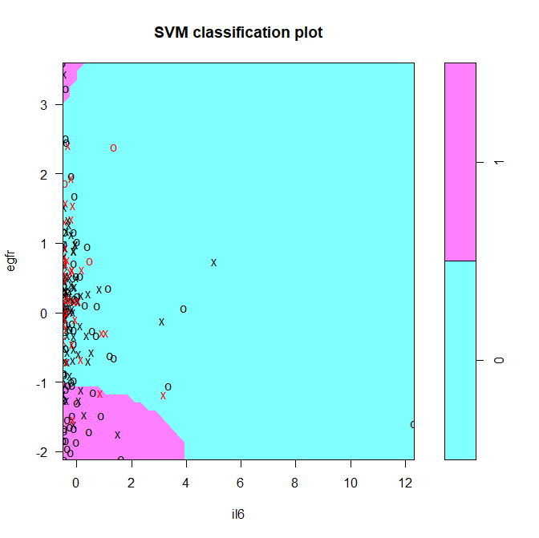
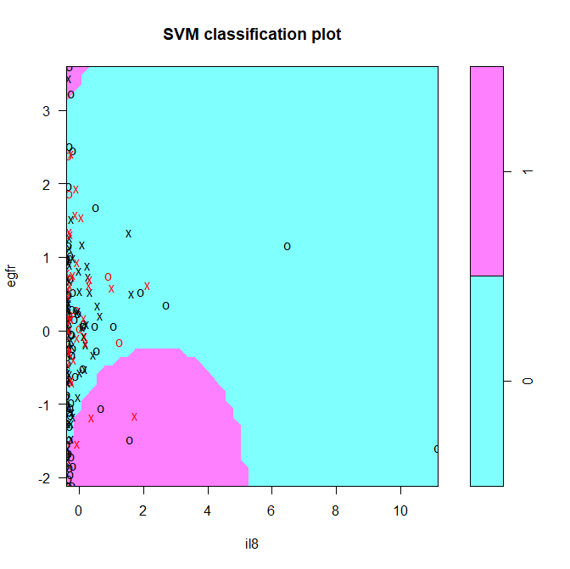

Slide 49
e1071
#### Fitting an SVM using e1071 package
pred<-predict(model, LN[-sub,])
pred
1 3 5 13 14 16 24 27 29 37 40 41 42 54 55 56 57 58 62 63 64 65 66 67 72 73 77 80
0 0 1 1 1 0 0 0 1 1 0 0 0 1 0 0 1 1 1 0 1 0 0 0 0 0 1 0
…
217 221 227 230 231 237 240 242 246 248 250 261 264 265 269 276 278 280
1 1 1 0 0 0 0 0 0 0 0 1 1 0 1 0 0 0
Levels: 0 1
table(pred, LN$CR90[-sub])
pred 0 1
0 52 14
1 16 11

Slide 50
e1071 (polynomial kernel)
#### Fitting an SVM using e1071 package
tmodel2<-tune.svm(as.factor(CR90)~., data=LN[sub,], kernel="polynomial", type="C", degree=c(2:4) , gamma=10^(-6:-1), cost=10^(1:3), class.weights=cwts[2])
tmodel2$best.parameters
degree gamma cost class.weights
4 0.1 100 3.816327
tmodel2$best.performance
[1] 0.2780702
tmodel2$best.model
Call:
best.svm(x = as.factor(CR90) ~ ., data = LN[sub, ], degree = c(2:6), gamma=10^(-6:-1), cost = 10^(1:3), class.weights = cwts[2], kernel = "polynomial",
type = "C")
Parameters:
SVM-Type: C-classification
SVM-Kernel: polynomial
cost: 100
degree: 4
coef.0: 0
Number of Support Vectors: 108

Slide 51
e1071 (polynomial kernel)
#### Fitting an SVM using e1071 package
model2<-svm(as.factor(CR90)~., data=LN[sub,], kernel="polynomial", type="C", cost=100, degree=4,
gamma=0.1, cross=10)
model2$decision.values
0/1
2 1.0433848
3 2.2333284
…
278 -0.1773095
280 -1.0000194
model2$tot.accuracy
[1] 71.12299
table(model2$fitted, LN$CR90[sub])
0 1
0 138 3
1 0 46

Slide 52
e1071: Comparing Kernels
Training
table(model$fitted, LN$CR90[sub])
0 1
0 138 0
1 0 49
Test
table(pred, LN$CR90[-sub])
pred 0 1
0 52 14
1 16 11
Training
table(model2$fitted, LN$CR90[sub])
0 1
0 138 3
1 0 46
Test
table(pred2, LN$CR90[-sub])
pred2 0 1
0 54 18
1 14 7

Slide 53
kernlab
### The R package kernlab is an alternative to e1071
### Provides more possible kernel functions and different types of svm implementation
### However, it does not have a built in tuning function (and requires more knowledge to use)
library(kernlab)
model3<-ksvm(as.factor(CR90) ~ ., data=LN[sub,], type="C-svc", kernel="rbfdot", kpar=list(sigma=0.1), C=100, prob.model=T)
slotNames(model3)
[1] "param" "scaling" "coef" "alphaindex" "b" "obj" "SVindex"
[8] "nSV" "prior" "prob.model" "alpha" "type" "kernelf" "kpar"
[15] "xmatrix" "ymatrix" "fitted" "lev" "nclass" "error" "cross"
[22] "n.action" "terms" "kcall“
table(model3@fitted, LN$CR90[sub])
0 1
0 138 2
1 0 47

Slide 54
Compare Models from e1071 and kernlab
Training
table(model$fitted, LN$CR90[sub])
0 1
0 138 0
1 0 49
Test
table(pred, LN$CR90[-sub])
pred 0 1
0 52 14
1 16 11
Training
table(model3@fitted, LN$CR90[sub])
0 1
0 138 2
1 0 47
Test
table(pred3, LN$CR90[-sub])
pred3 0 1
0 54 14
1 14 11

Slide 55
kernlab
The kernlab package also has some nice plotting features
We can plot the contours for the SVM “posterior probability” for any pair of variables in the model
svp<-ksvm(as.factor(CR90) ~ il2ra + egfr + age, data=LN[sub,], type="C-svc", kernel="rbfdot", kpar=list(sigma=0.1), C=100, prob.model=T)
x<-LN[sub,c(2,6,7)]
plot(svp,data=x, slice=list(age=0))
plot(svp,data=x, slice=list(age=-1.5))
plot(svp,data=x, slice=list(age=1.5))
plot(svp,data=x, slice=list(egfr=-2))
plot(svp,data=x, slice=list(egfr=0))
plot(svp,data=x, slice=list(egfr=2))

Slide 56
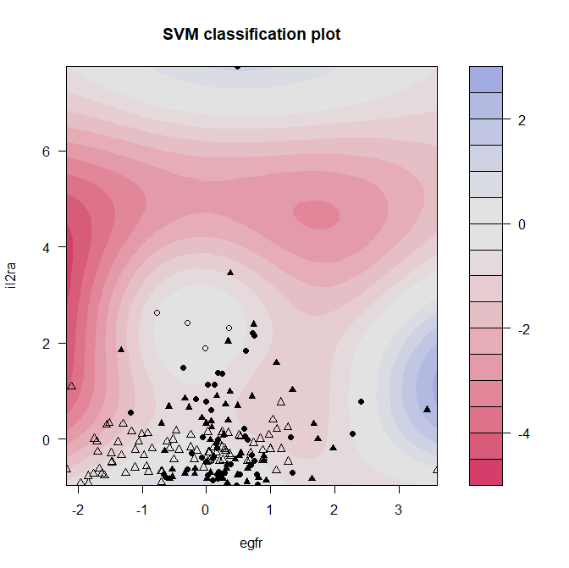
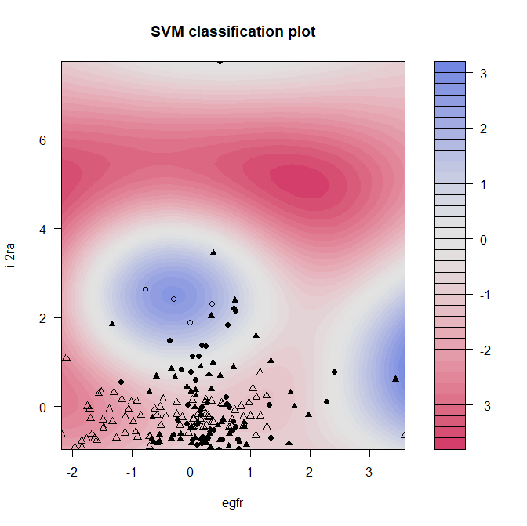
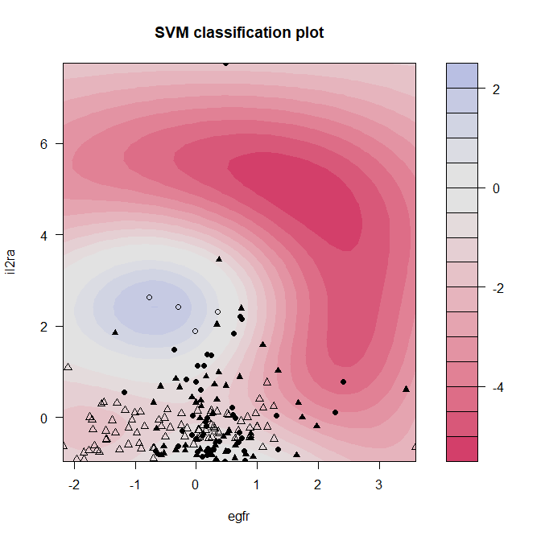
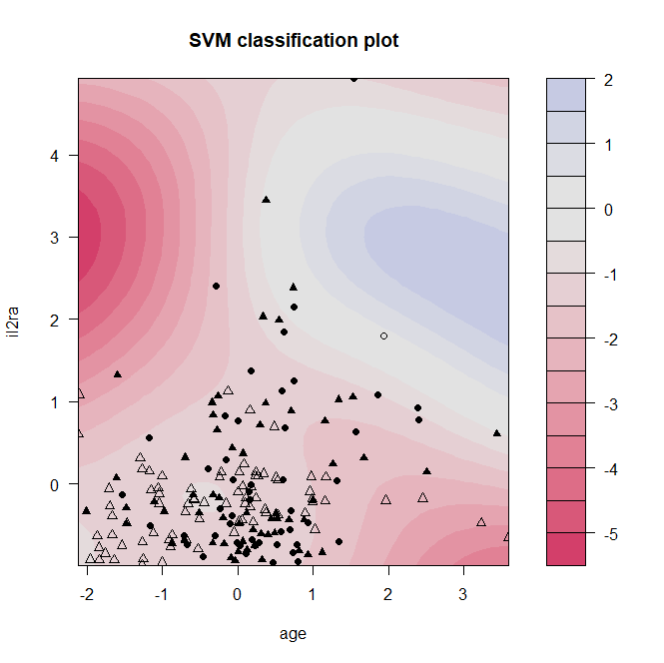
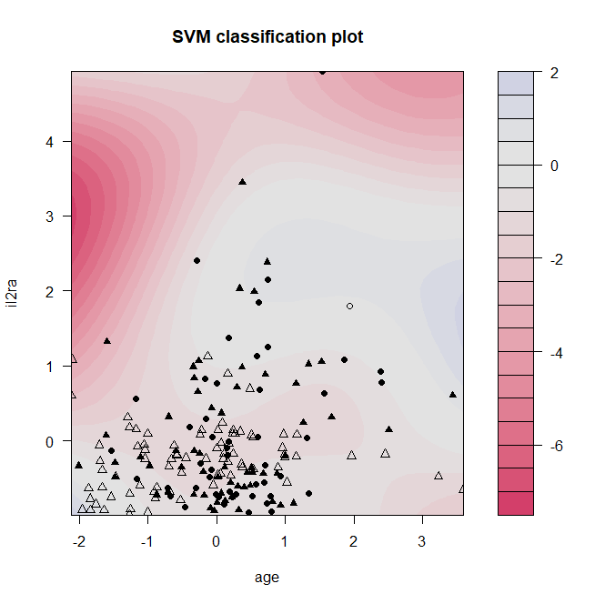
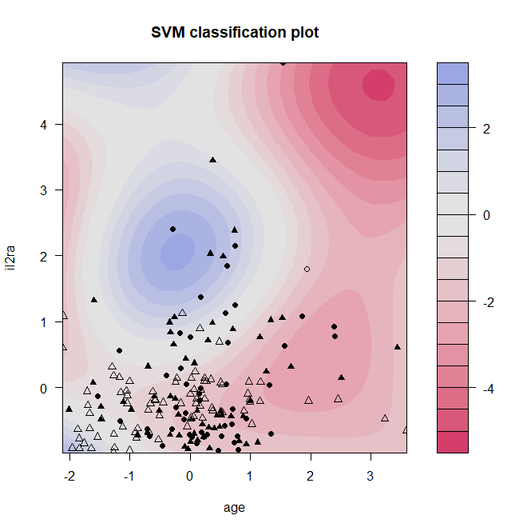
Age = -1.5
Age = 0
Age = 1.5
EGFR = -2
EGFR = 0
EGFR = 2

Slide 57
A More Interesting Example Application
Prediction of RNA-protein binding residues
Involved in transcription regulation, splicing and protein synthesis
This problem has been tackled by several different methods in the past
  ANNs, Naïve Bayes classifiers (NBc), SVMs
Ref: Maetschke SR and Yuan Z (2009). Exploiting structural and topological information to improve prediction
of RNA-protein binding sites. BMC Bioinformatics, 10: 341, http://www.biomedcentral.com/1471-2105/10/341.

Slide 58
Training Data
From BR144, 144 protein-RNA complexes with annotated residues
  4304 binding residues
  27937 non-binding residues
  very low sequence similarity
Data includes:
  Sequence data (PSI-BLAST profile)
  Accessible surface area (ASA) – residue location and correlation with interface regions
  Betweeness-centrality (BC)– A node’s relative importance in a network, calculated from a spatial patch
  Retention coefficeint (RC) - ability to hold peptide nucleic acids in that region, at pH of 2

Slide 59
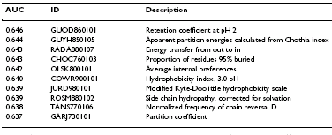
Region selection
Initially evaluated the predictive power of binding residues of all amino acid indicies in the AAIndex database
This established a baseline for prediction accuracy based on a single residue feature

Slide 60
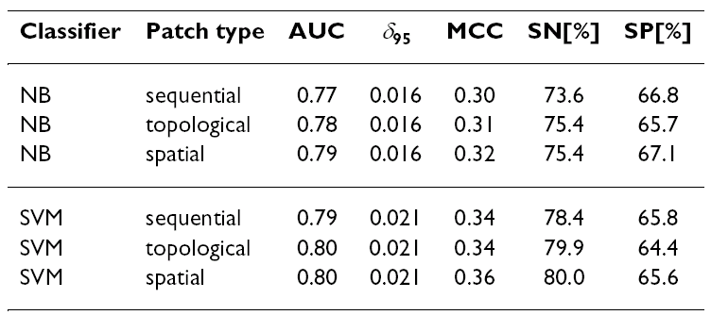
Region selection
Next step was to examine the impact on prediction accuracy by considering the aa’s “near” an interface residue
Refer to these regions as “patches” and they are defines by three different measures of nearness
Defined by ordering in chain
Euclidian distance between
carbon atoms of residues
Vertices with smallest
geodesic distance to
the central vertex

Slide 61
Prediction
A test against tRNA psudouridine synthase (IRE3:A)
front
binding cleft
True positive
True negative
False positive
False negative
back
Known
True binding (yellow)
SVM predicted
Binding (yellow)
Comparison

Slide 62
Method Comparison

