Slide 1
Multivariate Adaptive Regression Splines (MARS)
BMTRY 790: Machine Learning

Slide 2
Decision Trees: Concerns
We recently discussed tree-based methods
Non-parametric and semi-parametric methods
Models can be represented graphically for easy interpretation
Intuitive and easy to interpret relative to many statistical models
Similar to how clinicians think to make decisions about patient care
There are issues however with decision tree methods:
Have a tendency to over-fit the data (not uncommon among machine learning methods)
Referred to as weak learners
Small changes in the data results in very different models

Slide 3
Multivariate Adaptive Regression Splines (MARS)
Linear regression, linear basis expansions, and non-linear regression all make assumptions about the “model”
Incorrect assumptions lead to poor results
Reduced interpretability
CART (and similar) models interpretable but have the issues discussed previously
Also tend to perform poorly for regression tasks (i.e. continuous outcomes)
Difficulty capturing additive relationships
Can we combine several features of these approaches?
Basis functions
Minimal a priori assumptions
Reasonable computational complexity
"good" error rates

Slide 4
Multivariate Adaptive Regression Splines (MARS)
Adaptive nonparametric regression procedure
Makes no assumption about any underlying functional relationship
Constructs models from a set of coefficients and basis functions that are entirely "driven" by the data
Partition feature space into regions, each with its own regression equation
Recall we used this idea in CART
Also makes it useful for larger number of inputs (high dimension)

Slide 5
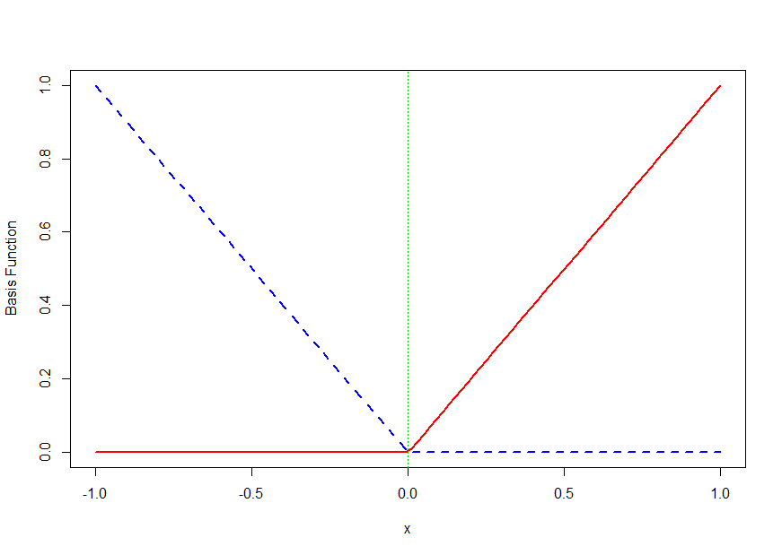
Multivariate Adaptive Regression Splines (MARS)
MARS uses a piecewise linear basis expansion approach

Slide 6
Advantages of MARS Approach
Key advantage to MARS is that features are allowed to operate locally
Only regions where inputs or cross-products are non-zero impact prediction
Result: regression surface that is built in a parsimonious manner
Also has a computational advantage by using piecewise linear basis expansions
Exploits form of basis function when evaluating choice of knots
Needs only O(N) operations
Forward modeling strategy means higher-order interactions only considered when the lower-order versions are in the model
Thus avoid searching over exponentially growing space of possible models

Slide 7
More on MARS
Each function estimated for a MARS model is piecewise linear with a knot at t
i.e. these are linear splines
Idea: Generate reflected pairs for each feature X_{j} with knots at unique x_{ij} yielding a collection of basis functions (recall the figure)
If all values in X are unique, there will be 2Np basis functions
Each basis function depends only on a single X_{j}

Slide 8
Building a MARS Model
Use a forward stepwise approach using functions from set C and their products to yield a model
For the selected h_{m}(X), coefficients β_{m} estimated using OLS approach
i.e. estimate based on minimizing residual sums of squares
So how do we determine what basis functions are added to the model as the algorithm progresses

Slide 9
Building a MARS Model
Start with the constant model with h_{m}(X) = 1
Consider all functions in C as candidate functions
At each stage, consider
Reflected pairs in C
Products of functions h_{m}(X) in current model set M with reflected pairs in C
In general considered for inclusion:

Slide 10
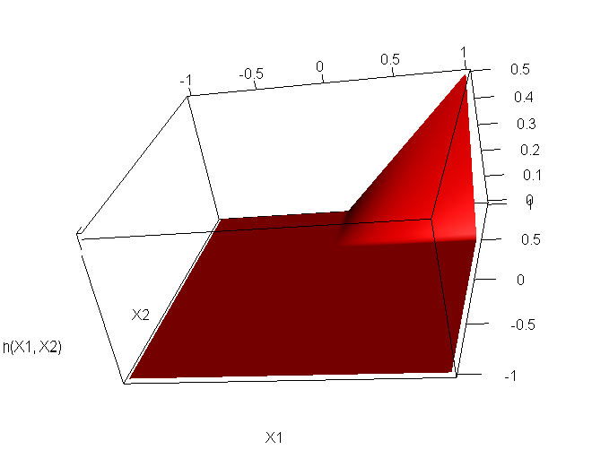
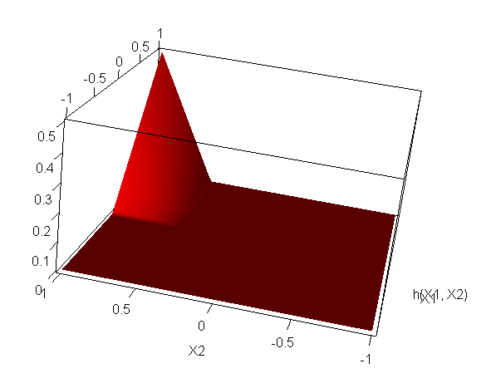
Results is a 3-D Surface

Slide 11
Building a MARS Model
At each step, the reflected pair and product with h_{m}(X) that yield the largest decrease in training error added to the model
The terms added to the model take the form
MARS can consider higher order interactions (i.e. multiply more than 2 linear basis functions) but interpretability can be tough
One restriction placed on model terms is that each input can only appear in a product once

Slide 12
Example
The algorithm might proceed as follows

Slide 13
Overfitting and MARS
Large number of basis functions/interactions makes it easy to over fit
MARS uses GCV to determine the appropriate number of model parameters
r = number of independent basis functions
K = number of knots
c = constant
2 if model includes only additive terms
3 if model includes products

Slide 14
Overfitting and MARS
Most implementations of MARS still fit to a “full” model using a forward step-wise approach
As terms added to the model, both “sides” of the reflected pair are included
Once the full model is constructed, pruning implemented via backward step-wise selection
The GCV used to conduct the backward selection
Under pruning
Not required to include both “sides” of the reflected pair
Also not required to include main effects when interactions are present

Slide 15
Comparison of MARS and CART
Note: MARS and CART are strongly related to one another
Following modification to MARS yields the same results as CART
Replace the piecewise linear basis functions in MARS with step functions
Model terms multiplied by a candidate term are replaced by the interaction and thus not available for additional interactions
However, implementation of MARS allows the models to capture additive effects that one can’t identify directly with CART

Slide 16
Fitting a MARS Model in R
There are (at least) 2 R libraries that can be used to fit MARS models
mda:
Developed by Hastie and Tibshirani
Uses GCV approach to select model and can prune models as well
Also has functions to fit models by several related methods
earth (Enhanced Adaptive Regression Through Hinges)
Specifically for fitting MARS models
More functionality than mda
Has a function to convert MARS models fit in mda to an earth object

Slide 17
Example: Immune Response
Recall our environmental exposure and immune response data
Endocrine Disrupting Compounds (EDCs) are ubiquitous natural and man-made chemicals found in consumer products that have the ability to mimic natural hormones.
Studies suggest EDCs may induce an inflammatory response.
Study goal to evaluate impact of environmental EDC levels on inflammatory
Study population
75 serum samples
Predictors: levels of 9 EDCs
Outcome: Level of inflammatory cytokine INFγ

Slide 18
mda Package
### Fitting MARS model using mda pakage
library(mda)
immresp<-read.csv("H:\\public_html\\BMTRY790_Spring2023\\Datasets\\EnvironContamImmuneResp2.csv")
### Fitting an ADDITIVE MARS model using the mda package
mars.fit1<-mars(immresp[,-10], immresp[,10], degree=1, prune=TRUE, forward.step = TRUE)
names(mars.fit1)
[1] "call" "all.terms" "selected.terms" "penalty" "degree" "nk"
[7] "thresh" "gcv" "factor" "cuts" "residuals" "fitted.values"
[13] "lenb" "coefficients" "x"

Slide 19
mda Package
### Information about our ADDITIVE MARS model
mars.fit1$gcv
[1] 371.9659
mars.fit1$all.terms
[1] 1 2 3 4 5 6 7 8 10 11 12 13 14 15 16 17 18 20 21
mars.fit1$selected.terms
[1] 1 3 5 8
mars.fit1$coef
[,1]
[1,] 23.4345
[2,] 0.0578
[3,] 330.817
[4,] 0.0451

Slide 20
mda Package
mars.fit1$cuts
[,1] [,2] [,3] [,4] [,5] [,6] [,7] [,8] [,9]
[1,] 0.0 0 0.0 0 0.00 0.00 0.00 0.00 0
[2,] 0.0 0 0.0 0 0.00 0.00 0.00 0.00 919
[3,] 0.0 0 0.0 0 0.00 0.00 0.00 0.00 919
[4,] 0.1 0 0.0 0 0.00 0.00 0.00 0.00 0
[5,] 0.1 0 0.0 0 0.00 0.00 0.00 0.00 0
[6,] 0.0 0 0.0 21 0.00 0.00 0.00 0.00 0
[7,] 0.0 0 0.0 21 0.00 0.00 0.00 0.00 0
[8,] 0.0 0 0.0 0 0.00 0.00 0.00 0.00 580
[9,] 0.0 0 0.0 0 0.00 0.00 0.00 0.00 580
[10,] 0.0 0 0.0 0 0.00 4.66 0.00 0.00 0
[11,] 0.0 0 0.0 0 0.00 4.66 0.00 0.00 0
[12,] 0.0 0 0.0 0 0.00 0.00 9.43 0.00 0
[13,] 0.0 0 0.0 0 0.00 0.00 9.43 0.00 0
[14,] 0.0 0 0.0 0 0.00 0.00 0.00 32.46 0
[15,] 0.0 0 0.0 0 0.00 0.00 0.00 32.46 0
[16,] 0.0 0 0.0 0 8.36 0.00 0.00 0.00 0
[17,] 0.0 0 0.0 0 8.36 0.00 0.00 0.00 0
[18,] 0.0 0 0.0 0 12.3 0.00 0.00 0.00 0
[19,] 0.0 0 0.0 0 12.3 0.00 0.00 0.00 0
[20,] 0.0 0 28.9 0 0.00 0.00 0.00 0.00 0
[21,] 0.0 0 28.9 0 0.00 0.00 0.00 0.00 0

Slide 21
mda Package
mars.fit1$factor
PFHxA PFHpA PFOA PFUnA PFDoA PFTriA PFHxS PFHpS PFOS
[1,] 0 0 0 0 0 0 0 0 0
[2,] 0 0 0 0 0 0 0 0 1
[3,] 0 0 0 0 0 0 0 0 -1
[4,] 1 0 0 0 0 0 0 0 0
[5,] -1 0 0 0 0 0 0 0 0
[6,] 0 0 0 1 0 0 0 0 0
[7,] 0 0 0 -1 0 0 0 0 0
[8,] 0 0 0 0 0 0 0 0 1
[9,] 0 0 0 0 0 0 0 0 -1
[10,] 0 0 0 0 0 1 0 0 0
[11,] 0 0 0 0 0 -1 0 0 0
[12,] 0 0 0 0 0 0 1 0 0
[13,] 0 0 0 0 0 0 -1 0 0
[14,] 0 0 0 0 0 0 0 1 0
[15,] 0 0 0 0 0 0 0 -1 0
[16,] 0 0 0 0 1 0 0 0 0
[17,] 0 0 0 0 -1 0 0 0 0
[18,] 0 0 0 0 1 0 0 0 0
[19,] 0 0 0 0 -1 0 0 0 0
[20,] 0 0 1 0 0 0 0 0 0
[21,] 0 0 -1 0 0 0 0 0 0

Slide 22
MARS Model from mda
### So using this info we can get the form of our MARS model
mars.fit1$coef
[1,] 23.4345
[2,] 0.0578
[3,] 330.817
[4,] 0.0451
mars.fit1$cuts[c(1,3,5,8),]
[,1] [,2] [,3] [,4] [,5] [,6] [,7] [,8] [,9]
[1,] 0.0 0 0.0 0 0.00 0.00 0.00 0.00 0
[3,] 0.0 0 0.0 0 0.00 0.00 0.00 0.00 919
[5,] 0.1 0 0.0 0 0.00 0.00 0.00 0.00 0
[8,] 0.0 0 0.0 0 0.00 0.00 0.00 0.00 580
mars.fit1$factor[c(1,3,5,8),]
PFHxA PFHpA PFOA PFUnA PFDoA PFTriA PFHxS PFHpS PFOS
[1,] 0 0 0 0 0 0 0 0 0
[3,] 0 0 0 0 0 0 0 0 -1
[5,] -1 0 0 0 0 0 0 0 0
[8,] 0 0 0 0 0 0 0 0 1

Slide 23
What Is The Actual Model?

Slide 24
Example Predictions
What is our prediction for PFOS = 975 and PFHxA = 0.05?

Slide 25
Example Predictions
What about for PFOS = 375 and PFHxA = 0.26?
And for PFOS = 680 and PFHxA = 0.04?

Slide 26
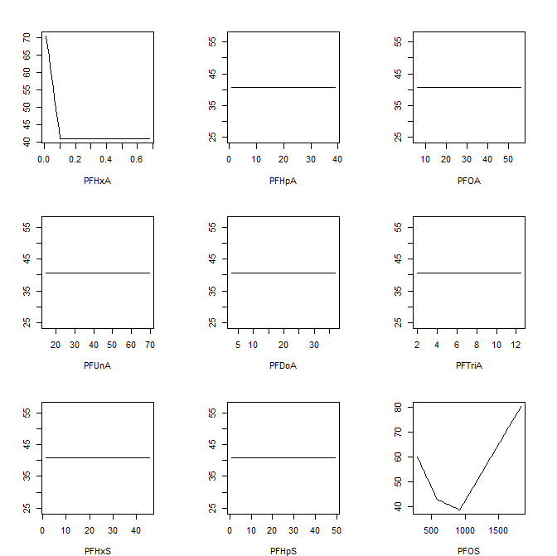
Effects of Each Predictor
### PLOTTING ALL INDIVIDUAL PREDICTORS
par(mfrow = c(3, 3), mar=c(4,3,3,2), pty="s")
for (i in 1:9)
{
xp <- matrix(sapply(immresp[,-10], mean),
nrow(immresp), ncol(immresp) - 1,
byrow = TRUE)
xr <- sapply(immresp, range)
xp[, i] <- seq(xr[1, i], xr[2, i], len=nrow(immresp))
xf <- predict(mars.fit1, xp)
plot(xp[, i], xf, xlab = colnames(immresp)[i],
ylab = "", type = "l")
}

Slide 27
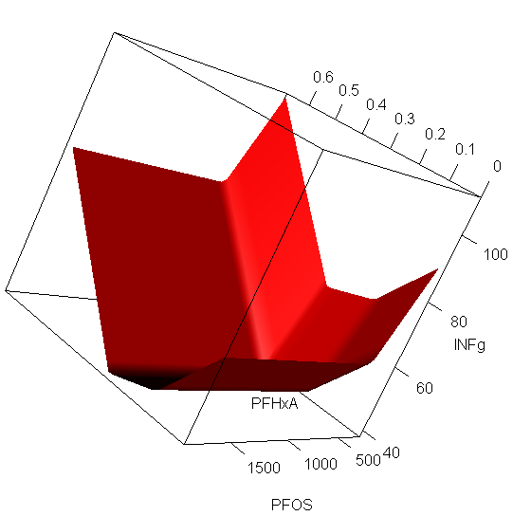
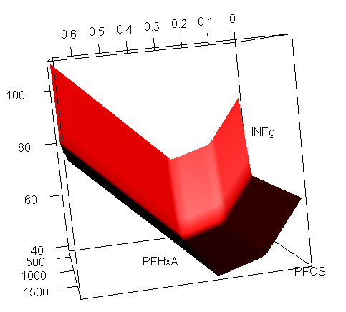
Response Surface

Slide 28
Interactions in MARS
### Fitting an INTERACTION MARS model using the mda package
mars.fit2<-mars(immresp[,-c(2:6,9)], immresp[,10], degree=2, prune=TRUE, forward.step = TRUE)
mars.fit2$gcv
[1] 425.879
mars.fit2$all.terms
[1] 1 2 3 4 5 6 8 9 10 12 13 14 15 16 18 20 21
mars.fit2$selected.terms
[1] 1 2 5
mars.fit2$coef
[,1]
[1,] 47.6428
[2,] 0.0341
[3,] 0.0123

Slide 29
Interactions in MARS
### So using this info we can get the form of our MARS model
mars.fit2$coef
[1,] 47.6428
[2,] 0.0341
[3,] 0.0123
mars.fit2$cuts[c(1,2,5),]
[,1] [,2] [,3] [,4] [,5] [,6]
[1,] 0 0 0.0 0 0 0
[2,] 0 0 0.0 0 0 919
[3,] 0 0 19.5 0 0 919
mars.fit2$factor[c(1,2,5),]
PFHpA PFOA PFUnA PFDoA PFTriA PFOS
[1,] 0 0 0 0 0 0
[2,] 0 0 0 0 0 1
[3,] 0 0 -1 0 0 -1

Slide 30
What Is the Model Allowing for Interactions?

Slide 31
Example Predictions (Interaction Model)
What is our prediction for PFOS = 180 and PFUnA = 14.2?
Is there a region where both model terms have an impact?

Slide 32
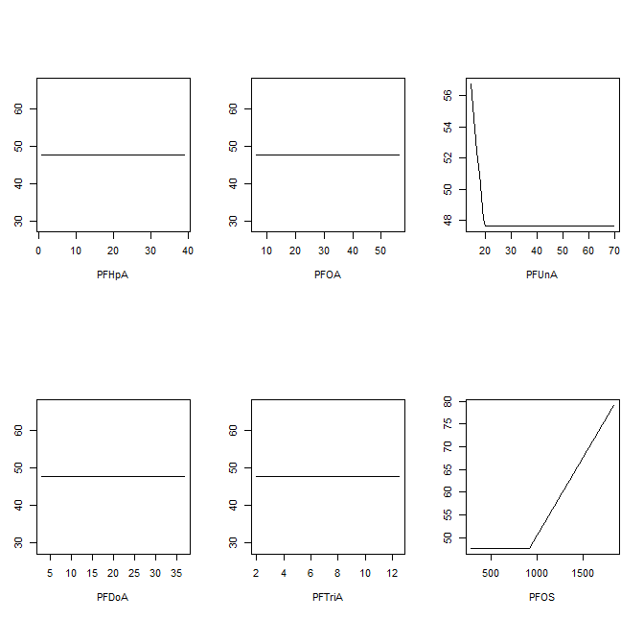
Effects of Each Predictor
par(mfrow = c(2, 3), mar=c(4,3,3,2), pty="s")
for (i in 1:6)
{
xp <- matrix(sapply(immresp[,c(2:6,9)], mean),
nrow(immresp), 6, byrow = TRUE)
xr <- sapply(immresp[,c(2:6,9)], range)
xp[, i] <- seq(xr[1, i], xr[2, i], len=nrow(immresp))
xf <- predict(mars.fit2, xp)
plot(xp[, i], xf, xlab = colnames(immresp) [c(2:6,9)][i],
ylab = "", type = "l")
}

Slide 33
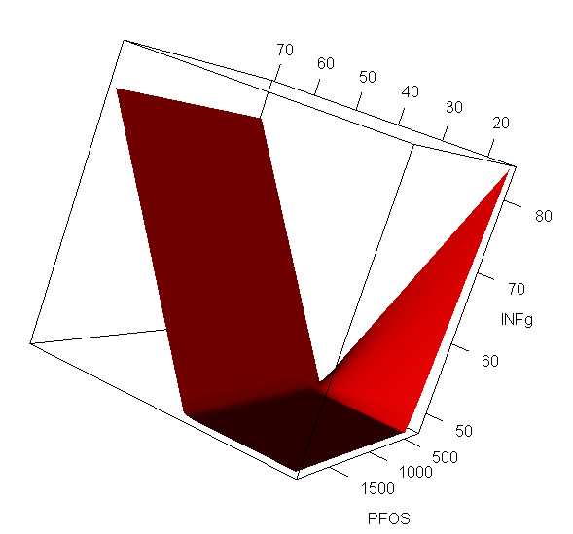
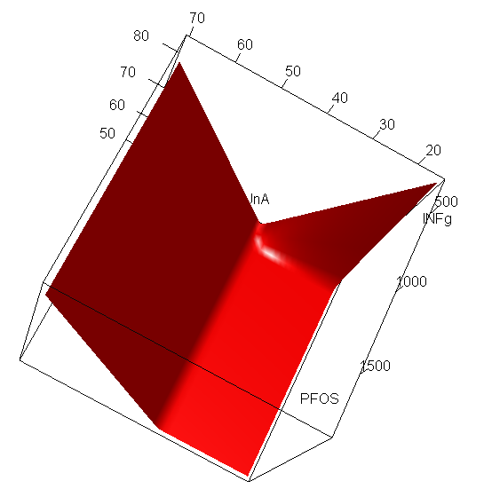
Response Surface (Interaction Model)

Slide 34
earth Package
### Fitting an ADDITIVE MARS model using the earth package
mars.fit3<-earth(immresp[,-10], immresp[,10], degree=1, prune=TRUE, forward.step = TRUE)
mars.fit3
Selected 9 of 16 terms, and 4 of 9 predictors
Termination condition: Reached nk 21
Importance: PFOS, PFHxA, PFUnA, PFTriA,
PFHpA-unused, PFOA-unused, PFDoA-unused, PFHxS-unused, PFHpS-unused
Number of terms at each degree of interaction: 1 8 (additive model)
GCV 376.3404 RSS 16880.12 GRSq 0.2197695 RSq 0.5206911
names(mars.fit3)
[1] "rss" "rsq" "gcv" "grsq" "bx"
[6] "dirs" "cuts" "selected.terms" "prune.terms" "fitted.values"
[11] "residuals" "coefficients" "rss.per.response" "rsq.per.response" "gcv.per.response"
[16] "grsq.per.response" "rss.per.subset" "gcv.per.subset" "leverages" "pmethod"
[21] "nprune" "penalty" "nk" "thresh" "termcond"
[26] "weights" "call" "namesx.org" "namesx"

Slide 35
earth Package
### Fitting an ADDITIVE MARS model using the earth package
mars.fit3$coef
immresp[,10]
(Intercept) 40.26172178
h(914-PFOS) 0.03890829
h(PFHxA-0.13) 370.02511425
h(20.8-PFUnA) 4.60377589
h(PFOS-594) 0.03927793
h(PFTriA-3.76) -224.01447772
h(PFTriA-4.08) 122.52065846
h(PFTriA-3.38) 103.71368915
h(PFHxA-0.07) -367.77967552

Slide 36
earth Package
mars.fit3$selected.terms
[1] 1 3 4 7 8 9 14 15 16
mars.fit3$cuts
PFHxA PFHpA PFOA PFUnA PFDoA PFTriA PFHxS PFHpS PFOS
(Intercept) 0.00 0 0 0.0 0 0.00 0.00 0 0
h(PFOS-914) 0.00 0 0 0.0 0 0.00 0.00 0 914
h(914-PFOS) 0.00 0 0 0.0 0 0.00 0.00 0 914
h(PFHxA-0.13) 0.13 0 0 0.0 0 0.00 0.00 0 0
h(0.13-PFHxA) 0.13 0 0 0.0 0 0.00 0.00 0 0
h(PFUnA-20.8) 0.00 0 0 20.8 0 0.00 0.00 0 0
h(20.8-PFUnA) 0.00 0 0 20.8 0 0.00 0.00 0 0
h(PFOS-594) 0.00 0 0 0.0 0 0.00 0.00 0 594
h(PFTriA-3.76) 0.00 0 0 0.0 0 3.76 0.00 0 0
h(3.76-PFTriA) 0.00 0 0 0.0 0 3.76 0.00 0 0
h(PFHxS-9.87) 0.00 0 0 0.0 0 0.00 9.87 0 0
h(9.87-PFHxS) 0.00 0 0 0.0 0 0.00 9.87 0 0
h(PFHxS-34.02) 0.00 0 0 0.0 0 0.00 34.02 0 0
h(PFTriA-4.08) 0.00 0 0 0.0 0 4.08 0.00 0 0
h(PFTriA-3.38) 0.00 0 0 0.0 0 3.38 0.00 0 0
h(PFHxA-0.07) 0.07 0 0 0.0 0 0.00 0.00 0 0

Slide 37
earth Package
mars.fit3$dirs.[mars.fit3$selected.terms,]
PFHxA PFHpA PFOA PFUnA PFDoA PFTriA PFHxS PFHpS PFOS
(Intercept) 0 0 0 0 0 0 0 0 0
h(914-PFOS) 0 0 0 0 0 0 0 0 -1
h(PFHxA-0.13) 1 0 0 0 0 0 0 0 0
h(20.8-PFUnA) 0 0 0 -1 0 0 0 0 0
h(PFOS-594) 0 0 0 0 0 0 0 0 1
h(PFTriA-3.76) 0 0 0 0 0 1 0 0 0
h(PFTriA-4.08) 0 0 0 0 0 1 0 0 0
h(PFTriA-3.38) 0 0 0 0 0 1 0 0 0
h(PFHxA-0.07) 1 0 0 0 0 0 0 0 0

Slide 38
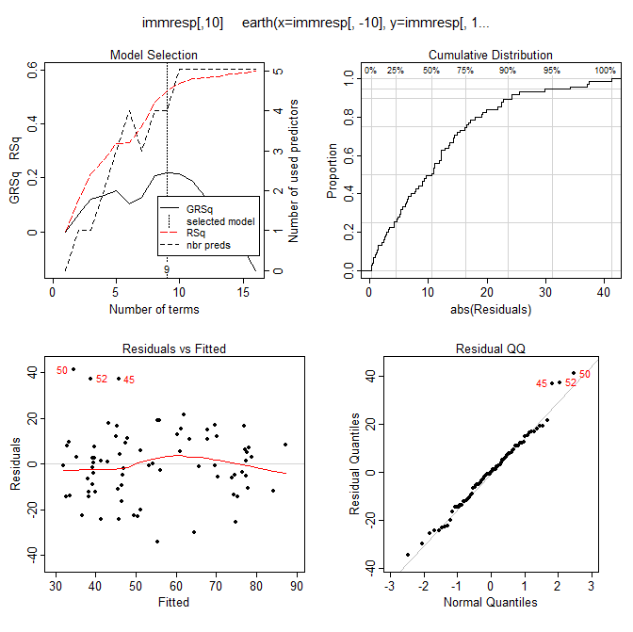
Diagnostic Plots for earth
plot(mars.fit3)
Note, the GRSq is:

Slide 39
Converting a MARS from mda to earth
### We can convert a MARS model developed in mda into the format observed in earth using the earth package
mars.fit4<-mars.to.earth(mars.fit2)
mars.fit4
Selected 3 of 18 terms, and 2 of 6 predictors
Termination condition: Unknown
Importance: object has no prune.terms, call update() on the model to fix that
Number of terms at each degree of interaction: 1 1 1
GCV 425.879 RSS 27034.8 GRSq 0.1170658 RSq 0.2323503
update(mars.fit4)
Termination condition: Unknown
Importance: PFOS, PFUnA, PFHpA-unused, PFOA-unused, PFDoA-unused, PFTriA-unused
Number of terms at each degree of interaction: 1 1 1
GCV 425.879 RSS 27034.8 GRSq 0.1170658 RSq 0.2323503

Slide 40
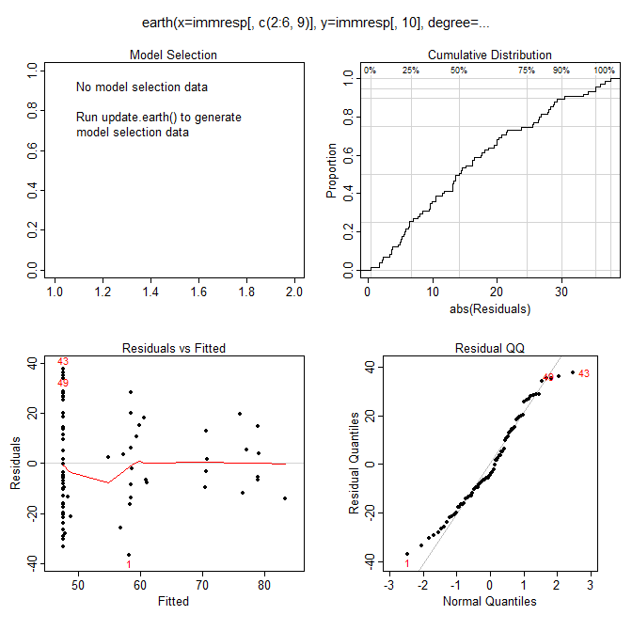
Diagnostic Plots for MARS from mda using earth
plot(mars.fit4)

Slide 41
Recall Our Concerns with Decision Trees
Single decision trees methods have a tendency to over-fit the data
They also tend to be rather “weak classifiers”
Small changes in the training data can result in very different models
Test error rate may be only slightly better than guessing
MARS was designed to address poor regression performance of an approach like CART…
Can still have issues with over-fitting and poor test performance
This leads us to a discussion of methods to improve the performance of these models!

Slide 42
Next Time
Ensemble Models:
Build a classification or prediction model from a group of simple base models (e.g. CART)
Prediction via committee

