Slide 1
Generalized Additive Models
BMTRY790: Machine Learning

Slide 2
Generalized Additive Models (GAMs)
Regression models are useful in many data analyses
Provide prediction and classification rules
As data analytic tools for understanding the importance of different inputs.
Although attractively simple, the traditional linear model often fails:
As we’ve noted, in real life, effects are often not linear.
We’ve already talked about splines which use pre-defined basis functions
Generalized Additive Models (GAMs) are a more automatic flexible statistical method that may be used to identify and characterize nonlinear regression effects.

Slide 3
Format of GAMs
In the regression setting, a generalized additive model has the form
E(Y |X₁, X₂, . . . , X_{p} ) = α + f₁(X₁) + f₂(X₂) + . . . + f_{p} (X_{p} )
Here X₁, X₂, . . . , X_{p} are p input features/predictors and y is a continuous outcome of interest.
The f_{j} ’s are unspecified smooth (nonparametric) functions.
So how are GAMs different?

Slide 4
Format of GAMs
If each function was modeled using an expansion of basis functions, we could fit this model using least squares
GAMs fit each function within our model expression using a scatterplot smoother (like a spline or kernel smoother)
But simultaneously applied to estimate all p functions

Slide 5
Format of GAMs for Link Function
We can extend this to the generalized linear model case
For example, logistic regression relates the mean of the binary response μ(X) = P(Y = 1|X = x) to the predictors through a link functions
The additive logistic regression model replaces each linear term by a more general functional form:

Slide 6
Format of GAMs for Link Function
As in the linear regression case, the f_{j}‘s are unspecified smooth functions for each predictors.
The use of these nonparametric functions, f_{j}, allows for model flexibility in estimating the probability of Y = 1.
However, the additivity of the model allows us to interpret the impact of the predictors on Y

Slide 7
General Form of a GAM
This model form can easily be extended to alternative link functions for other types of links
Examples include
g (μ) = μ is the identity link for linear and additive models for continuous response
g (μ) = logit(μ) or g (μ) = probit(μ) for modeling binomial probabilities
Probit function is the inverse Gaussian CDF:
g (μ) = log(μ) for log-linear or log-additive models for Poisson count data

Slide 8
Additive Models with Linear and Non-Linear Effects
Can consider both linear and other parametric forms with the nonlinear terms
Note this is necessary for qualitative input variables (e.g. sex)
Nonlinear terms not restricted to main effects
Can have nonlinear components in two or more variables
Separate curves in an input X_{j} for different levels of a factor variable X_{k}
For example:
Semiparametric model:
Nonparametric in 2 inputs:

Slide 9
Fitting Additive Models
If model each function f_{j} as a natural spline, the resulting model can be fit using a regression approach
The basic form of this additive model is:

Slide 10
Fitting Additive Models
Now, given data with observations (x_{i}, y_{i}) we could treat this like we did a smoothing spline and use a penalize fitting approach
Where λ_{j} are tuning parameters
Minimizer is additive cubic spline model where each f_{j} is a cubic spline in input X_{j}
Knots are each unique value of x_{ij}

Slide 11
Fitting Additive Models
Without restrictions there isn’t a unique solution… So what can we do?
The constant α is not identifiable because we can add/subtract any constants from each f_{j} and adjust α accordingly.
So consider the restriction
i.e. functions average to 0 over the data
If the matrix of input values also has full column rank, then PRSS is strictly convex and the minimizer is unique

Slide 12
Backfitting Algorithm
A simple iterative procedure exists for finding the solution.
Set and initialize
Cycle through j = 1, 2, …, p to estimate and update
Repeat this process for each f_{j} until f_{j} stabilizes

Slide 13
Fitting Additive Models
This backfitting algorithm is also referred to as is the grouped cyclic coordinate descent algorithm
Alternative smoothing operators other than smoothing splines can be used
For example S_{j} can be:
Other regression smoothers
Linear regression operators
Surface smoothers, higher-order interactions, etc.
For generalized additive models (e.g. logistic additive model), we can use the penalized log-likelihood as our criterion

Slide 14
Local Regression (loess)
Loess is an alternative smoother (rather than splines)
In the class of neared neighbor algorithms
Simplest type is a running mean smoother
Nonparametric regression technique
Loess = locally estimated scatterplot smoothing
Capture general patterns with minimal assumptions while reducing noise
Line through the moving central tendency of X vs. Y

Slide 15
Local Regression (loess)
Basic format
Select a smoothness based on a span parameter (proportion of data included in sliding mean average, aka neighbors)
Calculate where h is the width of the neighborhood
Construct weights based on
Fit a weighted regression with using the weights calculated above

Slide 16
Fitting GAMs
GAMs can be fit in both SAS and R
SAS can fit these models using:
proc gam
In R there are two libraries for fitting GAMS
gam
Uses backfitting
Matches fitting algorithm in SAS
mgcv library
Different approach to picking the amount of smoothness (quadratic penalized maximum likelihood approach)
Only one that will handle thin-plate splines

Slide 17
Ozone Example
Example: Ozone Concentrations over time
Data include 111 observations for an environmental study
Measured six variables over 111 (nearly) consecutive days.
Ozone: surface concentration of ozone(parts per billion)
Solar.R: level of solar radiation (lang)
Wind: Wind speed (mph)
Temp: Air temperature (ºF)
Month: Calendar month
Day: Day of the month

Slide 18
SAS: proc gam
The general form of the proc gam is
PROC GAM < option > ;
CLASS variables ;
MODEL dependent = < PARAM(effects) > smoothing effects
< /options > ;
SCORE data=SAS-data-set out=SAS-data-set ;
OUTPUT <out=SAS-data-set> keyword < ...keyword> ;
BY variables ;
ID variables ;
FREQ variable ;

Slide 19
SAS: proc gam
Most options are familiar. The two important ones are:
MODEL dependent = < PARAM(effects) > smoothing effects </options >:
Model terms can be added by the following possibilities
PARAM(x) : Adds a linear term in x to the model
SPLINE(x): Fits smoothing spline with the variable x. Degree of smoothness can be controlled by DF (default = 4)
LOESS(x): Fits local regression with variable x. Degree of smoothness can be controlled by DF (default = 4)
SPLINE2(x,y): Fits bivariate thin-plate smoothing spline in x and y. Degree of smoothness can be controlled by DF (default = 4).
At least one model term must be defined, though any combination of these is fine.

Slide 20
SAS: proc gam
The two important options for the MODEL statement are:
METHOD = GCV: Chooses smoothing parameters by generalized cross-validation.
If DF is set for a variable, that choice overrides the GCV.
DIST = : Specifies the conditional distribution of the response variable. The choices are
GAUSSIAN (default)
BINARY
BINOMIAL
GAMMA
IGAUSSIAN
POISSON.
As mentioned before, only the canonical link can be used in each case..

Slide 21
Single Spline in SAS
ods html;
ods graphics on;
proc gam data = air;
model Ozone = spline(Temp);
output out = air_spline predicted residual;
run;
ods graphics off;
ods html close;

Slide 22
Multiple Splines in SAS
ods html;
ods graphics on;
proc gam data = air;
model Ozone = spline(Solar_R) spline(Wind) spline(Temp);
output out = air_spline predicted residual;
run;
ods graphics off;
ods html close;

Slide 23
Splines + Linear Parameter in SAS
ods html;
ods graphics on;
proc gam data = air;
model Ozone = spline(Solar_R) spline(Wind) spline(Temp) param(time);
output out = air_spline predicted residual;
run;
ods graphics off;
ods html close;

Slide 24
Loess in SAS
ods html;
ods graphics on;
proc gam data = air;
model Ozone = loess(Temp);
output out = air_loess predicted residual;
run;
ods graphics off;
ods html close;

Slide 25
GAM Models in R
### Fitting GAMs using gam library
library(gam)
air<-read.csv("H:\\public_html\\BMTRY790_Spring2023\\Datasets\\Air.csv")
head(air)
Ozone Solar.R Wind Temp Month Day time
1 41 190 7.4 67 5 1 1
2 36 118 8.0 72 5 2 2
3 12 149 12.6 74 5 3 3
4 18 313 11.5 62 5 4 4
5 NA NA 14.3 56 5 5 5
6 28 NA 14.9 66 5 6 6

Slide 26
GAM Models in R
### Fitting GAMs using gam library
ozmod<-gam(log(Ozone)~s(Solar.R)+s(Wind)+s(Temp), family=gaussian(link=identity),data=air)
summary(ozmod)
Call: gam(formula = log(Ozone) ~ s(Solar.R) + s(Wind) + s(Temp), family = gaussian(link = identity), data = air)
Deviance Residuals:
Min 1Q Median 3Q Max
-1.84583 -0.24538 -0.04403 0.31419 0.99890
(Dispersion Parameter for gaussian family taken to be 0.2235)
Null Deviance: 82.47 on 110 degrees of freedom
Residual Deviance: 21.9077 on 98.0001 degrees of freedom
AIC: 162.8854
42 observations deleted due to missingness
Number of Local Scoring Iterations: 2

Slide 27
GAM Models in R
### Fitting GAMs using gam library
ozmod2<-gam(log(Ozone)~s(Solar.R)+s(Wind)+s(Temp), family=gaussian(link=identity),data=air)
summary(ozmod2)
…
Anova for Parametric Effects
Df Sum Sq Mean Sq F value Pr(>F)
s(Solar.R) 1 16.041 16.0408 71.756 2.484e-13 ***
s(Wind) 1 17.208 17.2083 76.978 5.521e-14 ***
s(Temp) 1 12.723 12.7227 56.913 2.351e-11 ***
Residuals 98 21.908 0.2235
---
Signif. codes: 0 ‘***’ 0.001 ‘**’ 0.01 ‘*’ 0.05 ‘.’ 0.1 ‘ ’ 1
Anova for Nonparametric Effects
Npar Df Npar F Pr(F)
(Intercept)
s(Solar.R) 3 2.8465 0.04151 *
s(Wind) 3 3.4736 0.01897 *
s(Temp) 3 2.9358 0.03713 *
---
Signif. codes: 0 ‘***’ 0.001 ‘**’ 0.01 ‘*’ 0.05 ‘.’ 0.1 ‘ ’ 1

Slide 28
GAM Models in R
### Fitting GAMs using gam library WITH LINEAR EFFECTS!!!
ozmod2a<-gam(log(Ozone)~Solar.R+Wind+Temp+s(Solar.R)+s(Wind)+s(Temp), family=gaussian(link=identity),data=air)
summary(ozmoda)
…
Anova for Parametric Effects
Df Sum Sq Mean Sq F value Pr(>F)
Solar.R 1 16.041 16.0408 71.756 2.484e-13 ***
Wind 1 17.208 17.2083 76.978 5.521e-14 ***
Temp 1 12.723 12.7227 56.913 2.351e-11 ***
Residuals 98 21.7862 0.2246
---
Anova for Nonparametric Effects
Npar Df Npar F Pr(F)
(Intercept)
Solar.R
Wind
Temp
s(Solar.R) 3 2.8465 0.04151 *
s(Wind) 3 3.4736 0.01897 *
s(Temp) 3 2.9358 0.03713 *
---
Signif. codes: 0 ‘***’ 0.001 ‘**’ 0.01 ‘*’ 0.05 ‘.’ 0.1 ‘ ’ 1

Slide 29
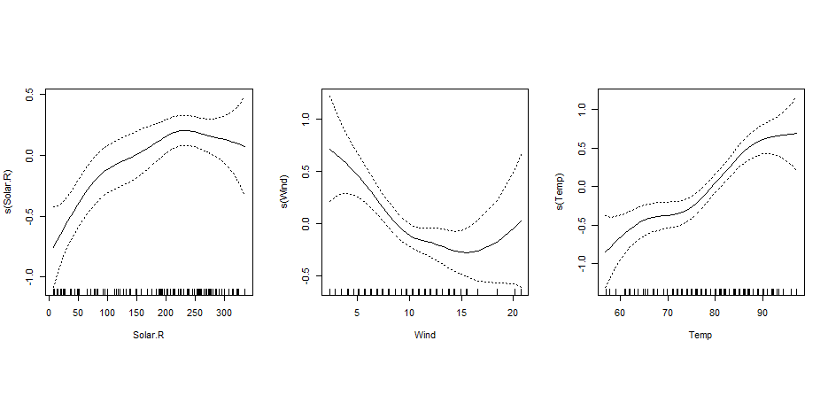
GAM Models in R
plot(ozmod2, se=T)

Slide 30
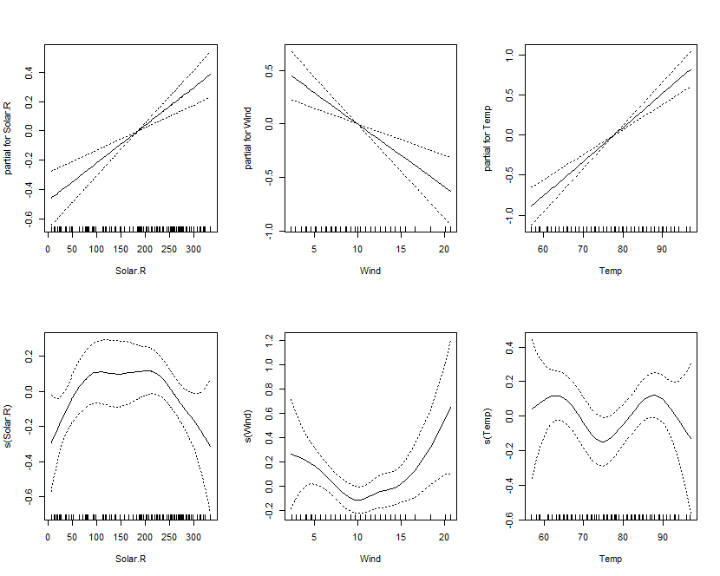
GAM Models in R
plot(ozmod2a, se=T)

Slide 31
GAM Models in R (using mcgv)
### Fitting GAMs using mcgv library
ozmod2<-gam(log(Ozone)~s(Solar.R)+s(Wind)+s(Temp), family=gaussian(link=identity),data=air)
summary(ozmod2)
Formula:
log(Ozone) ~ s(Solar.R) + s(Wind) + s(Temp)
Parametric coefficients:
Estimate Std. Error t value Pr(>|t|)
(Intercept) 3.41593 0.04486 76.14 <2e-16 ***
---
Signif. codes: 0 ‘***’ 0.001 ‘**’ 0.01 ‘*’ 0.05 ‘.’ 0.1 ‘ ’ 1
Approximate significance of smooth terms:
edf Ref.df F p-value
s(Solar.R) 2.240 2.818 9.129 3.80e-05 ***
s(Wind) 2.351 2.986 6.372 0.000513 ***
s(Temp) 4.494 5.532 10.890 4.25e-09 ***
---
Signif. codes: 0 ‘***’ 0.001 ‘**’ 0.01 ‘*’ 0.05 ‘.’ 0.1 ‘ ’ 1
R-sq.(adj) = 0.702 Deviance explained = 72.7%
GCV = 0.24574 Scale est. = 0.22341 n = 111

Slide 32
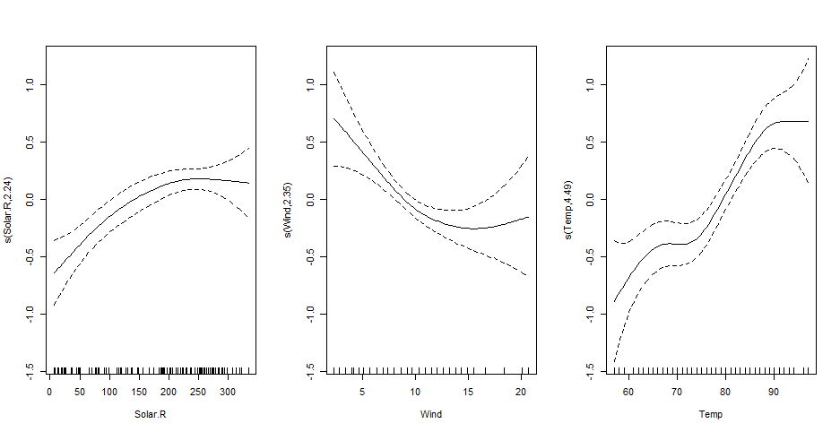
plot(ozmod2, se=T)

Slide 33
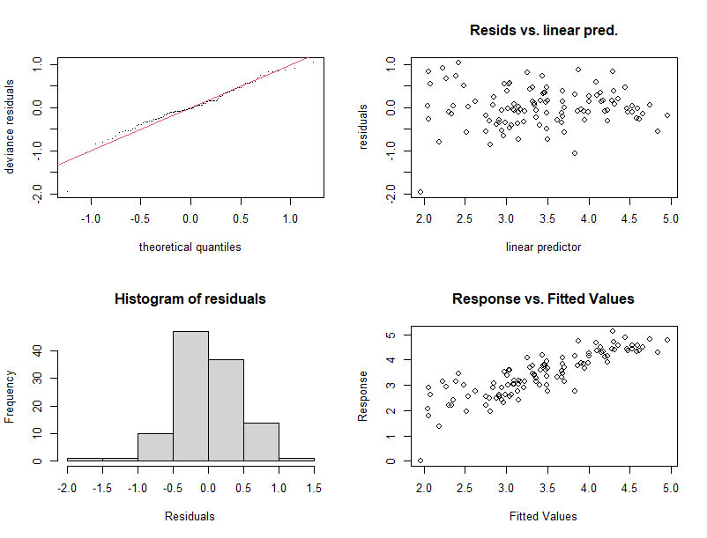
Model Checking using mcgv
gam.check(ozmod2)

Slide 34
Lupus Nephritis
Example: Treatment response in patients with treatment response
Data include 280 observations examining treatment response at 1 year in patient with lupus nephritis
Data includes
Demographics: age, race
Treatment response: Yes/No
Clinical Markers: c4c, dsDNA, EGFR, UrPrCr
Urine markers: IL2ra, IL6, IL8, IL12

Slide 35
Lupus Nephritis
### Fitting GAM model with a binary outcome using gam library
ln<-read.csv("H:\\public_html\\BMTRY790_Spring2023\\Datasets\\LupusNephritis.csv")
head(ln)
race age urprcr dsdna c4c egfr il2ra il6 il8 il12 CR90
1 1 21.6 7.390 1 34.7 115.816 84.6 15.7 105.3 0.0 0
2 1 21.6 5.583 1 16.7 51.568 597.5 4.5 23.2 285.8 0
3 0 31.6 5.530 1 1.6 20.034 275.2 22.0 29.0 38.9 0
4 0 31.6 2.161 1 9.7 6.650 279.3 72.2 1691.9 764.4 0
5 1 37.6 2.340 1 5.1 120.722 2313.2 4.7 108.5 949.6 0
6 1 37.6 0.249 0 22.1 102.931 496.3 1.7 26.4 1010.0 0

Slide 36
Lupus Nephritis (using gam)
### Fitting GAM model with a binary outcome using gam library
lnmod<-gam(CR90 ~ race + s(urprcr) + s(egfr) + s(il2ra), family = binomial(link=logit), data=ln, trace=TRUE)
GAM s.wam loop 1: deviance = 263.3679
GAM s.wam loop 2: deviance = 257.5799
GAM s.wam loop 3: deviance = 256.0531
GAM s.wam loop 4: deviance = 255.5129
GAM s.wam loop 5: deviance = 255.3848
GAM s.wam loop 6: deviance = 255.3683
GAM s.wam loop 7: deviance = 255.3668
GAM s.wam loop 8: deviance = 255.3666
GAM s.wam loop 9: deviance = 255.3666

Slide 37
Lupus Nephritis (using gam)
### Fitting GAM model with a binary outcome using gam library
summary(lnmod)
Call: gam(formula = CR90 ~ race + s(urprcr) + s(egfr) + s(il2ra), family = binomial(link = logit),
data = ln, trace = TRUE)
Deviance Residuals:
Min 1Q Median 3Q Max
-1.7493 -0.7121 -0.5046 0.5204 2.8217
(Dispersion Parameter for binomial family taken to be 1)
Null Deviance: 323.3956 on 279 degrees of freedom
Residual Deviance: 255.3666 on 266.0001 degrees of freedom
AIC: 283.3664
Number of Local Scoring Iterations: 9

Slide 38
Lupus Nephritis (using gam)
### Fitting GAM model with a binary outcome using gam library
summary(lnmod)
Anova for Parametric Effects
Df Sum Sq Mean Sq F value Pr(>F)
race 1 0.128 0.1277 0.1214 0.727771
s(urprcr) 1 9.746 9.7463 9.2637 0.002572 **
s(egfr) 1 6.236 6.2364 5.9276 0.015563 *
s(il2ra) 1 10.286 10.2861 9.7767 0.001963 **
Residuals 266 279.858 1.0521
Anova for Nonparametric Effects
Npar Df Npar Chisq P(Chi)
race
s(urprcr) 3 6.3233 0.096907 .
s(egfr) 3 12.2630 0.006535 **
s(il2ra) 3 7.8942 0.048240 *
Signif. codes: 0 ‘***’ 0.001 ‘**’ 0.01 ‘*’ 0.05 ‘.’ 0.1 ‘ ’ 1

Slide 39
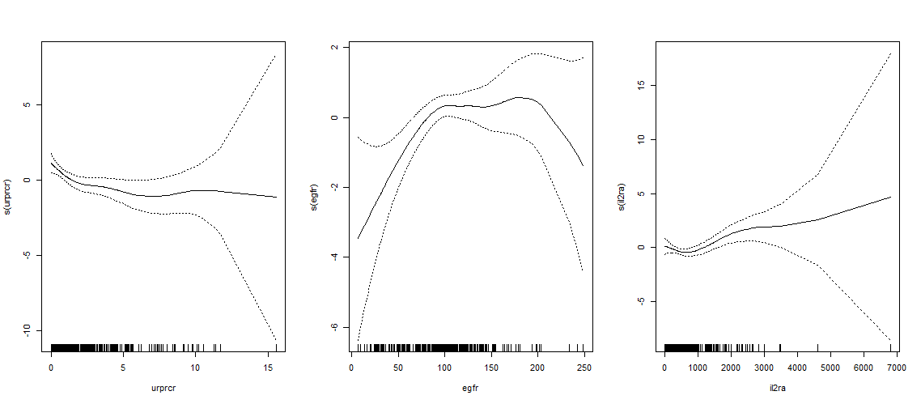
GAM Models in R
plot(lnmod, se=T)

Slide 40
Lupus Nephritis (using mcgv)
### Fitting GAM model with a binary outcome using mcgv library
lnmod<-gam(CR90 ~ race + s(urprcr) + s(egfr) + s(il2ra), family = binomial(link=logit), data=ln, trace=TRUE)
summary(lnmod)
Family: binomial
Link function: logit
Formula:
CR90 ~ race + s(urprcr) + s(egfr) + s(il2ra)
Parametric coefficients:
Estimate Std. Error z value Pr(>|z|)
(Intercept) -1.34589 0.27744 -4.851 1.23e-06 ***
race 0.04299 0.31947 0.135 0.893
---
Signif. codes: 0 ‘***’ 0.001 ‘**’ 0.01 ‘*’ 0.05 ‘.’ 0.1 ‘ ’ 1

Slide 41
Lupus Nephritis (using mcgv)
### Fitting GAM model with a binary outcome using mcgv library
lnmod<-gam(CR90 ~ race + s(urprcr) + s(egfr) + s(il2ra), family = binomial(link=logit), data=ln, trace=TRUE)
summary(lnmod)
…
Approximate significance of smooth terms:
edf Ref.df Chi.sq p-value
s(urprcr) 1.842 2.309 13.54 0.00212 **
s(egfr) 3.868 4.833 12.93 0.01951 *
s(il2ra) 3.016 3.851 13.82 0.00565 **
---
Signif. codes: 0 ‘***’ 0.001 ‘**’ 0.01 ‘*’ 0.05 ‘.’ 0.1 ‘ ’ 1
R-sq.(adj) = 0.195 Deviance explained = 19.4%
UBRE = 0.0075104 Scale est. = 1 n = 280
Note, UBRE stands for unbiased risk estimator and is used like GCV (similar formula)

Slide 42
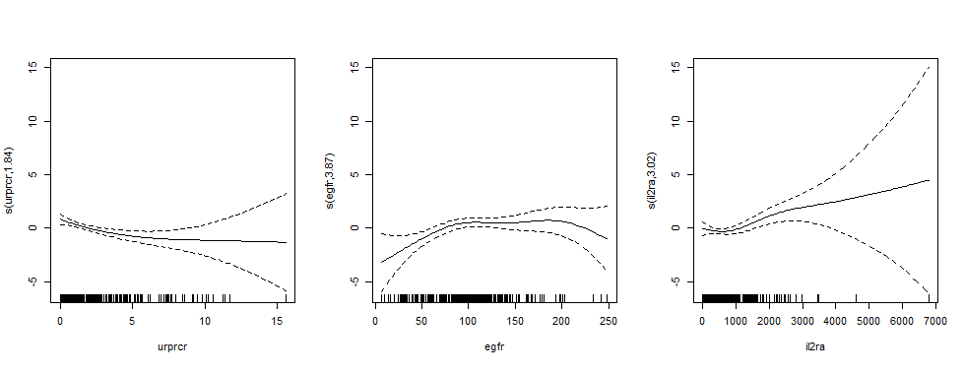
Lupus Nephritis (using mcgv)
par(mfrow=c(1,3), pty="s")
plot(lnmod, se=T)

Slide 43
Lupus Nephritis (using mcgv)
The mcgv package has some additional features that make it a little nicer than gam
Specifically, it will apply an additional penalty parameter to conduct variable selection
lnmod2<-gam(CR90 ~ race + s(urprcr) + s(egfr) + s(il2ra) + s(il6) + s(il8) + s(il12), family = binomial(link=logit), data=ln, trace=TRUE)
lnmod3<-gam(CR90 ~ race + s(urprcr) + s(egfr) + s(il2ra) + s(il6) + s(il8) + s(il12), family = binomial(link=logit), select=T, data=ln, trace=TRUE)

Slide 44
Lupus Nephritis (using mcgv)
summary(lnmod2)
Parametric coefficients:
Estimate Std. Error z value Pr(>|z|)
(Intercept) -1.3231 0.3239 -4.084 4.42e-05 ***
race -0.2312 0.3377 -0.685 0.493
Approximate significance of smooth terms:
edf Ref.df Chi.sq p-value
s(urprcr) 1.767 2.205 12.858 0.00245 **
s(egfr) 3.874 4.833 12.305 0.02525 *
s(il2ra) 2.711 3.486 11.707 0.01031 *
s(il6) 1.000 1.001 0.823 0.36472
s(il8) 2.586 3.279 4.419 0.25455
s(il12) 2.502 3.154 4.681 0.21274
R-sq.(adj) = 0.217 Deviance explained = 23.5%
UBRE = 0.00046012 Scale est. = 1 n = 280
summary(lnmod3)
Parametric coefficients:
Estimate Std. Error z value Pr(>|z|)
(Intercept) -1.3704 0.3168 -4.326 1.52e-05 ***
race -0.1707 0.3304 -0.517 0.605
Approximate significance of smooth terms:
edf Ref.df Chi.sq p-value
s(urprcr) 1.922e+00 9 15.270 0.000132 ***
s(egfr) 3.011e+00 9 13.454 0.001529 **
s(il2ra) 3.070e+00 9 12.892 0.001895 **
s(il6) 3.956e-06 9 0.000 0.590378
s(il8) 3.214e+00 9 6.595 0.077541 .
s(il12) 3.059e-01 9 0.438 0.215320
R-sq.(adj) = 0.214 Deviance explained = 22.7%
UBRE = -0.010709 Scale est. = 1 n = 280

Slide 45
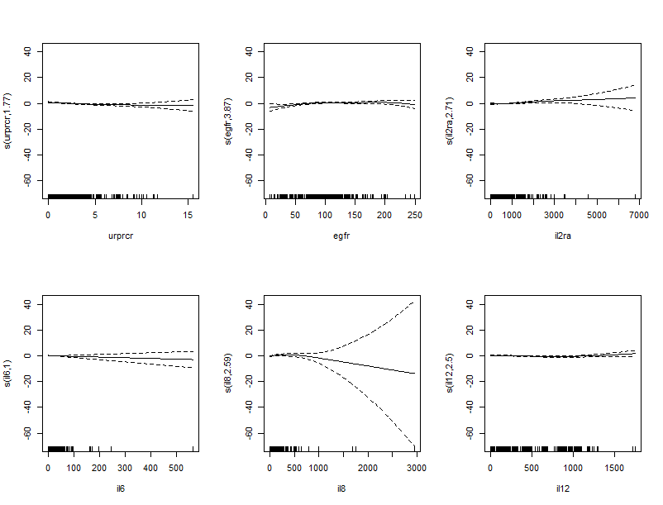
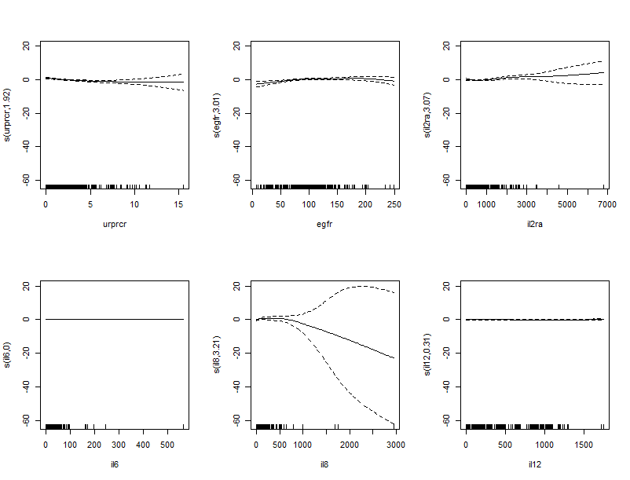
Plots of lnmod2 and lnmod3

Slide 46
Lupus Nephritis (using mcgv)
In the mcgv package, the default basis dimensions used for smooth terms are somewhat arbitrary.
Thus these should be checked that they are not too small.
However, there is a function to check this.

Slide 47
Lupus Nephritis (using mcgv)
### Checking choice of smoothness parameters
lnmod2<-gam(CR90 ~ race + s(urprcr) + s(egfr) + s(il2ra) + s(il6) + s(il8) + s(il12), family = binomial(link=logit), data=ln, trace=TRUE)
gam.check(lnmod2)
Method: UBRE Optimizer: outer newton
…
Model rank = 56 / 56
Basis dimension (k) checking results. Low p-value (k-index<1) may indicate that k is too low, especially if edf is close to k'.
k' edf k-index p-value
s(urprcr) 9.000 1.767 1.066 0.92
s(egfr) 9.000 3.874 0.923 0.18
s(il2ra) 9.000 2.711 0.904 0.07
s(il6) 9.000 1.000 0.955 0.26
s(il8) 9.000 2.586 1.010 0.63
s(il12) 9.000 2.502 0.837 0.00

Slide 48
Lupus Nephritis (using mcgv)
### Package authors suggest that if one or more terms appears to have k too small, then try doubling k for that parameter
### Checking choice of smoothness parameters
lnmod4<-gam(CR90 ~ race + s(urprcr) + s(egfr) + s(il2ra, k=20) + s(il6) + s(il8) + s(il12, k=20), family = binomial(link=logit), data=ln, trace=TRUE)
gam.check(lnmod4)
Method: UBRE Optimizer: outer newton
…
Model rank = 56 / 56
Basis dimension (k) checking results. Low p-value (k-index<1) may indicate that k is too low, especially if edf is close to k'.
k' edf k-index p-value
s(urprcr) 9.000 1.77 1.066 0.905
s(egfr) 9.000 3.87 0.923 0.155
s(il2ra) 19.000 2.94 0.904 0.085
s(il6) 9.000 1.00 0.955 0.300
s(il8) 9.000 2.62 1.010 0.565
s(il12) 19.000 2.52 0.837 0.000

Slide 49
Training a GAM using caret
The caret package has the ability to “train” gam models using either the gam or mcgv packages
To use gam, specify the following methods
“gamLoess” → loess smoothers, span and df
“gamSpline” → spline smoother, df
To use mcgv, specify the following methods
“bam” → spline smoothers, select and method
“gam” → spline smoothers, select and method

Slide 50
Training a GAM using caret
### Training a model using the caret package with mcgv
trgam<-train(as.factor(CR90) ~ race + urprcr + egfr + il2ra + il6 + il8 + il12, family = binomial(link=logit), data=ln, method="gam", trControl=trainControl(method="cv", number=10), tuneGrid=expand.grid(select=c("FALSE","TRUE"), method=c("GCV.Cp","GCV.Cp")))
trgam
Generalized Additive Model using Splines
280 samples
7 predictor
2 classes: '0', '1'
No pre-processing
Resampling: Cross-Validated (10 fold)
Summary of sample sizes: 253, 251, 252, 253, 251, 252, ...
Resampling results across tuning parameters:
select Accuracy Kappa
FALSE 0.7541553 0.2452008
TRUE 0.7541553 0.2452008

Slide 51
Training a GAM using caret
### Training a model using the caret package with mcgv
names(trgam)
[1] "method" "modelInfo" "modelType" "results" "pred" "bestTune" "call" "dots"
[9] "metric" "control" "finalModel" "preProcess" "trainingData" "ptype" "resample" "resampledCM"
[17] "perfNames" "maximize" "yLimits" "times" "levels" "terms" "coefnames" "xlevels"
trgam$finalModel
Family: binomial
Link function: logit
Formula:
.outcome ~ race + s(il6) + s(il12) + s(il8) + s(urprcr) + s(il2ra) +
s(egfr)
Estimated degrees of freedom:
0.000 0.306 3.215 1.923 3.070 3.011 total = 13.52
UBRE score: -0.01070889

Slide 52
Training a GAM using caret
### Training a model using the caret package with mcgv
summary(trgam$finalModel)
Family: binomial
Link function: logit
Formula:
.outcome ~ race + s(il6) + s(il12) + s(il8) + s(urprcr) + s(il2ra) + s(egfr)
Parametric coefficients:
Estimate Std. Error z value Pr(>|z|)
(Intercept) -1.3704 0.3168 -4.326 1.52e-05 ***
race -0.1707 0.3304 -0.517 0.605
---
Signif. codes: 0 ‘***’ 0.001 ‘**’ 0.01 ‘*’ 0.05 ‘.’ 0.1 ‘ ’ 1
Approximate significance of smooth terms:
edf Ref.df Chi.sq p-value
s(il6) 3.956e-06 9 0.000 0.595567
s(il12) 3.059e-01 9 0.438 0.215257
s(il8) 3.214e+00 9 6.595 0.076266 .
s(urprcr) 1.922e+00 9 15.270 0.000163 ***
s(il2ra) 3.070e+00 9 12.892 0.002023 **
s(egfr) 3.011e+00 9 13.454 0.001648 **
---
Signif. codes: 0 ‘***’ 0.001 ‘**’ 0.01 ‘*’ 0.05 ‘.’ 0.1 ‘ ’ 1
R-sq.(adj) = 0.214 Deviance explained = 22.7%
UBRE = -0.010709 Scale est. = 1 n = 280

