Slide 1
Model Selection and Assessment, Part II
Machine Learning, BMTRY 790

Slide 2
Model Assessment
Recall we said the best solution
Split data into three set
Training Set (50% of the sample): Use to build models
Validation Set (25% of the sample): Use to validate prediction performance of models developed in training data
Test Set (25% of the sample): Used to estimate prediction error on final model selected from first two sets
In the event that data are not sufficiently large, there are techniques to estimate model prediction error
Mathematical approaches
Resampling approaches

Slide 3
Overview: Model Selection
The most important use of validation is for model selection
For example, this could be:
Choosing a regression model from among all possible regression models for p inputs
Choice between a linear model and a nonlinear model
Choice of a regularization parameter
Any other choice that affects statistical learning process.
For all prediction modeling, there are choices to be made and we need a consistent way of making these choices.
Validation can be used to estimate the out-of-sample error for more than one model.

Slide 4
Analytical Approaches
Recall we’ve discussed several analytical approaches
These methods estimate training error by mathematical adjustment of the training error:
Focused on AIC, BIC
Typically used in stepwise model fitting approaches
Other methods:
Minimum description length(MDL)
Structural risk minimization (SRM)
However, these methods require that we have a way to estimate model complexity, which isn’t always the case

Slide 5
Resampling Methods
Basic steps
Repeatedly draw samples from a training set
Fit a model for the outcome of interest on each sample
Estimate information about the fitted model
Example:
Goal: Estimate the variability of a linear regression fit
Draw different samples from the training data and fit OLS regression to each
Examining the extent to which the resulting fits differ.
Can be useful in both model selection and model assessment

Slide 6
Resampling Methods
Cross-Validation
Useful to tune model parameters
Example: Shrinkage parameter l in penalized regression
Example: Number of knots in a cubic spline
Estimate test set prediction error rates associated with a given method to evaluate its performance
Bootstrap
Most often used to provide a measure of accuracy of a parameter estimate or of a given statistical or machine learning method.

Slide 7
Overview: Model Selection
M₁
M₂
…
M_{M}
Consider a case where we have M models; validation can be used to select one of these models
Fit models to the training data and evaluate each model on a validation set to obtain the validation errors.
Select the model with the lowest validation error
Fit selected model to the full data set
Training Data
…
Validation Data
…
pick the “best” model
Full Data

Slide 8
K-Fold Cross-Validation
General Approach:
Randomly split the data into K roughly equal-size subsets.
For the k^{th} subset calculate the prediction error of the model fit using the other K − 1 subsets.
Do this for k = 1, 2, . . . , K and combine the K estimates of the prediction error.
1
2
…
k
…
K - 1
K

Slide 9
K-Fold Cross-Validation
The mapping of indicates observation i belongs to the κ^{th} partition
f ^{-k}(x) is the model fitted to the data with the k^{th} subset removed
The cross-validation estimate of the prediction error is
Typical choices of K include 5 and 10-fold
The case where K = N is referred to as leave one out CV

Slide 10
K-Fold Cross-Validation
We could also consider statistical models where we need to consider some tuning parameter
λ = shrinkage parameter (penalized regression models)
k = number of knots (cubic regression spline
In this case, our model function, f(x), is also indexed by the tuning parameter, α, as f ^{-k}(x, α)
Thus the cross-validation estimate of the prediction error is

Slide 11
Choice of K?
Intuition says
When K = 5 or 10, then since training sets from different folds are fairly different
When K = N, then since the training sets are very similar for each fold
Simulation studies have shown that cross-validation really only effectively estimated Err.

Slide 12
Choice of K?
Computation increases
Variance decreases
bias decreases
K fold
Leave-one-out
K increases

Slide 13
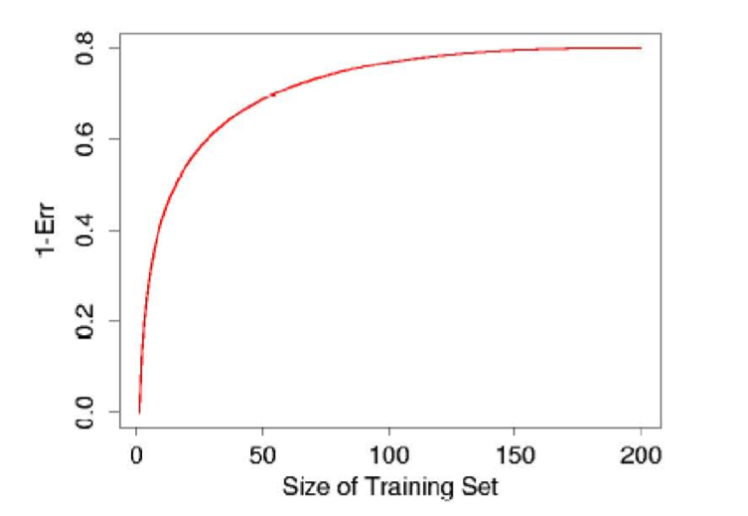
Hypothetical Learning Curve for a Classifier Based on Observed Training Set Sample Size
Figure 7.8 from ESL

Slide 14
Choice of K?
K = N
approximately unbiased estimate of Err.
has high variance since the N training sets are similar.
Computational burden is high (except for a few exceptions)
When K = 5
has low variance.
potentially upwardly biased estimate for Err.
Only occurs if for each fold there is not enough training data to fit a good model.
K-fold CV with K = 5 or K = 10 shown empirically to yield test error rate estimates that don’t suffer from excessively high bias or very high variance.

Slide 15
Generalized Cross-Validation
LOOCV can be computationally difficult, particularly in N is large
Linear fitting methods with squared error loss can be written as
, where S is a smoother matrix
For these methods, we can write our LOOCV estimated loss as
From this we get the GCV approximation

Slide 16
Conducting CV
There are right and wrong ways to do CV.
Consider the case where our goal is to develop a multivariable regression model.
A wrong strategy:
Screen the predictors and find a good subset among the all predictors that are correlated with outcome y.
Build a model based on the selected subset of “good” predictors.
Perform cross-validation to estimate the unknown tuning parameters and to estimate Err of the final model.

Slide 17
Conducting CV
Better strategy:
Divide the data into K randomly selected subsets of data.
For each fold k = 1, 2, …, K:
Find the subset of “good” predictors that show the strongest univariate association with the outcome y minus the k^{th} fold.
Using this subset of “good” predictors, build a multivariate statistical model, again minus the k^{th} fold.
Use the model to predict the outcome y in the k^{th} fold.
In general, if we are doing multi-step modeling, cross-validation should be applied to the entire sequence of modeling steps.

Slide 18
The Bootstrap
Consider training data, Z = {z₁, z₂, …, z_{N}} where z_{i} = {x_{i}, y_{i}}.
The bootstrap idea is:
For b = 1, 2, …, B
Randomly select N samples from Z with replacement to yield sample Z*^{b}
Fit a model using Z*^{b} and estimate some statistic of interest S(Z*^{b})
Examine the behavior of the B fits

Slide 19
Use of Bootstrap to Estimate Distribution of S(Z)
From the bootstrap sampling we can estimate any aspect of the distribution of S(Z), for example, its variance:
While this may be of interest, we really want to get at the prediction error for statistical models…

Slide 20
Use of Bootstrap to Estimate Prediction Error
We could consider the following to estimate prediction error for our model:
Here is the predicted value at x_{i} using the model estimated from the b^{th} bootstrap sample,
Why might this not be a good estimator?

Slide 21
Use of Bootstrap to Estimate Prediction Error
Alternatively, we could borrow from the idea of cross-validation
Consider only observations not in a bootstrap samples when estimating error
Equation for this “leave one out” bootstrap estimate is
C ^{–i} = set if indices of bootstrap samples b that don’t include observation i
|C ^{–i} | = the number of samples for which this is true
Better choice but
So similar to CV with 2-folds, which as noted earlier may yield high upward bias.

Slide 22
Use of Bootstrap to Estimate Prediction Error
The .632 estimators proposed to address bias in the leave one out bootstrap estimate
Here is the training error
And is the leave one out bootstrap error
Compromise between training and the leave-one-out bootstrap error.
Not easy to derive
Relates to the probability that an observation is in a bootstrap sample.
Does not do well if predictor tends to overfit.

Slide 23
Use of Bootstrap to Estimate Prediction Error
The .632 estimator can be improved if we account for the amount of over-fitting
First define the no-information error rate as
Estimate of the error rate of if the outcome and predictors were independent.
Note the prediction rule, , is evaluated for all possible combinations of the outcome y_{i} and the predictors x_{i’}

Slide 24
Use of Bootstrap to Estimate Prediction Error
We can then define the relative over-fitting rate as
R = 0 implies no over-fitting
R = 1 implies over-fitting is equal to the no-information error rate minus the training error.
0 < R < 1 implies some evidence of over-fitting with larger values implying more severe over-fitting

Slide 25
Use of Bootstrap to Estimate Prediction Error
Depending on amount of over-fitting, the best error estimate is as little as Err^{(.632)}, or as much as Err⁽¹⁾ (likely something in between)
Err^{(.632+)} is similar to Err^{(.632)} but applies adaptive weights, with Err⁽¹⁾ weighted at least .632
Thus Err^{(.632+)} adaptively mixes training error and leave-one-out error using the relative over-fitting rate (R)

Slide 26
Implementing Validation Methods In R
Mathematical adjustment of model error (AIC and BIC)
stats package
Functions that return AIC and BIC for linear models from a variety of other packages
Will also fit step-wise regressions and compare based on information criterion
MASS package
stepAIC function performs step-wise regression based on AIC (very similar to step function from stats package)
glmulti package
Calculate information criterion (AIC, BIC, QIC) for exhaustive evaluation of set of generalized linear models

Slide 27
Model Selection: Body Fat Example
Recall our regression model
Call:
lm(formula = PBF ~ Age + Wt + Ht + Neck + Chest + Abd + Hip + Thigh + Knee + Ankle + Bicep + Arm + Wrist, data = bodyfat, x = T)
Estimate Std. Error t value Pr(>|t|)
(Intercept) -18.18849 17.34857 -1.048 0.29551
Age 0.06208 0.03235 1.919 0.05618 .
Wt -0.08844 0.05353 -1.652 0.09978 .
Ht -0.06959 0.09601 -0.725 0.46925
Neck -0.47060 0.23247 -2.024 0.04405 *
Chest -0.02386 0.09915 -0.241 0.81000
Abd 0.95477 0.08645 11.04 < 2e-16 ***
Hip -0.20754 0.14591 -1.422 0.15622
Thigh 0.23610 0.14436 1.636 0.10326
Knee 0.01528 0.24198 0.063 0.94970
Ankle 0.17400 0.22147 0.786 0.43285
Bicep 0.18160 0.17113 1.061 0.28966
Arm 0.45202 0.19913 2.270 0.02410 *
Wrist -1.62064 0.53495 -3.030 0.00272 **
Residual standard error: 4.305 on 238 degrees of freedom. Multiple R-squared: 0.749,
Adjusted R-squared: 0.7353 . F-statistic: 54.65 on 13 and 238 DF, p-value: < 2.2e-16

Slide 28
Model Selection: Body Fat Example
### Regression Data Example
bodyfat<-read.csv("H:/public_html/BMTRY790_Spring2023/Datasets/Body_fat.csv")
bodyfat<-bodyfat[,2:15]
### Extracting AIC and BIC from single models
mod1<-lm(PBF ~ ., data=bodyfat)
AIC(mod1)
[1] 1466.502
BIC(mod1)
[1] 1519.444

Slide 29
Model Selection: Body Fat Example
### Forward selection using AIC with step/stepAIC function
mod1<-lm(PBF ~ ., data=bodyfat)
nmod1<-lm(PBF ~ 1, data=bodyfat)
fmod1a<-step(nmod1, scope=list(lower=nmod1, upper=mod1), direction="forward")
Start: AIC=1071.75
PBF ~ 1
Df Sum of Sq RSS AIC
+ Abd 1 11631.5 5947.5 800.65
+ Chest 1 8678.3 8900.7 902.24
…
Step: AIC=741.85
PBF ~ Abd + Wt + Wrist + Arm + Neck + Age + Thigh + Hip
Df Sum of Sq RSS AIC
<none> 4455.3 741.85
+ Bicep 1 20.7116 4434.6 742.68
+ Ht 1 11.7494 4443.6 743.19
+ Ankle 1 11.6199 4443.7 743.19
+ Knee 1 0.0365 4455.3 743.85
+ Chest 1 0.0001 4455.3 743.85

Slide 30
Model Selection: Body Fat Example
### Forward selection using AIC with step/stepAIC function
names(fmod1a)
[1] "coefficients" "residuals" "effects" "rank" "fitted.values" "assign" "qr" "df.residual" "xlevels" "call"
[2] "terms" "model" "anova"
fmod1a$coef
(Intercept) Abd Wt Wrist Arm Neck Age Thigh Hip
-22.65637291 0.94481514 -0.08985290 -1.53665172 0.51572117 -0.46655783 0.06577964 0.30239157 -0.19543492
fmod1a$anova
Step Df Deviance Resid. Df Resid. Dev AIC
1 NA NA 251 17578.990 1071.7477
2 + Abd -1 11631.52681 250 5947.463 800.6453
3 + Wt -1 1004.21778 249 4943.245 756.0398
4 + Wrist -1 157.19103 248 4786.054 749.8962
5 + Arm -1 127.81846 247 4658.236 745.0747
6 + Neck -1 51.06638 246 4607.169 744.2968
7 + Age -1 47.93419 245 4559.235 743.6612
8 + Thigh -1 67.38659 244 4491.849 741.9088
9 + Hip -1 36.52435 243 4455.324 741.8514

Slide 31
Model Selection: Body Fat Example
### Backward selection using AIC with step/stepAIC function
fmod1b<-step(mod1, direction="backward")
fmod1b$coef
(Intercept) Age Wt Neck Abd Hip Thigh Arm
-22.65637291 0.06577964 -0.08985290 -0.46655783 0.94481514 -0.19543492 0.30239157 0.51572117
Wrist
-1.53665172
fmod1b$anova
Step Df Deviance Resid. Df Resid. Dev AIC
1 NA NA 238 4411.448 749.3574
2 - Knee 1 0.07392147 239 4411.522 747.3616
3 - Chest 1 1.13294221 240 4412.655 745.4263
4 - Ht 1 8.67544475 241 4421.330 743.9212
5 - Ankle 1 13.28231735 242 4434.613 742.6772
6 - Bicep 1 20.71159705 243 4455.324 741.8514

Slide 32
Model Selection: Body Fat Example
### Forward-Backward selection using AIC with step/stepAIC function
fmod1c<-step(mod1, direction="both")
fmod1c$coef
(Intercept) Age Wt Neck Abd Hip Thigh Arm
-22.65637291 0.06577964 -0.08985290 -0.46655783 0.94481514 -0.19543492 0.30239157 0.51572117
Wrist
-1.53665172
fmod1c$anova
Step Df Deviance Resid. Df Resid. Dev AIC
1 NA NA 238 4411.448 749.3574
2 - Knee 1 0.07392147 239 4411.522 747.3616
3 - Chest 1 1.13294221 240 4412.655 745.4263
4 - Ht 1 8.67544475 241 4421.330 743.9212
5 - Ankle 1 13.28231735 242 4434.613 742.6772
6 - Bicep 1 20.71159705 243 4455.324 741.8514

Slide 33
Model Selection: Body Fat Example
### Forward-Backward selection using BIC with step/stepAIC function
n<-nrow(bodyfat)
fmod1d<-step(mod1, direction="both", k=log(n))
fmod1d$coef
(Intercept) Wt Abd Arm Wrist
-34.8540743 -0.1356315 0.9957513 0.4729284 -1.5055620
fmod1d$anova
Step Df Deviance Resid. Df Resid. Dev AIC
1 NA NA 238 4411.448 798.7694
2 - Knee 1 0.07392147 239 4411.522 793.2442
3 - Chest 1 1.13294221 240 4412.655 787.7794
4 - Ht 1 8.67544475 241 4421.330 782.7450
5 - Ankle 1 13.28231735 242 4434.613 777.9714
6 - Bicep 1 20.71159705 243 4455.324 773.6162
7 - Hip 1 36.52434618 244 4491.849 770.1442
8 - Neck 1 61.67131402 245 4553.520 768.0511
9 - Thigh 1 66.35368037 246 4619.874 766.1673
10 - Age 1 38.36216099 247 4658.236 762.7218

Slide 34
Model Selection: Breast Carcinoma
Consider the logistic regression model
Call:
glm(formula = Iclass ~ ., family = "binomial", data = btis[, -c(1:2, 9)])
Deviance Residuals:
Min 1Q Median 3Q Max
-1.78712 -0.13268 -0.01431 0.00000 2.42565
Estimate Std. Error z value Pr(>|z|)
(Intercept) 22.0599 16.1578 1.365 0.1722
I0 -0.1868 0.1136 -1.644 0.1001
PA500 -133.4658 90.9269 -1.468 0.1421
HFS -49.3899 27.2195 -1.815 0.0696 .
normArea -0.1020 0.2715 -0.376 0.7071
MaxIP 0.9928 0.6454 1.538 0.1240
DR 0.2647 0.1590 1.665 0.0960 .
(Dispersion parameter for binomial family taken to be 1)
Null deviance: 94.472 on 83 degrees of freedom
Residual deviance: 17.382 on 77 degrees of freedom
AIC: 31.382
Number of Fisher Scoring iterations: 11
>

Slide 35
Model Selection: Breast Carcinoma
### Classification Example
btis<-read.csv("H:\\public_html\\BMTRY790_Spring2023\\Datasets\\BreastTissue.csv")
btis<-btis[-which(btis$Class=="adipose"),]
btis$Iclass<-ifelse(btis$Class=="carcinoma", 1, 0)
mod2<-glm(Iclass ~ ., data=btis[,-c(1:2,8,9)], family="binomial")
AIC(mod2)
[1] 31.38202
BIC(mod2)
[1] 48.39773

Slide 36
Model Selection: Breast Carcinoma
### Forward-Backward selection using AIC with step/stepAIC function
mod2<-glm(Iclass ~ ., data=btis[,-c(1:2,9)], family="binomial")
fmod2c<-step(mod2, direction="both")
fmod2c$coef
(Intercept) I0 PA500 HFS MaxIP DR
17.6046346 -0.1546919 -110.3712274 -43.7315077 0.7977925 0.2215606
fmod2c$anova
Step Df Deviance Resid. Df Resid. Dev AIC
1 NA NA 77 17.38202 31.38202
2 - normArea 1 0.14728 78 17.52930 29.52930

Slide 37
Implementing Validation Methods In R
Resampling methods
DAAG package (Data Analysis and Graphics Data and Functions)
Provides cross-validation function for linear and logistic regression models.
cvTools package
Provides functions to estimate cross-validation error for regression models
Bootstrap package
Provides functions for cross-validation, bootstrapping, and jackknifing
e1071 package
Provides function to tune model fit parameters for neural net, SVM, CART, random forest, and kNN models
caret package
Provides unified framework for running model validation via resampling for a variety of model types available in R
Able to select different types of cross-validation or bootstrap resampling validation methods
Provides user ability to set a specific model evaluation function

Slide 38
Model Selection: Body Fat Example
### Regression Data Example
library(caret)
tmod1.cv1<-train(PBF ~ ., data=bodyfat, trControl=trainControl("cv", number=10), method="glmStepAIC")
names(tmod1.cv1)
[1] "method" "modelInfo" "modelType" "results" "pred" "bestTune" "call"
[8] "dots" "metric" "control" "finalModel" "preProcess" "trainingData" "resample"
[15] "resampledCM" "perfNames" "maximize" "yLimits" "times" "levels" "terms"
[22] "coefnames" "xlevels"

Slide 39
Model Selection: Body Fat Example
### Regression Data Example, 10-fold CV
tmod1.cv1$results
parameter RMSE Rsquared RMSESD RsquaredSD
1 none 4.399959 0.7346191 0.6194202 0.08389727
tmod1.cv1$resample
RMSE Rsquared parameter Resample
1 4.545380 0.6634375 none Fold01
2 4.473056 0.7219830 none Fold02
…
9 4.953042 0.7037010 none Fold09
10 3.091050 0.8593599 none Fold10
tmod1.cv1$finalModel
Call: NULL
Coefficients:
(Intercept) Age Wt Neck Abd Hip Thigh Arm Wrist
-22.65637 0.06578 -0.08985 -0.46656 0.94482 -0.19543 0.30239 0.51572 -1.53665
Degrees of Freedom: 251 Total (i.e. Null); 243 Residual
Null Deviance: 17580
Residual Deviance: 4455 AIC: 1459

Slide 40
Model Selection: Body Fat Example
### Regression Data Example- Leave one out CV
tmod1.cv2<-train(PBF ~ ., data=bodyfat, trControl=trainControl("loocv", returnResamp="all"), method="glmStepAIC")
tmod1.cv2$results
parameter RMSE Rsquared RMSESD RsquaredSD
1 none 3.708457 NaN 2.564497 NA
tmod1.cv2$resample
RMSE Rsquared parameter Resample
1 3.639318251 NA none Fold001
3.295423590 NA none Fold002
…
251 1.573132933 NA none Fold251
252 4.837298106 NA none Fold252
tmod1.cv2$finalModel
Coefficients:
(Intercept) Age Wt Neck Abd Hip Thigh Arm Wrist
-22.65637 0.06578 -0.08985 -0.46656 0.94482 -0.19543 0.30239 0.51572 -1.53665
Degrees of Freedom: 251 Total (i.e. Null); 243 Residual
Null Deviance: 17580
Residual Deviance: 4455 AIC: 1459

Slide 41
Model Selection: Body Fat Example
### Regression Data Example-Bootstrap resampling
tmod1.bs1<-train(PBF ~ ., data=bodyfat, trControl=trainControl("boot", number=100, returnResamp="all"), method="glmStepAIC")
tmod1.bs1$results
parameter RMSE Rsquared RMSESD RsquaredSD
1 none 4.65436 0.7013852 0.3221535 0.04098558
tmod1.bs1$resample
RMSE Rsquared parameter Resample
1 4.542549 0.6317638 none Resample001
2 4.606437 0.6752286 none Resample002
…
99 4.333208 0.7067568 none Resample099
100 4.529748 0.6724845 none Resample100
tmod1.bs1$finalModel
Coefficients:
(Intercept) Age Wt Neck Abd Hip Thigh Arm Wrist
-22.65637 0.06578 -0.08985 -0.46656 0.94482 -0.19543 0.30239 0.51572 -1.53665
Degrees of Freedom: 251 Total (i.e. Null); 243 Residual
Null Deviance: 17580
Residual Deviance: 4455 AIC: 1459

Slide 42
Model Selection: Body Fat Example
### Regression Data Example- .632 Bootstrap and adaptive Bootstrap
tmod1.bs2<-train(PBF ~ ., data=bodyfat, trControl=trainControl("boot632", number=1000), method="glmStepAIC")
tmod1.bs2$results
tmod1.bs2$resample
tmod1.bs2$finalModel
tmod1.bs3<-train(PBF ~ ., data=bodyfat, trControl=trainControl("adaptive_boot", number=1000), method="glmStepAIC")
tmod1.bs3$results
tmod1.bs3$resample
tmod1.bs3$finalModel

Slide 43
Model Selection: Body Fat Example
### What about direction of selection?
### Backward (default)
back.cv<-train(x=bodyfat[,2:14], y=bodyfat[,1], trControl=trainControl("cv", number=10), method="glmStepAIC")
### Forward
for.cv<-train(x=bodyfat[,2:14], y=bodyfat[,1], trControl=trainControl("cv", number=10), method="glmStepAIC", direction="forward")
### Forward-Backward
both.cv<-train(x=bodyfat[,2:14], y=bodyfat[,1], trControl=trainControl("cv", number=10), method="glmStepAIC", direction="both")

Slide 44
Classification Model Selection: Breast Carcinoma
### Also using step AIC but for GLM model
tmod2.cv1<-train(x=btis[,3:7], y=as.factor(btis[,10]), trControl=trainControl("cv", number=10), metric="Accuracy", method="glmStepAIC", family="binomial")
tmod2.cv1$results
parameter Accuracy Kappa AccuracySD KappaSD
1 none 0.9163889 0.7878401 0.08287373 0.1958306
tmod2.cv1$resample
Accuracy Kappa Resample
1 0.8750000 0.7142857 Fold01
2 1.0000000 1.0000000 Fold02
3 1.0000000 1.0000000 Fold03
4 0.8750000 0.6000000 Fold04
5 0.9000000 0.7368421 Fold05
6 1.0000000 1.0000000 Fold06
7 0.8750000 0.6000000 Fold07
8 0.7500000 0.5000000 Fold08
9 0.8888889 0.7272727 Fold09
10 1.0000000 1.0000000 Fold10

Slide 45
Classification Model Selection: Breast Carcinoma
### Also using step AIC but for GLM model
tmod2.cv1$finalModel
Call: NULL
Coefficients:
(Intercept) PA500 normArea
-9.5550 38.1756 0.1181
Degrees of Freedom: 83 Total (i.e. Null); 81 Residual
Null Deviance: 94.47
Residual Deviance: 30.24 AIC: 36.24
confusionMatrix(tmod2.cv1)
Cross-Validated (10 fold) Confusion Matrix
(entries are percentual average cell counts across resamples)
Reference
Prediction 0 1
0 70.2 3.6
1 4.8 21.4
Accuracy (average) : 0.9167

Slide 46
Thermoregulation During Surgery
Occurrence of hypothermia during surgery is associated with increased complication rate
Hypothermia defined as temperature < 36.0ºC
The goal of the study was to identify patient/hospital factors associated with hypothermia to identify potential interventions
Information collected in the study included
Patient characteristics (gender, age, BMI)
Procedural characteristics (surgery, anesthesia type, EBL, Total IV Fluids)
Hospital characteristics (matress temperature, OR temperature, OR humidity)
Time in surgery

Slide 47
Using K-Fold CV to Tune Cubic Spline
### 10-fold cross-validation…
set.seed(12345)
cv.ids<-sample(1:370, 370, replace=F)
temp2<-temp[cv.ids]; time2<-time[cv.ids]
vecmat<-matrix(1:370, nrow=37, ncol=10, byrow=F)
cv.err<-matrix(nrow=10, ncol=7)
for(i in 1:10){
ids<-vecmat[,i]
trtemp<-temp2[-ids]; tstemp<-temp2[ids]
trtime<-time2[-ids]; tstime<-time2[ids]
for (j in 1:7)
{
fit<-lm(trtemp ~ ns(trtime, df=(j+3)))
cv.err[i,j]<-mean((temp2[ids]-predict(fit, newdata=data.frame(trtime=tstime)))^2)
}
}
round(colMeans(cv.err), 4)
[1] 0.3106 0.3120 0.3136 0.3124 0.3147 0.3126 0.3176

Slide 48
Using LOOCV to Tune Cubic Spline
### Leave one out cross-validation…
cv.err2<-matrix(nrow=length(time), ncol=7)
for(i in 1:length(time))
{
trtemp<-temp[-i]; tstemp<-temp[i]
trtime<-time[-i]; tstime<-time[i]
for (j in 1:7)
{
fit<-lm(trtemp ~ ns(trtime, df=(j+3)))
cv.err2[i,j]<-(tstemp-predict(fit, newdata=data.frame(trtime=tstime)))^2
}
}
round(colMeans(cv.err2), 4)
[1] 0.3095 0.3100 0.3108 0.3115 0.3123 0.3101 0.3116

Slide 49
Using Bootstrap Sampling to Tune Cubic Spline
### Bootstrap validation
nboot<-1000
berrs<-vector("list", length=7)
berrs[[1]]<-berrs[[2]]<-berrs[[3]]<-berrs[[4]]<-berrs[[5]]<-berrs[[6]]<-berrs[[7]]<-sids<-
matrix(0, nrow=length(time), ncol=nboot)
set.seed(12345)
for(i in 1:nboot)
{ ibids<-sample(1:length(time), length(time), replace=T)
nibids<-c(1:length(time))[-unique(ibids)]
sids[nibids,i]<-1
trtemp<-temp[ibids]; tstemp<-temp[nibids]
trtime<-time[ibids]; tstime<-time[nibids]
for (j in 1:7) {
fit<-lm(trtemp ~ ns(trtime, df=(j+3)))
berrs[[j]][nibids,i]<-(tstemp-predict(fit, newdata=data.frame(trtime=tstime)))^2
}
}
bootsum<-function(x) {mbserr<-mean(colSums(x)/colSums(sids))}
round(unlist(lapply(berrs, bootsum)), 4)
[1] 0.3143 0.3154 0.3169 0.3185 0.3197 0.3192 0.3213

Slide 50
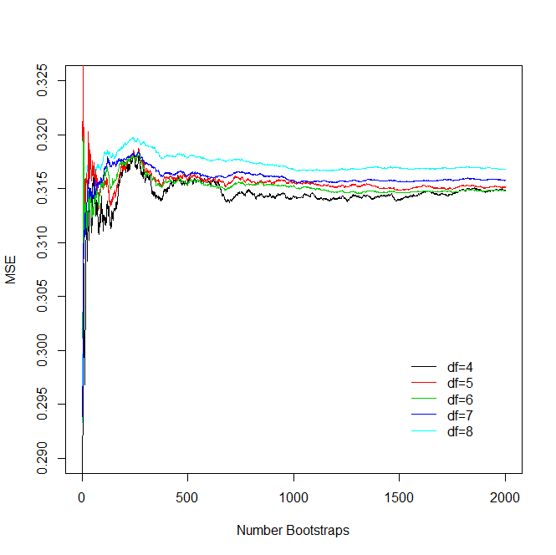

Slide 51
Using .632 Bootstrap to Tune Cubic Spline
### .632 Bootstrap Validation…
berrs<-vector("list", length=7)
berrs[[1]]<-berrs[[2]]<-berrs[[3]]<-berrs[[4]]<-berrs[[5]]<-berrs[[6]]<-berrs[[7]]<-sids<-iids<-
matrix(0, nrow=length(time), ncol=nboot)
trerrs<-berrs
set.seed(12345)
for(i in 1:nboot)
{ ibids<-sample(1:length(time), length(time), replace=T); uibids<-sort(unique(ibids))
nibids<-c(1:length(time))[-uibids]
sids[nibids,i]<-1; iids[uibids,i]<-1
trtemp<-temp[ibids]; tstemp<-temp[nibids]
trtime<-time[ibids]; tstime<-time[nibids]
for (j in 1:7) {
fit<-lm(trtemp ~ ns(trtime, df=(j+3)))
berrs[[j]][nibids,i]<-(tstemp-predict(fit, newdata=data.frame(trtime=tstime)))^2
trerrs[[j]][uibids,i]<-(trtemp[uibids]-predict(fit, newdata=data.frame(trtime=trtime[uibids])))^2
}
}
bs1<-function(x) {mbserr<-mean(colSums(x)/colSums(sids))}
bs2<-function(x) {mtrerr<-mean(colSums(x)/colSums(iids))}
round(.368*unlist(lapply(trerrs,bs2))+.632*unlist(lapply(berrs, bs1)), 4)
[1] 0.3084 0.3078 0.3075 0.3088 0.3084 0.3085 0.3089

Slide 52
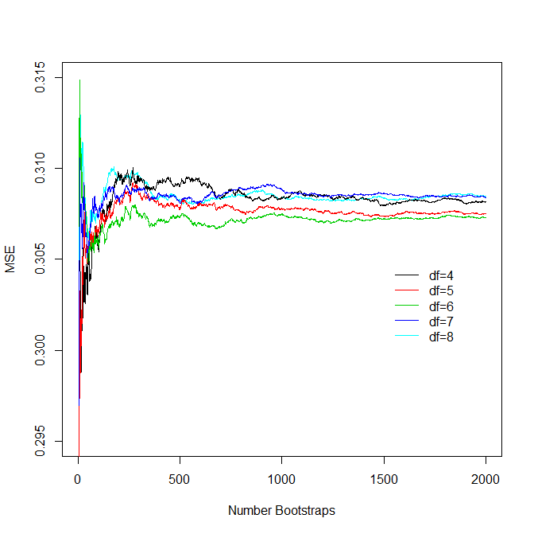

Slide 53
Comparison of Validation Results
DF = 4 DF = 5 DF = 6 DF = 7 DF = 8 DF = 9 DF = 10
10-Fold CV: [1] 0.3106 0.3120 0.3136 0.3124 0.3147 0.3126 0.3176
LOOCV: [1] 0.3095 0.3100 0.3108 0.3115 0.3123 0.3101 0.3116
Bootstrap (1000): [1] 0.3143 0.3154 0.3169 0.3185 0.3197 0.3192 0.3213
.632 Bootstrap (1000): [1] 0.3084 0.3078 0.3075 0.3088 0.3084 0.3085 0.3089

