Slide 1
Splines Part II: Cubic and Smoothing Splines
BMTRY 790
Summer 2020

Slide 2
Cubic Splines
Recall, we defined a cubic spline as follows
Given a < ξ₁ < ξ₂ < … < ξ_{K} < b, a function h is a cubic spline if
On each interval (a , ξ₁), (ξ₁, ξ₂), …, (ξ_{K}, b), h is a cubic polynomial
The polynomial pieces fit together at points ξ_{i} (knots) s.t. h itself and its first and second derivatives are continuous at each ξ_{i}, and hence on the whole [a,b]
Thus, we want the function y = f (x) that is:
a cubic polynomial between every pair of knots ξ_{i} , ξ_{i+1}
continuous at each knot.
has continuous first and second derivatives at each knot.

Slide 3
Cubic Splines
We can write f (x) in terms of K + 3 basis functions

Slide 4
Natural Cubic Splines
Polynomial fits tend to be erratic at the boundaries of x
This is even worse for cubic splines
Natural cubic splines ameliorate this problem by adding additional constraints
A cubic spline f is called a natural cubic spline if its 2nd and 3rd derivatives are 0 at a and b
Implies that f is linear on extreme intervals

Slide 5
Natural Cubic Splines
This additional constraint provides 4 additional degrees of freedom
Result is that cubic spline with K knots represented by K basis functions
Can be used for more knots if needed
Basis functions for a natural cubic spline start with what we already have from cubic splines

Slide 6
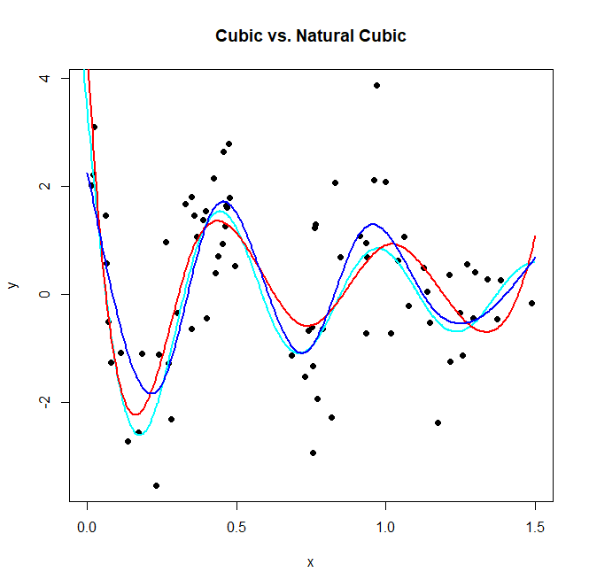

Slide 7
Fitting a Regression Spline
Recall the set of basis functions we described for the continuous piecewise model is an example of the truncated power basis
The truncated power basis is nice because:
Conceptual simplicity
Linear model is nested inside it, leading to simple tests of the null hypothesis of linearity
However, it has computational/numerical issues..
It is inefficient and can lead to overflow and nearly singular matrix problems
As a results, the fit for a cubic spline is generally fit using a B-spline basis
More complicated
Numerically more stable and efficient

Slide 8
Fitting a Regression Spline in R
Consider, the set of all cubic splines (with given knots) forms a vector space
B-spline basis functions form a basis for this vector space
i.e. we can write any spline uniquely as a linear combination of these basis functions.
When you write a spline curve as a linear combination of basis functions in this way, it's called a “B-spline"
R provides a function for fitting B-splines

Slide 9
Fitting a Regression Spline in R
R also provides a function to compute a basis for the natural cubic splines
works similarly to the B-spline approach for cubic splines
But there isn’t an option to change the degree
However the natural spline has m+ K - 4 degrees of freedom
Therefore a natural cubic spline with K knots has K degrees of freedom

Slide 10
Mean and Variance
Because the basis functions are fixed, all standard approaches to inference for regression are valid
So we let L = X(X’X)⁻¹X’ denote the projection matrix,
Furthermore, extensions to logistic regression, Cox proportional hazards regression, etc., are straightforward

Slide 11
Spline Parameters
We also have choices regarding degree of the spline and location and number of knots
Unless there is a reason to choose specific knot locations, the default is to use quantiles of the observed distribution of x
We can use an internal selection approach to select the number of knots
Cross-validation
K-fold
GCV
Bootstrap approach

Slide 12
Check for Non-Linearity
We also want to check whether or not use of a spline (i.e. non-linearity) is appropriate
Since the linear model is technically nested within the spline model, we can use an ANOVA approach

Slide 13
Thermoregulation During Surgery
Occurrence of hypothermia during surgery is associated with increased complication rate
Hypothermia defined as temperature < 36.0ºC
The goal of the study was to identify patient/hospital factors associated with hypothermia to identify potential interventions
Information collected in the study included
Patient characteristics (gender, age, BMI)
Procedural characteristics (surgery, anesthesia type, EBL, Total IV Fluids)
Hospital characteristics (mattress temperature, OR temperature, OR humidity)
Time in surgery

Slide 14
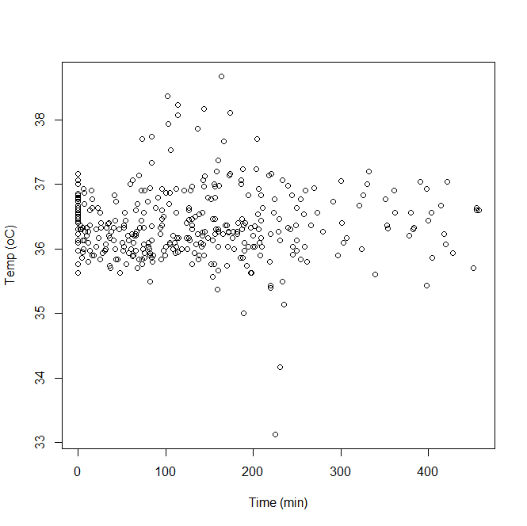

Slide 15
Fitting a Regression Spline in R
(If we want) we can develop a cubic spline model by hand based on transformations defined by the basis functions
What are the basis functions for a cubic spline with K = 3 knots?

Slide 16
R-Code to Hand Fit the Model
temp<-read.csv("H:\\public_html\\BMTRY790_Spring2023\\Datasets\\Thermoreg.csv")
temp<-temp$Temp
time<-temp$Time
qtime<-quantile(time)[2:4]
qtime
25% 50% 75%
52.00 116.50 193.75
It1<-ifelse(time>qtime[1], 1, 0); It2<-ifelse(time>qtime[2], 1, 0); It3<-ifelse(time>qtime[3], 1, 0)
csx<-cbind(temp, time, time^2,time^3,It1*(time-qtime[1])^3,It2*(time-qtime[2])^3,It3*(time-qtime[3])^3)
colnames(csx)<-c("temp","h1","h2","h3","h4","h5","h6")
csx<-as.data.frame(csx)
csx
temp h1 h2 h3 h4 h5 h6
1 37.00000 0 0 0 0 0 0
2 36.76667 0 0 0 0 0 0
3 36.46667 0 0 0 0 0 0
...
369 36.63333 455 207025 94196375 65450827 39304000 17881958.375
370 36.60000 455 207025 94196375 65450827 39304000 17881958.375
371 36.60000 458 209764 96071912 66923416 40353607 18504486.125

Slide 17
R-Code to Hand Fit the Model
lmfit1<-lm(temp ~ ., data=csx)
summary(lmfit1)
Call:
lm(formula = temp ~ ., data = csx)
Residuals:
Min 1Q Median 3Q Max
-3.11383 -0.34001 -0.04953 0.30128 2.24896
Coefficients:
Estimate Std. Error t value Pr(>|t|)
(Intercept) 3.649e+01 9.025e-02 404.304 < 2e-16 ***
h1 -1.839e-02 1.314e-02 -1.399 0.16263
h2 3.124e-04 3.885e-04 0.804 0.42182
h3 -1.350e-06 3.045e-06 -0.443 0.65780
h4 2.142e-07 3.657e-06 0.059 0.95333
h5 1.860e-06 9.323e-07 1.995 0.04680 *
h6 -8.711e-07 3.248e-07 -2.682 0.00765 **
---
Residual standard error: 0.5516 on 363 degrees of freedom; Multiple R-squared: 0.03978, Adjusted R-squared: 0.0239
F-statistic: 2.506 on 6 and 363 DF, p-value: 0.02175

Slide 18
What Does the Model Look Like?
Our model:
And predictions at 30, 90, 150, or 210 minutes?

Slide 19
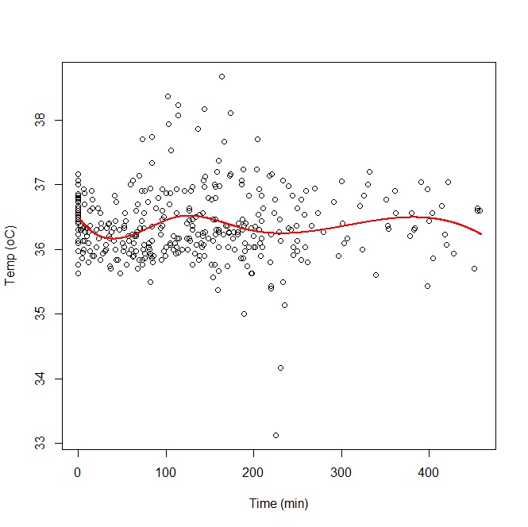

Slide 20
Fitting a Regression Spline in R
We can fit by hand, but R has several package/functions that can fit splines
splines package (installed with base package but must be loaded)
bs() fits B-splines
ns() fits natural cubic splines (again using B-spline approach)
By default, bs uses degree=3, knots at evenly spaced quantiles
Does not return a column for the intercept
rms package:
rcs() fits natural cubic splines

Slide 21
Fitting Cubic Spline Using bs()
bsfit1<-bs(time, df=6)
round(bsfit1, 4)
1 2 3 4 5 6
[1,] 0.0000 0.0000 0.0000 0.0000 0.0000 0.0000
[2,] 0.0000 0.0000 0.0000 0.0000 0.0000 0.0000
[3,] 0.0000 0.0000 0.0000 0.0000 0.0000 0.0000
…
[368,] 0.0000 0.0000 0.0000 0.0003 0.0333 0.9664
[369,] 0.0000 0.0000 0.0000 0.0003 0.0333 0.9664
[370,] 0.0000 0.0000 0.0000 0.0000 0.0000 1.0000
attr(,"degree")
[1] 3
attr(,"knots")
25% 50% 75%
52.00 116.50 193.75
attr(,"Boundary.knots")
[1] 0 458
attr(,"intercept")
[1] FALSE
attr(,"class")
[1] "bs" "basis" "matrix"

Slide 22
Fitting Cubic Spline Using bs()
### To actually fit a model of temperature over time…
lmfit2<-lm(temp ~ bs(time, df=6))
summary(lmfit2)
Call: lm(formula = temp ~ bs(time, df = 6))
Residuals:
Min 1Q Median 3Q Max
-3.11285 -0.33950 -0.05206 0.30212 2.24753
Coefficients:
Estimate Std. Error t value Pr(>|t|)
(Intercept) 36.48654 0.09025 404.304 < 2e-16 ***
bs(time, df = 6)1 -0.31868 0.22777 -1.399 0.16263
bs(time, df = 6)2 -0.40185 0.16942 -2.372 0.01822 *
bs(time, df = 6)3 0.22579 0.15958 1.415 0.15797
bs(time, df = 6)4 -0.72189 0.24724 -2.920 0.00372 **
bs(time, df = 6)5 0.42008 0.35543 1.182 0.23803
bs(time, df = 6)6 -0.24603 0.26312 -0.935 0.35039
---
Signif. codes: 0 ‘***’ 0.001 ‘**’ 0.01 ‘*’ 0.05 ‘.’ 0.1 ‘ ’ 1
Residual standard error: 0.5516 on 363 degrees of freedom; Multiple R-squared: 0.03978, Adjusted R-squared: 0.0239
F-statistic: 2.506 on 6 and 363 DF, p-value: 0.02175

Slide 23
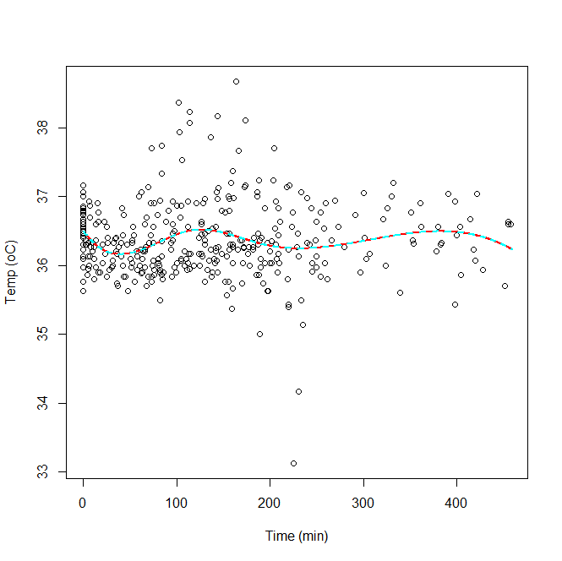

Slide 24
Fitting Natural Cubic Spline Using ns()
nsfit1<-ns(time, df=6)
round(nsfit1, 4)
1 2 3 4 5 6
[1,] 0.0000 0.0000 0.0000 0.0000 0.0000 0.0000
[2,] 0.0000 0.0000 0.0000 0.0000 0.0000 0.0000
[3,] 0.0000 0.0000 0.0000 0.0000 0.0000 0.0000
…
[368,] 0.0000 0.0000 0.0000 -0.1453 0.3721 0.7732
[369,] 0.0000 0.0000 0.0000 -0.1453 0.3721 0.7732
[370,] 0.0000 0.0000 0.0000 -0.1631 0.3736 0.7896
attr(,"degree")
[1] 3
attr(,"knots")
16.66667% 33.33333% 50% 66.66667% 83.33333%
24.33333 73.00000 115.00000 163.00000 229.33333
attr(,"Boundary.knots")
[1] 0 458
attr(,"intercept")
[1] FALSE
attr(,"class")
[1] "ns" "basis" "matrix"

Slide 25
Fitting Natural Cubic Spline Using ns()
### To actually fit a model of temperature over time…
lmfit3<-lm(temp ~ ns(time, df=6))
summary(lmfit3)
Call: lm(formula = temp ~ ns(time, df = 6))
Residuals:
Min 1Q Median 3Q Max
-3.1635 -0.3443 -0.0540 0.2772 2.2783
Coefficients:
Estimate Std. Error t value Pr(>|t|)
(Intercept) 36.47394 0.08564 425.903 <2e-16 ***
ns(time, df = 6)1 -0.23605 0.16451 -1.435 0.152
ns(time, df = 6)2 0.15829 0.17293 0.915 0.361
ns(time, df = 6)3 -0.15983 0.14387 -1.111 0.267
ns(time, df = 6)4 -0.06279 0.19805 -0.317 0.751
ns(time, df = 6)5 -0.41944 0.26097 -1.607 0.109
ns(time, df = 6)6 0.20319 0.20010 1.015 0.311
---
Signif. codes: 0 ‘***’ 0.001 ‘**’ 0.01 ‘*’ 0.05 ‘.’ 0.1 ‘ ’ 1
Residual standard error: 0.5534 on 363 degrees of freedom; Multiple R-squared: 0.0335, Adjusted R-squared: 0.01752
F-statistic: 2.097 on 6 and 363 DF, p-value: 0.05293

Slide 26
Fitting Natural Cubic Spline Using ns()
### To actually fit a model of temperature over time…
lmfit3<-lm(temp ~ ns(time, df=6))
summary(lmfit3)
Call: lm(formula = temp ~ ns(time, df = 6))
Residuals:
Min 1Q Median 3Q Max
-3.1635 -0.3443 -0.0540 0.2772 2.2783
Coefficients:
Estimate Std. Error t value Pr(>|t|)
(Intercept) 36.47394 0.08564 425.903 <2e-16 ***
ns(time, df = 6)1 -0.23605 0.16451 -1.435 0.152
ns(time, df = 6)2 0.15829 0.17293 0.915 0.361
ns(time, df = 6)3 -0.15983 0.14387 -1.111 0.267
ns(time, df = 6)4 -0.06279 0.19805 -0.317 0.751
ns(time, df = 6)5 -0.41944 0.26097 -1.607 0.109
ns(time, df = 6)6 0.20319 0.20010 1.015 0.311
---
Signif. codes: 0 ‘***’ 0.001 ‘**’ 0.01 ‘*’ 0.05 ‘.’ 0.1 ‘ ’ 1
Residual standard error: 0.5534 on 363 degrees of freedom; Multiple R-squared: 0.0335, Adjusted R-squared: 0.01752
F-statistic: 2.097 on 6 and 363 DF, p-value: 0.05293

Slide 27
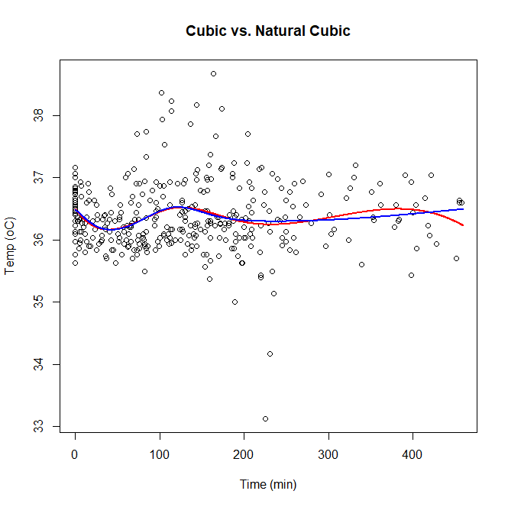

Slide 28
Using CV to Find Best DF…
### K fold cross-validation…
set.seed(12345)
Kfoldcv<-function(y, x, K, k)
{
n<-length(y)
cv.ids<-sample(1:n, n, replace=F)
y2<-y[cv.ids]; x2<-x[cv.ids]
vecmat<-matrix(1:n, nrow=n/K, ncol=K, byrow=F)
cv.err<-matrix(nrow=K, ncol=k)
for(i in 1:K)
{
ids<-vecmat[,i]
try<-y2[-ids]; tsy<-y2[ids]
trx<-x2[-ids]; tsx<-x2[ids]
for (j in 1:k)
{
fit<-lm(try ~ ns(trx, df=(j+3)))
cv.err[i,j]<-mean((y2[ids]-predict(fit, newdata=data.frame(trx=tsx)))^2)
}
}
return(colMeans(cv.err))
}
Kfoldcv(y=temp, x=time, K=10, k=7)
[1] 0.3091958 0.3111311 0.3111485 0.3114347 0.3103196 0.3097953 0.3113089
Notes:
-Up to this point we’ve arbitrarily set the number of knots to be 3 (At least for the b-splines)
-Ideally we evaluate how many knots is appropriate
-As we’ve done with other models that required tuning, we can employ K-fold cross-validation to find the appropriate number of knots
-However, the is not a built in function in w=either the splines or rcs packages that can do this
-Still, it ie relatively easy to write a CV function (or just a for loop) to compare performance for different numbers of knots
-Walk through the code

Slide 29
Using CV to Find Best DF…
### Leave one out cross-validation…
set.seed(12345)
LOOcv<-function(y, x, k)
{
n<-length(y)
cv.err<-matrix(nrow=n, ncol=k)
for(i in 1:n)
{
try<-y2[-i]; tsy<-y2[i]
trx<-x2[-i]; tsx<-x2[i]
for (j in 1:k)
{
fit<-lm(try ~ ns(trx, df=(j+3)))
cv.err[i,j]<-(y2[i]-predict(fit, newdata=data.frame(trx=tsx)))^2
}
}
return(colMeans(cv.err))
}
LOOcv(y=temp, x=time, k=7)
[1] 0.3094580 0.3099629 0.3107523 0.3114506 0.3122655 0.3101377 0.3116486
Notes:
-Ask the why we don’t consider mean in the middle for loop

Slide 30
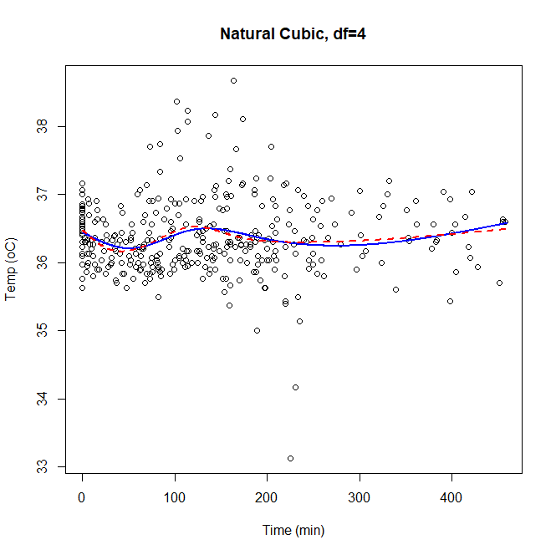

Slide 31
Checking Non-Linearity Assumptions
### Also want to evaluate need for non-linear approach for modeling temperature over time…
lmfit3<-lm(temp ~ ns(time, df=4))
lmfitlin<-lm(temp ~ time)
anova(lmfitlin, lmfit3)
Analysis of Variance Table
Model 1: temp ~ time
Model 2: temp ~ ns(time, df = 4)
Res.Df RSS Df Sum of Sq F Pr(>F)
1 368 115.01
2 365 111.73 3 3.2792 3.5708 0.01428 *
---
Signif. codes: 0 ‘***’ 0.001 ‘**’ 0.01 ‘*’ 0.05 ‘.’ 0.1 ‘ ’ 1

Slide 32
Fitting Cubic Spline Using rcs()
nsfit2<-rcs(time, df=5)
round(nsfit2, 4)
time time' time'' time''‘
[1,] 0.0000 0.0000 0.0000 0.0000
[2,] 0.0000 0.0000 0.0000 0.0000
[3,] 0.0000 0.0000 0.0000 0.0000
…
[368,] 455 361.1749 323.3341 123.7762
[369,] 455 361.1749 323.3341 123.7762
[370,] 458 365.1780 326.9671 125.3089
attr(,"class")
[1] "rms"
attr(,"name")
[1] "time"
attr(,"label")
[1] "time"
attr(,"assume")
[1] "rcspline"
attr(,"assume.code")
[1] 4
attr(,"parms")
[1] 2.0 13.0 87.2 170.4 380.6
attr(,"nonlinear")
[1] FALSE TRUE TRUE TRUE
attr(,"colnames")
[1] "time" "time'" "time''" "time'''"

Slide 33
Fitting Cubic Spline Using rcs()
### RCS model of temperature over time…
lmfit4<-ols(temp~rcs(time,5))
lmfit4
Linear Regression Model
ols(formula = temp ~ rcs(time, 5))
Model Likelihood Discrimination
Ratio Test Indexes
Obs 370 LR chi2 12.32 R2 0.033
sigma 0.5521 d.f. 4 R2 adj 0.022
d.f. 365 Pr(> chi2) 0.0151 g 0.114
Residuals
Min 1Q Median 3Q Max
-3.1656 -0.3317 -0.0538 0.2846 2.2698
Coef S.E. t Pr(>|t|)
Intercept 36.4941 0.0838 435.30 <0.0001
time -0.0173 0.0053 -3.28 0.0011
time' 1.5600 0.4474 3.49 0.0005
time'' -1.8612 0.5330 -3.49 0.0005
time''' 0.3735 0.1075 3.47 0.0006

Slide 34
Checking Non-Linearity Assumptions
### Checking non-linear assumptions
lmfit4<-ols(temp~rcs(time,5))
anova(lmfit3, ss=FALSE)
Analysis of Variance Response: temp
Factor F d.f. P
time 3.09 4 0.0160
Nonlinear 4.08 3 0.0072
TOTAL 3.09 4 0.0160
Error d.f.: 365

Slide 35
Smoothing Splines
Fixed df splines are useful but they are not truly nonparametric.
The choice regarding number of knots and where they are located are essentially parametric and impact the fit.
Additionally, if knots are placed at the quantiles of x, models are not truly nested (when comparing different numbers of knots) which complicates hypothesis testing

Slide 36
Smoothing Splines
Avoids the knot selection completely by using a maximal set of knots
The complexity of the fit is controlled by regularization
Setup: among all functions f (x) with two continuous derivatives, find one that minimizes the penalized residual sum of squares
λ = smoothing parameter
The second term penalizes curvature in the function

Slide 37
Smoothing Splines
The solution is a natural cubic spline with knots at the unique values of the x_{i}, i = 1,..., N
The penalty term translates to a penalty on the spline coefficients that shrinks towards the linear fit

Slide 38
Smoother Matrix
The predicted outcome y on our set of cubic basis splines determined from the expression
Here S_{λ} is called the smoother matrix and we can see that y is linear in S_{λ}, where S_{λ} only depends x_{i} and λ.
The effective degrees of freedom for S_{λ} are

Slide 39
Penalty Parameter
Recall λ is called the smoothing parameter (like ridge regression)
So the choice of λ controls the smoothness of our spline model
We can choose λ using something like a cross validation approach
Based on choiced of λ
Or based on df (1 < df < n)

Slide 40
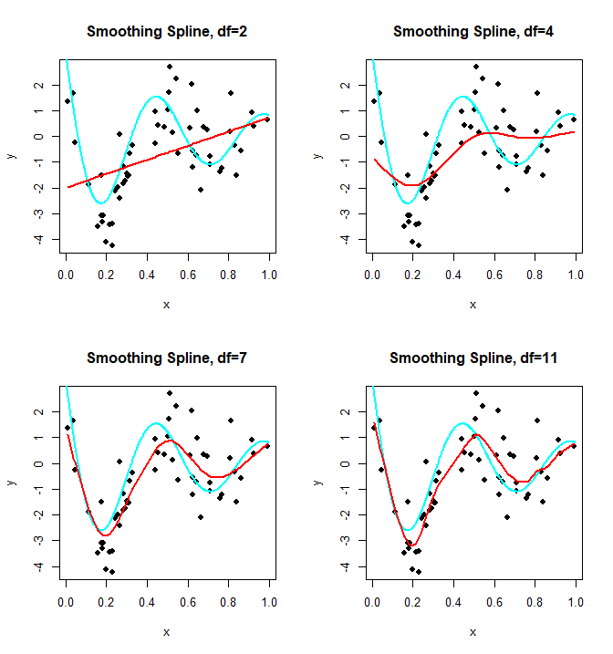

Slide 41
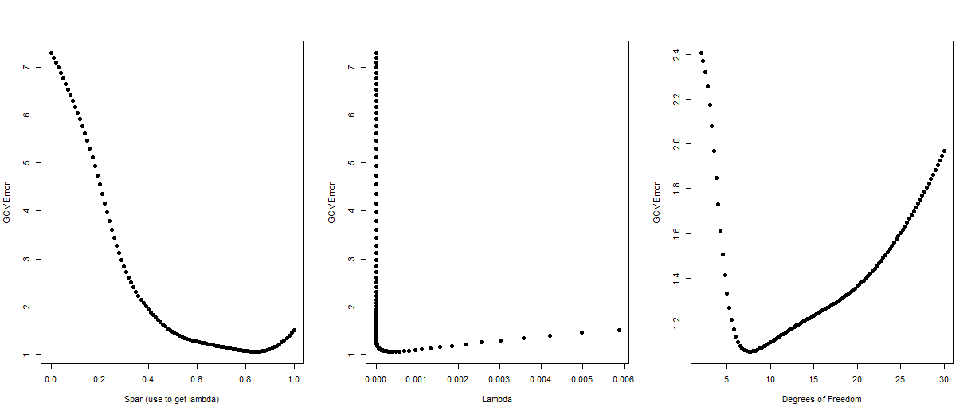
λ = r*256^{3s-1}, s = spar, r = trace (X’WX)/trace(Σ)

Slide 42
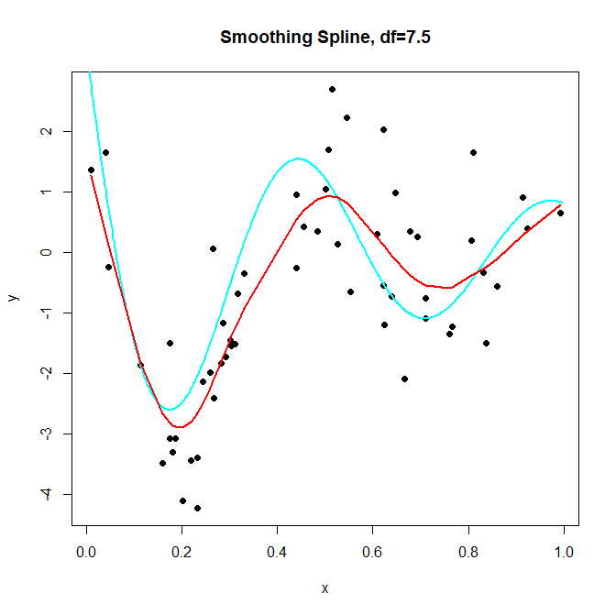

Slide 43
Fitting Temperature Data With Smoothing Spline
### First consider appropriate choice of lambda using cross-validation
df<-seq(1.5, 30, by=0.25); spar<-seq(0, 1, length.out=length(df))
cv.df<-c(); cv.spar<-c()
for (i in 1:length(df))
{
cv.df<-append(cv.df, smooth.spline(time, temp, df=df[i])$cv.crit)
cv.spar<-append(cv.spar, smooth.spline(time, temp, spar=spar[i])$cv.crit)
}
round(cv.df, 3)
[1] 0.314 0.314 0.314 0.315 0.315 0.315 0.315 0.315 0.315 0.315 0.314 0.314 …
[109] 0.327 0.327 0.327 0.328 0.328 0.328 0.328
round(cv.spar, 3)
[1] 0.363 0.363 0.362 0.361 0.361 0.360 0.359 0.358 0.358 0.357 0.356 0.355…
[109] 0.310 0.310 0.310 0.311 0.311 0.311 0.311
which(cv.df==min(cv.df))
[1] 24
which(cv.spar==min(cv.spar))
[1] 106

Slide 44
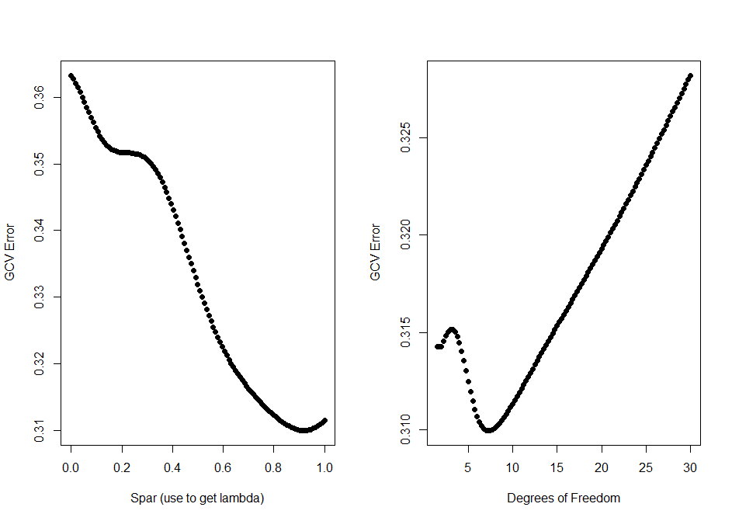

Slide 45
Fitting Temperature Data With Smoothing Spline
### Model based on “best” df
bdf<-df[which(cv.df==min(cv.df))]
smspfit1<-smooth.spline(time, temp, df=bdf)
smspfit1
Call:
smooth.spline(x = time, y = temp, df = bdf)
Smoothing Parameter spar= 0.9200563 lambda= 0.003109123 (12 iterations)
Equivalent Degrees of Freedom (Df): 7.24909
Penalized Criterion: 69.75926
GCV: 0.3099457
### Model based on “best” spar (again used to calculate lambda)
bspar<-spar[which(cv.spar==min(cv.spar))]
smspfit2<-smooth.spline(time, temp, spar=bspar)
smspfit2
Call:
smooth.spline(x = time, y = temp, spar = bspar)
Smoothing Parameter spar= 0.9210526 lambda= 0.003159333
Equivalent Degrees of Freedom (Df): 7.224468
Penalized Criterion: 69.77451
GCV: 0.3099465

Slide 46
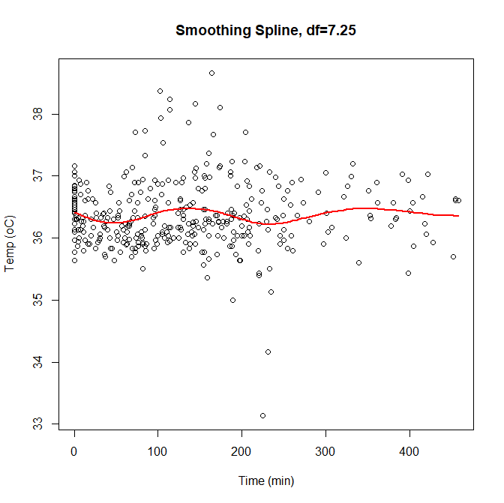

Slide 47
Fitting Temperature Data With Smoothing Spline
### Model based on “best” df
names(smspfit1)
[1] "x" "y" "w" "yin" "data" "lev"
[7] "cv.crit" "pen.crit" "crit" "df" "spar" "lambda"
[13] "iparms" "fit" "call“
smspfit1$w
[1] 31 2 1 1 3 2 3 1 2 3 3 1 3 1 2 1 1 2 2 1 1 2 1 1 2
[26] 2 1 1 2 1 3 2 1 1 1 1 1 4 1 1 1 1 2 1 1 1 2 2 2 4
[51] 1 2 2 1 2 3 2 3 3 1 2 1 6 6 2 1 1 1 2 1 4 2 2 2 1
[76] 1 1 3 1 2 1 1 3 1 3 1 1 1 2 1 4 1 1 5 1 1 1 2 1 2
[101] 1 1 4 2 3 2 2 2 5 2 4 1 1 1 5 1 1 1 1 1 2 1 2 1 2
[126] 1 1 1 2 1 1 2 2 2 2 2 1 1 2 2 1 2 2 1 1 1 2 1 1 3
[151] 1 1 1 1 3 1 1 1 1 1 1 2 2 1 2 1 1 2 1 3 2 1 1 1 1
[176] 1 1 1 1 1 1 1 1 1 1 1 1 1 1 1 1 1 1 1 1 1 1 1 1 1
[201] 1 2 1 1 1 1 1 1 1 1 1 2 1
smspfit1$lambda
[1] 0.003109123

Slide 48
Fitting Temperature Data With Smoothing Spline
### Model based on “best” df
smspfit1$fit
$knot
[1] 0.000000000 0.000000000 0.000000000 0.000000000 0.006550218 0.010917031
[7] 0.015283843 0.021834061 0.028384279 0.034934498 0.043668122 0.054585153
…
[91] 0.707423581 0.720524017 0.740174672 0.770742358 0.788209607 0.829694323
[97] 0.838427948 0.868995633 0.882096070 0.906113537 0.917030568 0.934497817
[103] 1.000000000 1.000000000 1.000000000 1.000000000
$nk
[1] 102
$min
[1] 0
$range
[1] 458

Slide 49
Fitting Temperature Data With Smoothing Spline
### Model based on “best” df
smspfit1$fit
....
$coef
[1] 36.41848 36.41223 36.40181 36.38740 36.37322 36.35742 36.34039 36.32245
[9] 36.30247 36.28491 36.27114 36.26144 36.25429 36.24913 36.24489 36.24087
…
[89] 36.45447 36.46868 36.47576 36.47654 36.46941 36.45671 36.43904 36.42634
[97] 36.41047 36.40015 36.38972 36.37216 36.36144 36.35366
attr(,"class")
[1] "smooth.spline.fit"

Slide 50
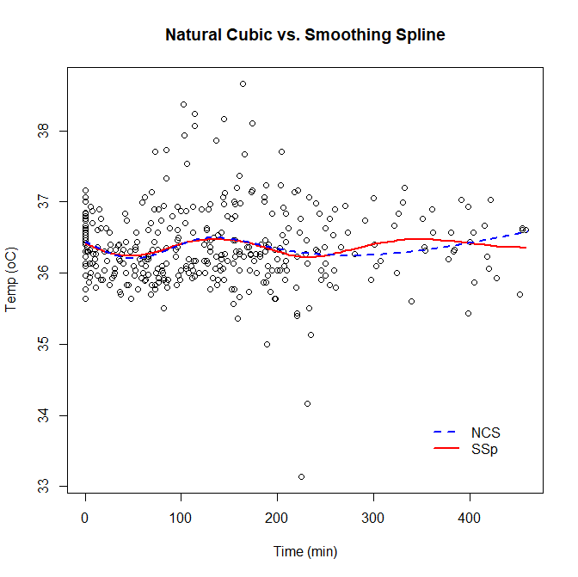

Slide 51
Checking Non-Linearity Assumptions
In the case of cubic splines, we had a way to compare back to the OLS fit to determine if non-linearity made sense
Linear effect included in a spline model
So treat models as “nested” and use an ANOVA approach
Use of smoothing spline results in a non-nested model so what can we do?
We can compare cross-validation error to see if model fits better using spline approach

Slide 52
Checking Non-Linearity Assumptions
### Checking non-linear assumptions
smspfit1<-smooth.spline(time, temp, df=bdf)
smspfit1$cv.crit
[1] 0.3099457
cv.errols<-c()
for(i in 1:length(time)){
trtemp<-temp[-i]; tstemp<-temp[i]
trtime<-time[-i]; tstime<-time[i]
fit<-lm(trtemp ~ trtime)
cv.errols<-append(cv.errols, (tstemp-predict(fit, newdata=data.frame(trtime=tstime)))^2)
}
mean(cv.errols)
[1] 0.3137011

Slide 53
Multidimensional Splines
We’ve focused on splines for a single feature x with one outcome y
Consider the case of 2 variables x₁ and x₂, this means we have
Basis of functions h_{1k}(X₁), k = 1, ..., M₁ for x₁
Basis of functions h_{2k}(X₂), k = 1, ..., M₁ for x₂
Potentially yields the M₁ x M₂ dimensional tensor product basis defined by
which can be used to represent a 2-D function
The coefficients can be fit by least squares, as before, but the dimension of the basis grows exponentially fast.

Slide 54
Multidimensional Splines in R
We can fit these in R via several packages
rms package:
We’ve already seen the rcs() fits natural cubic splines
mgcv package:
gam() fits generalized additive models (more on these later)

Slide 55
Example Using the Temperature Data
### Multidimensional Splines
### First just consider case where have sets of basis functions for two variables
library(rms)
ddist <- datadist(temperature) ### determines summaries of variables for effect and plotting ranges
options("datadist" = "ddist")
lmfit5<-ols(Temp~rcs(Time,3)+rcs(ORhumidity, 3), data=temperature)

Slide 56
Example Using the Temperature Data
### Multidimensional Splines
lmfit5<-ols(Temp ~ rcs(Time,3) + rcs(ORhumidity, 3), data=temperature)
ols(formula = Temp ~ rcs(Time, 5) + rcs(ORhumidity, 5), data = temperature)
Model Likelihood Discrimination
Ratio Test Indexes
Obs 370 LR chi2 28.39 R2 0.074
sigma 0.5433 d.f. 8 R2 adj 0.053
d.f. 361 Pr(> chi2) 0.0004 g 0.170
Residuals
Min 1Q Median 3Q Max
-2.92865 -0.33447 -0.06397 0.28986 2.16150
Coef S.E. t Pr(>|t|)
Intercept 35.3833 0.5680 62.30 <0.0001
Time -0.0168 0.0052 -3.22 0.0014
Time' 1.5384 0.4427 3.47 0.0006
Time'' -1.8356 0.5275 -3.48 0.0006
Time''' 0.3681 0.1066 3.45 0.0006
ORhumidity 0.0378 0.0201 1.88 0.0612
ORhumidity' -0.0416 0.0364 -1.14 0.2547
ORhumidity'' 0.6326 1.3537 0.47 0.6406
ORhumidity''' -1.8953 2.9602 -0.64 0.5224

Slide 57
Example Using the Temperature Data
### To avoid overfitting we will try to select models based upon the AIC/BIC criteria.
### Find lowest value (AIC allows slightly more complex models compared to BIC)
getInfCrit <- function(no, fit, rm_var, add_var_str, ic_fn)
{
new_var <- sprintf(add_var_str, no)
updt_frml <- as.formula(sprintf(".~.-%s+%s", rm_var, new_var))
ret <- ic_fn(update(fit, updt_frml))
names(ret) <- new_var
return(ret)
}
### select best df for model with just Time using AIC. Note we need to initiate model first
fit1 <- ols(Temp~rcs(Time,3), data=temperature)
sapply(3:9, getInfCrit, fit = fit1, rm_var = "rcs(Time, 3)", add_var_str = "rcs(Time, %d)", ic_fn=AIC)
rcs(Time, 3) rcs(Time, 4) rcs(Time, 5) rcs(Time, 6) rcs(Time, 7) rcs(Time, 8) rcs(Time, 9)
625.6624 626.7314 617.4593 619.1843 621.0223 622.9778 623.7240

Slide 58
Example Using the Temperature Data
### Next, select best df for model with ORhumdity using Time variable we just selected…
fit2 <- ols(Temp~rcs(Time,5) + rcs(ORhumidity, 3), data=temperature)
sapply(3:9, getInfCrit, fit = fit2, rm_var = "rcs(ORhumidity, 3)", add_var_str = "rcs(ORhumidity, %d)", ic_fn=AIC)
rcs(ORhumidity, 3) rcs(ORhumidity, 4) rcs(ORhumidity, 5) rcs(ORhumidity, 6) rcs(ORhumidity, 7)
606.2494 607.9073 609.3874 611.2097 612.5762
rcs(ORhumidity, 8) rcs(ORhumidity, 9)
613.8118 613.1099

Slide 59
Example Using the Temperature Data
### Now let’s look at our selected model…
fit3 <- ols(Temp~rcs(Time,5) + rcs(ORhumidity, 3), data=temperature)
fit3
ols(formula = Temp ~ rcs(Time, 5) + rcs(ORhumidity, 3), data = temperature)
Model Likelihood Discrimination
Ratio Test Indexes
Obs 370 LR chi2 27.53 R2 0.072
sigma 0.5424 d.f. 6 R2 adj 0.056
d.f. 363 Pr(> chi2) 0.0001 g 0.170
Residuals
Min 1Q Median 3Q Max
-2.97227 -0.32391 -0.07125 0.27435 2.14265
Coef S.E. t Pr(>|t|)
Intercept 35.7547 0.3126 114.40 <0.0001
Time -0.0165 0.0052 -3.17 0.0017
Time' 1.4955 0.4399 3.40 0.0007
Time'' -1.7834 0.5240 -3.40 0.0007
Time''' 0.3558 0.1057 3.36 0.0008
ORhumidity 0.0229 0.0087 2.64 0.0087
ORhumidity' -0.0579 0.0149 -3.89 0.0001

Slide 60
Checking
anova(fit3, ss=F)
Analysis of Variance Response: Temp
Factor F d.f. P
Time 3.11 4 0.0155
Nonlinear 3.88 3 0.0094
ORhumidity 7.62 2 0.0006
Nonlinear 15.12 1 0.0001
TOTAL NONLINEAR 6.94 4 <.0001
TOTAL 4.67 6 0.0001
Error d.f.: 363

Slide 61
Adding Tensor Products…
### ADDING "Restricted" Interaction between basis functions for Time and OR humidity
fit4<- ols(Temp~rcs(Time,5) + rcs(ORhumidity, 3) + rcs(Time,5)%ia%rcs(ORhumidity, 3), data=temperature)
ols(formula = Temp ~ rcs(Time, 5) + rcs(ORhumidity, 3) + rcs(Time, 5) %ia% rcs(ORhumidity, 3), data = temperature)
Model Likelihood Discrimination
Ratio Test Indexes
Obs 370 LR chi2 39.01 R2 0.100
sigma0.5378 d.f. 11 R2 adj 0.072
d.f. 358 Pr(> chi2) 0.0001 g 0.200
Coef S.E. t Pr(>|t|)
Intercept 36.6668 0.7482 49.01 <0.0001
Time 0.0050 0.0427 0.12 0.9072
Time' -2.0595 3.5981 -0.57 0.5674
Time'' 2.5687 4.2882 0.60 0.5495
Time''' -0.8482 0.8801 -0.96 0.3358
ORhumidity -0.0052 0.0206 -0.25 0.8001
ORhumidity' 0.0041 0.0274 0.15 0.8801
Time * ORhumidity -0.0005 0.0011 -0.44 0.6567
Time * ORhumidity' -0.0006 0.0002 -2.94 0.0035
Time' * ORhumidity 0.0895 0.0939 0.95 0.3410
Time'' * ORhumidity -0.1094 0.1118 -0.98 0.3284
Time''' * ORhumidity 0.0299 0.0228 1.31 0.1902

Slide 62
Checking
anova(fit4, ss=F)
Analysis of Variance Response: Temp
Factor F d.f. P
Time (Factor+Higher Order Factors) 2.66 9 0.0054
All Interactions 2.26 5 0.0483
Nonlinear (Factor+Higher Order Factors) 3.13 6 0.0053
ORhumidity (Factor+Higher Order Factors) 3.83 7 0.0005
All Interactions 2.26 5 0.0483
Nonlinear (Factor+Higher Order Factors) 12.79 2 <.0001
Time * ORhumidity (Factor+Higher Order Factors) 2.26 5 0.0483
Nonlinear 2.58 4 0.0373
Nonlinear Interaction : f(A,B) vs. AB 2.58 4 0.0373
Nonlinear Interaction in Time vs. Af(B) 2.30 3 0.0768
Nonlinear Interaction in ORhumidity vs. Bg(A) 8.63 1 0.0035
TOTAL NONLINEAR 4.92 8 <.0001
TOTAL NONLINEAR + INTERACTION 4.39 9 <.0001
TOTAL 3.62 11 0.0001
Error d.f.: 358

Slide 63
Extensions To Splines
Alternative link functions
Spline models can be fit to data with non-continuous outcomes
Book briefly discusses logistic regression using splines
“Variable” Selection Approaches
In case of multidimensional splines, we can see the number of basis functions can get very large
Multivariate Adaptive Regression Splines (MARS) offers a means of conducting variable selection while fitting spline
Clustered outcomes data
We often have more than one observation per experimental unit
Mixed modeling allows us to model within subject correlation
Spline models have been adapted to for this as well

Slide 64
Our Thermoregulation Example
In the previous spline models we considered for these data, we treated observations as independent
However, these data represent temperature data collected on individuals throughout their procedure
Measurements taken in the same patient are likely correlated
Model should account for this within subject correlation
Actual analysis used spline modeling that accounted for these repeated measures over time
Modeled patient temperature profiles over time
Clustered patients by their profiles
Identified factors associated with “cold” patients

Slide 65
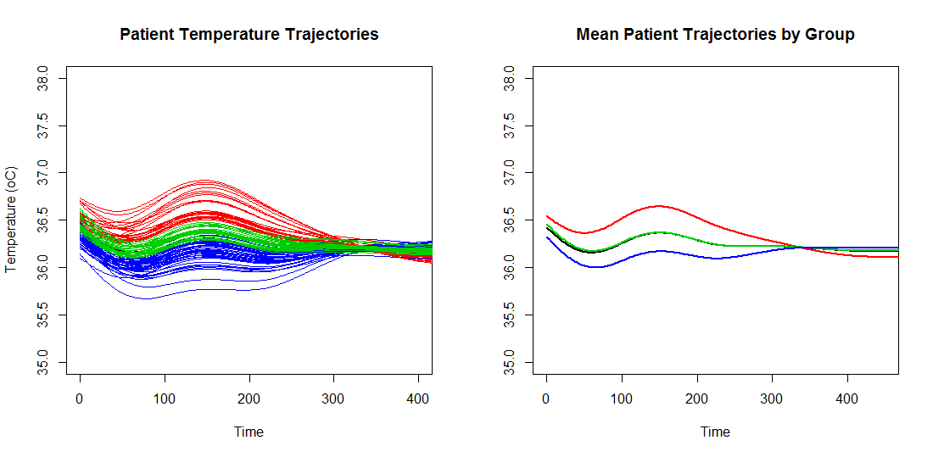

Slide 66
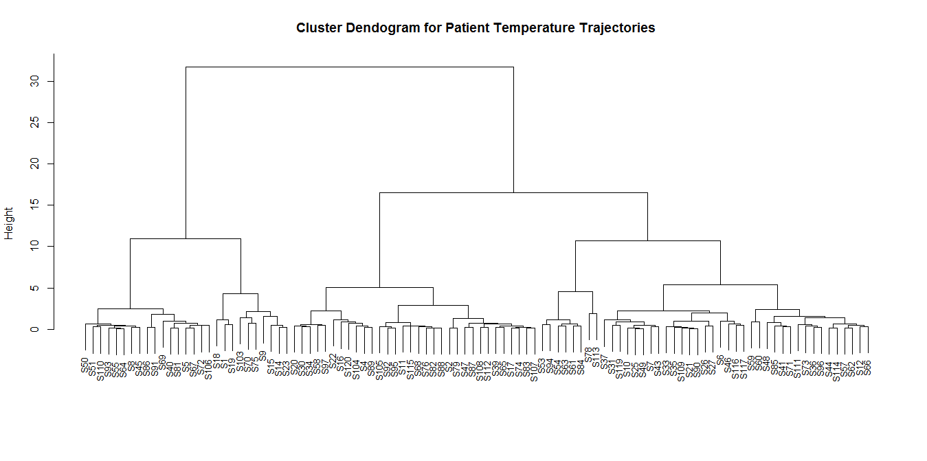

Slide 67
Our Thermoregulation Example
Patient and procedural/hospital factors associated with being consistently colder
Female Gender
Temperature upon arrival to the hospital
Mattress temperature
OR humidity
Procedure type (total knee vs. total hip)
Possible intervention strategies
Provide a thermal blanket in holding to warm the patient
Mattress warmers

