Slide 1
Piecewise Polynomials and Splines
BMTRY 790

Slide 2
Linear Methods
We have been focusing on the idea of using linear combinations of input features in X to make some determination about an outcome y
Linear regression
Logistic regression
LDA
In general, it seems unlikely that the relationship between our outcome of interest is always linear in our X’s
So how might we relax this assumption?

Slide 3
Motivation
Why consider alternatives to a “standard” linear model in any kind of regression modeling?
Though we often treat relationships as linear, this is not generally reality
Convenient and easy to interpret
May be a reasonable under constraints
Sometimes necessary
Large p, small N (avoid overfitting)
Sometimes however, it makes sense to move beyond linearity

Slide 4
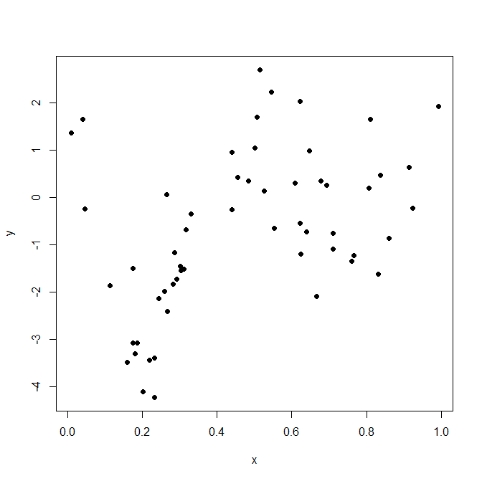
Motivation

Slide 5
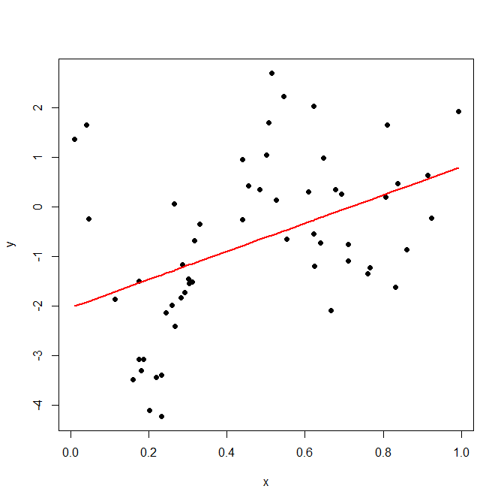
Motivation

Slide 6
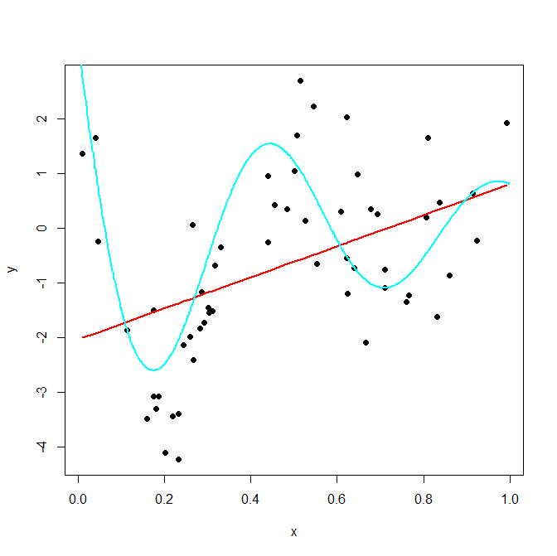
Motivation

Slide 7
Example: Polynomial Model
Consider first a simple linear regression model y = xβ + ε
General model for fitting a relationship that is linear
If we observe however that y is not linear in x, we are already familiar with the use of polynomials to “relax” the linearity assumption
Polynomial regression model:

Slide 8
Polynomial Models in One Variable
Basic principal
A second order model (quadratic model)
A k^{th} order polynomial model in one variable

Slide 9
Polynomial Models
Useful in situations where the analyst knows that curvilinear effects are present in the true response function.
Also useful as approximating functions to unknown and possible very complex nonlinear relationship.
BUT, polynomials are not the only possibility
what alternatives might we consider to relax linearity

Slide 10
Basis
In linear algebra, basis Β is set of vectors in a space V for which
The vectors in Β are linearly independent
Every other vector in the V is a linear combination of the set Β
No element of the set can be represented as a linear combination of the others.
In a function space, a basis is degenerated to a set of basis functions
Each function in the function space can be represented as a linear combination of the basis functions.

Slide 11
Basis Expansion
Polynomials are part of larger class of linear models referred to as linear basis expansions
Basic idea: augment or replace the original features in X with a transformed version of X
E.g. quadratic model with a single x, the basis expansion includes:
We can then fit a linear model on this augmented set of features yielding a familiar form….

Slide 12
Linear Basis Expansion
Some widely used basis expansions:
h_{m}(x) = x_{m}, m = 1, . . . , p → the original linear model
h_{m}(x) = x_{j}², h_{m}(x) = x_{j}x_{k} or higher order polynomials → augment the inputs with polynomial terms
Note the number of variables grows exponentially in the degree of the polynomial: O(p^{d}) for a degree-d polynomial
h_{m}(x) = log(X_{j}), ... → other nonlinear transformations
h_{m}(x) = I(L_{m} ≤ x_{k} < U_{m}), breaking the range of x_{k} up into non-overlapping regions → piecewise constant

Slide 13
Linear Basis Expansion
Linear Regression
Question: How do you find ?
x₁ | x₂ | x₃ | y
1 | -3 | 6 | 12
… | … | … | …

Slide 14
Linear Basis Expansion
Non-linear Model
Question: Now how do you find ?
x₁ | x₂ | x₃ | y
1 | -3 | 6 | 12
… | … | … | …

Slide 15
Linear Basis Expansion
We can easily fit any model of type
i.e. we can easily do a linear basis expansion in X
However, if the model is thought to be nonlinear, but exact form unknown, we can try to introduce interaction terms

Slide 16
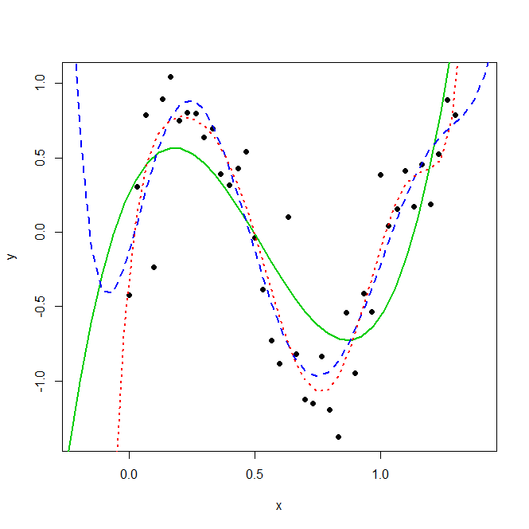
Polynomial bases are a popular choice
The can provide a flexible representations for f (x)
However, the usual way we apply polynomials are global
tweaking functional forms to suite a region causes the function to fluctuate wildly in remote regions.
Green = 4 degree
Blue = 6 degree
Red = 8 degree

Slide 17
Global vs. Local Bases
It sounds like it might be impossible to select an appropriate model, f(x) when there are so many possible basis expansions
The solution, it turns out, depends on a class of functions called splines
Spline:
Defined as a special function defined piecewise by polynomials
In Computer Science, the term spline frequently refers to a piecewise polynomial (parametric) curve.

Slide 18
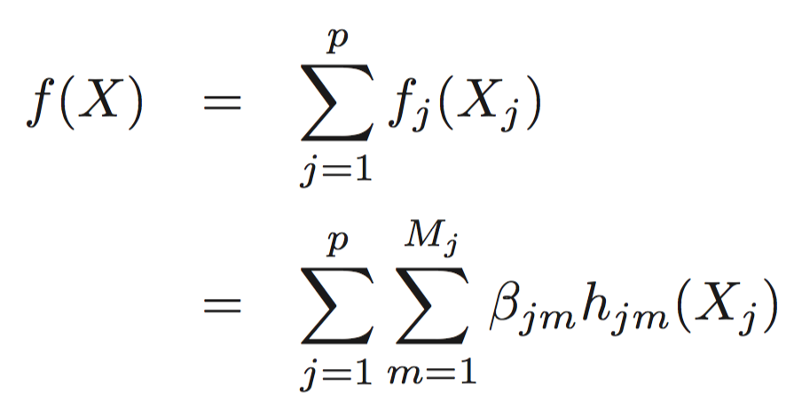
More on Polynomial Basis Expansion
Piecewise-polynomials and splines allow for local polynomial representations
Problem: the number of basis functions can grow too large to fit using limited data.
Solution:
Restriction methods - limit the class of functions
Example: additive model

Slide 19
Piecewise Polynomial Functions
Let’s start from the point where X is one-dimensional
Definition:
Assume the domain [a, b] of X is split into intervals [a, ξ₁), [ξ₂, ξ₃),…, [ξ_{m}, b].
Then f (X) is said to be a piecewise polynomial if f (X) is represented by separate polynomials in the different intervals.
The points ξ₁, ξ₂, …, ξ_{m} are called knots

Slide 20
Piecewise Constant Model
To understand splines, we start by building a piecewise model
First we partition x into K+1 intervals by choosing K points, , called knots
For our example, we consider three knots and the inflection points of our true curve (i.e. no noise)
These occur at

Slide 21
Basis Functions
What do the basis functions for this piecewise constant basis expansion model look like?

Slide 22
Constant Piecewise Model Form?
What does the model look like?

Slide 23
Constant Piecewise Model Form?
What does the model look like?

Slide 24
Constant Piecewise Model Form?
What does the model look like?

Slide 25
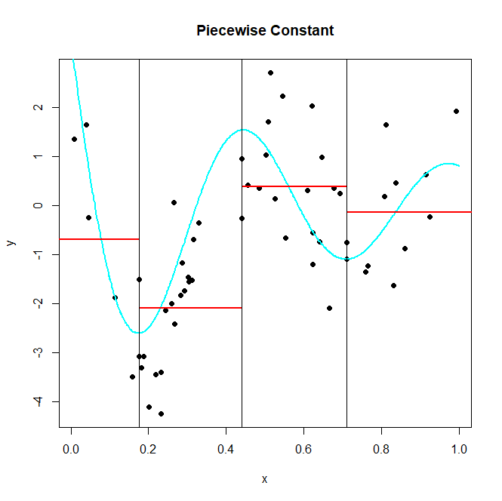

Slide 26
Linear Piecewise Model
The piecewise constant model isn’t particularly interesting (especially in this case)
We can extend this to a piecewise linear case where we actually allow the value of x to impact our predicted values in each of our K regions
In this case we can accomplish this by adding 4 additional functions to our linear basis expansion

Slide 27
Basis Functions
What do the basis functions for this piecewise linear basis expansion model look like?

Slide 28
Linear Piecewise Model Form?
What does the model look like?

Slide 29
Linear Piecewise Model Form?
What does the model look like?

Slide 30
Linear Piecewise Model Form?
What does the estimate look like in each region?

Slide 31
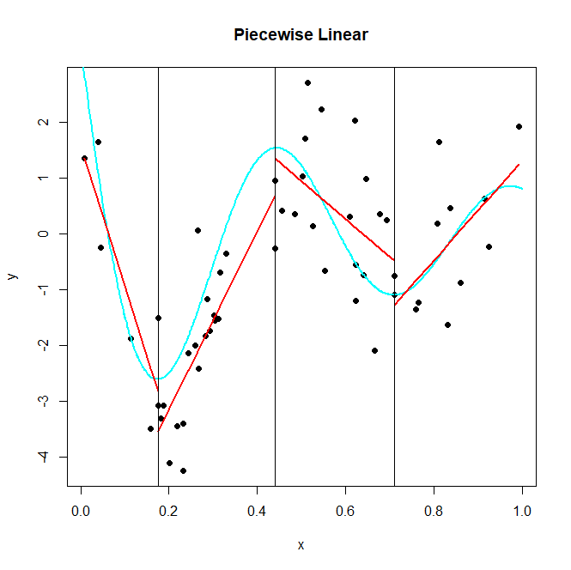

Slide 32
Piecewise Linear Model with Constraints
For a continuous piecewise linear function we need to add constraints
linear functions on each interval with constraints

Slide 33
Piecewise Continuous Linear Model
These constraints can be incorporated directly into the basis functions:
Where (.)₊ denotes the positive portion of its argument:

Slide 34
Piecewise Continuous Linear Model
Under this definition we get:
And our model is:

Slide 35
Piecewise Continuous Linear Model
So consider the following conditions and our model…

Slide 36
Piecewise Continuous Linear Model
It can easily be checked that these basis functions lead to a composite function f (x) that:
It is everywhere continuous
It is linear everywhere except the knots
Has a different slope for each region
Also, note that the degrees of freedom add up:
4 regions x 2 degrees of freedom in each region – 3 constraints = 5 basis functions

Slide 37
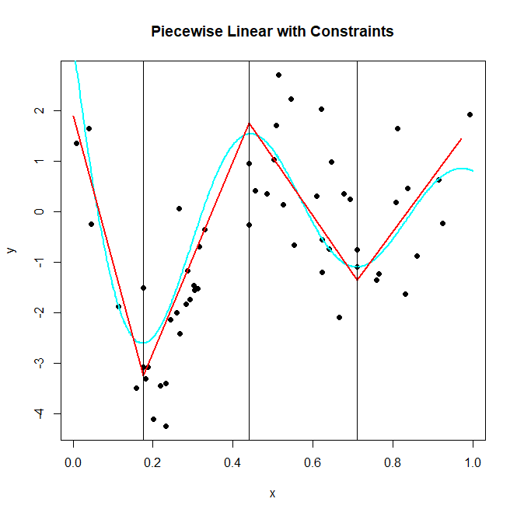

Slide 38
Splines
The preceding is an example of a spline:
A piecewise m – 1 degree polynomial that is continuous up to its first m – 2 derivatives
Requiring continuous derivatives ensures that the resulting function is as smooth as possible
We can obtain more flexible curves by increasing the degree of the spline and/or by adding knots
However, there is a tradeoff
Few knots/low degree: resulting class of functions may be too restrictive (bias)
Many knots/high degree: run the risk of overfitting (variance)

Slide 39
Splines
A piecewise polynomial is called an order-M spline if it has continuous derivatives up to order M-1
Constant piecewise function is an order-1 spline
Continuous piecewise linear function is an order-2 spline
Generally, we prefer a smoother function…
The set of basis functions we described for the continuous piecewise model is an example of the truncated power basis

Slide 40
Splines
The truncated power basis set can more generally be represented by a basis function (K = # knots)
4th order spline is called a cubic spline
Note, in cubic splines, knot-discontinuity is not visible

Slide 41
Cubic Spline
The basis functions in a cubic spline with 2 knots (based on the truncated power basis) are:

Slide 42
Regression Splines
All fixed order splines are referred to as regression splines
Have to select the order
Also select number and location of knots
Most common choices are M = 1, 2, and 4
To select the model, one could parameterize a family of splines based on the number of basis functions or degrees of freedom
Then allow data to inform location of knots

Slide 43
Cubic Splines
Cubic splines are the lowest order spline that appears smooth.
Generally isn’t much need to consider more complicated splines
Given a < ξ₁ < ξ₂ < … < ξ_{n} < b, a function h is a cubic spline if
On each interval (a , ξ₁), (ξ₁, ξ₂), …, (ξ_{n},b), h is a cubic polynomial
The polynomial pieces fit together at points ξ_{i} (knots) s.t. h itself and its first and second derivatives are continuous at each ξ_{i}, and hence on the whole [a,b]

Slide 44
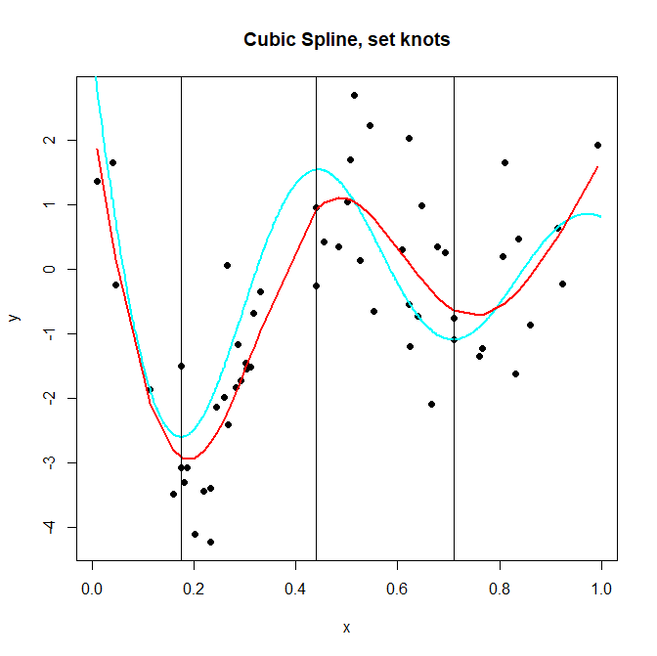
ξ₁ = 0.175
ξ₂ = 0.44
ξ₂ = 0.71

Slide 45
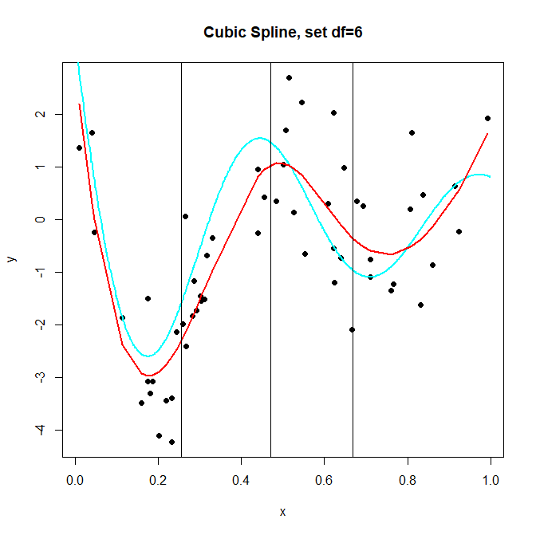
ξ₁ = 0.255
ξ₁ = 0.471
ξ₁ = 0.669

Slide 46
Natural Cubic Splines
Polynomial fits tend to be erratic at the boundaries of x
This is even worse for cubic splines
Natural cubic splines ameliorate this problem by adding additional constraints
A cubic spline f is called a natural cubic spline if its 2nd and 3rd derivatives are 0 at a and b

Slide 47
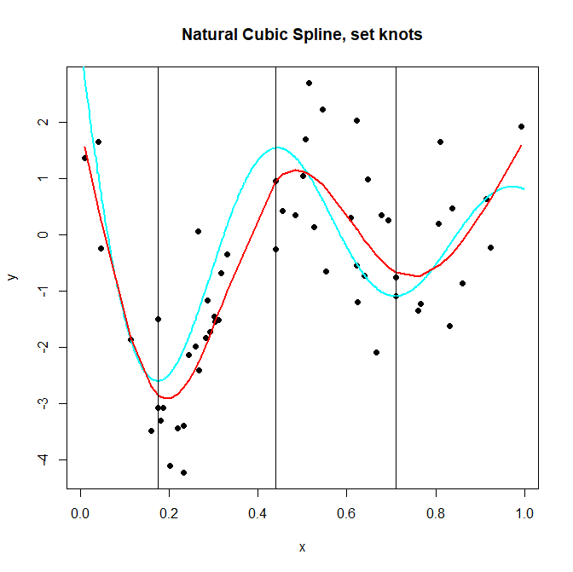

Slide 48
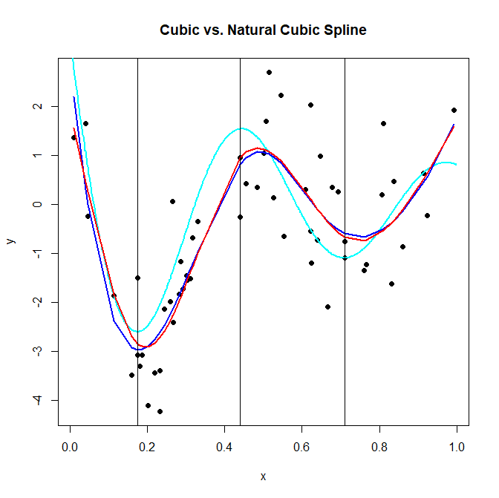

Slide 49
Next Time
Example of an application
Smoothing splines
Feature selection

