Slide 1
BMTRY 790: Machine Learning
Bayesian Additive Regression Trees

Slide 2
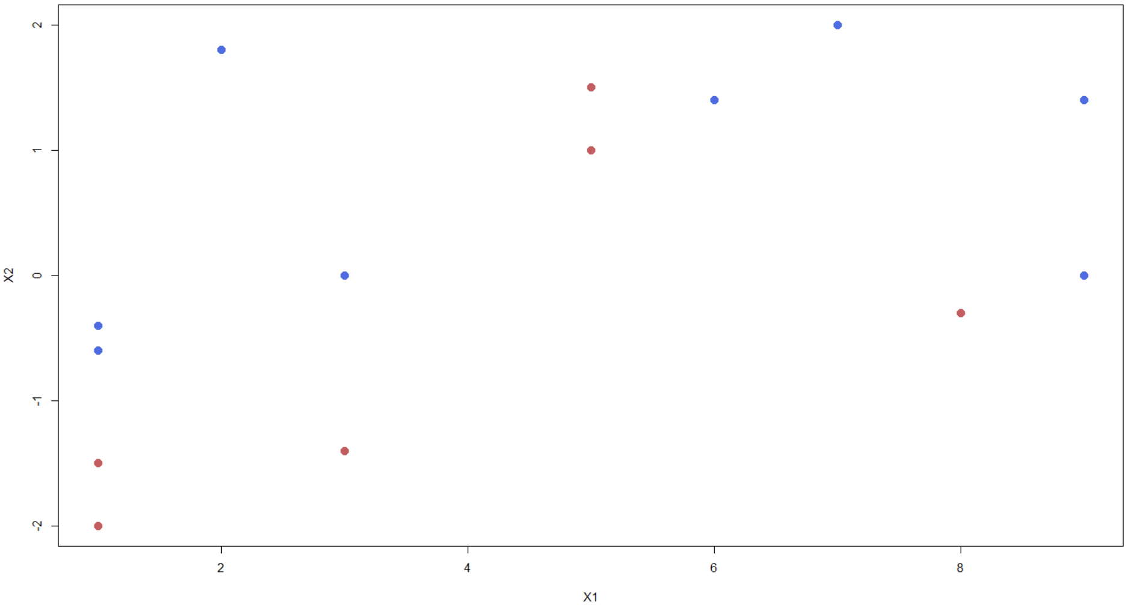
Decision Trees
Tree Structure
Block Regions
Root

Slide 3
Decision Trees
Tree Structure
Block Regions
Root
$$X_{2}≤−1$$
Red
Internal

Slide 4
Decision Trees
Tree Structure
Block Regions
Root
$$X_{2}≤−1$$
Red
Internal
$$μ_{h1}$$

Slide 5
Decision Trees
Tree Structure
Block Regions
Root
$$X_{2}≤−1$$
Red
Internal
$$X_{1}≤3.9$$
Blue
Internal
$$μ_{h1}$$

Slide 6
Decision Trees
Tree Structure
Block Regions
Root
$$X_{2}≤−1$$
Red
Internal
$$X_{1}≤3.9$$
$$μ_{h2}$$
Blue
Internal
$$μ_{h1}$$

Slide 7
Decision Trees
Tree Structure
Block Regions
Root
$$X_{2}≤−1$$
Red
Internal
$$X_{1}≤3.9$$
$$μ_{h2}$$
Blue
Internal
$$X_{1}≤5.45$$
Red
Internal
$$μ_{h1}$$

Slide 8
Decision Trees
Tree Structure
Block Regions
Root
$$X_{2}≤−1$$
Red
Internal
$$X_{1}≤3.9$$
$$μ_{h2}$$
$$μ_{h3}$$
Blue
Internal
$$X_{1}≤5.45$$
Red
Internal
$$μ_{h1}$$

Slide 9
Decision Trees
Tree Structure
Block Regions
Root
$$X_{2}≤−1$$
Red
Internal
$$X_{1}≤3.9$$
$$μ_{h2}$$
$$μ_{h3}$$
Blue
Internal
$$X_{1}≤5.45$$
Red
Internal
$$μ_{h1}$$
$$X_{2}≤−0.25$$
Red
Blue

Slide 10
Decision Trees
Tree Structure
Block Regions
Root
$$X_{2}≤−1$$
Red
Internal
$$μ_{h5}$$
$$X_{1}≤3.9$$
$$μ_{h2}$$
$$μ_{h3}$$
Blue
Internal
$$X_{1}≤5.45$$
$$μ_{h4}$$
Red
Internal
$$μ_{h1}$$
$$X_{2}≤−0.25$$
Red
Blue

Slide 11
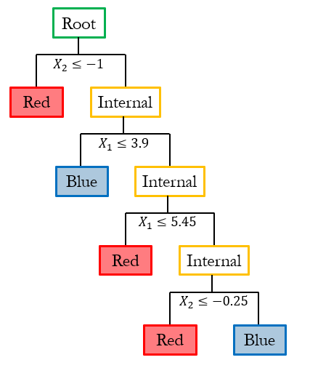
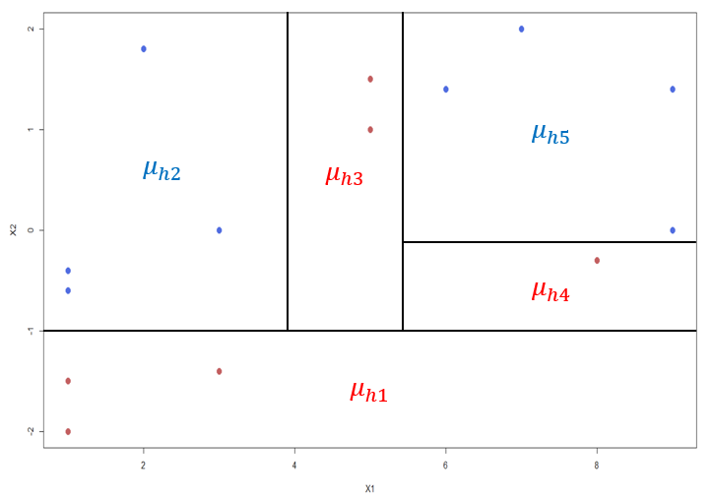
Decision Trees
Tree Structure
Mathematically
The prediction function corresponding to the $h^{th}$ tree is defined by two sets:
$T_{h}$ is the set of edges and nodes together with the decision rules associated with the internal nodes of the $h^{th}$ tree
$M_{h}=(μ_{h1}, μ_{h2}, …,μ_{hv_{h}})^{′}$ represents the set of parameter values associated with each of the $v_{h}$ terminal nodes of $T_{h}$
In general, a tree and parameter pair $(T_{h},Μ_{h})$ parameterizes a step function $g$ that is constant over elements of the partition:
$g(x;T_{h},M_{h})=μ_{hv}$ if $x∈R_{hv}$
Block Regions

Slide 12
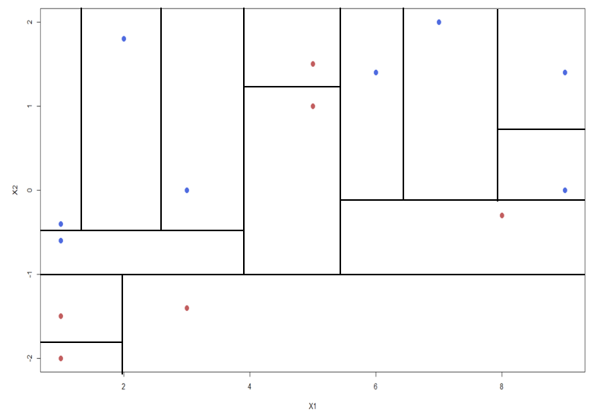
Decision Trees
Overly-Complex Partition
Issues with Tree-Based Models
Trees can be very non-robust, as small changes in the data can cause a large change in the final estimated tree (i.e., weak learner). This becomes a larger issue the more complex of a tree structure.
In tree-based modeling, we prune an overly-complex model to create a subtree.
For our topic today, we would rather fit a smaller tree with fewer splits. As a result, each individual tree is only capable of explaining a small portion of the data. To get a proper solution for our model, we combine these small trees to create an ensemble.

Slide 13
Ensemble Learning
Ensemble learning combines a set of base models developed to predict one or more outcomes based on a set of features in order to produce a composite prediction model. Generally, the selected base model is ideally low in bias but with potentially high variability (i.e., weak learners). The ensemble is designed to build on the strength of the weak learners while reducing the noise and variability in the prediction.
Approaches for ensemble learning using tree-based models as weak learners include:
Non-Bayesian methods:
Bagging
Boosting
Random Forests
Bayesian method:
BART
A downside to ensembles of tree-based models is that we lose the interpretability of a single decision tree; however, we have gained flexibility and generalizability.

Slide 14
Bayesian Additive Regression Trees
BART is a sum-of-trees model that starts with an overall fit, $f$, defined as the sum of fit of many trees:
$$f(x)=g(x;T_{1},M_{1})+g(x;T_{2},M_{2})+…+g(x;T_{m},M_{m})$$
Each $(T_{m},M_{m})$ represents a single subtree model. Intuition behind BART:
Start with a single weak-learning tree, $g(x;T_{1},M_{1})$
Recall $T_{1}$ is constrained to be small
Therefore, the elements of $M_{1}$ are shrunk towards 0
This 1st tree only explains a small amount of variation in $Y$
This fit is then subtracted from the observed response $Y$ to create residuals
The next tree is then fit to these residuals explaining slightly more of the variation in $Y$
Repeat this process $m$ times
The fit of earlier trees in the sampler could be updated using the partial residuals from later trees iterating to a stable value of some loss function.
This intuition can easily lead to overfitting. BART avoids this based on its prior distributions, posterior sampling, and averaging rather than loss minimization.

Slide 15
Priors for BART
Similar to Boosting, BART allows the number of subtrees, $m$, to be large.
Boosting algorithms avoid overfitting through tuning parameters chosen typically through cross-validation:
Maximum depth for each tree that constrains the tree to be a weak-learner
Fit from each tree is weighted by a small number to shrink the sum of the fit of trees toward 0
BART’s strategy:
Assume that the structure of the tree $T_{h}$ and the leaf values $M_{h}$ are independent. Assuming independence, the model can factor the joint distribution of the trees, the means in the terminal leaves, and the residual standard deviation, and these distributions can be simplified by a series of independence assumptions.
$$p[(T_{1},M_{1}),(T_{2},M_{2}),…,(T_{m},M_{m}),σ]=p(T_{1},T_{2},…,T_{m})⋅p(M_{1},M_{2},…,M_{m}|T_{1},T_{2},…,T_{m})⋅p(σ)$$

Slide 16
Priors for BART
Prior for the tree structure, $T_{h}$:
This prior is specified by three aspects:
The probability that a node at depth $d=\left(0,1,2,…\right)$ is non-terminal (i.e., splits) is given by
$α(1+d)^{−β}$ where $α∈(0,1)$, $β∈[0,∞)$
Default prior specification is $α=0.95$ and $β=2$. This specification strongly favors small, stubby trees.
For example, it sets the probability of a tree a set number of terminal nodes at:
# of Terminal Nodes | Probability of Tree
1 | 0.05
2 | 0.55
3 | 0.28
4 | 0.09
5+ | 0.03

Slide 17
Priors for BART
Prior for the tree structure, $T_{h}$:
This prior is specified by three aspects:
The distribution of the splitting variable in each non-terminal node. The default specification is uniform over all available choices within that node.
Given a variable to split on, the distribution on the splitting rule. The location of the split is defaulted to be uniform over the range of available values for that variable.

Slide 18
Priors for BART
Calibrate the priors over the terminal leaf parameters, $μ_{hv}$:
Scale the outcome to lie between -0.5 and 0.5 so the expectation that $f(x)$ falls within that range will be highly probable.
Assume the prior distribution for each $μ_{hv}$ to follow a Normal distribution
$μ_{hv} ∼ N(0,σ_{μ}^{2})$ where $σ_{μ}=\frac{0.5}{k⋅\sqrt{m}}$
Each tree will contribute one $μ_{hv}$ to the overall fit, and thus, the regression function $f$ at covariate value $x$ is normally distributed with mean 0 and standard deviation $\frac{0.5}{k}$ where $k$ is the number of prior standard deviations between 0 and 0.5.
The default prior parameterization for $k$ is 2.
This assigns a 95% prior probability that $E[Y|x]$ lies between -0.5 and 0.5

Slide 19
Priors for BART
Prior for $σ^{2}$:
Specified as an inverse-$χ^{2}$ and calibrated using the observed data
The degrees of freedom is specified to represent the probability that the BART residual standard deviation, $σ$, is less than the estimated residual standard deviation from a linear regression fit to the data, ${\hat{σ}}_{OLS}^{2}$
Default prior sets the degrees of freedom where $P(σ<{\hat{σ}}_{OLS}^{2})=0.9$
This was determined from prior literature using cross-validation finding it performed well in practice.

Slide 20
BART Computation
Posterior inference in BART models is generally carried out via Markov chain Monte Carlo (MCMC)
Adapts methods developed for single-tree models
Embeds those methods within Metropolis-within-Gibbs samplers.

Slide 21
BART Computation
MCMC for single-tree models:
To update the current value of a tree:
Propose a new tree $T^{⋆}$ by sampling from some proposal distribution $q(T^{⋆};T)$
Compute the Metropolis ratio
$$a≔\frac{L(T^{⋆}) p(T^{⋆})}{L(T) p(T)}⋅\frac{q(T;T^{⋆})}{q(T^{⋆};T)}$$
Note:
$L(T)=∫\prod_{i}{p(Y_{i}\left|x_{i},T,M) p(M\right|T) dM}$ is the marginal likelihood of the tree $T$
The probability the proposed tree is accepted is $min(a,1)$.
If the proposed tree is accepted, then $T$ is set to $T^{⋆}$. Otherwise, $T$ remains at its current value.
Parameters $M$ are updated by sampling them from their full conditional distribution $p(M|T,D)$ where $D$ denotes the data $D=\{(Y_{i},x_{i}):i=1,…,n\}$

Slide 22
BART Computation
Proposal distributions for $T^{⋆}$:
Random perturbations of the current tree $T$:
Split a current terminal node into two new terminal nodes (GROW)
Collapse adjacent terminal nodes back into a single node (PRUNE)
Reassign the decision rule for an internal node (CHANGE)
Swap the decision rule assigned to two internal nodes (SWAP)
GROW and PRUNE are typically computationally efficient and yield acceptable mixtures for MCMC

Slide 23
BART Computation
MCMC for BART models using Bayesian backfitting:
Each $(T_{h},M_{h})$ pair is updated in turn while conditioning on $σ$ and the remaining trees along with their associated parameters. This approach implements a proper partially collapsed Metropolis-within-Gibbs MCMC sampler. To better grasp this approach, let’s examine one instance of Bayesian backfitting:
Each MCMC update of $(T_{h},M_{h})$ starts by reparametrizing the outcome.
Thus, the likelihood function only depends on $(T_{h},M_{h})$ through partial residuals
$$R_{hi}=Y_{i}−\sum_{l≠h}^{m}{g(x_{i},T_{l},M_{l})}$$
Due to the MCMC update conditioning on all remaining trees and associated parameters, then the model can be reparametrized based on these partial residuals. Thus,
$$R_{hi}∼N(g(x_{i},T_{h},M_{h}), σ^{2})$$
Therefore, to update $(T_{h},M_{h})$, any single-tree MCMC update can be implemented treating the partial residuals as the data

Slide 24
BART Computation
MCMC for BART models using Bayesian backfitting:
The backfitting does break down in more complicated models.
However, efficiency gains can be maintained using block updates for $(T_{h},M_{h})$ given that the integrated likelihood function can be computed.

Slide 25
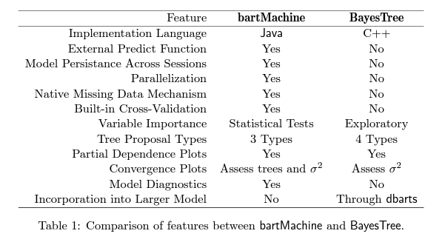
BART in R
BART can be implemented in R using two packages:
BayesTree (native implementation by the original authors)
bartMachine (computationally efficient)

Slide 26
BART in R
BART using BayesTree for Ozone Example:
Example: Ozone Concentrations over time
Data include 111 observations for an environmental study
Measured six variables over 111 (nearly) consecutive days.
Ozone: surface concentration of ozone(parts per billion)
Solar.R: level of solar radiation (lang)
Wind: Wind speed (mph)
Temp: Air temperature (ºF)
Month: Calendar month
Day: Day of the month

Slide 27
BART in R (bartMachine – Ozone)

Slide 28
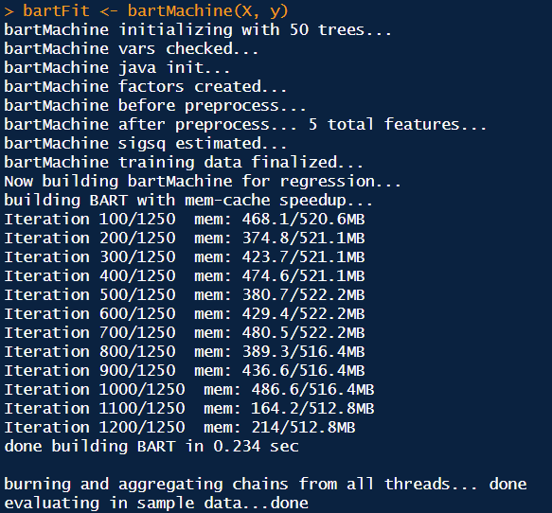
BART in R (bartMachine – Ozone)

Slide 29
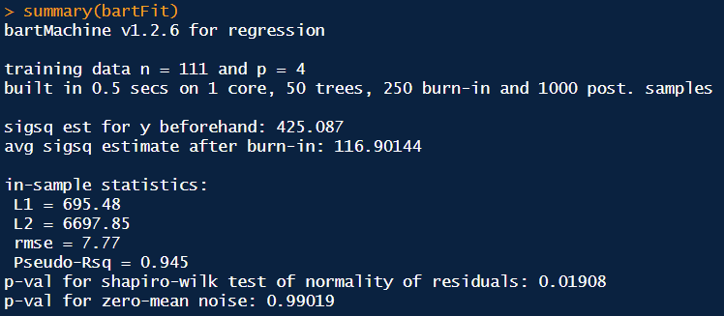
BART in R (bartMachine – Ozone)

Slide 30
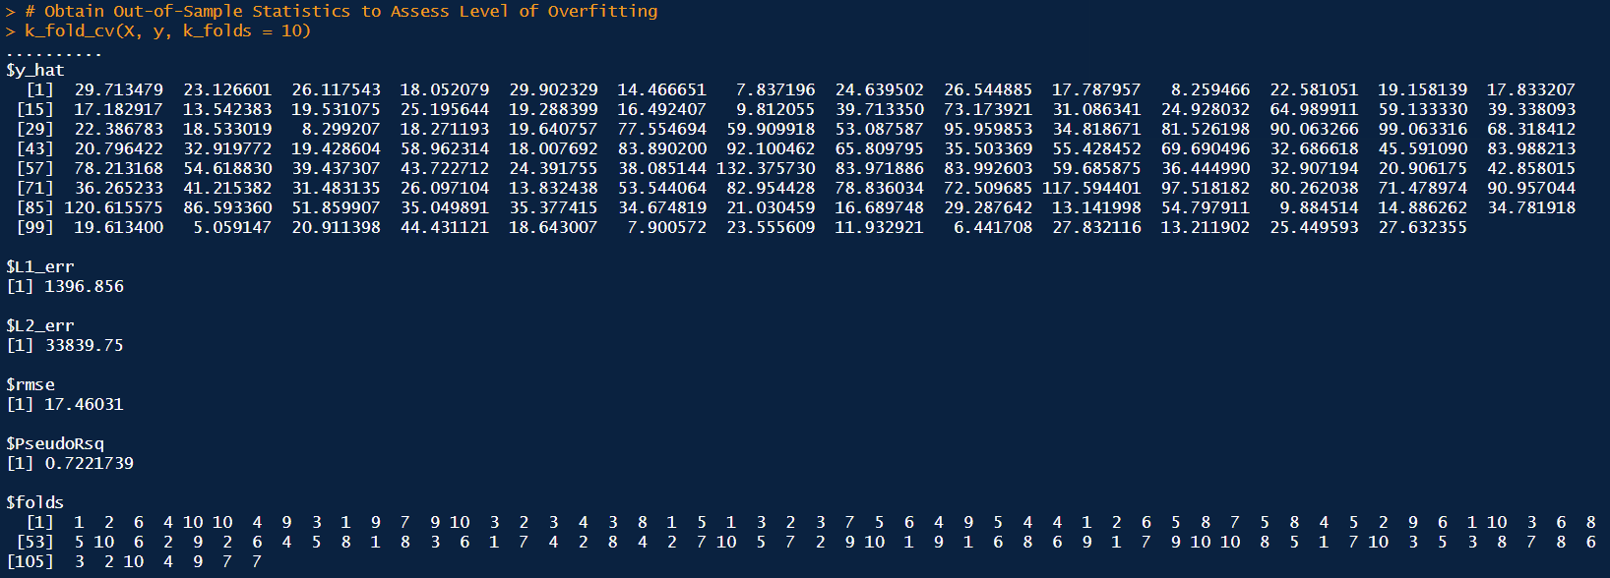
BART in R (bartMachine – Ozone)
Recall the pseudo-$R^{2}$ in the in-sample was 0.945. The lower pseudo-$R^{2}$ in the out-of-sample suggests that the model is slightly overfitting (note that the training sample during the cross-validation was 10% smaller).

Slide 31
BART in R (bartMachine – Ozone)
We may also want to know if the number of trees $m$ affects performance. We can examine how the out-of-sample predictions vary by the number of trees. It seems that increasing the number of trees does not result in a substantial increase in performance.

Slide 32
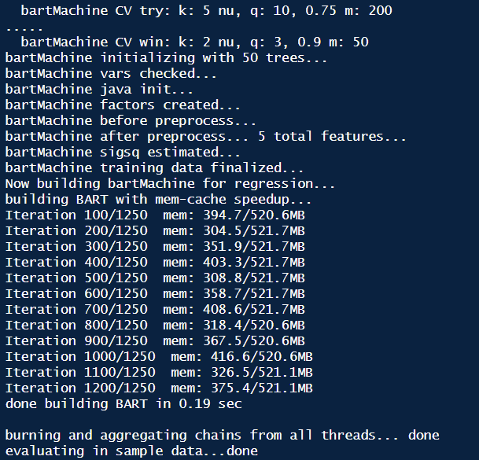
BART in R (bartMachine – Ozone)
However, we may want to try to build a better BART by tuning the set of hyperparameter combinations. For regression, $k$, determines the prior distribution that $E[Y|X]$ is contained in the range $(y_{min},y_{max})$. $q$ is the quantile of the prior on the error variance at which the data-based estimate is placed, and nu is the degrees of freedom for the inverse-$χ^{2}$

Slide 33
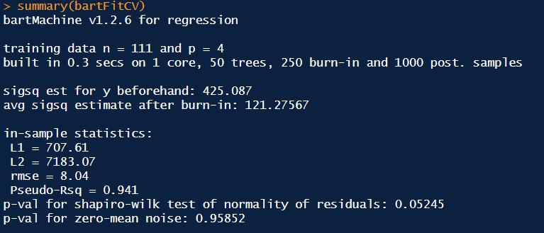
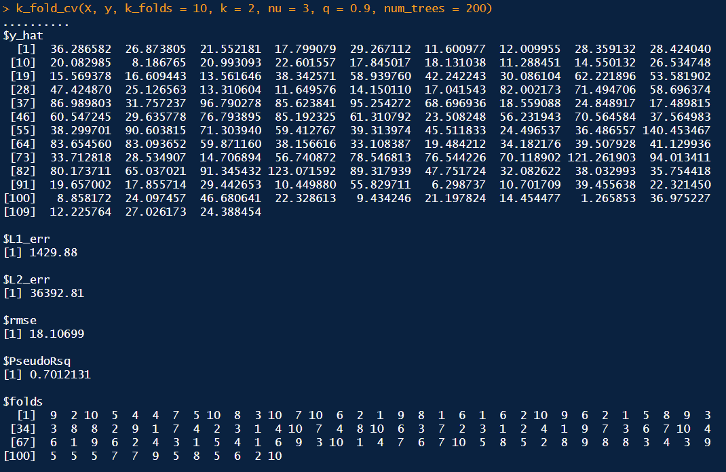
BART in R (bartMachine – Ozone)
Relative to the original model, the CV model had slightly worse performance both in-sample and out-of-sample.

Slide 34
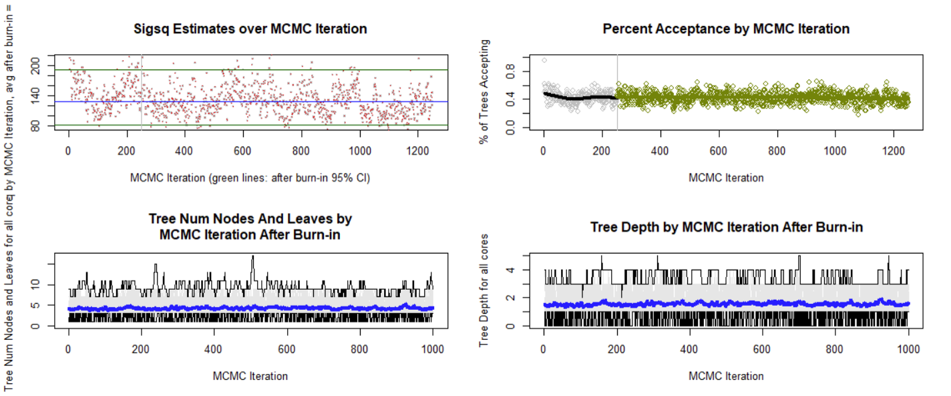
BART in R (bartMachine – Ozone)
Determine whether the convergence diagnostics of our model.

Slide 35
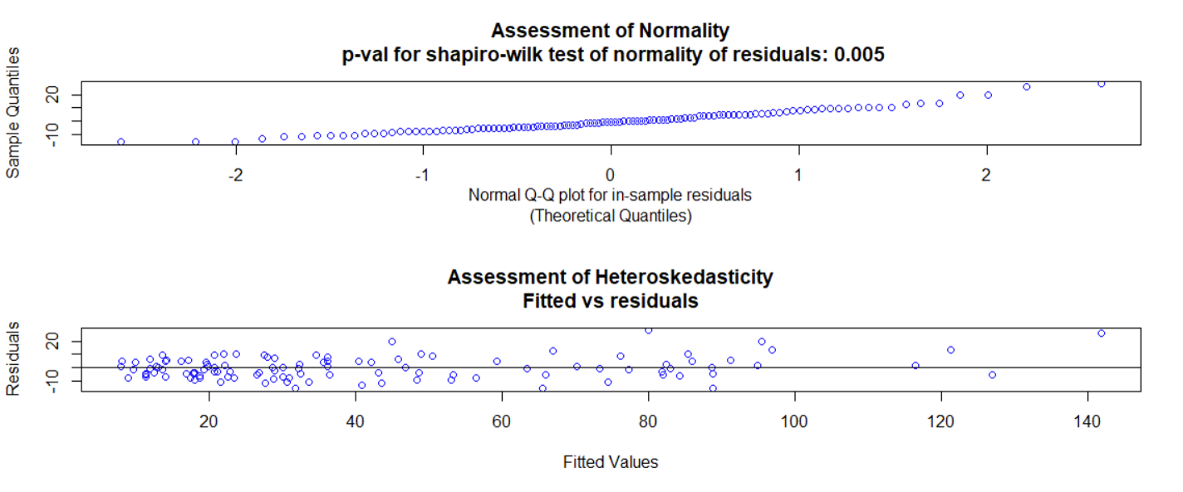
BART in R (bartMachine – Ozone)
We can check whether the BART model assumptions are plausible such as whether the mean-centeredness of the noise is both normal and heteroskedastic.

Slide 36
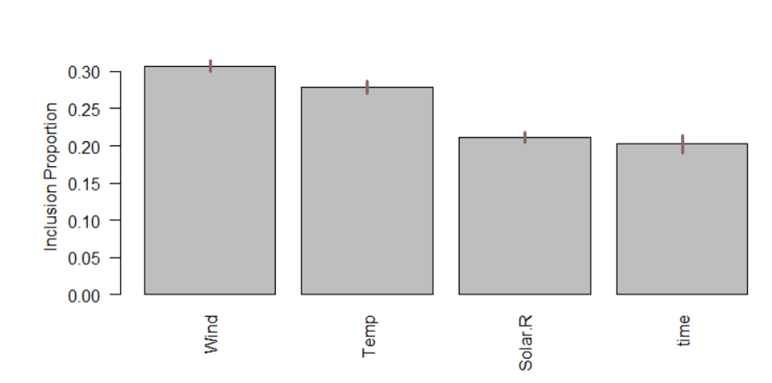
BART in R (bartMachine – Ozone)
The assessment of which variables are important is made by examining the splitting rules in the $m$ trees across the post burn-in MCMC iterations to determine the proportion of times any given predictor is chosen as a splitting rule out of all splitting rules among the posterior draws of the sum-of-trees model.

Slide 37
Developments in BART Modeling
While BART was originally proposed for continuous data, it has been extended to binary classification by taking
$$P(Y_{i}=1|x_{i})=φ(f(x_{i}))$$
$φ$ represents the standard normal cumulative distribution function.
Chipman (and others) used the data augmentation developed by Albert & Chib to adapt the Bayesian backfitting sampler
$Y_{i}^{⋆}=f(x_{i})+ε_{i}$, where $ε_{i}∼N(0,1)$
$$Y_{i}=1(Y_{i}^{⋆}>0)$$
This yields a probit formulation for binary classification.

Slide 38
Developments in BART Modeling
BART prior distributions have been applied to functions in a wide variety in the literature:
Regression Models:
Models with Gamma-Poisson Likelihoods
Binary and multinomial logistic regression
Poisson and negative binomial regression (with or without zero inflation)
Gamma/IG regression
Multivariate BART
Survival models
Adjusting the prior specification of BART
In high dimensionality using a sparsity-inducing Dirichlet prior
Causal inference

