Slide 1
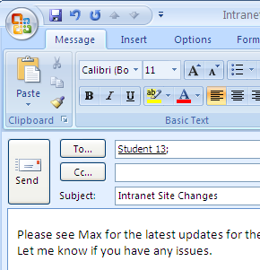
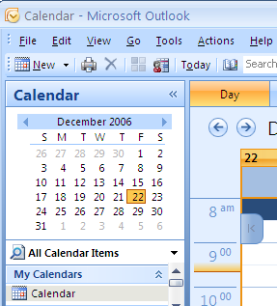
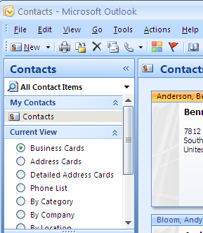
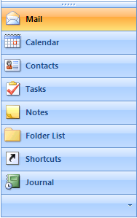
Microsoft Office Outlook 2007
Email Page
Calendar Page
Contacts Page

Slide 2
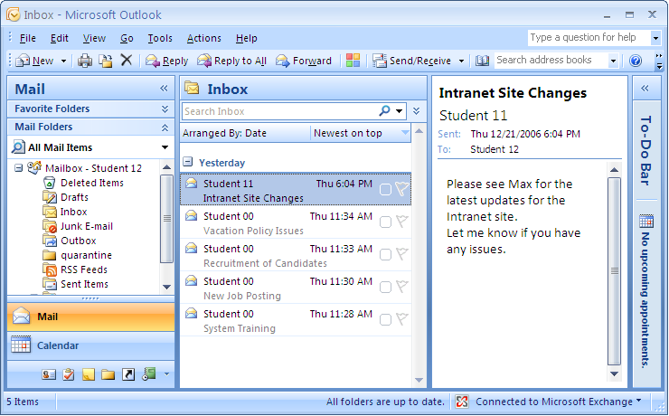
The Microsoft Office Outlook 2007 Window
Title Bar
Type A Question
For Help Box
Menu Bar
Standard
Toolbar
Task Pane
Navigation
Pane
Reading
Pane
To-Do
Bar
Go Menu
Status Bar
Quick Launch
Bar
Page 3

Slide 3
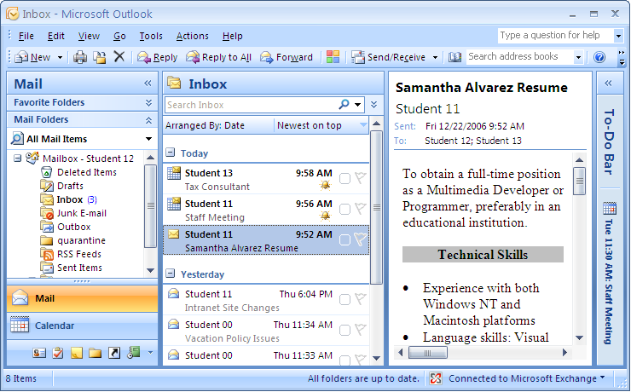
Item
Items in Outlook
includes messages,
appointments,
meetings, and tasks
Page 4

Slide 4
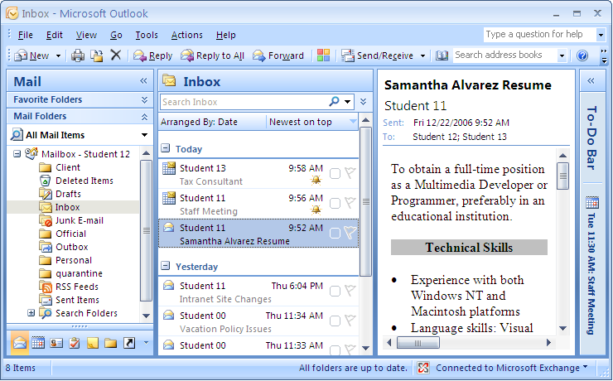
Folder
The Inbox folder
stores and
organizes messages
Page 5

Slide 5
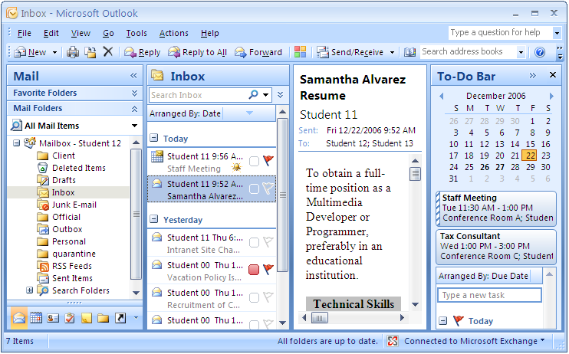
The To-Do Bar
Minimizes the
To-Do bar
The To-Do bar
displays the
Calendar, upcoming
appointments, and
follow-up messages
Page 6

Slide 6
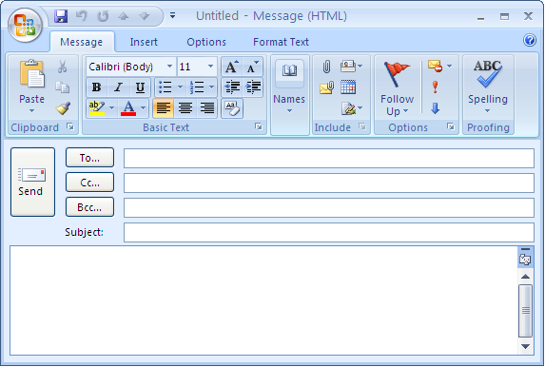
The New Message Window
Message Body

Slide 7
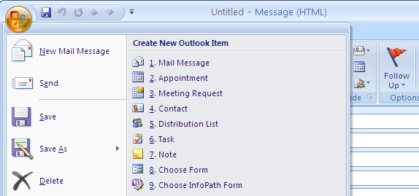
The Office Button
The Office
Button

Slide 8
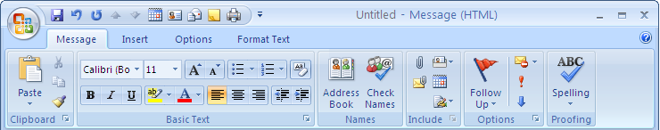
The Quick Access Toolbar
Quick Access
Toolbar
Default Options

Slide 9
The Ribbon
Tabs
Groups
Commands

Slide 10
The Message Tab
Groups available
in the Message tab

Slide 11
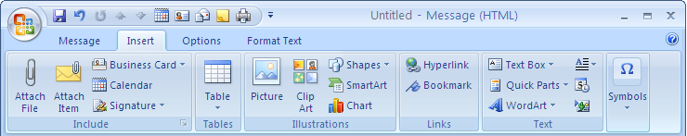
Insert Tab
Groups available
in the Insert tab

Slide 12
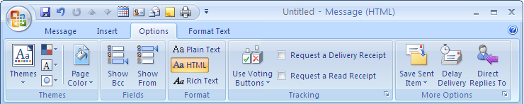
Options Tab
Groups available
in the Options tab

Slide 13
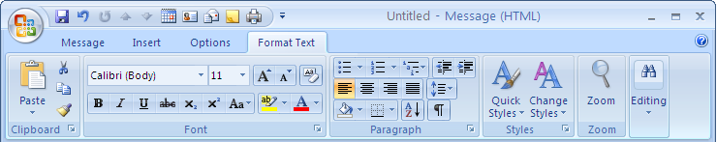
The Format Text Tab
Groups available
in the Format Text tab

Slide 14
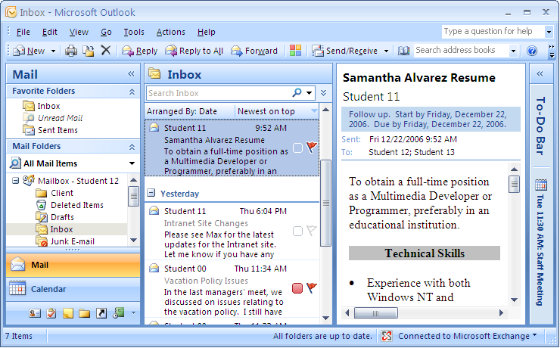
The AutoPreview Feature
First few lines of
the mail message

Slide 15
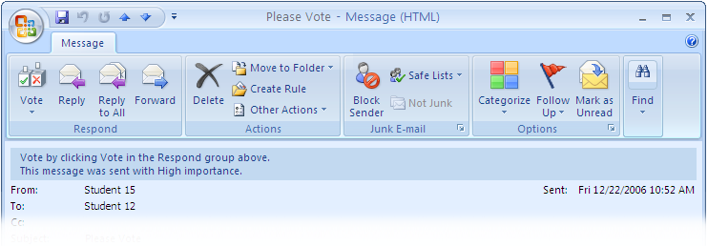
The Infobar
The Infobar
displays information
about what action
you need to perform
in the mail box

