Slide 1
TEACH Teen Education and Careers in Healthcare
American Medical Students Association

Slide 2
Why is healthcare a good choice?
Healthcare affects many people
Illnesses do not discriminate based on ethnicity, wealth, or location
As a professional in healthcare, you help a wide variety of people. You will always have something to do.
Depending on which career it is, situations may change constantly and present you with new, exciting scenarios

Slide 3
Why is healthcare a good choice?
Healthcare careers ensure job stability
Illnesses aren’t going anywhere, so there will always be a need for professionals in the healthcare field
Some professions are being put out of business by improving technology
Healthcare careers require human interpretation, not just technology
As people continue to get sick and the population grows, there is an increased need for health professionals
4 of America’s top 10 fastest-growing careers are healthcare-related

Slide 4
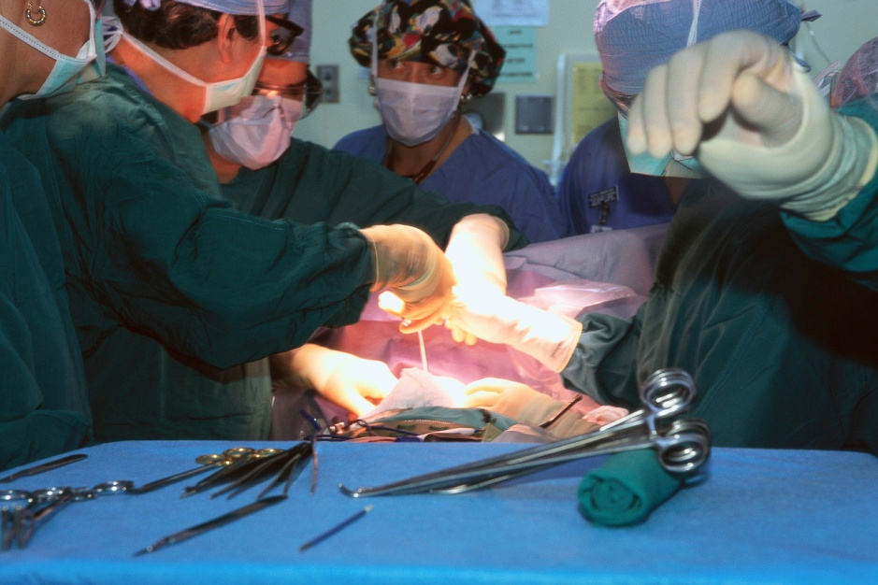
Why is healthcare a good choice?
Health-related careers are well-paid
14 of America’s top 20 well-paying careers are healthcare-related
With just a training program after high school, you could be making above the average annual income in the US
But careers that require college make much more

Slide 5
Why is healthcare a good choice?
Healthcare careers are diverse
There are many aspects to maintaining good health and preventing illness
Foot, mouth, heart, drugs, community health… the list goes on!

Slide 6
Medicine opens many options
With a degree in medicine, you can pursue:
Practice
Policy/Politics
Administration
Teaching
Volunteering
Advocacy
Sports
Business
Law

Slide 7
Who are health-related careers right for?
If you…
Like to solve problems or are a creative thinker
Are eager to learn and/or a fast learner
Like to help people
Are a people-person
Like science/medicine
Pay attention to details
Handle pressure well

Slide 8
What can I do in healthcare?
MANY different options
Aside from doctors (MD, DO) and nurses (RN)…
Technicians (ECG, surgical, x-ray, clinical lab, etc…)
Dentists (dental hygienist, dental lab technician, etc…)
Optometrists (dispensing, ophthalmic lab tech, etc…)
Sports medicine (trainer, physical therapist, etc…)
Alternative medicine (acupuncture, etc…)
Emergency medicine (paramedic, EMT, etc…)
And many more! (genetic counselor, massage therapist, home care aide, nutritionist, dosimetrist, speech pathologist, chiropractor, occupational therapy, etc…)

Slide 9
Doctors (DO or MD)
Duties:
Treat and prevent illness, injury, or disease
Training/education required:
Requires 4 year college and 4 year medical school
Also requires additional training after medical school
Examples:
Surgeons, radiology/oncology, OBGYN, family medicine, etc.

Slide 10
Nurses
Duties:
Treat patient under doctor’s recommendations
Training/education required:
Requires 4 year college
Length of additional training depends on degree pursued
Examples:
Registered nurse
Nurse practitioner

Slide 11
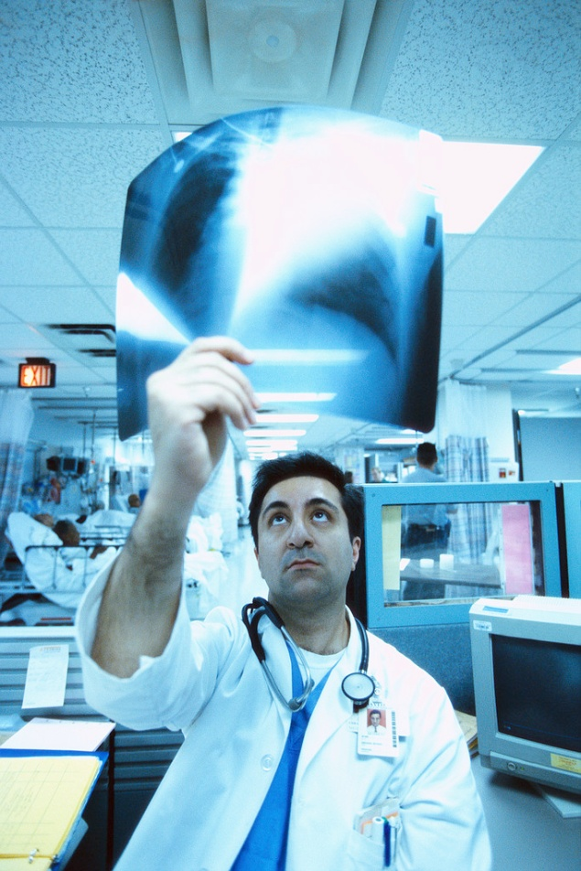
Technicians
Duties:
Tend to have one specific function in workplace, limited duties
Training/education required:
Most don’t require college
Most require short training program (~1 year)
Examples:
Surgical tech, radiology tech, ER tech, etc.

Slide 12
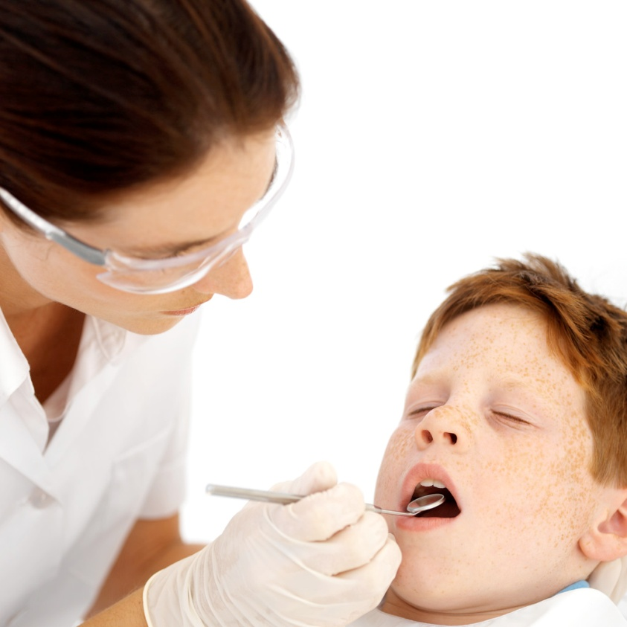
Dentistry
Duties:
Preventative healthcare and treatment dealing with the mouth, teeth, tongue, and gums
Training/education required:
Dentist: college, dental school (8 years after HS)
Assistant: training program (2 years)
Hygienist: training program (2 years)
Lab Tech: training optional (2 years)

Slide 13
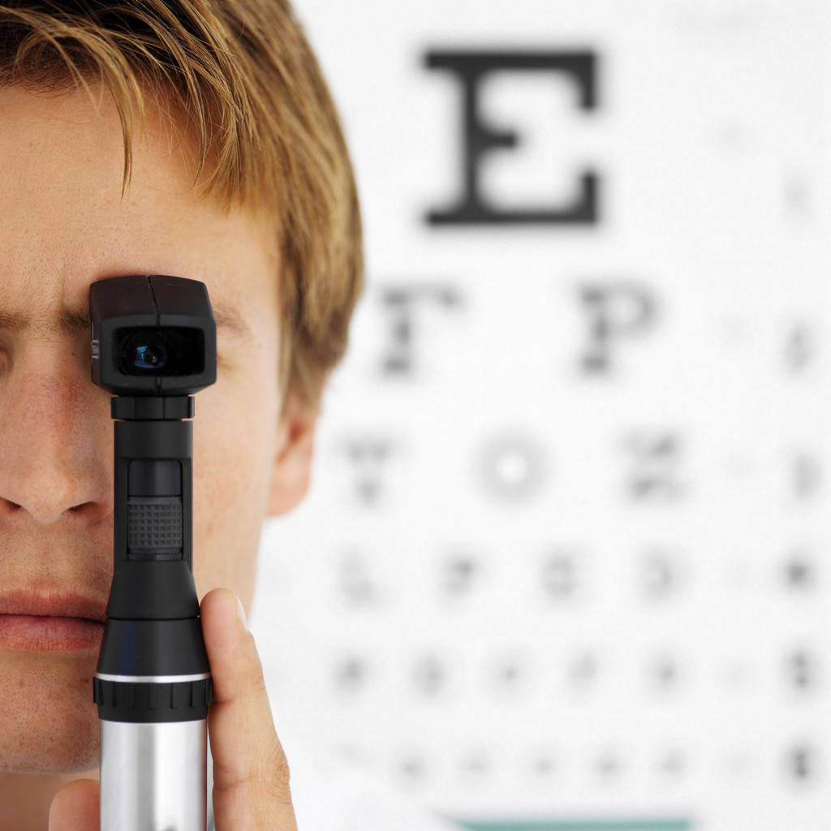
Optometry
Duties:
Preventative healthcare and treatment dealing with the eyes and patients’ sight
Training/education required:
Dispensing: optional training (0-2 years after HS)
Optometrist: college, optometry school (8 years)
Lab tech: training with employer

Slide 14
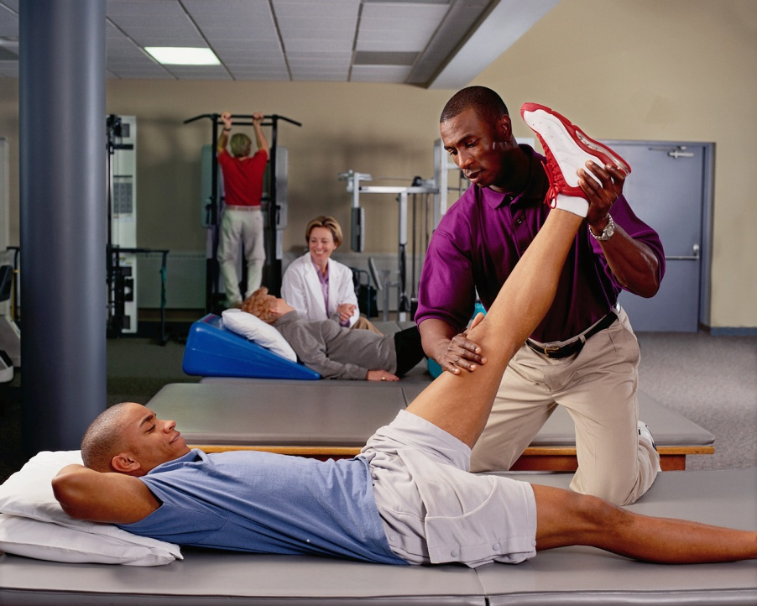
Sports Medicine
Duties:
Treating mostly athletes at various skill levels to improve their range of motion or to aid recovery
Training/education required:
Exercise Physiologist: college, training (0-2 years after high school)
Physical Therapist:
college, physical
therapy school
(6-9 years)

Slide 15
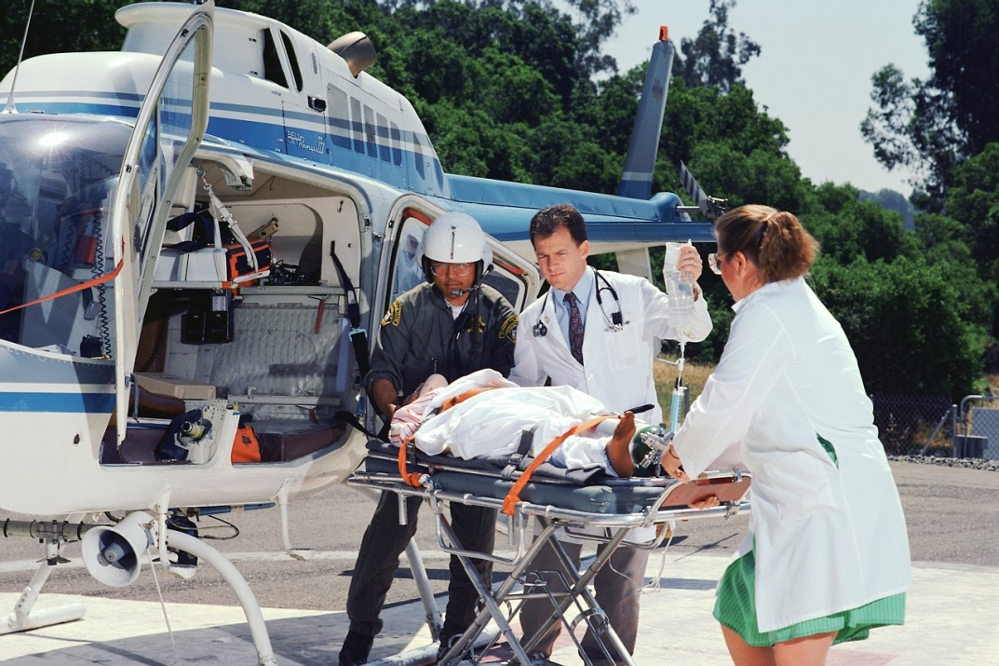
Emergency Medicine
Duties:
Treat patients requiring immediate medical attention in/on the way to the hospital
Training/education required:
Emergency medical technician: training (1 year after high school)
-- Paramedic: EMT
and 1 year
additional training

Slide 16
Other options…
There are also many other healthcare-related careers:
Veterinarian and veterinarian technician
Community health worker
Hospital administration
Hospital information manager
Food safety specialist
Medical coder
Etc…

Slide 17
So what should I do now?
Finish high school
get a diploma
Increased pay, more opportunities
Do your research
Figure out what interests you and what extra schooling/training it requires
Technician? – short training
Doctor? – college and medical school
Specialist (e.g. physical therapy) – college and extra training

Slide 18
So what should I do now?
Seek out resources
Ask for help
Contact a professional in
that particular field
Parents
Career counselor
Advisor
Get experience now
Shadow a professional
Volunteer in healthcare

Slide 19
In Conclusion…
Healthcare is awesome!
Helping people is rewarding
More detailed information is
available if you’d like
Get involved now!
There are plenty of
opportunities available
Looks good for college too!
Notes:
Conclusion: mention

Slide 20
Thank you for your time!

