Slide 1
OSAH Hand Protection Section: Personal Protective Course

Slide 2
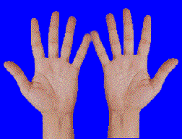
Why Hand Protection is Important
Take a moment to hold your hands out in front of you. Look at them. They are the only two hands you will ever have. It has been estimated that almost 20% of all disabling accidents on the job involve the hands. Without your fingers or hands, your ability to work would be greatly reduced.
Human hands are unique. No other creature in the world has hands that can grasp, hold, move, and manipulate objects like human hands. They are one of your greatest assets. And, as such, must be protected and cared for.

Slide 3
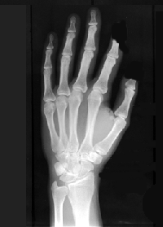
Potential Hazards
Traumatic Injuries
You can suffer a traumatic injury to your hands in many ways.
- Tools and machines with a sharp edges can cut your hands.
- Staples, screwdrivers, nails, chisels, and stiff wire can puncture your hands.
- Getting your hands caught in machinery can sprain, crush, or remove your hands and fingers.

Slide 4
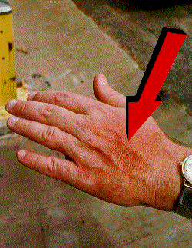
Potential Hazards
Contact Injuries
Coming into contact with caustic or toxic chemicals, biological substances, electrical sources, or extremely cold or hot objects can irritate or burn your hands.
WARNING: Toxic substances are poisonous substances that can be absorbed through your skin and enter your body.

Slide 5
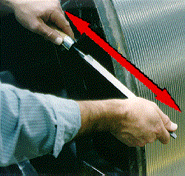
Potential Hazards
Repetitive Motion Injuries
Whenever you repeat the same hand movement over a long period of time, you run the risk of repetitive motion problems. Repetitive motion problems often appear as a numbness or tingling sensation accompanied by pain and the loss of gripping power in your hands.

Slide 6
Preventative Measures
Housekeeping and Hygiene
Poorly maintained machinery, tools, sloppy work areas, and cluttered aisles all contribute to hand injuries.
Good hygiene includes handwashing. Handwashing helps to remove germs and dirt from your hands. Clean hands are less susceptible to infection and other skin problems such as contact dermatitis.

Slide 7
Personal Protective Equipment: Gloves
There are many type of gloves that are designed to protect your hands.
There are many type of gloves that are designed to protect your hands.
Metal
mesh gloves resist sharp edges and prevent cuts.
Leather gloves
shield your hands
from rough surfaces.
Vinyl and neoprene gloves protect your hands against toxic chemicals.
Rubber
gloves protect you when working around electricity.

Slide 8
Wearing and Using Gloves
Select and use the right kind of glove for the job you are going to be performing.
Select gloves that fit.
Some gloves may be chemical specified and have a life expectancy. Discard them after the recommended time has expired.
Remove any rings, watches, or bracelets that might cut or tear your gloves.
Wash your hands before and after wearing your gloves.
Inspect your gloves before you use them. Look for holes and cracks that might leak.
Replace gloves that are worn or torn.
After working with chemicals, hold your gloved hands under running water to rinse away any chemicals or dirt before removing the gloves.
Wash cotton gloves as needed.
Avoid borrowing gloves. Gloves are personal protective equipment.
Store gloves right side out in a clean, cool, dry, and ventilated area.
Never wear gloves around powered rotating equipment - drills, lathes, etc.

Slide 9
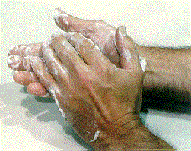
Other Protective Measures
Barrier Creams
Water Repellent Creams are used to protect your hands from caustic chemicals.
Solvent-Repellent Creams are used to protect your hands from solvents, oils, and other organic chemicals.
Sunscreens protect your skin from the damaging effects of the sun.
Vanishing Creams protect your skin against mild acids, and make cleaning up easier.
WARNING: Never substitute a barrier cream when you should use gloves.

Slide 10
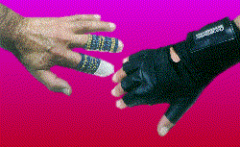
Other Protective Measures
Forearm Cuffs are used to protect your forearm.
Thumb Guards and Finger Cots protect only your thumb or fingers.
Mittens protect your hands while working around very cold or hot materials.
Hand Pads are often found in kitchens and laboratories. Hand pads protect your hands while working around very hot materials.

Slide 11
Remember! Your hands are one of your greatest assets. Protect them!
Information provided by
http://www.free-training.com/osha/ppe/HAND/618.htm

