Slide 1
Eye and Face Protection Section: Personal Protective Equipment Course

Slide 2
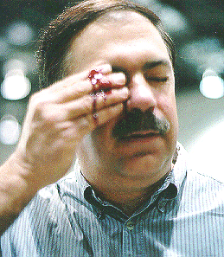
Why Eye and Face Protection is Important
Thousands of people are blinded each year from work related eye injuries. Injuries that could have been prevented, if only people would have used eye or face protection.

Slide 3
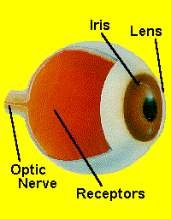
The Delicate Structure of the Eye
Your eyes are very delicate. You can think of them as the color television cameras for your brain. Like a camera, your eyes include:-A lens that focuses light; - An iris that controls the amount of light that enters the eye; - Receptors that "pick up" the image of what you see, and; - An optic nerve that serves as a "cable" to transmit information from the receptors in your eye to your brain.
Unlike a television camera that is made of plastic and metal, your eye is made of soft tissues and blood vessels. Damage your eyes, and you have big trouble. Trouble that is often permanent.

Slide 4
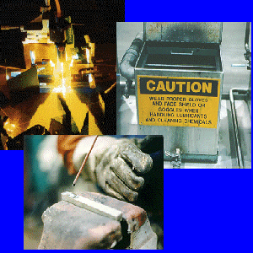
What Types of Accidents Cause Eye Injuries?
The major types of accidents that cause blindness include:- Objects striking the eye; - Contact with chemicals and
other hazardous materials; - Being struck by swinging objects
such as chains and ropes; and - Viewing radiant energy sources
such as welding operations or
lasers.

Slide 5
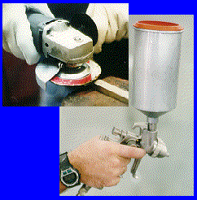
Potential Hazards
Dusts, Powders, Fumes, and MistsSmall particles of matter can enter your eyes and damage them. Operations such as grinding, chiseling, sanding, hammering, and spraying can create small airborne particles; particles that can injure your eyes.

Slide 6
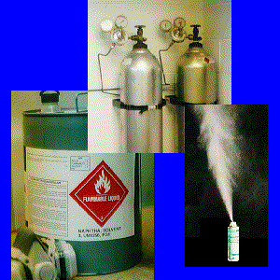
Potential Hazards
Toxic Gases, Vapors, and LiquidsToxic chemicals in the form of gases, vapors, and liquids can damage your eyes. Always read the appropriate MSDS before working with any hazardous material.
NOTE: Some manufacturing processes
produce hazardous gases,
vapors and liquids. Always
check with your supervisor or
safety manager to learn the
type of eye or face protection you
will need to use in order to work
safely.

Slide 7
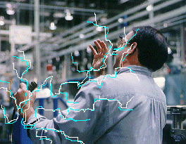
Potential Hazards
Electrical Hazards
Any time you work around electricity, there is the potential for arcs and sparks to occur. Take time to talk with your supervisor or safety manager concerning the type of eye protection you should wear if you will be working around electrical hazards.

Slide 8
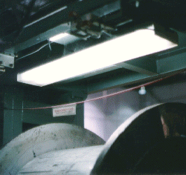
Protective Measures
Lighting Good
lighting is important in work areas. Good lighting reduces eye strain and glare. It also promotes both safety and improved productivity.

Slide 9
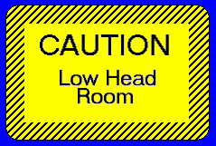
Protective Measures
Signs and Warnings
Obstructions and protruding objects should be identified and marked. Use caution when working around obstructions and protruding objects.

Slide 10
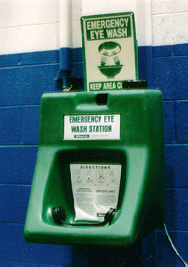
Protective Measures
Eyewash Stations
Eyewash stations should be located within 100 feet of your work area. If you accidentally get something in your eyes, go directly to the eyewash station and flush your eyes with water for 15 minutes. Be sure to hold your eyes open with your fingers and "look" directly into the water streams. DO NOT RUB YOUR EYES! Rubbing your eyes may scratch or embed particles into your eyes. Once you have flushed your eyes with water, seek medical attention immediately.
CAUTION: Some chemicals are water reactive and become toxic when mixed with water. Talk with your supervisor or safety manager about the chemicals you will be using on your job. Be familiar with the MSDSs for all chemicals used in your job.

Slide 11
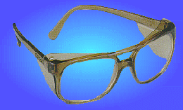
Personal Protective Equipment
Safety Glasses
Safety glasses are perhaps the most widely used type of eye protection. While they may look similar to regular glasses, they are much stronger and more resistant to impact and heat than regular glasses. In addition, most safety glasses are equipped with side shields that give you protection from hazards that may not be directly in front of you. Both prescription and nonprescription safety glasses are available. In addition, a wide variety of lens coatings are available for special work situations. Safety glasses should be Z-87 approved to meet OSHA regulations.

Slide 12
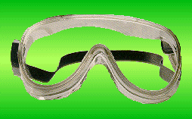
Personal Protective Equipment
Goggles
Goggles give you more protection than safety glasses because they fit closer to your face. Because goggles surround the eye area, they give you more protection in situations where you might encounter splashing liquids, fumes, vapors, powders, dusts, and mists. Different types of goggles are available. They must indicate that they are chemical splash goggles to be worn for that purpose.

Slide 13
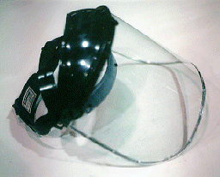
Personal Protective Equipment
Face Shields
Face shields offer you full face protection and are often used around operations which expose you to molten metal, chemical splashes, or flying particles. Many face shields can be used while wearing a hard hat.
NOTE: You should always wear safety glasses or goggles when using a face shield for added protection. Face shields alone are NOT considered adequate eye protection.

Slide 14
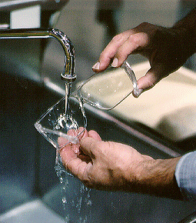
Care of Eye Protection Equipment
Clean your eye protection equipment. You can usually use mild soap and water. You may also use special wipes that are designed for cleaning protective eye equipment. Never use abrasive soaps, rough paper, or cloth towels. These items will scratch and damage your equipment.
Always keep your eye protection equipment in good working condition. If it is damaged, have it repaired or replaced.
Store your eye protection equipment in a sanitary, cool, dry area away from moisture.
Read the manufacturer's directions and warnings before using any eye protection equipment.
If you have any questions concerning your eye protection equipment, talk with your supervisor or safety manager.

Slide 15
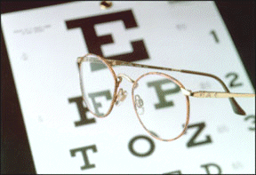
Vision Exams
Let's face it. You only have two eyes, and they must last you a lifetime. As you age, your eyes will change.
These changes can affect your safety at work and at home.
So, it's a good idea to take a little time each year for a vision exam.

