Slide 1
Strategies for Success in the College Search
The Three “Fs” for Helping Your Child Make a Great Choice
Marc M. Camille, Ed.D.
Vice President for Enrollment Management and Communications

Slide 2
Strategies for Success in the College Search
The College Search Is, and Is Not…
Start Early
Keep an Open Mind
College Costs
Value for Your Investment
Campus Visits
Fit? Finance? Feeling?
Humor!

Slide 3
Strategies for Success in the College Search
The College Search is:
An opportunity and a milestone
A process of self-assessment, reflection, and discovery
About 3 decisions, two of which are controlled by students/parents-
You decide where to apply for admission
Colleges decide which students to admit
You decide where to enroll
The College Search is not:
Something that should take place only in the senior year
The sole responsibility of parents or college counselors; students must take an active role

Slide 4
Strategies for Success in the College Search
Start early
Sophomore/junior year
3,000+ four-year colleges in US = Options
Large; small; urban; suburban; rural; private; public; research; liberal arts… Jesuit and Catholic
There are many questions to ask and choices for consideration

Slide 5
Strategies for Success in the College Search
Getting started
College fairs/ college nights
PSAT/ACT Plan
Classroom Surveys
Mail, mail, and more mail… email
Web sites
National Center for Education Statistics’ College Navigator (unbiased)- http://nces.ed.gov/collegenavigator/
Collegeboard’s bigfuture- https://bigfuture.collegeboard.org/

Slide 6
Strategies for Success in the College Search
Keeping an Open Mind
Don’t fall into the “name brand” or “prestige” trap
Guidebooks/ Rankings can be helpful; use them in the proper context
US News- http://www.usnews.com
Peterson’s- http://www.petersons.com
Princeton Review- http://www.princetonreview.com
National Survey of Student Engagement- http://nsse.iub.edu/

Slide 7
Strategies for Success in the College Search
College Costs
Don’t let “sticker price” eliminate colleges from your consideration
Need-based financial aid and/or merit or talent-based scholarships often make a private education affordable
Net price calculators
Financial aid/ scholarships
Fastweb- http://www.fastweb.com/

Slide 8
Strategies for Success in the College Search
ROI: Value for Your Investment
Regardless of the “cost,” what is the likely return?
Graduation rates; graduate/medical/law school acceptance rates; employment rates
Salary earnings: Payscale.com surveys
Lifetime ROI: http://www.payscale.com/college-education-value#
Starting & Mid-Career Salaries: http://www.payscale.com/college-salary-report-2013/full-list-of-schools
Federal Government’s College Scorecard
http://www.whitehouse.gov/issues/education/higher-education/college-score-card

Slide 9
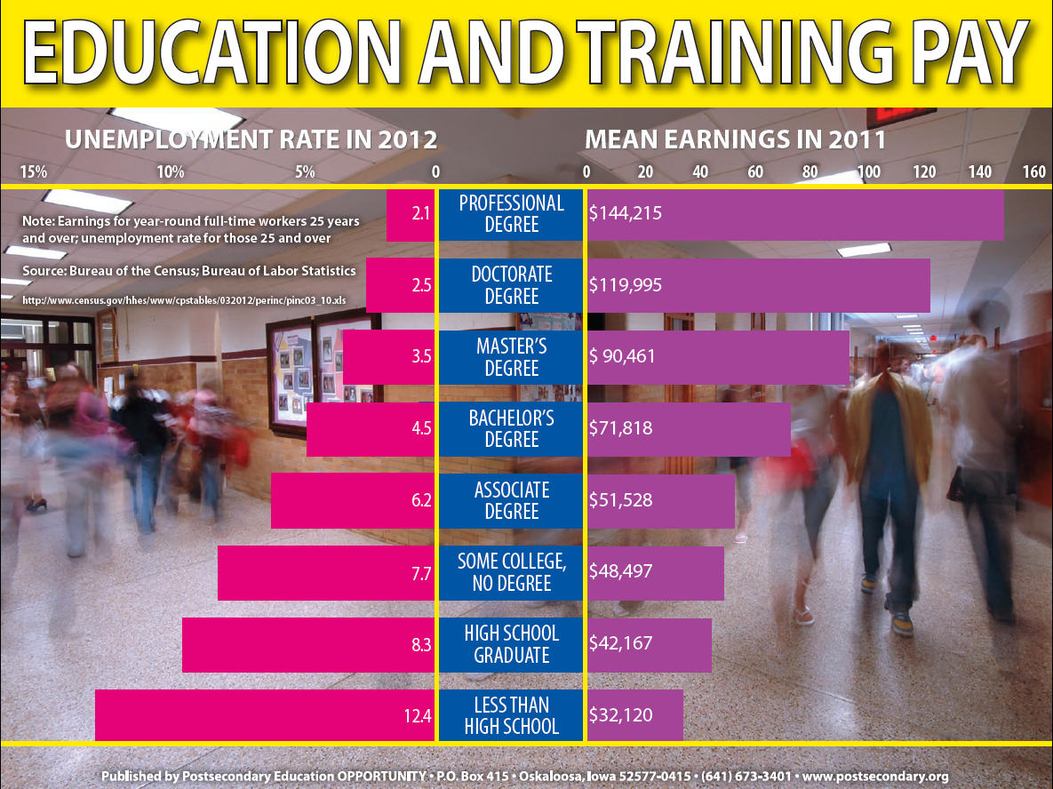
An Investment in the Future
Consider the value of a college degree
Nearly double the unemployment rate
Average salary increases by more than 70%

Slide 10
Strategies for Success in the College Search
Campus Visits
Seeing is believing (vs. brochures and web sites)
Open houses/ interviews- group vs. individual
Take a tour; sit in on a class; eat a meal; meet with faculty, current students
Virtual tours- college web sites
Ask questions; take notes; take pictures
Social media- interact; user-generated content
Facebook http://www.facebook.com/LoyolaMaryland
Twitter https://twitter.com/LoyolaMaryland
YouTube http://www.youtube.com/loyolamaryland

Slide 11
Strategies for Success in the College Search
The Three Fs of the College Search—
Fit - finding the right college based on your child’s desired characteristics; there is a college out there for every student
Finance – paying for college requires a considerable investment; return on that investment includes more than just earnings potential
Feeling - it’s all about the feeling your child will get during the visit; it will just feel right; they’ll know they’re home

Slide 12
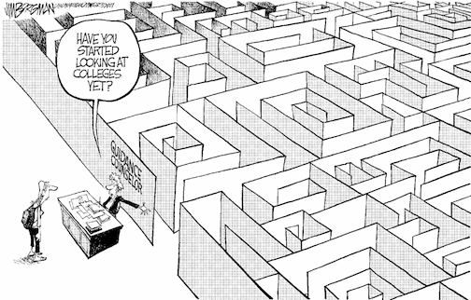
College Search Humor

Slide 13
College Search Humor

Slide 14
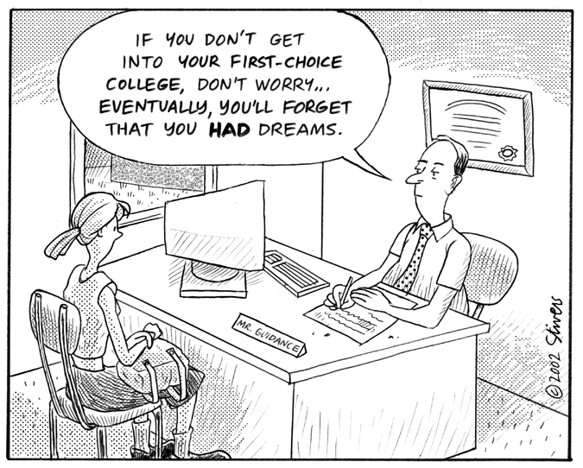
College Search Humor

Slide 15
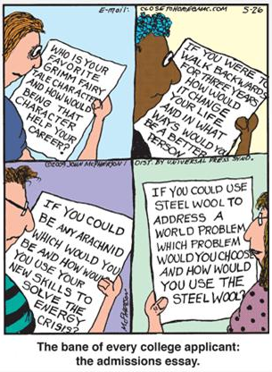
College Search Humor

Slide 16
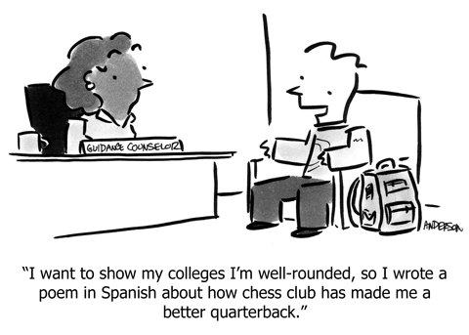
College Search Humor

Slide 17
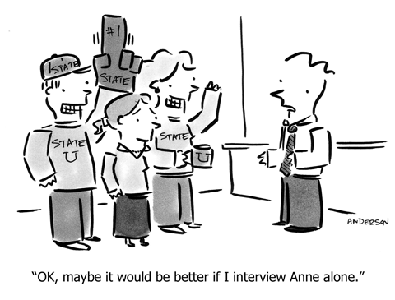
College Search Humor

Slide 18
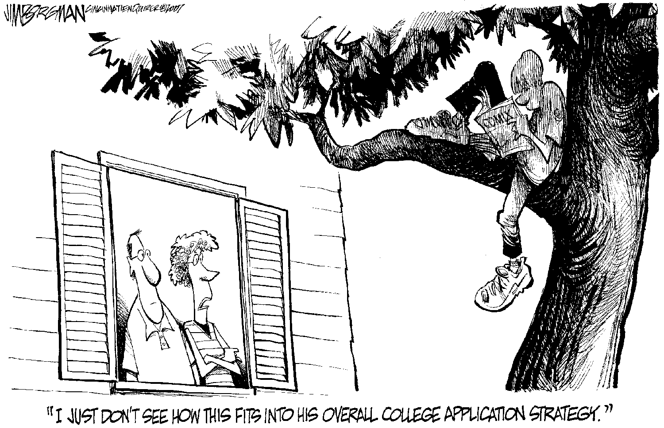
College Search Humor

Slide 19
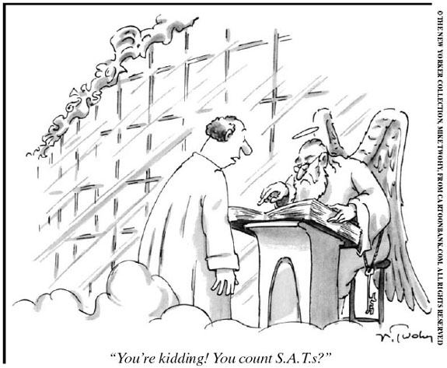
College Search Humor

Slide 20
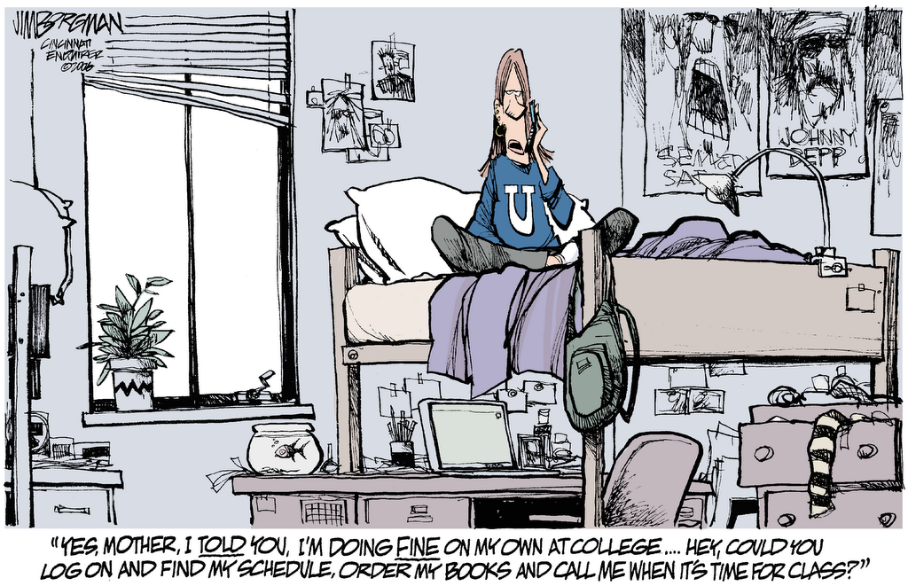
College Search Humor

Slide 21
Enjoy the Day! Marc M. Camille, Ed.D. vice president for enrollment management and communications mcamille@loyola.edu
Thank you for visiting Loyola.

