Slide 1
Personal Appearance & Characteristics
A Module of the
South Carolina AHEC Health Careers Academy
© South Carolina AHEC 2008

Slide 2
OBJECTIVES
At the conclusion of this lesson, the student will
understand how to:
Demonstrate the standards of professional appearance as they apply to uniforms, clothing, shoes, nails, hair, jewelry and make-up.
Create a characteristic profile of a healthcare worker.
Recognize the implications of first impressions

Slide 3
PRE-TEST
Notes:
Facilitator’s Instructions: Administer the Personal Appearance & Characteristics Pre-Test

Slide 4
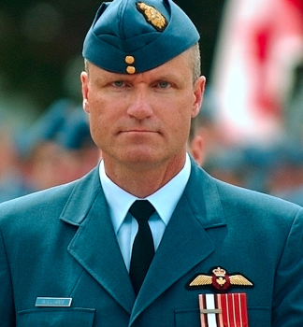
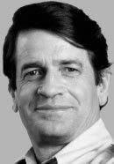
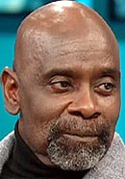
Who’s Who?
Congressman
Stock Broker
Convicted Murderer
Notes:
Facilitator’s Instruction: Facilitate the “Who’s Who?” activity embedded in the module power point presentation on slides 4 - 7.
Activity Instructions: Ask the learners to assign one of the listed labels to each photograph. The answers are revealed by a click of the mouse on slides 5 & 7.

Slide 5
Who’s Who?
C. Colonel Russell Williams
A. Charlie Wilson
B. Chris Gardner
Former Texas Congressman
B. Stock Broker & Author
C. Convicted Murderer

Slide 6
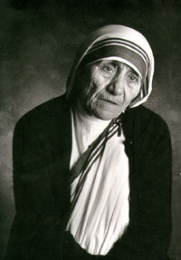
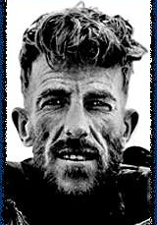
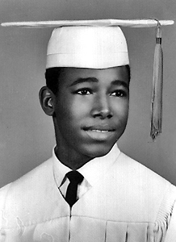
Who’s Who?
Missionary
Pediatric Neurosurgeon
English Knight

Slide 7
Who’s Who?
A.
Mother Teresa of Calcutta
C.
Sir Edmund Hillary
B.
Ben Carson, MD
Missionary
B. Pediatric Neurosurgeon
C. English Knight

Slide 8
“Don’t Judge a Book By its
Cover”
A metaphorical phrase that means we should not prejudge the worth or value of a person or thing simply by what is seen.
HOW they are dressed
Speech
Hair and Nails
Associations
Facial Expression
Race
Notes:
FACILITATOR SCRIPT: “Don’t judge a Book by its Cover” is a well-known phrase. What does it mean to judge a book by it’s cover? What are ways that we judge people? In our every day walk, we observe and meet new people. Often times, we quickly judge WHO a person is by the way they look, communicate and carry themselves.
Dress
people who wear:
- Sagging pants may be assumed to be a “thug” or a gang member
- Hijab (a veil traditionally worn by some Muslin women) or sherwani (a knee-length coat buttoning to the neck, worn by men from South Asia) because of religious affiliation may be associated with terrorism
Hair & Nails
- Dirty fingernails or unkempt hair can be translated as a person who is living a hard life
Facial Expression
- A pleasant expression can make a person seem very nice and friendly
- A grimace can make a person seem mean or grumpy
Speech
- The use of bad grammar can be interpreted as a lack of education
Associations
- It could be assumed that if you hang out with troublemakers, you are probably a troublemaker
Race
- Some people associate specific behaviors with certain ethnic groups
What are other ways that we sometimes judge people?
[Discussion Point : Ask students to brainstorm ways that people are sometimes judged.]

Slide 9
First Impressions
Healthcare providers MUST present an appearance that inspires confidence and a positive self image.
Notes:
Facilitator’s Script: Research has shown within 20 seconds – 4 minutes people form an impression about another person based mainly on appearance.
[Discussion Point]: How many of you have been misjudged by your peers because of your appearance? Please share an example.

Slide 10
Personal Appearance
DOs
&
DON’Ts
Notes:
Facilitator’s Script: As with most things in life, there are things that are some tips that can help us to navigate through experiences. Let’s take a few moments to reflect on the following basic rules…

Slide 11

Uniform & Clothing
Most places of employment have a standard of dress.
Healthcare workers attire should always be:
Neat
Well-Fitted
Appropriate
Clean
Wrinkle-Free
Notes:
Facilitator’s Script: Different departments within a healthcare facility will require different standards of dress. Scrubs and/or lab coats are usually worn in the clinical areas of a hospital, and business attire generally in the non-clinical areas. Whether wearing uniforms or regular clothing, attire should always be clean, neat, and in good condition.

Slide 12

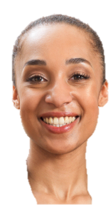
Identification
ID Badges confirm:
Who is employed by the facility
The area where the employee works
FACILITY ‘S NAME
NAME
TITLE
DEPARTMENT
Notes:
Facilitator‘s Notes: Most healthcare offices and facilities require employees to wear identification badges for the protection of employees and patients. Identification badges should be worn on the upper chest near the face so that the picture on the ID badge can be compared and confirmed. It not only confirms who you are, but also the area of the facility where you work. ID badges generally include:
(components of the badge will appear on the slide with a mouse click)
Name of the Facility
Employee’s Name
Title or Position
Department

Slide 13
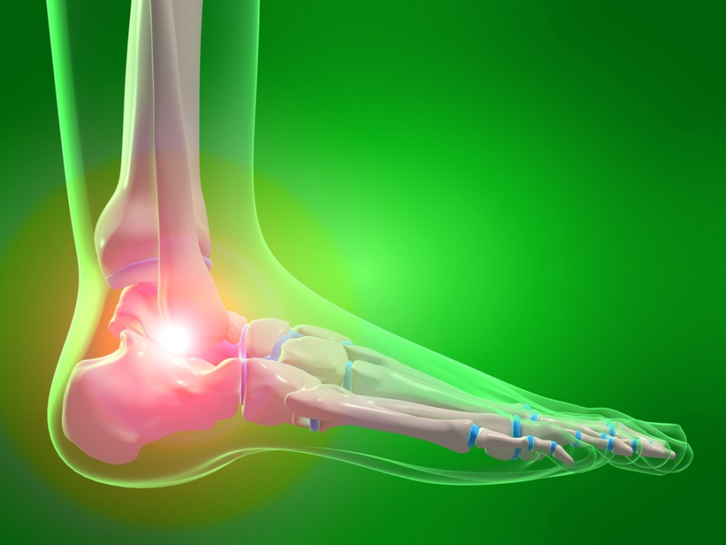
Shoes
Footwear should be:
Well fitted
Comfortable
Supportive
Closed toe
Non-slip
Clean
Notes:
Facilitator’s Script: Most healthcare providers are required to do a lot of standing during the work day. The feet support the entire body. Twenty-five percent (25%) of the bones in your body are located in the feet. Feet in distress, even if a single bone in the foot is misaligned, can change the balance and alignment of the body which can have painful side effects.
Ill-fitted shoes can cause corns, blisters, and bunions that can lead to the need for foot surgery
Supportive shoes help to reduce the shock absorbing motion of the ankle, foot and lower leg, and control balance. Non-supportive shoes can result in back pain.
Closed-toe shoes are generally required in clinical settings to protect the healthcare worker from spills.
Shoes that provide traction helps to reduce the potential for slips and falls.
Clean shoes supports the presentation of professionalism.

Slide 14
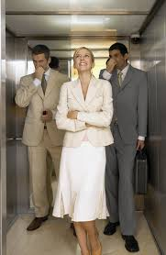
Personal Hygiene
Acceptable personal hygiene is essential when working in close contact with others and includes:
Daily Bathing
Clean Clothing & Undergarments
Good Dental Hygiene
Use of Deodorant/Antiperspirant
Clean Hair & Fingernails
Notes:
Facilitator’s Script: Personal hygiene practices are essential to minimizing the spread of disease and a primal courtesy to those around you. A daily bath or shower, use of deodorant or antiperspirant, good oral hygiene, and clean undergarments all help prevent body odor. Tobacco, perfumes, scented hair sprays, and after shaves can be offensive and should not be present in a healthcare setting! Some scents can cause allergic reactions.

Slide 15
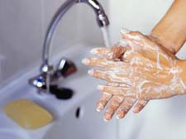
Fingernails
Should be kept:
Short
Clean
Neat
Clear
Notes:
Facilitator’s Script: According to the CDC (Centers for Disease Control), “hospital patients in America get nearly 2 million infections per year. That’s about 1 patient out of every 20.” Good hand hygiene can help to minimize the transfer of infections. The fingernails of healthcare professionals should be kept:
SHORT - Research conducted by the Infectious Disease Society of America concludes that artificial and natural nails longer than 3 millimeters beyond the tip of the finger carry more harmful bacteria and yeast than shorter nails. Long nails can tear or puncture gloves which can be harmful to both the practitioner and patient.
Clean – Dirt, visible or hidden, can introduce harmful bacteria to the patient.
Neat – having snagged or broken nails can cause scratches, and may also be a “turn off” for the patient calling the practitioner’s professionalism into question.
Clear - The use of colored nail polish and elaborate designs are discouraged because it can hide dirt that may be collected under the nail.

Slide 16
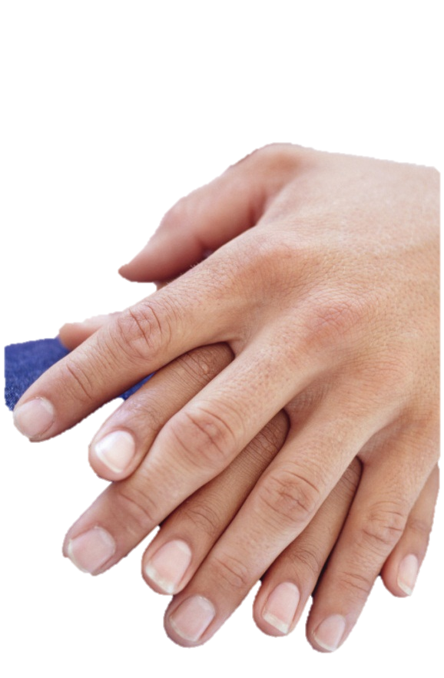
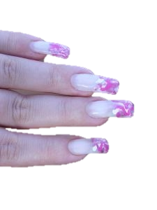
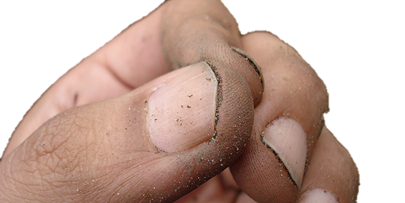
Which Do You Prefer?
A
B
C
X
X
Notes:
Facilitator’s Notes: Based upon the information that was just discussed, which set of hands would you prefer to belong to your healthcare provider?

Slide 17
Hair
Hair should be kept:
Clean
Well groomed
Pulled back & pinned-up off the collar
Notes:
Facilitator’s Notes: The hair on the human head provides a primary source of heat insulation and cooling, helping to keep the body’s internal temperature regulated. It also provides protection from ultraviolet (UV) radiation exposure. Eyebrows and eyelashes help to protect the eye from dirt and sweat. Because hair acts as a protective shield for the human body, it should be kept:
Clean – Dirty hair can cause, or aggravate, acne breakouts on the face, neck, shoulders and even scalp. It also can result in causing an offensive odor
Well Groomed – Hair that is neatly styled and naturally colored supports a more professional presentation. A healthcare professional who looks professional increases the likelihood of creating a rapport of comfort with patients more quickly through first impressions
Pulled Back & Pinned up off the Collar – Whether in fields of research or providing direct patient care, healthcare professionals should wear hairstyles that will help to prevent strands from falling/shedding in the work area, or falling on or touching a patient.

Slide 18
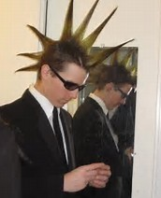
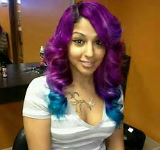
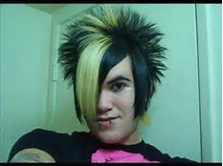
Unprofessional hair styles

Slide 19
Additions
MAKEUP should:
Add to the individual’s attractiveness
Look natural
JEWELRY should not:
Be oversized or excessive
Distract from the professional appearance
Notes:
Facilitator’s Notes: Excessive jewelry could interfere with the patient’s care, and detracts from the professional appearance of the healthcare provider. With the exception of small earrings, a watch, and wedding rings, many healthcare settings do not allow jewelry and/or facial piercings in direct patient care areas because it can cause injury to the patient and transmits germs and pathogens.

Slide 20
Characteristics
of an
Effective Healthcare Professional
Notes:
Facilitator’s Notes: Character is defined by the features or traits that make up of the individual nature of a person. The way you act in general instances, and react to situations demonstrates your character.

Slide 21
Professionalism
Professionalism includes the ability to:
Collaborate
Communicate well
Present a neat and well groomed appearance
Practice discretion
Notes:
Facilitator’s Notes: Healthcare workers should demonstrate a high level of professionalism characterized by an ability to:
Collaborate – work well with others. Teamwork is essential when providing direct patient care. A prime example is when working in the emergency room, each person must understand their role and be able to perform the responsibilities of that role in order to provide patient care quickly and accurately.
Communicate well – Healthcare providers must be able to briefly and clearly explain both verbally and in writing, the status of a patient and directions for the continued care of the patient.
Well-groomed appearance – helps to create a higher level of comfort for the patient.
Discretion – Patient information is confidential. Healthcare providers must not share the information of patients with individuals outside of the healthcare team.

Slide 22
Emotional Stability
Emotions support the health professional’s ability to cope with work-related stressors.
EMPATHY is the ability to identify with and understand the feelings, situations and motives of others.
SYMPATHY is the ability to agree with or feel similar feelings of others.
COMPASSION is the ability to demonstrate sympathy and empathy.
Notes:
Facilitator’s Notes: Healthcare providers must be able to handle stressful situations that often occur when caring for patients or the loss of a patient. The stressors of the job cannot interfere with job performance.

Slide 23
Integrity
Effective healthcare workers are:
Honest
Trustworthy
Able to distinguish between right & wrong
Able to make sound decisions
Notes:
Facilitator’s Notes: Integrity is the basis of who we are as individuals. It can be described as honesty and the adherence to moral and ethical principles. The integrity of healthcare providers requires that they are honest and trustworthy, and their ability to distinguish between right and wrong supports their ability to make sound decisions.

