Slide 1
Introduction to Health Careers
Video Facilitator: Tavy Smalls Health Careers Program Coordinator
Pee Dee AHEC
Notes:
ACTION POINTS
Administer Pre-Test: Introduction to Health Careers
Instructor: Today we are going to discuss Health Careers. Each student should think of a health career. Name a health career when you are called upon. No duplications are allowed.
[STOP TAPE – Restart when students are unable to name additional health careers]
Instructor: We were able to name several health careers, but there are over 200 different careers in health. No matter your interest, there is a health career that fits your personality and the things that you like.

Slide 2
Introduction to Health Careers Class Discussion / Activity
Pre- Test
Name a Health career

Slide 3
Introduction to Health Careers Class Discussion / Activity
Pause video
To complete Pre-test and
Class activity

Slide 4
Healthcare is Always Changing
Especially in rural areas (in the country)
Factors
People are living longer
People are living more productive lives
Advances in technology (applying scientific knowledge through machinery and equipment)
Notes:
ACTION POINTS
Read slide.
Instructor: Healthcare is always changing to meet the needs of population.
Technology is being used to increase the quality and availability of healthcare resources to residents of the more rural areas of the state.
Question: What is considered a “rural” area?
Answer: An area that is not developed, often called “the country”, and consists largely of farms and undeveloped land.
Does anyone have living grandparents or great-grandparents? How old are they? This is evidence that people are living longer lives. Not long ago, people could only expect to live to just over 50. Now, due to advances in medicine, nutrition, and fitness, people can expect to live to over 70 years old.

Slide 5
America Needs Healthcare Workers
By 2030, one-fourth of the U.S. population will be over age 65
90
80
70
60
50
40
30
20
10
0
1960
1970
1980
1990
2000
2010
2020
2030
2040
2050
Source: U.S. Bureau of the Census
Notes:
ACTION POINTS
Review slide to demonstrate how Americans are living longer lives.
Instructor: What is Gerontology? Gerontology is defined as the study of older individuals and the process of aging itself. There will be more job opportunities in this field because of an increasing number of older patients. What jobs could be affected?

Slide 6
Challenges
The population is getting older because people are living longer.
The population is getting larger and is more diverse.
The costs associated with healthcare are increasing.
Notes:
ACTION POINTS
Read slide
Instructor: What are some possible challenges that could affect healthcare in the future?

Slide 7
IMPACT
More health professionals are needed.
New health career specialty areas are developing.
Home healthcare demands will increase (a rapidly expanding area in the delivery of healthcare outside of a hospital, clinic or office; usually in the home).
Notes:
ACTION POINTS
Review slide.
Discuss the pros and cons of shorter trainings for careers.
Instructor: When people live longer, you have an increase in the population, and possibly the emergence of new illnesses. This will result in:
A need for more health professionals
A need for the development of new health specialty areas and training programs
A need to expand the way healthcare is delivered
Instructor: What are the pros and cons of the shortening health profession training programs? Will professionals be trained as well if a training program is shortened? Could the cost of training be less expensive?

Slide 8
IMPACT
Hospital stays are shorter because
of advancing technology
care can be delivered outside of hospital
of cost
Health professions training programs vary in length.
Notes:
ACTION POINTS
Review slide
Distribute HANDOUT 2: South Carolina Inventory of Health Care Training Programs
Allow time for reading and discussion
Instructor:
Improved technology will result in the development of new professions that will require employees with computer skills. Even current health careers are increasing the use of technology and the need for computer skills.
The education required will vary in length from 2-years to 4 or more years.
The key is to be academically prepared. Understand the relevance between what you are learning in your classes today and the requirements of the workforce. Your high school classes ranging from English and communications to history, math and science provide a foundation for future undergraduate classes.

Slide 9
Introduction to Health Careers Class Discussion / Activity
Pause video
To review and discuss activity
Handout 2: Colleges and Universities

Slide 10
Why Choose a Career in Health?
NO
Will it be easy?
Will it make you a productive and successful member of society?
You will be able to easily find a job which is well-paying, satisfying and always in demand in any location?
YES
YES
Notes:
ACTION POINTS
Review slide
Instructor:
There is little in life that is easy. As you prepare for any career, you will find that some aspects of the required education and training may not be too hard, and you may even find it a lot of it fun – it all lies in your areas of interest. However, becoming a health professional takes a great deal of commitment and requires a great deal of preparation.
As a health professional, you make an on-going impact in the lives of the people that you work with providing a necessary service with quality and care.
The healthcare field is one of the fastest growing fields in the nation. Job security is very strong because, unfortunately, people will always get sick

Slide 11
Why Choose a Career in Health?
There are 100’s of health professions.
Healthcare providers are in great demand due to people living longer.
The shortage is going to continue and grow, especially in rural areas or areas considered “country”.
The healthcare is the 2nd fastest growing field in America.
Notes:
ACTION POINTS
Read slide
Instructor:
There are careers that meet every personality and interest. Within one of the five health career majors (therapeutic services, diagnostic services, health informatics, support services, biotech research and development) charted on Handout 2, there are many careers that are also considered a part of one of the other 15 career clusters – business, culinary, art, engineering, education, and more.
As discussed earlier, the aging population is an increasing portion of the population, and we have more older adults than ever before. This is also true with the current health professions workforce. Many health professionals are reaching retirement age and leaving the workforce. More people needing healthcare combined with more people retiring from the healthcare workforce means that shortages exist within the workforce and more people are needed to become trained healthcare providers.
South Carolina has a lot of rural areas where there are not enough practicing healthcare professionals. These areas are considered “medically underserved areas” or “MUA’s”. New healthcare professionals are especially needed in these areas.
15 of the 30 fastest growing occupations are health-related.

Slide 12
The Skills
Multi-skilled providers are more marketable.
Multi-lingual providers are in high demand.
Computer skills will be necessary for better and more cost effective care.
Effective problem-solving and decision-making skills are important in addition to the skills needed to perform your job.
Notes:
ACTION POINTS
Read slide
Instructor:
The multi-skilled worker is in high demand in every profession and has a higher earning potential. For example: The nurse who is also a nutritionist is able to provide more services for a patient.
Because of the increased diversity in the American population, there is a greater need to have providers who are able to communicate in a variety of languages including sign language.
The use of computerized health records, patient charting, medication dispensing and even E-health through electronic platforms is requiring health providers to gain a proficiency in the use of technology.
The delivery of healthcare is changing. With an increase in home healthcare, professionals are working more independently than ever before and must be able to make good decisions

Slide 13
5 Majors within the Health Career Cluster
Biotechnology Research and Development
Health Informatics
Therapeutic Services
Support Services
Diagnostic Services
Notes:
Instructor: (refer to Handout 1: Health Career Cluster Majors)
The Health Career Cluster is 1 of the 16 South Carolina Personal Pathways career clusters
There are 5 majors within the Health Career Cluster:
Biotechnology Research and Development – Pursues advances in science and technology to support and improve the diagnosis and treatment of disease.
Health Informatics – Manages and documents healthcare system information to support patient care.
Therapeutic Services – Counters the effects of disease and injury to maintain or improve the health of patients. Includes physicians, dentists, psychologists and others who assist in the delivery of care.
Support Services – Creates and maintains a healthcare delivery environment that supports diagnosis and therapy to ensure the safe and efficient delivery of care.
Diagnostic Services – Analyzes and records the state of a patients health at the time of the examination. Includes the technicians who conduct procedures to provide the physician with the necessary information.

Slide 14
Introduction to Health Careers Class Discussion / Activity
Pause video
To review and discuss
Handout: 1

Slide 15
PREPARATION
The education and training for health careers varies from one career to the next.
Many health professions require a residency or internship.
A strong academic foundation supports a smooth progression through the health careers pipeline.
Notes:
Instructor: (reference Handout 2: South Carolina Inventory of Health Care Training Programs)
Educational requirements can last anywhere from a few months to receive special certifications like a CNA (certified nursing assistant) to a 2-year degree like a dental hygiene or physical therapy assisting to a 4-year degree like health promotion or medical technology or more like dental medicine or medicine
An internship, practicum or residency that varies in length may be required to successfully complete a health professions training program or prior to be able to fully practice within a profession of health
Having a basic foundation in math, biology, anatomy and communications helps students at each level of education. Understand the importance and relevance of what you are learning in the classroom now as the foundation for what you will learn in college, which will serve as the foundation to what you will need once you enter the profession.
Learning good study habits is a vital element to success!

Slide 16
Introduction to Health Careers Class Discussion
Pause Video
To discuss activity handout

Slide 17
7 Steps to a Successful Career in Health
Determine your likes, dislikes, and personal qualities.
Explore a variety of careers that are interesting to you.
Find the career(s) that suit your likes, dislikes and qualities.
Talk to professionals in those careers to determine what are the responsibilities of the job.
Volunteer and participate in service-learning projects.
Create an academic and career plan to follow.
Believe in yourself.
Notes:
ACTION POINTS
Review slide
Instructor:
With the wide array of health careers, you should be able to identify a profession that will allow you to do some of the things that you enjoy doing as a part of your job responsibilities.
Talking with practicing health professionals about what they do, the education and training required will be useful in helping you to explore careers.
Participating in service learning projects and volunteering at a hospital, clinic or other health-related facility will give you the opportunity to have an inside view to health careers while making an impact within the community that you live.
Becoming involved in programs like the South Carolina AHEC Health Careers Program and HOSA can assist you in exploring health careers and developing a plan. The career specialist and/or guidance counselor in your school is also a great resource.

Slide 18
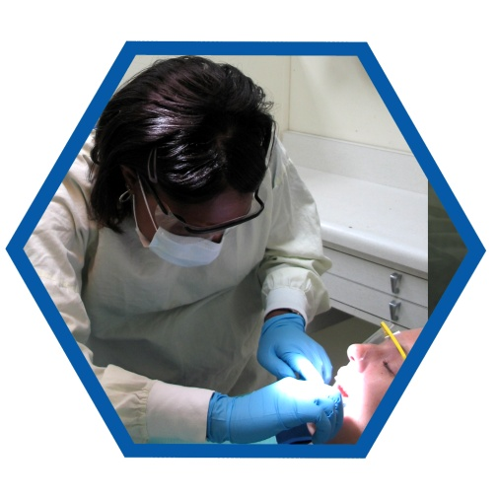
QUESTIONS & WRAP UP!!
Notes:
ACTION POINTS
Ask for questions
Facilitate Health Career Jeopardy (optional)
Disseminate Post-Test: Introduction to Health Careers

Slide 19
Introduction to Health Careers Class Activity
Health Career Jeopardy

Slide 20
Introduction to Health Careers Class Discussion / Activity
Pause video
To complete Health Career Jeopardy
(optional)
To complete Post-test

Slide 21
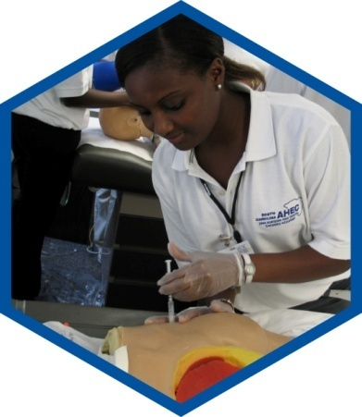
The South Carolina AHEC Health Careers Academy
Benefits
Opportunities to:
Participate in regional and state activities
Secure letters of reference for college
Network with health professionals
How?
Sign up at WWW.SCAHEC.NET
Contact your regional Health Careers Program Coordinator

