Slide 1
Health Careers Cluster
A Module of the
South Carolina AHEC Health Careers Academy
© South Carolina AHEC 2008

Slide 2
Educational Standards
Healthcare workers must:
Understand how employability skills enhance employment opportunities and job satisfaction
Demonstrate key employability skills within the workplace
Maintain and upgrade employability skills as needed

Slide 3
Objectives:
At the conclusion of this module, the learner will be able to:
Identify the 5 Pathways within the Health Sciences Cluster
Identify specific careers within the 5 Health Sciences Pathways

Slide 4

Please Pause
to
administer the module’s
Pre-Assessment
Notes:
Facilitator’s Notes
Activity: Administer the Handout 1: Health Careers Cluster Pre-Assessment. The assessment is provided on the next slide to allow students to use their own paper if you choose. Or hard copies may be printed for dissemination using the file located on the accompanying Health Careers Cluster DVD .

Slide 5












16 Career Clusters
SOURCE: http://www.sccsc.edu/Media/Website%20Resources/images/publications/Cluster-Templates-for-Students-and-Parents.pdf
Notes:
Facilitator’s Notes
SCRIPT: The Personal Pathways to Success includes 16 different career clusters to help South Carolina students gain the information, knowledge and skills that are important to establish, plan and achieve their career goals.

Slide 6
Health Sciences Cluster
Includes 5 career paths or majors:
Therapeutic Services
Diagnostic Services
Health Informatics
Support Services
Biotechnology Research & Development
Notes:
Facilitator’s Script: There are opportunities for management, planning, and provision of care within the 5 Health Sciences Cluster pathways which are:
Therapeutic Services
Diagnostic Services
Health Informatics
Support Services
Biotechnology Research & Development
Let’s take a few minutes to explore each of these paths and examples of careers available within each.

Slide 7
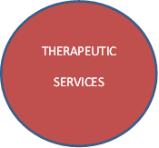

Who Does What?
DIAGNOSTIC
SERVICES
HEALTH INFORMATICS
SUPPORT
SERVICES
SUPPORT
SERVICES
HEALTH INFORMATICS
DIAGNOSTIC
SERVICES
Notes:
Facilitator’s Script: Let’s take a look at a brief description of each of the five career majors:
Therapeutic Services healthcare providers work to counter the effects of disease and injury, maintaining or improving patients’ health. They provide services for the treatment of disease and normal processes.
Diagnostic Services healthcare providers analyse, diagnose and record the state of a patient’s health at the time of the examination.
Health Informatics healthcare providers manage and document health care system information to support patient care.
Support Services healthcare providers often work in hospitals providing the range of information-management services needed to maintain the delivery of health care.
Biotechnology Research & Development healthcare providers often work in laboratories, offices and healing settings. They generally perform scientific procedures that further the delivery of healthcare.

Slide 8
Health Career Pathways
DIAGNOSTIC
SERVICES
HEALTH INFORMATICS
SUPPORT
SERVICES
PHYSICIAN
GENETICIST
EPIDEMIOLOGIST
HOSPITAL
MAINTENANCE
ENGINEER
GENETICIST
MEDICAL
TECHNOLOGIST
PHYSICIAN
GENETICIST
HOSPITAL MAINTENANCE ENGINEER
MEDICAL TECHNOLOGIST
EPIDEMIOLOGIST
Notes:
Facilitator’s Script: With the basic overview of the five career paths that was just discussed, in which path would you place the following healthcare professions:
[NOTE: Provide the following description of each of the listed professions. Allow the students to select which health career pathway the profession belongs within.]
PHYSICIAN – a doctor of medicine who focuses on promoting, maintaining, promoting, maintaining or restoring human health through the study, diagnosis, and treatment of disease, injury and other physical and mental impairments. There are general practitioners, also known as family practice physicians, as well as a variety of areas of specialization. PATHWAY: Therapeutic Services
GENETICIST – a biologist who studies the science of genes, heredity and variation of organisms. A geneticist can be employed as a researcher or lecturer. Some geneticists perform experiments and analyze data to interpret the inheritance of skills. A geneticist is also a Consultant or Medical Doctor who has been trained in genetics as a specialization. They evaluate, diagnose , and manage patients with hereditary conditions or congenital malformations, genetic risk calculation, and mutation analysis as well as refer patients to other medical specialties. PATWAYS: Diagnostic Services AND Biotechnology Research & Development
HOSPITAL MAINTENANCE ENGINEER - maintains the extensive heating, air-conditioning, refrigeration, and ventilation systems in hospitals. The equipment they operate includes boilers, air-conditioning equipment, diesel engines, turbines, pumps, condensers, generators, and compressors. They start up, regulate, shut down, or repair this equipment. They manually operate equipment, make adjustments, and regularly check safety devices. It is their responsibility to ensure that all of these systems are operating not just correctly, but also efficiently and safely. PATHWAY: Support Services
MEDICAL TECHNOLOGIST – also known as clinical laboratory technologists, or clinical laboratory scientists, play a crucial role in the detection, diagnosis, and treatment of disease. They perform complex chemical, biological, hematological, immunologic, microscopic, and bacteriological tests. Technologists microscopically examine blood and other body fluids. They make cultures of body fluid and tissue samples, to determine the presence of bacteria, fungi, parasites, or other microorganisms. Technologists analyze samples for chemical content or a chemical reaction and determine concentrations of compounds such as blood glucose and cholesterol levels. They also type and cross match blood samples for transfusions. PATHWAY: Diagnostic Services
EPIDEMIOLOGIST – a public health profession that studies health-event, health-characteristic, or health-determinant patterns in a society. It is the cornerstone method of public health research, and helps inform policy decisions and evidence-based medicine by identifying risk factors for disease and targets for preventive medicine. Epidemiologists are involved in the design of studies, collection and statistical analysis of data, and interpretation and dissemination of results. Major areas of epidemiologic work include outbreak investigation like what was portrayed in the 2011 movie Contagion, disease surveillance and screening (medicine), bio-monitoring, and comparisons of treatment effects such as in clinical trials. PATHWAY: Health Informatics

Slide 9
Health Career Pathways
DIAGNOSTIC
SERVICES
HEALTH INFORMATICS
SUPPORT
SERVICES
PHYSICIAN
MEDICAL
TECHNOLOGIST
EPIDEMIOLOGIST
HOSPITAL
MAINTENANCE
ENGINEER
GENETICIST
DIETITIAN
APPLIED RESEARCHER
PHARMACEUTICAL SCIENTIST
AUDIOLOGIST
GENETICIST
NUTRITIONIST
BIOMEDICAL ENGINEER
TOXICOLOGIST
PHARMACEUTICAL SCIENTIST
TOXICOLOGIST
APPLIED RESEARCHER
NUTRITIONIST
AUDIOLOGIST
BIOMEDICAL ENGINEER
Notes:
FACILITATOR’S SCRIPT:
PHARMACEUTICAL SCIENTIST – health professionals who discover, develop, test and manufacture new medications. These highly trained experts spend most of their time in a laboratory studying how different molecules and compounds interact with the human body and with the cells and organisms that cause disease.
TOXICOLOGIST – health professionals who plan and carry out laboratory and field studies to identify, monitor and evaluate the impact of toxic materials and radiation on human and animal health, and on the health and current status of the environment, as well as the impact of future technology. Forensic Toxicologists utilize science to help solve crime solves vaguely similar to what is portrayed in the CSI series of television shows.
APPLIED RESEARCHER – health professionals who use systematic inquiry involving the practical application of science. They accesses and use some part of the research communities' accumulated theories, knowledge, methods, and techniques, for a specific purpose. They deal with solving practical problems and generally use empirical methodologies.
NUTRITIONIST – health professionals who are also known as DIETITIANS plan food and nutrition programs, supervise meal preparation, and oversee the serving of meals. They prevent and treat illnesses by promoting healthy eating habits and recommending dietary modifications. For example, dietitians might teach a patient with high blood pressure how to use less salt when preparing meals, or create a diet reduced in fat and sugar for an overweight patient.
AUDIOLOGIST – This health professional uses various tools to diagnose ear problems including hearing difficulties and balance problems. They develop and implement courses of treatment to help their patients adjust to these problems , sometimes working with other medical professionals.
BIOMEDICAL ENGINEER – This professional uses math and science principals and design concepts to address technical issues in the areas of medicine and biology. Their work links scientific discoveries to commercial applications to meet consumer needs.

Slide 10

Embed BMH video clip
SOURCE: http://www.sccsc.edu/Media/Website%20Resources/images/publications/Cluster-Templates-for-Students-and-Parents.pdf
Notes:
Facilitator’s Script: Each of the 5 Health Career Cluster Pathways includes lots of different professions. Let’s take a closer look at the pathways and a sample of occupations within them. As shared earlier, occupations within the Therapeutic Services pathway work to counter the effects of disease and injury, maintaining or improving patients’ health. They provide services for the treatment of disease and normal processes.

Slide 11

Embed BMH video clip
SOURCE: http://www.sccsc.edu/Media/Website%20Resources/images/publications/Cluster-Templates-for-Students-and-Parents.pdf
Notes:
Facilitator’s Script: Employees in Diagnostic Services include all the technicians who conduct procedures that give physicians the information they need to provide effective treatment

Slide 12

Embed BMH video clip
SOURCE: http://www.sccsc.edu/Media/Website%20Resources/images/publications/Cluster-Templates-for-Students-and-Parents.pdf
Notes:
Facilitator’s Script: The occupations with the Health Informatics pathway manage and document health care system information to support patient care.

Slide 13

Embed BMH video clip
SOURCE: http://www.sccsc.edu/Media/Website%20Resources/images/publications/Cluster-Templates-for-Students-and-Parents.pdf
Notes:
Facilitator’s Script: Biotechnology Research & Development healthcare providers often work in laboratories, offices and healing settings. They generally perform scientific procedures that further the delivery of healthcare.

Slide 14
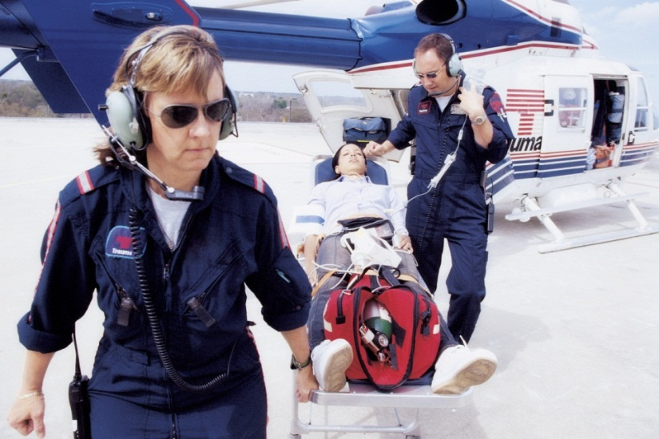
Embed BMH video clip
SOURCE: http://www.sccsc.edu/Media/Website%20Resources/images/publications/Cluster-Templates-for-Students-and-Parents.pdf
Notes:
Facilitator’s Notes: Support Services workers create and maintain a health care delivery environment that supports diagnosis and therapy. They maintain the health care setting in a way that ensures the safe and efficient delivery of care

Slide 15
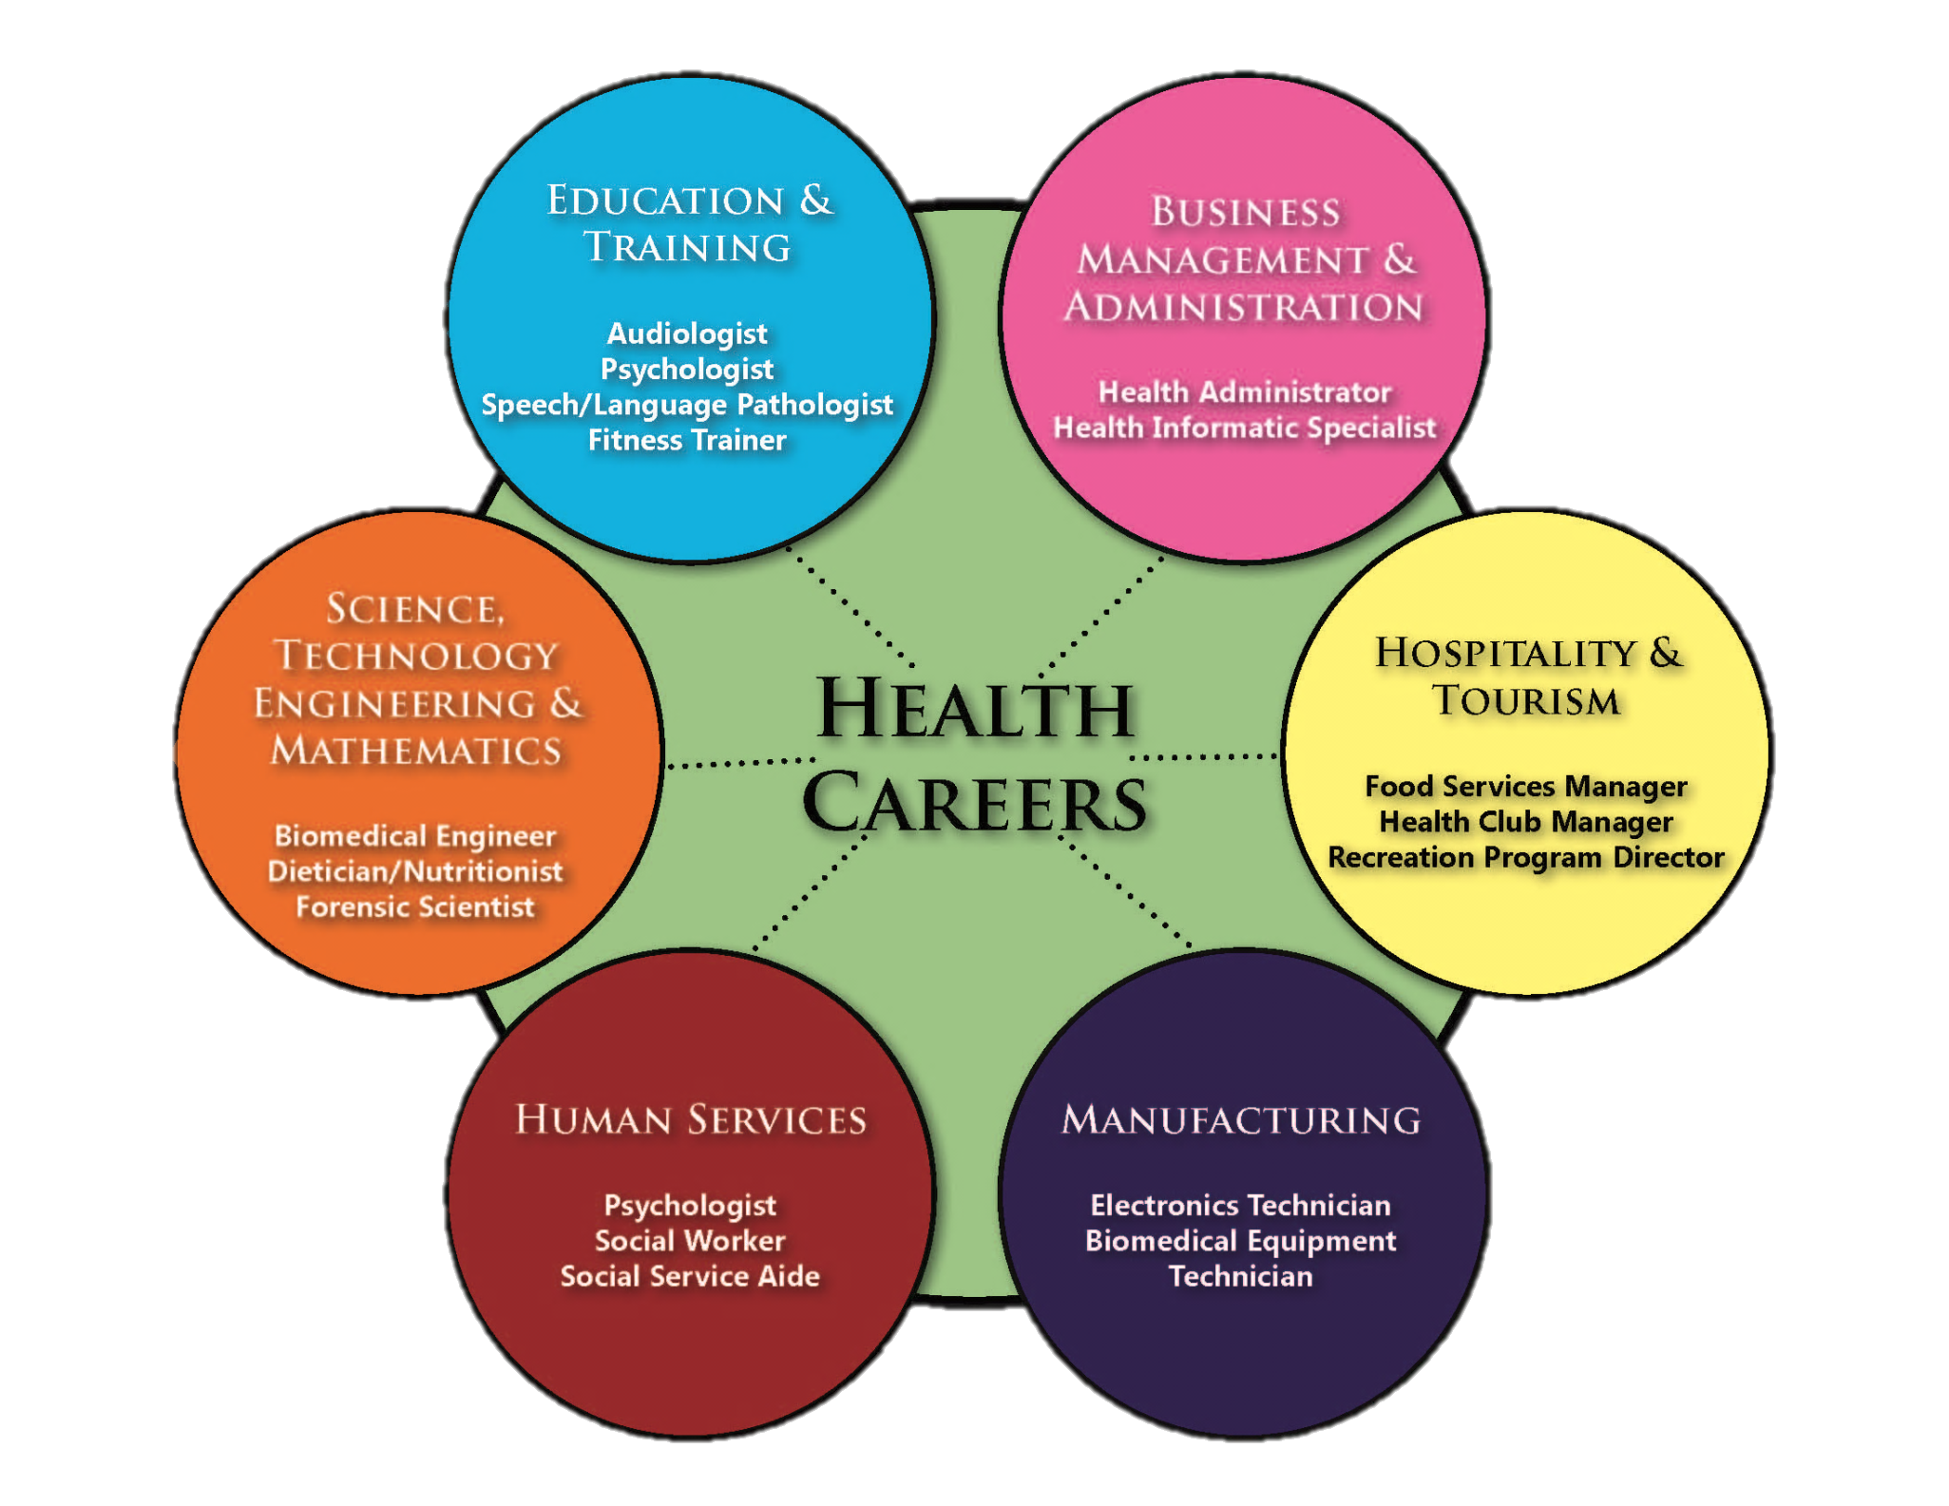
Notes:
Facilitator’s Script: There are approximately 300 professions within the Health Career Cluster. Several professions from many of the other 15 career clusters are also found within the health careers cluster. A few of them are shown here in the venn diagram shown here, but there are many more. Can you think of others?
Health Profession Career Cluster
Geneticist Science Technology, Engineering & Mathematics
Health Illustrator Arts, AV Technology & Communication
Forensic Scientist Law, Public Safety & Security
Health Educator Education & Training
Mental Therapist Education & Training & Human Service
Pharmaceutical Sales Marketing, Sales & Service

Slide 16
SOURCE: http://www.sccsc.edu/Media/Website%20Resources/images/publications/Cluster-Templates-for-Students-and-Parents.pdf
Notes:
Facilitator’s Script: This chart also demonstrates a few examples of careers that are found in more than one of the health science pathways. The careers that overlap are highlighted in red.

Slide 17
Compensation
The Amount of Education Required
Risk of Malpractice
Location
For Profit or Non-Profit Care
Level of Experience
Multi-Skilled
Multilingual
Shift Differential
Notes:
Facilitator’s Script: Generally, the more you invest in preparing for a career in healthcare, the more money you can anticipate earning. However, there are a few factors that can be associated with the amount of money a health professional can earn.
[NOTE: Categories appear on slide at mouse click)
Education – A career in healthcare can be accomplished with a different levels of education from a continuing education (CE) certificate that could take 3 to 6 months, a 2-year Associate’s degree, a 4-year Bachelor’s degree, or a 4-year Bachelor’s degree plus an additional 2-year or 4-year advanced degree.
Risk of Malpractice – professions that have a higher risk of causing temporary or permanent harm or injury to a patient could occur usually can command a higher rate of pay. However, the fees associated with malpractice insurance should be taken into account.
Location – there a some areas of the country and state that would pay salaries at a higher rate, but you must also take the cost of living into account
For Profit or Non-Profit Care – employees of a for-profit facility usually earn higher salaries than employees who work in non-profit facilities like clinics.
Level of Experience – as with many professions, salary increases are awarded to competent employees for years of experience
Multi-Skilled – employees who are able to perform multiple roles within a facility may be paid a salary differential
Multilingual – employees who are able to speak multiple languages eliminate the need to hire translators and are usually paid a salary differential
Shift Differential – in some areas of a hospital, higher pay rates are awarded to employees who work 3rd shift, 12-hour shifts, or shifts that are difficult to staff

Slide 18


ACTIVITY
Please Pause the Video
Notes:
NEWSPAPER ACTIVITY: Ask students to bring in the classified section of the Sunday newspaper. Disseminate Newspaper Activity Handout or have students to use their own paper to answer the following questions using the classifieds:
How many healthcare job listings are posted?
Which healthcare profession is listed most often?
Identify an job that is listed and write down the following information:
Job Title
Job Requirements
Type of Healthcare Facility (job location)
Salary
Using the salary posted, calculate the hourly, weekly, monthly, and yearly salary.
Conversion Chart:
Hourly Wage = Annual Salary / 40 (hours) / 52 (weeks)
Monthly Salary = Annual Salary / 12 (months)
Weekly Salary = Hourly Wage X 40 (hours)
Annual Salary = Monthly Salary X 12 (months)

Slide 19
Fastest Growing Careers
Education/Training S.C. Salary Range
1. Biomedical Engineer Bachelor’s Degree $50,600 - $110,200
2. Home Health Aides On the Job Training $16,200 - $25,600
5. Medical Scientist Doctoral Degree $32,200 - $99,000
6. Physician Assistant Master’s Degree $47,700 - $110,400
8. Biochemists/Biophysicist Doctoral Degree $34,700 –$144,200
9. Athletic Trainers Bachelor’s Degree $22,000 – $64,400
11. Dental Hygienists Associate’s Degree $39,500 – $71,100
12. Veterinary Technologist Associate’s Degree $18,700 - $48,600
Source: Career One Stop: Pathways to Career Success http://www.careerinfonet.org
Notes:
Facilitator’s Script: According to the Career One Stop: Pathways to Career Success website, there are 16 health-related professions that are among the 25 fastest growing careers. There are approximately 400 occupations within the Health Career Cluster and the education and training varies.

Slide 20
Fastest Growing Careers
Education/Training S.C. Salary Range
13. Dental Assistant Technical Diploma $23,200 - $41,500
15. Medical Assistant Technical Diploma $21,000 - $38,200
16. Physical Therapist Assist. Associate’s Degree $32,800 - $65,400
17. Veterinarian Professional Degree $58,600 - $166,400
20. Occupational Therapist Aide Short Term Training $16,900 - $29,200
21. Environmental Engineer Bachelor’s Degree $44,000 - $114,400
22. Pharmacy Technician Short Term Training $17,600 - $36,800
25. Physical Therapist Master’s Degree $37,900 - $103,200
Source: Career One Stop: Pathways to Career Success http://www.careerinfonet.org
Notes:
Facilitator’s Note: According to Bureau of Labor and Statistics, about 26% of all new jobs are within the healthcare field. When you take a few minutes to think about it, people will always have health-related illness and challenges.
According to the US Bureau of Labor and Statistics, the baby boomer generation continues to age, that’s the 55 and older age group that is projected to increase by 29.7%, more than any other age group. The population aged 16 to 24 will grow 3.4%, and minorities and immigrants are expected to constitute a larger share of the U.S. population in 2018. The numbers of Asians and people of Hispanic origin are projected to continue to grow much faster than other racial and ethnic groups.
[source: http://www.bls.gov/oco/oco2003.htm, retrieved 09/2011]
All of this suggests that:
The baby boomers that are currently employed in healthcare are beginning to retire at a fast pace
There is going to be an increased need for geriatric care. Geriatrics refers to the care of elderly patients
There will be an increased need for a more diverse level of care to meet the needs of a more diverse population.
These factors leads one to conclude that more healthcare providers and more diverse healthcare providers will be needed to meet the healthcare demands across the nation.

Slide 21

Highest Paying Careers
Education or Training 2010 Median Salary
1. Anesthesiologist Medical Degree $166,400+
2. Internist, General Medical Degree $166,400+
3. Obstetrician/Gynecologist Medical Degree $166,400+
4. Oral/Maxillofacial Surgeon Medical Degree $166,400+
5. Orthodontist Dental Medicine Degree $166,400+
6. All Other Physicians Medical Degree $166,400+
7. All Other Surgeons Medical Degree $166,400+
9. Psychiatrist Medical Degree $164,200
Source: Career One Stop: Pathways to Career Success http://www.careerinfonet.org
Notes:
Facilitator’s Script: 16 Health-related professions were among the 25 highest paying careers in the nation in 2010 according to the Career One Stop: Pathways to Career Success website. Additional information is available through the One Stop website at www.careerinfonet.org.

Slide 22
Highest Paying Careers
Education or Training 2010 Median Salary
10. Family/General Practitioner Medical Degree $163,500
11. Dental, All Other Specialist Dental Medicine Degree $161,000
12. Pediatrician, General Medical Degree $154,400
13. Dentist, General Dental Medicine Degree $141,000
16. Prosthodontist Master’s Degree $118,400
17. Podiatrist Medical Degree $118,000
18. Natural Sciences Managers Bachelor’s Degree $116,000
23. Pharmacist Doctorate Degree $111,600
Source: Career One Stop: Pathways to Career Success http://www.careerinfonet.org
Notes:
Facilitator’s Script: Wage estimates include base rate, cost-of-living allowances, guaranteed pay, hazardous-duty pay, incentive pay (e.g. commissions and production bonuses), and on-call pay. The estimates DO NOT include shift differentials, nonproduction bonuses or tuition reimbursements that are often provided for health professionals who return to school for additional education and training to support professional advancement.

Slide 23
Quick Summary
There are 5 Personal Pathways within the Health Career Cluster:
  Therapeutic Services
  Diagnostic Services
  Health Informatics
  Support Services
  Biotechnology Research & Development

Slide 24
Quick Summary
Many professions included in one of the other 15 Career Clusters can also be found within the Health Career Cluster
Health professions are consistently represented on the nation’s fastest growing occupations list

Slide 25
Quick Summary
Many factors influence the salary of practicing health professionals:
  Education
  Malpractice Risks
  Location
  Experience
  Skill-set
  Language Abilities
  Shift Differentials

Slide 26
?? QUESTIONS ??
Post-Test
Please Pause
to
administer the
Post-Assessment
Notes:
[Facilitator Notes]: Open the floor for questions. You can anticipate questions about the educational requirements and salary levels of specific health professions. Students can be referred to the SC Occupational Information System (SCOIS) on-line resource to explore answers to these questions. The Health Career Cluster Handout can be utilized as an extended learning assignment to encourage students to begin the process for an in depth career and education exploration.
Students who choose to gain membership in the South Carolina AHEC Health Careers Academy (HCA) will be provided with free access to SCOIS and receive a variety of activities that can be completed through the website. Please see your regional HCP coordinator for additional information.

