Slide 1
Applications of GLMs in Genetics and Genomics
Dongjun Chung
7/13/2015

Slide 2
Table of Contents
Logistic regression in statistical genetics.
Negative Binomial regression in statistical genomics.

Slide 3
Logistic Regression: Statistical Genetics

Slide 4
The Story begins with…

Slide 5
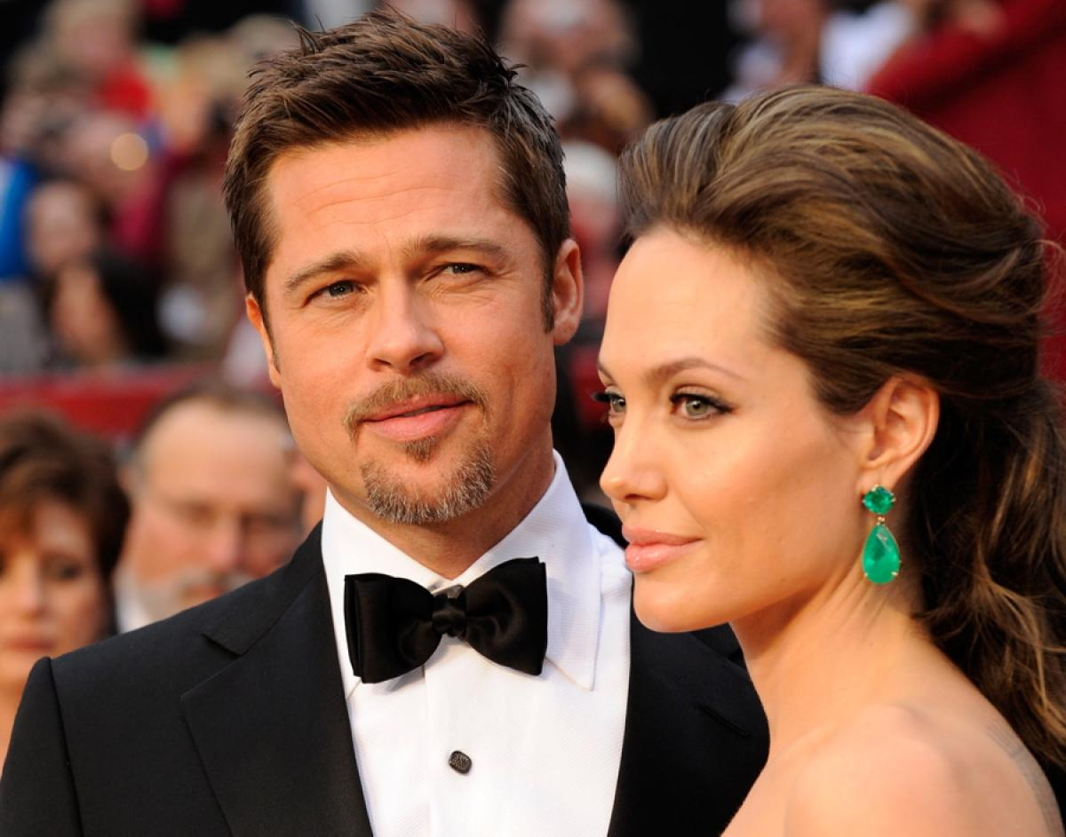
She was famous for…

Slide 6
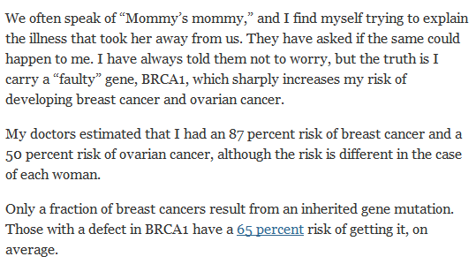
Recently also became famous for…
http://www.nytimes.com/2013/05/14/opinion/my-medical-choice.html?_r=0

Slide 7
BRCA1 Gene?
http://www.breastcancer.org/risk/factors/genetics

Slide 8
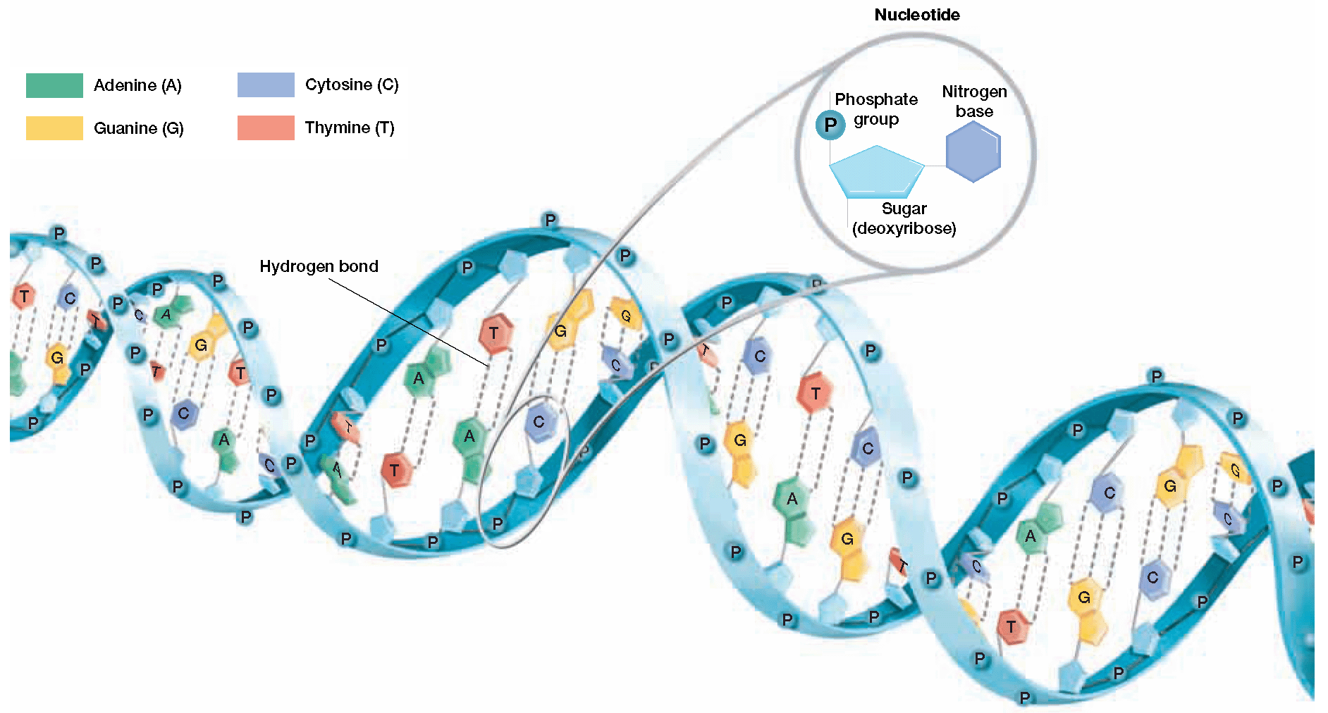
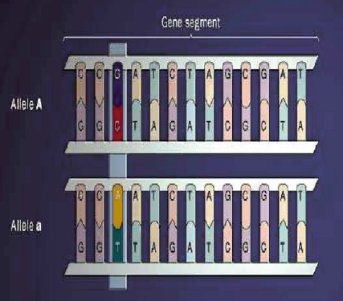
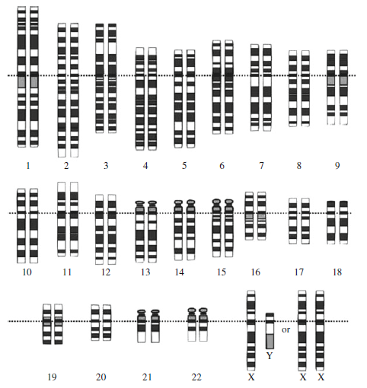
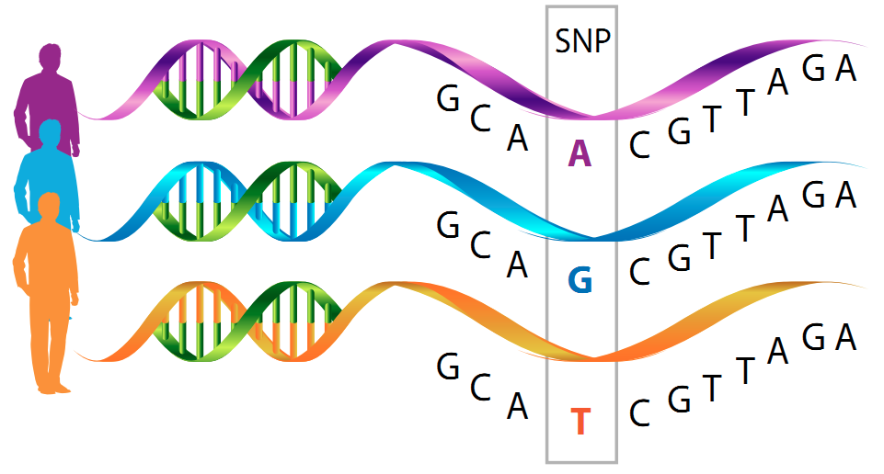
Single Nucleotide Polymorphism (SNP)
Diploid
Laird & Lange (2011)
http://biogeniq.ca/snp/
http://biologydiva.pbworks.com/w/page/47793659/Chapter%209

Slide 9
Another Story…
Anne Wojcicki
http://www.makers.com/anne-wojcicki
https://en.wikipedia.org/wiki/Sergey_Brin
Sergey Brin

Slide 10
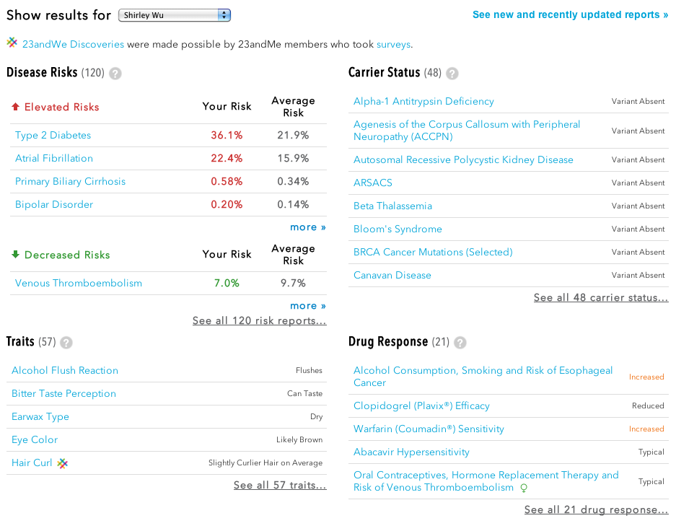
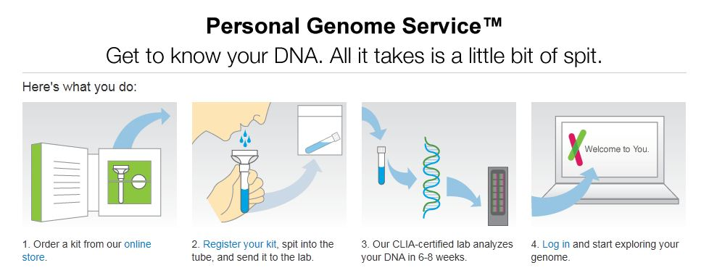
23andMe: Risk Prediction
http://blog.23andme.com

Slide 11
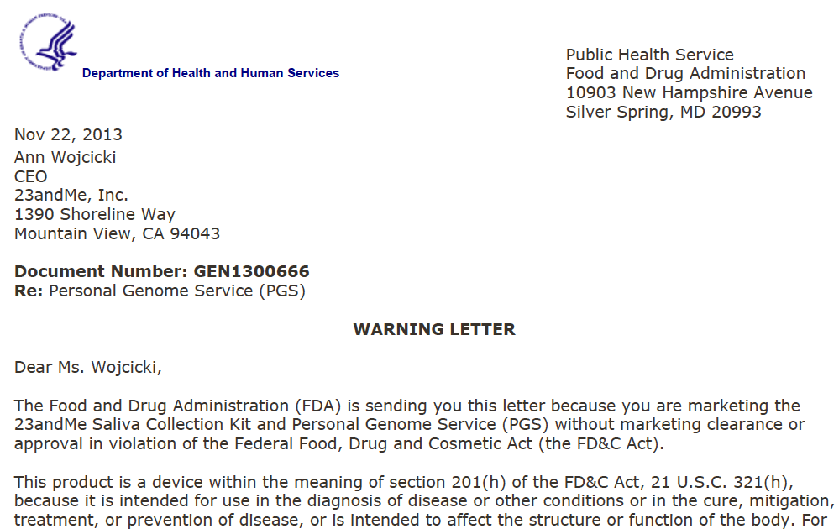
23andMe: Now..
http://www.fda.gov/ICECI/EnforcementActions/WarningLetters/2013/ucm376296.htm

Slide 12
PTSD
PTSD: Post-Traumatic Stress Disorder.
Zhewu
Wang, M.D.
https://www.youtube.com/watch?v=I3Ir3xdwqWw

Slide 13
PTSD: Research Question
Why only 30% of veterans have symptoms of PTSD?
Is there any biological pathways associated with high risk group of PTSD?
Is there any genetically high risk group of PTSD?

Slide 14
PTSD

Slide 15
PTSD: Data Description
SLC1A1 gene:
SLC1A1 is a glutamate transporter, regulating extrasynaptic glutamate level.
No prior work examined glutamatergic genes in relation to PTSD.
However, evidence has been cumulated for its connection to fear conditioning, stress, anxiety disorders, memory, & synaptic plasticity.

Slide 16
PTSD: Data Description
Combat exposure scale

Slide 17
Data Structure
X: SNP genotype data from SLC1A1 (p = 13).
Coding of genotype matrix based on minor allele count.
 | SNP #1 | SNP #2 | SNP #3 | SNP #4
Person #1 | GG | AA | CC | TT
Person #2 | GA | AA | CC | TC
Person #3 | AA | GG | CC | TC
 | SNP #1 | SNP #2 | SNP #3 | SNP #4
Person #1 | 0 | 2 | 0 | 0
Person #2 | 1 | 2 | 0 | 1
Person #3 | 2 | 0 | 0 | 1

Slide 18
Data Analysis: Association mapping
Identification of risk-associated SNPs.
Logit(y) = β₀ + β_{C} [ covariate ] + β_{G} [ SNP genotype ].
Estimation of β_{G} & hypothesis testing of H₀: β_{G} = 0.
Example: “faulty gene” BRCA1 for breast cancer.
So what?
Used as a biomarker for disease risk.
Understand biology underlying disease risk.
Potential therapeutic targets.

Slide 19
PTSD: Association mapping
Gender is associated with PTSD while age & race are not.
One SNP, rs10739062, was associated with PTSD.
However, this SNP-level test has limited power.

Slide 20
PTSD: Association mapping
Genetic risk sum score (GRSS):
Sum of # risk alleles in the direction of risk.
GRSS is significantly associated with PTSD.
OR = 1.15, p = 0.003, 95% CI = 1.05 – 1.26.
A greater # of copies of risk alleles across SLC1A1 is related to higher odds of PTSD.

Slide 21
Data Analysis: Risk prediction
Identification of people at risk.
Estimation of p_{new} = sigmoid( y_{new} ), based on X_{new}.
Example: 23andMe.
So what?
Allow people know about their disease risk.
Allow early intervention to delay the disease.
e.g., preventive mastectomy for Angelina Jolie.
Allow “personalized medicine”.

Slide 22
23andMe: How It Works?
X
β
p_{new}
X_{new}
http://blog.23andme.com

Slide 23
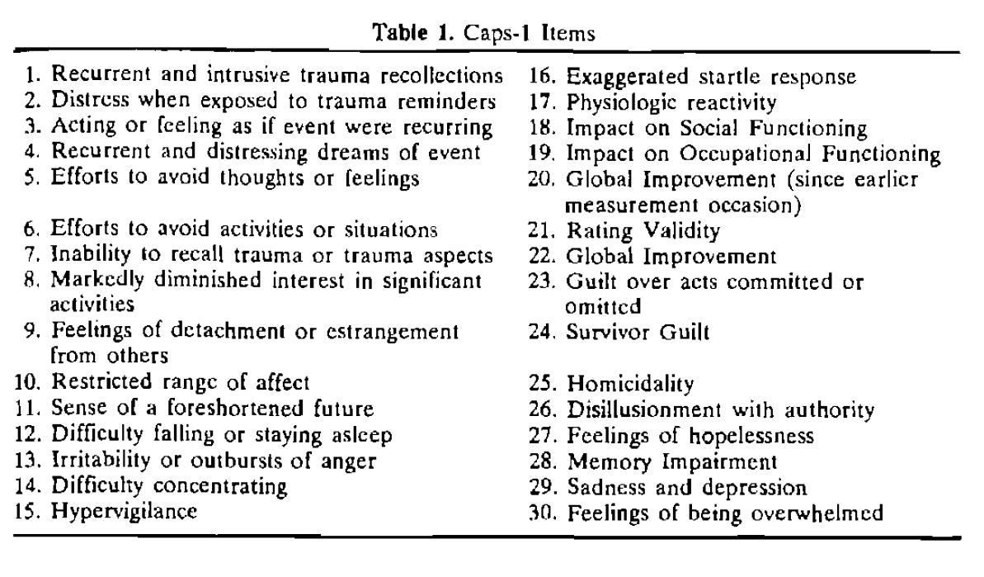
Issues
Response (Y):
Phenotyping accuracy?
E.g., PTSD is “mainly” determined using the CAPS (Clinician Administered PTSD Scale) score.

Slide 24
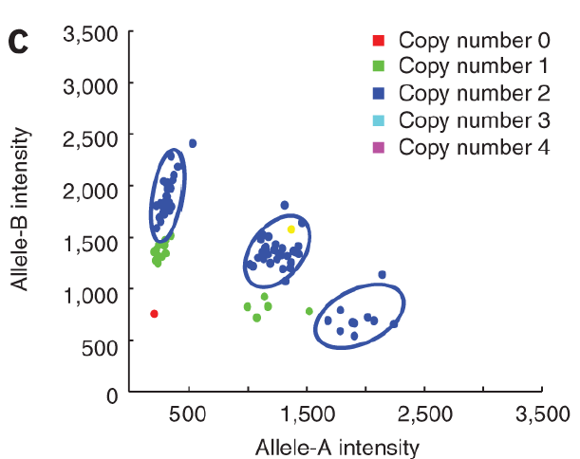
Issues
Predictor (X):
Coding of SNPs:
Genetic models: Additive, dominant, recessive.
Gene-level summary:
GRSS, PCA, …
SNP selection?
Genotyping error?
Missing genotype?
How to impute?

Slide 25
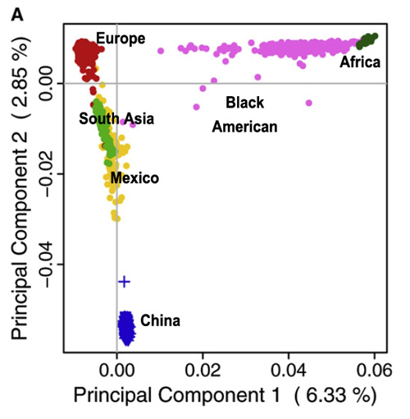
Issues
Independence among observations:
Family-based study.
Covariates:
Age, Gender, Race, …
Accuracy of covariate?
Admixture?
Shared environment?
http://scienceblogs.com/gnxp/2009/02/16/genomic-diversity-historical-i/

Slide 26
Statistical Issues
Limitation of candidate gene studies:
Hypothesis-based studies.
We need to figure out good candidates that might contain risk-associated SNPs.
Alternative:
Hypothesis-free approach.
Scan “all” the SNPs on a genome (or large #).
“Genome-wide association studies (GWAS)”.
Utilize high throughput microarray (e.g., 1M SNPs).

Slide 27
Statistical Issues
High dimensional data analysis:
In GWAS, p = 10⁶ SNPs, while n = 10³ ~ 10⁵ people.
Interaction among SNPs:
10⁶ * (10⁶ - 1 ) / 2!
Interaction between SNP and environment.
Issues:
Limited statistical power.
False discoveries.

Slide 28
Negative Binomial Regression: RNA-Seq Data Analysis

Slide 29
The story begins again with…

Slide 30
BRCA1 Gene
http://www.breastcancer.org/risk/factors/genetics

Slide 31
The Cancer Genome Atlas

Slide 32
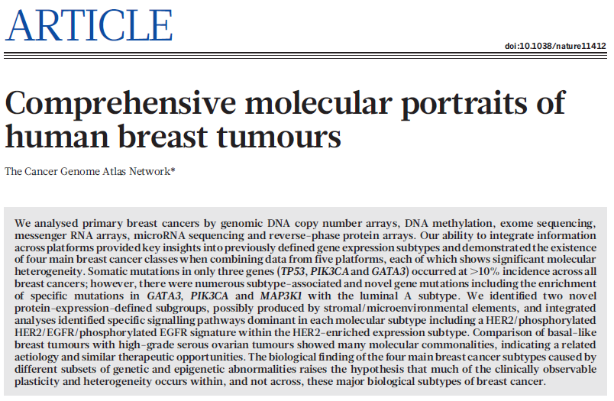
The Cancer Genome Atlas

Slide 33
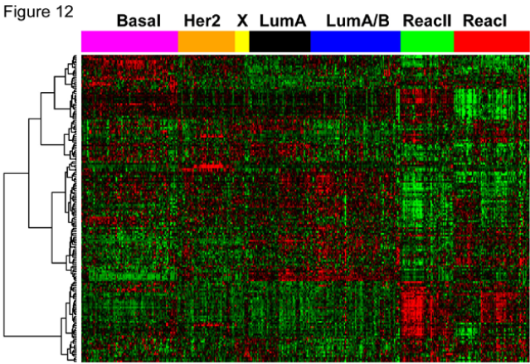
The Cancer Genome Atlas

Slide 34
Oral Squamous Cell Carcinoma
Question:
Which genes are differentially expressed (DE) between tumor and normal tissues?
Reference:
McCarthy et al. (2012), Nucleic Acids Research.
edgeR User’s Guide, Section 4.4.
Tuch et al. (2010), PLoS One.

Slide 35
RNA-seq
High throughput sequencing (HTS) & RNA-seq:
Revolutionized genomic studies.
de facto standard in current genomic studies.

Slide 36
RNA-seq
Essentially, HTS is a sampling process.
For class (treatment) i & library (replicate) j of library size (# reads) m_{ij},
…
Gene₁
Gene₂
Gene_{p-1}
Gene_{p}
…
λ_{ij,1}
λ_{ij,2}
λ_{ij,(p-1)}
λ_{ij,p}
…
Y_{ij,1}
Y_{ij,2}
Y_{ij,(p-1)}
Y_{ij,p}

Slide 37
RNA-seq
(Y_{ij,1}, …, Y_{ij,p}) ~ Multinomial( m_{ij}, (λ_{ij,1}, …, λ_{ij,p}) ).
For given gene, we have
Y_{ij,g} ~ Binomial( m_{ij}, λ_{ij,g} ).
In our case,
m_{ij} is usually several million.
λ_{ij,g} close to zero: we have about 20K genes.
m_{ij}λ_{ij,g} can be assumed to be constant (gene expression level).
Y_{ij} can be approximated with Poisson( m_{ij}λ_{ij,g} ).

Slide 38
RNA-seq
Over-dispersion:
In practice, biological & technical variability exist and abundance (m_{ij}λ_{ij}) is not constant between replicates.
If we assume that true gene abundances follow Gamma distribution between replicates, we have Negative Binomial.
Anders et al. (2013), Nature Protocols

Slide 39
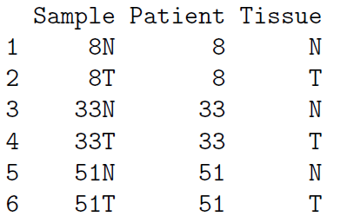
Data Structure
Y: Gene expression measurement.
Count of reads mapping to each gene.
Higher counts might imply higher level of gene expression.
X: Design matrix.
Tumor vs. normal.
Patient as the block factor.
[Note] Both tumor and normal tissues are obtained from each of three patients.

Slide 40
Estimation
Small sample size!
We have only 3 samples in each condition (n = 6).
This is usually the case in RNA-seq studies: cost!
We need to estimate three coefficients (β) & one over-dispersion parameter (φ_{g}) for each gene.
Inaccurate estimation can result in low statistical power.

Slide 41
Estimation
Estimation of gene-specific over-dispersion parameter is unreliable due to small sample size.
Fortunately, there might be some information shared among genes, which can improve estimation accuracy.
Robinson & Smyth (2008), Biostatistics:
Assumed common over-dispersion parameter for all the genes, i.e., φ_{g} = φ, for all g. More stable than gene-specific parameter BUT too strong assumption!

Slide 42
Estimation
Empirical Bayes approach:
Adaptive strategies.
Information sharing across genes.
It provides regularization between gene-specific estimate (Φ_{g}*) & common estimate (Φ).
Φ₁*
φ₁
⁞
⁞
φ
φ_{G}*
φ_{G}

Slide 43
Estimation
Likelihood to estimate over-dispersion:
Robinson & Smyth (2007), Bioinformatics:
l( φ_{g} ) + α l_{C}( φ_{g} ).
McCarthy et al. (2012), NAR:
APL_{g}( φ_{g} ) + G₀ APL_{Sg}( φ_{g} ).
α and G₀ determine degree of shrinkage of estimates to “prior” & are chosen by reflecting degree of confidence about common dispersion.
Should be higher when dispersions not very different.

Slide 44
Multiple Testing
We have 16K genes to investigate DE between tumor and normal tissues, i.e., 16K tests.
Control for family-wise error rate (FWER).
P( reject at least one H₀ | all H₀ is true ) ≤ α.
Bonferroni correction? 0.05 / 16K = 0.000003.
Almost no gene passes this cut-off in RNA-seq studies.
FWER too conservative; insufficient statistical power.
Is such FWER control actually needed?
RNA-seq is a hypothesis generating studies.

Slide 45
Multiple Testing

Slide 46
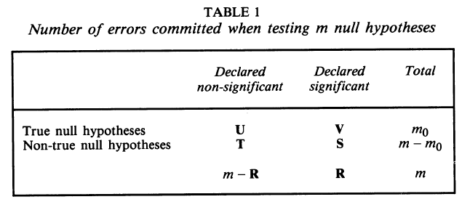
Multiple Testing
Control for False Discovery Rate (FDR).
FWER: P( V ≥ 1 ) ≤ α: prob of at least one mistake.
FDR: E( V / R ) ≤ α: expected ratio of mistakes.

Slide 47
Multiple Testing
Properties of FDR:
If H₀ is true for all genes, FDR = FWER.
If m₀ < m, then FDR ≤ FWER.
Benjamini-Hochberg FDR control procedure:
In R, p.adjust( pval, method = “BH” )

Slide 48
Oral Squamous Cell Carcinoma
At 5% FDR, 1268 genes are differentially expressed.
332 up-regulated & 936 down-regulated in tumor.
The up-regulated genes in tumors tend to be associated with cell differentiation, cell migration, and tissue morphogenesis.

Slide 49
Issues
Response (Y):
Quantification of gene expression.
Essentially, HTS is a sampling process. The more reads, the more accurate quantification we have. However, at the time, the higher cost will be.
However, we also want to increase # replicates to improve statistical power.
Given fixed cost, there is a trade off between more replicates in differential expression test vs. more accurate quantification of gene expression.

Slide 50
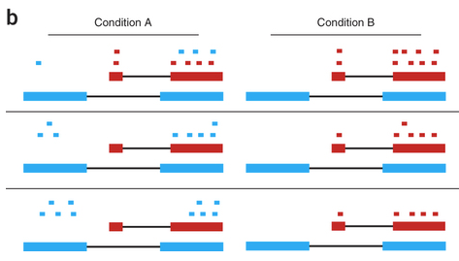
Issues
Response (Y):
Quantification of gene expression.
Mapping, annotation, novel transcriptome, isoform-level analysis, …

Slide 51
Statistical Models in Bioinformatics

Slide 52
Spring 2016
“Statistical Methods in Bioinformatics”

Slide 53
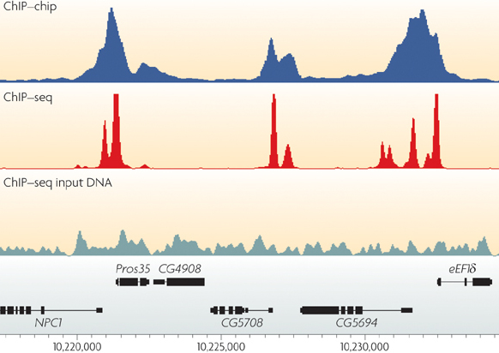
Coverage: Genomics/Genetics

Slide 54
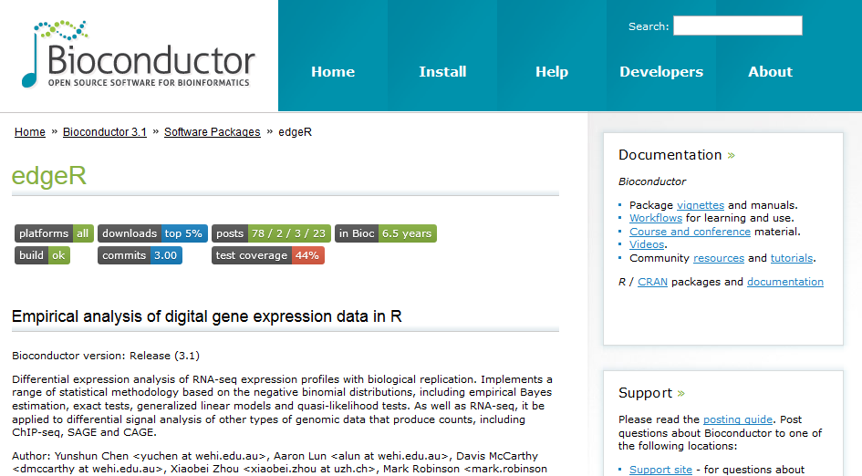
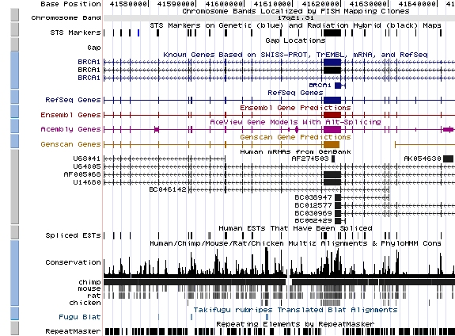
Coverage: Software/DB

Slide 55
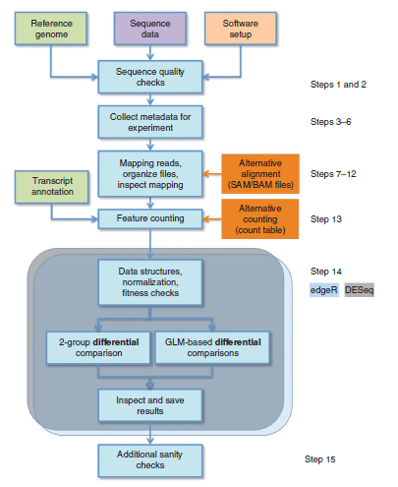
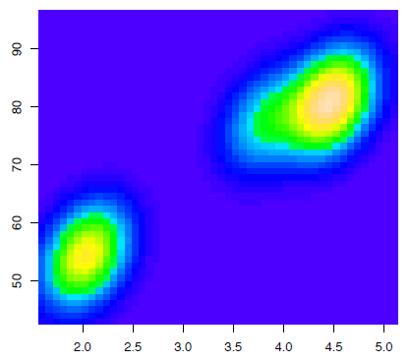
Coverage: Statistical Models

Slide 56
Take Home Messages
GLM works as powerful tools and are widely utilized in genetics and genomics.
High dimensionality is a big issue, especially, (1) low statistical power, (2) false discoveries, (3) computation, (4) asymptotics, & (5) QC.
Information sharing & regularization are powerful approaches to address this issue.

Slide 57
Questions?

Slide 59
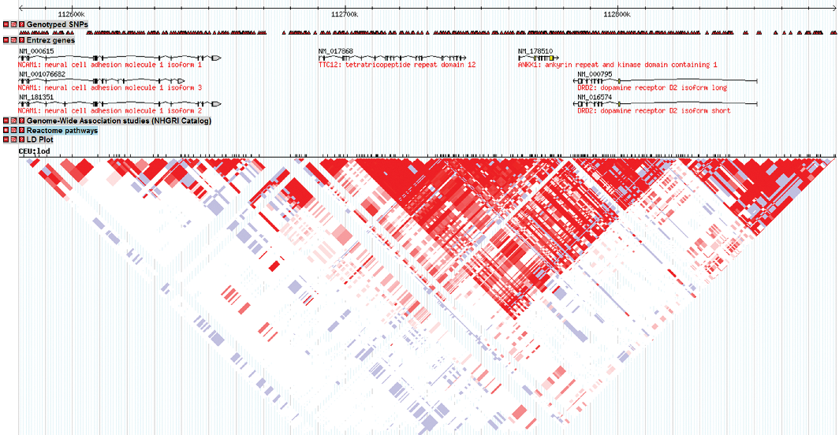
Statistical Issues
Correlation among SNPs:
Dick et al. (2011), Frontiers in Psychiatry

Slide 60
Statistical Issues
Utilization of prior biological knowledge:
Lu et al. (2015), Nature Scientific Reports
http://genocanyon.med.yale.edu/index.html

Slide 61
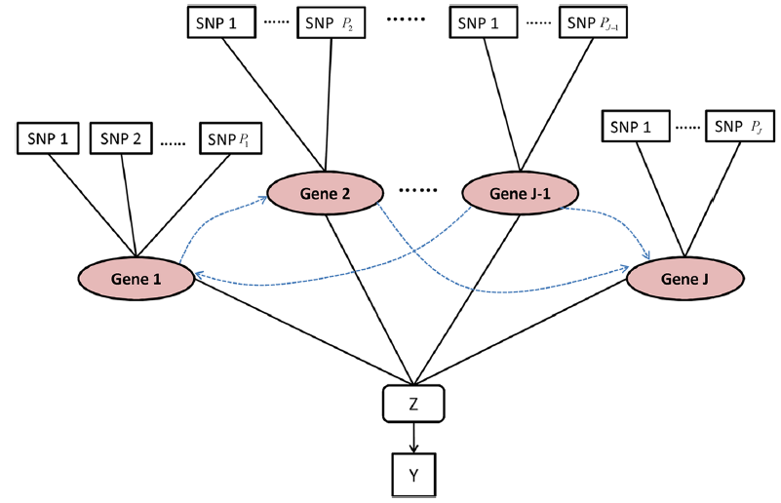
Statistical Issues
Utilization of prior biological knowledge:
Zhang et al. (2014), BMC Genetics

