Slide 1
“It’s like iTunes meets Facebook for academic research”
Statistical Computing
Spring 2013

Slide 2
Program Capabilities
Add and Organize
Import and organize PDFs from your computer, EndNote™, Papers or Zotero.
Reference Manager
Generate citations and bibliographies in Microsoft Word, OpenOffice, and LaTeX.
Read and Annotate
Open PDFs and capture your thoughts through sticky notes and highlights.
Collaborate
Connect with colleagues and securely share your papers, notes and annotations.
Backup, Sync and Mobile
Access your papers on the web, iPhone or iPad.
Network and Discover
Discover papers, people and public groups.
http://www.mendeley.com/features/

Slide 3
Getting Started
http://www.mendeley.com/
Click the green sign up and download button (or you can link through your facebook account)

Slide 4
Mendeley Setup
Tools->Options
File Organizer: Select a location on the computer where Mendeley will keep a complete set of all papers
Rename all papers using a common convention
Watched Folder: Identify folder(s) where you commonly save pdfs. Program will automatically check this folder and add items to library
Can set up different watched folders for each desktop

Slide 5
Adding Papers Manually
Add Files
If there is a specific saved document not in the watch folder
Add Entry Manually
Useful if you cant find a document copy but want an entry in the bibliography
Drag and Drop
Drag document onto Mendeley desktop to add manually

Slide 6
Managing Documents
Program automatically searches document for key bibliography info

Slide 7
Managing Documents
Ability to flag important or seminal papers

Slide 8
Managing Documents
Occasionally program cannot find key bibliography information and it must be added manually

Slide 9
Managing Documents
Can create folders and subfolders to organize papers
A paper can be added to multiple folders

Slide 10
Managing Documents
Can create groups to share papers with others…
More on this later

Slide 11
Finding Documents
Within a folder, can filter results
Using Bibliographic Information
Using the search bar
Note: If using bibliographic information be careful…
J. Doe, John Doe, and JN Doe
will each be different entries!

Slide 12
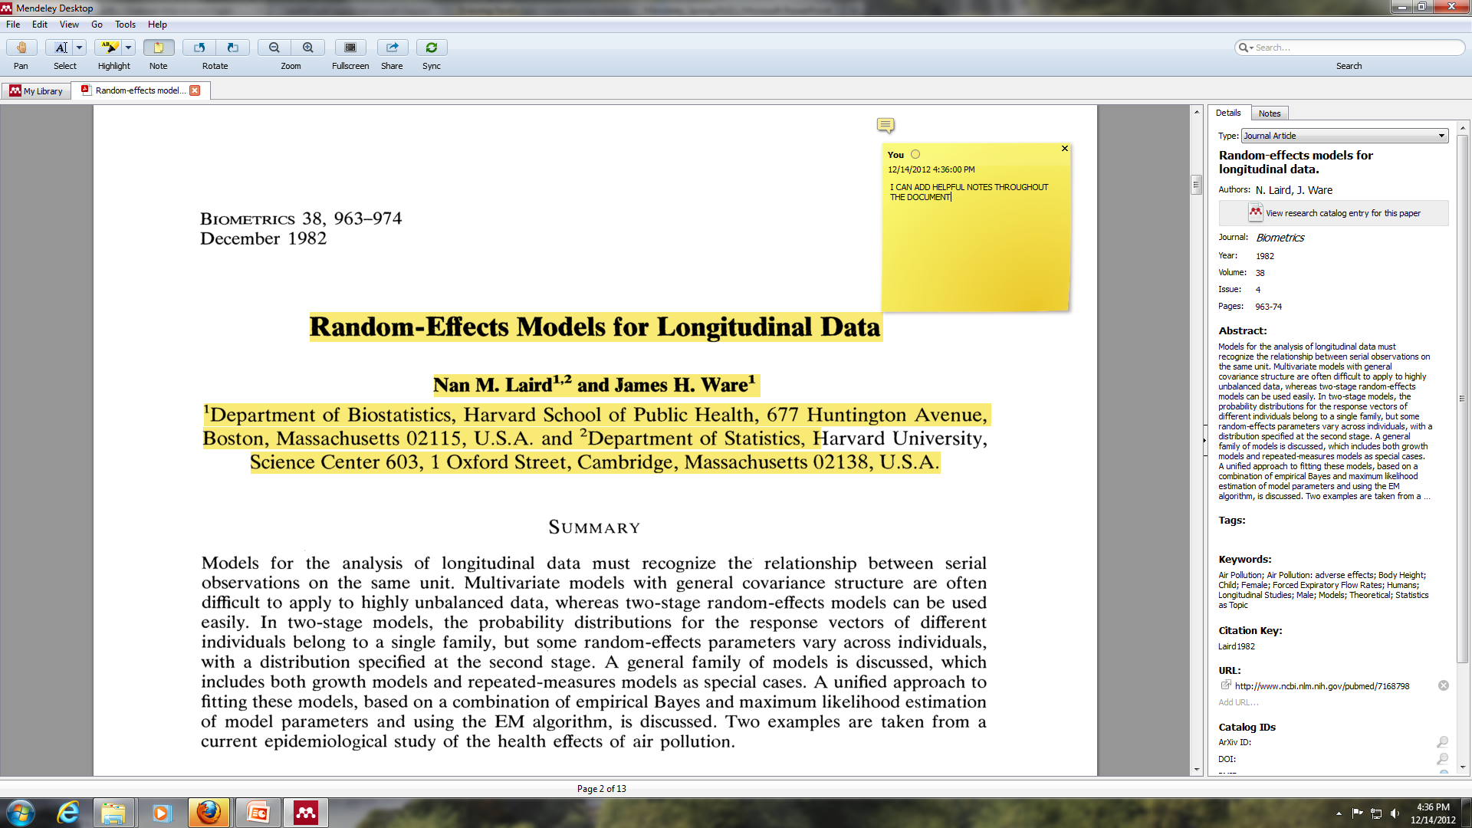
Working on Documents
To export document with notes/highlights: File →Export PDF with Annotations → Click (1) Article Content which will include the highlights (2) Notes to include stick notes

Slide 13
Additional Notes on Papers
All changes are accessible on any linked desktop or online AS LONG AS YOU SYNC.
Once a document has been read the radio button will turn from green to gray

Slide 14
Reference Manager Compatible with Word, Mac Word, Open Office and Bibtex
Microsoft Word
To Install: In mendeley Tools→Install MSWord Plugin
*Can also add citations by drag and drop

Slide 15
Reference Manager Compatible with Word, Mac Word, Open Office and Bibtex
BibTex
Continuously updated BibTex File
Tools->Options -> BibTex tab
Specific BibTex file
File ->Export->Save as .bib

Slide 16
Reference Manager Compatible with Word, Mac Word, Open Office and Bibtex
Setting the Citation Style
View->Citation Style (->More Styles)
Also possible to create your own specific style
http://csl.mendeley.com/about/
https://github.com/citation-style-editor/csl-editor/wiki/Using-the-Citation-Style-Editor-with-Mendeley-Desktop

Slide 17
Collaborate Creating a Group
Notes:
Anything other than public/open limited to 3 members

Slide 18
Collaborate Interacting with a Group
Notes:
Communication made easy
Group members can see papers and folders you add to the group on their newsfeed. Keep up-to-date with your collaborators and make working together a walk in the park.
See when others add documents
Comment and like to start discussion
Watch projects progress over time
All your ideas in real-time
Reviewing an article with your colleagues? When a group member adds a note, highlight or summary to a group document, the edit is visible to all the members of the group.

Slide 19
Collaborate Public Groups
Public groups act as a sort of academic facebook to identify new colleagues, discuss ideas, etc.

Slide 20
Collaborate Identify New Papers

Slide 21
Maintaining a Profile
When adding unpublished work to your library be sure to click the box in the bibliography pane for “Unpublished work – Exclude from Mendeley Web Catalog”

Slide 22
Backup, Sync, Mobile
Online backup of all sync files (1 GB of storage)
Can sync multiple devices
Can be used on the iPhone, iPad, Android, and others
http://blog.mendeley.com/tipstricks/android-on-mendeley-an-app-guide/
Download from the App Store now (Apple)

