Slide 1
Introduction to Latex
Manuscript Production
Caitlyn Ellerbe
Statistical Computing
Spring 2014

Slide 2
Introduction

Slide 3
What is LaTeX?
Typesetting Program
  You focus on the document content and the formatting is relatively automated
  Easy to change formatting without affecting content
Designed to produce books, thesis, and articles
  Great for Math!

Slide 4
Why you should learn it
Looks Professional
Low hassle journal submissions
Don’t have to wrestle with math equations
Small, transportable document
Great referencing system
Easy to compile very large files
It “doesn't” crash

Slide 5
Why you’ll drag your feet
Not WYSIWYG
Must think in terms of structure and pre-plan documents
Your collaborators may not use it
No reviewing software (track changes, add comments, etc.)
Customization can be tricky/time consuming
Need other software to process figures
Can’t cut and paste tables/figures
Rudimentary spell check, No grammar check

Slide 6
Resources
Official project site
  http://www.latex-project.org/
Greenberg’s Simplified Introduction to LaTeX
  http://www.tex.ac.uk/ctan/info/simplified-latex/simplified-intro.pdf
Comprehensive TeX Archive Network (CTAN)
  http://www.ctan.org/

Slide 7
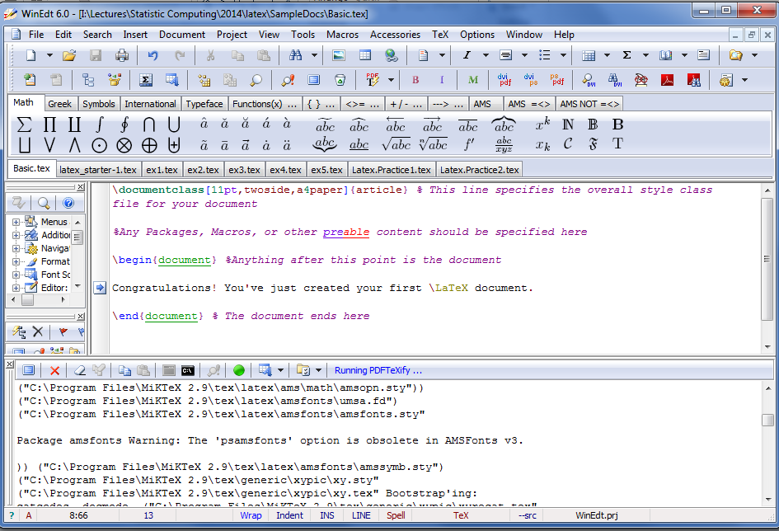
WinEdt Layout
Compile (Saves at the same time)
Hotkeys
Files
Document
Line Numbers
Log file
Stop Compile
Option Toggles

Slide 8
Getting Started
How to produce a basic document

Slide 9
WARNING!!!!!
Never use folders or file names that contain spaces. While Windows OS allows this, Latex will freak out and not identify these objects!

Slide 10
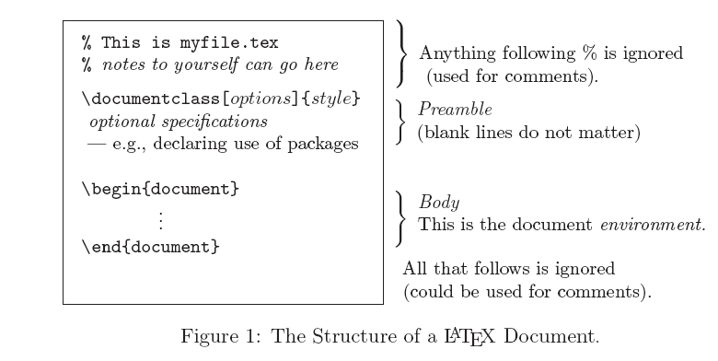
LaTeX Skeleton

Slide 11
Document Class
\documentclass[option1,option2,…]{style}
Styles
  Article: Most common, use for short documents
  Book: For longer documents
  Beamer: Use this for making slides (next lecture)
  Can create customized styles
  Many journals have a custom style file
Other styles to check out at CTAN
  Exam, fancyhdr, leaflet, hitec

Slide 12
Document Class Options
Option | Application
10pt, 11pt, 12pt | Sets the size of the main font in the document. (Default: 10pt)
letterpaper, legalpaper, executivepaper | Defines the paper size. (Default: letterpaper)
landscape | Changes the layout of the document to print in landscape mode
final, draft | Draft makes latex indicate hyphenation and justification problems with a small square in the right-hand margin. Also suppresses the inclusion of images and shows a frame where they would normally occur. (Default: final)
onecolumn, twocolumn | Instructs Latex to typeset the document in one or two columns. (Default: onecolumn)
fleqn | Typesets displayed formulas left-aligned instead of centered
leqno | Places the numbering of formulas on the left hand side instead of the right

Slide 13
Document Class Options
Option | Application
oneside, twoside | Specifies whether double or single sided output should be generated. The classes article and report are single sided and the book class is double sided by default. Note that this option concerns the style of the document only. The option twoside does not tell the printer you use that it should actually make a two-sided printout.
openright, openany | Makes chapters begin either only on right hand pages or on the next page available. This does not work with the article class, as it does not know about chapters. The report class by default starts chapters on the next page available and the book class starts them on right hand pages.
titlepage, notitlepage | Specifies whether a new page should be started after the document title or not. The article class does not start a new page by default, while report and book do. The titlepage option causes the \maketitle command to make a separate title page and the abstract environment to put the abstract on a separate page. The default is titlepage for all classes except article, for which it is notitlepage.

Slide 14
Preamble
In addition to the document class argument, this section is where you specify all of the options, packages and macros for the document

Slide 15
Packages
\usepackage[options]{package}
amsmath, amsfonts, amsthm
  Handles all of the math features
graphicx
  Allows you to insert figures
geometry
  Adjust margins of a certain page
hyperref
  Makes citations “clickable” in the .pdf document
booktabs
  Create journal style tables
natbib
  Better implementation of bibliography and citation commands

Slide 16
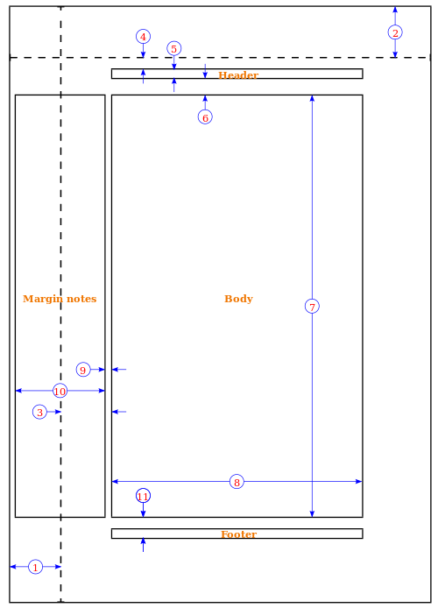
Setting Page Margins
one inch + \hoffset= 0pt
one inch + \voffset= 0pt
\oddsidemargin = 31pt
\topmargin = 20pt
\headheight = 12pt
\headsep = 25pt
\textheight = 592pt
\textwidth = 390pt
\marginparsep = 10pt
\marginparwidth = 35pt
\footskip = 30pt
\marginparpush = 7pt (not shown)
\paperwidth = 597pt
\paperheight = 845pt
\usepackage{fullpage} : 1” margins

Slide 17
Sentence Spacing
French Spacing
  Inserts spaces around most punctuation marks, but single spaced after sentences, colons, and semicolons.
    \frenchspacing
    \nonfrenchspacing
English Spacing (default)
  Removes spaces around most punctuation marks, but double spaced after sentences, colons, and semicolons.

Slide 18
Title & Abstract
Title Page
  \title{}
  \author{}, \author{First \and Second}
  \date{}, \date{\today}
  \maketitle
Abstract
  \begin{abstract}
  \end{abstract}

Slide 19
More Preamble Content
\newcommand{\commandname}{Action}
  \newcommand{\R}{\mathbb{R}}
  \newcommand{\name}[Args]{#1 Action for arg1}…\name{arg1}{arg2}
  To overwrite an existing command: \renewcommand
\newenvironment{name}{actions before}{actions after}
  \newenvironment{lines}{\hline}{\hline\hline}
\definecolor{colorname}{RGB}{R,G,B}
  \definecolor{navy}{RGB}{25,25,112}
\newtheorem{Name}{PrintName}
  \newtheorem{Prop}{\textbf{Proposition}}
  \begin{Prop} … \end{Prop}

Slide 20
Simple Example
%Example1.tex
\documentclass[12pt,draft]{article}
  \usepackage{amsmath,amsthm}
  \usepackage{graphicx}
  \newcommand{\lazy}[1]{$#1^{th}$}
  \newtheorem{Prop}{\textbf{Proposition}}
  \hoffset -20pt
\begin{document}
  This is a sample document
\end{document}
%Things I still need to complete
Preamble

Slide 21
Text Hazards
The basics of writing in latex

Slide 22
Environments
Groups
  A set of text defined by a pair of braces where the command is limited
  E.g. \textbf{Only this text will be bold}
  Alternatively {\bf Only this test will be bold}
Commands \command[optional]{req}
  Case sensitive!
  Switch commands have no braces and apply to everything below the command

Slide 23
Environments (cont.)
Environments
  Special display instructions (Mini style file)
  \begin{environment} Affected Text \end{environment}
  E.g. center, table, equation, figure
  Blank lines already precede and follow environments, so \\ will throw an error code
Recall that you can specify your own commands and environments!

Slide 24
Spacing
Adjust vertical spacing: \vspace
Adjust horizontal spacing: \hspace
Spacing Environments
  \begin{doublespace} … \end{doublespace}
  \begin{singlespace} … \end{singlespace}
  \begin{spacing}{2.5} … \end{spacing}
Under English spacing all periods “.” are treated as full stops and latex adds two spaces
  For abbreviations use .e.g\ or .i.e\
To insert discretionary hyphen into word use \-
  E.g. super\-caif\-fragilistic\-expialidocious

Slide 25
Text Display
Font
  Roman: \textrm{}, Arial: \textsf{}, Typewriter: \texttt{}
Size
  \Huge{}, \LARGE{},\small{},\footnotesize{},\tiny{}
Shape
  \textit{italic},\textsl{slanted},\emph{italics}
  \textsc{small caps}
  \textbf{bold}
  \underline{underlined}

Slide 26
Special Characters
Groups of characters separated by spaces are words
  Number of spaces are ignored
A blank line signifies the end of a paragraph
  Force a new line using \\
Paragraphs are automatically indented
  \indent, \noindent
There are reserved characters with special meanings
  \ $ &%~_{ } # ^
  If you want these to print use \ (e.g. \%)
  For \ you should use \slash
  \~ and \^ these will put the character over a letter unless you use \^{}

Slide 27
Special Characters (cont.)
Left and right quotes are different entities
  Left quote: ` (the key left of the 1 key)
  Right quote: ‘ (the key left of the return key)
To create superscripts you have to use the math environmnet
  $6^{th}$
If you want elipses (…) use \ldots
Verbatim environment prints text exactly how you paste it

Slide 28
List Environments

Slide 29
List Environment
For standard bulleted list of items
\begin{itemize}
  \item The first item
  \item The second item
  \item The third etc
\end{itemize}

Slide 30
Enumerate Environment
For ordered lists numbered sequentially
\begin{enumerate}
  \item The first item
  \item The second item
  \item The third etc
\end{enumerate}

Slide 31
Description Environment
For lists with labels
\begin{description}
  \item[First] The first item
  \item[Second] The second item
  \item[Third] The third etc.
  \item[Fourth] \hfill\\
  An item below the bullet
\end{description}

Slide 32
Nested List Environment
You can nest one to four list environments…
\begin{enumerate}
  \item The first item
  \begin{itemize}
    \item The first subitem
    \item The second subitem
  \end{itemize}
  \item The second item
\end{enumerate}

Slide 33
Tables and Figures

Slide 34
Constructing a Table
\begin{tabular}{orientation_column1orientation_column2}
\hline
element1 & element2 \\
element3 & element4 \\
\hline
\end{tabular}
element1 | element2
element3 | element4

Slide 35
Column Orientation
Orientation Options (one for each column)
To define multiple columns *{num}{orientation}
Add vertical lines with (|) e.g. {r|cc}
To specify the font format for the column >{\format}
No Word Wrap |  | Word Wrap (paragraph)
l | Left-justified | p(width) | Top Aligned
c | Centered | m(width)* | Middle Aligned
r | Right-justified | b(width)* | Bottom Aligned
*Requires the array package

Slide 36
Column Orientation (cont.)
\begin{tabular}{*{3}{>{\bf}r}c|>{\tiny\em}p{5cm}}
  Three column bold/right-justified, the fourth column plain text centered, verticle line, and the sixth column paragraph witdth of 5cm in italics
  First three columns: bold, right-justified
  Fourth Column: centered
  Verticle Line
  Fifth Column: Paragraph, width 5cm, tiny font

Slide 37
Table Features
Command | Feature
& | Column separator
\\ | Start new row
\hline | Horizontal line
\newline | Start a new line within a cell (only works if the column is specified as a paragraph (‘p’)
\cline(i-j) | Partial horizontal line beginning in column I and ending in column j. Note that if you only want a line for a single column the syntax is \cline(i-i)
\multicolumn{#Columns} {position}{content} | Specifies that a single content should fill multiple columns
\multirow{#Rows}{Width}{Contents} | Similar to multicolumn, requires the multirow package

Slide 38
Booktabs Package
Used to produce more professional looking tables
Command | Feature
\toprule | Top Line
\midrule | Any lines appearing in the center of the table
\cmidrule{i-j} | Partial midrule line spaning column i-j.
\morecmidrules | If you want to define more than one partial line, use this command followed by the rest of the \cmidrule commands (do NOT have to use \morecmidrules between each set of \cmidrule)
\bottomrule | Bottom Line

Slide 39
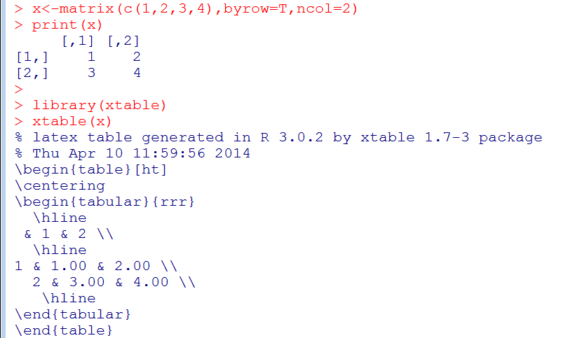
Importing Tables from R
Fairly simple formatting – quick and dirty method
library(xtable)

Slide 40
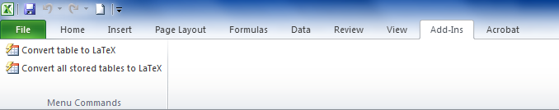
Importing Tables from Excel
To Install the Excel2Latex Plugin
  Download Excel2Latex.xla at http://www.ctan.org/tex-archive/support/excel2latex
  Excel: file-> options->add-ins ->manage->browse
You will have to close and reopen excel before the add-in ribbon has been updated

Slide 41
Table Environment
\begin{table}
\caption{caption text}
\begin{tabular}{orientation}
\centering
...
\end{tabular}
\legend{tab:}
\end{table}
← For tables, captions go above

Slide 42
Figures
Requires the graphicx package
\begin{figure}[h!]
\centering
\includegraphics[height=3in]{Path/Fig1.jpg}
\caption
\label{fig:}
\end{figure}
Options
  width=, height= allows you to specify height and width of image. If you specify both it won’t maintain aspect ratio
  resolution= set the image resolution
← For figures, captions go below image
.jpg works best, can also do pdf or eps (\usepackage[dvips]{graphicx}

Slide 43
Positioning Tables & Figures
To control where an object is printed in the document
You can specify multiple choices
  \begin{table}[h!tbp]
  \begin{figure}[tbp]
Command | Position
h | Here
t | Top of page
b | Bottom of page
p | on a dedicated page
! | overrides default restrictions

Slide 44
Math

Slide 45
Displaying Math
Inline vs. Display Math
  In-line equations: $ MATH $
  Display equation:
    \begin{equation} … \end{equation}
    \begin{eqnarray} … \end{eqnarray}
Numbering Equations (Display Only)
  Default is numbered, to supress use *
    \begin{equation*} … \end{equation*}
  To supress numbering on a single line (eqnarray) use \nonumber
Custom Numbering
  \numberwithin{equation}{section}
  \numberwithin{figure}{section}

Slide 46

Typesetting
Super-, Sub- scripting
  Superscript with ^
  Subscript with _
  If you need to subscript multiple things use group
    \sum_{i=1}^{H_k} X $\sum_{i=1}^{H_{k}}{X}$
Fractions: \frac{num}{denom}
Square Roots: \sqrt{}, \sqrt[#]{}

Slide 47
Typesetting
For brackets spanning multiple lines
  Line One: \left( … \right.
  Line Two: \left. … \right)
To stack subscripts
  \substack{Line One\\LineTwo}
  E.g. \sum_{\substack{i=1,\ldots,n \\ j=1,\ldots J }}
Adding dots for equations, matrices, etc.
  \ldots for 1,2,3,…
  \cdots for x+y+ ∙∙∙ +z
  Others…
Adding text between lines of an equation
  \intertext{text}

Slide 48
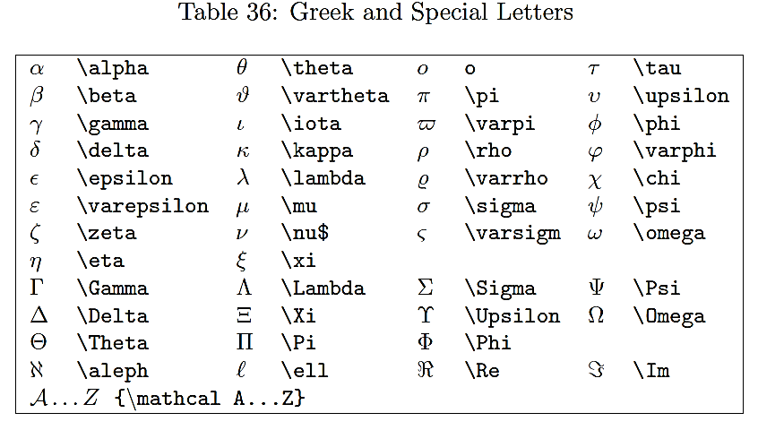
Typesetting Math

Slide 49
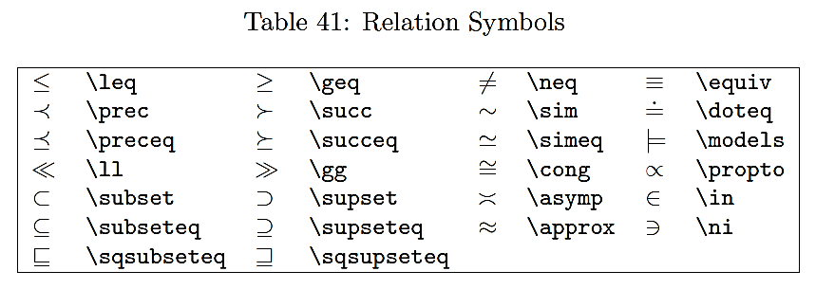
Typesetting Math

Slide 50
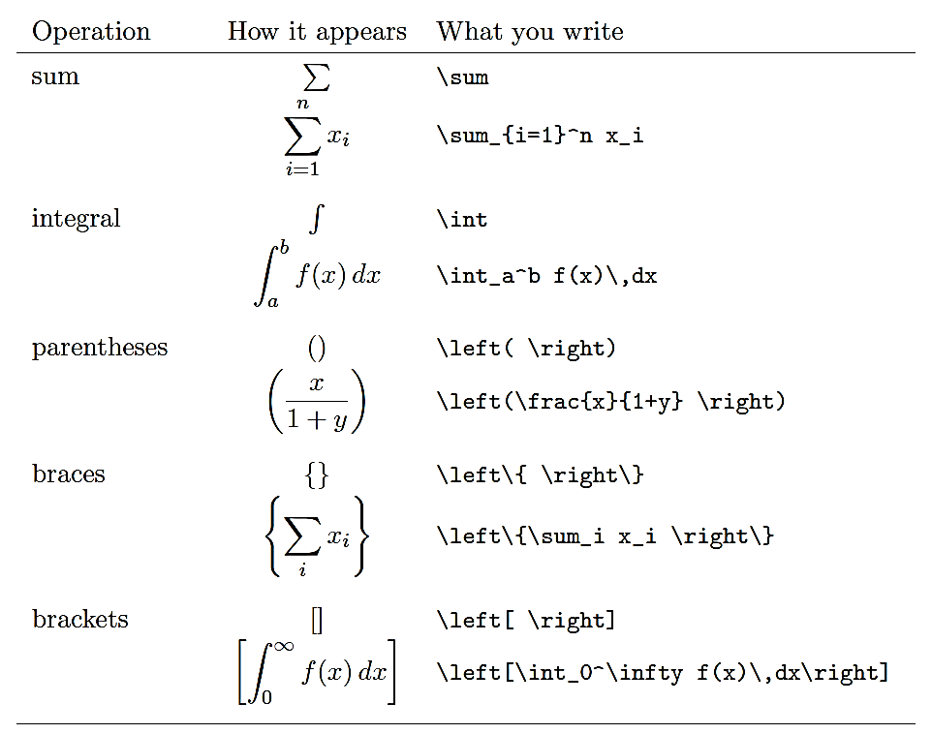
Typesetting Math

Slide 51
Parenthesis
In equations, the parenthesis must be tall enough to “match” the equation
  Using ( or ) won’t work
  Instead use \left( and \left), also works for square brackets and braces
For sequences of parentheses
  ( , \big(, \Big(, \bigg(, \Bigg(
  Use either \left( and \right) or \big( and \big)

Slide 52
Equation Environment
For a single line equation
\begin{equation}
…
\end{equation}
You can also label equations for referencing later
  \label{eq:MyEquation}
  \ref{eq:MyEquation} will give the equation number without parenthesis or \eqref{eq:MyEquation} with numbers

Slide 53
Multiline Equation Environments
\begin{eqnarray}
\begin{split}
Y = & X1+X2 \nonumber \\
& +X3+X4
\end{split}
\end{equation}
Not recommended – amspackage replaced this with multiple other options
Aligns multiple lines using the & symbol
  Will number each line unless \nonumber is used

Slide 54
Multiline Equation Environments
\begin{equation}
\begin{split}
Y = & X1+X2 \\
& +X3+X4
\end{split}
\end{equation}
Aligns multiple lines using the & symbol
  Can introduce extra space using \quad and \qquad
  Number assigned to equation not line

Slide 55
Multiline Equation Environments
\begin{equation}
\begin{split}
Y = & X1+X2 \\
& +X3+X4
\end{split}
\end{equation}
Aligns multiple lines using the & symbol
  Can introduce extra space using \quad and \qquad
  Number assigned to equation not line

Slide 56
Additional Environments
Multiline: For single very long equation
  \begin{multiline} … \end{multiline}
  No & alignments
  Maximum separation of lines
Gather: For multiple equations
  \begin{gather} … \end{gather}
  Does not align equations
Align: To align several sets of equations
  \begin{align} … \end{align}
  Uses multiple & alignments
    Similar to tabular environment
  Great for adding comments
    Equation & &\text{by \eqref{eq:C}}\\

Slide 57
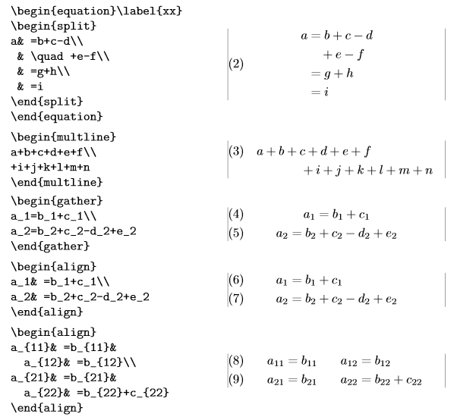
Multiple Equation Environments

Slide 58
Subequations
\begin{subequations}
Maxwell's equations:
\begin{align}
B'&=-\nabla \times E,\\
E'&=\nabla \times B - 4\pi j,
\end{align}
\end{subequations}

Slide 59
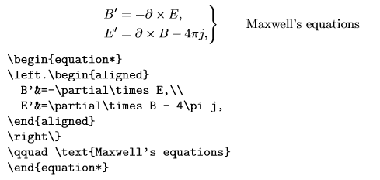
Commenting
Alignment environments like equation or align are designed to produce a full-width output. Thus if you need to add a single comment aligned to several equation lines, you can use the alternate –ed environments (aligned and gathered)

Slide 60
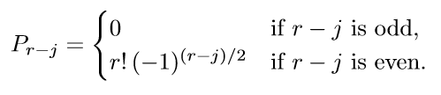
Cases
P_{r-j} = \begin{cases}
0 & \text{if $r-j$ is odd} ,\\
r!(-1)^{(r-kj/2} & \text{ if $r-j$ is even} .
\end{cases}

Slide 61
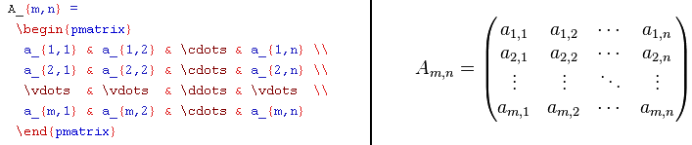
Specifying Matrices
Environment Name | Surrounding Delimiter
matrix | none
pmatrix | ()
bmatrix | []
Bmatrix | {}
vmatrix | ||
Vmatrix | || ||
Note: this should be put inside a math environment (e.g. either $...$ or equation

Slide 62
Theorems and Proofs
Ensures that formatting is consistent and that the numbering and cross-referencing is automated
First specify your environments (theorem, lemma, corollary, etc.)
  \newtheorem{name}{Printed output}[numberby]
  \newtheorem{Lma}{Lemma}[section]
In the text to state a theorem use
  \name, e.g. \Lma
  You can also label these to refer to elsewhere
Next comes the proof environment
  \begin{proof}[Optional Proof Name] … \end{proof}
  Inside this environment you can have multiple sequences of text and math environments like equation

Slide 63
Larger Documents
Additional Features that you’ll need for a dissertation

Slide 64
Sections
To create a short title
  \section[Short Title]{Long Title}
Change depth of numbering
  \setcounter{secnumdepth}{level}
    Default: level 2
  \setcounter{tocdepth}{level}
    Default: level 3
Unnumbered section
  \section*{name}
  Won’t appear in table of contents
Unnumbered, but appears in toc
  \section*{name}
  \addcontentsline{toc}{section}{name}
  \phantomsection (for hyperref only)
Command | Level
\part{name} | -1*
\chapter{name} | 0*
\section{name} | 1
\subsection{name} | 2
\subsubsection{name} | 3
\paragraph{name} | 4
\subparagraph | 5
* Handled differently in book vs. article
Page Numbers:
\setcounter{page}{1}
\pagenumbering{arabic,roman}

Slide 65
Table of Contents
Table of contents
  \tableofcontents
  \listoftables
  \listoffigures
To change the name
  \renewcommand{\contentsname}{NewName}
  \renewcommand{\listfigurename}{NewName}
  \renewcommand{\listtablename}{NewName}
  Place inside document, usually after \maketitle

Slide 66
Modular Document
More convenient when working on large projects
  Each chapter becomes its own document
  Add to single file using \input
  In the subfiles, don’t include preamble or \begin{document} … \end{document}
http://en.wikibooks.org/wiki/LaTeX/Modular_Documents

Slide 67
Custom Title Page
This is critical for creating the front page for your dissertation
Everything must be manually specified
  Create the title page separately then apply to main document using \input{./title}
  Must use same class file
Title Environment
  \begin{titlepage}
  \end{titlepage}
Notes:
\begin{titlepage}
\begin{center}
% Upper part of the page. The '~' is needed because \\
% only works if a paragraph has started.
\includegraphics[width=0.15\textwidth]{./logo}~\\[1cm]
\textsc{\LARGE University of Beer}\\[1.5cm]
\textsc{\Large Final year project}\\[0.5cm]
% Title
\HRule \\[0.4cm]
{ \huge \bfseries Lager brewing techniques \\[0.4cm] }
\HRule \\[1.5cm]
% Author and supervisor
\begin{minipage}{0.4\textwidth}
\begin{flushleft} \large
\emph{Author:}\\
John \textsc{Smith}
\end{flushleft}
\end{minipage}
\begin{minipage}{0.4\textwidth}
\begin{flushright} \large
\emph{Supervisor:} \\
Dr.~Mark \textsc{Brown}
\end{flushright}
\end{minipage}
\vfill
% Bottom of the page
{\large \today}
\end{center}
\end{titlepage}
%%%%%%%%%%%%%%%%%%%%%%%%%%%%%%%%%%%%%%%%%%%%%%%%%
%Main Document
\usepackage[pdftex]{graphicx}
\newcommand{\HRule}{\rule{\linewidth}{0.5mm}}
\begin{document}
\input{./title.tex}
\tableofcontents
...

Slide 68
Book
Two-sided
Chapter and Section printed in header
Sections content using
  \frontmatter
  \mainmatter
  \appendix
  \backmatter
\begin{document}
\frontmatter
\maketitle
% Introductory chapters
\chapter{Preface}
% ...
\mainmatter
\chapter{First chapter}
% ...
\appendix
\chapter{First Appendix}
\backmatter
\chapter{Last note}
Notes:
LaTeX Files for a Book or Thesis
http://www.math.mun.ca/~edgar/thesis.html
When I write a book or other lengthy document which contains chapters and sections, I create a master file with a name like master.tex which looks like this:
\documentclass[11pt]{book}
\usepackage{amsmath} %Never write a paper without using amsmath for its many new commands
\usepackage{amssymb} %Some extra symbols
\usepackage{makeidx} %If you want to generate an index, automatically
\usepackage{graphicx} %If you want to include postscript graphics
\usepackage{mystyle} %Create your own file, mystyle.sty where you put all your own \newcommand statements, for example.
%\includeonly{chaptr2} %If you just want to process chaptr2.tex
\begin{document}
\author{E. G. Goodaire}
\title{How to Write a Book}
\date{May 2002}
\frontmatter
\tableofcontents
\include{preface}
\mainmatter
\include{chaptr1}
\include{chaptr2}
\include{chaptr3}
\include{chaptr4}
\include{chaptr5}
\backmatter
\include{glossary}
\include{notat}
\bibliographystyle{amsalpha} %The style you want to use for references.
\bibliography{mr,refs} %The files containing all the articles and books you ever referenced.
\printindex %Make an index AUTOMATICALLY
\end{document} ********End of master.tex
With a statement like \include{preface}, LaTeX looks for a file called preface.tex which is read in literally, line by line. So preface.tex might look like:
This is the preface to my book. It is a wonderful book which I hope many people will read.
Note: No \begin{document} or \end{document}. You already have these in master.tex.
My file chaptr1.tex looks like this
\chapter{Alternative Rings}
\label{altrings} % So I can \ref{altrings} later.
\section{Definitions}
\label{defs}
\input{chap1/sec11}
\section{The Cayley Numbers}
\label{cayley}
\input{chap1/sec12}
\section{Zorn's Vector Matrix Algebra}
\label{zorn}
When LaTeX sees a line like \input{chap1/sec11}, it looks for the file sec11.tex in the directory chap1 and inputs this file line by line into master.tex. (The file sec11.tex is the contents of my Section 1.1 of my book.) Again, don't use \begin{document} or \end{document}: sec11.tex should contain just the exposition of this section.
Finally, a couple of comments about bibliographies. Especially near the start of your careers, when you start writing papers and theses, I advise you strongly to create a file called refs.bib which contains like this:
@ARTICLE{EGG:96a, %A code of your own making by which you refer to this paper
AUTHOR = "Edgar G. Goodaire and D. A. Robinson",
TITLE = "A construction of loops which admit right alternative loop rings",
JOURNAL = RESUM, %RESUM is defined in mr.bib; it expands to an official journal name
YEAR = {1996},
VOLUME = {59},
PAGES = {56--62} }
@UNPUBLISHED{EGG:98,
AUTHOR = "Edgar G. Goodaire and D. A. Robinson",
TITLE = "Commutative alternative rings: A construction",
NOTE = "preprint"
@BOOK{EGG:99a,
AUTHOR = "Edgar G. Goodaire and Sean May and Maitreyi Raman",
TITLE = "The {M}oufang Loops of Order less than $64$",
PUBLISHER = "Nova Science Publishers, Inc.",
ADDRESS = "Commack, New York",
YEAR = {1999}
Each time you want to reference something, if it is not in your refs.bib, you must add, with formatting as above. YOU DO THIS ONLY ONCE IN YOUR LIFE. Ever thereafter, if you want to reference Goodaire and Robinson in your paper, you write \cite{EGG:96a}. After you latex master.tex, you bibtex master.tex. At this point, the bibtex program will go into your refs.bib file and pull into your paper or book just those references which you require in your current work. Run latex master.tex once (or twice) more and look at the output. Your references will be numbered and alphabetized automatically and all the references in your exposition will be just as you want them.
The file mr.bib is a short version of mrabbrev.bib, which is available from the AMS (if it isn't on our own systems). It's a list of all official abbreviations for journals and is invaluable.
The command \bibliographstyle{amsalpha} asks bibtex to use the amsalpha style. There are numerous other possibilities. Many book publishers have their own. There is much much more to all this than I can outline here. I do urge you, however, to read the sections in Lamport's book which deal with bibliographies (and making your index). Good luck.

Slide 69
Hyperlinking the PDF
Package hyperref
  Somewhat temperamental, add as the last \usepackage
  Enormous number of options
Once you add the package all \ref commands will be automatically hyperlinked to the corresponding \label

Slide 70
Tracking Changes
Latex does a horrible job of this!
trackchanges package tries to imitate word
  No utility to click through and accept/reject changes
  \usepackage[compileoption]{trackchanges}
Can change how the file is compiled
  finalold: clean version, all changes rejected
  finalnew: clean version, all changed accepted
  footnotes: commens and deletions in footnote
  margins: comments in the margins, all other inline
  inline: all edits are inline

Slide 71
Tracking Changes
Can specify multiple editors in the preamble
  \addeditor{name}
To track changes
  \note[editor]{The Note}
  \add[editor]{Text to add}
  \remove[editor]{text to remove}
  \change[editor]{text to remove}{text to add}

Slide 72
Bibliography

Slide 73
Create Bibliography in Doc
Bibliography Environment
  \begin{thebibliography}{99} … \end{thebibliography}
  \bibitem{label} entry
Example
  \bibitem{Author2014} Author,First. (2014) Title. \emph{Journal} \textbf{Volume(Issue)}:page
To cite in the document
  \cite{label,label,label}
  Typing \cite{} will pull up a list of available refs
  Note that latex isn’t smart about arranging multiple numbered citations so you may end up with [6,2,12]

Slide 74
Bibtex File
To cite from an external Bibtex file requires two arguments
  \bibliographystyle{bibstyle file}
  \bibliography{bib file}
Entries in bibtex file
  Create new file, save it as MyBib.bib
  To generate entries: Insert-> Bibtex items

Slide 75
Science Bibliography
natbib package allows author-year and numerical citations
  \usepackage[options]{natbib}
  A few options: authoryear, numbers, super, sort
Two ways to reference
  Textual: \citet{Author2014}
    Author et. al. (2014)
  Parenthetical
    (Author et al., 2014)

Slide 76
Bibliography Managers
Endnote
  Subscription service, MUSC has access
  https://www.myendnoteweb.com
Mendeley
  Free
  http://www.mendeley.com/
AMS Mref
  http://www.ams.org/mref
  Formats the reference, but doesn’t manage a bibtex file

Slide 77
Final Thoughts

Slide 78
How to “hack” MS Office
Many of your colleagues won’t use Latex
  Provide PDFs which they can comment on ☹
  Convert the document to a file they can use ☺
Convert from word to latex and back
  http://www.grindeq.com/index.php?p=latex2word
  Convert from pdf to word
Partial workarounds (more stable)
  Equations: Mathtype add-in
  Bibliography: Mendeley or Docear add-in

Slide 79

Troubleshooting
Notes:
The error messages are pretty explicit
The most common errors are:
Non-symmetric delimiters , e.g. {
Mistyped commands, e.g. \begin{centre}
Blank line in a equation environment
Incorrect specification of special characters, e.g. % without \
What to do?
Insert \end{document} before the line with errors and move it
further down the document until you identify the problem.
Check the numerline where the error is listed to occur

Slide 80
Some Points on Writing
Dr. Efron on Scientific Writing
Writing Mathematically
  Knuth’s book
  University of London textbook

