Slide 1
Revolution R and DPHS Cluster
Statistical Computing
4/9/14

Slide 2
Revolution R

Slide 3
What is it?
Front End
Back End
Notes:
Revolution R enterprise allows for the same functionality as R, however this version has been modified to be more stable and efficient (faster).
Some of the specific features include:
RevoR: this is the company’s equivalent to R, the main difference is that where R uses a single stream RevoR can use multiple streams. This component requires no additional knowledge.
PlatformR: this component allows you to connect directly from your R to the cluster without having to juggle lots of code and objects. This component requires no additional knowledge.
ConnectR: this allows you to quickly bring in data from other sources (including SAS, SPSS, .csv and .txt files)
ScaleR: Library of functions specific to Revolution R enterprise that lets you take advantage of the optimizations and features built into the back end of the program. This component requires additional knowledge (BUT there is an entire help manual included when you install Revolution R)
DevelopR: Integrated Development environment with special features for debugging and package writing (most uselful if you find yourself developing a package in R… We can do this in traditional R but there are additional debugging features and packaging features that are very nice in Revolution R)
DeployR: Allows you to put your code onto a web user interface

Slide 4
What is it?
Notes:
Since we are most interested in simply using R, we focus on RevoR and Platform R. Recall these serve to
RevoR: this is the company’s equivalent to R, the main difference is that where R uses a single stream RevoR can use multiple streams. This component requires no additonal knowledge.
PlatformR: this component allows you to connect directly from your R to the cluster without having to juggle lots of code and objects. This component requires no additonal knowledge.

Slide 5
Single Versus Multi Threading
R uses a single thread
Revolution R uses multiple threads
Notes:
Threads = Processors
Includes improved algorithms for things like matrix algebra

Slide 6
The Standard R Interface
Notes:
-In the standard R interface, we have a console (where we run our r scripts), an R editor (where we write our scripts before running them), and may have a graphics window if we have been plotting something

Slide 7
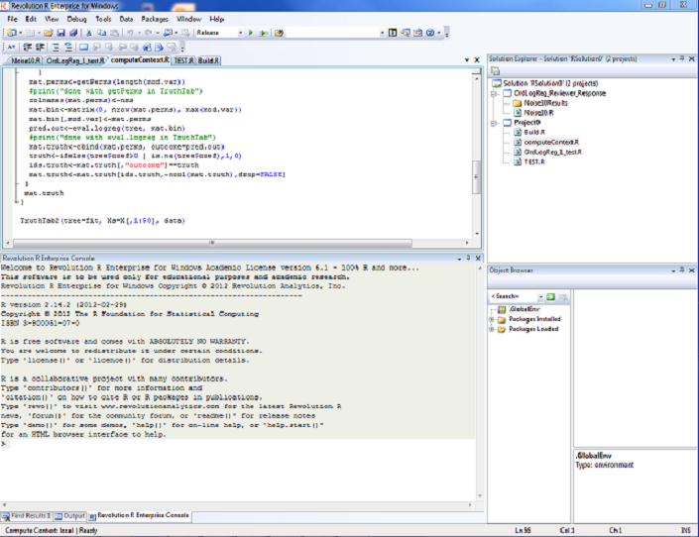
Revolution R Environment
Script(s)
Console
Notes:
-The interface in Revolution R is very similar in that still have a script editor (note this is very similar to the WinEdt). Built on Microsoft Visual Studio Platform
-Unlike the traditional script editor that opens with R, revolution R provide “coloring” that may make it easier for us to see what we’re doing
-In this version of the editor, we can see that strings are in red, comments (denoted by a #) are in green, and numbers and certain special commands (like the “for” for a loop) are in blue.
-We also have a console like normal R where we could simply type in code if we so desired.
-However we have some additional features…

Slide 8
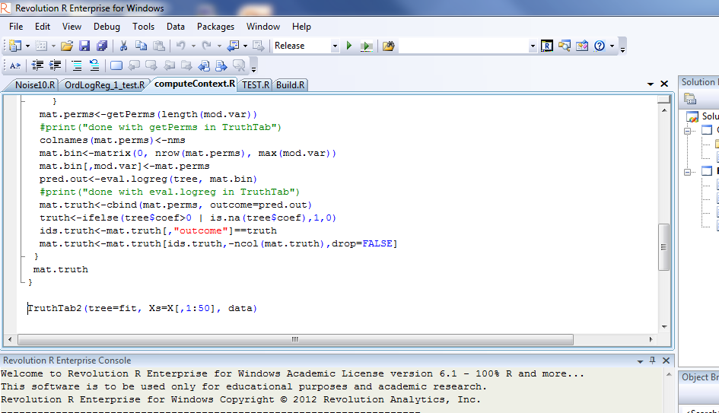
Revolution R Environment
Running R Script
Notes:
-One potentially particularly nice feature (particularly when developing your own functions or simulations) is the debugging feature
-So in order to use the debugging feature we must switch to debugging mode. We can do this using the little pull down menu in the tool bar at the top of our revolution R window (generally this will be in the Release mode)
-You then add Breakpoints to let R know where you

Slide 9
Revolution R Environment
Running Line or Section
Notes:
-One potentially particularly nice feature (particularly when developing your own functions or simulations) is the debugging feature
-So in order to use the debugging feature we must switch to debugging mode. We can do this using the little pull down menu in the tool bar at the top of our revolution R window (generally this will be in the Release mode)
-You then add Breakpoints to let R know where you

Slide 10
Revolution R Environment
Available Objects
Installed/ Loaded Packages
Object Details
Notes:
-The interface in Revolution R is very similar in that still have a script editor (note this is very similar to the WinEdt). Built on Microsoft Visual Studio Platform
-Unlike the traditional script editor that opens with R, revolution R provide “coloring” that may make it easier for us to see what we’re doing
-In this version of the editor, we can see that strings are in red, comments (denoted by a #) are in green, and numbers and certain special commands (like the “for” for a loop) are in blue.
-We also have a console like normal R where we could simply type in code if we so desired.
-However we have some additional features…

Slide 11
Revolution R Environment
Project Manager
Notes:
-The interface in Revolution R is very similar in that still have a script editor (note this is very similar to the WinEdt). Built on Microsoft Visual Studio Platform
-Unlike the traditional script editor that opens with R, revolution R provide “coloring” that may make it easier for us to see what we’re doing
-In this version of the editor, we can see that strings are in red, comments (denoted by a #) are in green, and numbers and certain special commands (like the “for” for a loop) are in blue.
-We also have a console like normal R where we could simply type in code if we so desired.
-However we have some additional features…

Slide 12
Project Manager
Solutions
Corresponds to one R workspace/working directory
Storage for common files for projects
Project
Independent set of R scripts
Scripts and Documentation
Single Files that can be sourced, run, viewed, etc.
Notes:
Standardize project structures encourages the use of relative file names and allows for the creation of project templates
With a project folder, you can just zip and send for someone else to be able to run the same file
Creating a Project
To create a project:
From the File menu, point to New, and then click Project....
In the Name text box of the New Project dialog, enter the name for your project.
Click OK.
By default, a new project also creates an enclosing solution. You can specify where to create the project in the Location text box.
To add a project to the current solution:
From the File menu, point to New, and then click Project....
In the Name text box of the New Project dialog, enter the name for your project.
In the Solution drop-down menu, click Add to Solution.
Click OK.
--or--
In the Solution Explorer, right-click the solution name, point to Add, and then click New Project....
In the Add New Project dialog, enter a name for the project in the Name text box.
(Optional) Specify a location for the project in the Location text box.
Click OK.
To create a project from a folder containing existing R scripts:
From the File menu, point to New, and then click Solution From Folder....
Choose the folder from the dialog provided and click OK.

Slide 13
Scripts
R syntax checking and parenthesis highlighting
IntelliSense word completion
CTRL+Space
Setting Breakpoints
Breakpoints tell the R debugger where to stop execution, so that you can examine the state of the computation at that point.
Place the cursor anywhere on the desired line and press F9.
Click the gray bar to the left of the desired line.
Repeat the procedure to delete the breakpoint.
Run all or part of a script in the command window
Set Bookmarks
Bookmarks make it easy to move from place to place within a large script, and also to move from script to script. You set bookmarks using any of the following methods:
Place the cursor anywhere on the desired line and press CTRL-K, CTRL-K.
Repeat the procedure to delete the bookmark.
Automatically comment out sections

Slide 14
Snippets
A predefined template for common R idioms
Insert snippet, then fill in the blanks
Right Click ->Insert Snippet
Code Snippet Manager
Create and Share your own snippets (Using XML and Visual Studio)
Allows you to automate programming frequent tasks
NOT the same as a SAS macro
Standardize analyses and enforce coding standards

Slide 15
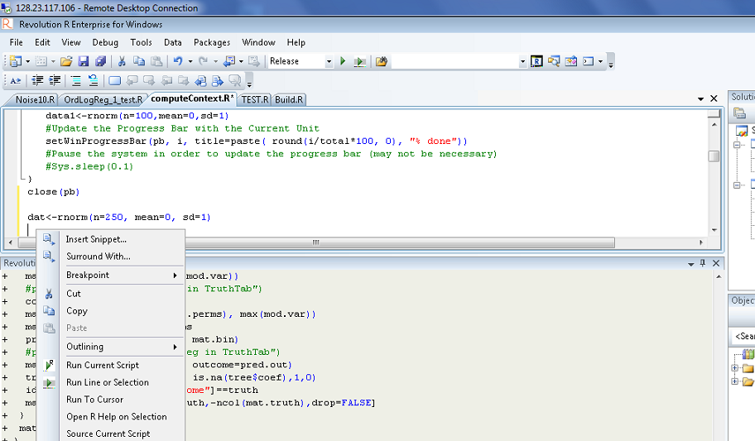
Snippets in Revolution R

Slide 16
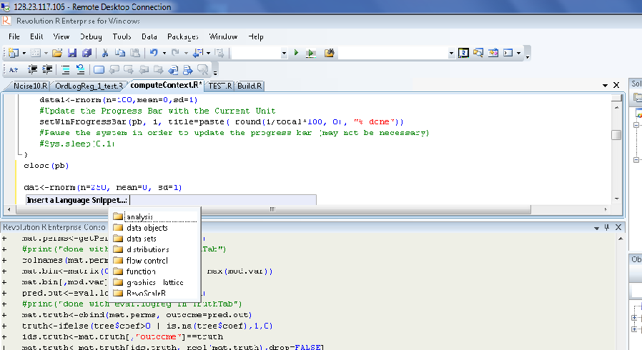
Snippets in Revolution R

Slide 17
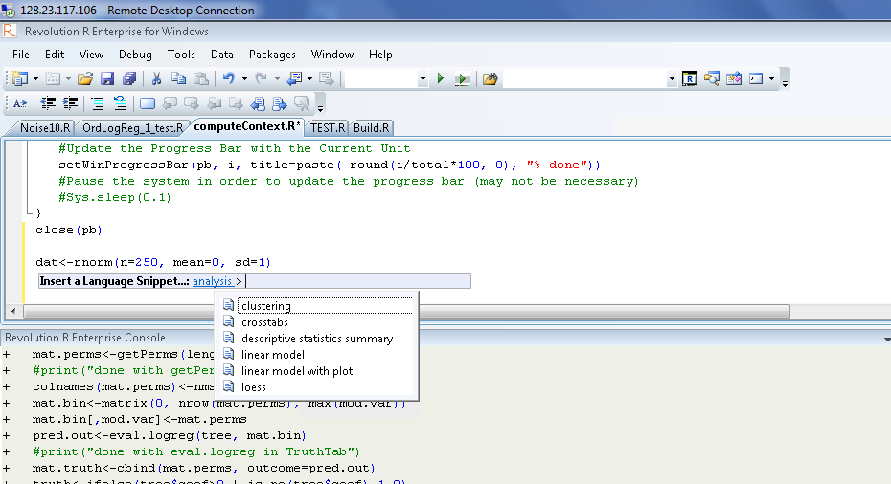
Snippets in Revolution R

Slide 18
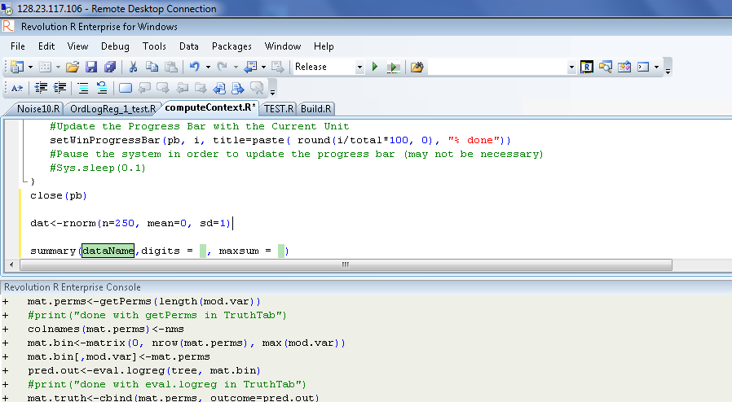
Snippets in Revolution R

Slide 19
Debugging
Revolution R has a debugging feature
Helpful to identify reasons code won’t run
Excellent way to check more complicated code
Complex analyses
Simulation Studies
Also extremely helpful if you are writing an R package

Slide 20
Debugging in Revolution R
Debugging
Notes:
-One potentially particularly nice feature (particularly when developing your own functions or simulations) is the debugging feature
-So in order to use the debugging feature we must switch to debugging mode. We can do this using the little pull down menu in the tool bar at the top of our revolution R window (generally this will be in the Release mode)
-You then add Breakpoints to let R know where you

Slide 21
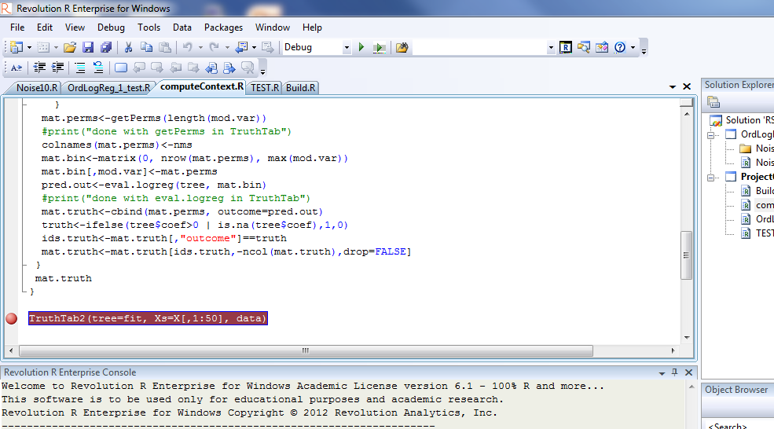
Debugging in Revolution R
Debugging
Notes:
-One potentially particularly nice feature (particularly when developing your own functions or simulations) is the debugging feature
-So in order to use the debugging feature we must switch to debugging mode. We can do this using the little pull down menu in the tool bar at the top of our revolution R window (generally this will be in the Release mode)
-You then add Breakpoints to let R know where you

Slide 22
Available Objects
Inspect objects in current environment
List installed and loaded packages
Browse objects in packages
Inspect and edit data
Plot data objects

Slide 23
Other
Interactive Debug Feature
Debug vs. Release mode: control whether breakpoints are used
Step Execution

Slide 24
Shortcut | Action
Ctrl-A | Select All
Ctrl-B | New Breakpoint
Ctrl-C | Copy
Ctrl-F | Find
Ctrl-L | Cut current line or selection to clipboard
Ctrl-N | New File
Ctrl-O | Open File
Ctrl-P | Print
Ctrl+R | Ctrl+R, Ctrl+W - View white space
Ctrl+R, Ctrl+S | Run Selection
Ctrl+R, Ctrl+C | Run Current Script
Ctrl-T | Transpose characters
Ctrl-U | Changes selected text to lowercase
Ctrl-V | Paste
Ctrl-W | Selects the word containing the cursor or to the right of the cursor
Ctrl-X | Cut
Ctrl-Y | Redo
Ctrl-Z | Undo

Slide 25
Notes:
http://nicercode.github.io/blog/2013-04-05-projects/

Slide 26
DPHS Cluster
This only works for Revolution R Enterprise

Slide 27
Accessing The Cluster
PHSCLUSTER <- RxHpcServer(
#Location of revolution R Enterprise on each node
revoPath="C:\\Revolution\\R-Enterprise-Node-6.1\\R- 2.14.2\\bin\\x64",
#Location of big Data files on each node
dataPath="c:\\data",
#User Directory for read/write
shareDir="\\Clustershare\\cne2" ,
)
#Sets Compute Context to the Cluster
rxOptions( computeContext = PHSCLUSTER )
#Sets Compute Context to the Local Machine
rxOptions( computeContext = RxLocalSeq())
Notes:
-We can use Revolution Rthe same way we would use regular R (although the interface looks somewhat different)
-However, the main advantage to using Revolution R is that we use our regualr laptop/desktop OR run our can call the cluster to run our R code instead.
-The advantage of the cluster is that it provides additional computing power (i.e. it has a large amount of porcessing and memory relative to a local machine).
-If we want to use the cluster, we first have to let R Revolution know we want to use it by providing the path for it to access the cluster
-Once we’ve provides a path we can go back and forth between the cluster and our local machine
-Note this first section of code (the object PHSCLUSTER and the function RxHpcServer and its arguments) help us to create a computing context within R revolution (i.e. we are letting it know about the available cluster as one possibel computing environment we might use)
-Because this computing context becomes a object within R, we can refer to it to go back and forth between our computer and the cluster
-So let’s take a little more in depth look at how we access the cluster…
-Random Number Generation for Parallel Processing:
http://blog.revolutionanalytics.com/2013/06/intro-to-parallel-random-number-generation-with-revoscaler.html

Slide 28
Accessing The Cluster
PHSCLUSTER <- RxHpcServer(
#Location of revolution R Enterprise on each node
revoPath="C:\\Revolution\\R-Enterprise-Node-6.1\\R- 2.14.2\\bin\\x64",
#Location of big Data files on each node
dataPath="c:\\data",
#User Directory for read/write
shareDir="\\Clustershare\\cne2" ,
)
#Sets Compute Context to the Cluster
rxOptions( computeContext = PHSCLUSTER )
#Sets Compute Context to the Local Machine
rxOptions( computeContext = RxLocalSeq())
Notes:
-The first section of code is where we define the cluster, provide a location of our data, and tell it who we are (i.e. which user we are).
-Specifically this first argument within th eRxHpcServer function specifies the path to the directory on the cluster containing R Revolution.
-The last statement in this argument is x64 which refers to whether this is a 64 bit or a 32 bit system. This should always be set to x64 (regardless of you local machine).

Slide 29
Accessing The Cluster
PHSCLUSTER <- RxHpcServer(
#Location of revolution R Enterprise on each node
revoPath="C:\\Revolution\\R-Enterprise-Node-6.1\\R- 2.14.2\\bin\\x64",
#Location of big Data files on each node
dataPath="c:\\data",
#User Directory for read/write
shareDir="\\Clustershare\\cne2" ,
)
#Sets Compute Context to the Cluster
rxOptions( computeContext = PHSCLUSTER )
#Sets Compute Context to the Local Machine
rxOptions( computeContext = RxLocalSeq())
Notes:
-The first section of code is where we define the cluster, provide a location of our data, and tell it who we are (i.e. which user we are).
-The second argument within the RxHpcServer function specifies the path for accessing data.

Slide 30
Accessing The Cluster
PHSCLUSTER <- RxHpcServer(
#Location of revolution R Enterprise on each node
revoPath="C:\\Revolution\\R-Enterprise-Node-6.1\\R- 2.14.2\\bin\\x64",
#Location of big Data files on each node
dataPath="c:\\data",
#User Directory for read/write
shareDir="\\Clustershare\\cne2" ,
)
#Sets Compute Context to the Cluster
rxOptions( computeContext = PHSCLUSTER )
#Sets Compute Context to the Local Machine
rxOptions( computeContext = RxLocalSeq())
Notes:
-Finally the last line of code specifies the directory on the head node (think of this as the captain of the cluster) that is shared among all nodes of the cluster
-Basically, this is telling R revolution which nodes in the cluster your program will use
-In this case some portion of the node in the cluster are dedicated for you and as such, the path is specified using your username

Slide 31
Accessing The Cluster
PHSCLUSTER <- RxHpcServer(
#Location of revolution R Enterprise on each node
revoPath="C:\\Revolution\\R-Enterprise-Node-6.1\\R- 2.14.2\\bin\\x64",
#Location of big Data files on each node
dataPath="c:\\data",
#User Directory for read/write
shareDir="\\Clustershare\\cne2" ,
)
#Sets Compute Context to the Cluster
rxOptions( computeContext = PHSCLUSTER )
#Sets Compute Context to the Local Machine
rxOptions( computeContext = RxLocalSeq())
Notes:
-Once all the pieces are in place, you only need to run this once before you run any additional R code and the cluster will be available to you as a computing environment (remember because it is stored as an object in R)

Slide 32
Accessing The Cluster
PHSCLUSTER <- RxHpcServer(
#Location of revolution R Enterprise on each node
revoPath="C:\\Revolution\\R-Enterprise-Node-6.1\\R- 2.14.2\\bin\\x64",
#Location of big Data files on each node
dataPath="c:\\data",
#User Directory for read/write
shareDir="\\Clustershare\\cne2" ,
)
#Sets Compute Context to the Cluster
rxOptions( computeContext = PHSCLUSTER )
#Sets Compute Context to the Local Machine
rxOptions( computeContext = RxLocalSeq())
Notes:
-Now that we’ve let Revolution R know the cluster exists and have included it as a possible computing environment we may use, we need to let Revolution R know we actually want to use it ☺
-In order to do this we can use the rxOptions command which tells Revolution R which computing environment to use to do our processing
-the argument within the rxOptions command is “computeContext” and we then specify the cluster environment… Recall, we assigned the cluster computing environment the name PHSCLUSTER so we can use this to direct R to use the cluster computing environment
-We need to have this statement included prior to any code we want to run on the cluster (but only need to read it in one time)

Slide 33
Accessing The Cluster
PHSCLUSTER <- RxHpcServer(
#Location of revolution R Enterprise on each node
revoPath="C:\\Revolution\\R-Enterprise-Node-6.1\\R- 2.14.2\\bin\\x64",
#Location of big Data files on each node
dataPath="c:\\data",
#User Directory for read/write
shareDir="\\Clustershare\\cne2" ,
)
#Sets Compute Context to the Cluster
rxOptions( computeContext = PHSCLUSTER )
#Sets Compute Context to the Local Machine
rxOptions( computeContext = RxLocalSeq())
Notes:
-Similarly, once we are done using the cluster we can switch Revolution R back to our local machine by letting computeContext = RxLocalSeq()
-Specifically, this is telling Revolution R to compute anything after this command on your local machine.

Slide 34
Setting a Progress Timer
#Create a Progress Bar Object
pb <- winProgressBar(title = "progress bar", min = 0, max = total, width = 300)
for(i in 1:total){
data1<-rnorm(n=100,mean=0,sd=1)
#Update the Progress Bar with the Current Unit
setWinProgressBar(pb, i, title=paste( round(i/total*100, 0), "% done"))
#Pause the system in order to update the progress bar (may not be necessary)
#Sys.sleep(0.1)
}
close(pb)
Notes:
-When we send our code off into cluster land to be run by Revolution R, we may want to know how our program is progressing
-We can actually tell Revolution R to generate a Windows based progress bar to keep track of our timing.
-In order to do this we must first initialize our progress bar

Slide 35
Other Features

Slide 36
RevoScaleR Package

Slide 37
RevoScaleR Package

Slide 38
RevoScaleR Package

Slide 39
DeployR

Slide 40
DeployR

