Slide 1
An Introduction to Bioconductor
Bethany Wolf
Statistical Computing I
April 9, 2014

Slide 2
Overview
Background on Bioconductor project
Installation and Packages in Bioconductor
An example: working with microarray meta-data

Slide 3
Bioconductor
Biological experiments continually generate more data and larger datasets
Analysis of large datasets is nearly impossible without statistics and bioinformatics
Research groups often re-write the same software with slightly different purposes
Bioconductor includes a set of open-source/open-development tools that are employable in a broad number of biomedical research areas

Slide 4
Bioconductor Project
The Bioconductor project started in 2001
Goal: make it easier to conduct reproducible consistent analysis of data from new high-throughput biological technologies
Core maintainers of the Bioconductor website located at Fred Hutchinson Cancer Research Center
Updated version released biannually coinciding with the release of R
Like R, there are contributed software packages

Slide 5
Goals of the Bioconductor Project
Provide access to statistical and graphical tools for analysis of high-dimensional biological data
micro-array analysis
analysis of high-throughput
Include comprehensive documentation describing and providing examples for packages
Website provides sample workflows for different types of analysis
Packages have associated vignettes that provide examples of how to use functions
Have additional tools to work with publically available databases and other meta-data

Slide 6
Biological Question
Experimental Design
Experiment (e.g. Microarray)
Image analysis
Experimental Design
Pre-processing
Normalization
Analysis
…..
Estimation
Testing
Clustering
Prediction
Biological verification
and interpretation

Slide 7
Bioconductor website
Lets take a look at the website...
http://bioconductor.org/

Slide 8
Installing Bioconductor
All packages available in Bioconductor are run using R
Bioconductor must be installed within the R environment prior to installing and using Bioconductor packages
> source("http://bioconductor.org/biocLite.R")
> biocLite()

Slide 9
Bioconductor Packages
749 packages total (for now… there were 610 this time last year)
Biobase is the base package installed when you install Bioconductor
It includes several key packages (e.g. affy and limma) as well as several sample datasets
> biocLite(“Biobase”)
> library(Biobase)

Slide 10
Basic Classes of Packages
General infrastructure
Biobase, DynDoc, reposTools, rhdf5, ruuid, tkWidgets, widgetTools
Annotation
annotate, AnnBuilder → data packages
Graphics
geneplotter, hexbin
Pre-processing (affy and 2-channel arrays)
affy, affycomp, affydata, makecdfenv, limma, marrayClasses, marrayInpout, marrayNorm, marrayPlots, marrayTools, vsn
Differential gene expression
edd, genefilter, limma, multtest, ROC, siggenes
Graphs and Networks
graph, RBGL, Rgraphviz
Flow Cytometry
prada, flowCore, flowViz, flowUtils
Protein Interactions
ppiData, ppiStats, ScISI, Rintact
An so on…

Slide 11
Help Files for Bioconductor Packages
Like R, there are help files available for Bioconductor packages.
They can be accessed in several ways.
> help(Biobase)
> library(help=”Biobase”)
> browseVignettes(package=”Biobase”)
OR Use the Vignettes pull down menu in R
Note vignettes often contains more information than a traditional R help page.

Slide 12
Package Nuances
Similar to R packages and are loaded into and used in R
However, Bioconductor makes more use of the S4 class system from R
R packages typically use the S3 class system. The difference. . .
S4 more formal and rigorous (makes it somewhat more complicated than R)
If you really want to know more about the S4 class system you can check out
http://cran.r-project.org/doc/contrib/Genolini-S4tutorialV0-5en.pdf

Slide 13
Example Use: Microarray Experiments
Microarrays are collections of microscopic DNA spots attached to solid surface
Spots contain probes, i.e. short segments of DNA gene sections
Probes hybridize with cDNA or cRNA in sample (targets)
Fluorescent probes used to quantify relative abundance of targets
Can be used to measure expression level, change in expression, SNPs,...

Slide 14
Gene Detection
1-Channel array: hybridized cDNA from single sample to array and measure intensity
label sample with a single fluorophore
compare relative intensity to a reference sample done on a separate chip
2-Channel arrays: hybridized cDNA for two samples (e.g. diseased vs. healthy tissue)
label each with one of two different fluorophores
mix two samples and apply to single microarray
look at fluorescence at 2 wavelengths corresponding to each fluorophore
measure ratio of intensity for each fluorophore

Slide 15
Microarray Analysis
Microarrays are large datasets that often have poor precision
Statistical challenges…
Account for effect of background noise
Data normalization (remove non-biological variability)
Detecting/removing poor quality or low quality feature (flagging)
Multiple comparisons and clustering analysis (e.g. FDR, hierarchical clustering)
Network analysis (e.g. Gene Ontology)

Slide 16
Meta-Data
Meta-data are data about the data
Datasets in Bioconductor often have meta-data so you know something about the dataset
sample.ExpressionSet is an example of microarray meta-data provided in Biobase
It is of class ExpressionSet (example of an S4 class). This class includes data describing the lab, the experiment, and an abstract that are all accessible in R.
> data(sample.ExpressionSet)
> sample.ExpressionSet

Slide 17
Exploring sample.ExpressionSet
What information exists in the meta-data sample.ExpressionSet
Number of sample
Number of “features”
Protocol for data collection
Sample names
Annotation type

Slide 18
Difference from S3 class object
So how different is this from a S3 class object? Linear models fit using lm are S3 class objects for example.
> x<-rnorm(100); y<-rnorm(100)
> fit<-lm(y~x)
> class(fit)
> names(fit)
> fit$coefficients
What happens if we use some familiar R functions to look at sample.ExpressionSet?
> class(sample.ExpressionSet)
> names(sample.ExpressionSet)

Slide 19
S4 Commands
There are sometimes slightly different commands and nuances to look at an S4 class object in R
Use “slotNames” rather than “names”
>slotNames(sample.ExpressionSet)
Also use “@” rather than “$” to look things within an S4 class object
>sample.ExpressionSet@experimentData

Slide 20
Accessing and Expression Set
Accessing data and parts of the data using the “@” symbol can be dangerous
R does not provide a mechanism for protecting data (i.e. we can overwrite our data by accident)
A better idea is to subset the parts of the data you want to handle

Slide 21
Exploring sample.ExpressionSet
Although slotNames tells us what attributes sample.ExpressionSet has,
we are interested in accessing the microarray data itself.
> abstract(sample.ExpressionSet)
[1] "An example object of expression set (ExpressionSet) class"
> varMetadata(sample.ExpressionSet)
labelDescription
sex Female/Male
type Case/Control
score Testing Score

Slide 22
Exploring sample.ExpressionSet
Accessing the microarray data itself.
> #Names of the genes
> featureNames(sample.ExpressionSet)
[1] "AFFX-MurIL2_at" "AFFX-MurIL10_at"
[3] "AFFX-MurIL4_at" "AFFX-MurFAS_at"
…
> exprs(sample.ExpressionSet)[1:5,1:5]
A B C D E
AFFX-MurIL2_at 192.7420 85.75330 176.7570 135.5750 64.49390
AFFX-MurIL10_at 97.1370 126.19600 77.9216 93.3713 24.39860
AFFX-MurIL4_at 45.8192 8.83135 33.0632 28.7072 5.94492
AFFX-MurFAS_at 22.5445 3.60093 14.6883 12.3397 36.86630
AFFX-BioB-5_at 96.7875 30.43800 46.1271 70.9319 56.17440

Slide 23
Visualizing the Data
Let’s look at the distribution of gene expression values for all of the arrays.
> dim(sample.ExpressionSet)
Features Samples
500 26
> plot(density(exprs(sample.ExpressionSet)[,1]), xlim=c(0,6000), ylim=c(0, 0.006), main="Sample densities")

Slide 24
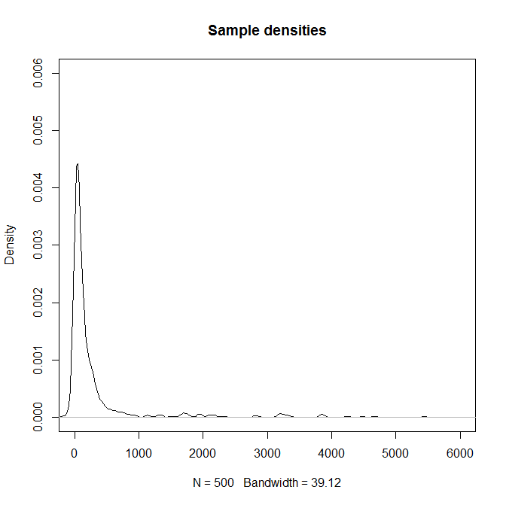
Visualizing the Data

Slide 25
Visualizing the Data
What about the distribution of several gene expression values for all of the arrays.
>plot(density(exprs(sample.ExpressionSet)[,1]), xlim=c(0,6000), ylim=c(0, 0.006), main="Sample densities")
>for (i in 2:25){
lines(density(exprs(sample.ExpressionSet)[,i]), col=i) }

Slide 26
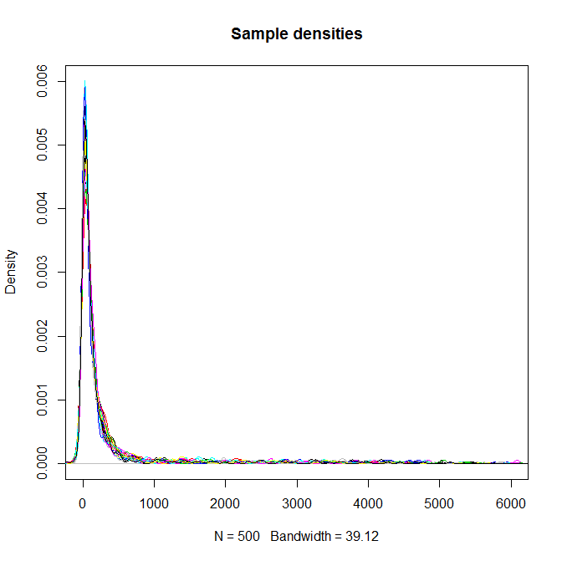
Visualizing the Data

Slide 27
Subsetting the data
We can subset our microarray object just like a matrix.
In gene array datasets, samples are columns and features are rows.
Thus if we want to subset of samples (i.e. things like cases or controls) we want columns.
However if we are interested in particular probes, we subset on rows.
> sample.ExpressionSet$sex
> subESet<-sample.ExpressionSet[1:10,]
> exprs(sample.ExpressionSet)[1:10,]
> exprs(subESet)

Slide 28
Subsetting the data
What if we only want to consider females?
> f.ids<-which(sample.ExpressionSet$sex==”Female”)
> femalesESet<-sample.ExpressionSet[,f.ids]
What if we only want to only AFFX genes? We can use the command grep in this case...
> AFFX.ids<-grep(“AFFX”, featureNames(sample.ExpressionSet))
> AFFX.ESet<-sample.ExpressionSet[AFFX.ids,]

Slide 29
Next Steps?
Now we are familiar with the data, we could go the next step and do the analysis...
Pre-processing: assess quality of the data, remove any probes we know to be non-informative
Look for differential expression using a machine learning technique
Annotation
Gene set enrichment
...
Fortunately, Bioconductor provides workflows for many common analyses to help you get started.
http://bioconductor.org/help/workflows

Slide 30
Although R has many statistical packages, packages in Bioconductor are designed for bioinformatics type problems
We have only touched on one small part of what is available
For further help using Bioconductor
The Bioconductor website has workshops from previous years
There is also an annual User’s group meeting
Package vignettes and help files also often contain examples with “real” data so you can work through and example

