Slide 1
Regression Commands in R
April 2nd, 2014
Computing for Research I
Notes:
How do you guys like r?
In today’s lecture, we will learn some regression commands in r.
We will also learn how to check regression diagnositcs.

Slide 2
A Simple Experiment
What is the linear relationship between age and height?
age in months | height in CM
18 | 76.1
19 | 77
20 | 78.1
21 | 78.2
22 | 78.8
23 | 79.7
24 | 79.9
25 | 81.1
26 | 81.2
27 | 81.8
28 | 81.8
29 | 83.5
Notes:
Here is a motivating example.
We have two variables, age and height.
We want to know if there is a linear relationship between age and height. At this moment, everyone know linear regression is the right
Technique we should use to address this question.

Slide 3
Y
ε
ε
X
Notes:
3
RECALL, Simple linear regression describes the linear relationship between x, the predictor variable, and y, the response variable.
b0 is intercept, b1 is slope, epsilon is the error term.
If we assume height is the response variable, age is the predictor variable, then we can regress height on age.

Slide 4
Linear Regression
For linear regression, R uses 2 functions.
Could use function “lm”
Could use the generalized linear model (GLM) framework
function called “glm”
Notes:
Luckily, r finds beta coefficients aotomatically for us!
Use lm, or glm based on the generalized linear model.

Slide 5
LM Function
lm(formula, data, subset, weights, na.action, method = "qr", model = TRUE, x = FALSE, y = FALSE, qr = TRUE, singular.ok = TRUE, contrasts = NULL, offset, ...)
reg1 <- lm(height~age, data=dat) #simple regression
reg2 <- lm(height ~ 1 , data=dat) #intercept only
http://stat.ethz.ch/R-manual/R-patched/library/stats/html/lm.html
Notes:
Let’s look at the function lm at first. You might have played with some r functions so far.
For the lm function, formula specifies who is the response variable, who are predictors. For our example, we write height~age,
If you want a intercept only model, just use height matilda 1.
Data is the data you want to work with, it is typically a data frame
Subset: only use a subset of observations
For more information on how to use lm, visit…..

Slide 6
LM Function
Can accommodate weights (weighted regression)
Survey weights, inverse probability weighting, etc.
Results including beta, SE(beta), Wald T-tests, p-values
Can obtain ANOVA, ANCOVA results
Can specify contrasts for predictors
Can do some regression diagnostics, residual analysis
Let’s have fun!
Notes:
anova(reg1)
summary(reg1)

Slide 7
LM Example
age <- c(18,19,20,21,22,23,24,25,26,27,28,29)
height <- c(76.1,77,78.1,78.2,78.8,79.7,79.9,81.1,81.2,81.8,81.8,83.5)
dat <- as.data.frame(cbind(age,height))
dat
dim(dat)
is.data.frame(dat)
reg1 <- lm(height~age, data=dat)
summary(reg1)
Notes:
Create age vector and height vector.
Cbind combine age and height column into a matrix
As.data.frame force the matrix to be a dataframe, r likes data frame!
A data frame is used for storing data tables. It is a list of vectors of equal length.
#summary function will summarize the results of reg1.
#names(reg1) will tell you the variable names returned from the r function.
If you want to see the coefficients, just use reg1$coefficients

Slide 8
Summary(lm)
Call: lm function
Quantiles of Residuals
Coefficients
Residual standard error
R-squared
F-statistic

Slide 9
We have got linear regression done! Really??? But it is not beer time yet!

Slide 10
4 Assumptions of linear regression
Linearity of Y in X
Independence of the residuals (error terms are uncorrelated)
Normality of residual distribution
Homoscedasticity of errors (constant variance)
Notes:
Remember, there are four assumptions for linear regression. Before reporting the results, we first need to check these assumptions.
Independence determined by study design.
Homoscedasticity: you variance is constant regardless the values of predictors

Slide 11
Basic Checks
par(mfrow=c(2,2))
par(mar=c(5,5,2,2))
attach(reg1)
hist(residuals)
plot(age,residuals)
plot(fitted.values,residuals)
plot(height,fitted.values)
abline(0,1)
http://stat.ethz.ch/R-manual/R-patched/library/stats/html/plot.lm.html
Notes:
Mfrow: plan to have 4 graphs, arrange in 2by2
You can use the attach command, or you can use reg1$residuals.
In order to check the normal assumption, we can create a histogram of residuals, see if it is semmetric, looks normal
I would be very cautious here, because we don’t have many datapoints.
If you have more data, histogram looks more semmetric. There is no patterns in
variance check.
It appears to be a good fit.

Slide 12
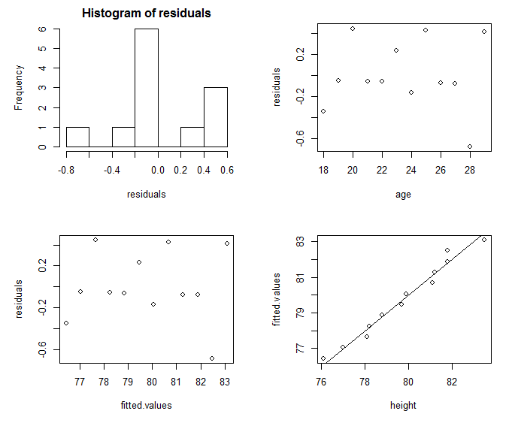
Notes:
In order to check the normal assumption, we can create a histogram of residuals, see if it is semmetric, looks normal
If you have more data, histogram looks more semmetric.
to check the assumption of Homoscedasticity, we can plot residuals as a function of age and fitted values, if there is no patterns in these plots, we
Are ok with the assumpion on variance
The points on the last graph is close to the 1to1 line, It appears to be a good fit.

Slide 13
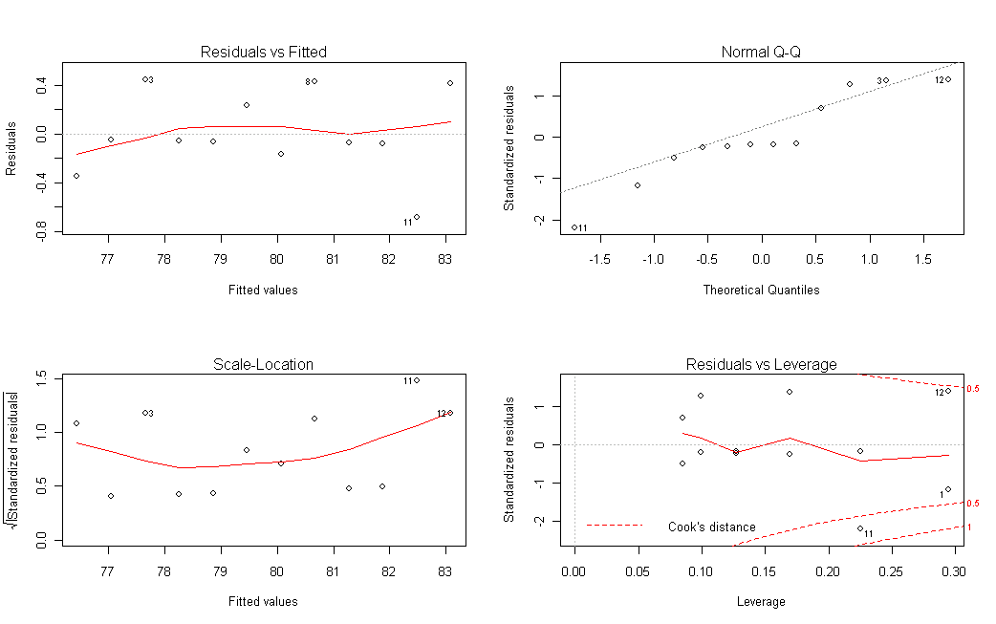
Checks for homogeneity of error variance (1), normality of residuals (2),
and outliers respectively (3&4).
plot(reg1) #built in diagnostics
Notes:
Or we can use built in diagnostics.Red line is a fitted smooth curve
Leverage measures the distance from xbar to observation xi,
Cook’s D Measures effect of deleting an observation. It is determined by leverage and residual.

Slide 14
ANOVA
X<-c(0,1,0,0,1,1,0,0,0)
Y<-c(15,2,7,5,2,5,7,8,4)
reg2 <- lm(Y~X)
reg2.anova<-anova(reg2)
names(reg2.anova)
reg2.anova
Calculate R2 = Coefficient of determination
“Proportion of variance in Y explained by X”
R2 = 1- (SSerr/Sstot)
R2 <- 1-(81.33/(43.56+81.33))
fstat<- reg2.anova$F
pval <- reg2.anova$P

Slide 15
Generalized Linear Models
GLM contains:
A probability distribution from the exponential family
A linear predictor X
A link function g
We use the command: glm(formula, family = gaussian, data, weights, subset, na.action, start = NULL, etastart, mustart, offset, control = list(...), model = TRUE, method = "glm.fit", x = FALSE, y = TRUE, contrasts = NULL, ...)
GLMs default is linear regression, no need to specify link function
or distribution.
http://web.njit.edu/all_topics/Prog_Lang_Docs/html/library/base/html/glm.html
Notes:
Now lets look at glm.

Slide 16
Generalized Linear Models
GLM takes the argument “family”
family = description of the error distribution and link function to be used in the model. This can be a character string naming a family function, a family function or the result of a call to a family function.

Slide 17
Some families
family(object, ...)
binomial(link = "logit")
gaussian(link = "identity") #REGRESSION, DEFAULT
gamma(link = "inverse")
inverse.gaussian(link = "1/mu^2")
poisson(link = "log")
quasi(link = "identity", variance = "constant")
quasibinomial(link = "logit")
quasipoisson(link = "log")
Notes:
Here is just a list of distributions you might use in the family statement

Slide 18
Let’s look an example
Data From psychiatric study
X=number of daily hassles, predictor
Y=anxiety symptom, response
Do number of self reported hassles predict anxiety symptoms?

Slide 19
Code
setwd("C:\\Users\\smartbenben\\Desktop")
data1 <- read.table("data.dat", header = TRUE)
hist(data1$HASSLES)
plot(data1$HASSLES,data1$ANX)
glm(ANX ~HASSLES, data = as.data.frame(data1))
#LINEAR REGRESSION IS DEFAULT. IF IT WERE NOT, WE'D
#SPECIFY FAMILY
glm.linear <- glm(ANX ~HASSLES, data = as.data.frame(data1), family = gaussian)

Slide 20
R output for GLM call
glm(ANX ~HASSLES, data = as.data.frame(data1))
Call: glm(formula = ANX ~ HASSLES, data = as.data.frame(data1))
Coefficients:
(Intercept) HASSLES
5.4226 0.2526
Degrees of Freedom: 39 Total (i.e. Null); 38 Residual
Null Deviance: 4627
Residual Deviance: 2159 AIC: 279

Slide 21
Summary
summary(glm.linear) #Gives more information
Call:
glm(formula = ANX ~ HASSLES, family = gaussian, data = as.data.frame(data1))
Deviance Residuals:
Min 1Q Median 3Q Max
-13.3153 -5.0549 -0.3794 4.5765 17.5913
Coefficients:
Estimate Std. Error t value Pr(>|t|)
(Intercept) 5.42265 2.46541 2.199 0.034 *
HASSLES 0.25259 0.03832 6.592 8.81e-08 ***
---
Signif. codes: 0 ‘***’ 0.001 ‘**’ 0.01 ‘*’ 0.05 ‘.’ 0.1 ‘ ’ 1
(Dispersion parameter for gaussian family taken to be 56.80561)
Null deviance: 4627.1 on 39 degrees of freedom
Residual deviance: 2158.6 on 38 degrees of freedom
AIC: 279.05

Slide 22
How to Report Model Results
Beta coefficients (size, directionality)
Wald T tests and p-values
Potentially log likelihood or AIC values if doing model comparison
names(glm.linear) #Many important things can be pulled off from a glm object that will be of use in coding your own software.

Slide 23
Intercept only model
glm(ANX ~ 1, data = as.data.frame(data1))
Call: glm(formula = ANX ~ 1, data = as.data.frame(data1))
Coefficients:
(Intercept)
19.65
Degrees of Freedom: 39 Total (i.e. Null); 39 Residual
Null Deviance: 4627
Residual Deviance: 4627 AIC: 307.5

Slide 24
GLM
summary(glm.linear) #Shows t-tests, pvals, etc
## code our own t-test !
#give the var-cov matrix of parameters
var<-vcov(glm.linear)
var
beta <- glm.linear$coefficients[[2]]
var.beta <- var[2,2]
se.beta<-sqrt(var.beta)
t.test <- beta/se.beta #SAME AS IN SUMMARY
df<-glm.linear$df.residual

Slide 25
GLM
# Results Table:
results.table <- summary(glm.linear)$coefficients
# compare to glm.linear$coefficients
# pvalue for Wald test of slope:
results.table[2,4]
#LRTs.
> glm.linear$null.deviance
[1] 4627.1
> glm.linear$deviance
[1] 2158.613
Notes:
# One reason I love r is you can get all the pieces you want!
LRT=glm.linear$null.deviance-glm.linear$deviance
pval=format(1-pchisq(LRT,1),scientific = TRUE)

Slide 26
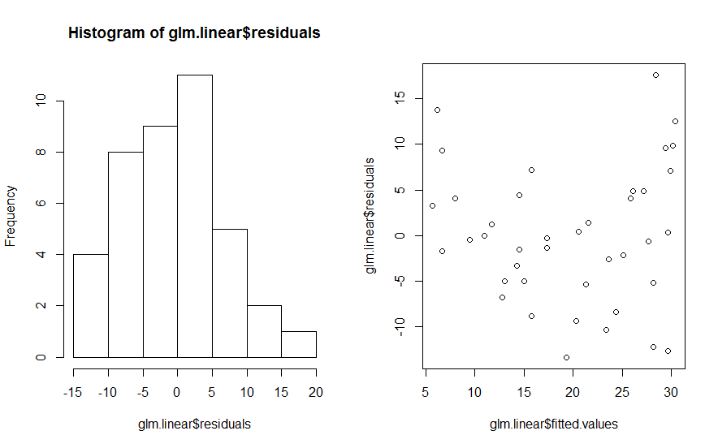
Plots for model check
hist(glm.linear$residuals)
plot(glm.linear$fitted.values,glm.linear$residuals)
Notes:
Histogram of residuals and plot of residuals to check for homoscedasticity. Can also check for outliers this way.

Slide 27
Multiple regression – Anxiety data
Lets add gender to anxiety for previous model and refit glm.
1=male, 0=female
gender<- c(0,0,1,1,0,1,1,1,0,1,1,1,0,0,0,0,1,0,1,1,0,1,1,0,0,0,1,1,0,0,1,0,1,1,0,0,0,1,1,0)
ANX <- data1$ANX
HASSLES<-data1$HASSLES
glm.linear2 <- glm(ANX ~HASSLES+gender)

Slide 28
Check assumptions
Spend some time to interpret the relevant output.
par(mfrow=c(2,1))
hist(glm.linear2$residuals)
plot(glm.linear2$fitted.values, glm.linear2$residuals)

Slide 29
Back to Regression Diagnostics
If you are analyzing a dataset carefully, you may consider regression diagnostics before reporting results
Typically, you look for outliers, residual normality, homogeneity of error variance, etc.
There are many different criteria for these things that we won’t review in detail.
Recall Cook’s Distance, Leverage Points, Dfbetas, etc.
CAR package from CRAN contains advanced diagnostics using some of these tests.
Notes:
Before sending results to your clinical colligues, you need to check regression assumptions.
CAR Package have advanced diagnostics. Let’s try it!

Slide 30
Multicollinearity
Two or more predictor variables in a multiple regression model are highly correlated
The coefficient estimates may change erratically in response to small changes in the model or the data
Indicators that multicollinearity:
1) Large changes in the estimated regression coefficients when a predictor variable is added or deleted
2) Insignificant regression coefficients for the affected variables in the multiple regression, but a rejection of the joint hypothesis that those coefficients are all zero (using an F-test)
Notes:
In real life, when we do regression, there might be 10 or 20 predictors you have to consider. Some of them might be correlated.
Have multicolinearity can make your model unstable.

Slide 31
Multicollinearity
A formal measure of multicollinearity is variance inflation factor (VIF)
VIF >10 indicates multicollinearity.

Slide 32
Regression diagnostics using LM CAR package
#Fit a multiple linear regression on the MTCARS data library(car)
fit <- lm(mpg~disp+hp+wt+drat, data=mtcars)
# Assessing Outliers
outlierTest(fit) # Bonferonni p-value for most extreme obs
qqPlot(fit, main="QQ Plot") #qq plot for studentized resid
leveragePlots(fit, ask=FALSE) # leverage plots
# Influential Observations # Cook's D plot # identify D values > 4/(n-p-1)
cutoff <- 4/((nrow(mtcars)-length(fit$coefficients)-2))
plot(fit, which=4, cook.levels=cutoff)
Notes:
The Bonferroni adjustment multiplies the usual two-sided p-value by the number of observations

Slide 33
CAR for Diagnostics, normality
# Distribution of studentized residuals library(MASS)
sresid <- studres(fit)
hist(sresid, freq=FALSE, main="Distribution of Studentized Residuals")
#Overlays the normal distribution based on the observed studentized #residuals xfit<-seq(min(sresid),max(sresid),length=40)
yfit<-dnorm(xfit) #Generate normal density based on observed resids
lines(xfit, yfit)
Notes:
We can also check normality of studentized residuals.
First we create a histogram of studentized residuals then we add a normal density curve to the histogram

Slide 34
CAR for Diagnostics

Slide 35
CAR for Diagnostics, constant variance
#Non-constant Error Variance
# Evaluate homoscedasticity # non-constant error variance Score test
ncvTest(fit)
# plot studentized residuals vs. fitted values
spreadLevelPlot(fit)
#Multi-collinearity
# Evaluate Collinearity
vif(fit) # variance inflation factor
Notes:
It is nice to have a test on constant variance assumption!
VIF>10, clear indicator of multcolinearity
VIT>5, WORRY

Slide 36
Assuming our Y were counts
glm.poisson <- glm(ANX ~HASSLES, data=as.data.frame(data1), family = poisson)
glm.poisson2 <- glm(ANX ~HASSLES, data =as.data.frame(data1), family = quasipoisson)
summary(glm.poisson)
summary(glm.poisson2)
#Compare variance estimates
Review:
Poisson Regression
What is overdispersion?
What is Poisson parameter interpretation?
What is overdispersed Poisson parameter interpretation?
Notes:
In real life, we don’t always have continuous data. Sometimes, we can encounter counts data.
Poisson regression is often used for modeling count data.
The link function for posission is log.
Remember in posisson regression, lamda is the mean of counts, the variance equals to the mean. The dispersion parameter is 1.
But the assumption is not always met, if the variance is much larger than the mean, we will have overdispersion.
What is the consequence of overdispersion? Underestimate variance, type 1 error increase.
If you have overdispersion (see if residual deviance is much larger than degrees of freedom), you may want to use quasipoisson() instead of poisson().
In quasipossion, the overdispersion parameter is estimated from the data.

Slide 37
Overdispersion in counts
Example:
Y= #red blood cell units administered, X=drug (aprotinin vs. lysine analogue)
Overdispersion
Excess 0: > 50% zeros
Notes:
Patients were given two drugs, drug a vs drug l, then the number of rbc administered are counted.
We want to see which drug is effective in reducing the number of rbc administered.

Slide 38
ZIP Model
Two component mixture model: model of structural zeros that do not originate from any process, and counts that originate from a Poisson process.
Thus, the 0/1 process is modeled separately from the Poisson process when the observed 0 is determined not to have arisen from a Poisson process
0/1 binary process modeled as logistic regression
Count process simultaneously modeled as Poisson regression
Notes:
two-component mixture model.
0s cannot be explained by a possion model is modeled by a logistic regression.

Slide 39
VGAM Package
library(VGAM)
fit2 <- vglm(y ~ x1, zipoisson, trace = TRUE)

Slide 40
Results - ZIP
> summary(fit2)
Call:
vglm(formula = y ~ x1, family = zipoisson, trace = TRUE)
Pearson Residuals:
Min 1Q Median 3Q Max
logit(phi) -1.8880 -0.93828 0.59499 0.86550 1.0504
log(lambda) -1.3104 -0.31901 -0.31901 -0.18509 10.3208
Coefficients:
Value Std. Error t value
(Intercept):1 -0.025409 0.16450 -0.15446
(Intercept):2 0.703619 0.08129 8.65569
x1:1 -0.040470 0.33087 -0.12231
x1:2 -0.774116 0.17667 -4.38181
Notes:
Phi is the parameter for the binary process, lamda is the mean of counts data

Slide 41
Interpretation
Odds of observing a (structural) zero in blood product usage in the durg a versus drug l are exp(-.040) = 0.96[0.50,1.83].
The risk of blood product usage in drug a versus drug l group is exp(-0.774) =0.46[0.33,0.65].
Conclusion: there is a significant decreased risk of RBC usage in the aprotinin versus lysine analogue group.
Notes:
Odd ratio
Risk ratio

