Slide 1
Introduction to R Graphics
Delia Voronca
2013

Slide 2
Objectives
Create basic graphical displays such as scatter plots, boxplots, histograms, interaction plots and 3-D plots
Change plot symbols, add an arbitrary straight line, add points or lines, add an OLS line fit to points, add a normal density curve to a histogram
Add titles, footnotes, mathematical symbols, arrows and shapes
Add a legend
Change size of the graph, point, text, margins, put multiple plots per page
Changes axis, line styles, add colors
Save graphs

Slide 3
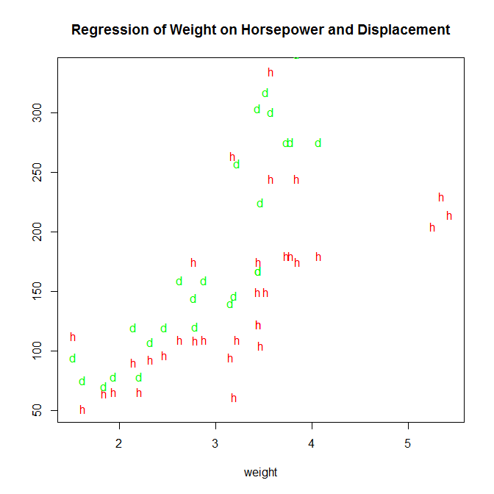
Useful Plots
Scatterplot
plot(x, y)
Multiple y values
plot(x, y1)
points(x, y2)
points(x, y3)
...
Use pch=“d” and
pch=“h” to change
the plotting symbols

Slide 4
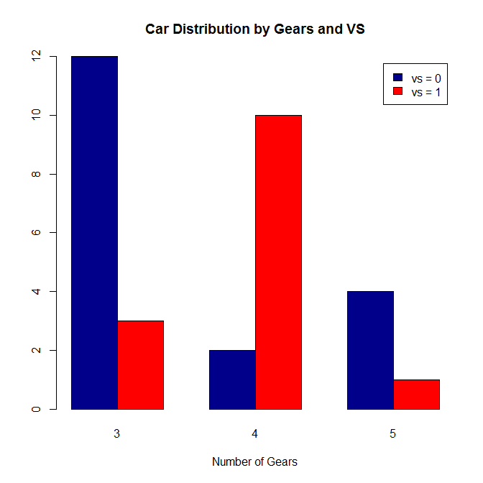
Useful Plots
Barpot
barplot(table(x1, x2), legend=c(“x1.grp1", “x1.grp2"), xlab="X2“, beside=TRUE)
Or
library(lattice)
barchart(table(x1,x2,x3))

Slide 5
Useful Plots
Histogram
hist(x)
Stem-and-leaf Plot
stem(x)
The decimal point is at the |
1 | 0000000
2 | 0000000000
3 | 000
4 | 0000000000
5 |
6 | 0
7 |
8 | 0

Slide 6
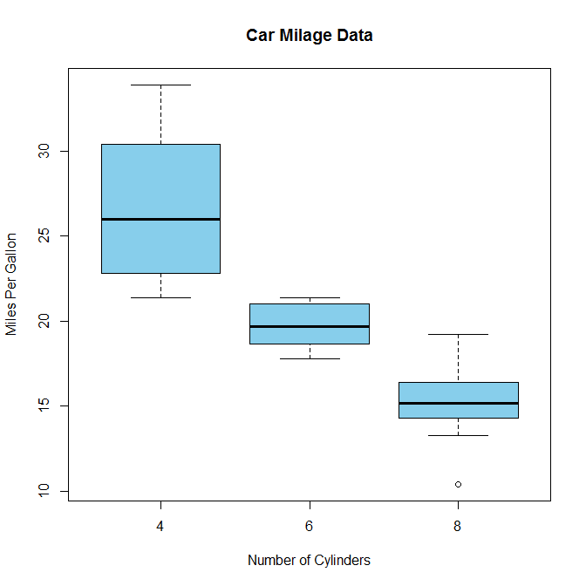
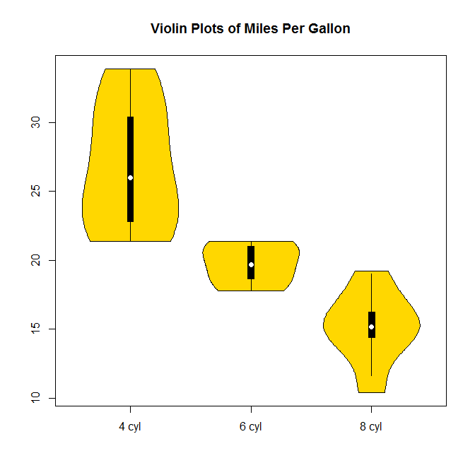
Useful Plots
Side-by-side boxplots
boxplot(y~x)
Or
library(lattice)
bwplot(y~x)
Boxplots and Violin Plots
boxplot(x)
horizontal = TRUE
library(vioplot)
vioplot(x1, x2, x3)

Slide 7
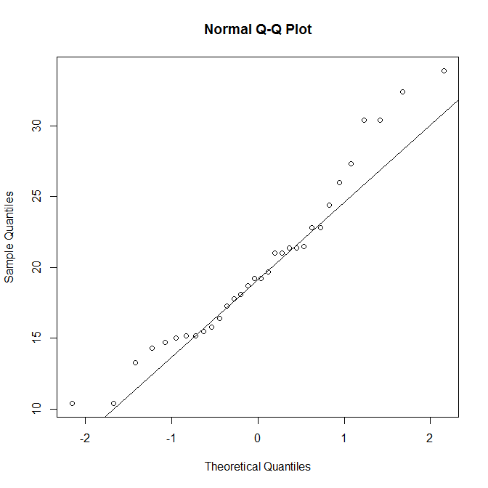
Useful Plots
Quantile-quantile plots
qqnorm(x)
qqline(x)
Quantile – Quantile-Quantile plot
qqplot(x, y)

Slide 8
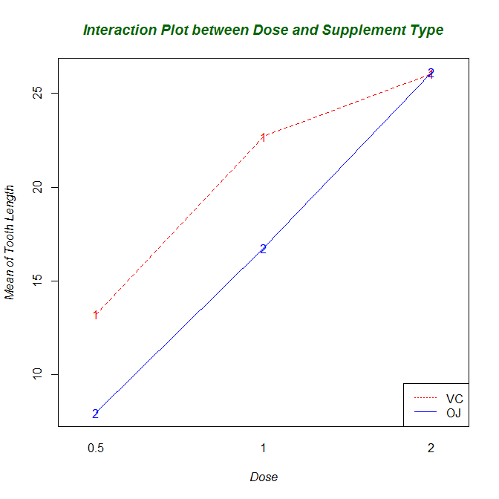
Useful Plots
Interaction plot
Display means by 2 variables (in a two-way analysis of variance)
interaction.plot(x1, x2, y)
fun (option to change default statistic which is the mean)

Slide 9
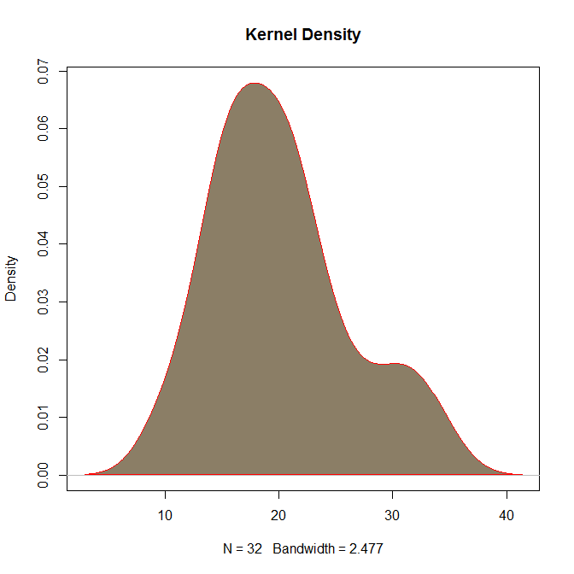
Useful Plots
Empirical probability density plot
Density plots are non-parametric estimates of the empirical probability density function
#univariate density
plot(density(x))
One could compare groups
by looking at kernel density
plots

Slide 10
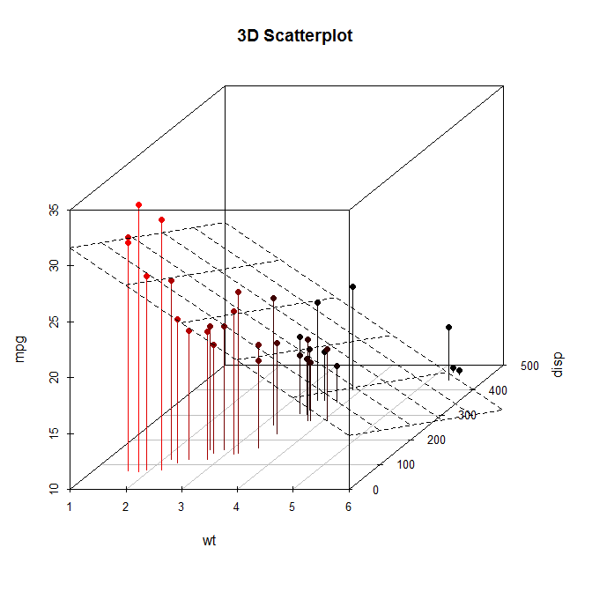
Useful Plots
3 – D plots
persp(x, y, z)
contour(x, y, z)
Image(x, y, z)
OR
library(scatterplot3d)
scatterplot3d(x, y, z)
The values for x and y must be in ascending order

Slide 11
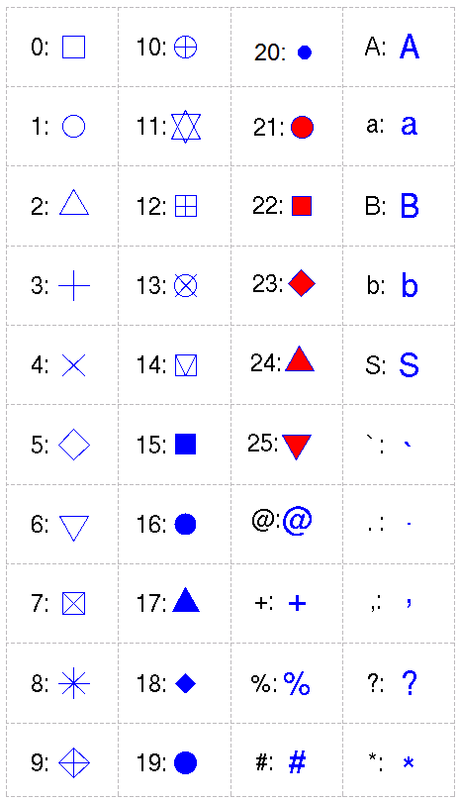
Adding Elements
Add an arbitrary straight line:
plot(x, y)
abline(intercept, slope)
Plot symbols
plot(x, y, pch=pchval)
PCH symbols used in R
“col=“ and “bg=” are also specified
PCH can also be in characters such as
“A”, “a”, “%” etc.

Slide 12
Adding Elements
Adding Points or Lines to an Existing Graphic
plot(x, y)
points(x, y)
lines(x, y, type=“type”)
type =
p points
l lines
o overplotted points and lines
b, c points (empty if "c") joined by lines
s, S stair steps
h histogram-like vertical lines
n does not produce any points or lines
OLS line fit to the points
plot(x, y)
abline(lm(y~x))

Slide 13
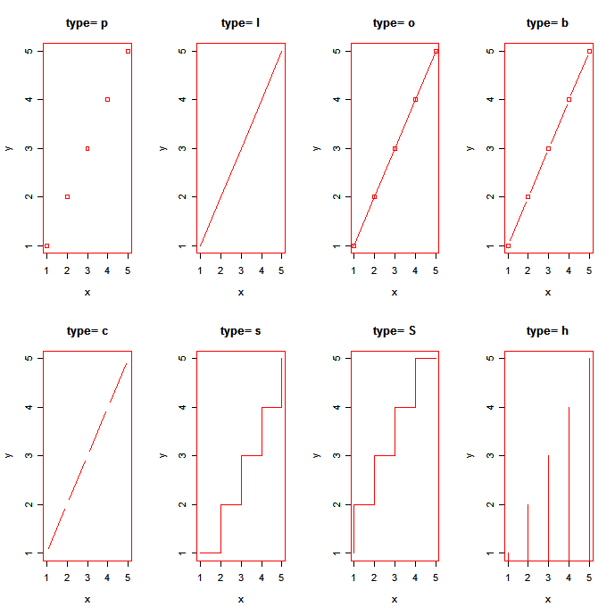

Slide 14
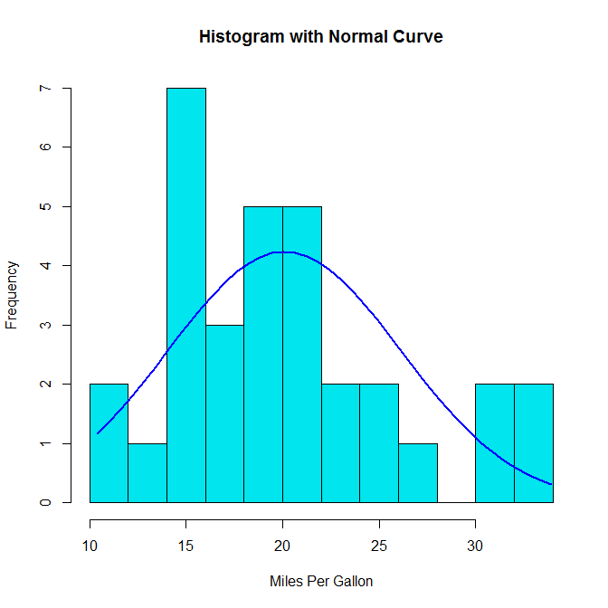
Adding Elements
Add a Normal Curve
h<-hist(x, breaks=10, col="red", xlab=“Xlab",
main="Histogram with Normal Curve")
xfit<-seq(min(x),max(x),length=40)
yfit<-dnorm(xfit,mean=mean(x),sd=sd(x))
yfit <- yfit*diff(h$mids[1:2])*length(x)
lines(xfit, yfit, col="blue", lwd=2)

Slide 15
Adding Elements
Titles
title(main=“main” , sub = “sub”, xlab=“xlab”, ylab=“ylab”)
Mathematical Symbols
plot(x, y)
expr = expression(paste(mathexpression)))
title(xlab=c(expr))
Arrows and Shapes
arrows(x, y)
rect(xleft, ybottom, xright, ytop)
polygon(x, y)
library(plotrix)
draw.circle(x, y, r)

Slide 16
Adding Elements
Legend
plot(x, y)
legend(xval, yval, legend = c(“Grp1”, “Grp2”), lty=1:2, col=3:4, bty=“box type”)
Add a legend at the location at (xval, yval)
A vector of legend labels, line types,
and colors can be specified
using legend, lty and col options.
bty =“o” or “n”

Slide 17
Options and Parameters
Graph Size
pdf(“filename.pdf”, width = Xin, height = Yin)
Point and text size
plot(x, y, cex = cexval)
cex number indicating the amount by which plotting text and symbols should be scaled relative to the default. 1=default, 1.5 is 50% larger, 0.5 is 50% smaller, etc.
cex.axis magnification of axis annotation relative to cex
cex.lab magnification of x and y labels relative to cex
cex.main magnification of titles relative to cex
cex.sub magnification of subtitles relative to cex
Box around plots
plot(x, y, bty = btyval)

Slide 18
Options and Parameters
Size of margins
par(mar=c(bot, left, top, right))
Save graphical settings
par() #view currents settings
opar <- par() #make a copy of current settings
par(opar) #restore original settings
Multiple plots per page
par(mfrow=c(a, b)) #a rows and b columns
par(mfcol=c(a,b))

Slide 19
Options and Parameters
Axis Range and Style
plot(x, y, xlim = c(minx, maxx), ylim = c (miny, maxy), xaxs=“i”, yaxs=“i”)
The xaxs and yaxs control whether the tick marks extend beyond the limits of the plotted observations (default) or are constrained to be internal (“i”)
See also:
axis()
mtext()
Omit axis
plot(x, y, xaxt = “n”, yaxy=“n”)

Slide 20
Options and Parameters
Axis labels, values, and tick marks
plot(x, y, lab=c(x, y, len), #number of tick marks
las=lasval, #orientation of tick marks
tck = tckval, #length of tick marks
xaxp = c(x1, x2, n), #coordinates of the extreme tick marks
yaxp = c(x1, x2, n),
xlab = “X axis label”, ylab=“Y axis label”)
las = 0 labels are parallel to axis
las=2 labels are perpendicular to axis
tck = 0 suppresses the tick mark

Slide 21
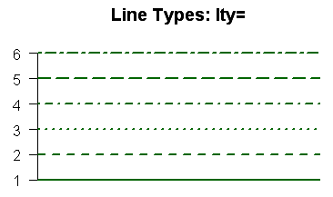
Options and Parameters
Line styles, line width and colors
plot(….)
lines(x, y, lty=ltyval, lwd = lwdval,
col=colval)
col Default plotting color. Some functions (e.g. lines) accept a vector of values that are recycled.
col.axis color for axis annotation
col.lab color for x and y labels
col.main color for titles
col.sub color for subtitles
fg plot foreground color (axes, boxes - also sets col= to same)
bg plot background color

Slide 22
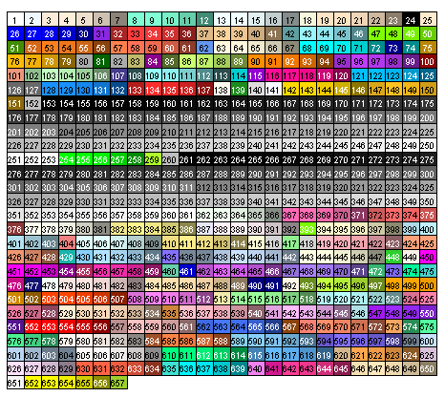
Options and Parameters
More on how to change colors
You can specify colors in R by index, name, hexadecimal, or RGB.
For example col=1, col="white", and col="#FFFFFF" are equivalent.
colors() #list of color names

Slide 23
Options and Parameters
Fonts
font Integer specifying font to use for text.
1=plain, 2=bold, 3=italic, 4=bold italic, 5=symbol
font.axis font for axis annotation
font.lab font for x and y labels
font.main font for titles
font.sub font for subtitles
ps font point size (roughly 1/72 inch)
text size=ps*cex
family font family for drawing text. Standard values are "serif", "sans", "mono", "symbol".

Slide 24
Saving Graphs
pdf(“file.pdf”)
plot(….)
dev.off()
jpeg(“file.jpeg”)
plot(…)
dev.off()
win.metafile(file.wmf)
plot(…)
dev.off()
Similar code for BMP, TIFF, PNG, POSTSCRIPT
PNG is usually recommended
The dev.off() function is used to close the graphical device

Slide 25
Go Over R Code

Slide 26
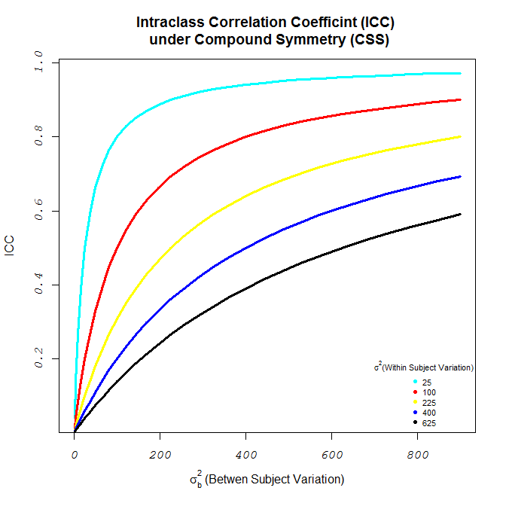
In Class Activity
Any ideas on how to reproduce this graph?
What are some things
you need to know?
Data and ICC formula
Add a title
Change axis labels
Change tick marks
Change color
Add legend
Change font and size
*Use a for loop

Slide 27
In Class Activity
Let’s go over the code
Questions
Homework

Slide 28
References
SAS and R – data Management, Statistical Analysis, and Graphics, Ken Kleinman and Nicholas J. Horton
Quick – R : http://www.statmethods.net/index.html
R help

