Slide 1
Computing for Research I
Spring 2014
Regression Using Stata
March 3
Primary Instructor:
Elizabeth Garrett-Mayer

Slide 2
First, a few odds and ends
Dealing with non-stringy strings:
  gen xn = real(x)
encode and decode
  String variable to numeric variable
encode varname, gen(newvar)
  Numeric variable to string variable
  decode varname, gen(newvar)

Slide 3
Stata for regression
Focus on linear regression
Good news: syntax is (almost) identical for other types of regression!
More on that later
Personal experience:
  I use stata for many regression problems
  why?
    tons of options
    easy to handle complex correlation structures
    simple to deal with interactions and other polynomials
    nice way to deal with linear combinations

Slide 4
Linear regression example
How long do animals sleep?
Data from which conclusions were drawn in the article "Sleep in Mammals: Ecological and Constitutional Correlates" by Allison, T. and Cicchetti, D. (1976), Science, November 12, vol. 194, pp. 732-734.
Includes brain and body weight,
life span,
gestation time,
time sleeping,
predation and danger indices

Slide 5
Variables in the dataset
body weight in kg
brain weight in g
slow wave ("nondreaming") sleep (hrs/day)
paradoxical ("dreaming") sleep (hrs/day)
total sleep (hrs/day) (sum of slow wave and paradoxical sleep)
maximum life span (years)
gestation time (days)
predation index (1-5): 1 = minimum (least likely to be preyed upon) 5 = maximum (most likely to be preyed upon)
sleep exposure index (1-5): 1 = least exposed (e.g. animal sleeps in a well-protected den) 5 = most exposed overall
danger index (1-5): (based on the above two indices and other information) 1 = least danger (from other animals) 5 = most danger (from other animals)

Slide 6
Basic steps
Explore your data
  outcome variable
  potential covariates
  collinearity!
Regression syntax
  regress y x1 x2 x3….
  that’s about it!
  not many options

Slide 7
Interactions
“interaction expansion”
prefix of “xi:” before a command
Treats a variable in ‘varlist’ with i. before it as categorical (or “factor”) variable
Example in breast cancer dataset
  regress logsize graden
  vs.
  xi: regress logsize i.graden

Slide 8
Alternative
You don’t have to include xi: (for making dummy variables)
What is the difference?
  xi prefix:
    new ‘dummy’ variables are created in your variable list.
    variables begin with ‘_I’ then variable name, ending with numeral indicating category
  no xi prefix:
    new variables are not created, just included temporarily in command
    referring to them in post estimation commands uses syntax i.varname where i is substituted for category of interest

Slide 9
Example
xi: regress logsize i.graden ern
test _Igraden_2=_Igraden_3=_Igraden_4=0
regress logsize i.graden ern
test 2.graden=3.graden=4.graden=0

Slide 10
But that is not an interaction(?)
It facilitates interactions with categorical variables
xi: regress logsize i.black*nodeyn
  fits a regression with the following
    main effect of black
    main effect of node
    interaction between black and node
  be careful with continuous variables!

Slide 11
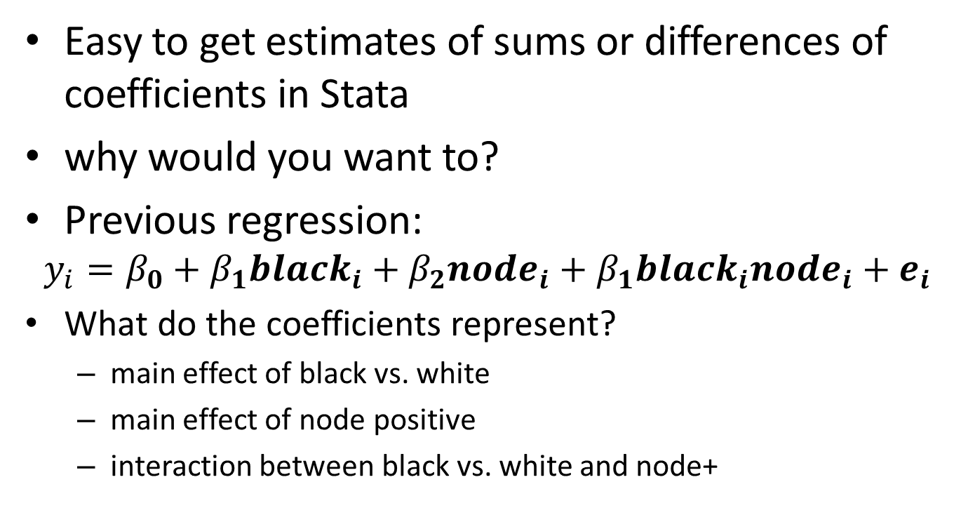
Linear Combinations
Easy to get estimates of sums or differences of coefficients in Stata
why would you want to?
Previous regression:
$$y_{i}=β_{0}+β_{1}{black}_{i}+β_{2}{node}_{i}+β_{1}{black}_{i}{node}_{i}+e_{i}$$
What do the coefficients represent?
  main effect of black vs. white
  main effect of node positive
  interaction between black vs. white and node+

Slide 12
Linear Combinations
What is the expected difference in log tumor size comparing….
  two white women, one with node positive vs. one with node negative disease?
  two black women, one with node positive vs. pne with node negative disease?
  a black woman with node negative disease vs. a white woman with node positive disease?
(see do file for syntax)

Slide 13
Other types of regression
logit y x1 x2 x3…. or logistic y x1 x2 x3…
  logit: log odds ratios (coefficients)
  logistic: odds ratios (exponentiated coefficients)
poisson y x1 x2 x3, offset(n)
Cox regression
  first declare outcome: stset ttd, fail(death)
  then fit cox regression: stcox x1 x2
xtlogit or xtregress
  random effects logistic and linear regression

Slide 14
Other nifty post-regression options
AUC curves after logistic
  estat classification reports various summary statistics, including the classification table
  estat gof Pearson or Hosmer-Lemeshow goodness-of-fit test
  lroc graphs the ROC curve and calculates the area under the curve
  lsens graphs sensitivity and specificity versus probability cutoff

Slide 15
Other nifty post-regression options
Post Cox regression options
  estat concordance: Calculate Harrell's C
  estat phtest: Test Cox proportional-hazards assumption
  stphplot: Graphically assess the Cox proportional-hazards assumption
  stcoxkm: Graphically assess the Cox proportional-hazards assumption

