Slide 1
Introduction to LaTeX and Bibtex
Manuscript Production
Cody Chiuzan
Computing for Research I
MUSC, April 16th 2013

Slide 2
What is LaTeX?
A computer typesetting system that specializes in producing mathematically oriented documents
A document ‘design’ language
Available for just about any computer system
Can be used to produce a range of documents, including handouts, reports, letters, theses, articles, books, etc.
Current version: LaTeX2Ɛ

Slide 3
Why LaTeX?
It looks professional
Many journals now encourage authors to submit manuscripts using LaTeX
Math formulas are produced easily and look polished
Equations, tables, figures can be labeled so that referencing is automated
Great for bibliography management
It doesn’t crash => not in danger of loosing your work
Somebody (colleague, professor) WILL advise you to learn about it

Slide 4
LaTeX is not WYSIWYG
It lacks the attraction of real-time display
Forces you to think in terms of structures: sections, subsections, listings rather than appearance
It takes a while to master the fundamentals
Has no spelling check ☹
Learn by example, practice, shared templates

Slide 5
General structure
Create a file with suffix .tex
\documentclass[options]{style}
.
preamble (use of optional packages)
\begin{document}
…your thesis here
\end{document}
Document classes: article, report, book, letter, seminar, beamer

Slide 6
Relevant packages (preamble)
Most LaTeX installations have a large of pre-installed packages
Or go to: http://www.ctan.org/ and look for styles, downloads and documentations
\usepackage{amsmath} – most important for math environments (\align)
\usepackage{graphicx} – essential for inserting figures (\includegraphics)
\usepackage[a4paper]{geometry} – adjust margins of a certain page
\usepackage{hyperref} – makes citations “clickable” in the .pdf document

Slide 7
Title page
Can be generated automatically by specifying the title, authors, affiliations, and date
\title{Learning \Latex}
\author{Cody Chiuzan\\
Department of Public Health Sciences}
\date{April 2013} -> if omitted, the current date is generated
-> to suppress use \date{}
\maketitle
Make an abstract
\begin{abstract}
…
\end{abstract}

Slide 8
Sectioning commands
LaTeX is organized hierarchically
\section{}, \subsection{}, \subsubsection{}
\section*{} -> no numbering
If you have an appendix, then insert
\appendix -> after this, everything is treated as appendix
Table of contents (run LaTeX twice)
\newpage
\begin
\tableofcontents
\end
\addcontentsline{toc}{chapter}{Abstract} -> if not an official structure

Slide 9
Some key concepts
LaTeX regards groups of characters separated by spaces as words
Number of spaces is immaterial, LaTeX makes its own mind including hyphenation
A blank line signifies the end of a paragraph
A paragraph is automatically indented - use \noindent in front
These characters have a special meaning – use \ in front:
\ , $ , & , % , ~ , _ , { , } , # , ^

Slide 10
Type Style – Don’t overuse!
The default size is 10 points – change in \documentclass{}
Shapes:
\textup – upright , \textit – italic, \textsl – slanted, \textsc – small caps
Series:
\textmd – medium, \textbf – boldface
Families:
\textrm – roman, \textsf – sans serif, \texttt – typewriter
Change size selectively:
\Huge, \LARGE, \small, \footnotesize, \tiny

Slide 11
Environments
Parts of the document that LaTeX treats differently:
\begin{environment name}
… your inspiration here
\end{environment name}
Lists, centering, tables, equations, arrays/matrices, figures, theorems, etc.
Blank lines already precede and follow every environment

Slide 12
Lists & Centering
Bulleted list: Numbered list:
\begin{itemize} \begin{enumerate}
\item LaTeX is great. \item Keep trying!
\item But I prefer Word. \item And Smile!
\end{itemize} \end{enumerate}
Nested lists:1 – a), b) Centering
\begin{enumerate} \begin{center}
\item …
\begin{enumerate} \end{center}
\item
\end{enumerate}
\end{enumerate}

Slide 13
Tables
Entries across each row are separated by &
Each line except the last ends with \\
Vertical lines can be drawn using |
\begin{tabular}{l|r|
\hline
Name & Age & Sex \\
\hline
Emma & 24 & F \\
John & 57 & M
\end{tabular}
\multicolumn{} and \multirow{} for entries that span>1 col. or row

Slide 14
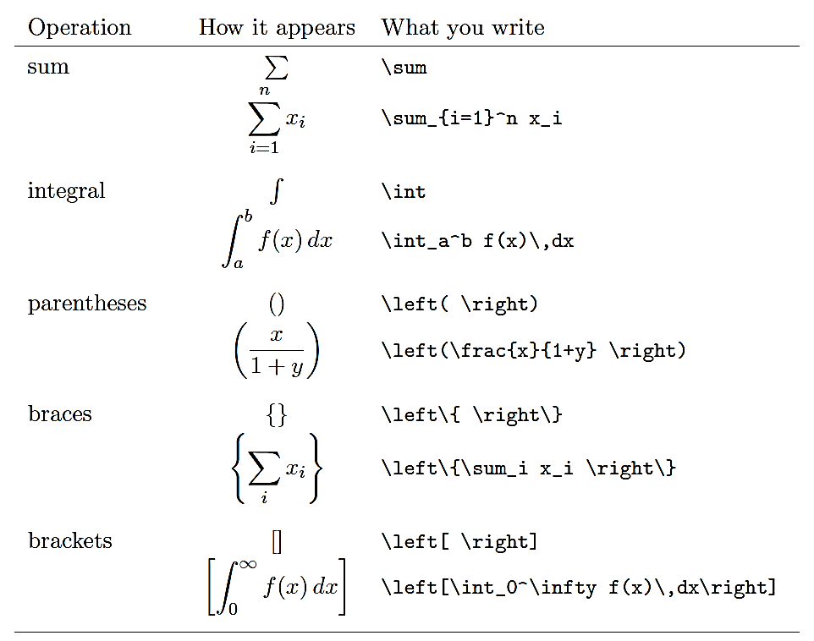
Typesetting Math
For mathematical symbols: $x$ or $a$
Use \ldots for 1,2,3,… and \cdots for x+y+ ∙∙∙ +z

Slide 15
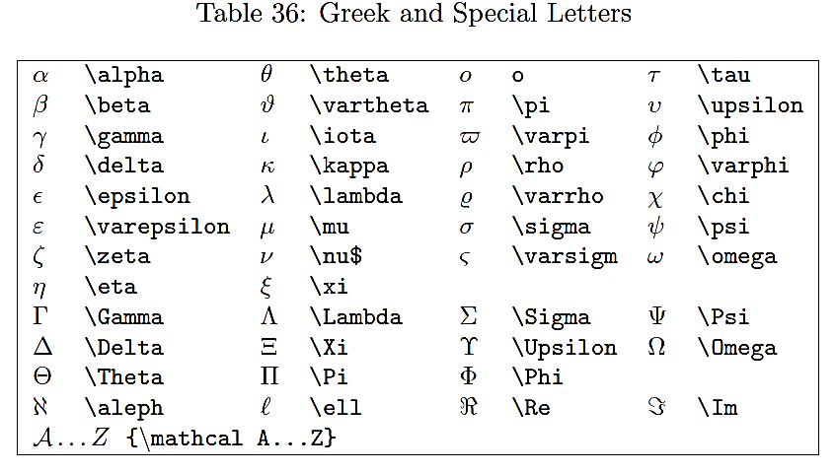
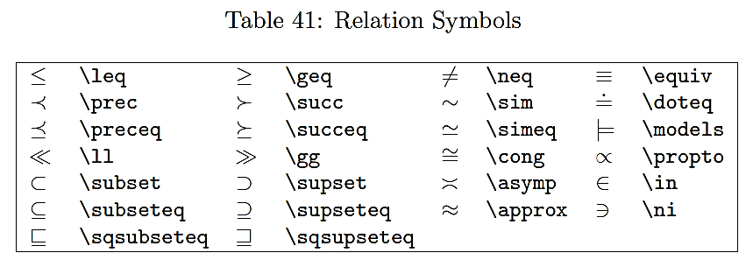
Typesetting Math

Slide 16
Equations
For just one-line expression:
\begin{equation*} -> *no number for the equation
…
\end{equation*}
To format sets of equations (multiple lines):
\begin{eqnarray}
Y &=& x^4 + 4 \nonumber\\
&\le&(x^2+2)^2 \label{yineq} -> number and label for the equation
\end{eqnarray}
In text, refer to the equation by its key \ref{yineq}

Slide 17
Equation arrays and matrices
Should be used in a math environment (e.g., equation)
Each row of the of the array must contain the same number of entries separated by &
Usually use command \mbox - temporarily leaves the math mode
\[ \delta_{ij}=
\left\{
\begin{array}{ll}
1 & \mbox{when $i=j$}, \\
0 & \mbox{when $i \ne j}$.
\end{array}
\right. -> creates a dummy right brace
\]

Slide 18
Inputting pictures
Use the figure environment and \usepackage{graphics}
Do not use any spaces for naming the imported picture !
\begin{figure}[!ht] -> h-here, t-top, b-bottom, p-page of float
\begin{center}
\includegraphics[height=2.9in, width=3.2in]{Path/Fig1.name.jpg}
\caption{Figure 1.}
\label{fig1} -> label for cross-referencing
\end{center}
\end{figure}
For .eps figures– \usepackage[dvips]{graphicx}
Can also include .jpeg, .pdf
Run >2 times

Slide 19
Theorem-like environment
Ensures that formatting is consistent and that the numbering and cross-referencing is automated
Contains structures like lemmas, theorems, assumptions, results, etc.
\newtheorem{thm}{Theorem}
\begin{thm} \label{Means}
Let $ A=(x+y)/2$ be the arithmetic mean…
\end{thm}
Use \ref{means} to cross-reference

Slide 20
Spacing
In LaTeX, any period that follows a lowercase letter and is followed by the blank space marks the end of a sentence
To force a normal inter-word space: \
Avoid redundant explanations, e.g. \ this one.
Useful commands:
\vspace{} -> adds space on the vertical; can take positive or negative values
\hspace{} -> adds space on the horizontal
\begin{doublespace} … \end{doublespace}
\begin{singlespace} … \end{singlespace}

Slide 21
Bibliography in LaTeX
Use thebibliography environment
\begin{thebibliography}{99} -> 99 gives an upper limit on the width of the labels
\bibitem{Senn12}
Stephen Senn.
Seven myths of randomisation in clinical trials.
\emph{Stat Med}, 32(9):1439-1450, 2012.
\end{thebibliography}
Refer to the item by the key - \cite{Senn12}
Can put multiple cites in one {}

Slide 22
Bibliography with BibTeX
BibTeX is used to create a bibliography in any of your LaTeX docs
Create a plain text or .tex file and save it with the extension .bib
BibTeX can have four different type of entries:
@string
@preamble - defines how special text should be formatted
@comment
Entries – each declaring a single reference to a type of publication
@article, @book, @inproceedings, etc.

Slide 23
BibTeX entries and styles
Each entry needs to have a type, a citation-key, and a number of tags @article{Senn12,
author = {Stephen Senn},
title = {Seven myths of randomisation in clinical trials},
journal = {Stat Med},
volume = {32},
number = {9},
pages = {1439-1450},
year ={2012}
}

Slide 24
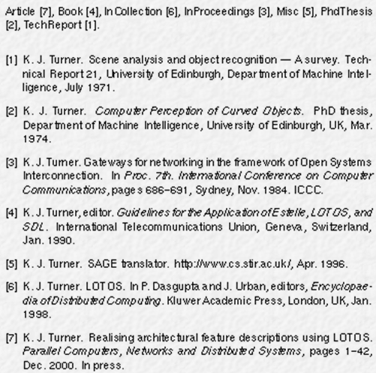
BibTeX entries and styles
http://www.bibtex.org/

Slide 25
BibTeX in LaTeX
At the end of the document put:
\bibliography{path/BiblioFileName} -> .bib file
\bibliographystyle{plain}
Run the .tex file >3 times

Slide 26
Easy BibTeX using Web-Endnote
Create your Web-Endnote account through MUSC (Information Services):
https://www.myendnoteweb.com/EndNoteWeb.html?SID=1DemhPE2JNB328p2dGn&returnCode=ROUTER.Success&SrcApp=CR&Init=Yes
Go to Pubmed, look for the article, send to Citation Manger (export to Web-Endnote)
Open the reference in Web-Endnote, create a label, and save it
Go to Format, Export References as a BibTeX file (.bib)
Open the BibTeX file and make sure everything is in the right format
Use the BibTeX file in your LaTeX code to generate bibliography (see previous slide)

Slide 27
Troubleshooting
The error messages are pretty explicit
The most common errors are:
Non-symmetric delimiters , e.g. {
Mistyped commands, e.g. \begin{centre}
Blank line in a equation environment
Incorrect specification of special characters, e.g. % without \
What to do?
Insert \end{document} before the line with errors and move it
further down the document until you identify the problem.

Slide 28
Resources
Official project site: http://www.latex-project.org/
Greenberg’s Simplified Introduction to LaTeX
Journal websites: http://www.ams.org/publications/authors/tex/tex
Templates from colleagues - modify and then create your own
Google – an endless resource

Slide 29
For first time authors…
Advice from Dr. Brad Efron:
http://www.youtube.com/watch?v=Ipk3HIIG9-o&feature=youtu.be

