Slide 1
Data Management: Procedures and Principles
Elizabeth Garrett-Mayer, PhD
February 26, 2013

Slide 2
Goals of data collection and management
Statisticians work with other team members to help establish databases
Often simple excel spreadsheets
Logics:
statistician logic ≠ basic scientist logic
statistician logic ≠ clinical scientist logic
Do your best to get involved BEFORE the data is entered!

Slide 3
Best examples are bad examples
 |  |  |  | DOB |  |  | 9/23 |  | 9/26 |  | 9/30 |  | 10/3 |  | 10/6 |  | 10/8 |  | 10/13 |  | 10/16 |  | 10/20
 |  |  |  |  |  |  | 28.0 |  | 28.5 |  | 29.0 |  | 29.5 |  | 30.0 |  | 30.5 |  | 31.0 |  | 31.5 |  | 32.0
Animal # | ear tag | genotype | gene # |  | gland
459+/+ | 2L | pdef+/+ neu+ | 2 | 3/11/08 | 1 |  |  |  |  |  | 301 |  | 583 |  | 681 |  | 707 |  | 1150 |  | 1596 |  | 1463
 |  |  |  |  | 3 |  |  |  |  |  |  |  | 640 |  | 585 |  | 472 |  | 1312 |  | 1203 |  | 1671
 |  |  |  |  | 7 |  |  |  |  |  |  |  |  |  |  |  |  |  |  |  |  |  | 177
 |  |  |  |  | total |  |  |  |  |  | 301 |  | 1223 |  | 1266 |  | 1179 |  | 2462 |  | 2799 |  | 3311
 |  |  |  |  | no. |  |  |  |  |  | 1 |  | 2 |  | 2 |  | 2 |  | 2 |  | 2 |  | 3
 |  |  |  |  |  |  | 12/6 |  | 12/9 |  | 12/12 |  | 12/16 |  | 12/19 |  | 12/23 |  | 12/26 |  | 12/30 |  | 1/3
 |  |  |  |  |  |  | 24.5 |  | 25 |  | 25.5 |  | 26 |  | 26.5 |  | 27 |  | 27.5 |  | 28 |  | 28.5
998+/+ | N | pdef+/+ neu+ | 2 | 6/17/08 | 1 |  | 151 |  | 277 |  | 468 |  | 525 |  | 747 |  | 958 |  | 793 |  | 659 |  | 1397
 |  |  |  |  | 2
 |  |  |  |  | 6
 |  |  |  |  |  |  | 151 |  | 277 |  | 468 |  | 525 |  | 747 |  | 958 |  | 793 |  | 659 |  | 1397
999+/+ | L | pdef+/+ neu+ | 2 | 6/17/08 | 2 |  | 0 |  | 0 |  | 0 |  | 0 |  | 0 |  | 0 |  | 0 |  | 0 |  | 96
 |  |  |  |  | 3
 |  |  |  |  | 7
 |  |  |  |  | 6

Slide 4
Fixed-ish
ID | type | gene | dob | glandid | date | volume | age
1527 | pdef+/+ neu+ | 2 | 9/3/08 | 2 | 2/27/2009 | 410 | 25.286
1527 | pdef+/+ neu+ | 2 | 9/3/08 | 2 | 3/4/2009 | 697 | 26
1527 | pdef+/+ neu+ | 2 | 9/3/08 | 3 | 2/13/2009 | 222 | 23.286
1527 | pdef+/+ neu+ | 2 | 9/3/08 | 3 | 2/20/2009 | 784 | 24.286
1527 | pdef+/+ neu+ | 2 | 9/3/08 | 3 | 2/27/2009 | 615 | 25.286
1527 | pdef+/+ neu+ | 2 | 9/3/08 | 3 | 3/4/2009 | 761 | 26
1527 | pdef+/+ neu+ | 2 | 9/3/08 | 7 | 2/7/2009 | 152 | 22.429
1527 | pdef+/+ neu+ | 2 | 9/3/08 | 7 | 2/13/2009 | 190 | 23.286
1527 | pdef+/+ neu+ | 2 | 9/3/08 | 7 | 2/20/2009 | 561 | 24.286
1527 | pdef+/+ neu+ | 2 | 9/3/08 | 7 | 2/27/2009 | 775 | 25.286
1527 | pdef+/+ neu+ | 2 | 9/3/08 | 7 | 3/4/2009 | 711 | 26
1528 | pdef+/+ neu+ | 2 | 9/3/08 | 1 | 10-Feb | 171 | 22.857
1528 | pdef+/+ neu+ | 2 | 9/3/08 | 1 | 2/17/2009 | 243 | 23.857
1528 | pdef+/+ neu+ | 2 | 9/3/08 | 1 | 2/27/2009 | 376 | 25.286
1528 | pdef+/+ neu+ | 2 | 9/3/08 | 1 | 3/4/2009 | 490 | 26
1528 | pdef+/+ neu+ | 2 | 9/3/08 | 2 | 2/3/2009 | 110 | 21.857
1528 | pdef+/+ neu+ | 2 | 9/3/08 | 2 | 2/10/2009 | 233 | 22.857
1528 | pdef+/+ neu+ | 2 | 9/3/08 | 2 | 2/17/2009 | 408 | 23.857
1528 | pdef+/+ neu+ | 2 | 9/3/08 | 2 | 2/27/2009 | 579 | 25.286
1528 | pdef+/+ neu+ | 2 | 9/3/08 | 2 | 3/4/2009 | 982 | 26
1528 | pdef+/+ neu+ | 2 | 9/3/08 | 7 | 2/3/2009 | 160 | 21.857
1528 | pdef+/+ neu+ | 2 | 9/3/08 | 7 | 2/27/2009 | 119 | 25.286
1528 | pdef+/+ neu+ | 2 | 9/3/08 | 7 | 3/4/2009 | 307 | 26
1528 | pdef+/+ neu+ | 2 | 9/3/08 | 8 | 2/3/2009 | 171 | 21.857
1528 | pdef+/+ neu+ | 2 | 9/3/08 | 8 | 2/10/2009 | 437 | 22.857

Slide 5
Principle 1: long format
In general, grow datasets ‘long’ not wide
Long data can be ‘reshaped’ to wide if needed
Each row represents a ‘unit of analysis.’
Patient? mouse?
observation on tumor for a mouse?
Think of repeated measures data: longitudinal

Slide 6
Wide format
Long format
group | id | day5 | day8 | day13 | day16 | day19 | day22 | day25 | day28 | day31
1 | 66051R | 0 | 0 | 0 | 111.7509 | 385.0947 | 650.2275 | 1951.205 | 3236.352 | 3869.84
1 | 66052L | 0 | 0 | 0 | 0 | 0 | 81.52639 | 438.1991 | 766.232 | 1034.28
1 | 66053B | 0 | 0 | 0 | 0 | 0 | 68.4 | 253.44 | 831.324 | 1113.6
1 | 66054N | 0 | 0 | 36.67601 | 382.3891 | 396.275 | 457.504 | 737.955 | 1034.28 | 1317.904
1 | 65971R | 0 | 0 | 0 | 103.6301 | 175.5 | 246.4346 | 544.6052 | 819.2 | 1270.72
1 | 65972L | 0 | 0 | 0 | 175.6789 | 275.184 | 501.76 | 604.8 | 784.08 | 1203.2
1 | 65973B | 0 | 0 | 0 | 0 | 12.96 | 32.912 | 146.1499 | 531.512 | 872.2
1 | 65974N | 0 | 0 | 0 | 197.0345 | 309.9802 | 330 | 515.188 | 850.176 | 1177.6
1 | 65975DL | 0 | 0 | 0 | 0 | 0 | 81.52639 | 438.1991 | 696.96 | 1203.2
2 | 65931R | 0 | 32.96963 | 107.5748 | 335.5935 | 526.848 | 977.7024 | 1285.401 | 2140.129 | 2783.375
2 | 65932L | 0 | 0 | 0 | 0 | 59.4 | 292.922 | 568.912 | 1039.68 | 1615.884
2 | 65933B | 0 | 0 | 0 | 0 | 37.5 | 171.462 | 484.416 | 823.2 | 1488.35
2 | 65934N | 256.515 | 325.6857 | 504.6 | 655.36 | 842.8 | 1180.98 | 1668.6 | 2535.123 | 3499.776
2 | 65935DR | 0 | 0 | 0 | 0 | 100.82 | 297.724 | 638.104 | 1280 | 2308.883
2 | 66011R | 0 | 0 | 213.86 | 510.0894 | 707.296 | 2183.808 | 4277.16 | 8690.074 | 7930.81
2 | 66012L | 0 | 0 | 0 | 40.45685 | 98 | 312.5995 | 629.1456 | 820.4225 | 1276.506
2 | 66013B | 0 | 0 | 0 | 0 | 47.04 | 275.7573 | 356.5 | 1137.934 | 1792.694
id | days | group | tsize
1 | 5 | 2 | 0
1 | 8 | 2 | 32.96963
1 | 13 | 2 | 107.5748
1 | 16 | 2 | 335.5935
1 | 19 | 2 | 526.848
1 | 22 | 2 | 977.7024
1 | 25 | 2 | 1285.401
1 | 28 | 2 | 2140.129
1 | 31 | 2 | 2783.375
2 | 5 | 2 | 0
2 | 8 | 2 | 0
2 | 13 | 2 | 0
2 | 16 | 2 | 0
2 | 19 | 2 | 59.4
2 | 22 | 2 | 292.922
2 | 25 | 2 | 568.912
2 | 28 | 2 | 1039.68
2 | 31 | 2 | 1615.884
3 | 5 | 2 | 0
3 | 8 | 2 | 0

Slide 8
Principle 2: numeric codes
StudyID | SEX | AGE | RACE | Surg Path Specimen Used | Final Path Diagnosis | EXP Censor | Primary COD | Primary COD Code | Secondary COD | Secondary COD Code
1 | F | 51 | W | S45-1764, 11/18/1998 | AML | 0
2 | M | 60 | W | S76-6965, 03/12/1999 | AML with MLD | 1 | Relapse | 1 | Sepsis | 1
3 | F | 42 | W | S34-13589, 04/28/1999 | RAEB-2* | 1 | Tx Related | 2 | GVHD / Septicemia ( aspergillous | 1 and 3
4 | F | 59 | W | S67-10420, 03/01/1999 | RAEB-2 | 1 | Tx Related | 2 | FTE | 4
5 | M | 32 | W | S23-7186, 03/01/1999 | AML/MDS | 0
6 | M | 50 | W | S09-15708, 5/101/99 | CMML | 0
7 | F | 63 | W | NO BM PRIOR TO BMT | NA | 0
8 | F | 50 | W | S145-20523, 5/1/00 | RAEB-2 | 0
9 | M | 53 | W | S87-43149, 09/12/2000 | AML wMLD* | 1 | Relapse | 1
10 | M | 57 | W | S09-38696, 8/1/00 | MPD/MDS-U* | 1 | Relapse | 1
11 | F | 63 | W | S56-47232, 10/03/2000 | AML/MDS | 1 | Tx Related | 2 | Graft Failure/Sepsis | 1 and 4
12 | M | 55 | W | S23-47159, 10/01/2000 | RAEB-1 | 1 | Relapse | 1
13 | F | 52 | W | S12-60174, 12/1/2000 | AML* | 0
14 | M | 30 | W | S90-4988, 01/29/2001 | RCMD | 1 | Relapse | 1 | Infection | 1
15 | F | 57 | W | S58-62446, 12/1/2000 | RCMD | 0
16 | M | 55 | W | S45-11389, 3/1/2001 | RAEB-1 | 1 | Multi-organ Failure | 3 | Liver and Resp. Failure | 2
17 | M | 65 | B | S378-8738, 02/1/2001 | RCMD | 0
18 | F | 63 | W | S854-11103, 03/01/2001 | RAEB-1 | 1 | Relapse | 1
19 | M | 59 | W | S43-26265, 05/21/2001 | MDS-U* | 1 | Tx Related | 2 | FTE/Infection | 1 and 4
20 | M | 61 | W | S90-41961 ,8/1/2001 | RCMD | 0
21 | F | 63 | W | S26-50236, 10/01/2001 | RAEB-1 | 0
22 | M | 53 | W | S49-60634, 11/01/2001 | RCMD* | 0
23 | M | 64 | W | S78-63086, 12/01/2001 | AML wMLD | 1 | Relapse | 1 | MSOF/Fungal Sinusisit | 1 and 2
24 | M | 45 | W | S56-3687, 01/01/2002 | AML from underlying CMML | 1 | Unknown | 3

Slide 9
Were any AEs observed during during this period? | AE Name | Grade | Treatment Relation | Event Status
Yes | Abdomen Distention/Ascites | 1 | Not Related | New
Yes | Acne Rash (face, shoulders, chest) | 2 | Probable | New
Yes | Acne Rash (face, shoulders, chest) | 1 | Probable | Ongoing without change
Yes | Acne Rash (head, arms, chest, legs) | 3 | Probable | New
Yes | Acneform Rash Face/Chest | 1 | Probable | Ongoing without change
Yes | Acneform Rash on Face | 1 | Probable | Ongoing without change
Yes | Acneform rash to face and chest | 2 | Probable | New
Yes | Acneform Rash-Face | 1 | Probable | New
Yes | Acneform Rash-Face | 1 | Probable | Ongoing without change
Yes | Acniform Rash | 2 | Definite | New
Yes | Acniform Rash to face | 3 | Definite | Ongoing with change in grade
Yes | acute coronary syndrome | 3 | Unlikely | New
Yes | Acute Renal Failure |  |  | New
Yes | Alkaline Phosphatase | 1 | Possible | Ongoing without change
Yes | Alkaline Phosphatase | 1 | Possible | Ongoing without change
Yes | Alkaline Phosphatase | 1 | Possible | New
Yes | Alkaline Phosphatase | 1 | Possible | Ongoing without change
Yes | Alkaline Phosphatase | 1 | Possible | Ongoing without change
Yes | Alkaline Phosphatase | 1 | Possible | Ongoing without change
Yes | Alkaline Phosphatase | 1 | Possible | Ongoing without change
Yes | Alkaline Phosphatase | 1 | Unlikely | New
Yes | alkaline phosphatase | 2 | Unlikely | New
Yes | Alkaline Phosphatase | 1 | Possible | New
Yes | alkaline phosphatase | 2 | Unlikely | Ongoing with change in grade
Yes | alkaline phosphatase | 2 | Unlikely | New

Slide 10
All 1181 AEs were tabulated AFTER combining categories of AEs.
AE Type | Grade 0 | Grade 1 | Grade 2 | Grade 3 | Grade 4 | Grade 5 | Total
DIARRHEA | 0 | 25 | 12 | 5 | 0 | 0 | 42
FATIGUE | 0 | 17 | 19 | 6 | 0 | 0 | 42
PAIN | 0 | 8 | 22 | 4 | 0 | 0 | 34
RASH | 0 | 9 | 16 | 5 | 0 | 0 | 30
NAUSEA | 0 | 16 | 9 | 2 | 0 | 0 | 27
ANOREXIA | 0 | 10 | 15 | 0 | 0 | 0 | 25
DRY SKIN | 0 | 15 | 9 | 0 | 0 | 0 | 24
WEIGHT LOSS | 0 | 18 | 5 | 0 | 0 | 0 | 23
ALKALIINE PHOSPATASE | 0 | 9 | 7 | 4 | 0 | 0 | 20
VOMITING | 0 | 10 | 9 | 1 | 0 | 0 | 20
HYPERTENSION | 0 | 13 | 4 | 2 | 0 | 0 | 19
BILIRUBIN | 0 | 9 | 8 | 2 | 0 | 0 | 19
AST | 0 | 6 | 5 | 6 | 0 | 0 | 17
PRURITIS | 0 | 12 | 3 | 0 | 0 | 0 | 15
WEAKNESS | 0 | 5 | 8 | 1 | 0 | 0 | 15
THROMBOCYTOPENIA | 0 | 9 | 4 | 1 | 0 | 0 | 14
TASTE CHANGE | 0 | 11 | 3 | 0 | 0 | 0 | 14
ALT | 0 | 9 | 3 | 1 | 0 | 0 | 13
ANEMIA | 0 | 10 | 0 | 2 | 0 | 0 | 12
CHILLS | 1 | 9 | 1 | 1 | 0 | 0 | 12
PROTEINURIA | 0 | 8 | 3 | 1 | 0 | 0 | 12
PLATELETS | 0 | 7 | 5 | 0 | 0 | 0 | 12
FEVER | 1 | 9 | 0 | 1 | 0 | 0 | 11

Slide 11
Principle 3: Be involved in data collection tools
Quantitative vs. qualitative
Avoid ‘open-ended’ options
no fill in the blank
be comprehensive in options
Allow ‘Other’ in case you have not considered all options
Consider “don’t know” and other missing codes (e.g., ‘not applicable’) to distinguish true missing from refused or DK.

Slide 12
Principle 3: Be involved in data collection tools
Basic science, too.
Provide a template for how the data should be entered. And NOT like this one!
Figure 5F PBMC EOMES/TBET Ratio
Healthy | Vitiligo
0.401389 | 0.239173
0.366845 | 0.311164
0.509524 | 0.3
vitiligo pbmc | EOMES | TBET | EOMES TBET RATIO
T CELLS_0634 TBET.fcs | 9.83 | 41.1 | 0.239173
T CELLS_0640 TBET.fcs | 13.1 | 42.1 | 0.311164
T CELLS_0939 TBET.fcs | 12.9 | 43 | 0.3
healthy pbmc
T CELLS_5079 TBET.fcs | 5.78 | 14.4 | 0.401389
T CELLS_50784 TBET.fcs | 6.86 | 18.7 | 0.366845
T CELLS_50891 TBET.fcs | 10.7 | 21 | 0.509524

Slide 13
Principle 4: consider ‘variance’
If there is no variance across your sample, you cannot learn anything
Exception is inclusion/exclusion criteria: you should have no variance!
Example: income
when querying incoming, it is almost always categorical.
Depending on your population of interest, which is more appropriate? Household income:
<$15K, $15K-25K, $25K -50K, $50K – 100K, >$100K
<$50K, $50-100K, $100K - $150K, $150K - $200K.

Slide 14
Principle 5: you may need more than one dataset per study
Longitudinal study with 52 visits per patient
Each patient gets 52 rows in the dataset tracking his clinical progress
How should age, race and gender be captured?
Probably best to have a separate ‘demographic’ dataset to capture those kinds of questions.
You can merge them later.

Slide 15
Principle 5: you may need more than one dataset per study
Common in clinical trials
clinical database
AE (adverse events) database
medications database
Do not try to force everything to be in one database! Structures may need to be very different
Forms to be completed are different
CRF: case report form

Slide 16
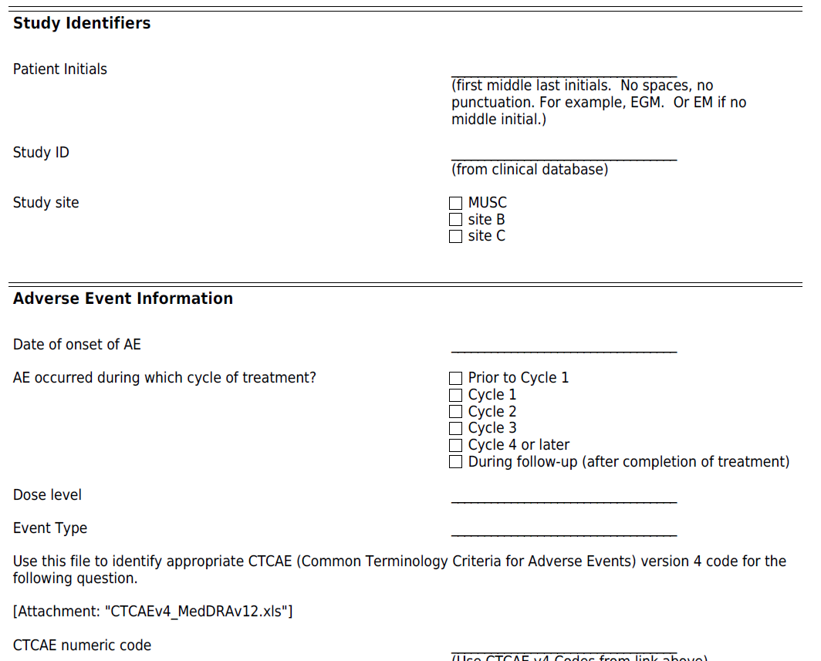
AE case report form

Slide 17
Principle 6: you want ‘raw data’
You will deal with triplicate values in some experiments
In most cases, you want the repeated values
This better reflects the true variance in the estimates.
In most cases, your inferences will be more precise when you include the raw data instead of making inferences on the means of replicates.

Slide 18
Principle 7: HIPAA!
Avoid identifiers whenever possible
Strip names and birthdates
Any dates might be identifiers (e.g., date of bone marrow transplant; date of death)
When you are sent data with identifiers, REMOVE them ASAP.
Respond to your colleague; ask him not to do that again.

Slide 19
Principle 8: EDA
Exploratory data analysis
Never assume that the data is clean!
You need to look at each and every variable you intend to use
Identify:
outliers: data entry or real outlier?
numeric codes for missings?
blank categories?
lots of missings? (e.g. date of death in survival analysis). Should there be lots of missings?

Slide 20
Principle 9: The research team
As the statistician you should not be a data manager or data entry person. TEAM-based research.
Who owns the data? The data is not yours to give/share/post on the web. Figure out who to ask if you need/want to.
Protect the data!
Interact regularly with the research team: the statistician should not meet up with the team only at the end of the study.

Slide 21
Principle 9: The research team
There should NOT be multiple versions of the dataset floating around.
excel can create a ‘version control’ nightmare
web-based databases such as RedCap help with this.

Slide 22
