Slide 1
Regression in R
Stacia DeSantis March 23, 2011
Computing for Research I

Slide 2
Introduction – R Terminology
Function
Declared by keyword function.
Takes a list of arguments in comma separated form
Performs some action using those arguments
Object
Specialized data structures
May be referred to through symbols or variables
May be manipulated in various ways.
Function typeof returns type of an R object
Attributes
Objects may have attributes attached to them
Stored as a list, which can be obtained using attributes
Examples include names, dimnames, dimensions

Slide 3
Data
RECALL, Simple linear regression describes the linear relationship between a predictor variable, plotted on the x-axis, and a response variable, plotted on the y-axis
dependent Variable (Y)
Independent Variable (X)

Slide 4
Y
ε
ε
X
Notes:
4

Slide 5
Y
1.0
X
Notes:
5

Slide 6
Fitting data to a linear model
intercept
slope
residuals
Notes:
6
Observations are measure in a bivariate way

Slide 7
Linear Regression
For linear regression, R uses 2 functions.
Could use built in function “lm”
Could use the generalized linear model (GLM) framework
Built in function called “glm”
A linear regression is a type of GLM.
Recall, GLM contains:
A probability distribution from the exponential family
A linear predictor
A link function g

Slide 8
Linear Regression
To implement linear regression using glm function, we must know:
The exponential family distribution assumed is Normal, that is, (Y|X) ~ Normal(μ,σ²)
The linear predictor is η = Xβ
The link function is the identity link, E(Y|X) = μ = Xβ
This distribution, linear predictor and link function will be specified in the glm function call as arguments.

Slide 9
Data
Mean Height versus Age in Months
age in months | height in CM
18 | 76.1
19 | 77
20 | 78.1
21 | 78.2
22 | 78.8
23 | 79.7
24 | 79.9
25 | 81.1
26 | 81.2
27 | 81.8
28 | 81.8
29 | 83.5

Slide 10
Read Data into R
age <- c(18,19,20,21,22,23,24,25,26,27,28,29)
height <- c(76.1,77,78.1,78.2,78.8,79.7,79.9,81.1,81.2,81.8,81.8,83.5)
dat <- as.data.frame(cbind(age,height))
dat
dim(dat)
is.data.frame(dat)
names(dat)

Slide 11
LM function in brief
http://stat.ethz.ch/R-manual/R-patched/library/stats/html/lm.html
lm(formula, data, subset, weights, na.action, method = "qr", model = TRUE, x = FALSE, y = FALSE, qr = TRUE, singular.ok = TRUE, contrasts = NULL, offset, ...)
reg1 <- lm(height~age, data=dat) #simple regression
reg2 <- lm(height ~ 1 , data=dat) #intercept only
#summary function will summarize the object.
#objects() will tell you which objects exist in your session.
#names(reg1) will tell you the attributes of the object.

Slide 12
summary(lm)
Call
Residuals
Coefficients
Residual standard error
R-squared
F-statistic

Slide 13
LM Function
Can accommodate weights (weighted regression)
Survey weights, inverse probability weighting, etc.
Results in standard regression model results including beta, SE(beta), Wald T-tests, p-values
Can obtain ANOVA, ANCOVA results
Can specify contrasts for predictors
Can do some regression diagnostics, residual analysis
Let’s do some of this

Slide 14
4 Assumptions of linear regression
Anyone remember?!

Slide 15
4 Assumptions of linear regression
Linearity of Y in X
Independence of the residuals (error terms are uncorrelated)
Normality of residual distribution
Homoscedasticity of errors (constant residual variance vs independent variables and fitted values)

Slide 16
Basic Checks
reg1
summary(reg1)
names(reg1)
plot(age,height)

Slide 17
Basic Checks
par(mfrow=c(2,2))
attach(reg1)
hist(residuals)
plot(age,residuals)
plot(fitted.values,residuals)
plot(height,fitted.values)
abline(0,1)
plot(reg1) #built in diagnostics
http://stat.ethz.ch/R-manual/R-patched/library/stats/html/plot.lm.html

Slide 18
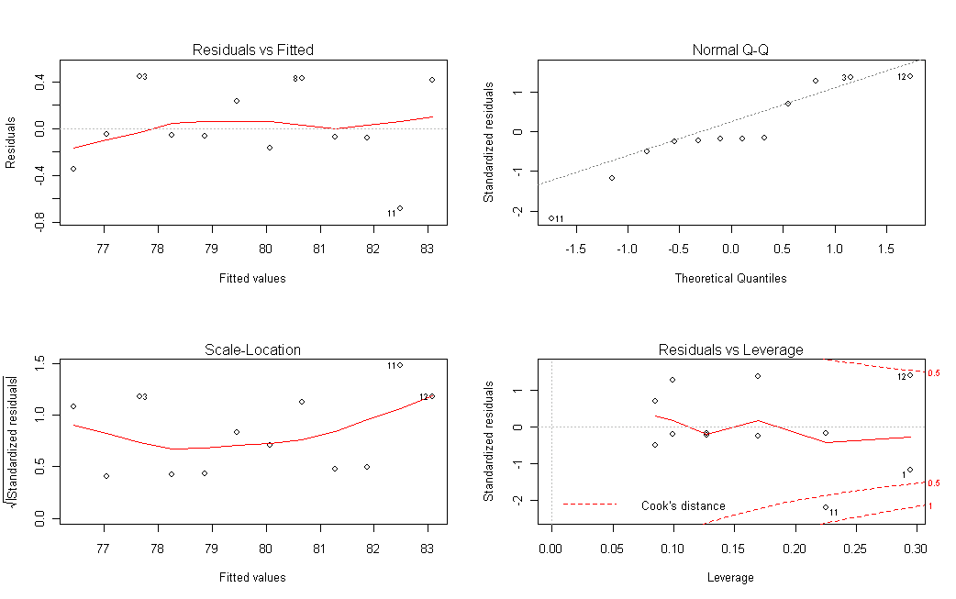
Checks for homogeneity of error variance (1), normality of residuals (2),
and outliers respectively (3&4).

Slide 19
Leverage is a measure of how far an independent variable deviates from its mean.
High leverage points can have a great amount of effect on the estimate of regression coefficients.
An extreme value on a predictor is a leverage point
Cook’s Distance
Measures effect of deleting an observation
Combines information on leverage and residual value.
Large value merits closer examination as that observation may be a leverage point.
“Large” is arbitrary but is denoted by contours on the fourth plot
Some suggest Di > 1 others suggest Di > 4/n

Slide 20
ANOVA
X<-c(0,1,0,0,1,1,0,0,0)
Y<-c(15,2,7,5,2,5,7,8,4)
reg2 <- lm(Y~X)
reg2.anova<-anova(reg2)
names(reg2.anova)
reg2.anova
Calculate R2 = Coefficient of determination
“Proportion of variance in Y explained by X”
R2 = 1- (SSerr/Sstot)
R2 <- 1-(81.33/(43.56+81.33))
fstat<- reg2.anova$F
pval <- reg2.anova$P

Slide 21
GLM Function
http://web.njit.edu/all_topics/Prog_Lang_Docs/html/library/base/html/glm.html

Slide 22
Generalized Linear Models
We use the command: glm(outcome ~ predictor1 + predictor2 + predictor3 )
GLMs default is linear regression, so need not specify link function or distribution.
GLM takes the argument “family”
family = description of the error distribution and link function to be used in the model. This can be a character string naming a family function, a family function or the result of a call to a family function.

Slide 23
GLM
Linear regression (normal, identity)
Logistic regression (binomial, logit)
Poisson regression (Poisson, log)
Variations of these and more

Slide 24
Some families
family(object, ...)
binomial(link = "logit")
gaussian(link = "identity") #REGRESSION, DEFAULT
gamma(link = "inverse")
inverse.gaussian(link = "1/mu^2")
poisson(link = "log")
quasi(link = "identity", variance = "constant")
quasibinomial(link = "logit")
quasipoisson(link = "log")

Slide 25
Data
From psychiatric study
X=number of daily hassles
Y=anxiety symptomatology
Do number of self reported hassles predict anxiety symptoms?

Slide 26
Code
setwd("I:\\")
data1 <- read.table(file=“HASSLES.txt”, header = TRUE)
data1[1] # Vector: See first variable values with name
data1[[1]] #List: See first variable values without name
hist(data1$HASSLES)
plot(data1$HASSLES,data1$ANX)
glm(ANX ~HASSLES, data = as.data.frame(data1))
#LINEAR REGRESSION IS DEFAULT. IF IT WERE NOT, WE'D
#SPECIFY FAMILY
glm.linear <- glm(ANX ~HASSLES, data = as.data.frame(data1), family = gaussian)

Slide 27
R output for GLM call
glm(ANX ~HASSLES, data = as.data.frame(data1))
Call: glm(formula = ANX ~ HASSLES, data = as.data.frame(data1))
Coefficients:
(Intercept) HASSLES
5.4226 0.2526
Degrees of Freedom: 39 Total (i.e. Null); 38 Residual
Null Deviance: 4627
Residual Deviance: 2159 AIC: 279

Slide 28
Summary
summary(glm.linear) #Gives more information
Call:
glm(formula = ANX ~ HASSLES, family = gaussian, data = as.data.frame(data1))
Deviance Residuals:
Min 1Q Median 3Q Max
-13.3153 -5.0549 -0.3794 4.5765 17.5913
Coefficients:
Estimate Std. Error t value Pr(>|t|)
(Intercept) 5.42265 2.46541 2.199 0.034 *
HASSLES 0.25259 0.03832 6.592 8.81e-08 ***
---
Signif. codes: 0 ‘***’ 0.001 ‘**’ 0.01 ‘*’ 0.05 ‘.’ 0.1 ‘ ’ 1
(Dispersion parameter for gaussian family taken to be 56.80561)
Null deviance: 4627.1 on 39 degrees of freedom
Residual deviance: 2158.6 on 38 degrees of freedom
AIC: 279.05

Slide 29
How to Report Model Results
Beta coefficients (size, directionality)
Wald T tests and p-values
Potentially log likelihood or AIC values if doing model comparison
names(glm.linear) #Many important things can be pulled off from a glm object that will be of use in coding your own software.

Slide 30
Intercept only model
glm(ANX ~ 1, data = as.data.frame(data1))
Call: glm(formula = ANX ~ 1, data = as.data.frame(data1))
Coefficients:
(Intercept)
19.65
Degrees of Freedom: 39 Total (i.e. Null); 39 Residual
Null Deviance: 4627
Residual Deviance: 4627 AIC: 307.5

Slide 31
Plots for model check
coefs <- glm.linear$coefficients
just.beta <- glm.linear$coefficients[[2]]
hist(glm.linear$residuals)
plot(glm.linear$fitted.values,glm.linear$residuals)
Histogram of residuals and plot of residuals to check for homoscedasticity. Can also check for outliers this way.

Slide 32
GLM
summary(glm.linear) #Shows t-tests, pvalues, etc
names(glm.linear) #Nothing for t-tests or pvalues
beta <- glm.linear$coefficients[[2]]
help(vcov)
var<-vcov(glm.linear)
var
var.beta <- var[2,2]
se.beta<-sqrt(var.beta)
t.test <- beta/se.beta #SAME AS IN SUMMARY
df<-glm.linear$df.residual

Slide 33
help(rt)
pval <- 2*pt(t.test, df=df, lower.tail = FALSE, log.p = FALSE) #SAME AS SUMMARY
#Recall for the Wald test, df = N- number parameters
#Thus, df = N-p-1 = N-1-1
#p=number of predictors
#subtract another “1” for the intercept

Slide 34
What about log likelihood?
https://stat.ethz.ch/pipermail/r-help/2001-July/013833.html
We may want to perform LRTs.
No obvious way that I see to extract this.
Of course we could compute the log L based on MLEs with some programming of the regression likelihood.

Slide 35
GLM object
We saved some components of this object. Why?
1.) Imagine you are doing a simulation study to which you repeatedly apply regression – you are repeatedly fitting glm and need to save the results across thousands of iterations for use later.
2.) Perhaps you need to save fitted values, or the coefficients, alpha, beta as an object, and make prediction later on a different dataset.
3.) You may need to extract AIC for model comparison later.
Example from my research – cross validation of a logistic regression model.

Slide 36
K fold Cross validation in regression
Similar for linear or logistic regression
Training data and test set data
Fit to K-1 splits of a dataset, a model of the form:
logistic.fit <- glm(Ytrain~ Xtrain, family = binomial(logit))
Then validate this model on the remaining kth split.
Repeat this process across 100 simulations.

Slide 37
Data Example
Study of cardiac biomarker predictors of left ventricular hypertrophy, LVH.
The outcome was whether or not a patient had LVH (0/1)
The predictors were 4 (continuous) biomarkers.
The model of interest was therefore a multiple logisitic regression with 4 predictor variables.
Not interested in p-values in this case, interested in AUC (area under the ROC curve) for biomarker discriminative ability of LVH 0/1.

Slide 38
Problem
N ~ 400 patients
Fitting a model to one dataset tends to result in “overfitting”
The model describes accurately that dataset but will it accurately apply in future settings?
Cross validation within a dataset may be used in this setting to get more accurate parameter estimates (as the resampling/refitting involved gives greater uncertainty around the estimate).
Gives a more accurate measure of predictive ability

Slide 39
Cross validation
Training set = dataset to build the model.
Test set = dataset used to “test” the model based on parameter estimates above.
Calculate some criteria (in this case, AUC) for the test data.
Summarize over all training/test splits of the data.
To fit the training set results to the test dataset you must save betas across all splits, to make prediction on test data.
Set K = 5, fit model to 4/5 of data, fit to 1/5, repeat (5 times) for all possible splits.
This involves a glm call and the glm object being saved for use in a subsequent step.
Then, this process is repeated over 30 simulations in this case.

Slide 40
Snapshot of Simulated K-fold cross validation
library(caTools)
library(ROCR)
for(k in 1:(K-1))
Xtrain <- data.train[,,k]
Xtest <- data.test[,,k]
logistic.fit <- glm(Xtrain[,1] ~ Xtrain[,2:M], family = binomial(logit))
x.matrix <- cbind(Xtest[,2:M])
beta <- logistic.fit$coefficients
pred <- antilogit(beta[1] + x.matrix %*% beta[2:M]) #PRED VALUE FOR Y BASED ON ESTIMATES FROM MY TRAINING DATA
truth <- Xtest[,1]
predict <- prediction(pred, truth)
perf <- performance(predict, measure = "tpr", x.measure = "fpr")
AUC[k] <- performance(predict,'auc')@y.values[[1]]
x.val[[k]] <- perf@x.values
y.val[[k]] <- perf@y.values
}
antilogit <- function(u){
exp(u)/(1+exp(u))
}

Slide 41
LVH Modeling Results
> CV(LVH4,5)
AUC quant1.5% quant2.95%
0.7725666 0.7337562 0.7971703
SIMULATED, CROSS VALIDATED AUC = 0.77[0.73,0.79]
OBSERVED AUC = 0.81
Cross validated less optimistic because does not suffer from overfitting.

Slide 42
Multiple regression – Anxiety data
Lets add gender to anxiety for previous model and refit glm.
1=male, 0=female
gender<- c(0,0,1,1,0,1,1,1,0,1,1,1,0,0,0,0,1,0,1,1,0,1,1,0,0,0,1,1,0,0,1,0,1,1,0,0,0,1,1,0)
ANX <- data1$ANX
HASSLES<-data1$HASSLES
glm.linear2 <- glm(ANX ~HASSLES+gender)

Slide 43
Multiple regression
Spend some time to interpret the relevant output.
par(mfrow=c(2,1))
hist(glm.linear2$residuals)
plot(glm.linear2$fitted.values, glm.linear2$residuals)

Slide 44
Back to Regression Diagnostics
If you are analyzing a dataset carefully, you may consider regression diagnostics before reporting results
Typically, you look for outliers, residual normality, homogeneity of error variance, etc.
There are many different criteria for these things that we won’t review in detail.
Recall Cook’s Distance, Leverage Points, Dfbetas, etc.
CAR package from CRAN contains advanced diagnostics using some of these tests.

Slide 45
Cook’s distance
Cook's Distance is an aggregate measure that shows the effect of the i-th observation on the fitted values for all n observations. For the i-th observation, calculate the predicted responses for all n observations from the model constructed by setting the i-th observation aside
Sum the squared differences between those predicted values and the predicted values obtained from fitting a model to the entire dataset.
Divide by p+1 times the Residual Mean Square from the full model.
Some analysts suggest investigating observations for which Cook's distance, D > 4/(N-p-1)

Slide 46
DFITS
DFITS_{i} is the scaled difference between the predicted responses from the model constructed from all of the data and the predicted responses from the model constructed by setting the i-th observation aside. It is similar to Cook's distance. Unlike Cook's distance, it does not look at all of the predicted values with the i-th observation set aside. It looks only at the predicted values for the i- th observation.

Slide 47
Multicollinearity
Two or more predictor variables in a multiple regression model are highly correlated
The coefficient estimates may change erratically in response to small changes in the model or the data
Indicators that multicollinearity may be present in a model:
1) Large changes in the estimated regression coefficients when a predictor variable is added or deleted
2) Insignificant regression coefficients for the affected variables in the multiple regression, but a rejection of the joint hypothesis that those coefficients are all zero (using an F-test)
3) Some have suggested a formal detection-tolerance or the variance inflation factor (VIF) for multicollinearity:

Slide 48
Multicollinearity
Tolerance = 1-R_{j}²
where R_{j}² is the coefficient of determination of a regression of predictor j on all the other explanatory variables.
ie, tolerance measures association of a predictor with other predictors
VIF = 1/Tolerance
VIF >10 indicates multicollinearity.

Slide 49
Regression diagnostics using LM CAR package
#Fit a multiple linear regression on the MTCARS data library(car)
fit <- lm(mpg~disp+hp+wt+drat, data=mtcars)
# Assessing Outliers outlier.test(fit) # Bonferonni p-value for most extreme obs
qq.plot(fit, main="QQ Plot") #qq plot for studentized resid
leverage.plots(fit, ask=FALSE) # leverage plots
# Influential Observations # Cook's D plot # identify D values > 4/(n-p-1)
cutoff <- 4/((nrow(mtcars)-length(fit$coefficients)-2))
plot(fit, which=4, cook.levels=cutoff)

Slide 50
CAR for Diagnostics, continued
# Distribution of studentized residuals library(MASS)
sresid <- studres(fit)
hist(sresid, freq=FALSE, main="Distribution of Studentized Residuals")
#Overlays the normal distribution based on the observed studentized #residuals xfit<-seq(min(sresid),max(sresid),length=40)
yfit<-dnorm(xfit) #Generate normal density based on observed resids
lines(xfit, yfit)

Slide 51
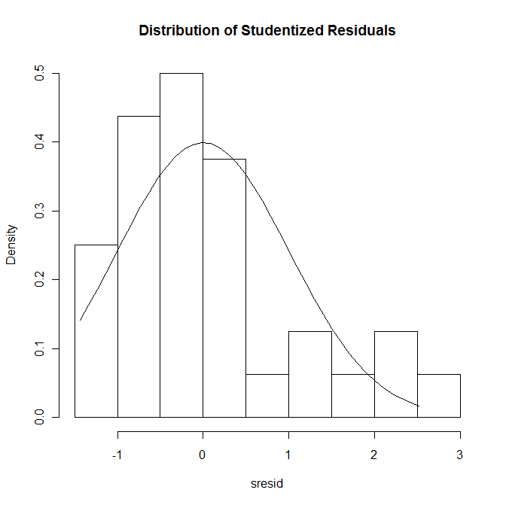
CAR for Diagnostics

Slide 52
CAR for Diagnostics
#Non-constant Error Variance
# Evaluate homoscedasticity # non-constant error variance Score test
ncv.test(fit)
# plot studentized residuals vs. fitted values
spread.level.plot(fit)
#Multi-collinearity
# Evaluate Collinearity
vif(fit) # variance inflation factor

Slide 53
Log transform and refit
log.mpg<- log10(mtcars$mpg)
fit.log <- lm(log10(mpg)~disp+hp+wt+drat, data=mtcars)
# distribution of studentized residuals
library(MASS)
sresid <- studres(fit.log)
hist(sresid, freq=FALSE, main="Distribution of Studentized
Residuals")
#Overlays the normal distribution based on the observed
#studentized residuals
xfit<-seq(min(sresid),max(sresid),length=40)
yfit<-dnorm(xfit)
lines(xfit, yfit)

Slide 54
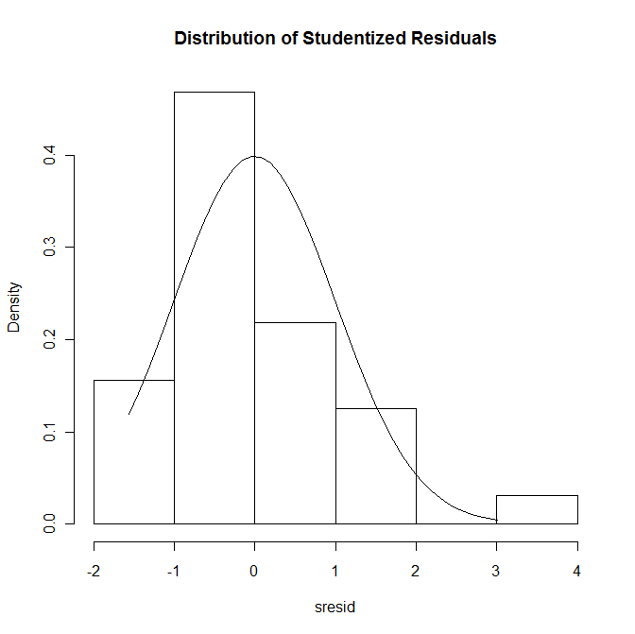
Log transform and refit
Not log10 transformed
log10 transformed

Slide 55
Some families
family(object, ...)
binomial(link = "logit")
gaussian(link = "identity") #REGRESSION, DEFAULT
Gamma(link = "inverse")
inverse.gaussian(link = "1/mu^2")
poisson(link = "log")
quasi(link = "identity", variance = "constant")
quasibinomial(link = "logit")
quasipoisson(link = "log")

Slide 56
Assuming our Y were counts
glm.poisson <- glm(ANX ~HASSLES, data=
as.data.frame(data1), family = poisson)
glm.poisson2 <- glm(ANX ~HASSLES, data =
as.data.frame(data1), family = quasipoisson)
summary(glm.poisson)
summary(glm.poisson2)
#Compare variance estimates
Review:
Poisson Regression
What is overdispersion?
What is Poisson parameter interpretation?
What is overdispersed Poisson parameter interpretation?

Slide 57
Overdispersion in counts
Zero inflated Poisson model
Zero inflated binomial model
Data Example:
Y= #red blood cell units administered, X=drug (aprotinin vs. lysine analogue)
> 50% zeros

Slide 58
ZIP Model
Joint model of structural zeros that do not originate from any process, and counts that originate from a Poisson process.
Thus, the 0/1 process is modeled separately from the Poisson process when the observed 0 is determined not to have arisen from a Poisson process
0/1 process modeled as logistic regression
Count process simultaneously modeled as Poisson regression

Slide 59
VGAM Package
library(VGAM)
fit2 <- vglm(y ~ x1, zipoisson, trace = TRUE)

Slide 60
Results - ZIP
> summary(fit2)
Call:
vglm(formula = y ~ x1, family = zipoisson, trace = TRUE)
Pearson Residuals:
Min 1Q Median 3Q Max
logit(phi) -1.8880 -0.93828 0.59499 0.86550 1.0504
log(lambda) -1.3104 -0.31901 -0.31901 -0.18509 10.3208
Coefficients:
Value Std. Error t value
(Intercept):1 -0.025409 0.16450 -0.15446
(Intercept):2 0.703619 0.08129 8.65569
x1:1 -0.040470 0.33087 -0.12231
x1:2 -0.774116 0.17667 -4.38181

Slide 61
Interpretation
Odds of observing a (structural) zero in blood product usage in the aprotinin versus lysine analogue group are exp(-.040) = 0.96[0.50,1.83].
The risk of blood product usage in the aprotinin versus lysine analogue group is exp(-0.774) =0.46[0.33,0.65].
Conclusion: there is a significant decreased risk of RBC usage in the aprotinin versus lysine analogue group.

