Slide 1
Introduction to SAS
Statistical Computing for Research
Kyra Robinson
March 1, 2012

Slide 2
Rationale for SAS
“Quick” analysis for collaborative work
Output is generally preferable to that output by R
The corporate and regulatory world usually prefers or even requires SAS versus “non-validated” software such as R
Can often check results using R
Remember, R is object oriented; SAS is not.
Cons include SAS’ debatably inferior graphics, though they have recently improved drastically!

Slide 3
Collaborative Work
As biostatisticians (or epidemiologists), we usually prefer to be involved in collaborative efforts from the study design phase
However, many times, we do not get involved until the investigators have collected data and/or already attempted to analyze the data (unsuccessfully)
What do we do?

Slide 4
Getting Data into SAS
We first must get the data into a format we can work with in SAS!
Most common approach: SAS Import Wizard
Click-and-point method
Can request output of PROC IMPORT code into another destination file (to be used to import same data again later)
Can use INFILE statement in DATA step
Could also write your own PROC IMPORT code, if desired

Slide 5
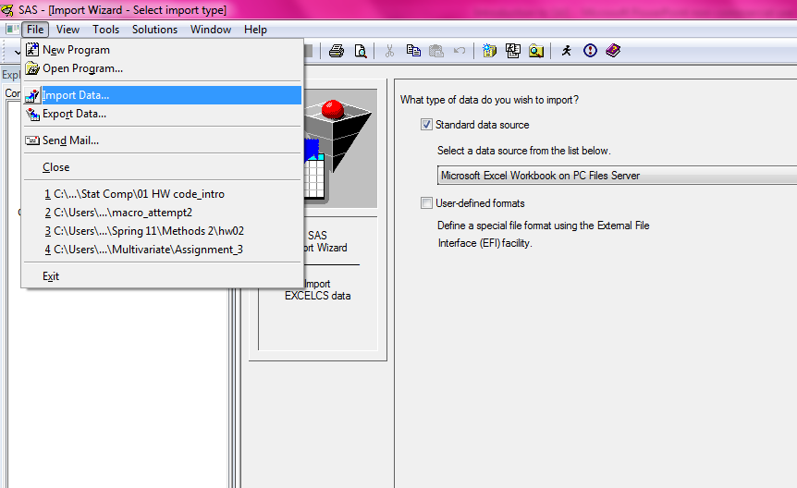
Import Wizard

Slide 6
The Basics of SAS: Data Steps and PROCS
Data steps
Create new datasets, modify datasets, add/delete variables, merge/stack datasets, subset, generate random numbers from specified distribution
PROCs (Procedures)
SORT, MEANS, UNIVARIATE, GPLOT, REG, CORR, FREQ, TTEST, ANOVA, NPAR1WAY, MIXED, GLM, GENMOD, LOGISTIC, GLIMMIX

Slide 7
Libraries
Libraries give us a way to permanently store datasets
Must be assigned before we can call the library (“libname” statement)
Called by “library.” before data name
Example:
libname kyraslibrary "C:\Users\Kyra\Documents\MUSC\THESIS_research";
DATA kyraslibrary.simdata;
.....
RUN;
If no library is specified, all data is stored in the default WORK library
This library is temporary and is cleared when SAS closes

Slide 8
Libraries-cont’d
Libraries can be really helpful, especially when we don’t want to re-import data each time we run a program.
Example: My simulations take about 3.5 hours to construct a dataset for each scenario. I don’t want to have to make this dataset every time!
Be careful with permanent datasets that have predefined formats:
Use “OPTIONS FMTSEARCH=(mylib);” outside of PROC and DATA steps
Creating permanent formats must be done with PROC FORMAT

Slide 9
Formats
Formatting data values
Examples
YES/NO is oftentimes coded as 1/0 in databases
1,2,3 may correspond to ‘mild,’ ‘moderate,’ and ‘severe’
Syntax:
PROC FORMAT LIBRARY=mylib; *creates permanent formats;
VALUE fmtgender 0=‘male’
1=‘female’;
RUN;
Calling formats in the DATA step
DATA kyraslib.example; *make the dataset a permanent dataset in my library;
set example;
format gender fmtgender.;
RUN;

Slide 10
Helpful Hints
Dates (see p.124 of Cody and Smith):
MMDDYY8., MMDDYY10.
Note that dates are tricky (read as numeric values, # days from 01/01/1960)
Labels can be used to make variable names more meaningful
DROP or KEEP statements can be used at the end of the DATA step to narrow down the number of variables in a dataset
WHERE can also help subset data
Note that the default character length is 8, but this can be overridden with INFORMAT myvar $20.; (or some other length, or myvar: $20. in the input statement)

Slide 11
Getting Data Out of SAS
Just like SAS has an Import Wizard for other file types, it also has an Export Wizard.
Can export SAS datasets as other types of files
Excel, CSV, etc.
Can request SAS to output the PROC EXPORT code it uses (for future use)
Again, can use PROC EXPORT if you desire

Slide 12
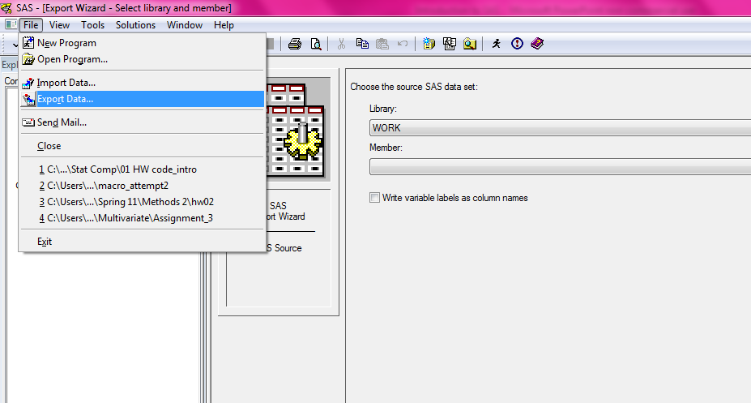
Export Wizard

Slide 13
@ vs. @@: Helpful Knowledge
Placing @@ at the end of the INPUT statement allows for multiple observations per line
Placing @ after a variable allows for a logic statement for that variable
Example:
DATA WEIGHT;
INFILE ‘…’;
INPUT GENDER$ @;
IF GENDER = ‘M’ THEN DELETE;
INPUT WEIGHT AGE;
RUN;

Slide 14
Conditional Operators
IF …. THEN ….
ELSE IF … THEN …
ELSE ….
LT, GT, =, NE, LE, GE
Be careful with missing values:
IF AGE NE . THEN DO;
IF AGE LT 18 THEN DELETE;
END;

Slide 15
Useful Functions
LOG: base e (natural log)
LOG10: base 10
SIN, COS, TAN, ARSIN, ARCOS, ARTAN
INT: drops fractional part of number
SQRT: square root
ROUND(X, .1), ROUND(X,1), ROUND(X,100)
MEAN(A,B,C); MEAN_X=MEAN(OF X1-X5)
Careful with missing values
MIN, MAX, SUM, STD, STDERR, N, NMISS

Slide 16
Date and Time Functions, FYI
MDY(month, day, year): converts to a SAS date
YRDIF(early date, later date, ‘ACTUAL’): Computes # of years from early to later date
‘ACTUAL’ tells SAS to factor in leap years and days of months
NOTE that a SAS date constant is represented by ‘ddMMMyyyy’D (‘15MAY2004’D)
YEAR, MONTH, DAY (from 1 to 31 returned), WEEKDAY (1 to 7), HOUR, MINUTE, SECOND
INTCK(‘interval’, start, end)
Returns number of intervals
Interval may be DAY, WEEK, MONTH, QTR, YEAR, HOUR, MINUTE, SECOND
INTNX(‘interval’,start,# intervals)
Returns a date
See Cody and Smith for more helpful information

Slide 17
Converting Numeric Character
PUT() converts numeric variables to character variables
Newvar = PUT(oldvar, format)
Formats: $length.
INPUT() converts character variables to numeric variables
Newvar = INPUT(oldvar, format)
Formats: length.length
Note: COMPRESS(var, delim) can take away things like dashes in Social Security Numbers: COMPRESS(SS, ‘-’)
Remember the “$” signifies character variables in SAS

Slide 18
Random Number Generation
x = ranuni(seed) /* uniform between 0 & 1 */
x = a+(b-a)*ranuni(seed); /* uniform between a & b */
x = ranbin(seed,n,p); /* binomial size n prob p */
x = rancau(seed); /* cauchy with loc 0 & scale 1 */
x = a+b*rancau(seed); /* cauchy with loc a & scale b */
x = ranexp(seed); /* exponential with scale 1 */
x = ranexp(seed) / a; /* exponential with scale a */
x = a-b*log(ranexp(seed)); /* extreme value loc a & scale b */
x = rangam(seed,a); /* gamma with shape a */
x = b*rangam(seed,a); /* gamma with shape a & scale b */
x = 2*rangam(seed,a); /* chi-square with d.f. = 2*a */
x = rannor(seed); /* normal with mean 0 & SD 1 */
x = a+b*rannor(seed); /* normal with mean a & SD b */
x = ranpoi(seed,a); /* poisson with mean a */
x = rantri(seed,a); /* triangular with peak at a */
x = rantbl(seed,p1,p2,p3); /* random from (1,2,3) with probs */
/* p1,p2,p3 */

Slide 19
Example
Example of sample from Uniform
DATA UNIFORM;
DO i = 1 TO 100;
uni=RANUNI(0);
OUTPUT;
END;
Do loops are often useful:
DO var = … TO …;
DO var = …….;
DO WHILE (); evaluated before loop
DO UNTIL (); evaluated after loop
Must finish with END, and OUTPUT ensures that new value created after each loop run
Seed should be 0 (uses clock to generate sequence) or positive integer
Seed is important for replicating results!!!

Slide 20
Arrays (Overview)
Arrays can provide a convenient way to process multiple variables at once.
One common use of arrays is converting datasets from long to short form, and vice versa
PROC TRANSPOSE can also be used for this
Personally, I prefer arrays ☺
Arrays are the topic of another lecture, so I will limit our discussion to the basics.
See handout for more about TRANSPOSE and arrays

Slide 21
Arrays-cont’d
Declaring arrays in the DATA step:
DATA NEW;
SET OLD;
ARRAY x[5] x1-x5; * Can also be ARRAY x[5] A B C D E
DO i = 1 to 5
IF x[i] = 999 THEN x[i] = .; *convert 999 code to missing;
End;
DROP i;
RUN:
If we use _NUMERIC_ (and x[*]) after array declaration, all numeric variables will have the new conversion
_CHARACTER_ can also be used, but $ must be placed after array name

Slide 22
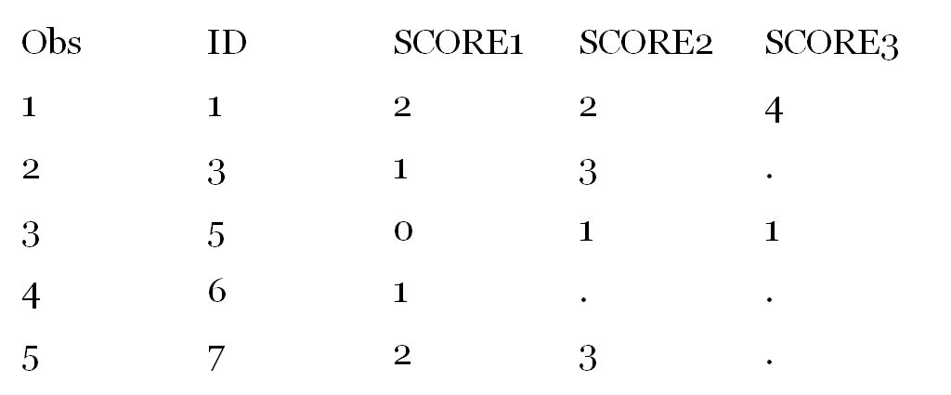
Arrays Example: Short to Long
Suppose we have the following dataset, and we want to convert this dataset to one with multiple observations per ID:

Slide 23
Use the following SAS Code:
*CONVERT TO MULTIPLE OBSERVATIONS PER SUBJECT;
DATA MULTIPLE;
SET SINGLE;
ARRAY SCORE_ARRAY[3] SCORE1-SCORE3;
/*Score1 is stored in Score_Array[1], etc*/
DO TIME = 1 TO 3;
SCORE=SCORE_ARRAY[TIME];
/*Score1-Score3 are each stored in the SCORE variable in order*/
*IF SCORE NE . THEN OUTPUT;
OUTPUT; /*After each time value, output score*/
END;
KEEP ID TIME SCORE; /*Only keep the variables we want*/
RUN;

Slide 24
Output Delivery System
While there is another lecture on ODS, I thought I would briefly show you (or remind you) about some of the ODS basics.
Can make .rtf, .pdf, html files that are much easier to read than the output window
Ideal for getting output into reports or homework assignments
This is very simple to do…
ODS PDF FILE=“…..pdf”;
------Whatever you want in the file-------
ODS PDF CLOSE;

Slide 25
List of Styles
Default
Journal
Statistical
Analysis
Astronomy
Banker
BarrettsBlue
Beige
BlockPrint
Brick
Brown
Curve
D3d
Education
Electronics
FancyPrinter
Gears
Magnify
Minimal
Money
NoFontDefault
Printer
RSVP
RTF
SansPrinter
SASDocPrinter
SASWeb
Science
SerifPrinter
Sketch
StatDoc
Theme
Torn
Watercolor
Examples at http://stat.lsu.edu/SAS_ODS_styles/SAS_ODS_styles.htm

Slide 26
Other Fun ODS Things
ODS GRAPHICS
Makes pretty diagnostic plots (perhaps default in 9.3?)
Proc Reg
ODS TRACE ON/LISTING;
Able to store SAS created objects as your own datasets
ods listing close; ** turns off output display;
proc means;
var x;
ods output summary=sum1;
run;
ods listing; ** turns it back on;
http://support.sas.com/rnd/base/topics/statgraph/v91StatGraphStyles.htm
http://support.sas.com/rnd/app/da/stat/odsgraph/index.html

Slide 27
Let’s work through some examples!

Slide 28
Questions?
Thank you! If you have any questions later,
stop by and see me or email me at
robinskm@musc.edu

