Slide 1
Work-Life Balance
Methods in Clinical Cancer Research
April 28

Slide 2
Topics
Stresses and challenges
Defining values
Setting goals and expectations
Choices and sacrifices
Strategies for success

Slide 3
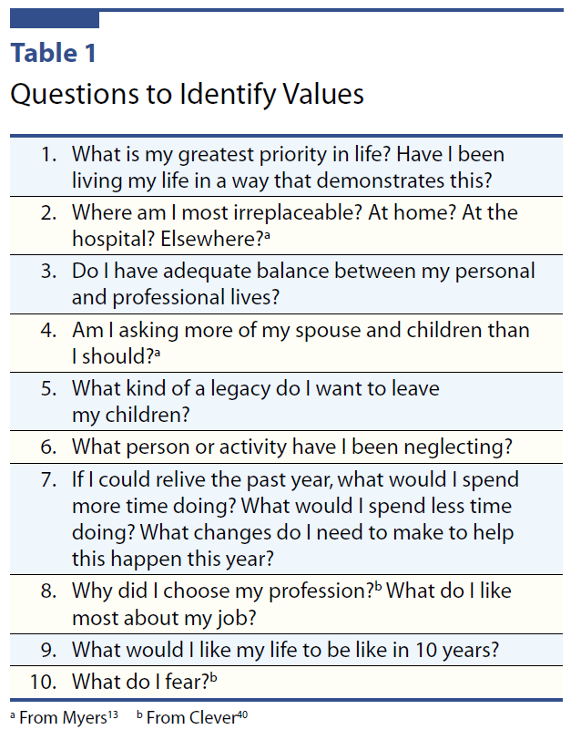
Shanafelt. Finding meaning, balance, and personal satisfaction in the practice of oncology. Supportive Oncology, 3(2), Mar/Apr 2005.

Slide 4
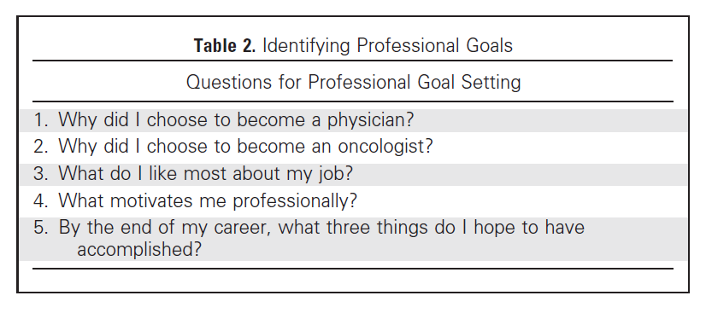
Shanafelt, et al. Shaping your career to maximize personal satisfaction in the practice of oncology. JCO, 24(24), Aug 20, 2006.

Slide 5
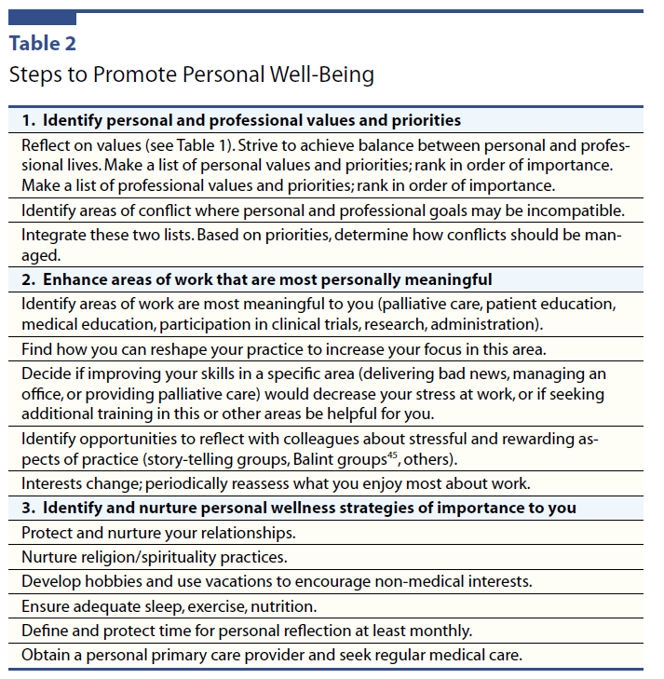
Shanafelt. Finding meaning, balance, and personal satisfaction in the practice of oncology. Supportive Oncology, 3(2), Mar/Apr 2005.

Slide 6
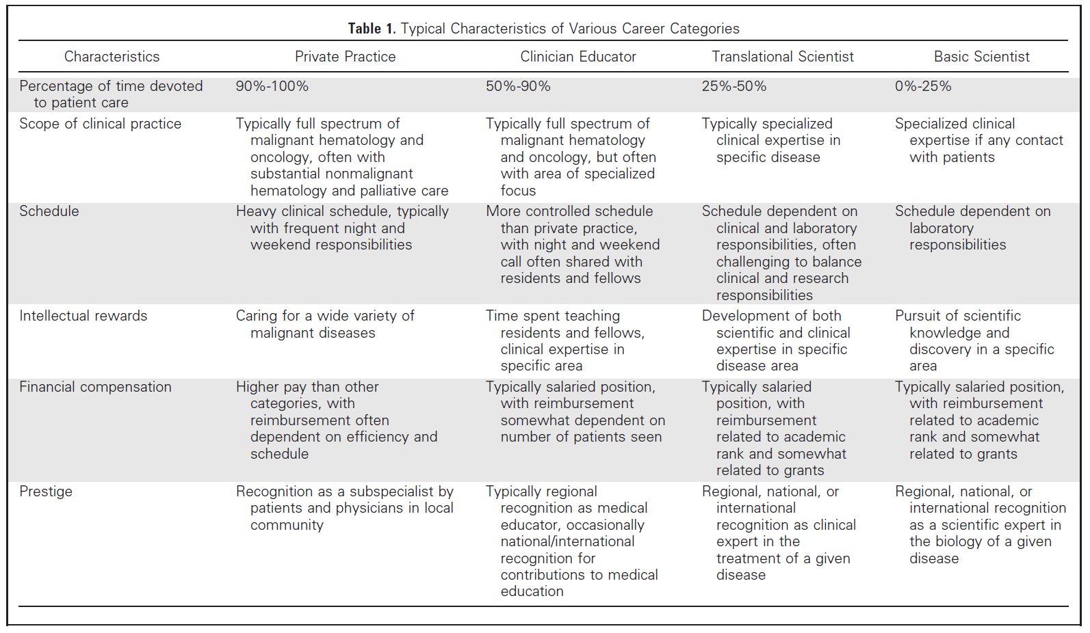
Shanafelt, et al. Shaping your career to maximize personal satisfaction in the practice of oncology. JCO, 24(24), Aug 20, 2006.

Slide 7
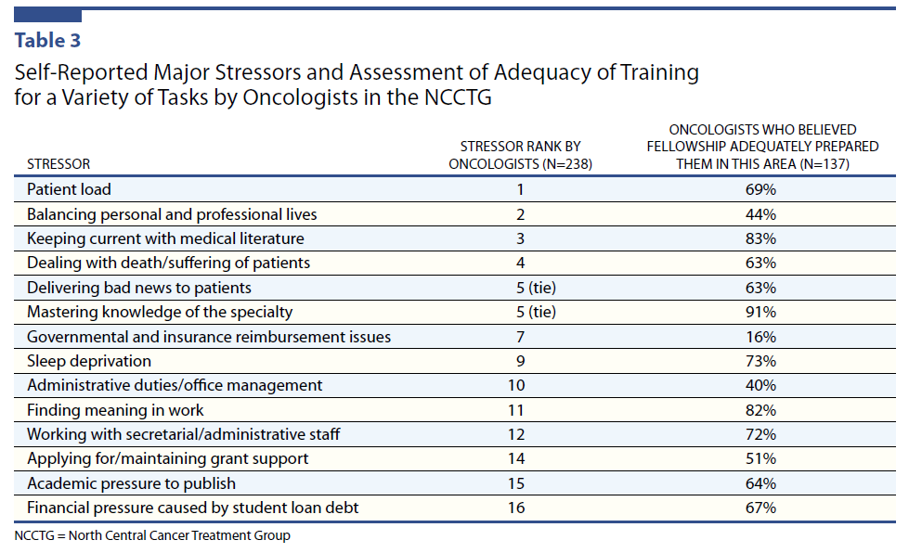
Shanafelt. Finding meaning, balance, and personal satisfaction in the practice of oncology. Supportive Oncology, 3(2), Mar/Apr 2005.

Slide 8
Table 3: Stressors Specific to Different Career Types
Career Type | Stressor
Private Practice | Heavy clinical patient volume Unpredictable work schedule due to patient care issues More frequent overnight call and weekend duties Greater exposure to patient death and suffering Administrative duties due to practice management Greater insurance reimbursement issues
Clinician Educator | Heavy clinical patient volume Significant exposure to patient death and suffering Path for academic promotion may be poorly defined Often perceive that they are less valued by academic medical centers than translational or basic science researchers Lower pay than private practice
Basic Scientist | Challenge of maintaining grant support Continuous pressure to publish with promotion and job security dependent on research publications Constant scientific competition where a 2- to 3-month delay in the date of publishing a discovery may equate to reporting a corroboration rather than novel discovery Stress related to laboratory management; basic scientists must manage how research funds are spent, make hiring/firing decisions, perform performance evaluations, and function as a supervisor for laboratory technicians, graduate students, and administrative staff in their laboratory

Slide 9
Career Type | Stressor
Translational Researcher | Challenge of maintaining both clinical expertise and scientific expertise; often feel clinical skills in areas outside their specific disease focus are eroding and simultaneously feel their scientific knowledge is inferior to their basic science colleagues who do not have patient care responsibilities; can lead to the unsettling notion that they are no longer a good general oncologist and will never be an expert scientist Difficulty obtaining protected time for research, often viewed by administrators as a safety valve for clinical overflow when divisional workload increases; must compete for grants with basic scientists who have no clinical demands competing for their effort Managing regulatory issues related to clinical trial conduct Path of academic promotion can be less clear than for basic scientists Often perceive that they are less valued by academic medical centers than basic science researchers Lower pay than private practice
Shanafelt, et al. Shaping your career to maximize personal satisfaction in the practice of oncology. JCO, 24(24), Aug 20, 2006.

Slide 10
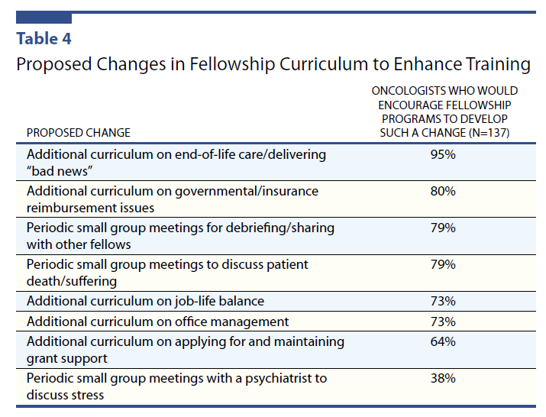

Slide 11
“The practice of oncology provides opportunities for both great distress and great satisfaction. Debunking the myth that “things will get better” and focusing on optimizing present circumstances are essential steps to achieving personal well-being. Identifying and acting on life values, maximizing the aspects of work that are the most personally meaningful, and nurturing activities that foster personal wellness can help oncologists achieve satisfaction in the personal and professional spheres of their lives.”
Shanafelt, T. Journal of Supportive Oncology, 3(2). March/April 2005.

Slide 12
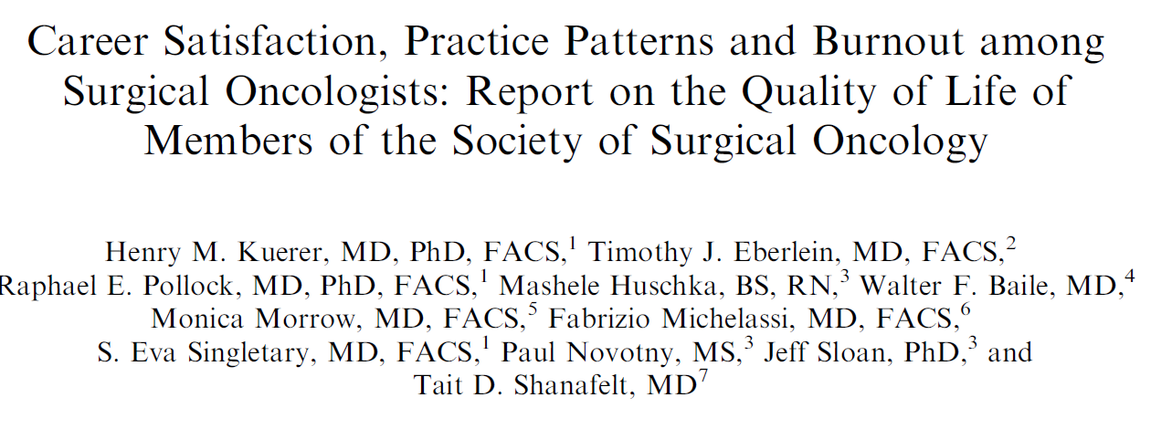
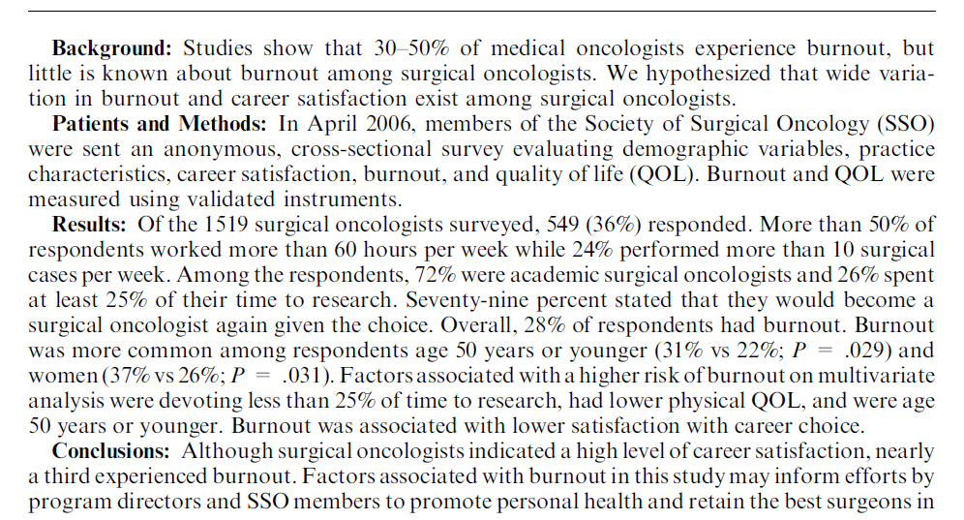

Slide 13
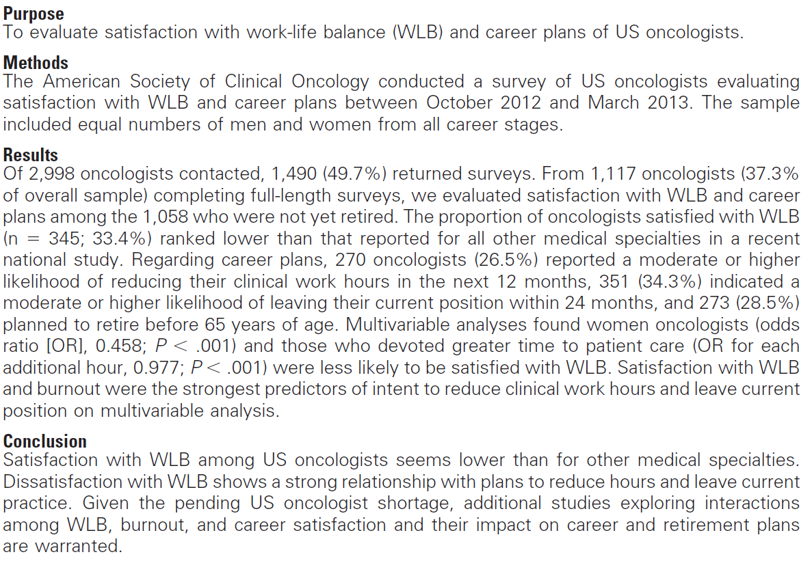

Slide 14
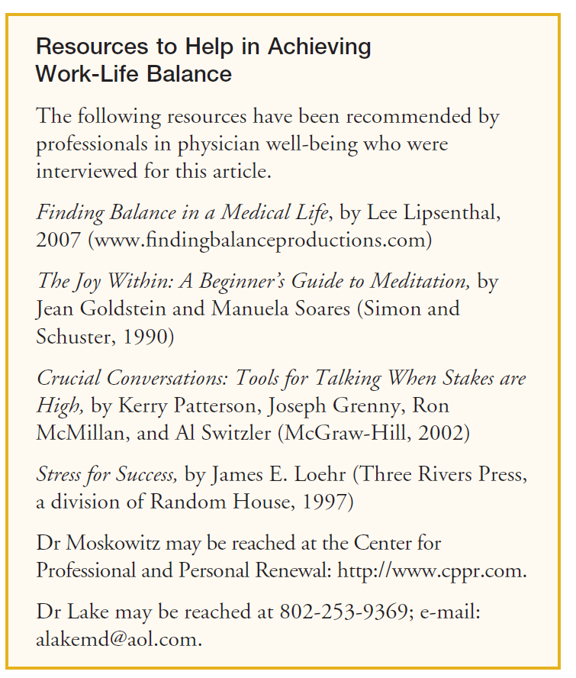

Slide 15
