Slide 1
Statistical Aspects of Correlative Studies
Slightly modified version based on talk by:
Meredith M. Regan, ScD
Dept. Biostatistics and Computational Biology
Dana-Farber Cancer Institute
2014 ASCO/AACR Methods in Clinical Cancer Research

Slide 2
Goals
Appreciate the parallels in clinical trial design and conduct and biomarker research design and conduct, and the need for rigor to eliminate bias
Consider what this means for how correlative studies will be planned and written into clinical trial protocol
Provide a brief overview of randomized trial designs with integral biomarkers (and prospective biomarker validation)

Slide 3
“Correlative” does not mean you can be vague
Correlative studies need to be well conceived
will you really learn anything?
Same principles apply to correlatives for
stating aims
specifying design and procedures
selecting outcome measure -- plus defining correlative measure
writing statistical analysis plan
*considering power and sample size

Slide 4
Biomarker Research
Principles of clinical research design and conduct apply to biomarker research
The research community is establishing similar paradigm and rigor for biomarker research
Frameworks [see refs] describe a series of studies, each requires
Defining clear objective
Specifying design
Specifying subject selection
Specifying methods and procedures
Statistical considerations

Slide 5
Biomarker Development: Framework
Levels of Evidence
Hayes et al., JNCI 1996;88:1456
Simon, Paik, Hayes. JNCI 2009;101:1446
Translational Research Working Group
Clin Cancer Res 2008;14(18) Sept 15, 2008
Omics classifiers
Simon R, JCO 2005;23:7332
Evolution of Translational Omics: IOM, March 2012 (http://www.iom.edu/ Reports/2012/Evolution-of-Translational-Omics.aspx)
Screening biomarker development
Pepe et al., JNCI 2001;93(14)
Pepe et al., JNCI 2008;100:1432
Notes:
These are some of the key frameworks, some mentioned earlier, each with more info at the end for you to review..

Slide 6
Biomarker Development: Framework
Analytic Validity
ability to measure the analyte or genotype of interest accurately and reliably
Clinical Validity
ability to detect or predict the associated disorder or phenotype
Clinical Utility
the balance of its associated risks and benefits if it were to be introduced into clinical practice
to be used in clinical situation, requires prospective testing
Notes:
They all boil down to the principles mentioned earlier, with series of studies establishing AV, CV and CU – akin to phase I,II,III.

Slide 7
Why all the Rigor: Bias
A systematic difference between what we [think we] observe and what we actually should observe
The more “haphazard” the data collection process, the more chances of bias creeping in
Example: do different labs get different results?
Why is bias a problem?
Cannot be “quantified” (within a study)
Does not diminish with increasing sample sizes

Slide 8
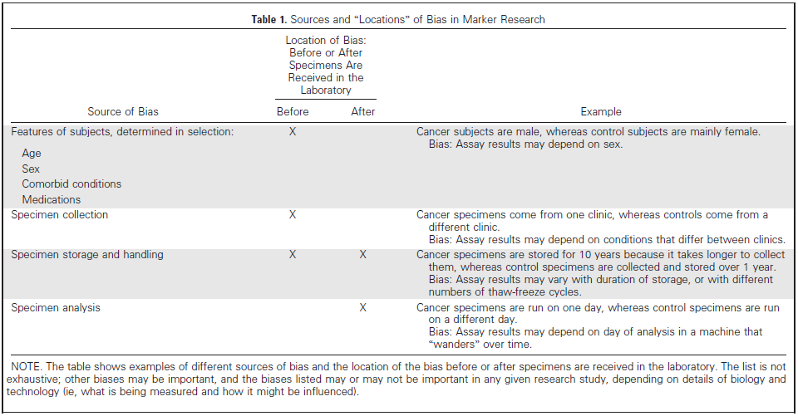
Bias
Very common: Systematic differences in subject selection and/or specimen collection between groups compared

Slide 9
Bias
Very common: Systematic differences in subject selection and/or specimen collection between groups compared
Avoid by prospective uniform collection of specimens in single cohort

Slide 10
Bias
Very common: Systematic differences in subject selection and/or specimen collection between groups compared
Avoid by prospective, uniform collection of specimens in single cohort
Population or clinical setting that is studied is not the setting for which the biomarker is intended
Retrospective case-control studies notorious for spectrum bias:
selected case patients tend to have more severe or well-documented disease and selected control subjects are especially healthy, leading to over-optimistic estimates of biomarker performance
A major concern in biomarker research is over-fitting bias
when performance of biomarker scoring (signature, cutpoint, etc) is evaluated with the same dataset that was used to develop it
Publication: failure to publish negative studies

Slide 11
Over-fitting Bias: Need for Validation
It is problematic to develop and evaluate performance with same data
Some validation is replication -- assess whether association of marker with outcome is in same direction, of similar magnitude observed in independent dataset
Usually multiple studies, with some heterogeneity of population, conducted in multiple labs
Some is formal validation of clinical application of model, signature, or testing algorithm, to assess whether expectation is actually observed

Slide 12
Rigor in Correlative Studies to Avoid Bias
Correlative studies need to be well conceived
will you really learn anything?
Same principles apply to correlatives for
stating aims
specifying design and procedures
selecting outcome measure -- plus defining correlative measure
writing statistical analysis plan
considering power and sample size
Notes:
So you, in designing the correlative studies in your trial protocols, are going to rigorously think through not only what you will learn, but how studies will be conducted to minimize bias.

Slide 13
Correlative Objectives
Just as for trial’s primary objective, correlative aims should be concrete and include a measurable outcome
Objectives are shaped (and may be constrained) by trial’s design
Examples:
To correlate presence of AR amplification, mutation and splice variants with PSA and radiographic response to abiraterone acetate-prednisone and dutasteride
To investigate gene biomarkers associated with trastuzumab emtansine-induced grade 2-4 thrombocytopenia, using an unbiased genome-wide assessment of SNPs and CNV

Slide 14
Correlative Design Aspects
Designs are shaped by (may be constrained by) the trial design
Things to consider (and clarify in protocol):
all patients, or some patients?
biological sample (or e.g. functional imaging) and methodology to determine biomarker
sampling time points
timing of obtaining sample (e.g., prior to dose of treatment)
procedures required
collection, processing, labeling, storage, shipping
assays to be performed with what methodology, by whom/where
data pre-processing approach, QC, scoring, etc.
Never take for granted that the samples are being obtained as planned!
Notes:
*Further along in development of bmkr, more refinement is necessary in your protocol.

Slide 15
Correlative Design Aspects
Correlatives may be integral to trial design
Parallel groups phase II
protocol includes 2 parallel, single-arm trials run in cohorts of patients defined by positive/negative biomarker status
marker status may be determined prior to or shortly after enrollment
statistical design (single-arm) decision rules for clinical outcome measure may be the same or different in 2 cohorts
not designed nor powered to compare outcome between biomarker groups
depending on marker prevalence, enrollment rates in the 2 cohorts may be different
necessitates sample availability as eligibility criterion

Slide 16
Correlative Measures
Choice of outcome measure:
usually 1e efficacy endpoint (eg response, pCR, PFS, OS)
could be 2e endpoint, eg, occurrence of a specific toxicity
Defining correlative measure
What will be quantified in each sample? e.g.,
ERCC1 mRNA expression; serum androgen levels
HER2 expression intensity by IHC (0,1+,2+,3+)
presence of AR mutation; presence of HER2 amplification by ISH
SUVmax of the hottest lesion and SUVmaxavg of the 5 hottest representative lesions on ¹⁸F-FDG and ¹⁸F-NaF PET/CT
What will be “correlated” with outcome measure?
Only 1 sample: raw value? categorical version (need defn)?
Multiple samples: change in level from pre-treatment (or %change, or fold-change)? change in status (e.g., present to absent)

Slide 17
Correlatives Analysis Plan
Analytical plan should be outlined for each correlative objective
descriptive or inferential?
what will be estimated or compared?
what hypothesis test?

Slide 18
Correlatives Power Considerations
Constrained by trial design and sample size
Needs to take into account that not all patients will have samples and successful assay results!
Power usually considered as detectable effect size with these constraints; shows there has been thought (quantitatively) about what can be learned

Slide 19
Power Considerations Example: ddMVAC
Phase II: evaluate the pathological response of pts with muscle-invasive urothelial cancer treated with neoadjuvant dose-dense methotrexate, vinblastine, doxorubicin, cisplatin (ddMVAC), followed by radical surgery with curative intent (Choueiri, JCO 2014)
Response=absence of residual muscle invasive cancer in resected specimen
Single-arm, 2-stage design [α=0.10, β=0.15]
H0: pr(response) ≤35% vs Ha: pr(response)≥55%
Reject H0 if ≥17 of 37 patients respond
Correlative objective: Investigate the tumor expression levels of DNA repair genes (eg ERCC1) in relation to response
FFPE tumor tissue from previous TURBT or biopsy
High tumor tissue levels of ERCC1 mRNA have been associated with clinical resistance to cisplatin-based chemotherapy in ovarian, gastric, cervical, colon and NSCLC patients

Slide 20
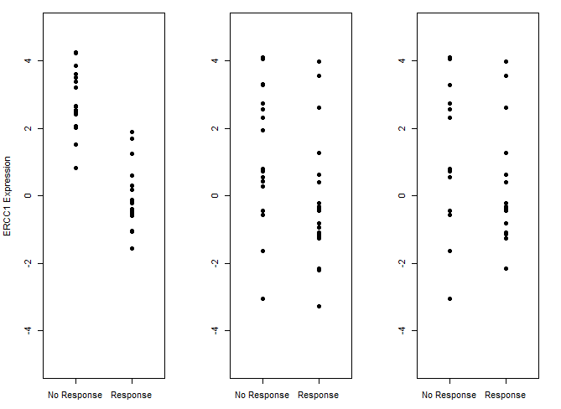
ddMVAC Example: Ideal vs. Reality
High tumor ERCC1 expression associated with resistance to cisplatin-based therapy in other cancers
Result the investigator anticipates: large, clear difference
ERCC1 compared using Wilcoxon rank sum test
P<.001
P=.03
P=.24
Ideal (n=37)
55% response
Reality (n=37)
55% response
Reality (n=27) successful assays
55% response
Notes:
*Here’s insight into my thoughts as I’m planning correlatives with an investigator ..
*This is what investigator is hoping to see: large, clear difference, ERCC1 expr (arbitrary standardized scale) higher in non-responders than responders
-------------
Plots of ERCC1 expression (normalized) vs path response: truth = high ERCC1 associated with non-response
Figure 1 ~55% response (17nr + 20r)
Ideal : true difference, small variance
Reality 1: smaller true difference, larger variance
Reality 2: lost ~10 obs, b/c only ~80% pre-rx tumor specimens & further only ~90% successful assay results (appx 12nr+15r)

Slide 21
ddMVAC Example: Ideal vs. Reality
High tumor ERCC1 expression associated with resistance to cisplatin-based therapy in other cancers
Statistician anticipates: smaller difference, more variability
ERCC1 compared using Wilcoxon rank sum test
P<.001
P=.03
P=.24
Ideal (n=37)
55% response
Reality (n=37)
55% response
Reality (n=27) successful assays
55% response
Notes:
This is closer to what’s in my mind, smaller difference, lots of variability.

Slide 22
ddMVAC Example: Ideal vs. Reality
High tumor ERCC1 expression associated with resistance to cisplatin-based therapy in other cancers
ERCC1 compared using Wilcoxon rank sum test
P<.001
P=.03
P=.24
Ideal (n=37)
55% response
Reality (n=37)
55% response
Reality (n=27) successful assays
55% response
Notes:
Then I introduce reality that we’ll likely have only about 27 samples and this is what we might see.

Slide 23
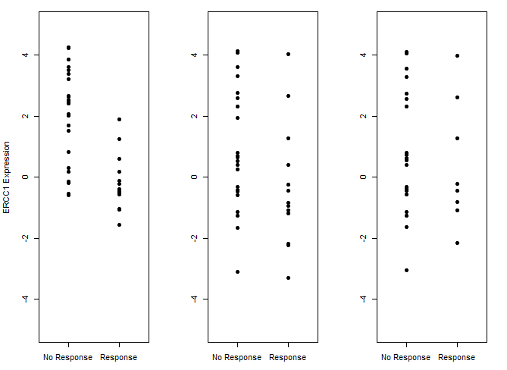
ddMVAC Example: Ideal vs. Reality
High tumor ERCC1 expression associated with resistance to cisplatin-based therapy in other cancers
ERCC1 compared using Wilcoxon rank sum test
P<.001
P=.06
P=.60
Diluted Ideal (n=37)
35% response
Reality (n=37)
35% response
Reality (n=27) successful assays
35% response
Notes:
Also crossing my mind is that if RR is only 35%, that has further implications for what we might learn.
----------------
Figure 2 ~35% response
Diluted Ideal: True difference and small variance, but difference diluted e.g., ~20% almost response but not quite so under “No Response” per protocol definition;
Reality 1: Smaller true difference, larger difference; if all 37 (24nr + 13r)
Reality 2: less ~10 without tumor tissue, (16nr + 9r)

Slide 24
Power Considerations: ddMVAC
Assume:
80% samples obtained, 90% assayed (n=27/37)
observe 55% response, or 35% response
For continuous tumor mRNA expression, 80% power to detect following difference between groups (Wilcoxon rank sum test; 2-sided α=0.05):
Response: | 55% | 55% | 35% | 35%
N samples (NoResp+Resp): | 37 (17+20) | 27 (12+15) | 37 (24+13) | 27 (16+9)
Detectable difference | 1 SD | 1.2 SD | 1.05 SD | 1.3 SD
Notes:
Back to power:

Slide 25
Power Considerations: ddMVAC
Also assess ERCC1 protein in pre-trt tumor tissue by IHC
Proportion with “high” expression unknown (hypothesized to be associated with non-response)
For range of prevalence of “high” expression, 80% power to detect very large differences between groups using Fisher’s exact test (2-sided α=0.05), with n=37:
Situation worse when sample size smaller and response rate lower
%Response overall: % “High” expression: | 55% 67% | 55% 50% | 55% 33% | 55% 20%
Detectable difference |  |  |  | (70% power)
High expr, %response | 35% | 30% | 15% | 10%
Low expr, %response | 90% | 80% | 70% | 65%

Slide 26
A Few Words on Biomarker Endpoints
Trial’s primary objective & endpoint may be biomarker-based, e.g.,
Compare prostate tissue androgen levels after 12 wks of treatment with either abiraterone acetate + leuprolide acetate and prednisone or leuprolide acetate alone for newly-diagnosed PCa pts undergoing prostatectomy.
Assess change in AR transcriptional activity, based on expression of AR-regulated genes, between pre- and on-treatment tumor biopsies, in mCRPC pts treated with HSP90 inhibitor.
Compare the endocrine activity of neoadjuvant GnRH antagonist and GnRH analogue in premenopausal pts with primary ER+ breast cancer. Endocrine activity is measured by time to optimal suppression of serum estrogen levels.
Crucial to success are
Obtaining all samples
Assay methodology specified
Endpoint definition and biologically-meaningful effect specified
Notes:
Switch gears & touch upon a few topics.

Slide 27
Prognostic vs. Predictive Biomarkers
Prognostic
To determine the potential need for further treatment based on the natural history and expected behavior of an individual patient’s cancer
Theoretically, shown in untreated population; usually shown in population receiving standard treatments
Statistically, biomarker associated with clinical outcome
Predictive
To determine whether specific therapies are likely to be effective
Statistically, treatment-by-biomarker interaction
On a specific treatment, biomarker associated with clinical outcome; but on other treatment, biomarker not associated with clinical outcome
In presence or absence of biomarker, the benefit of treatment vs control is of different magnitude

Slide 28
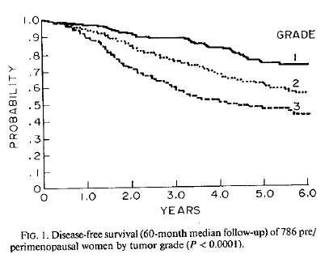
Histological Tumor Grade is Prognostic
Grading: modified Bloom, Richardson 1957

Slide 29
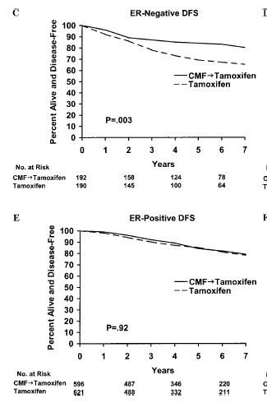
ER is predictive marker of adjuvant CMF chemotherapy benefit in N- postmenopausal patients receiving tamoxifen
ER-Negative:
HR(CMF>T vs T) = 0.52 (.34 - .79)
P=0.01 for treatment-by-ER interaction
ER-Positive:
HR(CMF>T vs T) = 0.99 (.75 - 1.30)

Slide 30
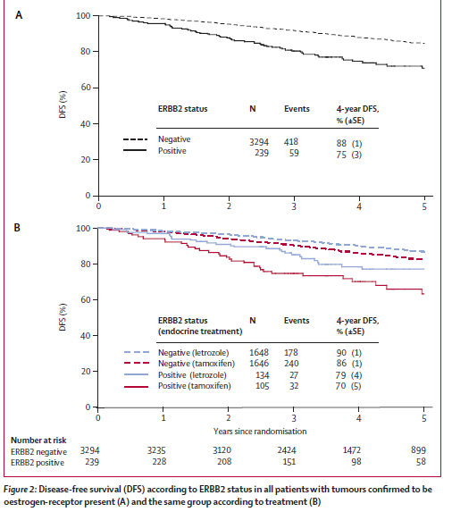
HER2+ is prognostic in postmenopausal ER+ disease treated with adjuvant endocrine therapy, but not predictive for choice of aromatase inhibitor vs tamoxifen
HR=2.1 (1.6-2.8)
HER2- HR(Let:Tam) = 0.72 (0.59-0.87)
HER2+ HR(Let:Tam) = 0.62 (0.37-1.03)
P=0.60 for treatment-by-HER2 interaction
Note, prior to trastuzumab approval

Slide 31
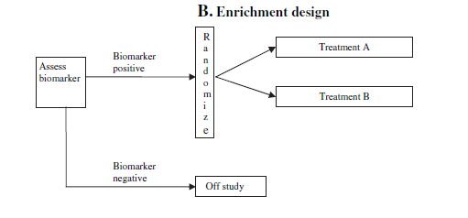
Randomized Designs
There are randomized trial designs with integral biomarkers (and prospective biomarker validation)
Enrichment / targeted
screen patients for presence of biomarker, only randomize patients who have the biomarker present
All-comers (unselected) designs
randomize subjects without regard to biomarker status
biomarker evaluation may be prospective or retrospective on banked specimens
necessitates sample availability as eligibility criterion

Slide 32
Randomized Designs
There are randomized trial designs with integral biomarkers (and prospective biomarker validation)
Enrichment / targeted
screen patients for presence of biomarker, only randomize patients who have the biomarker present
All-comers (unselected) designs
randomize subjects without regard to biomarker status
biomarker evaluation may be prospective or retrospective on banked specimens
necessitates sample availability as eligibility criterion

Slide 33
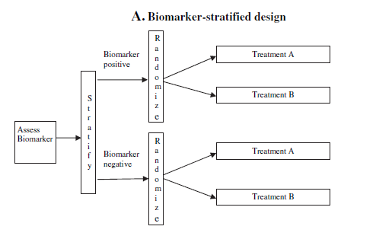
All-Comers (Unselected) Randomized Designs
Biomarker-stratified design
Assess biomarker; in each marker subgroup randomize to trt A vs trt B
Design may define
sequential testing strategy—compare treatments in overall population first, or in specific biomarker subgroup first—with control of type I error
testing for treatment-by-marker interaction (contrast treatment effects in the two biomarker subgroups)
testing treatment effects in each biomarker subgroup separately (each sample size prospectively specified), eg MARVEL
Marker-based strategy design
Assess biomarker; randomly assign patients to have treatment either based on or independent of the biomarker status

Slide 34
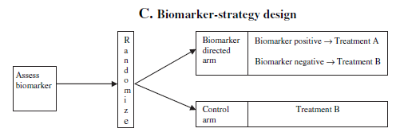
All-Comers (Unselected) Randomized Designs
Biomarker-stratified design
Assess biomarker; in each marker subgroup randomize to trmt A vs trmt B
Design may define
sequential testing strategy—compare treatments in overall population first, or in specific biomarker subgroup first—with control of type I error
testing for treatment-by-marker interaction (contrast treatment effects in the two biomarker subgroups)
testing treatment effects in each biomarker subgroup separately (each sample size prospectively specified), eg MARVEL
Marker-based strategy design
Assess biomarker; randomly assign patients to have treatment either based on or independent of the biomarker status

Slide 35
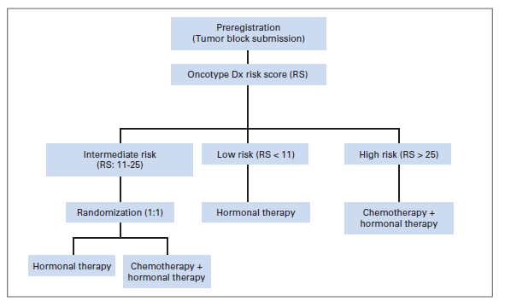
Randomized Designs
There are randomized trial designs with integral biomarkers (and prospective biomarker validation)
Enrichment / targeted
screen patients for presence of biomarker, only randomize patients who have the biomarker present
All-comers (unselected) designs
randomize subjects without regard to biomarker status
biomarker evaluation may be prospective or retrospective on banked specimens
necessitates sample availability as eligibility criterion
Hybrid designs
Only certain biomarker subgroups are randomly assigned; others are assigned standard of care
Adaptive designs
TAILORx

Slide 36
Randomized Designs
There are randomized trial designs with integral biomarkers (and prospective biomarker validation)
Enrichment / targeted
screen patients for presence of biomarker, only randomize patients who have the biomarker present
All-comers (unselected) designs
randomize subjects without regard to biomarker status
biomarker evaluation may be prospective or retrospective on banked specimens
necessitates sample availability as eligibility criterion
Hybrid designs
Only certain biomarker subgroups are randomly assigned; others are assigned standard of care
Adaptive designs
Notes:
Adaptive designs I don’t have time to mention

Slide 37
Randomized Designs
Notes:
Some criteria for thinking about which of these design approaches is appropriate, include:
Prelim evidence~ClinVal; Assay~AV; logistics turnaround time
------
**Also
Strength pre-clinical evidence, understanding of mechanism of action
Biomarker prevalence
Assay reliability, reproducibility, cost

Slide 38
References

Slide 39
Biomarker Development: Framework
Levels of Evidence
Hayes et al., JNCI 1996;88:1456
Simon, Paik, Hayes. JNCI 2009;101:1446
Translational Research Working Group
Clin Cancer Res 2008;14(18) Sept 15, 2008
Omics classifiers
Simon R, JCO 2005;23:7332
Evolution of Translational Omics: IOM, March 2012 (http://www.iom.edu/ Reports/2012/Evolution-of-Translational-Omics.aspx)
Screening biomarker development
Pepe et al., JNCI 2001;93(14)
Pepe et al., JNCI 2008;100:1432

Slide 40
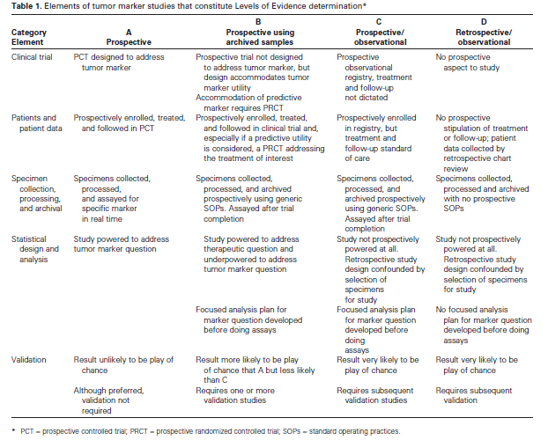

Slide 41
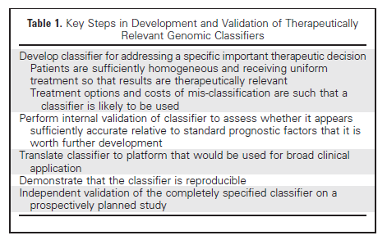

Slide 42
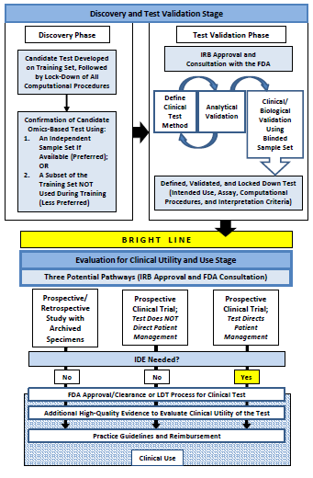

Slide 43
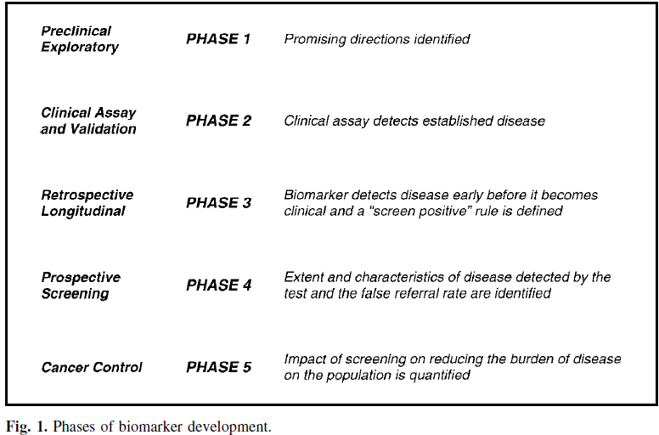

Slide 44
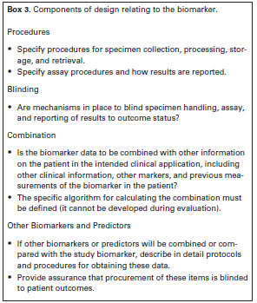
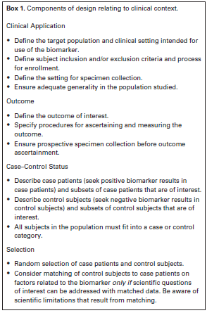
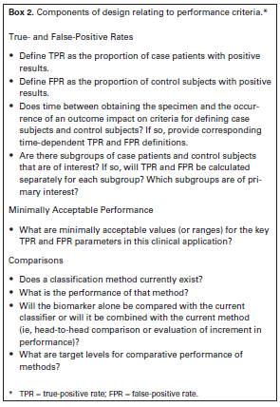
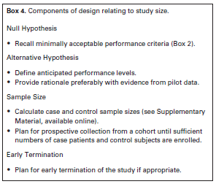
Notes:
prospective-specimen collection, retrospective-blinded-evaluation (PRoBE) design

Slide 45
Biomarker Development & Reporting
REMARK Guidelines
McShane et al., 2005 Aug
JNCI and several others
Altman et al.,
BMC Med 2012;10:51 and PLoS Med 2012; 9(5):e1001216
STARD (http://www.stard-statement.org/)
Bossuyt et al., Jan 2003 Br Med J and several others
Ransohoff. Nat Rev Cancer 2004;4:309
Buyse et al.,
Nat Rev Clin Oncol 2010;7:309
Expert Rev Mol Diagn 2011; 11(2), 171
McShane & Hayes, JCO 2012;30(34):4223

Slide 46
RCT Designs Integrating Prospective Biomarkers Validation
Sargent et al., JCO 2005;23:2020
Hoering et al., CCR 2008;14:4358
Clinical Trials 2010;7(5)
Mandrekar & Sargent
J Thorac Oncol 2011;6:658 and
Contemp Clin Trials epub 2013 May 8
Freidlin et al.,
JCO 2013 Apr 8 epub
JCO 2012;30(26):3304
JNCI 2010;102:152
McShane et al, CCR 2009;15:1898
Simon R, Stat Med 2012;31(25):3031

