Slide 1
Hollings Cancer Center Methods in Clinical Cancer Research Class: CTO issues
Terri Matson
Director, Research Administration
March 24, 2015

Slide 2
NCI Designation
Supports research infrastructure
$1M per year total HCC Core Grant
$100,000 for HCC Clinical Trials Office (CTO) CTO total budget is $2.64M and 55% underwritten by HCC and 45% by industry
Provides opportunity for additional grants
Attracts patients, donors, and pharma trials
Facilitates faculty recruitment

Slide 3
NCI Expectations for Clinical Trials
Accrual to Cancer Treatment Trials
Enroll 10% of new Dx to maintain status
Enroll 15% of new Dx to attain comprehensive status
Investigator-Initiated Clinical Trials
Derived from basic/translational science on campus
Centralized Clinical Trial Office
Regulatory Oversight
Protocol Review Committee (Scientific Review)
Data Safety & Monitoring Committee (QA)
Limit the number of activated non-enrolling trials

Slide 4
$0 funding for personnel
Very limited funding for ancillary services (labs, pharmacy, etc)
30% indirect rate if funded by industry
100% subsidized by HCC
Institutional
(Investigator-Initiated Trials)
Cooperative Group
(National/Federal Trials)
~$2k/per patient
49.5% indirect rate
~$6,500 is real cost inclusive of research staff costs
Subsidized by HCC
Industrial
(Initiated by Industry Sponsors)
~$27,000/completed patient (incl personnel & patient care costs assuming pt. completes all study visits)
30% indirect rate
Includes $ for PI “effort”
Budget is revenue neutral
Highly dependent on trial type & patient time on trial
Notes:
Institutional – sometimes studies use internal pilot funds which carry $0 for PI effort
Cooperative Group – pre NCORP – we lost the 49.5% off the payment. Post-NCORP that IDC was already taken off the top of the award. $2k is rough amount as it’s credit based now.
Industrial – that average was taken from the last 6 studies negotiated which included the LeeBet trial. HIGHLY variable. Budgets are driven up with patient clinical costs which may result in a reduction in PI fee or CTO fee to allow participation in the trial.

Slide 5
Hollings Clinical Trials
Phase I Trials
Treatment Accrual by Study Type
26
26
12
2008
2013
2014
Clinical Investigators Supported
Today, the CTO is managing 116 active interventional trials at MUSC and 18 trials throughout a 19-institution trials network

Slide 6
Clinical Trials Office Structure
Associate Director, Clinical Investigations
Carolyn D. Britten, MD
David Marshall, MD
Clinical Research Executive Committee (CREC)
CTO Medical Director
Robert K. Stuart, MD
CTO Administrative Director
T. Matson
Clinical Trials Network
3 FTE
Programmer
1 FTE
Admin Coord.
1 FTE
A.
Clinical Operations
Clinical Manager
L. Harris, RN, BSN, CCRP, OCN
Administrative Manager
S. Shannon, MEd, CCRC
28 FTE
B.
Research Finance
Manager
T. Wall, CCRP
3.5 FTE
C.
Regulatory and Quality Assurance
Manager
T. Bentz, MHA, CCRP
10 FTE
Protocol Review & Monitoring System Coordinator
1.5 FTE
Notes:
PRC and DSMC are staffed by CTO, but organizationally separate. They have their own reporting structure. PRC and DSMC staff report to Tricia. Any PRC or DSMC issue runs through the chairs.
Trials must be registered to ClinicalTrials.gov. If not, then it cannot be published.

Slide 7
Services
Assist HCC Principal Investigators in the activation and administration of studies, including the preparations and communications required for scientific, ethical, financial and operational reviews as well as ongoing support for annual regulatory reviews
Assist clinicians in screening and enrolling patients for clinical research studies
Ensure protocol compliance by coordinating the completion of patient-specific study requirements
Provide data management support for clinical research studies

Slide 8
Services
Prepare and/or conduct medical and research records for internal and external quality and compliance audits, inclusive of financial records
Provide training and education pertaining to the best practices in conducting clinical studies to clinical and CTO staff as well as new investigators
Communicate the availability of clinical studies to HCC physicians, referring physicians and the public
Administer the HCC Clinical Trials Network, which promotes statewide clinical trial access in addition to supporting IITs and multi-center operations

Slide 9
Study Start-up
GOAL: Activate studies in <90 days
Day 0 is the day in which all required elements (below) are received in the Clinical Trials Office
Final protocol
Budget template
Contract template
Regulatory packet
Final lab/operational manual
This metric is tracked via our in-house system, RAPID.
This database enables us to track every step during the new study start-up phase and allows study team members to see real time processing status. System generates notifications as a task approaches the predefined timeframe as well as for those tasks that have extended beyond the predefined timeframe.

Slide 10
New Protocol Process
PROTOCOL REVIEW PROCESS
New Protocol
Disease Specific Working Group
Submit to CTO
Scientific/IRB Review
Full Board Ethics / Institutional Review Board
Full Committee Scientific / Protocol Review Committee
90 days
PRC Approval
IRB Approval
Study Activation

Slide 11
Timelines: RaPID
*Days calculated from Day 0 (or date regulatory dates are assigned) | Days to Final Budget | Days to Executed Contract | Days to PRC approval | Days to IRB Submission | Days to IRB approval | Days to Site Visit | Days to Study Activation
National | 31 | 0 | 0 | 38 | 56 | 0 | 100
Ext. Peer Review | 38.5 | 0 | 14 | 54 | 76 | 0 | 128
Institutional | 28 | 44 | 43 | 41 | 58 | 36 | 130
Industry | 54 | 78 | 50 | 45 | 81 | 108 | 131
Notes:
The investigator wants to put patients on once IRB approval received.
The lag time between IRB and site visit is in part due to team and sponsor availability. (and no one owning the study)
The lag time between site visit and activation is in large part due to IDS drug build in Willow (drug management portion of EPIC).
A CTMS allows us to assign responsibilities to CTO team members, and IDS, and CTRC, etc…
Quintiles keeps this data on us.

Slide 12
Study Start-up
ACTIVATION
REGULATORY/IRB
BUDGET
CONTRACT
SCIENTIFIC/PRC
OPERATIONAL REVIEW
Ancillary Svcs:
-Laboratory
-Pharmacy
-Radiology
-Pathology
-Sub-specialties
Cardiology
Ophthalmology

Slide 13
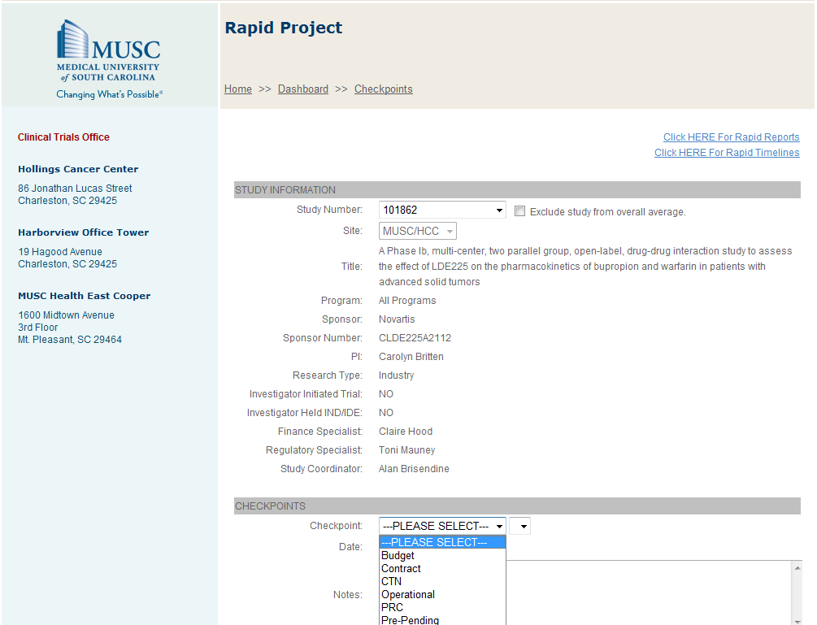
RaPID

Slide 14
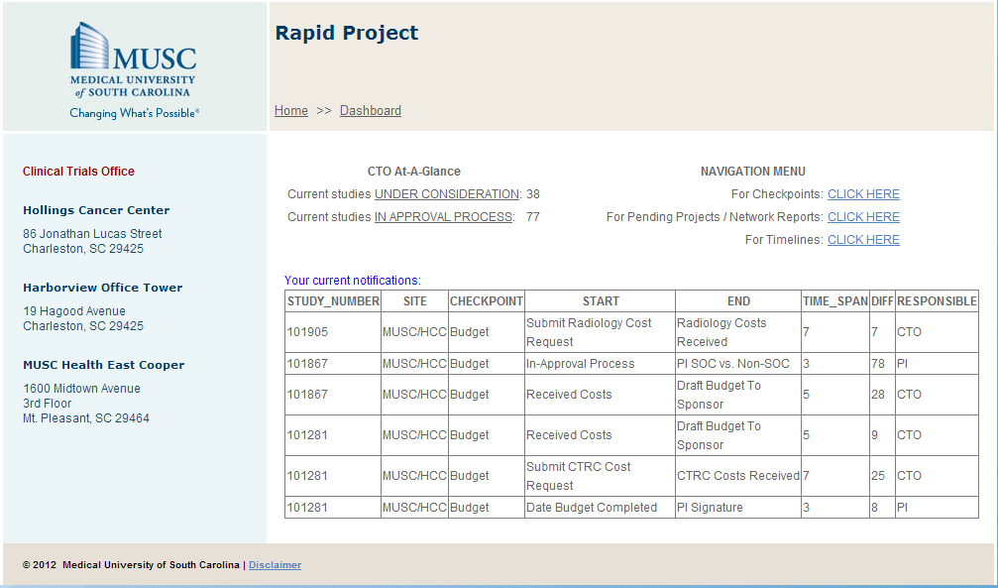
RaPID

Slide 15
RaPID

Slide 16
Review Process
Scientific Committee
Committee meets every 3 weeks
Expanded membership to reflect multiple disciplines (e.g., med, surg, rad
oncology, pediatrics, population sciences,
basic sciences, biostatistics, nursing, pharm)
21 day review cycle for PRC review
Review via web-based system prior to mtg
PI attends meeting to briefly present trial, address remaining issues
Committee performs annual accrual
review
Ethics Committee
Three Boards (industry meets 2x/month)
WIRB for Phase III/IV
Expanded AAHRPP Accredited
~21 day review cycle for IRB review
Reviewed prior to mtg
Comments provided to study team in advance of meeting to respond. (< 48 hours response)
Electronic web-based system
eIRB system integrates MUSC with other SC HSSC partners

Slide 17
Satellite Clinics
MUSC growth in North Charleston and East Cooper increases the denominator (new Dx) against which accruals are measured
Challenges in implementing clinical trials at satellite clinics
Space: for CTO staff, research equipment, monitors, investigator hoteling, subject evaluation
Labs: slow turn around (E. Cooper)
Study Drug: must be couriered, at increased cost

Slide 18
MD Engagement: Team Building
Monthly Disease Focus Group Meetings (with Marshall/Britten)
Review trial portfolio
Monitor accruals
Address research-related issues
Clinical Council Meetings (led by Staveley-O’Carroll)
Open forum to discuss research and service line issues
Pilot the Disease Focus Group Leader
Manage Clinical Trial Portfolio
Address Research and Service Line Issues
Lead Outreach to Basic Sciences for IIT Development
Held Accountable for Outcome
Reward Leader with funds for % effort
Reward Team with funds for projects/staff

Slide 19
Clinical Trials Network
Goal: Help fulfill “Sponsor-Investigator” activities for MUSC HCC Investigator Initiated Trials (IITs).
Scope of Services:
STUDY PHASE | SERVICE
LOI/Study Development | Enrollment and operational plans Assist with budget development Protocol development Study specific data safety monitoring plans
Activation | Oversee IIT regulatory and IND submissions Subsite start-up and training Data management Quality assurance
Closure | Assist with final reports Subsite closures

Slide 20
Trials Network
As MUSC develops partnerships with community practices, we have the potential to
expand our NCORP network
create referral patterns benefiting campus accrual

Slide 21
Information Technology
EPIC/Beacon
Treatment plan requires significant CTO time
Treatment plan build is slow process
Clinical trial alerts avaiable with May, 2015 upgrade

Slide 22
Information Technology
Clinical Trial Management System
CTMS must be responsive and adaptable
CTMS must integrate with EMR, and other services on campus
OnCore would best serve HCC

Slide 23
Current Status of Therapeutic Trial Accrual
257
14.3%
367
14%
340
12.5%
247
7.5%

Slide 24
Breakdown of Therapeutic Trial Accrual by Discipline
257
14.3%
367
14%
340
12.5%
247
7.5%

Slide 25
IRB/
WIRB
Information
Technology
Satellite
Clinics (space, staff, & ancillary
support)
Inverse
Relationship:
NCI Expectations & Funding Sources
(industry vs. IIT vs. corporation)
MD Recruitment
(with trial
experience)
HCC Clinical Trials
Organizational Capabilities
(integrating urology, neurology, & pediatrics)
Trials
Network
CTO
Support
MD Engagement
IDS
(investigational
drug service)
VAMC

Slide 26
Discussion

