Slide 1
Observational Studies
Methods in Clinical Cancer Research
March 17, 2015

Slide 2
Design Types
Experimental:
  Clinical Trials
  Randomized, sometimes
Observational:
  Prospective Cohort study
  Retrospective Cohort study
    “MRR” (Medical Record Review)
  Case-Control

Slide 3
Experimental Designs
Exposure/treatments are controlled by design
  dose levels fixed
  time course fixed
  systematic data collection
  predefined sample size
  usually randomized if comparative

Slide 4
Observational Studies
“Sit back and watch”
  no “control” over doses, treatments, exposures
  individuals (patients or doctors) select exposure based on a number of factors
    Generally not based on the flip of a coin.
Measurements
  Exposures
  Diagnoses
  Often self-reported

Slide 5
Prospective Cohort Studies
  E.g. Framingham study
  population followed forward in time
  assess exposures in the present tense
  watch for disease in the future
  usually a “representative”(random) sample, but sometimes sampling is based on exposure
  goal is to compare exposed and unexposed individuals

Slide 6
Case-Control Studies
  population followed backward in time
  assess disease status in the present tense
  look for exposure in the past
  designed so that sampling is based on disease status
  goal is to compare diseased and non-diseased individuals
  Expectation is that cases and controls are comparable
    How are controls identified?
    Can any differences be ‘adjusted for’?

Slide 7
Designs
Prospective Cohort:
X
D
X
X
D
today
future
Case-Control:
X
D
D
X
X
past
today

Slide 8
Retrospective cohort study
  Similar to prospective cohort because sample tends to be “representative”
  Sampling not based on case/disease status
  uses historical data (“chart review”)
  can be treated similarly to prospective cohort study because we are comparing exposed and non-exposed populations
  Caveat: quality of data is usually not nearly as good as prospective cohort study.

Slide 9
Key difference
WHO IS BEING COMPARED?
COHORT:
EXPOSED VS. UNEXPOSED
CASE-CONTROL:
DISEASED VS. NON-DISEASED

Slide 10
Pros & Cons:
Prospective cohort vs. case-control
Cohort studies are expensive
Cohort studies can (usually) measure exposure precisely
In cohort studies, disease prevalence can be measured
Cohort studies are impractical for study of rare disease.
Can assess temporal relationship
Case control studies are cheap
Case control studies tend to rely on recall for exposure measure
Case control studies don’t allow for measurement of disease prevalence
Case control studies are efficient in rare diseases
Can’t always assess temporal relationship

Slide 11
Case-Control and Cohort
In both, inferences can be biased due to confounders
Confounding would be protected against if we could randomize
Both allow for inference when randomized clinical trial would be unethical
  Smoking?
  Sun exposure?

Slide 12
Measuring Risk
Cohort Study:
  What is the probability of getting diseased if you are exposed as compared to unexposed?
Case-Control Study:
  What is the probability of having been exposed if you have the disease compared to not having the disease?

Slide 13
Risk in Cohort Studies
Relative Risk (RR):

Slide 14
Risk in Cohort Studies
Odds Ratio (OR):

Slide 15
Risk in Case-Control Studies
Odds Ratio (OR):

Slide 16
Take Home Point
Despite difference in design, the odds ratio is the SAME measure of risk in both types of studies.
In the simplest analytic approach, we can easily calculate AD/BC from the 2x2 table of an observational study.
But, things do tend to get more complicated:
  what if exposure is not binary?
  what if we need to adjust for known, measured confounders, such as BMI, smoking, age, parity, etc?

Slide 17
Logistic Regression
Logistic regression allows us to do 2x2 table analysis, and much more
We can account for ‘confounders’
example:
  Assume BMI is associated with exposure
  We know BMI is associated with breast cancer risk
  After adjusting for BMI, is exposure associated with breast cancer?
exposure
?
Breast
cancer
BMI

Slide 18
Why is logistic regression so important in observational studies?
We see it in clinical trials, but it is not as omnipresent as in observational
Big difference: in comparative clinical trials, we rely on randomization to ensure comparability of groups.
Primary analysis is a simple comparison of, for example, overall survival.
  Not adjusted
  Just a plain old HR that assumes randomization balanced groups
  And, we often use stratification to guarantee balance on key factors (e.g. previously treated vs. newly diagnosed).

Slide 19
Why is logistic regression so important in observational studies?
In observational studies, individuals self-select treatment/exposure and that choice may be related to other factors.
We MUST perform adjustment for confounding factors!
Issues:
  We need to know the confounders
  We need to have measured the confounders
Analogs for time to event endpoints?
  Cox regression (proportional hazards model)
  Additive hazards regression

Slide 20
Examples
1. Exercise and selenium: what if selenium is strongly associated with prostate cancer? People who exercise tend to eat better diets, rich in selenium. If we consider the association between exercise and prostate cancer without adjusting for selenium, then we may falsely conclude that exercise and prostate cancer are associated.
2. Coffee and lung cancer: A case-control study found a strong association between coffee and lung cancer. However, after adjusting for smoking, the association “went away.” Why? People who self-select smoking also tend to self-select coffee consumption

Slide 21
Confounding
Coffee
?
Lung Cancer
?
?
Smoking

Slide 22
Confounding
Coffee
Lung Cancer
Smoking

Slide 23
Implications
Randomized clinical trials are the “gold standard”
Many people don’t put much stock in observational studies
But we cant always do randomized trials due to
    Ethics
    Costs (time, money, etc.)
    General feasibility
Some observational studies have been enormously informative
  Framingham
  Nurses’ Health Study
  Physicians’ Health Study
  Olmsted County, Minnesota

Slide 24
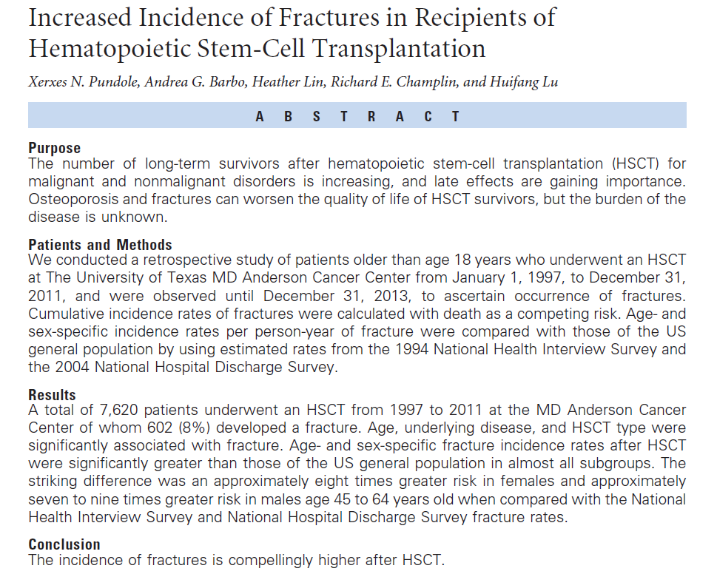
Recent JCO (Mar 16, 2015)

Slide 25
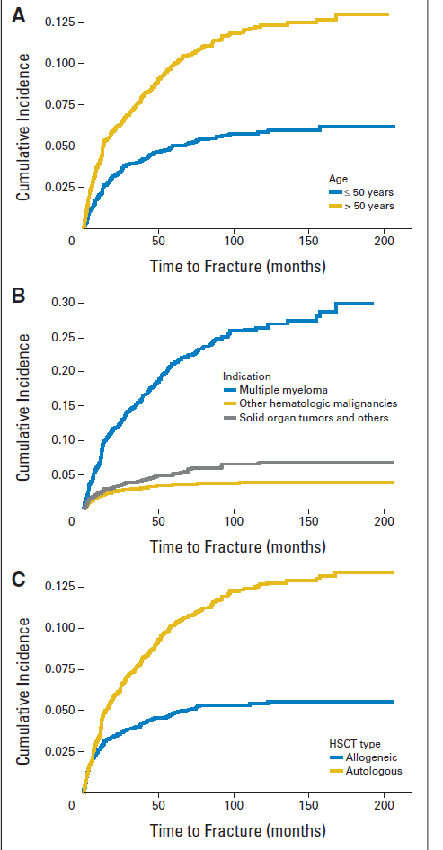
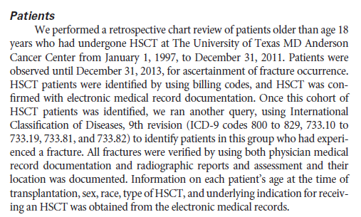
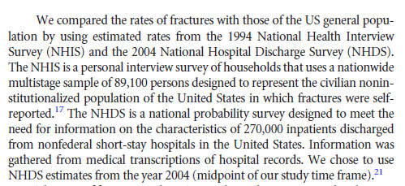

Slide 26
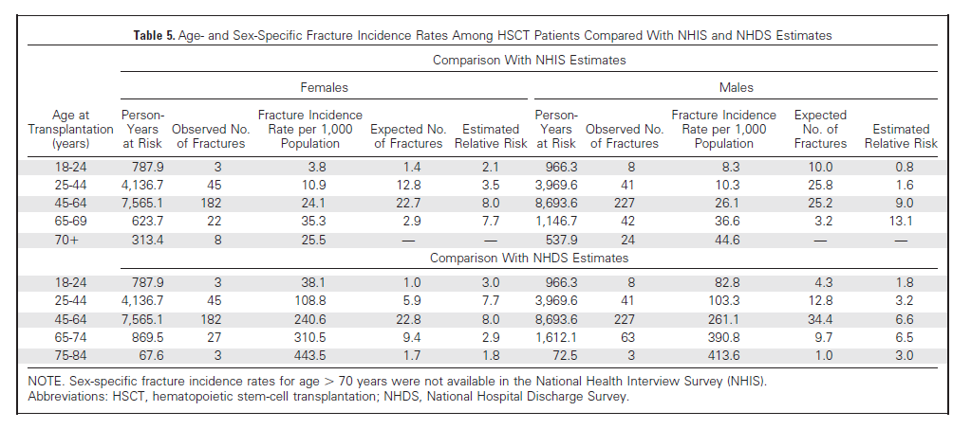
Important: hypothesis-driven!

Slide 27
Some are good, but plenty are BAD
Clinical trials are designed to detect a clinically meaningful difference
In some observational studies, esp. retrospective, the sample size is pre-determined:
  Based on what is available within a timeframe (e.g. diagnosed with the last 10 years)
  Based on another scientific question (i.e. this is 2ndary data analysis)
  Based on yet as determined questions, so the sample size is very large to accommodate rare diseases (e.g. Framingham cohort study)

Slide 28
Cautionary remarks
When the sample size is arbitrary, P-values should be interpreted with great caution.
The study is not appropriately ‘powered’ for a detectable difference.
  N too large for scientific question? Small p-values may occur but clinical effect size is small.
  N too small for scientific question? Large p-values may occur, but clinical effect size is large.
Focus on effect sizes and 95% confidence intervals

Slide 29
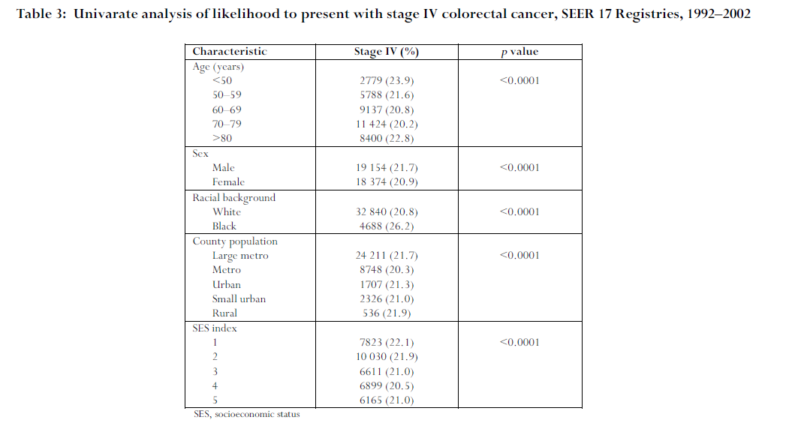
Cautionary Remarks
Colorectal cancer outcome inequalities: association between population density, race, and socioeconomic status. Rural and Remote Health, 2014.
A total of 176 011 patients were identified, with median age 71;

Slide 30
Example Article
Rebbeck, Troxel, Norman et al. (2007) A retrospective case-control study of the use of hormone-related supplements and association with breast cancer. Int J Cancer, 120, 1523-28.
Study Design: population-based case-control study.
949 cases
1524 controls
Disease: breast cancer
Exposure: hormone-related supplements

Slide 31
Hypothesis
Women who have diets rich in phytoestrogens may be at decreased risk of breast cancer.

Slide 32
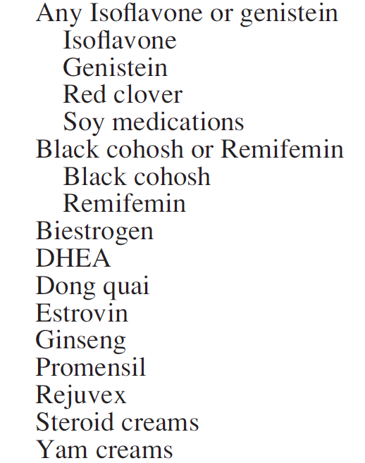
Hormone-related supplements

Slide 33
Identification of cases and controls?
Cases: identified through active surveillance of 38 hospitals.
Controls:
  “random-digit dialing” in the surrounding counties.
  Frequency matched on age (+/- 5 years) and race and date of interview (+/- 3 months).
  Changed from 1:1 ratio to 1:1.6 midway through to increase power
  Paid for participation? Not mentioned.

Slide 34
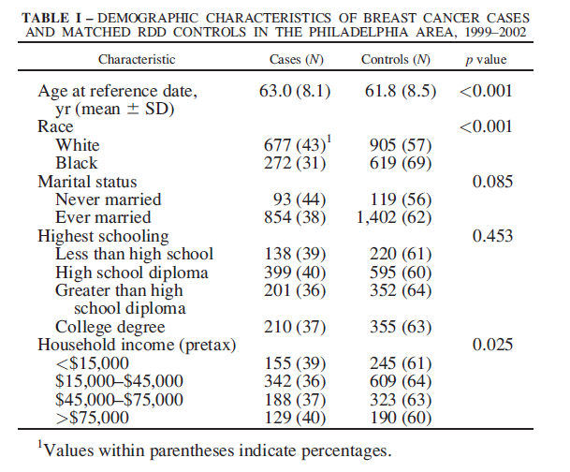
Demographics
38% of subjects are cases;
62% are controls.

Slide 35
Main results: Black Cohosh

Slide 36
Footnotes
1. The odds ratio (OR) represents the relationship of herbal exposure and breast cancer risk as estimated from conditional logistic regression matched on age and race, and adjusted for the following variables: (i) education, (ii) age at first full-term pregnancy (iii) menopause status (known natural, assumed natural at reference age of 50 if menopausal status is unknown, and induced), (iv) family history of breast cancer (any vs. none), (v) time from diagnosis/ascertainment to interview, (vi) reference age as a continuous variable and (vii) ever use of hormone replacement therapy.
2. Values within parentheses indicate percentages.
3. Values within square brackets indicate 95% CIs.
4. Odds ratio associations not undertaken due to limited number of women who used this preparation.

Slide 37
1. Most others were not as prevalent
2. all others were in the same direction

Slide 38
Power to detect differences?
Not mentioned.
What is a significant difference?

Slide 39
Hypothesis
Women who have diets rich in phytoestrogens may be at decreased risk of breast cancer.
What about other health habits?
  Diet?
  Nutrition?
  Exercise?
These might be related to HRS use

Slide 40
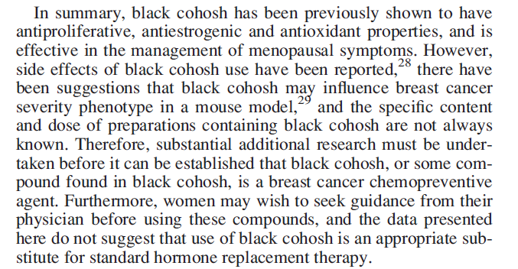
Discussion

Slide 41
Example of potential pitfalls of observational studies
Recursive Partitioning Identifies Patients at High and Low Risk for Ipsilateral Tumor Recurrence After Breast-Conserving Surgery and Radiation. Freedman, Hanlon, Fowble, Anderson, and Nicolaou, JCO, October 2002
PURPOSE: Recursive partitioning analysis (RPA), a method of building decision trees of significant prognostic factors for outcome, was used to determine subgroups at significantly different risk for ipsilateral breast tumor recurrence (IBTR) in early-stage breast cancer.
PATIENTS AND METHODS: 912 women underwent breast-conserving surgery, axillary dissection, and radiation. Systemic therapy was chemotherapy with or without tamoxifen in 32%, tamoxifen in 27%, or none in 41%. RPA was used to create a decision tree according to predictive variables that classify patients by IBTR risk, and the Kaplan-Meier method was used to calculate 10-year risks. Median follow-up was 5.9 years.

Slide 42
Prediction modeling example
Analytic Method: Recursive Partitioning Analysis
“Supervised classification” method
General ideas of RPA
  Build a “tree” for diagnostic profiling that can distinguish amongst groups of patients
  Example:
    useful for diagnosing based on symptom profiles versus more invasive approach.
    Useful for predicting survival based on symptom profile
  Variables are based on their ability to “differentiate” types of patients.
    In some cases, you might want to differentiate sub-types (e.g. build molecular profiles to differentiate squamous versus adenocarcinoma of the lung)
    In this case, differentiation is based on length of time to IBTR (survival outcome).

Slide 43
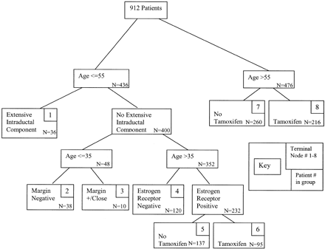
How is the tree built?
The root node contains the whole sample
From there, the tree is the “grown”.
The root node is partitioned into two nodes in the next layer using the predictor variable that makes the best separation based on the log rank statistic. This may cause a continuous variable to be dichotomized (e.g. age < 55 versus >55)
For each branch, the algorithm then looks for the next variable which creates the broadest separation.
The aim is to make the “terminal nodes” (i.e. the nodes which have no offsprings) as homogeneous as possible.

Slide 44
When does it stop?
It MUST stop if
  All predictors have the same values for all subjects within a node
  there is only one observation in each node
  All subjects in a node have the same outcome
“Backward Pruning”
  Test-statistics can be used to assess which are statistically significant nodes. For example, the log rank statistic can be used to assess whether a split should be “pruned”
  Zhang et al. (Statistics in Medicine, 1995) examine each tree to see
    Which splits are superficial?
    Which splits are scientifically unreasonable?
    Which splits might require more data?
  Pruning procedure is NOT completely automatic.
  It is unclear if any pruning was done in the Freedman article. If it was done, it was not explained and no guidelines for pruning were provided.

Slide 45
Prognostic indicators of IBTR:
  age (as a continuous variable),
  menopausal status,
  race,
  family history,
  method of detection,
  presence of EIC,
  margin status,
  ER status,
  number of positive lymph nodes,
  histology,
  lobular carcinoma-in-situ (LCIS),
  use of chemotherapy
  use of tamoxifen.

Slide 46
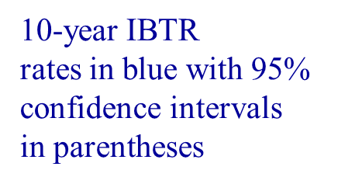
5%
(1,9)
2%
(-2,6)
23%
(5,41)
3%
34%
9%
(-3,9)
(-8,76)
(1,17)
20%
5%
(10,30)
(-1,11)

Slide 47
Author’s conclusions
CONCLUSION:
This RPA showed that age </= 55 versus more than 55 years was the most significant factor for IBTR. Patients </= 35 years old had a low risk of IBTR when tumors were EIC-negative with negative margins. EIC was an independent factor for IBTR for ages </= 55 years. Use of tamoxifen was the most significant factor for patients older than 55 years, but it resulted in a greater absolute decrease in risk of IBTR for patients 36 to 55 years old.

Slide 48
Problems with this approach
Many of age (as a continuous variable), menopausal status, race, family history, margin status, ER status, number of positive lymph nodes, histology, lobular carcinoma-in-situ (LCIS) are known risk factors for IBTR
These factors are strongly predictive of whether or not a patient receives tamoxifen and/or chemotherapy.
Why? Oncologists will tend to give patients at high risk of recurrence adjuvant treatment.
As a result:
  Low risk women do not receive adjuvant therapy
  High risk women do receive adjuvant therapy

Slide 49
Example
High risk women may still tend to have IBTR even in presence
of tamoxifen or chemotherapy, but it might still be higher than
the rates in the low risk women
This could make it appear that adjuvant therapy is
related to poor IBTR outcomes!
We are
comparing
these two
groups and
concluding
that the
difference
is due to
therapy
 | IBTR rate
High risk, no therapy | 25%
High risk, therapy | 15%
Low risk, no therapy | 5%
Low risk, therapy | 4%
Adjuvant therapy is confounded with
risk (i.e., those with high risk are more likely
to get adjuvant therapy).

Slide 50
As a result…..
Authors conclude that only modest effect is seen from tamoxifen
Chemotherapy does not appear in the tree (it is not predictive of outcomes based on the model)
For women less then 35, model suggests that chemotherapy and/or tamoxifen do not affect outcomes.

Slide 51
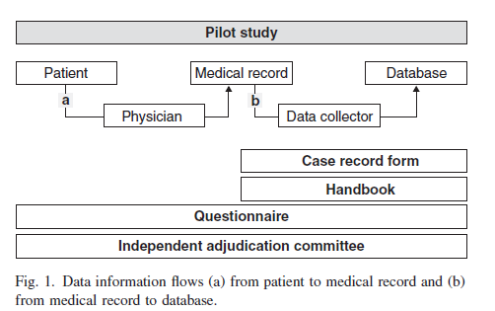
Avoiding pitfalls in retrospective analyses
Jansen et al. Guidelines were developed for data collection from medical records for us in retrospective analyses., J of Clinical Epi (2005).

Slide 52
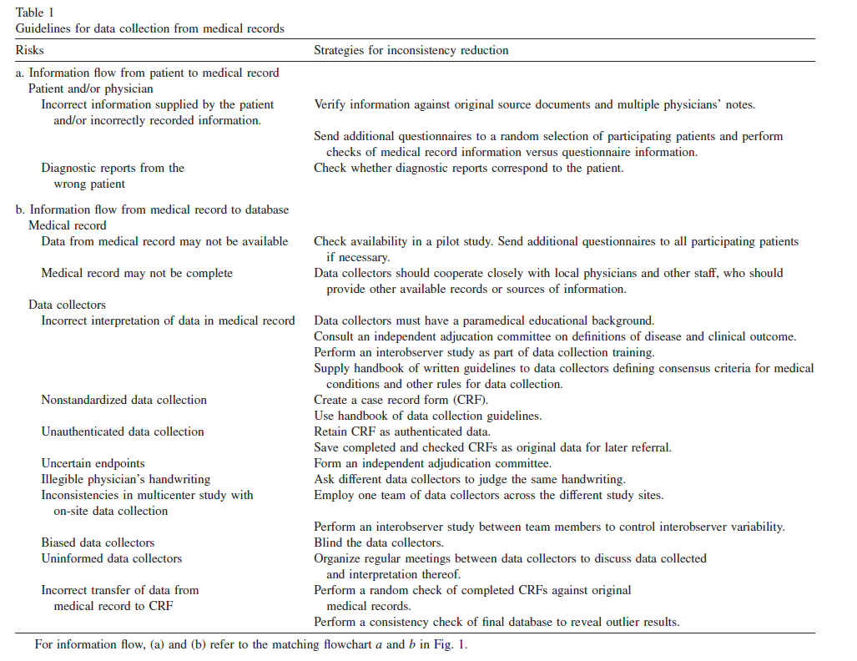

Slide 53
Conclusion
With guidelines for data collection, the quality of research data is enhanced. A well-designed case record form and a handbook for standardized data collection are essential for training the data collectors and for ensuring fastidious searching of the record
However, certain kinds of information are not always well documented in patient records.
It is essential to perform a pilot study to assess the study design and to use additional questionnaires.

Slide 54
“Making the most of chart reviews”
Eddy Lang: Mining of Gold instead of Scooping Poop: How to make the most of chart reviews and other retrospective studies.
MRR = Medical Record Review

Slide 55
“Chart reviews don’t get the respect they deserve”
Why? Historical pattern of
  Wrong questions
  Poor methods
  What happened vs. what was documented
  Missing data
  Case identification
Important data regarding methodology often absent (e.g., abstractor training, std’ized abstraction forms, blinding, etc.).

Slide 56
Seven key ingredients of good MRR
1. Abstractor Training: Need to convince the reader that the people pulling the charts are trained
  Describe the Qualifications and Training procedure for the data Abstractors
  Before the study begins pull some Trial charts to Test the data abstraction process
2. Case Selection: Needs to be explicit and well described
  Administrative codes is a start but has flaws
    Often this can lead to a substudy [i.e do the ultimate codes reflect the Dx?]
  Clear inclusion/exclusion criteria
  Screening procedures must be solid
3. Definition of the variables: Need to be done well
  Dictionary – define things e.g. vitals signs … at triage? by the EP? on reassessment?
  Timing and Source of the info needs to be described
  Adjudication – how are you going to categorise contradictions and inconsistencies?

Slide 57
Seven key ingredients of good MRR
4. Data Abstraction Tool: Make it good
  need to have a standardised data abstraction tool – use your research staff here
  need to have a uniform process of handling missing data – need to think about what to do with missing or unclear data
  Consider using software to manage data [e.g. Using Redcap]
5. Blinding:
  Are the abstractors unaware of the study hypothesis? – consider quizzing them afterwards to see.
6. Quality Control
  regular meetings to ensure standard process
  need to monitor the abstractors work – consider audits
  resolution of conflicting assessments
7. Inter-rater reliability: Report inter-rater reliability
  reported on a sample of charts reviewed by another [blinded] reviewer

Slide 58
Observational studies….
Read/interpret them with caution
  Pore over the methods section.
  Are the effect sizes meaningful?
  Are there inherent biases that have not been addressed?
They can be done well!
  They should be hypothesis-driven
  Data collection methods should be carefully done AND described.

