Slide 1
Human Subjects Research
Issues to consider for a successful IRB submission
Susan Sonne, PharmD, BCPP
Associate Professor of Psychiatry
Associate Director of SCTR Regulatory Knowledge and Support Core
Chair, IRB II

Slide 2
Definition of Research
As defined by DHHS regulations:
A systematic investigation, including
research development, testing and
evaluation designed to develop or contribute to generalizable knowledge
[45 CFR 46.102(d)].

Slide 3
Human Subject Definition:
A “living individual about whom an investigator obtains (1) data through intervention or interaction with the individual, or (2) identifiable private information.”

Slide 4
All Human Subjects Research
Must be reviewed and approved by the IRB
Must comply with applicable federal and state regulations
Must be conducted the way it is currently approved
Investigators should not deviate from the approved protocol without prior IRB approval via an approved amendment
Principal Investigator is ultimately responsible

Slide 5
Trainee Research
Subject to IRB review
Trainees may serve as PIs with a faculty mentor
The mentor must review the protocol prior to IRB submission to ensure the study has a valid research question and procedures are sufficient to answer the question and minimize risk to participants
The trainee PI and Mentor are BOTH responsible for the conduct of the research study

Slide 6
IRB Purpose
To protect the rights and welfare of human research subjects
Authority to approve, require modification and disapprove any research involving human subjects

Slide 7
Exempt Review
Educational settings (e.g. research on instructional techniques, tests with nonsensitive material)
Research using anonymous data obtained from educational tests
Use of residual biological material
DOES NOT apply to research involving deception or vulnerable populations

Slide 8
Responsibilities of IRB
Ensure research complies with all applicable federal regulations and local policies
Safeguard rights and welfare of human subjects
Ensure subjects are adequately informed
Ensure voluntary participation
Ensure risk/benefit ratio is acceptable
Suspend & report studies that violate regulations

Slide 9
Types of IRB Review
Exempt, Expedited and Full Board
Type of review depends on risks to subjects and federal regulations
For research not involving humans, the investigator submits an abbreviated application for IRB concurrence

Slide 10
What is eIRB ?
eIRB is a web based system for IRB submissions and management.
New Electronic Application System
https://eirb.healthsciencessc.org/HSSC/
The system uses smartforms to build applications based on answers provided by the research team.
On-line “Smart” Forms (screens)-prompt for data as needed (similar to Map-R and Turbo-Tax)

Slide 11
eIRB Log In Screen

Slide 12
Navigating to the Home Screen
Select “My Home”

Slide 13
Select “My Home” to view your
Personal workspace
Select New Study

Slide 14
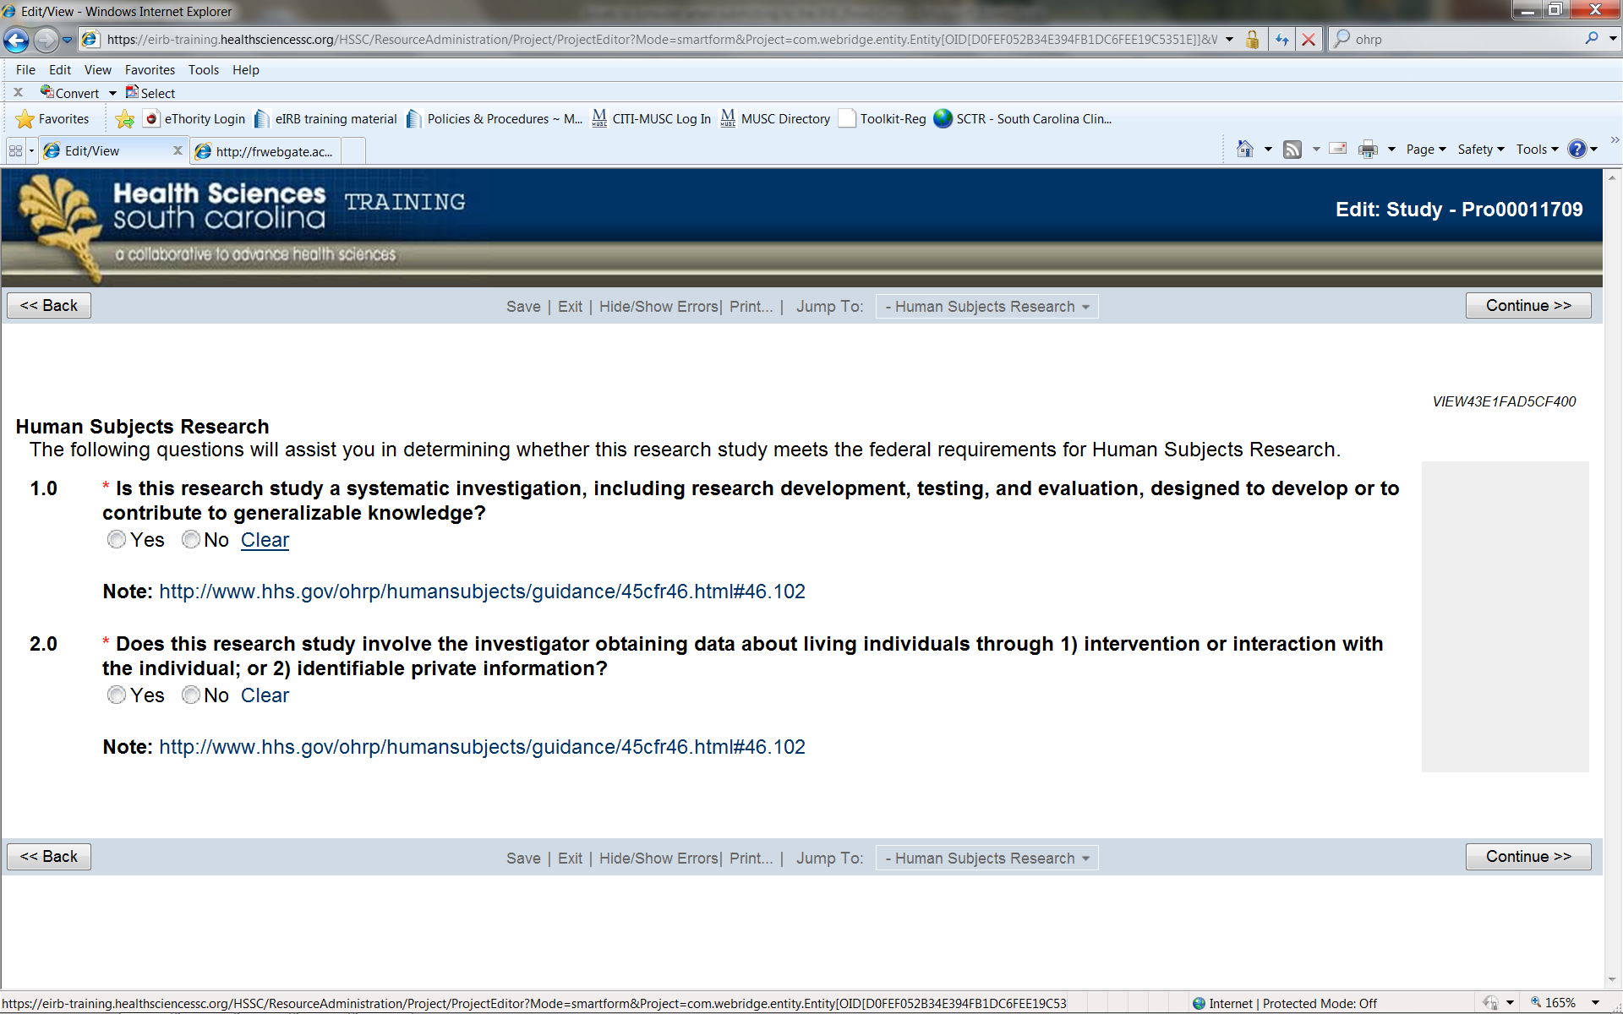
eIRB

Slide 15
Select Review Type
It is at this point in the application where the smartforms split into different paths depending on how you answer the question in section 1.0.

Slide 16
Exempt Research
A type of human subjects research that has so little risk it is exempt from the federal regulations
It must fit into one or more of the six specific federally defined categories of research set forth by the Office of Human Research Protections (OHRP)
An exempt determination is made by the IRB

Slide 17
Exempt Study Application
Choose a
Category
that applies
to your
study.

Slide 18
Exempt Study
Logged in as the PI
Select Submit Study

Slide 19
Expedited Research
Minimal risk to subjects
Does not mean “review light”
Reviewed by Chair or designee, not the Full Board
There is no deadline for submission
Examples
Studies involving venipuncture only
Prospective non-invasive collection of data / specimens
Collection of data from voice, video, digital, or image recordings made for research purposes.
Retrospective chart review in which identifiers must be documented

Slide 20
Minimal Risk
A risk is minimal when the probability and magnitude of harm or discomfort anticipated in the research is no greater than that ordinarily encountered in daily life or during the performance of routine physical or psychological examinations or tests.
Examples include: MRIs, chart reviews, surveys, interviews, blood draws, collection of left-over biological material

Slide 21
Expedited Study
Select the category(s) that applies to your study.

Slide 22
Expedited Study
Logged in as the PI
Submit Study

Slide 23
Full Board Review
Greater than minimal risk to subjects
Investigational drugs/devices
Sensitive issues
Does not fit expedited review categories
Reviewed by Full Board at convened

Slide 24
Submitting an IRB Application
Pay attention to deadlines (full board only)!
Clearly articulate what you are doing for research purposes
Do a mental walk through of your study
Where will it be done? By whom?
How will you enroll participants? How will you determine inclusion/exclusion criteria?
What will participants do? In what order?
What data do you need? How/where will data be stored?

Slide 25
What information is reviewed?
Protocol
Informed Consent Document(s)
Informed Consent process
HIPAA Authorizations/Waivers
Personnel-including who will obtain consent
Recruitment process/plan
Advertisements
Investigator’s brochure
Compensation
IND/IDE information (if applicable)
Adverse events/DSMB

Slide 26
IRB Website

Slide 27
Example of IRB Forms Page

Slide 28
IRB Process
Once submitted - IRB staff checks for completeness
Expedited and Full Board applications are reviewed by IRB Administrator and Primary Reviewer(s)
Comments/questions sent to PI (via electronic database)
PI provides response (via electronic database – upload revised documents)

Slide 29
What does IRB review after initial approval?
Amendments
Change in personnel
Protocol Change
Consent Change
Changes in recruitment process
Advertisements
Adverse events/ DSMB Reports
Protocol Violations
Updated investigator brochures
Continuing review applications
Unanticipated Problems
Audit findings and monitoring reports

Slide 30
What does IRB review after initial approval?
Continuing Review
Regulations require a yearly continuing review of Full Board and Expedited Studies
Submit to the IRB at least one month prior to expiration date
Allows the IRB to continue to assess the risk/ benefit ratio
Provides a current status of the study (enrolling subjects, enrollments closed, data analysis only, permanently closed, etc.)
Demographic information and enrollment numbers
Information regarding any problems or complications
Once all study activities are complete, please submit a continuing review application to PERMANENTLY CLOSE your study prior to leaving MUSC.

Slide 31
Responsibilities of Investigator
Obtain prospective IRB approval
Conduct study as it is approved
Maintain Documentation & Study Records
Original IRB application & all IRB communications
Regulatory binder
Document informed consent process
Submitting amendments, continuing reviews, protocol deviations, adverse events
Investigator can be held liable if willfully violates scope of research or does not obtain prospective IRB approval

Slide 32
Common Issues and Solutions
eIRB Application
Issue 1: Budget missing
Solution: All MUSC expedited and full board studies require a budget be submitted, regardless of the funding.
Issue 2: Lack of consistency throughout documents
Solution: Consistency is key across all forms and the application. If a request is made to change a document, the change needs to be made throughout all the documents.
Issue 3: Incomplete/ incorrect attachments
Solution: Use templates available on the IRB website for Protocol, informed consent, and HIPAA

Slide 33
Common Issues and Solutions
eIRB Application
Issue 4: Questions in eIRB not answered
Solution: Read questions carefully and only answer what is asked. Do not cut and paste the same thing for every question
Issue 5: Irrelevant information given without answering the question
Solution: Only answer the question being asked. Do not cut and paste from the protocol

Slide 34
Common Issues and Solutions
Protocol
Issue 1: Inadequate justification of study procedures
Solution: Cite appropriate literature to justify study design and safety; for medications review and cite package insert to ensure appropriate precautions and medication dosage.
Issue 2: No statistical considerations/Estimation of sample size provided
Solution: Provide power calculation; obtain statistical consult
Issue 3: Inadequate Inclusion/Exclusion criteria
Solution: Clarify the study population with complete inclusion/exclusion criteria. Exclusion criteria applied to those who meet inclusion. They are not polar opposites!

Slide 35
Common Issues and Solutions
Informed Consent
Issue 1: Consent process not clear
Solution: Document in protocol and eIRB smartforms when, where, how and by whom consent will occur; will participants have opportunity to read consent? Will questions be answered? Will they get a copy?
Issue 2: Consent poorly written
Solution: Use consent template; consult SUCCESS Center
Issue 3: Consent not written in lay terms
Solution: Consent should be written at an 8th grade reading level; do not cut and paste from protocol! SCTR toolkit has list of lay terms.

Slide 36
Informed Consent
Essential to ethical conduct of clinical investigation
Potential subject chooses whether or not they will participate
Obtained after full information is given and understood
Explanation of study objective, potential benefits, risks, inconveniences, subject’s rights and responsibilities

Slide 37
Ensuring Adequate Informed Consent
Given the imperative to protect the rights of participants, how can we be sure that our informed consent process is sufficient.
Ideas:
Reading aloud
Ask the participant questions
Quiz
Breathalyze/ Drug test
Signatures and Dates

Slide 38
Who Can Obtain Consent?
Individuals who obtain consent must be approved by the IRB
Must have appropriate knowledge to consent for specific study
Should be properly trained

Slide 39
Informed Consent Document
Purpose of the Study
Procedures
Potential Risks and Discomforts
Anticipated Benefits to Subjects
Anticipated Benefits to Society
Alternative to Participation
Emergency Care and Compensation for Injury
Payment to Participants
Financial Obligation
Privacy and Confidentiality
Participation and Withdrawal
Rights of Research Subjects
Signatures

Slide 40
Who Can Give Consent?
Adult participants with decision capacity
Parents of children
Legally authorized representatives
Who will consent and under what circumstances must be approved by the IRB

Slide 41
Research Scenario
An investigator wants to obtain a tablespoon of blood from approximately 20 “normal controls” for a laboratory experiment he is conducting on immune modulation in lupus erythematosus
What would be appropriate inclusion criteria?
What would be appropriate exclusion criteria?
How will criteria be determined?

Slide 42
Before You Start Your Study…
Obtain study supplies (e.g. urine cups, receipt book, petty cash)
Know what data you are collecting
Know how and where you are collecting it
Develop study binders/folders for each participant
Include CRFs, Logs, progress notes, Inclusion/exclusion checklists etc
Know where you will recruit participants
Determine who will do what for your study (document this on delegation of duties log)
Do an actual walk through of your study
TRAIN YOUR STAFF!!

Slide 43
General Rules
Conduct your study the way it was approved by the IRB!
Know what was approved
Who can obtain consent?
What did you say you were going to do in the application?
Before implementing a change, get IRB approval
Adding personnel
Changing consent procedures
Changing assessments

Slide 44
Human Subjects Research
Must be reviewed and approved by the IRB
Must comply with applicable federal and state regulations
Must be conducted they way it is currently approved
Investigators should not deviate from the approved protocol without prior IRB approval via an approved amendment
Principal Investigator is ultimately responsible

Slide 45
OHRP Suspensions
During the last 8-9 years, OHRP has suspended all human research at the following institutions:
University of Illinois, Chicago Campus
University of Colorado
Duke University
Johns Hopkins
University of Pennsylvania
And others

Slide 46
KEY CONTACTS
IRB Main Number- 792-4148
IRB II
Summer Young-IRB II- Administrator 792-4144 (youngsn@musc.edu)
Kaye Roberts IRB II-Coordinator 792-6710 (roberkk@musc.edu)
EXPEDITED STUDIES
Katherine Bright, Administrator 792-4843 (duncank@musc.edu)
SCTR SUCCESS Center 792-8300

Slide 47
Health Insurance Portability & Accountability Act (HIPAA) Privacy Rule
Federal regulation to protect the privacy of health information that identifies individuals (Protected Health Information-PHI)
Applies to health plans, health care clearinghouses, health care providers and their business associates who transmit health information in electronic form (covered entities)
In order to use PHI, you must obtain:
HIPAA authorization from the individual OR
HIPAA waiver/alteration of HIPAA OR
Business Associates Agreement (BAA)
US DHHS Office for Civil Rights 45 CFR 160 and 164

Slide 48
What is Protected Health Information?
Individually identifiable health information
Must have both health information AND one of the 18 HIPAA identifiers to have PHI

Slide 49
Identifiers Under HIPAA
Names
Addresses
All elements of dates relating to an individual (except year) e.g. Admission date
Telephone numbers
Fax numbers
Email addresses
Medical Record numbers
Social Security numbers
Health plan policy numbers
Account numbers
License Numbers
Vehicle ID/serial numbers
Device identifiers
URLs
IP addresses
Finger/voice prints
Full face photos
Any other unique identifier or code

