Slide 1
Choosing Endpoints and Sample size considerations
Methods in Clinical Cancer Research
March 3, 2015

Slide 2
Sample Size and Power
The most common reason statisticians get contacted
Sample size is contingent on design, analysis plan, and outcome
With the wrong sample size, you will either
Not be able to make conclusions because the study is “underpowered”
Waste time and money because your study is larger than it needed to be to answer the question of interest
And, with wrong sample size, you might have problems interpreting your result:
Did I not find a significant result because the treatment does not work, or because my sample size is too small?
Did the treatment REALLY work, or is the effect I saw too small to warrant further consideration of this treatment?
This is an issue of CLINICAL versus STATISTICAL significance

Slide 3
Sample Size and Power
Sample size ALWAYS requires the investigator to make some assumptions
How much better do you expect the experimental therapy group to perform than the standard therapy groups?
How much variability do we expect in measurements?
What would be a clinically relevant improvement?
The statistician CANNOT tell you what these numbers should be (unless you provide data)
It is the responsibility of the clinical investigator to define these parameters

Slide 4
Sample Size and Power
Review of power
Power = The probability of concluding that the new treatment is effective if it truly is effective
Type I error = The probability of concluding that the new treatment is effective if it truly is NOT effective
(Type I error = alpha level of the test)
(Type II error = 1 – power)
When your study is too small, it is hard to conclude that your treatment is effective

Slide 5
Three common settings
Binary outcome: e.g., response vs. no response, disease vs. no disease
Continuous outcome: e.g., number of units of blood transfused, CD4 cell counts
Time-to-event outcome: e.g., time to progression, time to death.

Slide 6
Most to least powerful
Continuous
Time-to-event
Binary/categorical
Example: mouse study
Metastases yes vs. no
Volume or number of metastatic nodules

Slide 7
Continuous outcomes
Easiest to discuss
Sample size depends on
Δ: difference under the null hypothesis
α: type 1 error
β type 2 error
σ: standard deviation
r: ratio of number of subjects in the two groups (usually r = 1)

Slide 8
Continuous Outcomes
We usually
find sample size
OR
find power
OR
find Δ
But for Phase III cancer trials, most typical to solve for N.

Slide 9
Example: sample size in EACA study in spine surgery patients*
The primary goal of this study is to determine whether epsilon aminocaproic acid (EACA) is an effective strategy to reduce the morbidity and costs associated with allogeneic blood transfusion in adult patients undergoing spine surgery. (Berenholtz)
Comparative study with EACA arm and placebo arm.
Primary endpoint: number of allogeneic blood units transfused per patient through day 8 post-operation.
Average number of units transfused without EACA is expected to be 7
Investigators would be interested in regularly using EACA if it could reduce the number of units transfused by 30% (to 5 units or less).
* Berenholtz et al. Spine, 2009 Sept. 1.

Slide 10
Example: sample size in EACA study in spine surgery patients
H₀: μ₁ – μ₂ = 0
H₁: μ₁ – μ₂ ≠ 0
We want to know what sample size we need to have large power and small type I error.
If the treatment DOES work, then we want to have a high probability of concluding that H₁ is “true.”
If the treatment DOES NOT work, then we want a low probability of concluding that H₁ is “true.”

Slide 11
Two-sample t-test approach
Assume that the standard deviation of units transfused is 4.
Assume that difference we are interested in detecting is μ₁ – μ₂ = 2.
Assume that N is large enough for Central Limit Theorem to ‘kick in’.
Choose two-sided alpha of 0.05

Slide 12
Two-sample t-test approach

Slide 13
Two-sample t-test approach
For testing the difference in two means, with equal allocation to each arm:
With UNequal allocation to each arm, where n₂ = rn₁

Slide 14
Sample size = 30,Power = 26%
Sampling distn under H₁: μ₁ - μ₂ = 0
Sampling distn under H₁: μ₁ - μ₂ = 2
Vertical line
defines
rejection region
μ₁ - μ₂

Slide 15
Sample size = 60,Power = 48%
Sampling distn under H₁: μ₁ - μ₂ = 0
Sampling distn under H₁: μ₁ - μ₂ = 2
Vertical line
defines
rejection region
μ₁ - μ₂

Slide 16
Sample size = 120,Power = 78%
Sampling distn under H₁: μ₁ - μ₂ = 0
Sampling distn under H₁: μ₁ - μ₂ = 2
Vertical line
defines
rejection region
μ₁ - μ₂

Slide 17
Sample size = 240, Power = 97%
Sampling distn under H₁: μ₁ - μ₂ = 0
Sampling distn under H₁: μ₁ - μ₂ = 2
Vertical line
defines
rejection region
μ₁ - μ₂

Slide 18
Sample size = 400, Power > 99%
Sampling distn under H₁: μ₁ - μ₂ = 0
Sampling distn under H₁: μ₁ - μ₂ = 2
Vertical line
defines
rejection region
μ₁ - μ₂

Slide 19
Likelihood Approach
Not as common, but very logical
Resulting sample size equation is the same, but the paradigm is different.
Create likelihood ratio comparing likelihood assuming different means vs. common mean:

Slide 20
Other outcomes
Binary:
use of exact tests often necessary when study will be small
more complex equations than continuous
Why?
Because mean and variance both depend on p
Exact tests are often appropriate
If using continuity correction with χ² test, then no closed form solution
Time-to-event
similar to continuous
parametric vs. non-parametric
assumptions can be harder to achieve for parametric

Slide 21
Single Arm, response rate
Ho: p= 0.20
Ha: p = 0.40
One-sided alpha 0.05

Slide 22
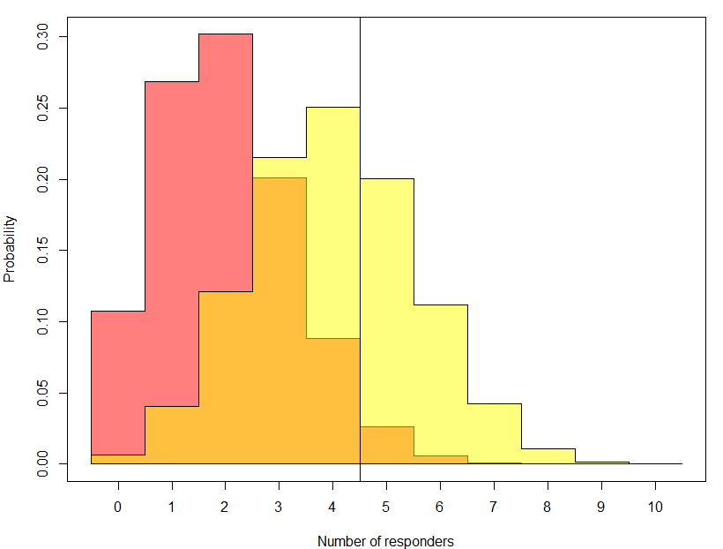
N = 10; power = 37%

Slide 23
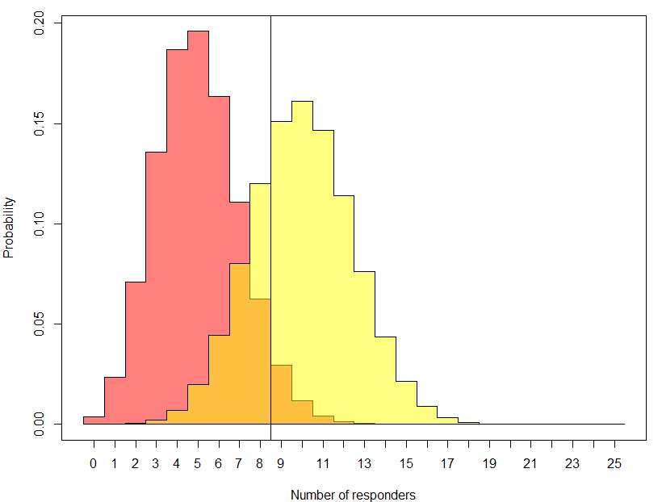
N = 25; power = 73%

Slide 24
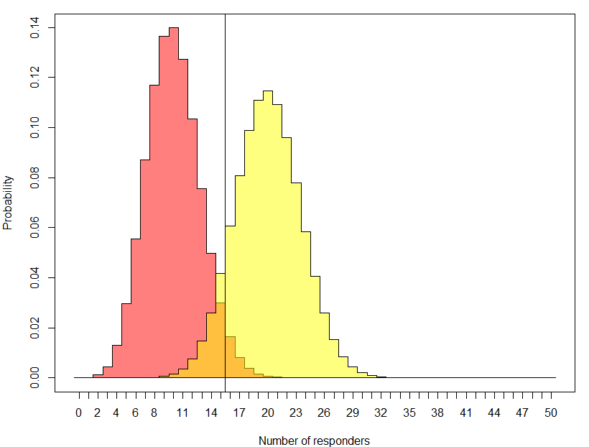
N = 50; power = 90%

Slide 25
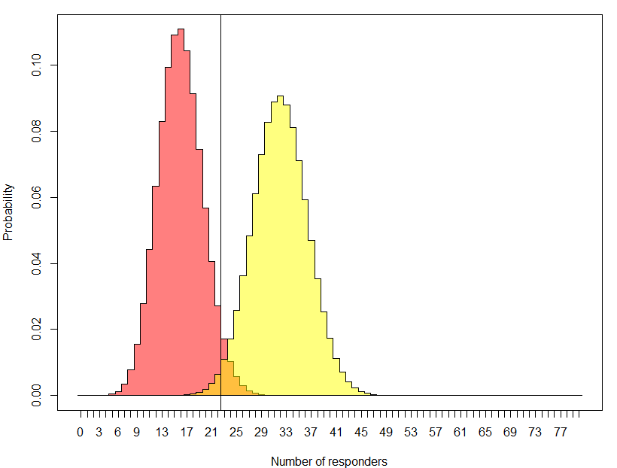
N = 80; power = 99%

Slide 26
Time to event endpoints
Power depends on number of events
For the same number of patients, accrual time, and expected hazard ratio, the power may be very different.
The number of expected events at time of analysis determines power.

Slide 27
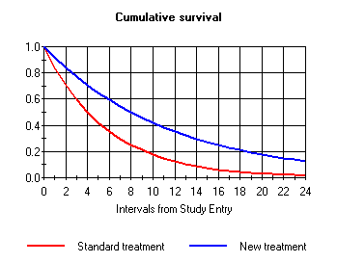
Example:
Median PFS 4 months vs. 8 months
HR = 0.5
12 month accrual, 12 month follow-up
Two-sided alpha = 0.05
Power = 94%

Slide 28
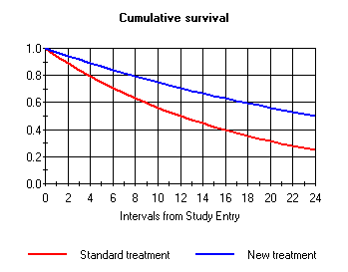
Example:
Median PFS 12 months vs. 24 months
HR = 0.5
12 month accrual, 12 month follow-up
Two-sided alpha = 0.05
Power = 77%

Slide 29
Choosing endpoints
Mostly a phase II question
Common predicament
PFS vs. response
OS vs. PFS
Binary PFS vs. time to event PFS

Slide 30
Choosing type I and II errors
Phase III:
Type I:
One-sided 0.025
Two-sided 0.05
Type II: 20% (i.e. power of 80%)
Phase II
More balanced
Common to have 10% of each
Common to see 1-sided tests with single arm studies especially

Slide 31
Other issues in comparative trials
Unbalanced design
why? might help accrual; might have more interest in new treatment; one treatment may be very expensive
as ratio of allocation deviates from 1, the overall sample size increases (or power decreases)
Accrual rate in time-to-event studies
Length of follow-up per person affects power
Need to account for accrual rate and length of study

Slide 32
Equivalence and Non-inferiority trials
When using frequentist approach, usually switch H₀ and H_{a}
“Superiority” trial
“Non-inferiority” trial

Slide 33
Equivalence and Non-inferiority trials
Slightly more complex
To calculate power, usually define:
H₀: δ > d
H_{a}: δ < d
Usually one-sided
Choosing β and α now a little trickier: need to think about what the consequences of Type I and II errors will be.
Calculation for sample size is the same, but usually want small δ.
Sample size is usually much bigger for equivalence trials than for standard comparative trials.

Slide 34
Equivalence and Non-inferiority trials
Confidence intervals more natural to some
Want CI for difference to exclude tolerance level
E.g. 95% CI = (-0.2,1.3) and would be willing to declare equivalent if δ = 2
Problems with CIs:
Hard-fast cutoffs (same problem as HTs with fixed α)
Ends of CI don’t mean the same as the middle of CI
Likelihood approach probably best (still have hard-fast rule, though).

Slide 35
Non-inferiority example
Recent PRC study.
Sorafenib vs. Sorafenib + A in hepatocellular cancer
Primary objective: demonstrate that safety of the combination is no worse than sorafenib alone.

Slide 36
Example
Toxicity rate of Sorafenib alone: assumed to be 40%.
A toxicity rate of no more than 50% would be considered ‘non-inferior’.
Hypothesis test for combination (c) and sorafenib alone (s)
H₀: p_{c} – p_{s} ≥ 0.10
H₁: p_{c} – p_{s} < 0.10

Slide 37
Example

Slide 38
Calculations
Must specify rate in each group and delta.
Note that the difference in rates may not need to equal delta.
Example:
Trt A vs. Trt B
Equivalent safety profiles might be implied by delta of 0.10 (i.e. no more than 10% worse).
But, you may expect that Trt B (novel) actually has a better safety profile.

Slide 39
Non-inferiority sample sizes
 | Example 1 | Example 2 | Example 3
 | New trt has lower toxicity | New trt has equal toxicity | New trt has worse toxicity
Alpha | 5% | 5% | 5%
Power | 80% | 80% | 80%
Toxicity rate, control group | 40% | 40% | 40%
Toxicity rate, novel trt group | 30% | 40% | 45%
Delta | 10% | 10% | 10%
Sample size required (total) | 140 | 594* | 2414
*If there is truly no difference between the standard and experimental treatment, then 594 patients are required to be 80% sure that the upper limit of a one-sided 95% confidence interval (or equivalently a 90% two-sided confidence interval) will exclude a difference in favor of the standard group of more than 10%.

Slide 40
Other considerations: cluster randomization
Example: Prayer-based intervention in women with breast cancer
To implement, identified churches in S.E. Baltimore
Women within churches are in same ‘group’ therapy sessions
Consequence: women from same churches has correlated outcomes
Group dynamic will affect outcome
Likely that, in general, women within churches are more similar (spiritually and otherwise) than those from different churches
Power and sample size?
Lack of independence → need larger sample size to detect same effect
Straightforward calculations with correction for correlation
Hardest part: getting good prior estimate of correlation!

Slide 41
Other Considerations: Non-adherence
Example: side effects of treatment are unpleasant enough to ‘encourage’ drop-out or non-adherence
Effect? Need to increase sample size to detect same difference
Especially common in time-to-event studies when we need to follow individuals for a long time to see event.
Adjusted sample size equations available (instead of just increasing N by some percentage)
Cross-over: an adherence problem but can be exacerbated. Example: vitamin D studies

Slide 42
Glossed over….
Interim analyses
These will increase your sample size but usually not by much.
Goal: maintain the same OVERALL type I and II errors.
More looks, more room for error.
But, asymmetric looks are a little different….

Slide 43
Futility only stopping
At stage 1, you can only declare ‘fail to reject’ the null
At stage 2, you can ‘fail to reject’ or ‘reject’ the null.
Two opportunities for a Type II error
One opportunity for a Type I error
Ignoring interim look in planning
Increases type II error; decreases power
Decreases type I error.
Why? Two hurdles to reject the null.
“Non-binding” stopping boundary.

Slide 44
Practical Considerations
We don’t always have the luxury of finding N
Often, N fixed by feasibility
We can then ‘vary’ power or clinical effect size
But sometimes, even that is difficult.
We don’t always have good guesses for all of the parameters we need to know…

Slide 45
Not always so easy
More complex designs require more complex calculations
Usually also require more assumptions
Examples:
Longitudinal studies
Cross-over studies
Correlation of outcomes
Often, “simulations” are required to get a sample size estimate.

Slide 46
(1) Odds ratio between cases and controls for a one standard deviation change in marker | (2) SD(a)/SD(marker) | (3) Matching | (4) Power for X₁ as simulated | (5) Power for X₁ replaced with median from respective quintile
1.12 | 0.25 0.5 1 | 1:1 1:2 1:1 1:2 1:1 1:2 | 0.52 0.70 0.50 0.59 0.29 0.38 | 0.48 0.65 0.44 0.53 0.26 0.36
1.16 | 0.25 0.5 1 | 1:1 1:2 1:1 1:2 1:1 1:2 | 0.76 0.88 0.70 0.81 0.50 0.64 | 0.72 0.87 0.66 0.74 0.44 0.56
1.22 | 0.25 0.5 1 | 1:1 1:2 1:1 1:2 1:1 1:2 | 0.94 0.98 0.92 0.97 0.79 0.92 | 0.92 0.97 0.89 0.95 0.71 0.89
1.28 | 0.25 0.5 1 | 1:1 1:2 1:1 1:2 1:1 1:2 | > 0.99 >0.99 0.99 >0.99 0.95 0.99 | 0.98 >0.99 0.98 >0.99 0.91 0.97
(1) Odds ratio between cases and controls for a one standard deviation change in marker (in units of standard deviations of the controls) |  | (2) SD(a)/SD(marker in controls) | (3) Matching | (4) Power for X₁ as simulated | (5) Power for X₁ replaced with median from respective quintile
 | 1.16 | 0.25 0.5 1 | 1:1 1:2 1:1 1:2 1:1 1:2 | 0.55 0.75 0.51 0.65 0.32 0.50 | 0.54 0.70 0.50 0.59 0.31 0.43
 | 1.22 | 0.25 0.5 1 | 1:1 1:2 1:1 1:2 1:1 1:2 | 0.77 0.88 0.75 0.87 0.64 0.78 | 0.73 0.84 0.73 0.82 0.57 0.72
 | 1.28 | 0.25 0.5 1 | 1:1 1:2 1:1 1:2 1:1 1:2 | 0.92 0.98 0.89 0.97 0.84 0.94 | 0.91 0.97 0.88 0.95 0.82 0.88

Slide 47
Helpful Hint: Use computer!
At this day and age, do NOT include sample size formula in a proposal or protocol.
For common situations, software is available
Good software available for purchase
Stata (binomial and continuous outcomes)
NQuery
PASS
Power and Precision
Etc…..
FREE STUFF ALSO WORKS!
Cedars Sinai software
https://risccweb.csmc.edu/biostats/
Cancer Research and Biostatistics (non-profit, related to SWOG) http://stattools.crab.org/

