Slide 1
Filling in the holes:
Other oncology trial designs
Methods in Clinical Cancer Research
February 19, 2015

Slide 2
Clinical Cancer Research
Dominated by medical oncology trials
Dominated by frequentist designs
Dominated by therapeutic trials with clinical outcomes focused on cancer burden or death
Dominated by Phase I – Phase III trials
There are quite few examples that lie outside of these areas (in one more ways) to consider.

Slide 3
Window of Opportunity Trials
Pre post design with evaluation of biomarkers
Example:
  Delayed surgery for newly diagnosed patients
  First receives a novel treatment regimen
  Then has surgery and resected tissue is used for analysis of biomarkers.

Slide 4
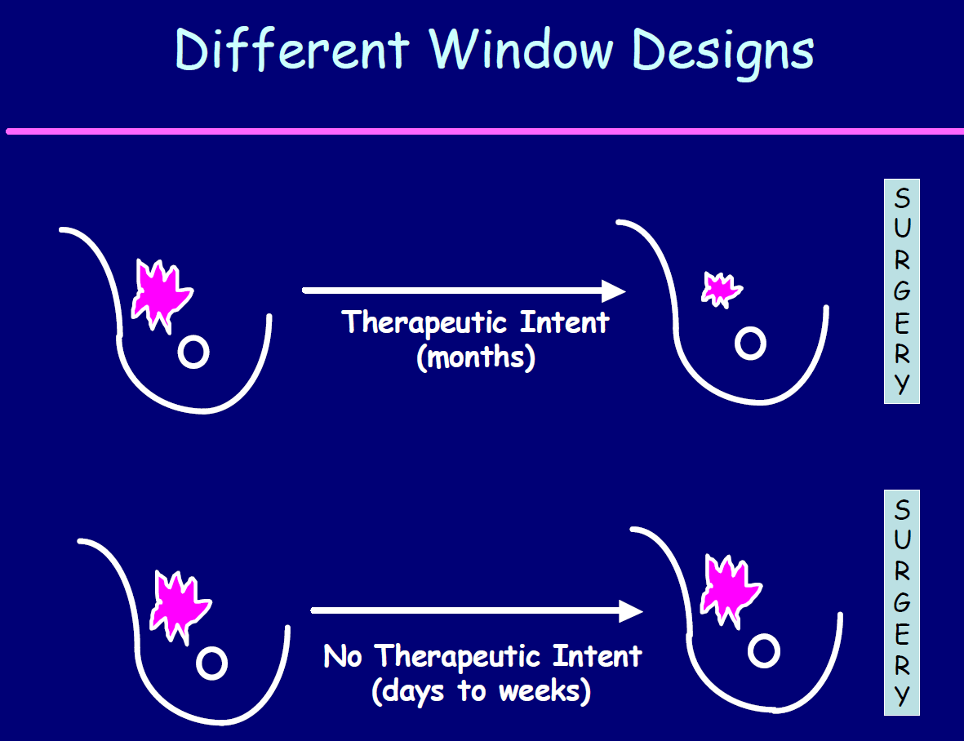
Slides from Matthew Ellis: http://ctep.cancer.gov/highlights/docs/ellis.pdf

Slide 5
Why conduct window studies?
Demonstrate that potential chemoprevention agents have relevant biological effects against tumor cells
Identify tumor resistance or sensitivity profiles to targeted agents
Demonstrate biological agent has expected mechanism of action
Establishing “biologically effective dose”

Slide 6
Practical constraints for
“no therapeutic intent” window studies
Ethical and practical difficulties of conducting studies when there is no expected patient benefit
Restricted to “non-toxic” agents with well-established toxicity profile
Logistics of sample collection and consent
Relies on robust surrogate endpoints for clinical events or relevant biological effects
Surgical setting may present special difficulties with certain agents.

Slide 7
Ethical Issues
Potential for patient harm in the early disease setting
Discussion of research with patients who are experiencing a high level of distress due to a recent diagnosis
May interfere with subsequent clinical trial accrual

Slide 8
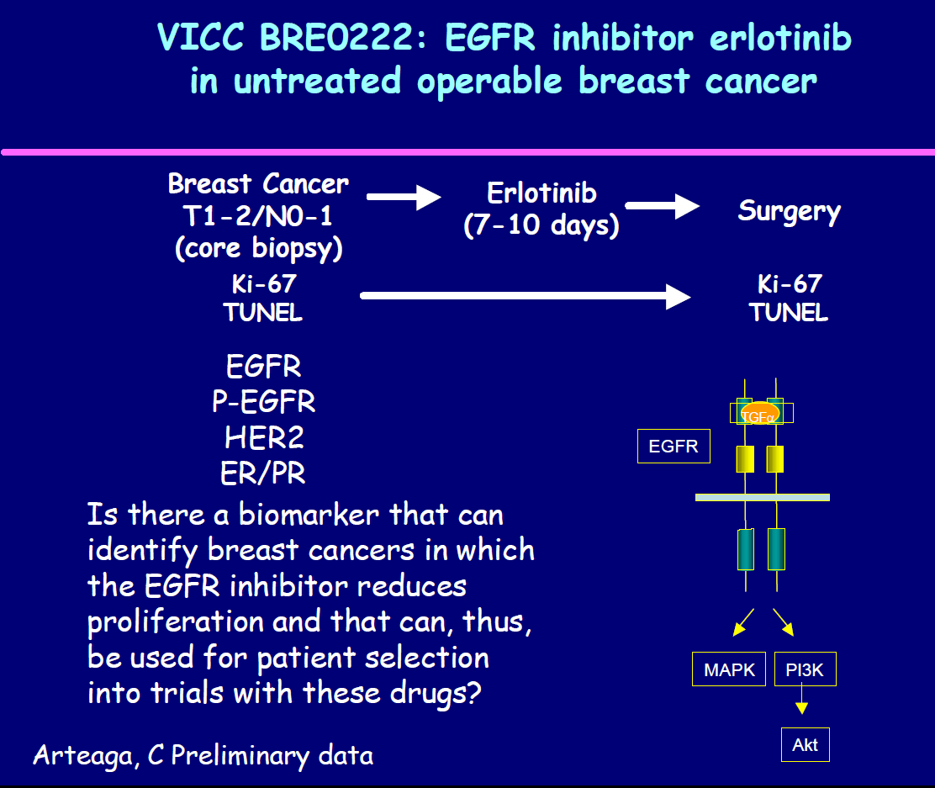
Demonstrate biological agent has expected mechanism of action

Slide 9
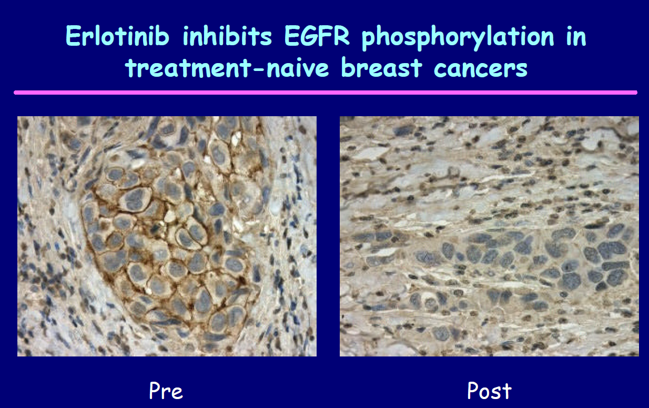
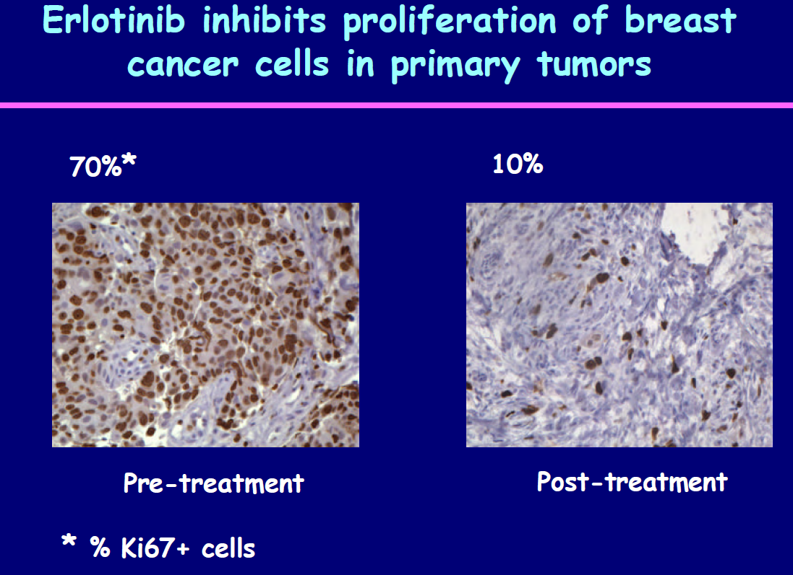
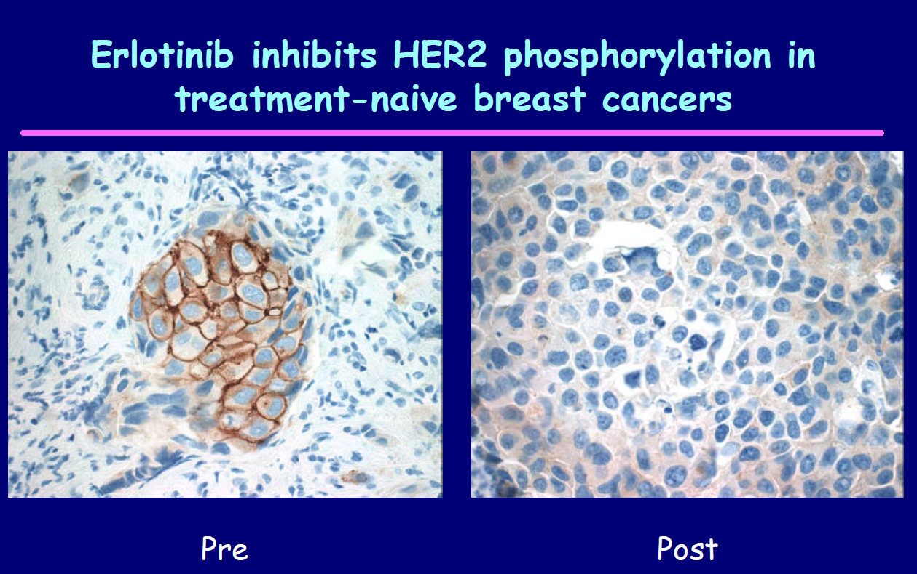


Slide 10
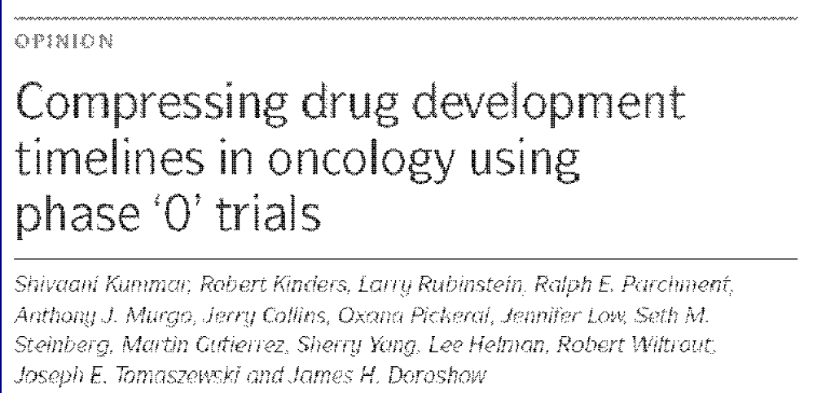
Related design: Phase 0 trials
Nature Reviews Cancer, Feb 2007

Slide 11
Adding in a pre-phase I level? Phase 0 trials
  “Human micro-dosing”
  First in man
  Not dose finding
  Proof-of-principle
    Give small dose not expected to be therapeutic
    Test that target is modified
    Small N (10-15?)
  Short term: one dose
  Requires pre and post patient sampling. Usually PD assay.
  Provides useful info for phase I (or if you should simply abandon agent).

Slide 12
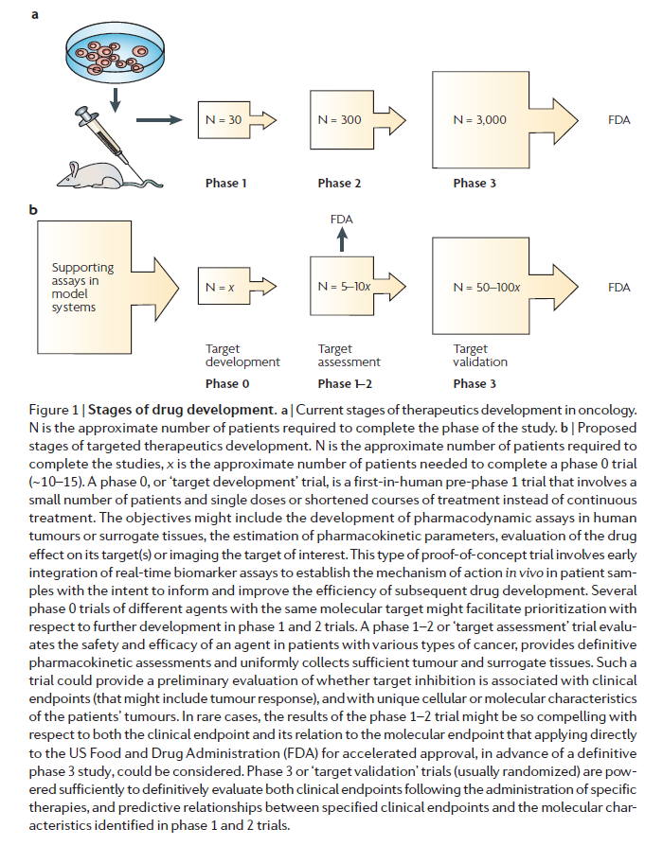

Slide 14
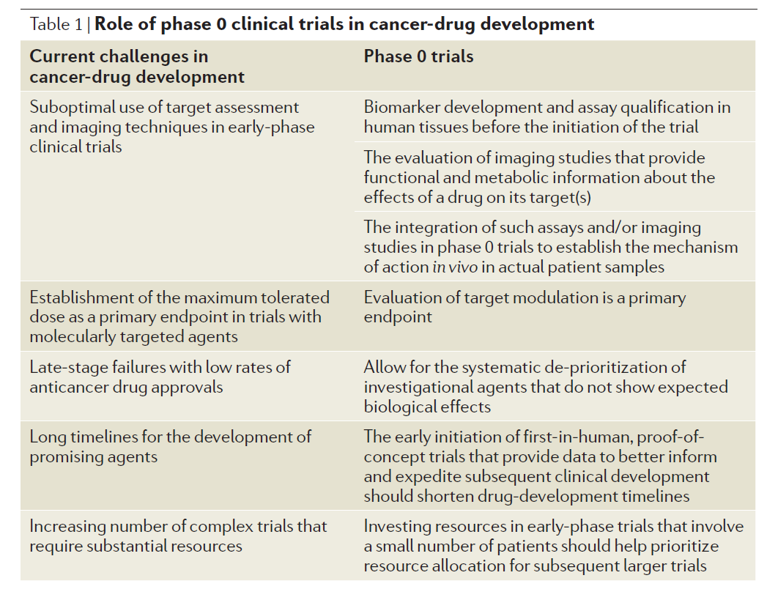

Slide 15
Phase 0: Example Parp-inhibitor
ABT-888 administered as a single oral dose of 10, 25, or 50 mg
Goals:
  determine dose range and time course over which ABT-888 inhibits PARP activity
    in tumor samples
    in PBMCs
  To evaluate ABT-888 pharmacokinetics
Blood samples and tumor biopsies obtained pre- and postdrug for evaluation of PARP activity and PK
If patients available, trials are quick.
Exploratory Investigational New Drug (EIND)
Kummar S, Kinders R, Gutierrez ME, et al.. Phase 0 clinical trial of the poly (ADP-ribose) polymerase
inhibitor ABT-888 in patients with advanced malignancies. J Clin Oncol 2009; 27.

Slide 16
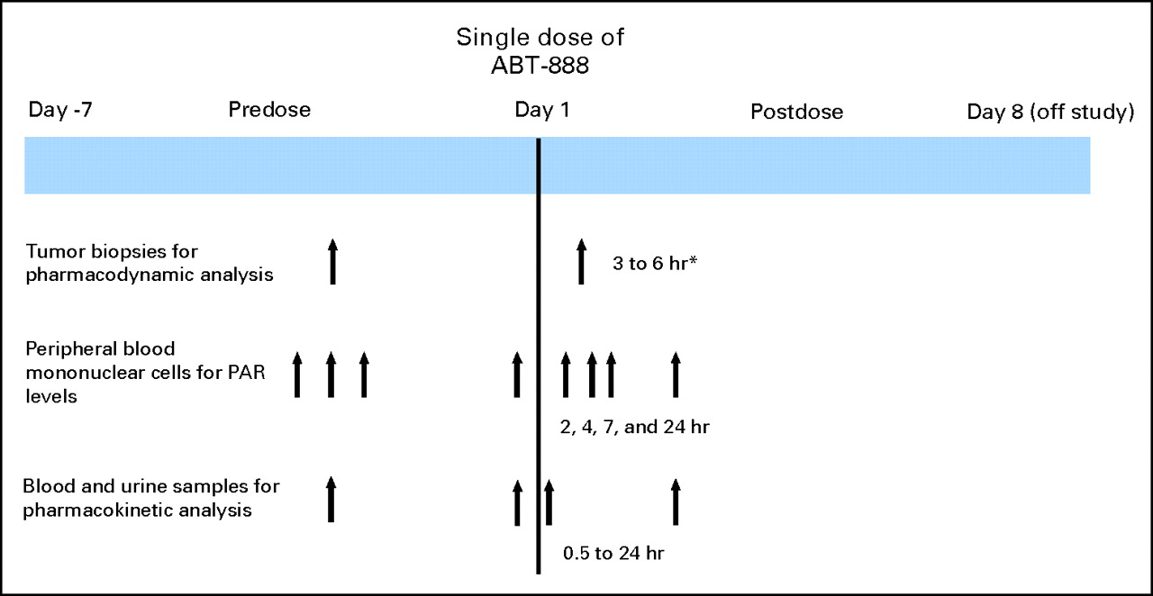
Study Schema

Slide 17
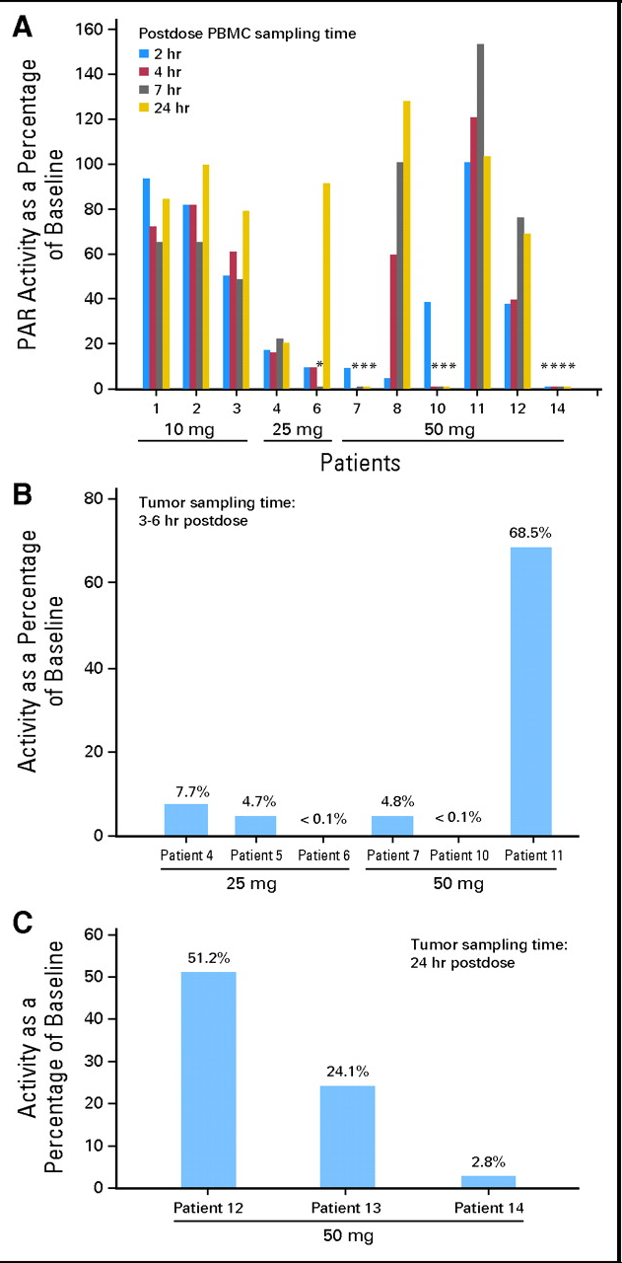
Phase 0: Example Parp-inhibitor
N = 13 patients with advanced malignancies
N = 9 had paired tumor biopsies

Slide 18
Clin Cancer Res June 15, 2008 14
Designing Phase 0 Cancer Clinical Trials
Oncologic Phase 0 Trials Incorporating Clinical Pharmacodynamics: from Concept to Patient
A Phase 0 Trial of Riluzole in Patients with Resectable Stage III and IV Melanoma
Preclinical Modeling of a Phase 0 Clinical Trial: Qualification of a Pharmacodynamic Assay of Poly (ADP-Ribose) Polymerase in Tumor Biopsies of Mouse Xenografts
Phase 0 Trials: An Industry Perspective
The Ethics of Phase 0 Oncology Trials
Patient Perspectives on Phase 0 Clinical Trials
The Development of Phase I Cancer Trial Methodologies: the Use of Pharmacokinetic and Pharmacodynamic End Points Sets the Scene for Phase 0 Cancer Clinical Trials
Phase 0 Trials: Are They Ethically Challenged?

Slide 19
Umbrella Trials
BATTLE and BATTLE-2
I-SPY
I-SPY 2

Slide 20
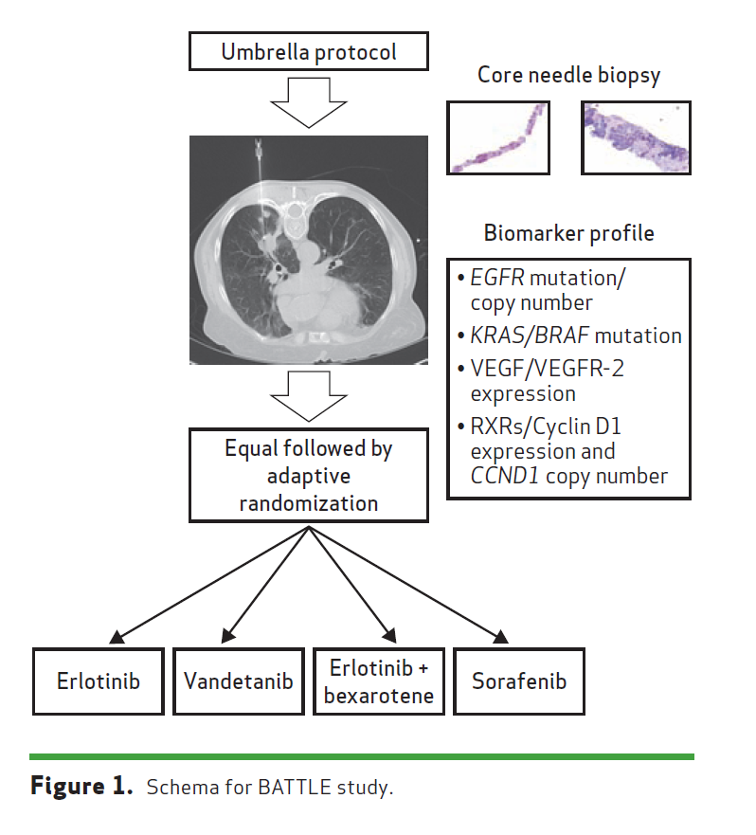
BATTLE: Personalizing Therapy for Lung Cancer
Biomarker-integrated Approaches of Targeted Therapy of Lung
Cancer Elimination

Slide 21
BATTLE Design
MD Anderson
Zhao, et al. Clinical Trials 2008; 5:181-193
Kim, et al. Cancer Discovery 2011; 1:44-53
“Umbrella” trial
Patients of same cancer type (here NSCLC) assigned
different treatments based on molecular profile
Four parallel phase II studies
Equal randomization followed by adaptive randomization
Primary endpoint = Eight week disease control rate (DCR)
Slides courtesy of betsy hill

Slide 22
BATTLE Trial Adaptive Randomization
Given the current data, estimate the posterior average 8-week DCR of each treatment within a marker group
For a patient within a particular marker group, probability of randomization to a given treatment is proportional to the posterior average 8-week DCR in that marker group with that treatment
Example:
  Next patient to be randomized has EGFR mutation
  Current estimated 8-week DCRs for each of the four treatments for patients with EGFR mutations are 0.6, 0.3, 0.2 and 0.1
  Patient randomized to first treatment with probability 0.6/(0.6 + 0.3 + 0.2 + 0.1) = 0.6/1.2 = 0.5
  Patient is randomized to second, third and fourth treatment with probability 0.25, 0.17, and 0.08, respectively.
Suspend treatment for a marker group if
Prob(8-week DCR > 0.5|data) < 0.1
Declare a treatment effective for a marker group if
Prob(8-week DCR > 0.3|data) > 0.8

Slide 23
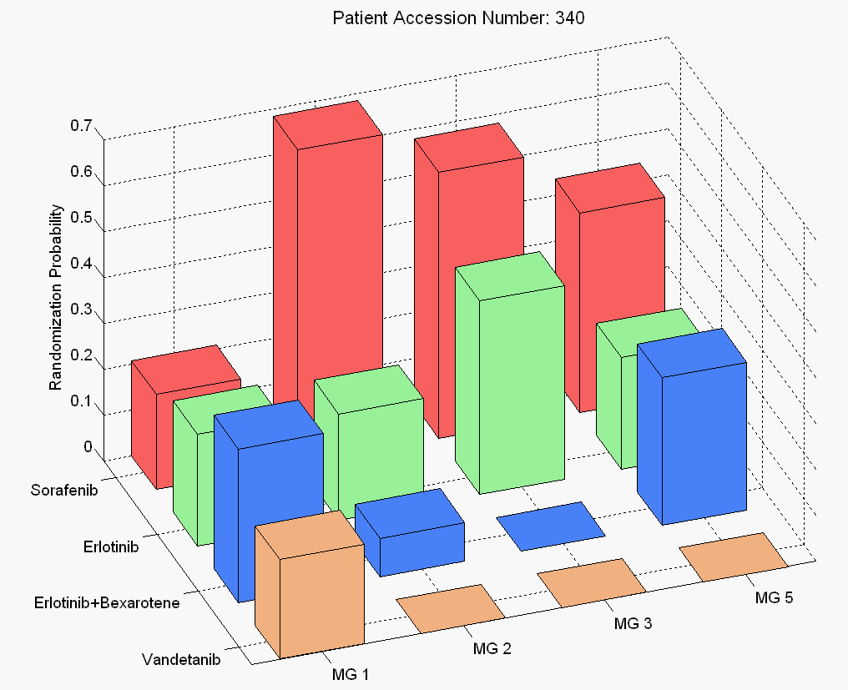
Slide from Jack Lee:
http://www.winsymposium.org/wp-content/uploads/2013/09/L-3.02-J.-Jack-Lee.pdf

Slide 24
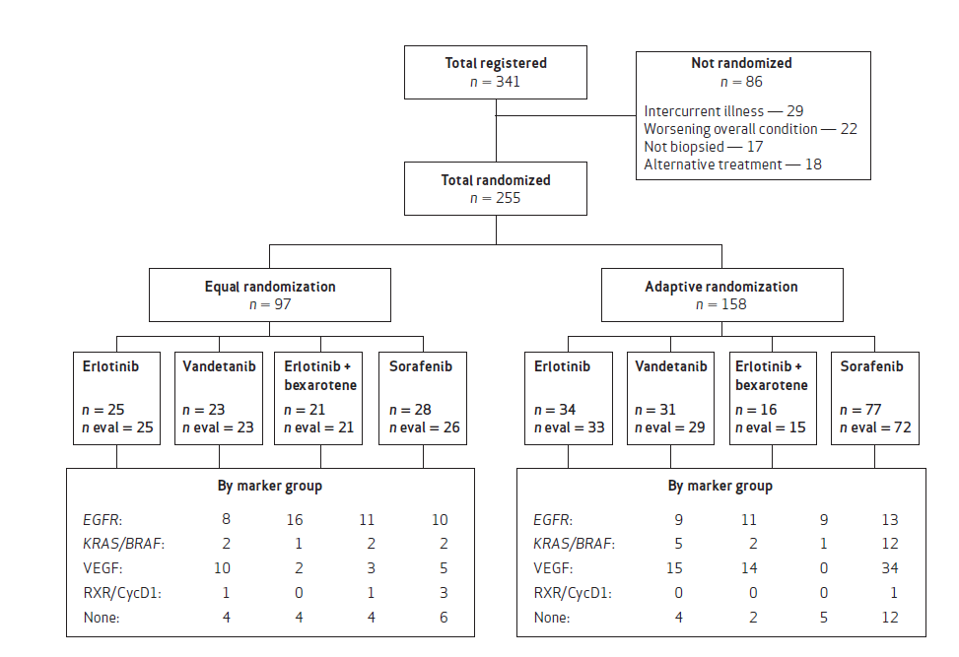

Slide 25
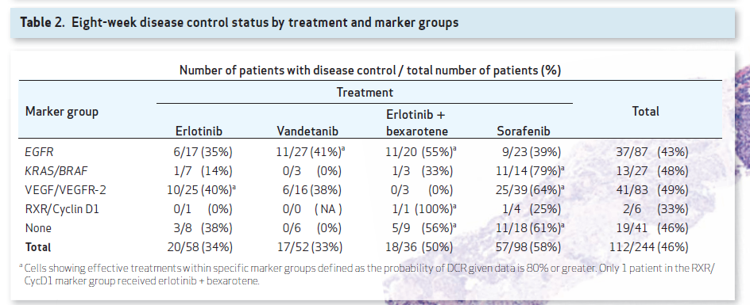

Slide 26
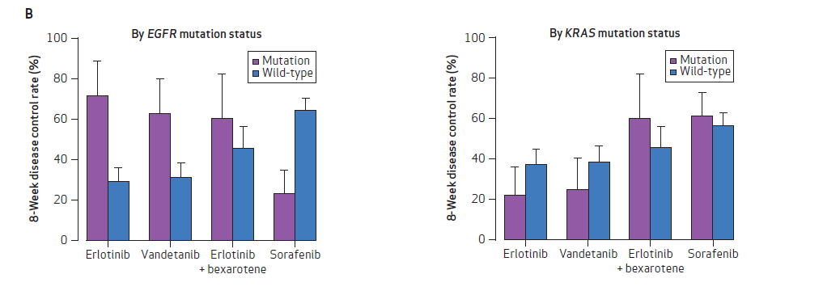

Slide 27
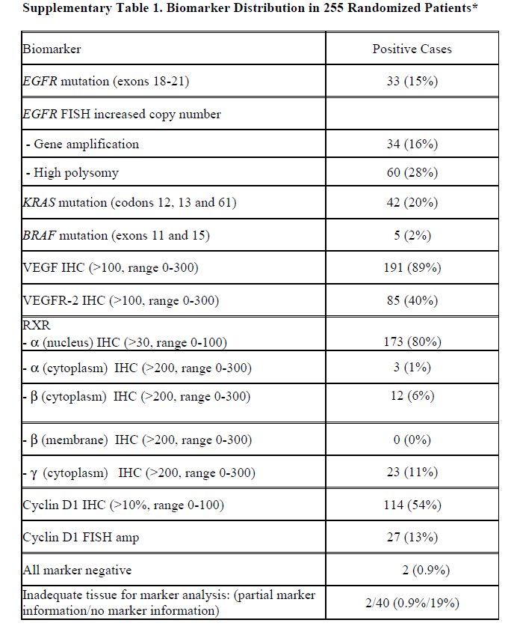
Limitations
Probably most important, our biomarker groups were less predictive than were individual biomarkers, which diluted the impact of strong predictors in determining treatment probabilities.
  For example, EGFR mutations were far more predictive than was the overall EGFR marker group.
  The unfortunate decision to group the EGFR markers also impacted the other marker groups and their interactions with other treatments, resulting in a suboptimal overall DCR as described.
Second, several of the prespecified markers (e.g., RXR) had little, if any, predictive value in optimizing treatment selections. This limitation will be addressed in future studies by not grouping or prespecifying biomarkers prior to initiating these biopsy-mandated trials.
In addition, adaptive randomization, which assigns more patients to the more effective treatments within each biomarker group, only works well with a large differential efficacy among the treatments (as evident in the KRAS/BRAF group), but its role is limited without such a difference (e.g., in the other marker groups).
Allowing prior use of erlotinib was another limitation and biased treatment assignments; in fact, the percentage of patients previously treated with erlotinib steadily increased during trial enrollment. Overall, 45% of our patients were excluded from the 2 erlotinib-containing arms because of prior EGFR TKI treatment. As erlotinib is a standard of care therapy in NSCLC second-line, maintenance, and front-line settings, the number of patients receiving this targeted agent will likely continue to increase.

Slide 28
Lessons learned (via Jack Lee)
Biomarker-based adaptive design is doable! It is well received by clinicians and patients.
Prospective tissues collection & biomarkers analysis provide a wealth of information
Treatment effect & predictive markers are efficiently assessed.
Pre-selecting and grouping markers are not good ideas. We don’t know what are the best predictive markers at get-go.
Adaptive randomization should kick in earlier & be closely monitored.
Adaptive randomization works well only when we have good drugs and good predictive markers.

Slide 29
BATTLE results:
Reporting ‘individual’ phase II trials
Sorafenib (Blumenschein et al, CCR, 2013).
“Comprehensive Biomarker Analysis and Final Efficay Results of Sorafenib in the BATTLE Trial
Vandetanib (Tsao et al., J of Thoracic Oncology, 2013).
“Clinical and Biomarker Outcomes of the Phase II Vandetanib Study from the BATTLE Trial”

Slide 30
BATTLE-2
Targeted agents in pretreated patients with advanced NSCLC.
“Extremely limited” set of markers in first stage (KRAS mutation)
Use first 200 patients to conduct prospective biomarker/signature testing.
Then the “best” markers will be used to guide patient treatment.

Slide 31
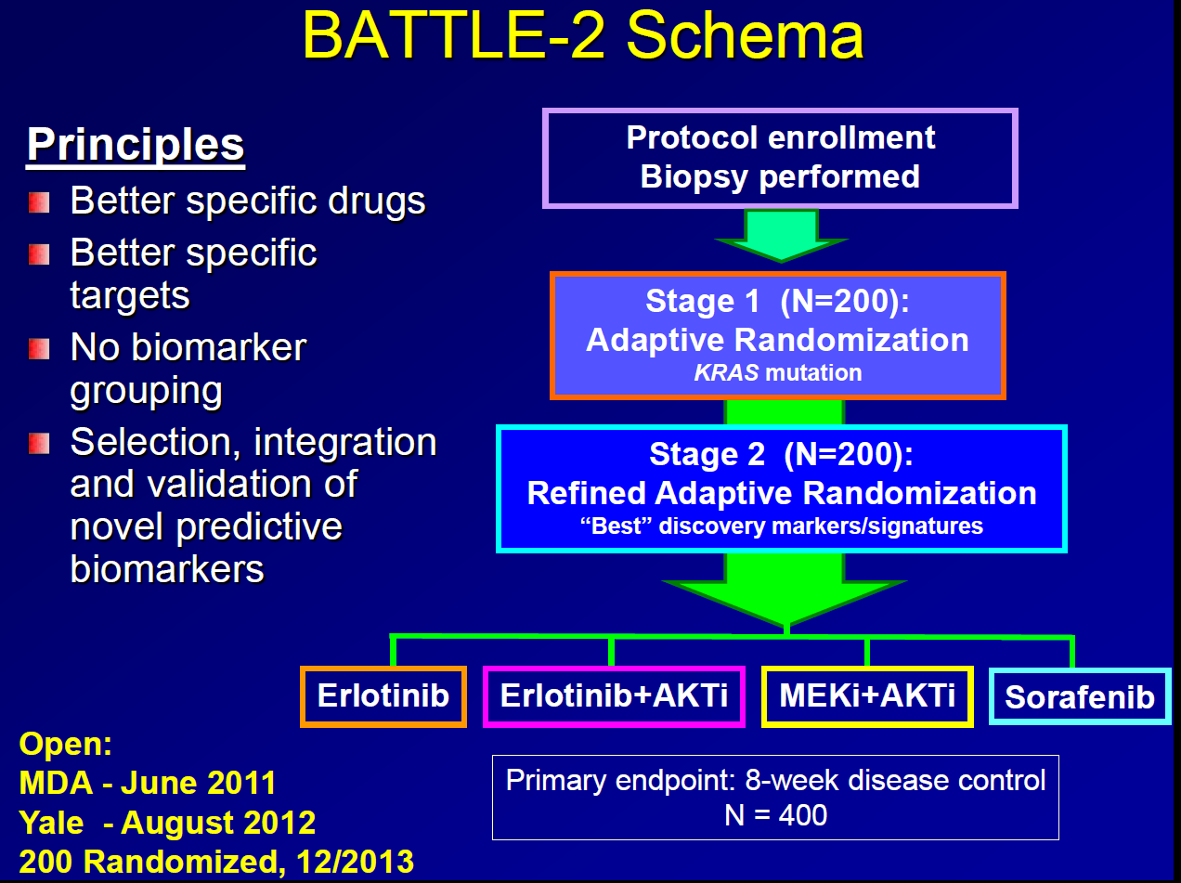
Slides from Jack Lee:
http://www.winsymposium.org/wp-content/uploads/2013/09/L-3.02-J.-Jack-Lee.pdf

Slide 32
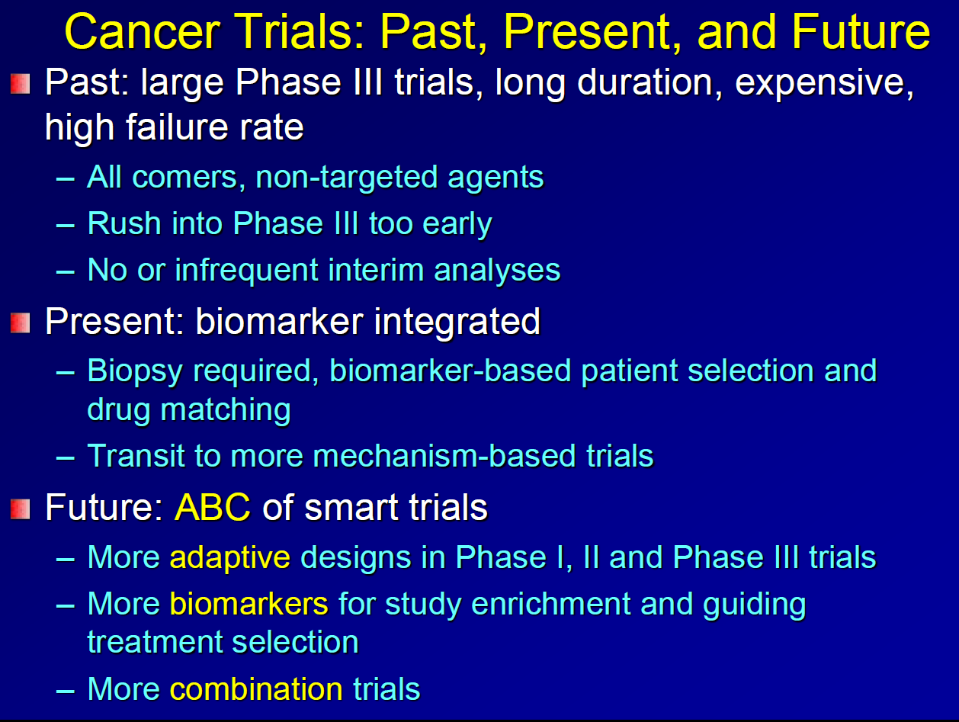

Slide 33
I-SPY
Esserman et al., JCO, 2012
The I-SPY 1 TRIAL (Investigation of Serial Studies to Predict Your Therapeutic Response With Imaging and Molecular Analysis) is a multicenter neoadjuvant breast cancer study designed to establish standards for collecting molecular and imaging data over the course of care
Primary objectives were to evaluate whether response to therapy—as measured by imaging (MRI volume) response and pathologic complete response (pCR)—would predict recurrence-free survival (RFS), overall and within biologic and imaging subsets.
Collaboration of the American College of Radiology Imaging Network (ACRIN), Cancer and Leukemia Group B (CALGB), and the NCI’s Specialized Programs of Research Excellence (SPORE).
Study for patients with invasive breast cancer measuring at least 3 cm and no evidence of metastatic disease

Slide 34
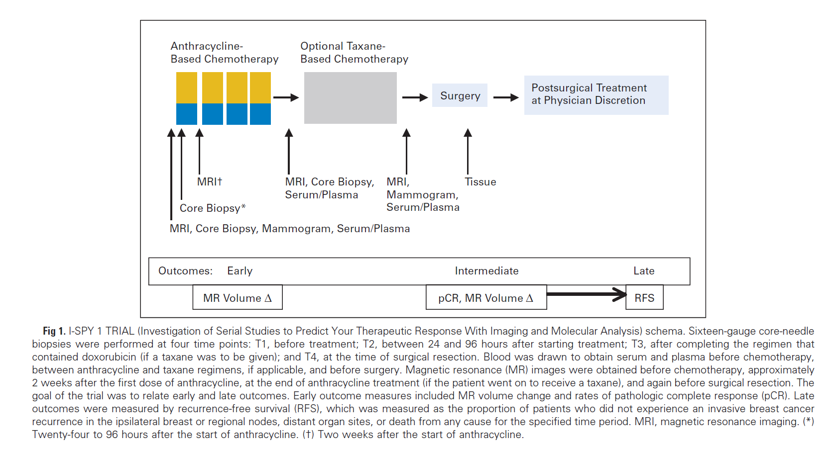
After 4 cycles of anthracycline-based therapy, patients could either undergo
surgical excision or receive a taxane before surgery.
Treatment after surgery (chemo, radiation, hormone therapy) was at physician’s
discretion.
Biopsies and imaging studies conducted at 4 time points during neoadjuvant chemo

Slide 35
Outcomes
The primary end point for the trial was RFS according to the STEEP (Standardization of Events and EndPoints) criteria.
RFS was calculated from the date of chemotherapy initiation.
An estimated target sample size of 244 patients with 15% drop rate was needed to be able to detect (with 90% power and alpha = 0.05 ) a hazard ratio of 0.5 between two biomarker-defined groups (e.g., MRI volume change in response to neoadjuvant chemotherapy or risk groups defined by molecular signatures).

Slide 36
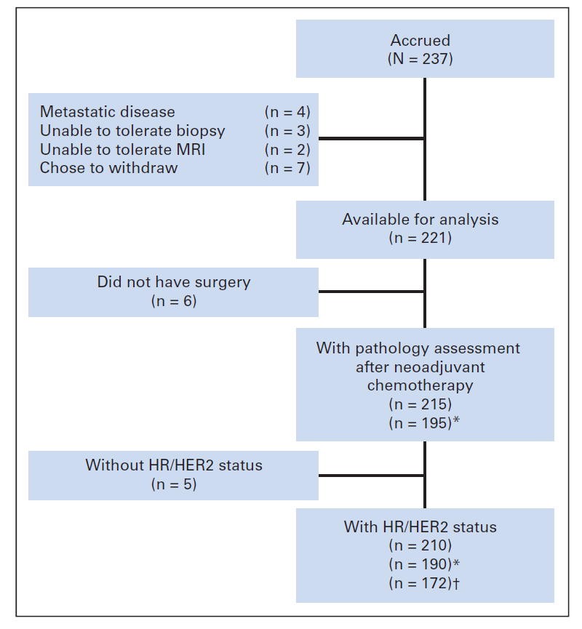

Slide 37
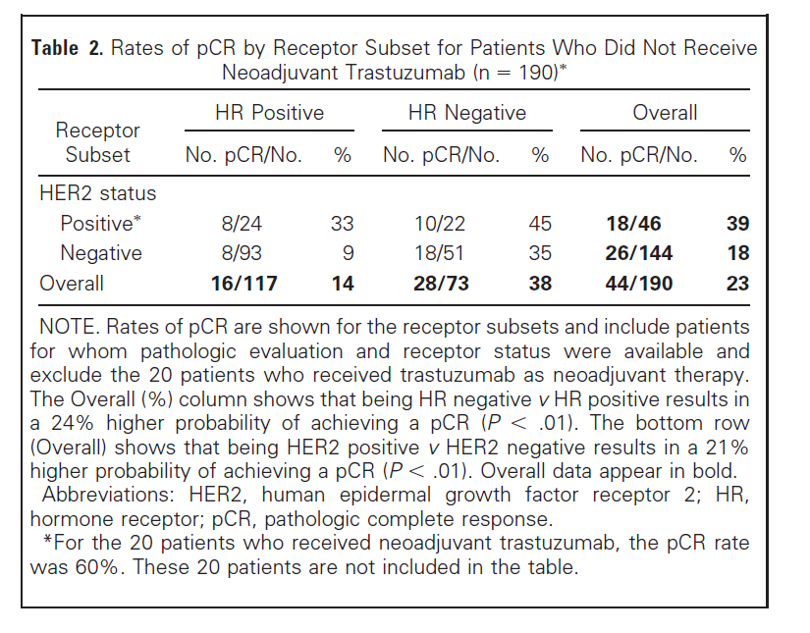

Slide 38
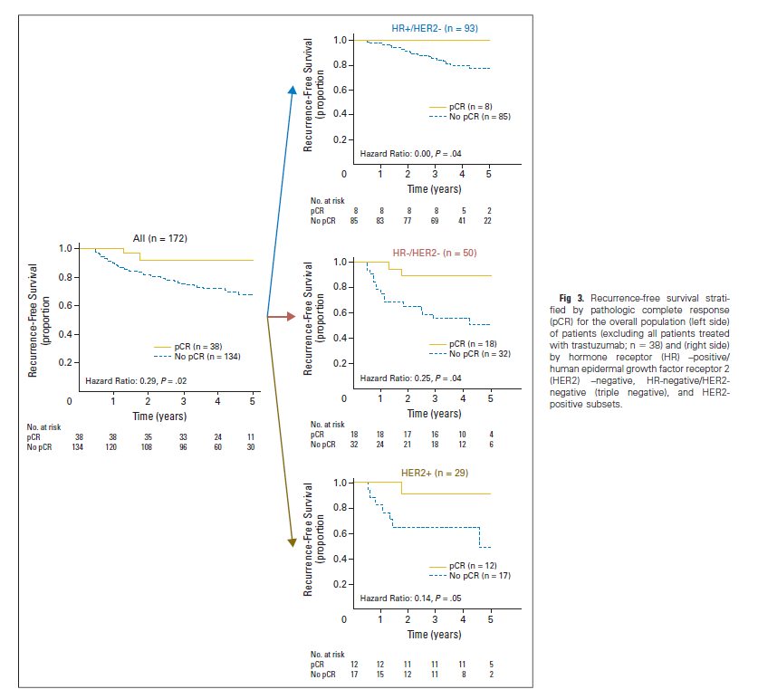

Slide 39
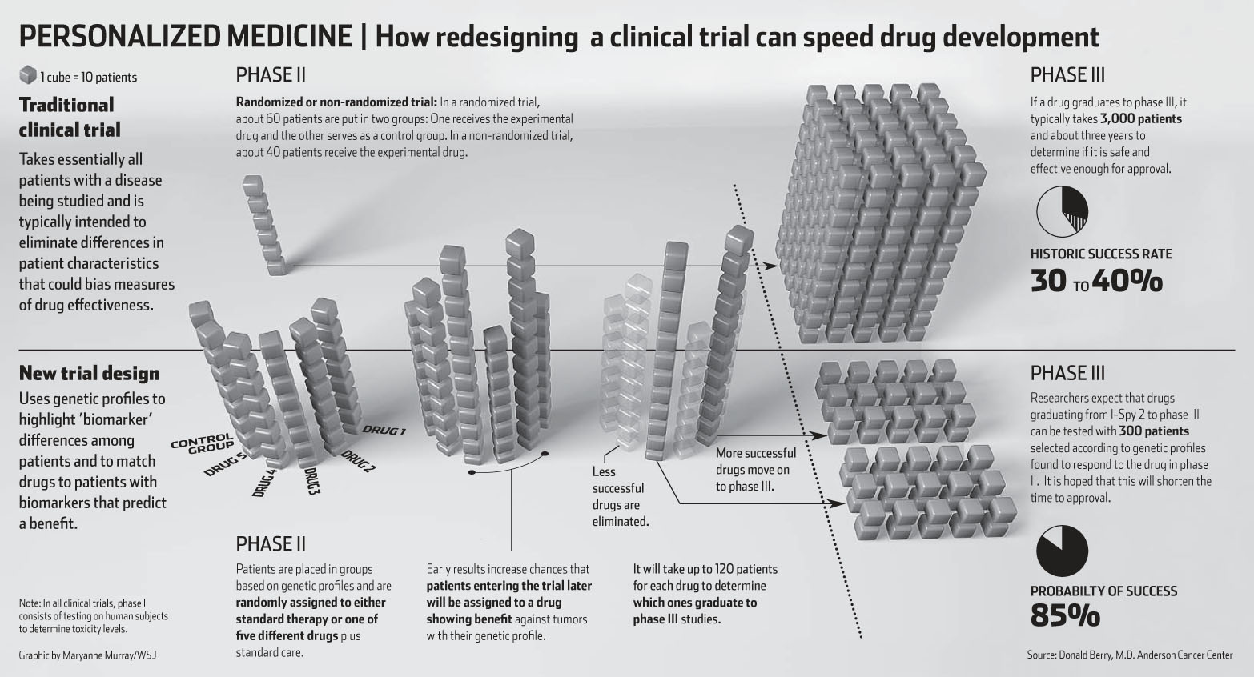
I-SPY2

