Slide 1
Phase III Trial Designs in Oncology
Methods in Clinical Cancer Research
Feb 17, 2015

Slide 2
Phase III: Comparative Trials
Head to head comparison of two (or more) treatment regimens
A vs. B
A vs. A+B
A vs. B vs. C
Etc.
“Definitive comparison:” these are designed to demonstrate to the FDA that a new treatment should be approved (if it works)
Expensive!

Slide 3
Who does these trials?
Pharma
Cooperative groups
Multi-center
Large coordination effort
Huge infrastructure for communication, data monitoring, randomization, data collection

Slide 4
Randomization
“Phase III randomized trial”
Why randomize?
Reduces bias
What is confounding?

Slide 5
Randomization is a wonderful thing but…
It doesn’t always work
The larger the sample size, the more likely you are to have “balance” of confounders across arms.

Slide 6
Stratified Randomization
Ensures balance on key factors
Example: newly diagnosed vs. relapsed disease
When patient enrolls, stratify by status
Within each group, perform randomization
Aside: Randomization isn’t really a flip of a coin
Pre-defined randomization list
Or, dynamic but ensures even numbers in treatment groups

Slide 7
Blocked Randomization
Creates sequential “blocks” of patients
Example:
100 patient study, 1:1 randomization
Blocks of size 10
After every set of 10 patients, the study will be balanced by treatment
AABBBAABAB BABAAABBAB etc.

Slide 8
Outcomes in Phase III Oncology Trials
Usually overall survival
Exceptions?
Breast cancer (earlier stages) and other cancers where time to death is long
Non-curative treatments
Other outcomes of interest
Quality of Life
PFS
Toxicity (related to QoL)

Slide 9
Classic randomized phase III cancer treatment trial
Classic randomized phase III
Patients are enrolled (e.g. over 3 years)
Followed until the trial ends (e.g. for an additional two years beyond last enrollment).
At the end of study period, overall survival is evaluated in both treatment arms.
The hazard ratio is estimated and the survival curves are shown.
A p-value tests that the HR<1.

Slide 10
Nuances
Inclusion/exclusion
Previous therapies? newly diagnosed?
Biomarker positive?
How similar are the patients to those in the phase II studies?
Early stopping rules
Safety
Efficacy
Futility
Cross-over: if a patient progresses, should s/he be allowed to cross-over?

Slide 11
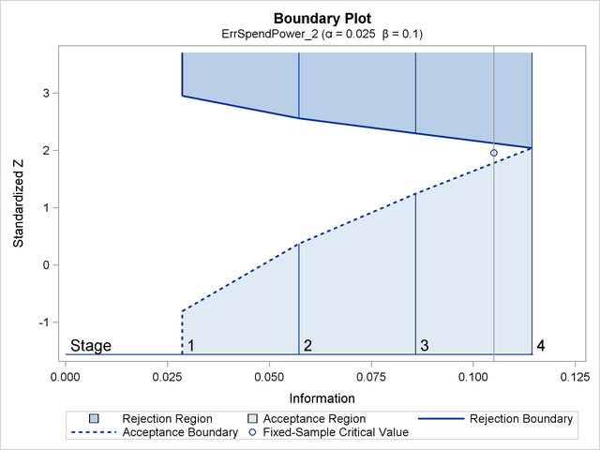
Examples of boundaries for early stopping

Slide 12
Stopping boundaries can be tricky…
If you find early efficacy in favor of the new agent before accrual completes, what should you do?
If you find early futility (i.e. new treatment doesn’t work better than the standard of care), what should you do?
If you stop the study, what about patients currently on trial that have stable disease?

Slide 13
More modern Phase III research
Adaptive trials
Big buzzword
The data is analyzed relatively frequently and the conduct of the trial is modified based on the results that are seen.
Often “Bayesian”.
Bayesian do not evaluate the data in the same way as frequentists
“alpha error” is different

Slide 14
Biomarker-driven trials
Tezak Z et al. Personalized Medicine. 2010;7(5):
517-530.

Slide 15
Designing a Phase III study
Need to consider
What is the expected/meaningful benefit?
What is a feasible sample size?
How willing are you to make a mistake in your conclusion?
What is the median survival (or 12 month, or 5 year survival) in your ‘reference’ group?
Is there a relevant biomarker to consider?
Sometimes a phase III study will require 5000 patients.

Slide 16
Ellis et al., JCO 2014

Slide 17
What is a meaningful improvement?

Slide 18
Triple negative breast cancer trials
* And don’t forget quality of life!

Slide 19
Other issues to consider
Blinding (or masking) and placebos?
Cross-over?
Drop-out?
How to deal with patients leaving study due to:
Non-disease and non-treatment reasons?
Toxicity?
Other clinical events?

Slide 20
Non-inferiority
Is it good enough to be ‘as good as’ the standard of care?
What if toxicity profile is improved?
Non-inferiority trials are good in theory: difficult in practice
Larger sample sizes
How do you define “as good as”?

Slide 21
Data monitoring committees
Related to, but not the same as, including early stopping rules
An independent group of individuals who review the safety, accrual, quality and efficacy data to ensure the study is being performed with integrity and the study continues to be ethical to perform.
Includes clinicians, statistician(s) always
Ad hoc members: ethicists, basic scientists or other PhD researchers.

Slide 22
Let’s look at some trials
Bevacizumab Combined With Chemotherapy for Platinum-Resistant Recurrent Ovarian Cancer: The AURELIA Open-Label Randomized Phase III Trial
Eric Pujade-Lauraine, Felix Hilpert, Béatrice Weber, Alexander Reuss, Andres Poveda,Gunnar Kristensen, Roberto Sorio, Ignace Vergote, Petronella Witteveen,Aristotelis Bamias, Deolinda Pereira, Pauline Wimberger, Ana Oaknin,Mansoor Raza Mirza, Philippe Follana, David Bollag, and Isabelle Ray-Coquard. JCO May 1, 2014:1302-1308; published online on March 17, 2014;10.1200/JCO.2013.51.4489.
[Abstract]
[Full Text]
[PDF]
[Protocol]
[JCO Podcast]

Slide 23
Let’s look at some trials
Sunitinib Versus Sorafenib in Advanced Hepatocellular Cancer: Results of a Randomized Phase III Trial
Ann-Lii Cheng, Yoon-Koo Kang, Deng-Yn Lin, Joong-Won Park,Masatoshi Kudo, Shukui Qin, Hyun-Cheol Chung, Xiangqun Song, Jianming Xu,Guido Poggi, Masao Omata, Susan Pitman Lowenthal, Silvana Lanzalone,Liqiang Yang, Maria Jose Lechuga, and Eric Raymond
JCO Nov 10, 2013:4067-4075; DOI:10.1200/JCO.2012.45.8372.
[Abstract]
[Full Text]
[PDF]
[Protocol]
[CiteTrack]

Slide 24
One more…
Multicenter, Randomized, Open-Label, Phase III Trial of Decitabine Versus Patient Choice, With Physician Advice, of Either Supportive Care or Low-Dose Cytarabine for the Treatment of Older Patients With Newly Diagnosed Acute Myeloid Leukemia
Hagop M. Kantarjian, Xavier G. Thomas, Anna Dmoszynska, Agnieszka Wierzbowska, Grzegorz Mazur, Jiri Mayer, Jyh-Pyng Gau, Wen-Chien Chou, Rena Buckstein, Jaroslav Cermak, Ching-Yuan Kuo, Albert Oriol, Farhad Ravandi, Stefan Faderl, Jacques Delaunay, Daniel Lysák, Mark Minden, and Christopher Arthur
JCO Jul 20, 2012:2670-2677; DOI:10.1200/JCO.2011.38.9429.
[Abstract]
[Full Text]
[PDF]
[Protocol]

