Slide 1
Biomarkers in Phase II designs in cancer clinical trials
Methods in Clinical Cancer Research
February 12, 2015

Slide 2
Effective incorporation of biomarkers into phase II trials
There are many roles for biomarkers in Phase II trial designs.
Examples of biomarkers with pivotal role in development of new therapies
HER-2 protein overexpression in breast cancer for trastuzumab
BCR-ABL fusion product for imatinib in CML
Rational inclusion of biomarkers into phase II will lead to higher success rates and more efficient phase III designs.
McShane, Hunsberger and Adjei, Clinical Cancer Research (2009); 15(6).

Slide 3
Predictive and Enrichment Biomarkers
Predictive Biomarker:
Measurement associated with response or lack of response to therapy
Includes biomarkers of toxicity.
Example: ER status for predictor of response to endocrine therapy for breast cancer
Biomarkers related to ‘target’ are natural candidates
Sometimes:
There is not a clearly identified biomarker
There is not a good assay for the biomarker

Slide 4
Predictive and Enrichment Biomarkers
Enrichment biomarkers
Factors use to limit the study population to patients believed more likely to benefit from the therapy.
May be predictive biomarkers or clinico-pathologic, or demographic characteristics.
The lower the proportion of truly benefiting patients, the more strongly an enrichment design should be considered.

Slide 5
Enrichment biomarkers
Enrichment biomarkers are sometimes imprecise (i.e., lacking high PPV and/or NPV) so that they only “approximately” define the benefiting population.
That is, not ready for ‘prime time’ as predictive biomarkers.
Using enrichment biomarker will tend to improve chances that drug will show benefit in tested population.
Example: trastuzumab (Mab that targets Her-2 neu receptor).
Pivotal phase II monotherapy studies required Her-2 overexpression via IHC and then FISH
Her2-neu positivity has about a 25-30% prevalence.
If enrichment had not occurred, trastuzumab may have been abandoned.

Slide 6
Enrichment biomarkers
EGFR targeting agents: not so clear cut
In colorectal cancers,
cetuximab has a clinical benefit
But no clear association between EGFR (epidermal growth factor receptor) overexpression and benefit
May be related to KRAS mutations

Slide 7
Enrichment biomarkers
Sometimes, putative target is incorrect
Using target as biomarker would lead to major errors
Example: sorafenib
Developed as inhibitor of kinase activity of c-Raf
Later found to be inhibitor of VEGFR (vascular endothelial growth factor receptors)
Misspecification of a target biomarker can have significant consequences
if agent benefits all patients regardless of biomarker.
Studying in enriched population slows accrual
Doesn’t allow patients who would benefit access to drug
Wrong subgroup studied
Good agent probably abandoned

Slide 8
Enrichment Biomarkers
Economics
If proportion expected to benefit is large (>80%), might not be cost-effective to spend time for biomarker for enrichment.
If proportion is small, then need to spend $$ on well-developed assay
Total sample size for enriched vs. not enriched depends on…
Proportion in enriched subgroup
Magnitude of benefit in enriched subgroup
GOALS:
Have a drug that works in some group of patients
To be able to identify the patients in that group
Decisions regarding enrichment have to be made with GOALS in mind.
Tension: rapid development vs. robust accurate assay that will be useful for identifying individual patients who will (or not) benefit

Slide 9
Biomarker-based correlative endpoints
Trial-level surrogate endpoints could be substituted for definitive endpoint (e.g. OS).
Trial-level surrogacy and individual-level surrogacy are different.
Surrogate biomarkers may work in some settings but not others
Example: PSA.
Not broadly validated surrogate endpoint for prostate cancer.
“working group” report issued cautions regarding PSA-based endpoints.
Even so, PSA doubling time and PSA levels are still important prognostic factors.

Slide 10
Biomarker-based phase II trial design
Main goal of incorporating biomarkers in phase II: determine if new drug should be developed for all patients without selection or developed for biomarker-defined patient subset(s) only.

Slide 11
Biomarker-based phase II trial design
Cautions for traditional single-arm designs
Problem? Benchmark response rate
Benchmark rate based on unselected population
Enrichment characteristic may be prognostic (i.e. related to outcome).
Often hard to find benchmark in enriched groups

Slide 12
Table 1.
Effect of enrichment for biomarker-positive cases on the probability of falsely concluding that a new therapy increases the response rate when a single-arm phase II study is designed using assumptions from an unselected population
Historical response rate in the unselected population (%) | Historical response rate in the subpopulation enriched for biomarker-positive cases (%) | Sample size | No. observed responses required to conclude that the response rate is increased by the new therapy | Actual probability of falsely concluding that the new therapy increases the response rate in the enriched subpopulation
10 | 15 | 30 | 6 | 0.29
10 | 20 | 30 | 6 | 0.57
20 | 25 | 36 | 11 | 0.27
20 | 30 | 36 | 11 | 0.53
30 | 35 | 39 | 16 | 0.26
30 | 40 | 39 | 16 | 0.51

Slide 13
Biomarker adaptive Simon two-stage
Assumes prespecified biomarker
Two parallel two-stage designs
Biomarker positive subgroup
Biomarker negative subgroup
Continues to stage two in two instances:
Both subgroups have activity
Biomarker positive subgroup has activity
Can lead to reduction of expected samples size.
Still requires ‘null’ response rate in EACH group!

Slide 14
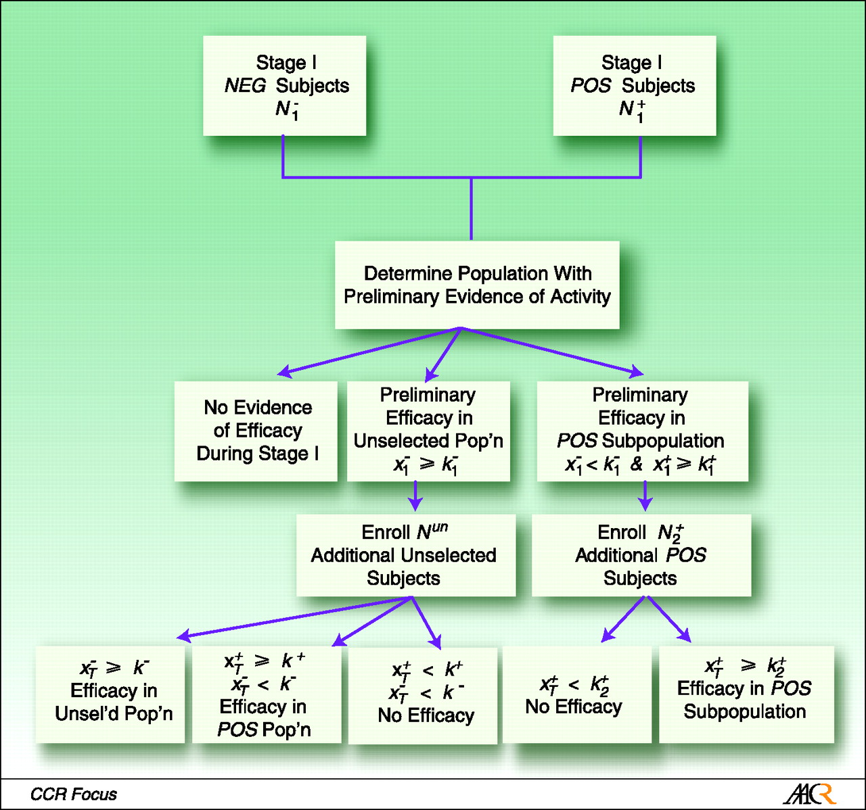
Schema of the adaptive parallel two-stage design.
McShane L M et al. Clin Cancer Res 2009;15:1898-1905
©2009 by American Association for Cancer Research

Slide 15
Tandem two-step phase II predictor biomarker evaluation trial design
Starts with unselected population.
If numbers in unselected population are low, then it ‘splits out’ by biomarker defined subgroups.
“pharmacogenomic classifier”
Termination based on standard two-stage criteria.
Authors skeptical regarding use of high-throughput expression profiling for problems of multiplicity and measurement error.

Slide 16
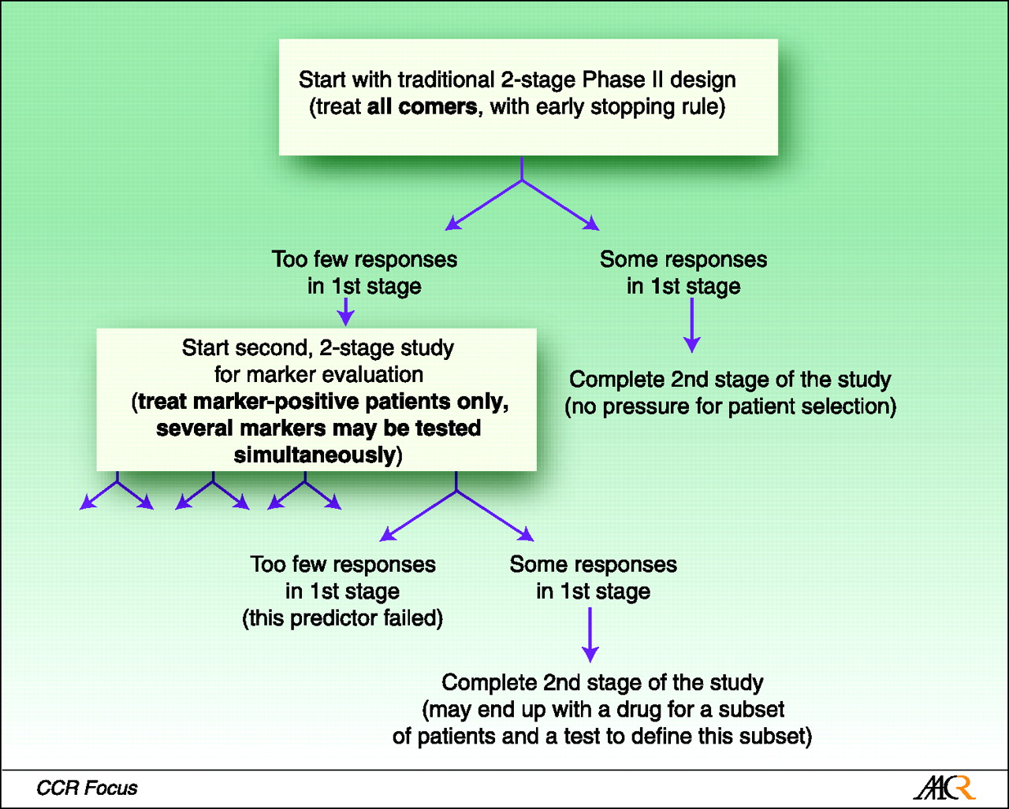
Schema of the tandem two-step phase II predictor biomarker evaluation trial design.
McShane L M et al. Clin Cancer Res 2009;15:1898-1905
©2009 by American Association for Cancer Research

Slide 17
Randomized Phase II Trial Design With Biomarkers
Should determine if biomarker is important for phase III design
Optimal phase III: Biomarker-stratified design with treatment randomized.
Requires a large sample size and so planning should be done based on accurate information.
Goal of this design: design that can be used to guide decision making for further development of experimental therapy.

Slide 18
Randomized Phase II Trial Design With Biomarkers
Four conclusions:
Perform RP3 with biomarker-enrichment design
Perform RP3 with biomarker-stratified design
Perform RP3 without using biomarker
Drop consideration of RP3
Notes:
Look at CI of HR decisions.
Rationale?

Slide 19
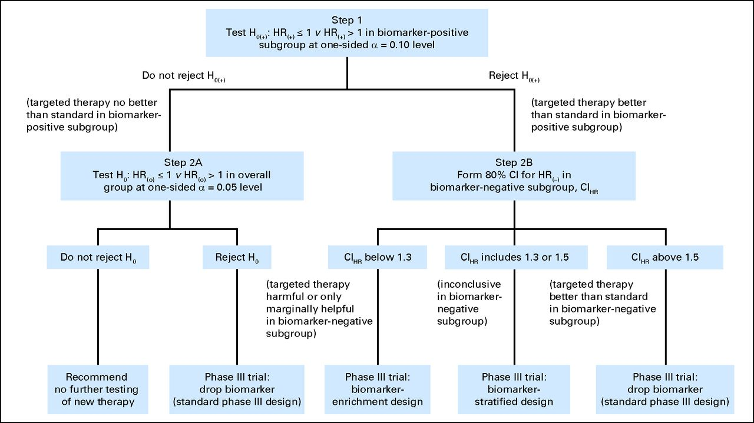
Decision algorithm for recommendation of phase III trial design based on the outcome of the proposed phase II biomarker trial design.
Freidlin B et al. JCO 2012;30:3304-3309
©2012 by American Society of Clinical Oncology

Slide 20
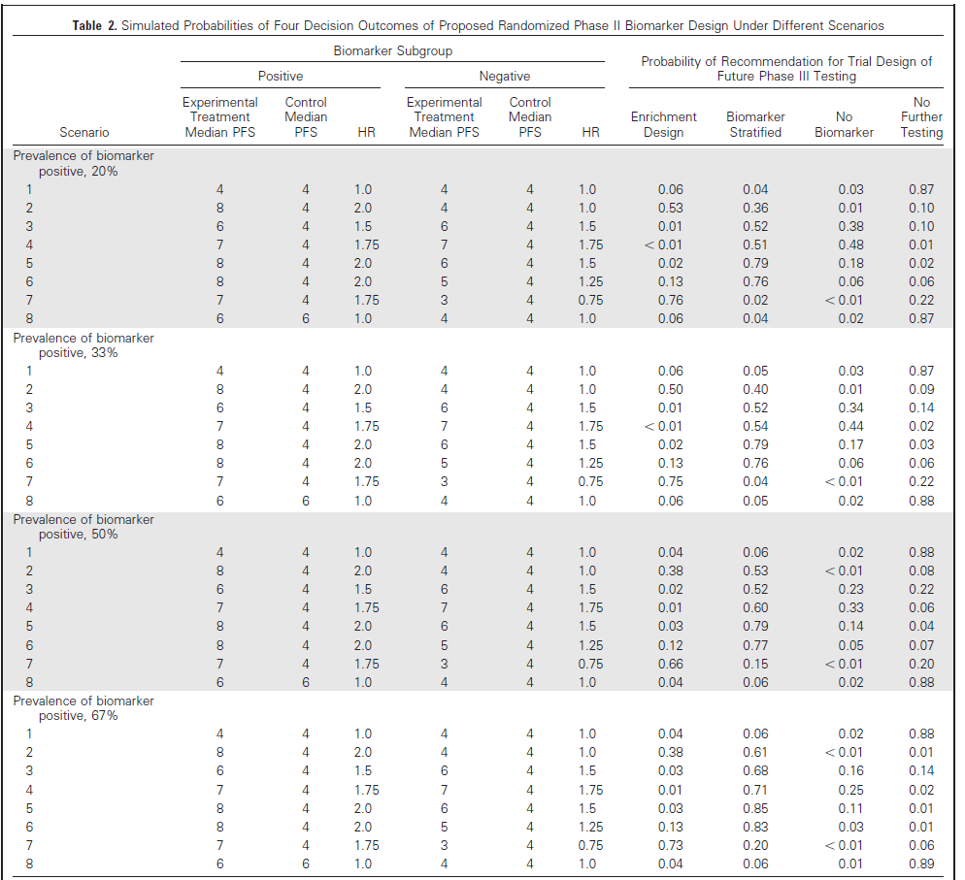

Slide 21
Basket Trials
Challenge earlier views of oncology where focus is on the tissue of origin
Primary site matters, but “genetic landscape” does too.
Several challenges:
1. Genetic classification and treatment may not always follow traditional approaches
HER2: common in breast cancer, but also in some lung cancers
BRAF: common melanoma, but also found in hairy cell leukemia, colon, lung, thyroid and brain cancers.
Hence, make-up of tumor may be very important or more important than site.
But, identifying patients can be a challenge
Redig and Janne, JCO, Feb 9 2015 (epub ahead of print).

Slide 22
Basket Trials
Challenges (cont.)
2. Evaluating target therapies is difficult when mutations are rare and span numerous diseases
Everolimus: mutations found so rare that trial was negative (two extraordinary responders).
Planning and resources?
Note: “standard” designs were developed for nontargeted cytoxics. (sound familiar?)

Slide 23
What is a basket trial?
New and evolving form of trial design based on hypothesis that presence of a molecular marker predicts response to targeted therapy independent of tumor histology.
Mutations identified, patients assigned to specific treatment arm (or randomization to subset of treatments) based on mutation status
Conducting several independent parallel phase II trials.
Advantage: Hypothesis-driven strategy, incorporating precision medicine into trials even for rare mutations

Slide 24
Example trial: CUSTOM
Molecular Profiling and Targeted Therapies in Advanced Thoracic Malignancies Trial
Seeking to identify molecular biomarkers in advanced NSCLC, small cell lung cancer, and thymic malignancies
5 targeted agents:
Erlotinib against EGFR mutations
Selumetinib (MEK inhibitor) against KRAS, HRAS, NRAS and BRAF mutations
MK2206 (AKT inhibitor) against PIK3CA, AKT1 and PTEN mutations
Lapatinib against HER2 mutations
Sunitinib against KIT and PDGFRA mtuations.
FIFTEEN (3 x 5) study arms.
Lopez-Chaves et al., JCO, Feb 9, 2015 (epub ahead of print)

Slide 25
CUSTOM stats
Each arm is an independent phase II trial using an optimal Simon two-stage design.
14 arms: null response rate = 10%; alternative = 40%
EGFR mutant NSCLC arm: null response rate = 30%; alternative = 60%.
No other details (!) like power, alpha, required sample size, etc.
For alpha = beta = 10%, required sample size is 18 (optimal) or 15 (minimax) for 14 arms. For NSCLC EGFR arm, N = 20.

Slide 26
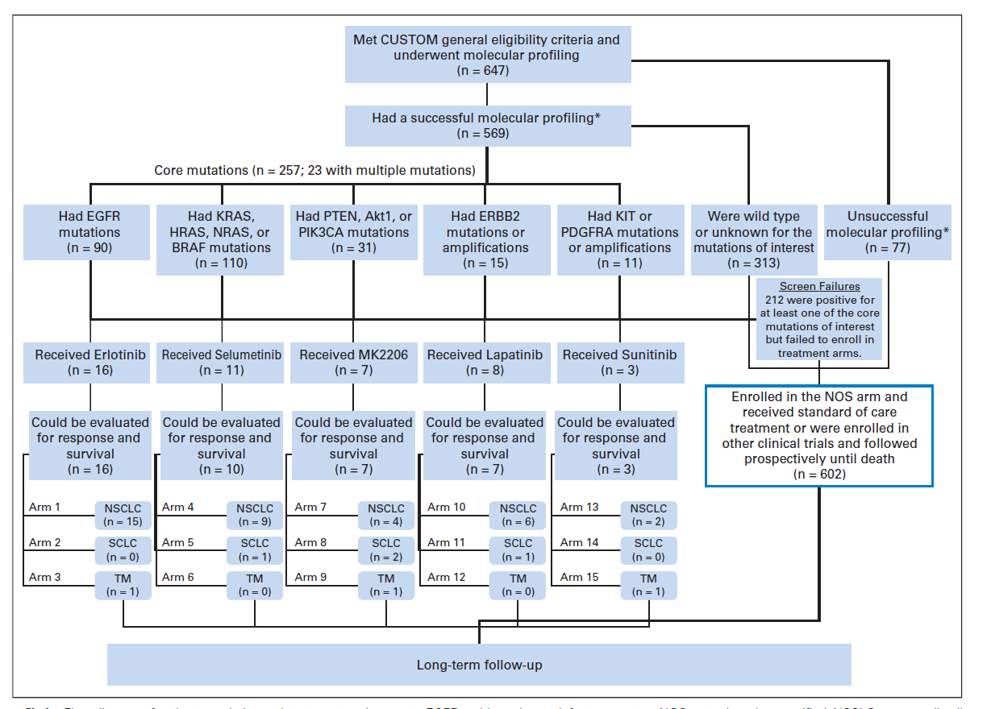
CUSTOM

Slide 27
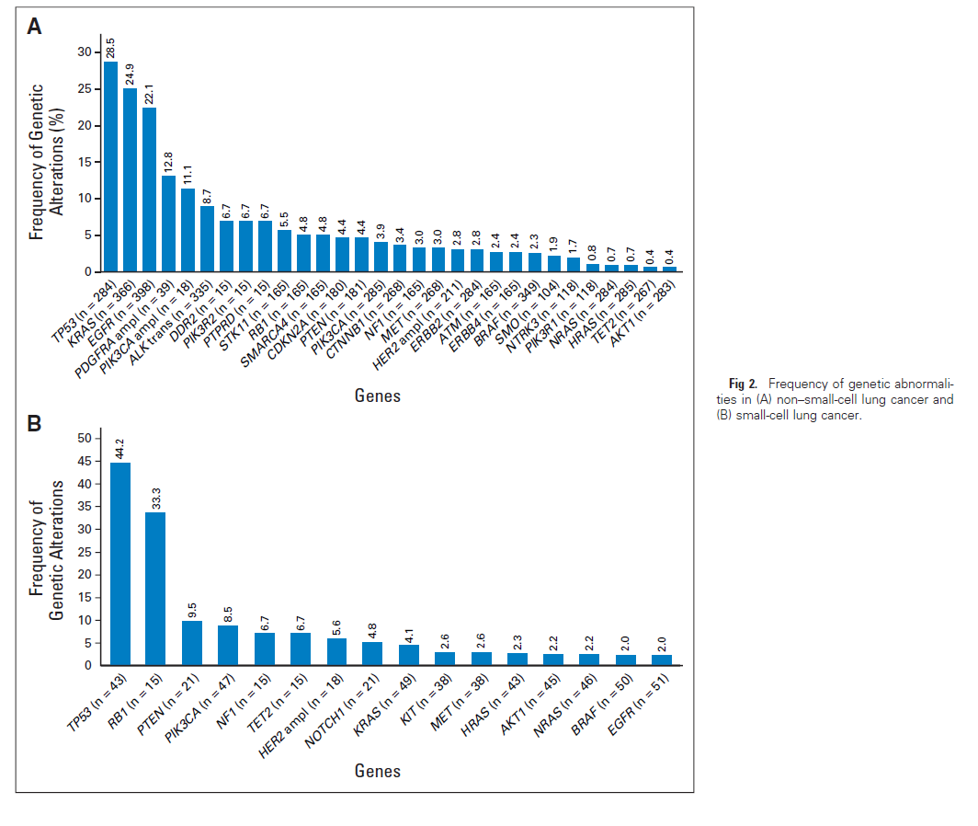

Slide 28
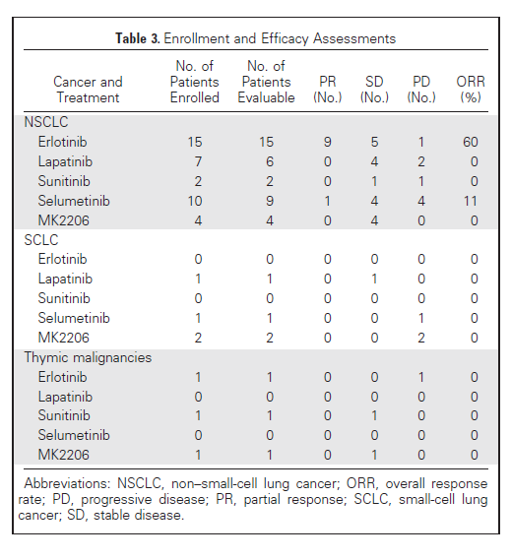

Slide 29
Strengths
Ability to identify favorable response to targeted therapy with small N and validate target
Only 15 pts on NSCLC with EGFR mutation enrolled, yet significant results (60% ORR).
(However, Arm closed early: overwhelming evidence of efficacy of erlotinib)
Proof-of-principle validation of putative target

Slide 30
Other basket trials
NCI-MATCH:
Plans to screen 3000 pts with enrollment of at last 1000 pts for targeted drug combinations. Independent of histology. Launching in early 2015.
Expected to have 20 different treatments, 20 pharma companies, and as many as 2400 sites.
NCI-IMPACT:
Randomly assigns pts with a mutation in specific genetic pathway to either targeted therapy for pathway or treatment not known to be pathway specific (NCT0182784)

Slide 31
Basket Trial Success
Success depends on strength of data linking target and targeted therapy
Two key conditions:
Tumor must depend on pathway
Targeted therapy must be able to reliably inhibit the target
More complex than it sounds?
Example: in CUSTOM, selumetinib as monotherapy did not work.
But docetaxel +selumetinib was active in a phase II study in 2013 in pts with KRAS mutations

Slide 32
Future and challenges with Basket trials
As NGS develops, basket trials MAY be more nuanced (e.g. multiple mutations dictate assignment).
Feasibility of accrual
CUSTOM only succeeded in accruing to two of 15 arms. (trial open for 22 months)
Low incidence of mutations and some rare cancers
Maybe should have been open to more types (i.e. independent of histology).

Slide 33
Future and challenges with Basket trials
Pathology does matter in many settings
The context in which tumor develops can affect developing mutations
E.g. V600E BRAF-mutant melanoma sensitive to BRAF inhibition, but colon cancers with same mutation are not.
Enthusiasm for genetics should not push histology “out of the basket”

Slide 34
Future and challenges with Basket trials
Statistics!
Ensuring screening strategies reflect expected genetic mutation frequencies is a crucial component
Use of multiple comparators, multiplicity testing (i.e., inflated type I error due to many hypothesis tests).
See NCI-MATCH. Thoughtful statistical design needed!

Slide 35
Related study
Exceptional Responders Pilot Study: Molecular Profiling of Tumors from Cancer Patients who are Exceptional Responders (NCT02243592)
PRIMARY OBJECTIVES:
I. To identify molecular indicators in malignant tissues from patients who were exceptional responders on clinical trials or treatments using whole exome and/or targeted deep sequencing as well as potentially other sequencing, and other molecular characterization methods (if adequate tissue exists).
II. To explore associations between the identified molecular indicators and the putative mechanism of action of the treatment received by the patient.
III. To test the feasibility of identifying "exceptional responders", obtaining the relevant tumor and normal tissue and clinical data, and performing whole exome and/or targeted deep sequencing on these samples.

