Slide 1

Patient-Reported Outcomes
Katherine Regan Sterba, PhD, MPH
Medical University of South Carolina
Tuesday February 10, 2015

Slide 2

Objectives
To describe the growing movement of patient-reported outcomes measurement in cancer research.
To highlight the specialized nature of patient-reported outcomes in head and neck cancer.
To use examples of head and neck cancer survivorship research projects to highlight challenges, lessons learned and opportunities in assessing patient-reported outcomes.

Slide 3

PROMs?
What is a
Patient-Reported Outcome?
PROs?

Slide 4

Patient Reported Outcomes as Fundamental to Research
Direct reports by patients about their health status, symptoms, functional status, satisfaction with health care
National movement for development of quality measures
Patient involvement in item generation is essential to content validity
http://www.nihpromis.org/
Patrick et al, 2008 (Cochrane Patient Reported Outcomes Methods Group)

Slide 5

Measurement Challenges
When a research field uses varied instruments, it is difficult to make conclusions across studies!
Must consider both the psychometric properties of instruments and burden to respondents.

Slide 6
National Focus on PROs:
US Food & Drug Administration
Why use PROs as endpoints in clinical trials:
  Some treatment effects known only to the patient
  Formal assessment more reliable than informal
FDA Statement (2006):
  “During the planning of clinical development programs, the FDA encourages sponsors to specify what claims they seek, determine what concepts underlie those claims, and then determine whether an adequate PRO instrument exists to assess and measure those concepts. If it doesn’t, a new PRO instrument can be developed.”
http://www.fda.gov/downloads/Drugs/GuidanceComplianceRegulatoryInformation/Guidances/UCM193282.pdf (2009)

Slide 7
National Focus on PROs: NIH
Part of the NIH “roadmap for medical research in the 21st century” to accelerate medical research by pooling national resources
Multi-center cooperative group initiative – 2002 Patient-Reported Outcomes Measurement Information System (PROMIS)
Focus on pain, fatigue, emotional distress, physical functioning, and social-role participation
Model methods for measure development
http://www.nihpromis.org/

Slide 8
NIH PROMIS Background
To push for consensus and shared use of high-quality instruments in our research
To adequately assess the concept of quality of life, a critical outcome not accounted for in clinical measures
To quantify how people feel and function, assess burden of disease in research and facilitate clinical practice and patient management

Slide 9
NIH PROMIS: 3 Components
Develop measure development standards.
Disseminate libraries of PRO measures of health in multiple languages, for adults and children (with a variety of health statuses).
Provide access to PRO measures through the "Assessment Center".
https://www.assessmentcenter.net/
https://www.assessmentcenter.net/documents/InstrumentLibrary.pdf

Slide 10
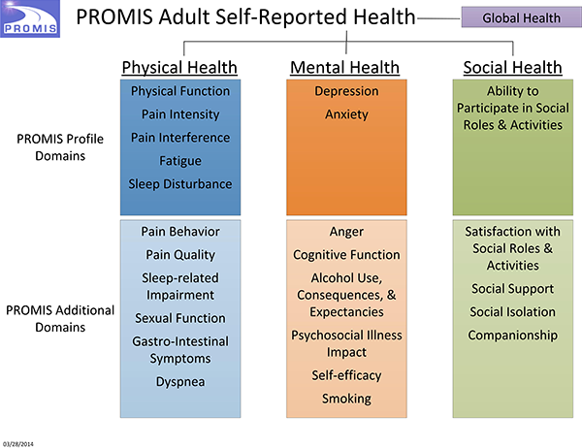
Domain Framework
http://www.nihpromis.org/measures/domainframework1#com

Slide 11
Intervention Research Continuum:
Focus on Head & Neck Cancer
Content Validity
Construct Validity
Predictive Validity
Understand factors that influence outcomes & identify high-risk groups
Characterize challenges facing head and neck cancer survivors
Develop interventions to promote optimal health and well-being
Evaluate, refine & disseminate
intervention
MEASUREMENT
Clinical/Psychosocial
Factors
Implementation/
Process Factors
Short/Long-Term Outcomes

Slide 12
Pinpointing Patient-Reported Outcomes for Study
Carefully define constructs of interest (what you want to measure).
Consider theory.
Think about unique patient characteristics/timeline of illness.
Use of qualitative methods is critical to confirm meaning of items used.
PROMIS.org

Slide 13
Guiding Conceptual Framework
Physical Well-Being
Physical Functioning
Symptoms
Clinical Factors
Activities of Daily Living
Psychological Well-Being
Emotions
Control / Uncertainty
Hope / Optimism
Expectations
Quality
of Life
Spiritual Well-Being
Meaning of Illness
Faith-based Coping Strategies
Global Guidance
Inner Strength
Social Well-Being
Finances/Work
Support
Communication
Roles
Relationships (health care providers and family/friends)
*adapted from the 2005 IOM report on Cancer Survivorship (Hewitt, et al)

Slide 14
Special considerations for patient-reported outcomes in head and neck cancer
Symptoms (speech, nutrition, dental, swallowing)
Intensive follow-up care schedule with multiple specialists
Smoking/tobacco use
Self image and appearance
Relationships and social functioning
Employment concerns
End of life preparation
Rogers et al., 2007; Murphy et al., 2007; Pusic et al., 2007

Slide 15
Selecting Measures
Systematic search of published instruments to examine available tools and evaluate fit
Examine properties of existing scales (validity and reliability)
Evaluate suitability of existing measures; contact other researchers if necessary
If existing instruments do not meet needs, consider adapting items (must test the properties of the adapted instrument to assure suitability)
Lastly, develop a new instrument (this is very resource-intensive!)
DeVellis, 2006

Slide 16

Understand factors that influence outcomes & identify high-risk groups
Characterize challenges facing head and neck cancer survivors
Develop interventions to promote optimal health and well-being
Evaluate, refine & disseminate
intervention
Funded By:
  Hollings Cancer Center seed funding, Medical University of South Carolina
  American Cancer Society Mentored Research Scholar Grant MRSG-12-221-01-CPPB

Slide 17

Study Methods
Study Design
  Ongoing pilot study at Hollings Cancer Center
Study Sample
  Newly diagnosed head and neck cancer patients
  Nominated primary caregivers
Data Collection
  Participants completed interviews within 1 month of definitive diagnosis and follow-up surveys every 6 months for 2 years
  Clinical data collected from medical chart

Slide 18
Measure Selection: Broad Examination of Patient-Caregiver Experiences
Health-related quality of life, depression, fear of recurrence
Social support
Illness beliefs
Patient symptoms
Caregiver burden
Satisfaction with treatment decisions
Clinical factors (chart review)

Slide 19
Participant Characteristics
 | Patients (n=84) | Caregivers (n=86)
Age (M, range) | 60 years (32-81) | M=57 years (29-80)
Gender | 73% Male | 23% Male
Race | 83% Caucasian | 83% Caucasian
Education HS or less Some college College grad/more | 38% 28% 34% | 36% 30% 34%
Diagnosis Oral cavity Pharynx Larynx Other | 39% 24% 14% 23% | n/a
Stage I-III IV | 47% 53% | n/a
Smoking Status Never Former Current/recent | 25% 24% 51% | 46% 28% 25%
Relationship Type Partner Sibling Child Parent | 51% 14% 15% 8%

Slide 20
Creative Data Collection Strategies May Be Needed for Head & Neck Cancer

Slide 21
Concerns 6 Months Post-Diagnosis (N=65)
> 50% report significant problems with:
  Dry mouth, sticky saliva, use of pain killers
  Worry about finances and burden on family
> 30% report:
  Use of a feeding tube, recent weight loss
  Pain/soreness in mouth/jaw, trouble swallowing
  Being bothered by appearance
  Worry about dying
Daily Behaviors:
  41% report routine drinking (and 37% of these report binge drinking)
  24% of patients report current daily smoking
(Bjordal et al, 1999 (EORTC); BRFSS 2010)

Slide 22
Patient and Caregiver
Unmet Needs at 6 Months (N=65 dyads)
(CaSUN and CaSPUN instruments, Hodgkinson et al., 2007)

Slide 23
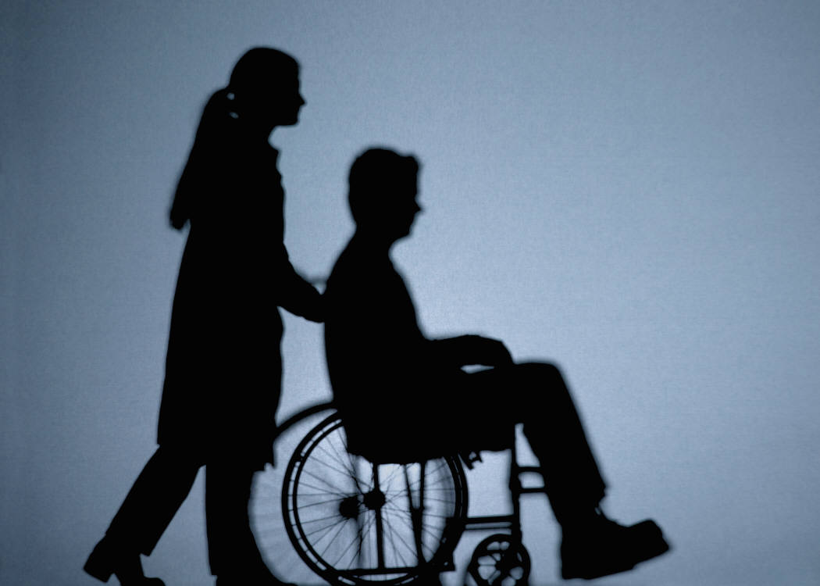
“Is There Anything About Your Treatment You Wish You Had Known Before?”
Everything…I am so uncomfortable and sick…
How uncomfortable the muscle flap in my mouth would be…
That I would lose my taste buds!!
I didn't have an understanding of side effects. I didn't understand things that they said were 'normal’…
I wish I was told more about radiation. I was laying there and thought it would hurt. It didn’t hurt.

Slide 24
Given these complex clinical experiences…how do we ask questions that adequately tap these experiences?
multi-specialist care and communication challenges
Health Care Organization
Interpersonal
unique caregiving tasks in head and neck cancer
Intrapersonal
distinct symptoms, physical/emotional concerns and health behaviors
(Rogers et al., 2007; Pusic et al., 2007; Murphy et al., 2007)

Slide 25
Exploring Causal Attributions in Head and Neck Cancer Patients and Their Caregivers

Slide 26
Background
Individuals use their causal attributions to find meaning in or gain control over their cancer.
Self-blaming attributions can be maladaptive and especially important in head and neck cancer.
Illness self-blame is associated with worse physical/social functioning in head and neck cancer.
Caregivers’ causal attributions may be important to support provision and coping.
(Scharloo et al., 2010)

Slide 27
Specific Aims
To describe and compare causal attributions in head and neck cancer patients and their primary caregivers.
To explore relationships between degree of patient blame and psychosocial and support factors in patients and caregivers.

Slide 28
Measurement Challenges:
Assessing Causal Beliefs
Illness Perception Questionnaire-Revised:
  We are interested in your beliefs about what caused your cancer. Please read the list below and check the boxes to indicate whether you believe each was a cause of your cancer…
    --heredity --aging
    --stress or worry --alcohol drinking
    --a germ or virus --smoking
    --diet or eating habits --poor medical care
(Moss-Morris et al., 2002)

Slide 29
Another Way to Assess Causal Beliefs
We asked participants (patients and caregivers) to describe in their own words, up to 3 factors they believed caused the patients’ cancer.
Factors were coded by 2 independent reviewers by type and degree of blame.

Slide 30
Causal Beliefs Reported
Expected Responses
  “Smoking” and “Years of drinking”
Not-So-Expected Responses
  “Too many pork rinds cutting side of mouth”
  “Siphoning out water from my swimming pool with a garden hose by mouth”
  “Too much singing”
  “Family problems with my children”
  “Mold and fungus caused me to have acid reflux erosion”

Slide 31
Causal Attribution Coding
Type (categorized reported beliefs using known/hypothesized risk factors and additional categories to capture other reported causes)
Degree of Patient Blame
  1 = No Blame (factors external to patient control)
  2 = Partial Blame (at least one factor within patient control and one factor external to patient control)
  3 = Full Blame (lifestyle/behavioral/modifiable factors)

Slide 32
Study Dependent Variables
Dependent Variable: | Instrument: | Completed By: | Citation:
Depression | CES-D | Patients/Caregivers | Radloff, 1977
Fear of Recurrence | Assessment of Survivor Concerns | Patients/Caregivers | Gotay & Pagano, 2007
Perceptions of Social Support | Social Provisions Scale | Patients | Cutrona, 1987
Caregiver Burden | Caregiver Reaction Assessment | Caregivers | Given et al., 1997

Slide 33
Measurement Challenges:
Social Support
Cutrona’s Social Provision Scale (1987)
  Instrument assessing support in 5 areas: guidance, attachment, nurturance, reliable alliance, and social integration
  Demonstrated poor functioning in our patient-caregiver dyads
    Several subscales had Cronbach’s alphas <0.60
Oh no!! What do we do now? Why did this happen?

Slide 34
Unique/Specialized Support
Behaviors in Head & Neck Cancer
“I love my brother but he is an alcoholic so it is difficult to support him…”
“I use the food processor to break up his food…”
“She helps me financially…”
“I care for his wound…”
“He helps me a lot and tells me to pray and read the Bible…”

Slide 35
Data Analysis
Descriptive statistics
Examined relationships among causal attributions and psychosocial and support factors using linear regression
  Controlled for clinical (cancer site and stage) and sociodemographic (race, age, gender, relationship type/length variables) factors

Slide 36
Participant Characteristics
 | Patients (n=47) | Caregivers (n=43)
Age (M, range) | 59 years (32-88) | M=58 years (29-80)
Gender | 77% male | 80% female
Race | 82% Caucasian | 85% Caucasian
Education HS or less Some college College grad/more | 36% 31% 33% | 31% 26% 43%
Diagnosis Oral cavity Pharynx Larynx Other | 34% 23% 19% 23% | n/a
Stage I-III IV | 47% 53% | n/a
Relationship Type | 51% Partnered

Slide 37
Patient and Caregiver Causal Attributions
Number of attributions:
  M = 1.7 for patients
  M = 1.5 for caregivers
(range 1-3)

Slide 38
Degree of Blame in Causal Attributions for Patients and Caregivers

Slide 39
Degree of Blame and Patient and Caregiver Psychosocial and Support Factors
Dependent Variable | Model | B | SE | p | R² Model
Fear of Recurrence | Patient | .38 | .14 | .01 | .45
 | Caregiver | -.004 | .11 | .96 | .35
Depression | Patient | 1.48 | 1.51 | .33 | .15
 | Caregiver | 1.36 | 1.21 | .27 | .09
Patient Perceptions of Support (attachment) | Caregiver | -.10 | .13 | .43 | .20
Caregiver Burden | Caregiver | .52 | .24 | .04 | .39
Note: All models controlled for cancer stage, and patient and caregiver depression (except in depression models), age, and gender.

Slide 40
Causal Attribution Concordance in Patient-Caregiver Dyads (N=40)
Percent

Slide 41
Conclusions
Patients and caregivers had similar beliefs about head and neck cancer causes:
  A wide variety of causes (~12) were reported.
  Tobacco was most commonly cited but only ~half of participants endorsed this cause and other known risk factors were not cited.
Within dyads, ~half of patients and caregivers shared at least one causal belief.
Blaming the patient was associated with higher recurrence fears in patients and higher burden in caregivers.

Slide 42
Study Considerations & Future Directions
This study was exploratory
  Cross-sectional study design/small sample size
  Future studies should examine causal attributions in clinical context and take advantage of more sophisticated dyadic data analysis techniques
Measurement implications
  Unique causal attributions in head and neck
  Consider developing new instruments to assess support behaviors in head and neck cancer
  Beneficial to use a mixed methods approach in this exploratory research

Slide 43
Health Behaviors &
Quality of Life Study
Funded by:
Hollings Cancer Center and Wake Forest University Comprehensive Cancer Center

Slide 44
Background
Growing evidence demonstrates that tobacco use after a head and neck cancer diagnosis is associated with poor outcomes
  decreased survival/increased recurrence risk
  interference with treatment
  diminished quality of life
A cancer diagnosis offers a “teachable moment” for smokers
More research needed to design patient-centered smoking cessation interventions
http://www.cancer.gov/cancertopics/pdq/supportivecare/smokingcessation
Gritz et al., 1993; Duffy et al., 2006; Schnoll et al., 2005

Slide 45
Health Behaviors &
Quality of Life Study
  Study Aims
    To describe smoking status in surgical head and neck cancer patients.
    To examine relationships between smoking status and sociodemographic factors and symptoms at clinic presentation.
    To characterize motivation, barriers to quitting and intervention preferences in surgical patients who use tobacco.

Slide 46
Methods
Study Sample
  Individuals scheduled for a major surgery with new or recurrent squamous cell carcinoma of the upper aerodigestive tract (N=104) were recruited at the Hollings and Wake Forest Cancer Centers.
Data Collection
  Participants completed questionnaires before surgery.
  Urine samples were collected the morning of surgery to assess cotinine level.

Slide 47
Measures
Health Behaviors
  Smoking status (self report and cotinine level)
  Diet, alcohol use, physical activity
Symptoms
  Depressive symptoms (CES-D)
  Head and neck cancer-specific symptoms (EORTC)
Quit intentions, barriers, preferences
Sociodemographic and clinical factors

Slide 48
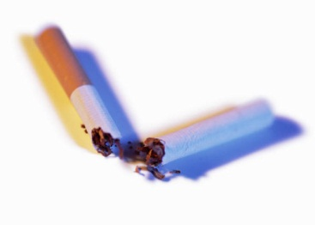

Measurement Challenges:
Health Behaviors
Smoking status and quit attempts
  How many quit attempts have you made since you were diagnosed with cancer?
    “None, but I can’t smoke because I have a trach…”
Fruit and vegetable intake
  How many servings of fruits and/or vegetables do you eat in a typical week?
    “I am on a liquid diet but sometimes have the fruit flavors…”

Slide 49
Measurement Challenges: Symptoms
During the past week, have you had problems with your teeth?
  “I do not have teeth…”
During the past week, have you had problems with your sense of taste?
  “Um, not really but I am on a liquid diet…”
During the past week, have you had problems swallowing solid food?
  “I have a feeding tube…”
EORTC: Aaronson et al., 1993 Bjordal et al, 1999

Slide 50
Data Analysis
Participants categorized as:
  Never smokers
  Former smokers (quit >6 months prior)
  Current/recent smokers (quit <6 months prior)
Differences by smoking status group examined using ANOVA/Fisher’s exact tests.
Linear regression models used to examine relationships between smoking status and symptoms.
Descriptive statistics used to characterize intervention preferences.

Slide 51
Participant Characteristics (N = 104)
Age | M=59 years (24-84)
Gender | 27.9% female
Race | 84% Caucasian
Education High school or less Some college College graduate/more | 49% 19% 32%
Diagnosis Oral cavity Pharynx Larynx Other | 42% 29% 23% 6%
Diagnosis type | 45% recurrent
Stage | 23% I-II 19% III 49% IVA 6% IVB 3% IVC

Slide 52
Tobacco Use Characteristics
Smoking status at diagnosis
  Never smokers = 23 (22%)
  Former smokers = 39 (38%)
  Current/recent smokers = 42 (40%)
Smoking status the morning of surgery
  25.9% positive for tobacco use when assessed by self-report
  41.1% positive for tobacco use when assessed by cotinine
Characteristic | N=28 current smokers
Years Smoked | M = 41.5 years (SD = 8.6)
Number of Daily Cigarettes | M = 14 (SD = 12)
Use of other tobacco products | 19%
Quit Attempt in Past Year (% yes) | 46%
Another Smoker in Household (% yes) | 64%

Slide 53
Smoking Status & Sociodemographic Characteristics
Smoking Status | Recent/ Current n=42 | Former n=39 | Never n=23 | p value*
Age (mean) | 57.9 | 61.8 | 57.4 | .17
Race (% non-White) | 26.2 | 10.3 | 13.0 | .16
Gender (% female) | 33.3 | 20.5 | 30.4 | .46
Education (% <high school) | 53.7 | 51.3 | 36.4 | .42
Marital status (% partnered) | 54.8 | 79.5 | 73.9 | .048
Health insurance (% private) | 38.1 | 64.1 | 73.9 | .02
Adequate finances to meet monthly expenses (% No) | 47.5 | 10.8 | 21.7 | .001
* ANOVA or Fisher’s Exact

Slide 54
Symptoms by Smoking Status
*
*
*
*
* p < .05

Slide 55
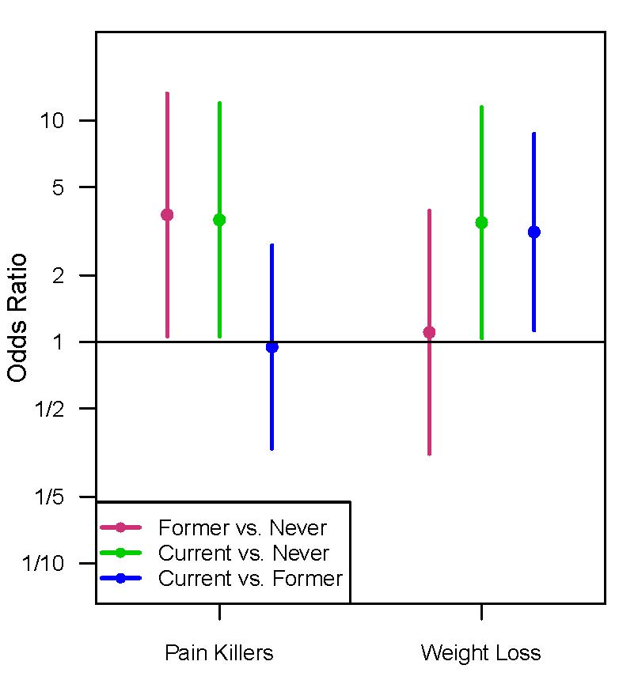
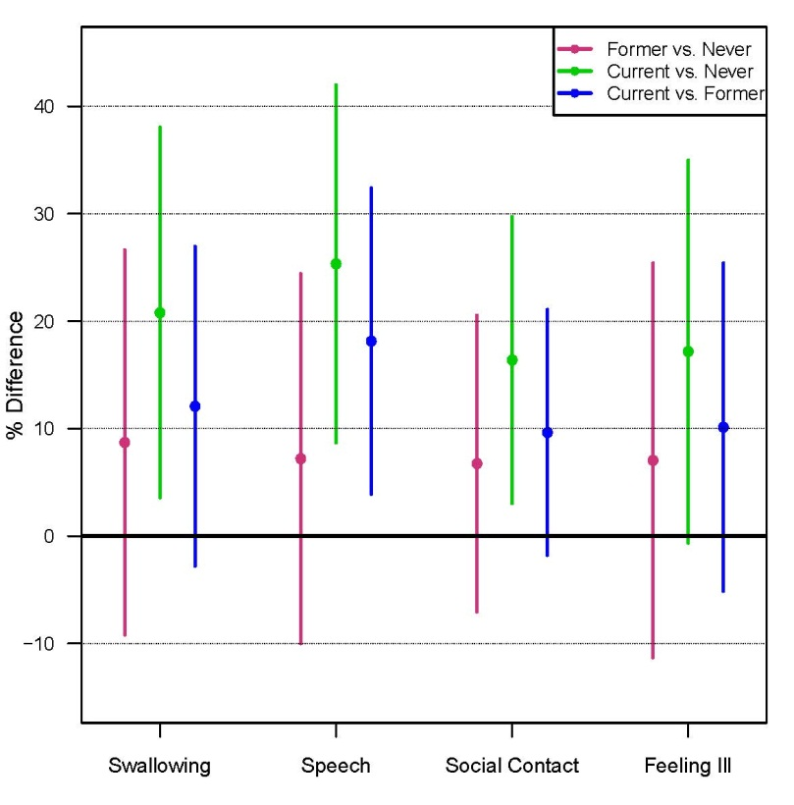
Adjusted Regression Models:
Smoking Status and Symptoms
All models controlled for age, race, education and cancer stage.

Slide 56
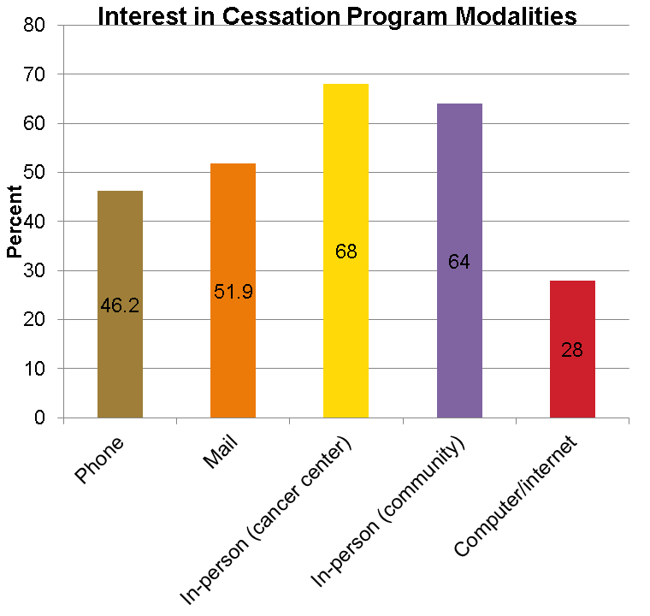
Intervention Preferences (N=28)
80.8% reported interest in participating in a smoking cessation program
32% used NRT during last quit attempt, 18% used counseling
Smokers had high intentions to quit in next month (70.4% very definitely yes)

Slide 57
Conclusions
Self-report failed to identify a significant number of smokers the morning of surgery.
Current/recent smoking head and neck cancer patients:
  Had the highest symptom burden compared to former and never smokers at clinic presentation.
  Had more financial and social challenges.
Smokers endorsed multiple barriers to quitting but were interested in in-person cessation interventions.

Slide 58
Study Considerations & Future Directions
Strengths and Limitations
  Diverse sample / validated instruments
  Cross-sectional design / limited sample size
Measurement Implications
  Assessment of health behaviors & symptoms must account for functional challenges
  Accurate measurement of tobacco use
  Coding and training issues are critical

Slide 59
Patient-Reported Outcomes in Head and Neck Cancer
Characterize key patient experiences after treatment
Use mixed methods to adapt existing and/or create new instruments
Test instruments in diverse head and neck cancer populations
Revise and re-evaluate as needed to achieve consensus
http://www.nihpromis.org/
Scale Development (DeVellis 2011)
Psychometric Theory (Nunnally 1994)

Slide 60
Acknowledgements
MUSC Co-Investigators
  Jane Zapka, ScD
  Terry Day, MD
  Anthony Alberg, PhD, MPH
  Matthew Carpenter, PhD
  Elizabeth Garrett-Mayer, PhD
  Keisuke Shirai, MD
  Kent Armeson, MS
Wake Forest Co-Investigators
  Kathryn Weaver, PhD
  Christopher Sullivan, MD
  Jeanne Hatcher, MD
  Janet Tooze, PhD
Funding
  Hollings Cancer Center
  American Cancer Society Mentored Research Scholar Grant MRSG-12-221-01-CPPB
Database Support
  REDCap SCTR Biomedical Informatics Services NIH/NCATS UL1TR000062

