Slide 1
Improving Phase II Designs: Increasing phase III success
Methods in Clinical Cancer Research
Feb 6, 2015

Slide 2
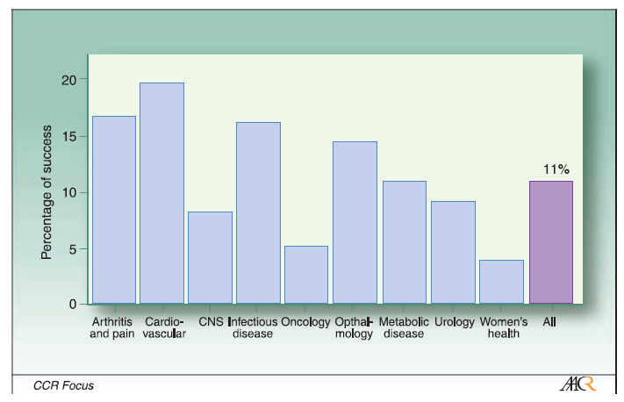
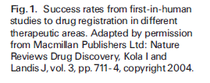
Failing in Phase III
Large number of negative Phase III trials.
Adjei , Christian, Ivy. Clinical Cancer Research, 2009.

Slide 3
Changes need to be made
The number of agents available for testing dictates that a more efficient system aimed at quickly and accurately identifying promising agents for phase III testing be developed.
This will allow investigators to efficiently discard nonefficacious agents and devote time to the development of the more promising agents, thus conserving financial and human resources.
A barrier to achieving this goal is the lack of good surrogates of true patient benefit, which in oncology is improvement in overall survival. Possible surrogates:
imaging biomarkers
biochemical, genetic, or molecular biology biomarkers,
Novel approaches to phase II study design need to be tested

Slide 4
Alternate endpoints
Phase II endpoint needs to be a good surrogate for the phase II endpoint
Example : Response rate?
Accumulating evidence suggests that the effect of novel agents inhibiting angiogenic and proliferative signaling, among others, may not be accurately captured by traditional radiographic evaluation.
Sorafenib: in the treatment of hepatocellular carcinoma. Sorafenib showed a doubling of the time-to-progression rate compared with a placebo, with an objective response rate of 2% (1).
Promising area: imaging using innovative analysis approaches.
Validation of endpoints is not trivial.

Slide 5
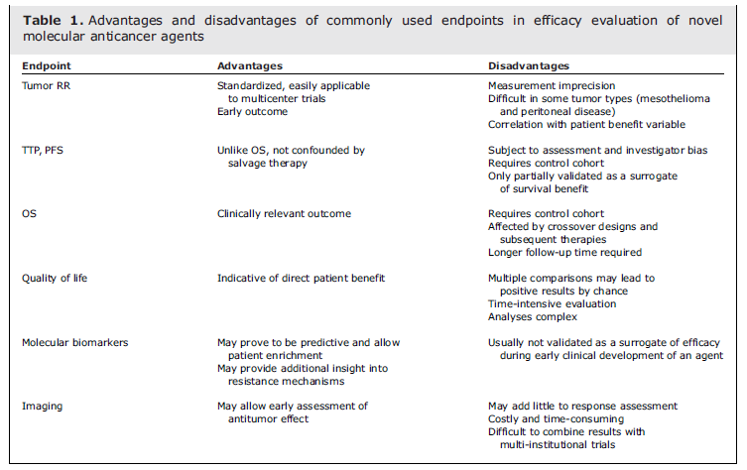
Common Phase II endpoints
Dhani et al. Clinical Cancer Research, 2009.

Slide 6
Improving predictive power
Randomized phase II studies.
Standard randomized Phase II (with SOC as reference).
Randomized discontinuation design.

Slide 7
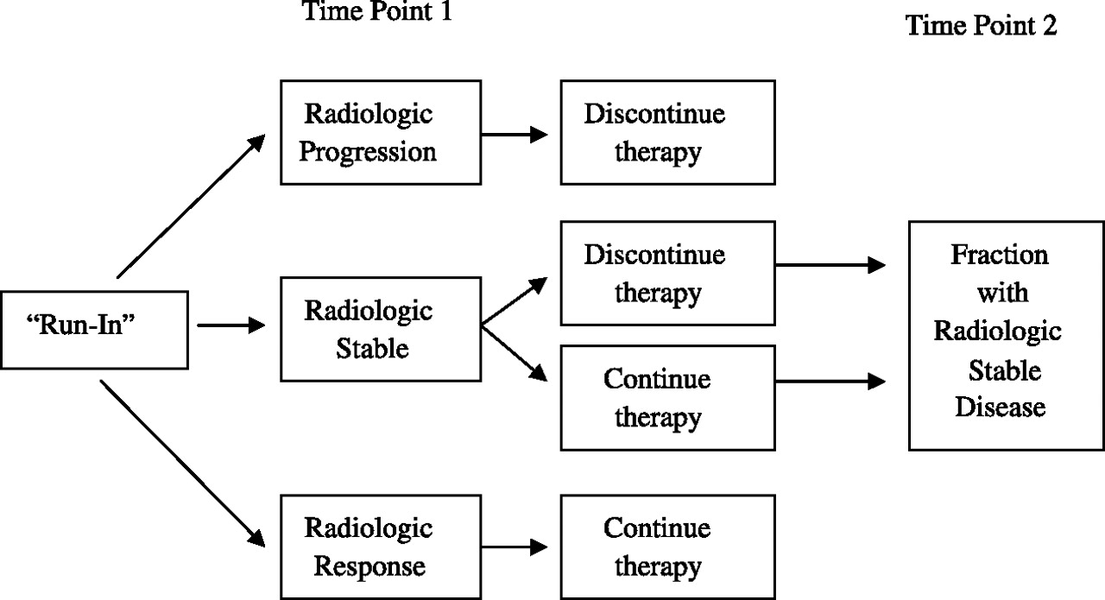

Generalized schema for a randomized discontinuation trial design.
Stadler W M Mol Cancer Ther 2007;6:1180-1185
©2007 by American Association for Cancer Research

Slide 8
What else?
FDG-PET and other functional imaging
Biomarkers: promise and challenge

Slide 9
Accrual
Complex, poorly designed studies, increasingly complicated regulatory policies, and financial hardship (lack of adequate funding and insurance coverage) are seen as some of the key barriers to clinical trial participation.
Clinicians and statisticians need to remember the challenge of poor accrual and ensure that novel phase II clinical trial designs do not include unnecessarily complex study-related procedures for patients because this could lead to poor accrual, resulting in the study question never being

Slide 10
Dose
Finding the appropriate dose and schedule for anticancer agents for testing in phase II studies can be problematic.
It may be misguided to use a recommended phase II dose determined in very few patients to a larger and more variable patient population in phase II and subsequent phase III trials.
An inappropriately low dose of an agent can contribute to negative phase III studies.
Gefitinib
Enzastaurin
vatalanib .
The issue of selecting the appropriate agents for phase II testing is particularly relevant with the current novel agents in testing, which happen to be mostly oral agents.
It is difficult to determine the delivered dose with these agents because heterogeneity of transport proteins and metabolic enzymes affect drug exposure.
To overcome these problems, rigorous dose-finding studies have to be undertaken after the initial determination of the maximum tolerated dose.
At least two dose levels should be tested with associated pharmacokinetic studies to help identify the appropriate dose.
Treating suitably sized patient population in this setting can give additional information about biomarkers, thus providing information on the relationship between dose and pharmacokinetic-pharmacodynamic markers.
phase II dose-selection designs are relatively common in other areas of medicine such as cardiovascular, endocrine, and infectious diseases.

Slide 11
Future class
Biomarker based phase II studies

