Slide 1
Phase I trials: A New era in OnCology drug development
Jan 22, 2015
Methods in Clinical Cancer Research

Slide 2
Expansion Cohorts
What is an expansion cohort? Generally, a cohort of patients enrolled at the MTD or RP2D after it is defined based on a small number of patients at the dose
Standard stated reasons for expansion cohorts:
To further evaluate toxicity
To evaluate PK at MTD
To evaluate efficacy
To evaluate biomarkers
Phase I/II? This implies a more rigorous design for the cohort enrolled at the RP2D.

Slide 3
Expansion Cohorts
Often a different/narrower patient population
Example 1:
Dose escalation: solid tumors
Dose expansion: renal cell carcinoma only
Example 2:
Dose escalation: all lung cancers
Dose expansion: lung cancer with a specific mutation

Slide 4
Expansion cohorts
Statisticians: we have a hard time with these in most studies.
Sample sizes are arbitrary: literature review showed between 9 and 100 patients included.
It’s often not clear how many patients will be included
There is often no description of how the data will be used
What if:
You have an expansion cohort that leads to 4 DLTS in 10 patients?
Should that still be the MTD?

Slide 5
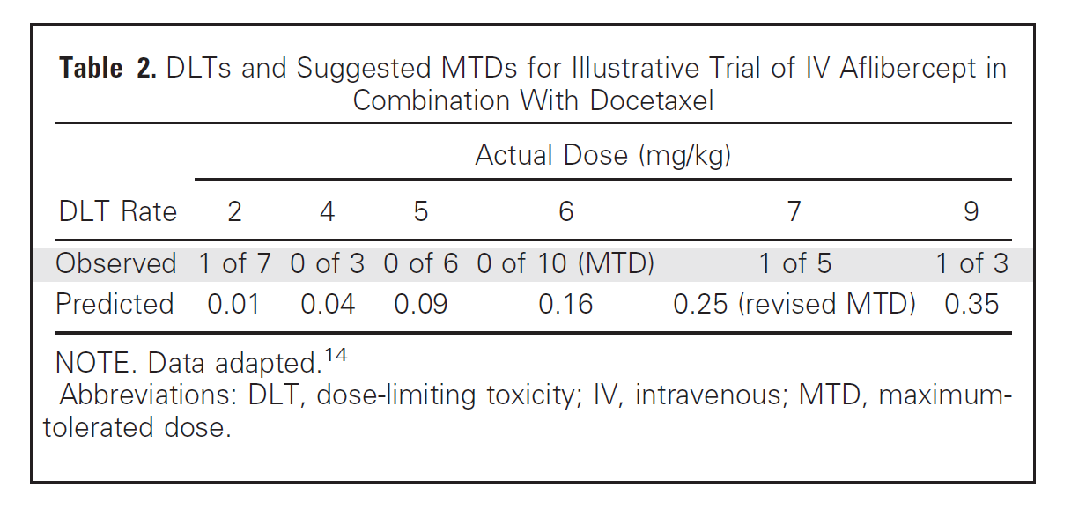
More rigorous approaches for DEC (dose expansion cohorts)
Iasonos and O’Quigley (JCO, 2013)
Option 1:
Use all of the date to revisit the appropriate level for the MTD

Slide 6
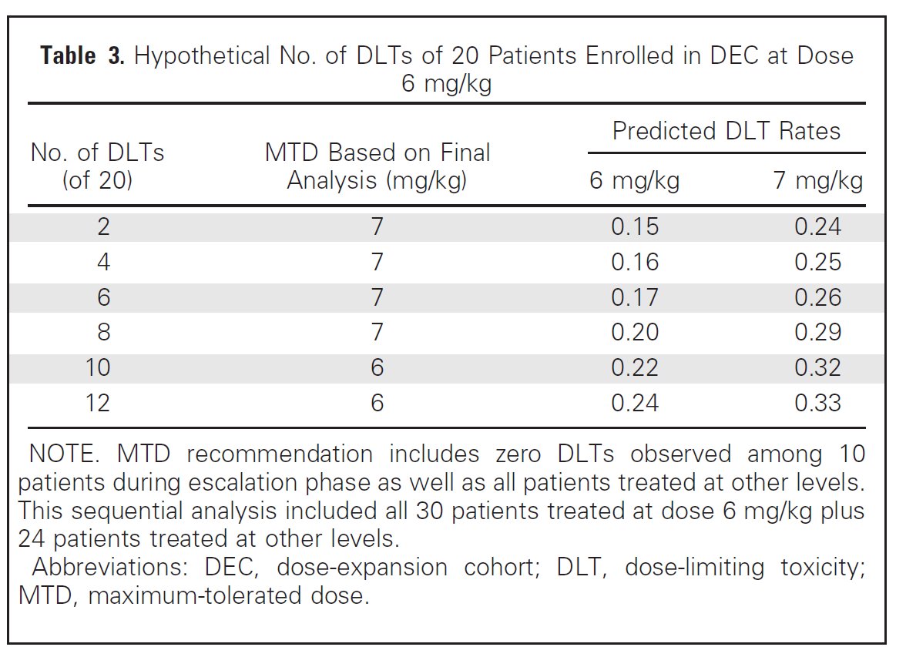
More sophisticated
Prospectively guided based on safety:
Stay at the MTD as long as it is within a safety threshold (needs to be defined).

Slide 7
Other options
Prospectively guided based on safety and efficacy
Requires a bivariate model (for both safety outcome and efficacy outcome).
Experimenting at more than one level
Consider the MTD and another (lower or higher) dose
Random assignment
Allows both efficacy and further toxicity assessment
Requires safety constraints

Slide 8
Other options
Prospectively guided based on safety and efficacy
Requires a bivariate model (for both safety outcome and efficacy outcome).
Experimenting at more than one level
Consider the MTD and another (lower or higher) dose
Random assignment
Allows both efficacy and further toxicity assessment
Requires safety constraints

Slide 9
Iasonos & Oquigley findings

Slide 10
The changing objectives in phase 1
Dana-Farber review of Phase I trials 1988 – 2012. (Dahlberg et al., 2014)

Slide 11
The changing objectives in phase 1

Slide 12
The changing objectives in phase 1

Slide 13
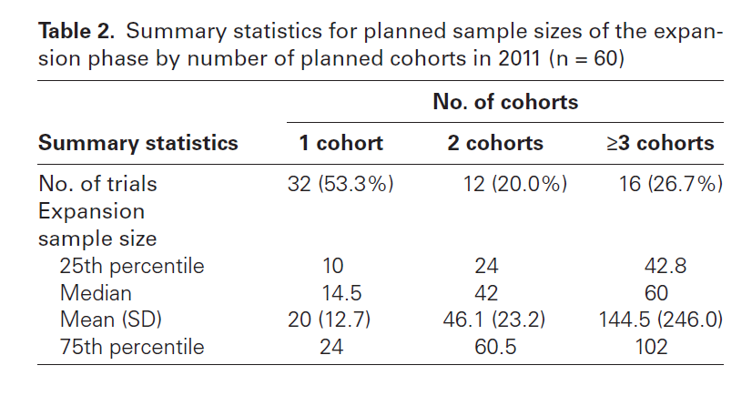
The changing objectives in phase 1

Slide 14
Issues with cohort expansions

Slide 15
Redefining the objectives
Ratain 2014; Nature Reviews Clinical Oncology
“The dogma of chemotherapy has always been to administer all drugs at the MTD, it has been recognised that such dogma would not be expected to apply to MTAs (molecularly targeted agents)”
“There is a need to redefine the criteria used for defining the recommended phase II dose, to consider not only traditional acute grade 3-4 toxic effects, but also chronic grade 1-2 adverse events (AEs).”
There is a challenge in distinguishing drug-related AEs from disease-related AEs.

Slide 16
Redefining the objectives
“The most important question is whether or not it is critical to precisely define a recommended phase II dose as part of a phase I trial. I would argue that it is finally time to model our drug development paradigms on those routinely used in other chronic diseases rather then trying to remodel our ancient oncology paradigms to fit modern oncology drugs.”
Dose-response should be an integral part of drug development
The highest tolerated dose is not always the optimal dose:
Parallel dose response,
Cross-over dose response,
Forced titration,
Optional titration

Slide 17
Redefining the objectives
“The question of optimal dose can only be addressed in randomized dose-ranging phase II studies with analysis of both efficacy and toxicity endpoints.”
These are infrequent in oncology.
Example 1:
Randomized phase II, temsirolimus in kidney cancer
3 doses: 25 mg, 75mg, 250mg.
25 mg selected as those doses appeared to be equivalent in efficacy
Example 2:
Anastrozole: 1 mg vs. 10mg were equivalent in trials.

Slide 18
Breakthrough designation
On July 9, 2012 the Food and Drug Administration Safety and Innovation Act (FDASIA) was signed which provides for a new designation of an experimental treatment - Breakthrough Therapy Designation.
A breakthrough therapy is a drug:
intended alone or in combination with one or more other drugs to treat a serious or life threatening disease or condition and
preliminary clinical evidence indicates that the drug may demonstrate substantial improvement over existing therapies on one or more clinically significant endpoints, such as substantial treatment effects observed early in clinical development.
If a drug is designated as breakthrough therapy, FDA will expedite the development and review of such drug. All requests for breakthrough therapy designation will be reviewed within 60 days of receipt, and FDA will either grant or deny the request.

Slide 19
Redefining the objectives
With Breakthrough designation, there have been recent attempts to use focused phase I trials as a basis for accelerated approval.
Example: Ceritinib
ALK-rearranged lung cancer
Received accelerated approval in April 2014 based on phase I data.
“Although there is indisputable activity of ceritinib at the approved dose of 750mg, there is also significant uncertainty regarding optimal dose and prandial conditions for administrations.”
FDA has mandated post-market testing which may require a re-labeling (i.e. different dose) and change in administration instructions.

Slide 20
Redefining the objectives
What should we expect to conclude about dosing as a result of a phase I study?
Qualtitative toxicity
Dose and AUC in relation to acute toxic effects
Full understanding of PK
Less focus on imaging, biopsies, etc.
Phase II trials should include two or more doses (or schedules), as is commonly done with MTAs in other areas.
Phase I should focus on defining a RANGE of phase II doses rather than a single RP2D.

Slide 21
Recent example: Nivolumumab
From FDA press release:
The FDA granted Opvido breakthrough therapy designation, priority review and orphan product designation because the sponsor demonstrated through preliminary clinical evidence that the drug may offer a substantial improvement over available therapies; the drug had the potential, at the time of the application was submitted, to be a significant improvement in safety or effectiveness in the treatment of a serious condition; and the drug is intended to treat a rare disease, respectively.
Opvido is being approved under the FDA’s accelerated approval program, which allows approval of a drug to treat a serious or life threatening disease based on clinical data showing the drug has an effect on a surrogate endpoint reasonably likely to predict clinical benefit to patients. This program provides earlier patient access to promising new drugs while the company conducts additional clinical trials to confirm the drug’s benefit.
Opdivo’s efficacy was demonstrated in 120 clinical trial participants with unresectable or metastatic melanoma. Results showed that 32 percent of participants receiving Opdivo had their tumors shrink (objective response rate). This effect lasted for more than six months in approximately one-third of the participants who experienced tumor shrinkage.

Slide 22
Recent Example: Nivolumumab
Protocol, version 1: 23 July 2008
3 dose levels. 1, 3, 10 mg/kg. 3+3 design (N = 12)
FOUR dose expansion cohorts with up to 16 pts per cohorts
Maximum N=76
Protocol, version 5: 23 Jan 2012
Doses 0.1 mg/kg and 0.3 mg/kg added as part of Amendment 4. “Did not impact the dose escalation plan or schedule”
Up to 14 expansion cohorts, enrollment to 7 expansion cohorts already completed.

Slide 23
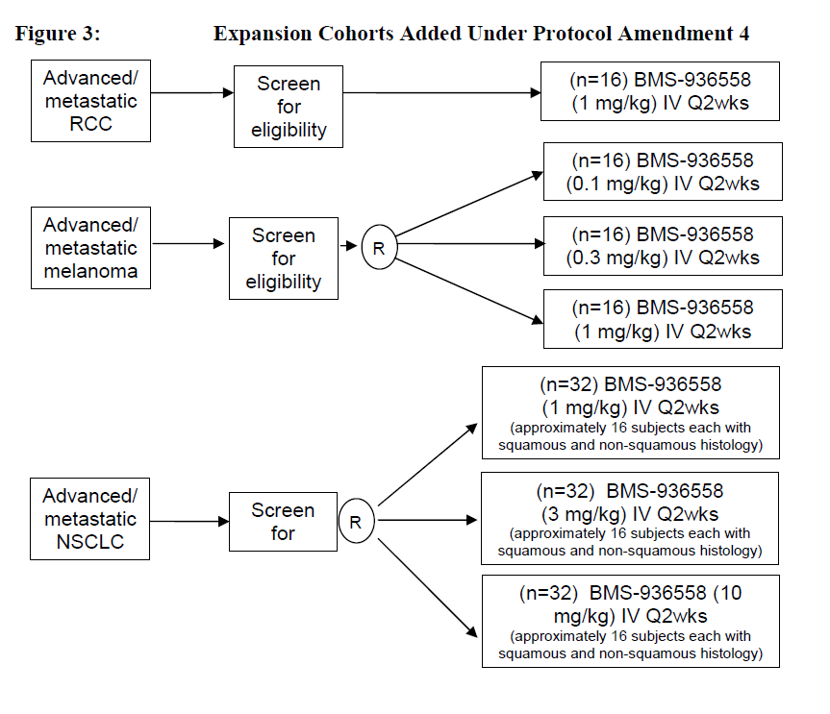
Expansion Cohorts
Table 4: Expansion Cohorts Completed Prior to Amendment 4
Melanoma 1 mg/kg
Melanoma 3 mg/kg
Melanoma 10 mg/kg
Renal Cell Carcinoma 10 mg/kg
Non-small Cell Lung Cancer 10 mg/kg
Colorectal Cancer 10 mg/kg
Prostate Cancer 10 mg/kg

Slide 24
Expansion Cohorts: Rationale
At expansion cohorts, up to 16 or 32 subjects will be treated at fixed doses in a tumor type, to provide additional safety information and preliminary assessment of tumor response, within a disease indication.
With 16 subjects treated in an expansion cohort, at a fixed dose and tumor type the 90% confidence interval for an objective response rate would be (5.3% to 42%) if 3 (19%) subjects had a response, (9.0% to 48%) if 4 (25%) subjects had a response and (13.2% to 54.8%) if 5 (31%) subjects had a response. Similarly, with 32 subjects in each NSCLC expansion cohort, the 90% confidence interval for an objective response rate would be(3% to 22%) if 3 (9.4%) subjects had a response, (4.4% to 26.4%) if 4 (12.5%) subjects had a response, and (6.4%, 30%) if 5 (16%) subjects had a response..

Slide 25
NEJM Nivolumumab (N=296)

Slide 26
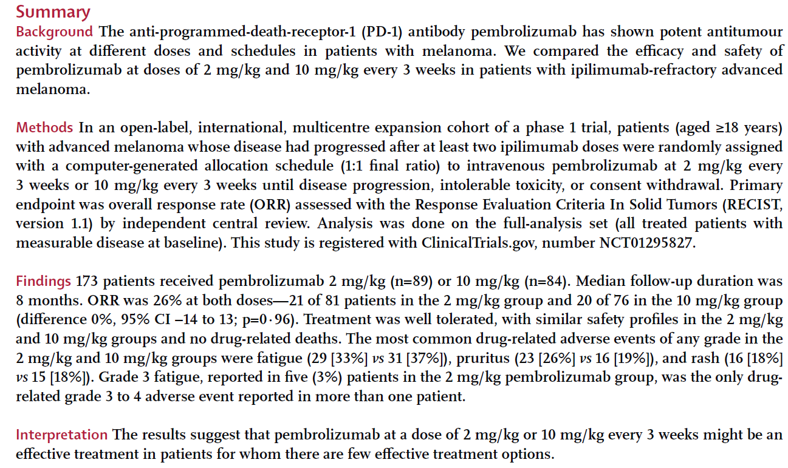
Another recent example: pembrolizumab

Slide 27
FDA press release
Keytruda’s efficacy was established in 173 clinical trial participants with advanced melanoma whose disease progressed after prior treatment.
All participants were treated with Keytruda, either at the recommended dose of 2 milligrams per kilogram (mg/kg) or at a higher dose of 10 mg/kg. In the half of the participants who received Keytruda at the recommended dose of 2 mg/kg, approximately 24 percent had their tumors shrink. This effect lasted at least 1.4 to 8.5 months and continued beyond this period in most patients. A similar percentage of patients had their tumor shrink at the 10 mg/kg dose.

Slide 28
New ASCO guidelines for Phase I
First update since 1997
Significant changes in the context of phase I trials
Affordable Care Act: increasing number of individuals with insurance; ACA requires payers to cover routine costs in Phase I to IV trials
Increase in MTAs and immunotherapies: increase in number of new agents, hence greater demand for patients.
Innovative trial designs:
Reduce exposure to ineffective treatment
Reduce exposure to toxic levels of treatment
Overall result: Phase I trials have greater potential as a treatment option than they did in 1997.

Slide 29
Current state of phase I
Researchers increasingly conducting phase I/II studies that accrue hundreds of patients in both dose escalation and expansions, and they include an assessment of efficacy.
Factors other than toxicity influence researchers’ determination of dosage to take forward to future studies.
New designs look at both efficacy and toxicity (not really, but the article says so!).
Five recommendations

Slide 30
Clinical Benefits
Improved QoL and psychological benefit
Direct medical benefit
Reduced Risk

