Slide 1
Phase I Trials:
Statistical Design Considerations
Elizabeth Garrett-Mayer, PhD
(Acknowledgement: some slides from Rick Chappell, Univ of Wisc)

Slide 2
Phase I Trial Design
Historically, DOSE FINDING study
Classic Phase I objective:
  “What is the highest dose we can safely administer to patients?”
  Translation: Kill the cancer, not the patient
  Assumes monotonic relationship between
    dose and toxicity
    dose and efficacy

Slide 3
Dose finding
Traditional goal: Find the highest dose with acceptable toxicity
New goals:
  find dose with sufficient effect on biomarker
  find dose with acceptable toxicity and high efficacy
  Find dose with acceptable toxicity in the presence of another agent that may also be escalated.

Slide 4
Classic Phase I Assumption:
Efficacy and toxicity both increase with dose
DLT =
dose-
limiting
toxicity

Slide 5
Schematic of Phase I Trial
100
% Toxicity
33
0
. . . mtd
d₁
d₂
Dose

Slide 6
Acceptable toxicity
What is acceptable rate of toxicity?
  20%?
  30%?
  50%?
What is toxicity????
  Standard in cancer: Grade 4 hematologic or grade 3/4 non-hematologic toxicity
  Always?
  Does it depend on reversibility of toxicity?
  Does it depend on intensity of treatment?
    Tamoxifen?
    Chemotherapy?

Slide 7
“Traditional” Designs
  Groups of three; dose increased (only) until some stopping criterion is achieved.
  “Designed” to estimate the MTD as 33%-ile or the next-largest dose.
  Underestimates the MTD.
  Not flexible (can spend a lot of patients at low-toxicity doses).

Slide 8
Phase I study design
“Standard” Phase I trials (in oncology) use what is often called the ‘3+3’ design (aka ‘modified Fibonacci’):
Maximum tolerated dose (MTD) is considered highest dose at which 1 or 0 out of six patients experiences DLT.
Doses need to be pre-specified
Confidence in MTD is usually poor.
Treat 3 patients at dose K
If 0 patients experience dose-limiting toxicity (DLT), escalate to dose K+1
If 2 or more patients experience DLT, de-escalate to level K-1
If 1 patient experiences DLT, treat 3 more patients at dose level K
  If 1 of 6 experiences DLT, escalate to dose level K+1
  If 2 or more of 6 experiences DLT, de-escalate to level K-1

Slide 9
Problems with the “Traditional Design”:
Storer and DeMets (1987) gave a clear illustration of bias potential in a phase I trial using the traditional stopping rule (“Design A”).
Due to the multiple opportunities for stopping, it stops too early and does not re-escalate. The stopping dose is not the 33rd %-ile - it is lower. But we don’t know how much lower:

Slide 10
Dose Actual (Unknown) Pr (Stopping)
Level Percentile at D.L.
1 .15 19%
2 .20 24%
3 .25 23%
4 .30 18%
5 .33 10%
“Even if dose level 5 corresponds exactly to the 33rd percentile, the probability (computed from the third column) that this particular trial will ever reach it is only 17%.”

Slide 11
Problems with the “Traditional Design” -
Cohorts of size 3 or 6 may tell you less than you think:
What can you learn from 3 patients at a single dose? What is the 95% exact c.i. for the probability of toxicity at a given dose if you observe
0/3 toxicities at that dose?
1/3 toxicities at that dose?
2/3 toxicities at that dose?
3/3 toxicities at that dose?

Slide 12
Problems with the “Traditional Design” -
Cohorts of size 3 or 6 may tell you less than you think:
What can you learn from 3 patients at a single dose? What is the 95% exact c.i. for the probability of toxicity at a given dose if you observe
0/3 toxicities at that dose? (0.00, 0.64)
1/3 toxicities at that dose? (0.09, 0.91)
2/3 toxicities at that dose? (0.29, 0.99)
3/3 toxicities at that dose? (0.36, 1.00)

Slide 13
Problems with the “Traditional Design” -
Cohorts of size 3 or 6 may tell you less than you think:
What can you learn from 6 patients at a single dose? What is the 95% exact c.i. for the probability of toxicity at a given dose if you observe
0/6 toxicities at that dose?
1/6 toxicities at that dose?
2/6 toxicities at that dose?
3/6 toxicities at that dose?

Slide 14
Problems with the “Traditional Design” -
Cohorts of size 3 or 6 may tell you less than you think:
What can you learn from 6 patients at a single dose? What is the 95% exact c.i. for the probability of toxicity at a given dose if you observe
0/6 toxicities at that dose? (0.00, 0.40)
1/6 toxicities at that dose? (0.04, 0.65)
2/6 toxicities at that dose? (0.11, 0.78)
3/6 toxicities at that dose? (0.22, 0.89)

Slide 15
Two examples:
Example 1: total N=21
 | Cohort 1 | Cohort 2 | Cohort 3 | Cohort 4 | Cohort 5 | Cohort 6 | Cohort 7
Dose | 1 | 2 | 2 | 3 | 3 | 4 | 4
DLTs | 0/3 | 1/3 | 0/3 | 1/3 | 0/3 | 1/3 | 1/3

Slide 16
Observed Data

Slide 17
Observed Data: with 90% CIs

Slide 18
Example 2:
Example 2: total N=12
 | Cohort 1 | Cohort 2 | Cohort 3 | Cohort 4
Dose | 1 | 2 | 3 | 4
DLTs | 0/3 | 0/3 | 0/3 | 2/3

Slide 19
Observed Data

Slide 20
Observed Data: with 90% CIs

Slide 21
Problems with the “Traditional Design” -
Conclusion
Single or double cohorts tell you little about a dose unless it is revisited.
Thus most biostatisticians prefer more flexible up-and-down designs (e.g., Storer’s “D”).

Slide 22
Should we use the “3+3”?
It is imprecise and inaccurate in its estimate of the MTD
Why?
  MTD is not based on all of the data
  Algorithm-based method
  Ignores rate of toxicity!!!
Likely outcomes:
  Choose a dose that is too high
    Find in phase II that agent is too toxic.
    Abandon further investigation or go back to phase I
  Choose a dose that is too low
    Find in phase II that agent is ineffective
    Abandon agent

Slide 23
Why is the 3+3 so popular?
People know how to implement it
“we just want a quick phase I”
It has historic presence
FDA (et al.) accept it
There is a level of comfort from the approach
The “better” approaches are too “statistical”

Slide 24
Accelerated Titration Design (Simon et al., 1999, JNCI)
The main distinguishing features
  (1) a rapid initial escalation phase
  (2) intra-patient dose escalation
  (3) analysis of results using a dose-toxicity model that incorporates info regarding toxicity and cumulative toxicity.
“Design 4:”
  Begin with single patient cohorts,
  double dose steps (i.e., 100% increment) per dose level.
  When the first DLT is observed or the second instance of moderate toxicity is observed (in any course), the cohort for the current dose level is expanded to three patients
  At that point, the trial reverts to use of the standard phase 1 design for further cohorts.
  dose steps are now 40% increments.

Slide 25
Accelerated Titration Design
“Rapid intrapatient dose escalation … in order to reduce the number of undertreated patients [in the trials themselves] and provide a substantial increase in the information obtained.”
If a first dose does not induce toxicity, a patient may be escalated to a higher subsequent dose.
Obviously requires toxicities to be acute.
If they are, trial can be shortened.

Slide 26
Accelerated Titration Design
After MTD is determined, a final “confirmatory” cohort is treated at a fixed dose.
Jordan, et al. (2003) studied intrapatient escalation of carboplatin in ovarian cancer patients and found “The median MTD documented here using intrapatient dose escalation ... is remarkably similar to that derived from conventional phase I studies.”
I.e., accelerated titration seems to work. Also, since it gives an MTD for each patient, it provides an idea about how MTDs vary between patients.

Slide 27
Alternative to algorithmic approaches?
Phase I is the most critical phase of drug development!
What makes a good design?
  Accurate selection of MTD
    dose close to true MTD
    dose has DLT rate close to the one specified
  Relatively few patients in trial are exposed to toxic doses
Why not impose a statistical model?
What do we “know” that would help?
  Monotonicity
  Desired level of DLT

Slide 28
“Novel” Phase I approaches
Continual reassessment method (CRM)
(O’Quigley et al., Biometrics 1990)
  Many changes and updates in 20 years
  Tends to be most preferred by statisticians
Other Bayesian designs (e.g. EWOC) and model-based designs (Cheng et al., JCO, 2004, v 22)
TiTE-CRM (more later)

Slide 29
Continual Reassessment Method (CRM)
Allows statistical modeling of optimal dose: dose-response relationship is assumed to behave in a certain way
Can be based on “safety” or “efficacy” outcome (or both).
Design searches for best dose given a desired toxicity or efficacy level and does so in an efficient way.
This design REALLY requires a statistician throughout the trial.
ADAPTIVE

Slide 30
CRM history in brief
Originally devised by O’Quigley, Pepe and Fisher (1990) where dose for next patient was determined based on responses of patients previously treated in the trial
Due to safety concerns, several authors developed variants
  Modified CRM (Goodman et al. 1995)
  Extended CRM [2 stage] (Moller, 1995)
  Restricted CRM (Moller, 1995)
  and others….

Slide 31
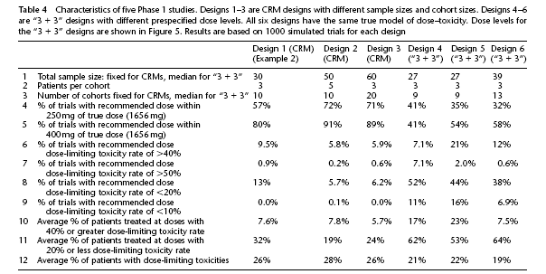
Some reasons why to use CRM

Slide 32
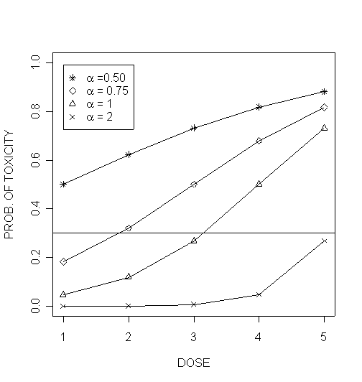
Basic Idea of CRM

Slide 33
Modified CRM
(Goodman, Zahurak, and Piantadosi, Statistics in Medicine, 1995)
Carry-overs from standard CRM
  Mathematical dose-toxicity model must be assumed
  To do this, need to think about the dose-response curve and get preliminary model.
  We CHOOSE the level of toxicity that we desire for the MTD (e.g., p = 0.30)
  At end of trial, we can estimate dose response curve.

Slide 34
Some other mathematical models we could choose

Slide 35
Modified CRM by
Goodman, Zahurak, and Piantadosi
(Statistics in Medicine, 1995)
Modifications by Goodman et al.
  Use ‘standard’ dose escalation model until first toxicity is observed:
    Choose cohort sizes of 1, 2, or 3
    Use standard ‘3+3’ design (or, in this case, ‘2+2’)
  Upon first toxicity, fit the dose-response model using observed data
    Estimate α
    Find dose that is closest to desired toxicity rate.
  Does not allow escalation to increase by more than one dose level.
  De-escalation can occur by more than one dose level.

Slide 36
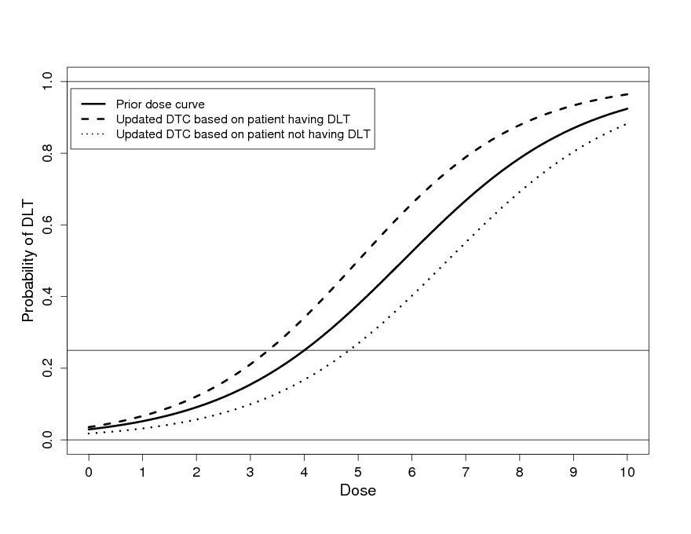
Principle of updating

Slide 37
Simulated Example
Shows how the CRM works in practice
Assume:
  Cohorts of size 2
  Escalate at fixed doses until DLT occurs
  Then, fit model and use model-based escalation
  Increments of 50mg are allowed
  Stop when 10 patients have already been treated at a dose that is the next chosen dose

Slide 40
Result
At the end, we fit our final dose-toxicity curve.
450mg is determined to be the optimal dose to take to phase II
30 patients (?!)
Confidence interval for true DLT rate at 450mg: 15% - 40%
Used ALL of the data to make our conclusion

Slide 41
Real Example Samarium in pediatric osteosarcoma:
Desired DLT rate is 30%.
2 patients treated at dose 1 with 0 toxicities
2 patients treated at dose 2 with 1 toxicity
➔ Fit CRM using equation below
Estimated α = 0.77
Estimated dose
is 1.4mCi/kg
for next cohort.
Loeb, Garrett-Mayer, Hobbs, Prideaxu, Schwartz et al. (2009), Cancer.

Slide 42
Example Samarium study with cohorts of size 2:
2 patients treated at 1.0 mCi/kg with no toxicities
4 patients treated at 1.4 mCi/kg with 2 toxicities
➔ Fit CRM using equation on earlier slide
Estimated α = 0.71
Estimated dose
for next patient
is 1.2 mCi/kg

Slide 43
Example Samarium study with cohorts of size 2:
2 patients treated at 1.0 mCi/kg with no toxicities
4 patients treated at 1.4 mCi/kg with 2 toxicities
2 patients treated at 1.2 mCi/kg with 1 toxicity
➔ Fit CRM using equation on earlier slide
Estimated α = 0.66
Estimated dose
for next patient
is 1.1 mCi/kg

Slide 44
Example Samarium study with cohorts of size 2:
2 patients treated at 1.0 mCi/kg with no toxicities
4 patients treated at 1.4 mCi/kg with 2 toxicities
2 patients treated at 1.2 mCi/kg with 1 toxicity
2 patients treated at 1.1 mCi/kg with no toxicities
➔ Fit CRM using equation on earlier slide
Estimated α = 0.72
Estimated dose for next patient is 1.2 mCi/kg

Slide 45
When does it end?
Pre-specified stopping rule
Can be fixed sample size
Often when a “large” number have been assigned to one dose.
This study enrolled an additional 3 patients treated at 1.24 mCi/kg
Total sample size was 13.
MTD was determined to be 1.21 mCi/kg

Slide 46
Dose increments
Can be discrete or continuous
Infusion?
Tablet?
Stopping rule should depend on nature (and size) of allowed increment!

Slide 47
Escalation with Overdose Control
EWOC (Babb et al.)
Similar to CRM
Bayesian
Advantage: overdose control
  “loss function”
  Constrained so that the predicted proportion of patients who receive an overdose cannot exceed a specified value
  Implies that giving an overdose is greater mistake than an underdose
  CRM does not make this distinction
  This control is changed as data accumulates

Slide 48
How far has the CRM come?
Rogatko et al., 2007
Literature review of phase I cancer studies and phase I design papers, 1991-2006
1,235 clinical studies and 90 design papers
Results:
  1.6% of trials followed novel design (n=20)
    1.4% were CRM (n=17)
  98.4% of trials used variations of up-down designs
Reasons cannot be just scientific!

Slide 49
Practical Roadblocks
lack of familiarity
“black box”
lack of control/reliance on statisticians
fear of regulatory acceptance
  IRBs
  FDA
  CTEP
regulatory rejection
disinterest is trail-blazing
time commitment/consumption

Slide 50
Steps towards acceptance
Regulatory agency encouragement of novel designs
  NIH/NCI reviewers need to ask for novel designs
  FDA needs to condone novel designs
Statisticians need to:
  promote existing methods more strongly: provide incentives to statisticians!
  stop developing new ones: the novel designs have proven to be similarly appropriate for dose identification (Zohar and Chevret, 2008)
Translation from statistical literature to medical literature
  education of regulators
  education of clinicians

Slide 51
Other Novel Ideas in Phase I
Outcome is not always toxicity
Even in phase I, efficacy can be outcome to guide dose selection
Two outcomes: safety and efficacy

Slide 52
Efficacy Example:
Rapamycin in Pancreatic Cancer
Outcome: response
Response = 80% inhibition of pharmacodynamic marker
Assumption: as dose increases, % of patients with response will increase
Desired proportion responding: 80%

Slide 53
Efficacy Example:
Rapamycin in Pancreatic Cancer

Slide 54
Safety and Efficacy
Zhang, Sargent, Mandrekar
Example: high dose can induce “over-stimulation”
Three categories:
  1 = no response, no DLT
  2 = response, no DLT
  3 = DLT
Use the continuation ratio model
Very beautiful(!)
Not particularly friendly at the current time for implementation

Slide 55
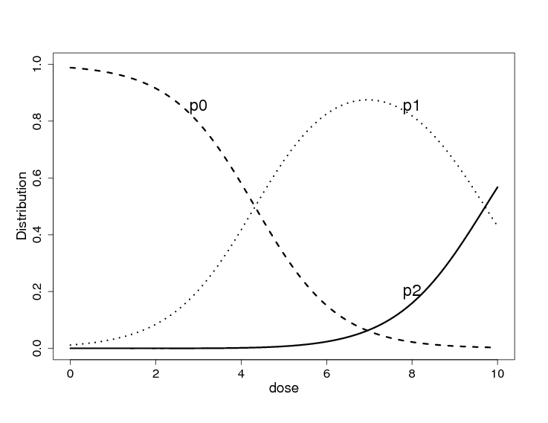
Safety and Efficacy Endpoints
Y = 0 if no toxicity, no efficacy
= 1 if no toxicity, efficacy
= 2 if toxicity

Slide 56
Summary: “Novel” Phase I trials
Offer significant improvements over “traditional” phase I design
  Safer
  More accurate

Slide 57
Why haven’t they been implemented more often?
They do not fit all types of phase I questions
Change in paradigm
Larger N
“I just want a quick phase I”
Large investment of time from statistician
Need time to “think” and plan it.
IRB and others (e.g. CTEP) worry about safety (justified?). Black box phenomenom.

Slide 58
Designs for Long-term Toxicities
When looking for long-term or chronic toxicities all of the above designs take a long time, even with rapid accrual.
Suppose investigators are interested in toxicities over a span of (say) two years.
For a study with only 15 patients, “three-at-a-time” designs require 10 years to complete, even with perfect accrual.

Slide 59
Since sequential (one-at-a-time or three-at-a-time, etc.) methods take so long in such cases, other designs should be considered.
The following scenario assumes that we are interested in the MTD as the 20%-ile of a toxicity which requires 2 years followup (so we now have cohorts of 5, not 3).

Slide 60
Prorated Designs (Cheung & Chappell, 2000)
Instead of collecting data on a group of 5 patients for 2 years each,
Collect data on more than 5 patients for a total of 10 patient-years.
One patient measured for one year counts (is “prorated” as) 1/2 of a patient.
A Bayesian version (TIme-To-Event Continual Reassment Method, TITE-CRM, is available).

Slide 61
Prorated Designs (continued):
Require more patients than traditional designs, provide more information at study’s conclusion; and
Are much quicker than traditional designs (commensurate with the number of extra patients).

Slide 62
TITE-CRM: Schematic Example

Slide 63
Proration Example - Dose-per-fraction Escalation in Prostate Cancer
Trial under way with spiral tomoradiotherapy at UWCCC with M. Ritter and M. Mehta.
Uses result of Teshima (1997) that the incidence of grade 2 rectal complications is roughly constant within first 2 years.
Teshima’s results also show that 2-year rate is close to final one.

Slide 64
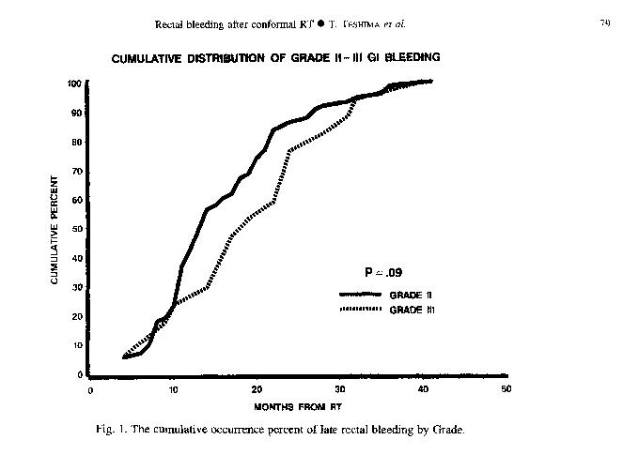
Teshima (1997), Fig 1:

Slide 65
MTD is defined as dose which yields at most a 20% rate of grade 2 rectal toxicity at 2 years.
Escalation requires:
  At least 10 patient-years of observation;
  At most a 20% toxicity rate per two years (I.e., at most 1 toxicity per 10 patient-years);
  A minimum of 5 patients followed for a full year, for safety’s sake.
Study duration is roughly halved.

Slide 66
Conclusion
Phase I study design should be tailored to the science.
“One size fits all” doesn’t work for phase III trials.
Why should it work for phase I?
Pick your design to simply and ethically answer your unique question.

Slide 67
More on the CRM (optional)
A Bayesian approach is popular
Requires ‘calibration’ of the prior
Seeing Cheung and Lee

Slide 68
Prior
VERY IMPORTANT
Prior has large impact on behavior early in the trial
But, what if you choose a ‘vague’ prior?
  ‘vague’ in the sense of strength of information?
  ‘vague’ in the sense of the most likely candidate?

Slide 69
Selecting prior
(assume desired DLT rate = 0.20)

Slide 70
Reconsidered prior:

Slide 71
OK: so, start at dose=2.7
Then what?
See how first patient does
Two options
  1. no DLT
  2. DLT
Use this information: combine prior and likelihood (based on N=1)
  α_{noDLT} = 0.97
  α_{DLT} = 0.012

Slide 72
Recall:
posterior = prior x likelihood x constant
On following pages, the distributions are NOT normalized for the constant
Relative heights are NOT important,
Shapes of curves ARE important

Slide 73
Is this what we would expect?
We’ve observed data on ONE patient. These are the possible results:
No DLT
DLT

Slide 74
Dose for next patient?
Find dose that is consistent with DLT rate of 20%
2.5

Slide 75
Why?
Prior choice:
  Too conservative: Favors small values (i.e., high toxicity)
  Not informative enough(!)
Want to be conservative BUT
  Need to check behavior!
  When a DLT occurs:
    We should decrease, but not go so low as to stop trial after 1 DLT
  When a patient has no DLT:
    We should increase the dose
    If prior is too conservative, we may still decrease after a ‘success’

Slide 76
Need to spend time on the design
Try a normal prior with mean 1: tweak variance
No DLT
DLT

Slide 77
Scenarios for next patient

Slide 78
A little more on the statistics:
Original design was purely Bayesian
Requires a prior distribution
  Prior is critically important because it outweighs the data early in the trial
  Computationally is somewhat challenging
Some revised designs use ML
  Simpler to use
  Once a DLT is observed, model can be fit
  Some will “inform” the ML approach using “pseudo-data” (Piantadosi)

Slide 79
Simple prediction, but backwards(?)
Usual prediction:
  Get some data
  Fit model
  Estimate the outcome for a new patient with a particular characteristic
CRM prediction
  Get some data
  Fit model
  Find the characteristic (dose) associated with a particular outcome (DLT rate)

Slide 80
Finding the next dose: ML approach
Use maximum likelihood to estimate the model.
What likelihood do we use? Binomial.
Algorithmic estimation of α

Slide 81
Finding next dose
Recall model, now with estimated α:
Rewrite in terms of d_{i}:

Slide 82
Finding next dose
Use desired DLT rate as p_{i}

Slide 83
Negative dose?
Doses are often mapped to another scale
dose coding:
-6 = level 1 (1.0)
-5 = level 2 (1.4)
-4 = level 3 (2.0)
-3 = level 4 (2.8)
-2 = level 5 (4.0)
WHY? Makes the statistics work….

Slide 84
CRM Software: http://www.cancerbiostats.onc.jhmi.edu/software.cfm

Slide 85
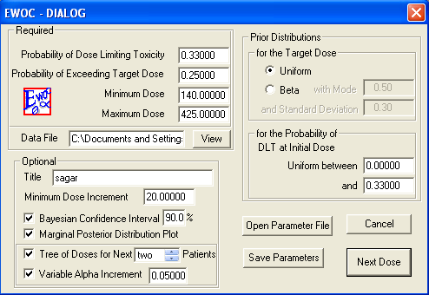
EWOC Software
http://www.sph.emory.edu/BRI-WCI/ewoc.html

