Slide 1
Phase I trials:
Practical Considerations
Most slides courtesy of:
Percy Ivy, MD
Associate Chief, Investigational Drug Branch
Cancer Therapy Evaluation Program
Pat LoRusso
Yale University

Slide 2
Most Common Types of Cancer Treatments Currently Use and Under Development
Surgery
Radiation
Transplants (e.g. bone marrow)
Chemotherapies: kill the cancer cells
Targeted therapies: drugs that interfere with specific molecules involved with cancer cell growth and survival. Most are ‘small molecule’ or ‘monoclonal antibodies.’
Angiogenesis Inhibitors: drugs that eliminate the blood supply to tumors.
Immunotherapies: stimulating or modifying the body’s immune system to attack the cancer cells

Slide 3
Standard Objectives of a Phase 1 Trial
Primary objective:
Identify dose-limiting toxicities (DLTs) and the recommended phase II dose(s) (RP2D)
Secondary objectives:
Define toxicity profile of new therapy(s) in the schedule under evaluation
Pharmacokinetics (PK)
Pharmacodynamic (PD) effects in tumor and/or surrogate tissues
Antitumor activity

Slide 4
Definition(s) of a Phase 1 Trial
First evaluation of a new cancer therapy in humans
First-in-human, first-in-kind (e.g. the first compound ever evaluated in humans against a new molecular target), single-agent
First-in-human, but not first-in-kind (i.e. others agents of the same class have entered human testing), single-agent

Slide 5
Definition(s) of a Phase 1 Trial
Multiple types of Phase 1 Trials
Investigational agent + investigational agent
Investigational agent + approved agent(s)
Approved agent + approved agent(s)
Approved or investigational agent with pharmacokinetic focus (adding of CYP inhibitor)
Typically considered drug-drug interaction study
Approved or investigational agent with pharmacodynamic focus (e.g. evaluation using functional imaging)
Approved or investigational agent with radiotherapy
Food effect study
QTc prolongation study
Bioequivalence study

Slide 6
Definitions of Key Concepts in Phase 1 Trials
Dose-limiting toxicity (DLT):
Toxicity that is considered unacceptable (due to severity and/or irreversibility) and limits further dose escalation
Defined with standard criteria CTCAE 4.1
http://evs.nci.nih.gov/ftp1/CTCAE/CTCAE_4.03_2010-06-14_QuickReference_5x7.pdf
Dose-limiting toxicity
defined in advance prior to beginning the trial
is protocol-specific
Typically defined based on toxicity seen in the first cycle
With select agents that have a more delayed toxicity (eg 2nd/3rd cycle), time allowed for DLT definition being re-evaluated

Slide 7
Definitions of Key Concepts in Phase 1 Trials
Examples of DLTs – chronic (daily) dosing:
Threshold for DLTs is lower
Some Grade 2 toxicities may be unacceptable and intolerable due to their persistence and lack of time period for recovery
Examples:
Grade 2 intolerable or worse non-hematologic toxicity despite supportive measures
Grade 3 or worse hematologic toxicity
Inability to complete a pre-specified percentage of treatment during the cycle due to toxicity (e.g. missing 10-15% of doses)

Slide 8
Two recent examples in current trials
Tazi study: DLT will be defined as any one of the following attributed to AZD5363/AZD1208 during course 1: grade 4 neutropenia ≥ 1 week; febrile neutropenia; grade 4 thrombocytopenia; grade 3 thrombocytopenia with bleeding; QTcF prolongation to > 500 msec, or an increase of > 60 msec from baseline QTcF to a QTcF value > 480 msec, confirmed on repeat EKG; grade 3 or 4 nausea, vomiting, or diarrhea despite use of adequate medical intervention; any other clinically significant ≥ grade 3 non-hematologic toxicity; and/or persistent, intolerable toxicity which delays scheduled treatment for > 14 days. All subjects will be evaluated for toxicity by history, physical exam, and clinical labs weekly during course 1, every 4 weeks during subsequent courses, and at EOS.
Adoptive T-cell transfer study: The DLT in our studies will be identical to DLT defined in NCI Surgery Branch adoptive T cell transfer protocols, which is 1) ≥Grade 2 or more bronchospasm or generalized uticaria (hypersensitivity), 2) ≥Grade 2 or more allergic reactions, 3) Grade 3 or greater toxicity occurring within 24 hours post cell infusion (related to cell infusion) and not reversible to a grade 2 or less within 8 hours with two doses of 650 mg po of acetaminophen or two doses of 50 mg po of dyphenhydramine, 4) any Grade 4 autoimmunity, 5) Grade 3 autoimmunity (excluding vitiligo, the depigmentation of the skin and/or hair) that cannot be resolved to less than or equal to a grade 2 autoimmune toxicity within 10 days, or 4) any grade 3 or greater non-hematologic toxicity, excluding injection site reactions, skin rash, pruritis, and local adenopathy (Severe skin rashes such as Steven-Johnson Syndrome or TEN will be considered DLT), 6) > Grade 3 toxicity of any kind related to the TIL 1383I TCR transduced T cells administration with particular attention to the following events: a) ≥Grade 3 injection site reaction due to TIL 1383I TCR transduced T cells administration, b) > Grade 3 hematological or hepatic toxicity that does not subside within 4 weeks after infusion of TIL 1383I TCR transduced T cells, c) > Grade 3 neurotoxicity: New motor or sensory deficits, encephalopathy, or signs and symptoms that may indicate either tumor progression or a productive immune response will be evaluated as noted in earlier in this section with radiological imaging, and, if warranted, biopsy.

Slide 9
Definitions of Key Concepts in Phase 1 Trials
Maximum Administered Dose (MAD), Maximum Tolerated Dose (MTD): confusing
Usage of these 2 phrases varies with country
More important term: Recommended phase 2 dose (RPTD or RD):
Dose associated with DLT in a pre-specified proportion of patients (e.g. > 33%) – dose that will be used in subsequent phase II trials

Slide 10
Dose-Response: Efficacy and Toxicity
Probability
Dose
Therapeutic window

Slide 11
Definitions of Key Concepts in Phase 1 Trials
Optimal biological dose (OBD):
Dose associated with a pre-specified desired effect on a biomarker
Examples:
Dose at which > XX% of patients have inhibition of a key target in tumor/surrogate tissues
Dose at which > XX% of patients achieve a pre-specified immunologic parameter
Challenge with defining OBD is that the “desired effect on a biomarker” is generally not known or validated before initiation of the phase 1 trial

Slide 12
Dose-Response: Efficacy and Toxicity
Probability
RECIST (tumor shrinkage, prolonged SD)
Achievement of target PK levels
Proof of target inhibition in surrogate/ tumor tissues
Functional imaging
OBD
Dose

Slide 13
Cancer Immunotherapy - “A Long Awaited Reality”
The over-riding relationship between the immune system and growing cancers is one of tolerance
Biologic therapy uses body’s own immune system to fight cancer by:
Stimulating the immune system to recognize and attack the cancer cells
Providing immune system components, such as man-made system proteins (antibodies)
Some immunotherapies have fewer side effects, with improved anti-cancer efficacy and survival, but also high costs

Slide 14
Some examples of immunotherapies for cancer treatment
Tumor-specific monoclonal antibodies (mAbs)
Rituximab for treating lymphoma
Trastuzumab (Herceptin) for treating breast cancer
Bevacizumab for treating colon, lung, and renal metastatic cancers
Immune-modulating antibodies
Ipilimumab (YervoyR ) first-line therapy for patients with metastatic melanoma
Cancer vaccines
Sipuleucel-T (ProvengeR ) for patients with advanced hormone-resistant prostate cancer
Adoptive cell transfer (ACT)

Slide 15
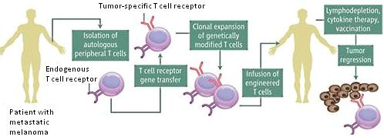
Specific Example of Adoptive Cell Transfer
Transfer of Genetically Engineered Lymphocytes in Melanoma Patients - A Phase I Dose Escalation Study
P. HUEY/SCIENCE 2006*

Slide 16
Challenges with Immunologic Outcomes
Actionable Phase I outcomes are usually continuous (e.g., persistence % of T-cells at follow-up)
Clinical outcomes take a long time to evaluate (e.g. duration of response)
Target levels not always known or well-defined
Need to account for heterogeneity across patients
Immunotherapies are expected to have lower or no-toxicity compared to cytotoxic agents
Monotonicity of dose-response is not necessarily implied
The highest tolerated dose might not have the most substantial immunologic response
More relevant to use efficacy-driven dose finding designs with safety boundaries

Slide 17
OBD: Defining the Context
Unselected patients
Selected patients
with common molecular profiles
Individual patients

Slide 18
Definitions of Key Concepts in Phase 1 Trials
Pharmacokinetics (PK):
“what the body does to the drug”
ADME: absorption, distribution, metabolism and excretion
PK parameters: Cmax, AUC (drug exposure), t1/2, Clearance, etc.
Pharmacodynamics (PD):
“what the drug does to the body”
e.g. nadir counts, non-hematologic toxicity, molecular correlates, imaging endpoints

Slide 19
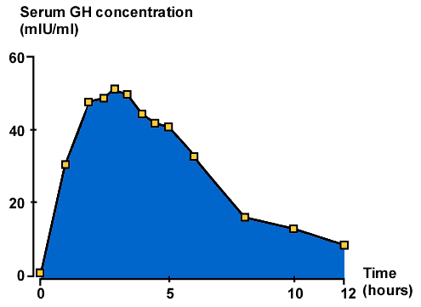
Pharmacokinetics
Serum concentration (mg/mL)
Cmax
AUC

Slide 20
Phase 1 Trials: Fundamental Questions
At what dose do you start?
What type of patients?
How many patients per cohort?
How quickly do you escalate?
What are the endpoints?

Slide 21
Phase 1 Trials: Fundamental Questions
At what dose do you start?
What type of patients?
How many patients per cohort?
How quickly do you escalate?
What are the endpoints?

Slide 22
Preclinical Toxicology
Typically a rodent (mouse or rat) and non-rodent (dog or non-human primate) species
Reality of animal organ specific toxicities – very few predict for human toxicity
Myelosuppression and GI toxicity more predictable
Hepatic and renal toxicities – large false positive
Toxicologic parameters:
LD₁₀ – lethal dose in 10% of animals
TDL (toxic dose low) – lowest dose that causes any toxicity in animals
NOAEL – no observed adverse effect level

Slide 23
Phase 1 Trials: Starting Dose
Starting dose
1/10 of the Lethal Dose 10% (LD10) in rodents OR
1/10 of LD10 in most sensitive species (non-rodent)
1/6 or 1/3 of the Toxic Dose Low (TDL) in large animals
Unless preclinical studies suggest a very steep dose/toxicity curve

Slide 24
Phase 1 Trials: Fundamental Questions
At what dose do you start?
What type of patients?
How many patients per cohort?
How quickly do you escalate?
What are the endpoints?

Slide 25
Phase 1 Patient Population
“Conventional” eligibility criteria- examples:
Advanced solid tumors (or select hematologic malignancies) unresponsive to standard therapies or for which there is no known effective treatment
Performance status (e.g. ECOG 0 or 1)
Adequate organ function (e.g. ANC, platelets, creatinine, AST/ALT, bilirubin)
Specification about prior therapy allowed
Specification about time interval between prior therapy and initiation of study treatment
No serious uncontrolled medical disorder or active infection

Slide 26
Phase 1 Patient Population
“Agent-specific” eligibility criteria - examples:
Restriction to certain patient populations – must have strong scientific rationale
Specific organ functions:
Cardiac function
if preclinical or prior clinical data of similar agents suggest cardiac risks
No recent (6-12 months) history of acute MI/unstable angina, cerebrovascular events, venous thromboembolism; no uncontrolled hypertension; no significant proteinuria (e.g.. antiangiogenic agents)
Prohibited medications if significant risk of drug interaction

Slide 27
Phase 1 Trials: Fundamental Questions
At what dose do you start?
What type of patients?
How many patients per cohort?
How quickly do you escalate?
What are the endpoints?

Slide 28
Number of Patients per Cohort
Predicated on several factors
Type of trial design
Accelerated Titration Design attempts to minimize Pt #
Typically 1 patient per cohort until >grade 2 toxicity and then increase to 3 (or 6 if DLT)
Fibonacci/ A+B design
Typically 3 patients per cohort until DLT then increase to up to 6 patients
Model-based
Usually 2-3 per cohort, with fixed total sample size.

Slide 29
Dose
A
3+3 design
B
PK guided escalation
Dose
DLT
DLT
DLT
DLT
3
3
3
3
3
3
RD
3
3
RD
3
3
3
1
Plasma drug AUC > prespecified treshold
3
1
Determination of plasma drug AUC
3
SD
1
SD
Dose
C
Time
Dose
D
Time
Accelerated titration
Up-and-down
DLT
DLT
DLT
DLT
3
3
1
DLT
DLT
1
2
3
RD
1
1
1
1
1
1
RD
1
SD
1
Intrapatient dose escalation
1
SD
Dose
E
Time
Dose
F
Time
mCRM
EWOC
DLT
DLT
DLT
1
DLT
1
1
1
1
3
RD
1
1
1
3
RD
1
1
1
Computation of p(DLT at next DL) = ideal dosing
1
Computation of p(DLT at next DL) = ideal dosing
1
SD
1
SD
Computation of p(DLT at next DL)
= overdosing or excessive toxicity
Time
Time
Le Tourneau, Lee, Siu, JNCI

Slide 30
Phase 1Trials: Fundamental Questions
At what dose do you start?
What type of patients?
How many patients per cohort?
How quickly do you escalate?
What are the endpoints?

Slide 31
Phase 1 Trial Basic Principles
Begin with a safe starting dose
Minimize the number of pts treated at sub-toxic (and thus maybe sub-therapeutic) doses
Escalate dose rapidly in the absence of toxicity
Escalate dose slowly in the presence of toxicity

Slide 32
Phase 1 Trial Assumption
The higher the dose, the greater the likelihood of efficacy
Dose-related acute toxicity regarded as a surrogate for efficacy
Highest safe dose is dose most likely to be efficacious
This dose-effect assumption is primarily for cytotoxic agents and may not apply to molecularly targeted agents

Slide 33
Phase 1 Trials: Fundamental Questions
At what dose do you start?
What type of patients?
How many patients per cohort?
How quickly do you escalate?
What are the endpoints?

Slide 34
Endpoints in Phase 1 Trials
Safety and tolerability-DLT and other toxicity
Pharmacokinetics (PK)
Pharmacodynamics (PD)
Biological correlates, imaging endpoints
Preliminary antitumor activity
Note that efficacy is generally determined in a phase 3 setting; compared to standard of care

Slide 35
Clinical Development of Molecularly Targeted Agents: Known Challenges
General requirement for long-term administration: pharmacology and formulation critical (PLX 4032)
Determining the optimal dose in phase I: MTD versus OBD
Do we need or can we determine the MTD with targeted agents? (Pharmaco-economic dose, Pharmaco-tolerable dose)
Absent or low-level tumor regression as single agents: challenging for making go / no-go decisions
Need for large randomized trials to definitively assess clinical benefit: need to maximize chance of success in phase III

Slide 36
Biomarkers: functional definitions
Predictive Markers
Predict outcome with specific therapy - match drugs with appropriate pts
e.g. KRAS mutations and anti-EGFR monoclonal antibodies in colorectal cancer
Pharmaco-dynamic Markers
Confirm biological activity
e.g. ↓ pERK with a targeted agent (such as a MEK inhibitor)
Prognostic Markers
Correlate with disease outcome regardless of intervention
e.g. Clinical: stage, PS
e.g. Lab: LDH in non-Hodgkin’s lymphoma

Slide 37
Biomarkers: regulatory definitions
Integral Markers
Used for patient selection
Used to determine patient treatment
Performed in CLIA environment
e.g. mutated BRaf (V600) with a targeted agent (dabrafinib, vemurafinib)
Exploratory Markers
Descriptive biomarkers
Not validated or fit for purpose
e.g. study of cross talk between Ras/Raf/MEK and PI3K signaling cascades
Integrated Markers
Used for patient description
Provide evidence of pathway activation
CLIA ready
e.g. study of biomarkers for Ras/Raf/MEK signaling

Slide 38
Biological Correlative Studies: Why Do We Need Them?
Conventional cytotoxic drugs have led to predictable effects on proliferating tissues (neutropenia, mucositis, diarrhea), thus enabling dose selection and confirming mechanisms of action
Targeted biological agents may or may not have predictable effects on normal tissues and often enter the clinic needing evidence/proof of mechanisms in patients
On target vs off-target effects

Slide 39
Use of Lab Correlates in Clinical Trials
Should be driven by sound scientific rationale
Phase I:
Proof-of-mechanism
Exploratory
Establish optimal biological dose and/or schedule in some trials (especially if little or no toxicity expected)
Often more practical to perform at an expanded cohort at the recommended phase 2 dose

Slide 40
PAR Levels in Tumors of Predose vs. Postdose
NCTVL
Notes:
ABT888 is able to decrease PAR levels across the board, regardless of ABT888 dose. It appears that the greater the baseline level of PAR, the greater the degree of decrease.
We lined the patients up based on pre-dose PAR levels. The greater the pre-dose PAR levels, the greater the degree of inhibition.
Treatment always decreased PAR levels, however there was much more inhibition if the predose levels are high.
The upper graph is a log scale. The lower graph is a linear scale.
No matter how much PAR in the tumor you have at baseline, you drop the PAR levels to reasonably low levels but they never drop to 0.
You can never drop the tumor PAR levels to 0 – there is always some detectable PAR levels – could be several explanations for this
-maybe different isoforms and the drug is not impacting on all isoforms
-some PAR products may be stable and do not degrade fast enough
-small number of proteins that have PAR polymers and small amount of proteins that do not get degraded very fast and are more stable, hence still detectable

Slide 41
Clinical Development of Molecularly Targeted Agents: Known Challenges
Patient Pre-selection
Other than typical Inclusion/Exclusion Criteria
Molecular Profiling
What about other targets?

Slide 42
Kaplan-Meier Survival Estimates for Subjects on J0658 (N=26)
≥2 Methylated Genes, All Demethylating (Methylation Signature)
Log rank p=0.090
1.00
Median survival (mths); IQR (25% − 75%)
Methylation Signature +: 10.42 (6.21 − NYR*)
Methylation Signature − : 6.54 (3.65 − 9.99)
0.75
Juergens et al. 2011 Cancer Discov 1(7):598
Azacitidine: 40 mg/m2/d days 1-6 and 8-10
Entinostat: 7 mg days 3 and 10
CR 1
PR 1
SD 10
PD 22
NE 11 (5 with early PD)
0.50
Proportion Surviving
0.25
Methylation Signature +
Methylation Signature −
0.00
0
12
24
Months From Start of Study
Number at Risk (Percent Survived):
Signature +: 8 (100) 4 (50.0) 3 (37.5)
Signature −: 18 (100) 3 (16.7) 1 (11.1)
*NYR; not yet reached
Brock, Wrangle, Herman, Rudin and team colleagues

Slide 43
Clinical development of molecularly targeted agents: known challenges
General requirement for long-term administration: pharmacology and formulation critical
Difficulty in determining the optimal dose in phase I: MTD versus OBD
Absent or low-level tumor regression as single agents: problematic for making go no-go decisions
Need for large randomized trials to definitively assess clinical benefit: need to maximize chance of success in phase III

Slide 44
Pitfalls of Phase 1 Trials
Chronic and cumulative toxicities usually cannot be assessed & may be missed
Most patients do not stay on trial beyond 2 cycles
Uncommon toxicities will be missed
Too few patient numbers in a phase 1 trial
Reason for toxicity evaluation & reporting through phase IV drug testing
Exactly what tumor or tumor cell subset are you treating
Heterogeneity
Resistance

Slide 45
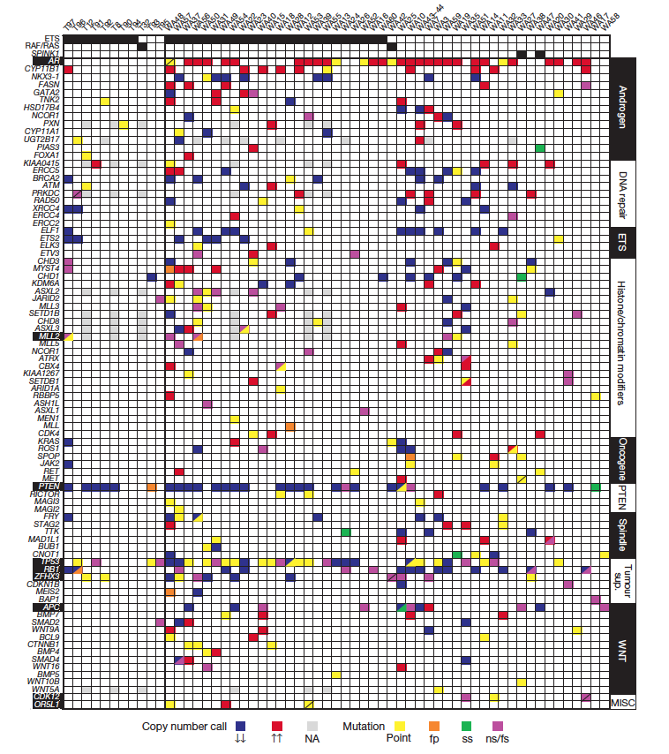
Genomic Complexity
Carcinogenesis usually involves the hijacking/altering multiple processes/pathways.
Advanced prostate cancer
DNA repair
AR signaling
ETS gene rearrangements
PTEN loss & PI3K/AKT
p53 mutation
Grasso et al, The mutational Landscape of Lethal CRPC. Nature 2012

Slide 46
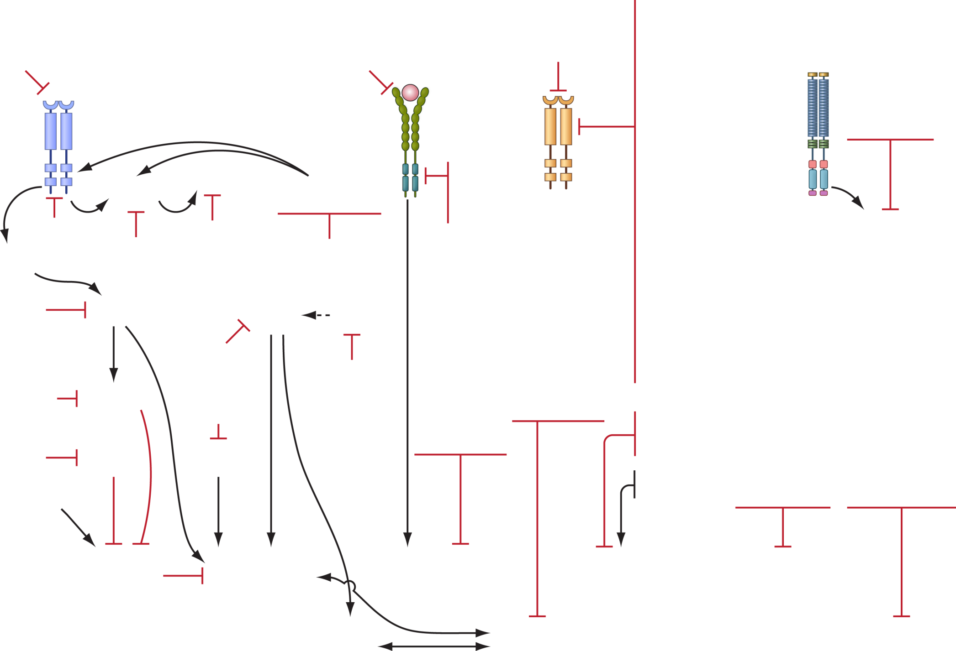
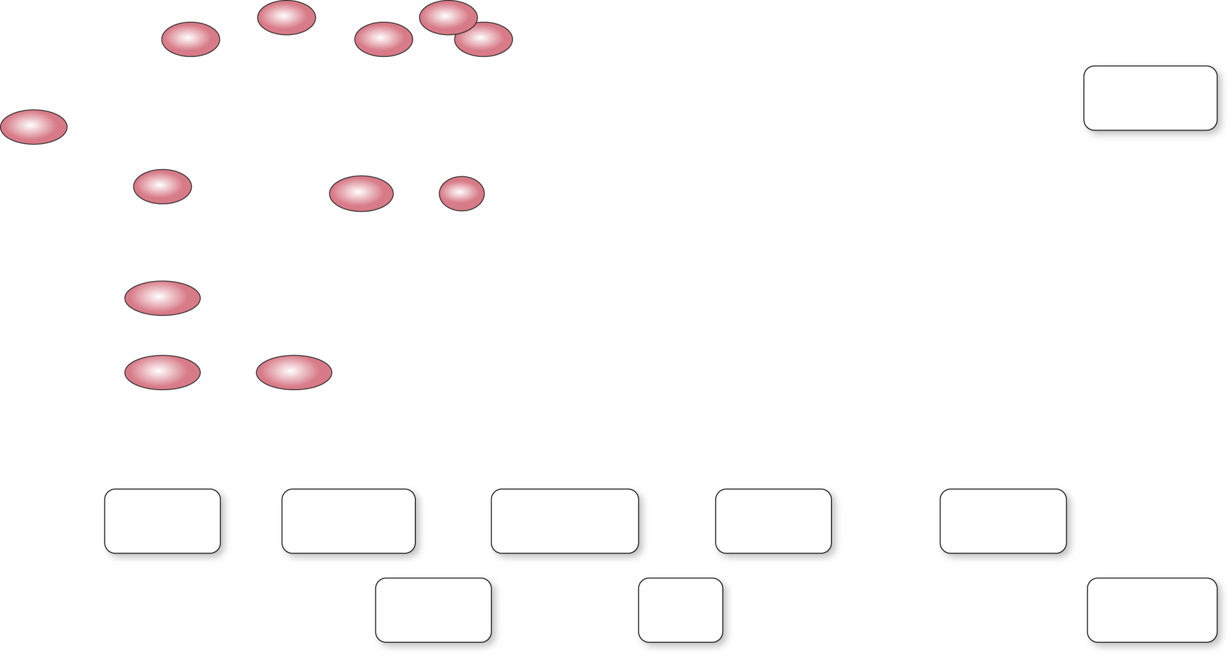
High Priority Targets and Drugs
IGF-1R
Surface antigens
AMG479
IMC-A12
linsitinib
bevacizumab
VEGF Trap
SGN 35 (CD30)
HA 22 (CD22)
cetuximab
HER2
VEGF
Lapatinib
Pertuzumab
trastuzumab
Notch
other
receptors
RO4929097
EGF-R
VEGF-R
c-Kit
Notch
Hedgehog
imatinib
sunitinib
sorafenib
vismodegib
Raf
Bcr
sorafenib
sunitinib
cediranib
pazopanib
Met
Ras
SRC
Abl
tivantinib
ERa
erlotinib
dasatinib
sorafenib
z-endoxifen
Stem cell
signalling
CDKs
PDGFR
tipifarnib
dasatinib
Saracatinib
imatinib
dinaciclib
sunitinib
imatinib
pazopanib
cediranib
P13 K
Microtubules
MK-2206
Akt
brentuximab
vedotin
Flt3,RET
PARP
MEK
Btk
CHK1
sorafenib
veliparib
SCH 900776
bFGFR
HDAC
tramitinib
selumetinib
Aurora kinase A
cediranaib
thalidomide
lenalidomide
pomalidomide
belinostat
entinostat
vorinostat
AT-101
obatoclax
navitoclax
PCI-32765
MLN 8237
BCR
torc ½, MLN0128
temsirolimus
CD105
Wee1 kinase
ibrutinib
Topoisomerases
BCL-2
TRC105
MK-1775
CTLA44
Angiopoietins
Hsp90
ipilimumab
ticilimumab
LMP400/776
AMG386
AT 13387
PU-H71
Alkylating
TL32711
XIAP
mTOR
IDO
Dimethane
sulfonate
Proteasome
1-Methyl-[D]-
tryptophan
Methylation inh.
fenretinide
bortezomib
FdCyd/THU
Ceramide
Apoptosis
Survival/
Proliferation
Angiogenesis
Protein
turnover
Immuno-
modulation
Migration/
invasion
Mitosis
DNA repair
epigenetics
Notes:
High priority targets and pathways go through NExT; NCI has a single pipeline. Broad portfolio for combination studies.

Slide 47
Phase I Trial of Combination of Agents
Combination phase I trials:
New drug A + Standard drug B
Need to provide rationale: why add A to B?
Need to think about overlapping toxicity in your definition of DLT
Ideally keep standard drug dose fixed and escalate the new drug (e.g. 1/2, 2/3, full dose)

Slide 48
Approaches to Combination Therapies
Opportunities | Pitfalls
Validate novel biological hypotheses | Unreliable pre-clinical models
Synergize anti-tumor effect without synergizing toxicity | Optimal selection of drugs and targets to study in combination
Increase therapeutic index/window | Optimal sequence and dose of combination therapy
Synthetic lethality: optimize combination use of single agents with limited single agent activity | Risk overlapping toxicity
Counteract primary and secondary resistance | Lack of standard design for phase 1 / 2 for combination therapies
Develop novel indications for existing and approved drugs | Competing interests of researchers, corporations and / or institutions to combine treatments
Yap, Omlin & de Bono, JCO 2013

Slide 49
Reversal of Resistance Approach
Important approach for proof of concept studies
when one of the drugs has antitumor activity

Slide 50
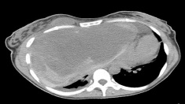
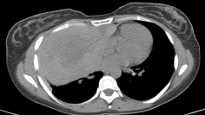
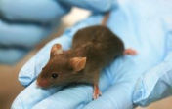
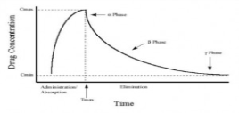
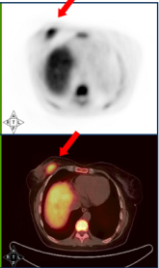
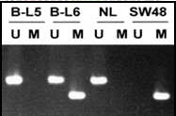
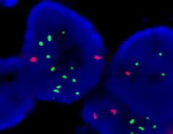
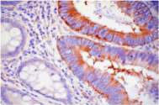
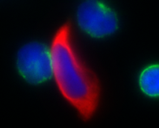
Clinical Translational Research and Cancer Biology: Bedside to Bench and Back
*Clinical observations:
Non-clinical models
for targets
Patients eligible for early phase clinical trials
Clinical response
*
Analysis of tumor and
Other tissues for pathway activation or biomarker
Translational research
with clinical models
PK
Sequencing
Patient assigned to trial
Based on molecular
characterization of tumor
Methylation
Functional
imaging
FISH
*
Tumor and normal
tissue PD markers
Patient monitoring
IHC
CTCs,
CECs
*
Patient monitoring:
Post-treatment molecular
re-analysis for response/ resistance
Expression
array
Tumor-initiating cells

Slide 51
Sequential Combinations Approach
Arguably the ‘traditional route’ used in cancer medicine today

Slide 52
Addition Approach
May be more rational if combination tolerable.
Eg LHRHa + abiraterone + MDV3100, OR LHRHa + abiraterone + PI3K/AKT/TOR inhibitor.

Slide 53
Alternating Approach
This approach clearly has some merit if tolerability an issue

Slide 54
Pulsed Dose Approach
Arguably more likely to impact tumor survival if tolerability is an issue

Slide 55
Potential strategy for early phase combination trial
Single agent trials completed
Patient selection strategies
for combination studies
Staggered drug A run-in for individual patient safety and PK-PD studies
Single patient cohorts
Schedule of Drug A
Daily dosing
Schedule of Drug A
Schedule of Drug B
Alternate day dosing
Weekly dosing
Week-on, Week-off dosing
Combination strategy
Intrapatient
dose escalation
Dose escalation of combination
Toxic
Poor PK-PD
Potential optimal
dose/schedule
Cohort expansion of
optimized dose/schedule(s)

Slide 56
Challenges to Developing Combination Therapies
Developing drug combinations is arguably the most important major challenge in cancer drug development today
Major hurdles
Establishing a strong hypothesis and selecting right combos
Understanding functional biology: Feedback loops, redundancies
Intra-tumor heterogeneity
Inter-patient PK-PD variability and optimizing target blockade to abrogate narrow therapeutic indices; multiple schedules?
Drug-Drug interactions
Providing early proof of concept to support Phase 3 investment
Combining agents from different sponsors
But with clear thinking we can find solutions to best serve our patients

Slide 57
The Successful Phase 1 TEAM
The Patient
Investigators
Scientists
Fellows
Data Coordinators
Pharmacists
Lab Personnel: pharmacology, reference, PK, PD
Biostatisticians
Radiologists
Finance

