Slide 1
Clinical 101: Clinical trial endpoints: Selection, analysis and interpretation
San Antonio Breast Cancer Symposium - Cancer Therapy and Research Center at UT Health Science Center – Dec10-14, 2013
Elizabeth Garrett-Mayer, PhD
Hollings Cancer Center
Medical University of South Carolina
December 10, 2013
This presentation is the intellectual property of the author/presenter. Contact her at garrettm@musc.edu for permission to reprint and/or distribute.

Slide 2
Classic Phases of Drug Development
San Antonio Breast Cancer Symposium - Cancer Therapy and Research Center at UT Health Science Center – Dec10-14, 2013
Phase I:
dose finding and safety evaluation
size: small. 10-50 patients
Phase II:
preliminary efficacy and further safety evaluation
size: medium. 20-100’s of patients
Phase III:
comparative efficacy trial
size: large. 500 to 1000’s of patients
This presentation is the intellectual property of the author/presenter. Contact her at garrettm@musc.edu for permission to reprint and/or distribute.

Slide 3
Phase I Trials: Dose Finding
San Antonio Breast Cancer Symposium - Cancer Therapy and Research Center at UT Health Science Center – Dec10-14, 2013
This presentation is the intellectual property of the author/presenter. Contact her at garrettm@musc.edu for permission to reprint and/or distribute.

Slide 4
Phase I trials
San Antonio Breast Cancer Symposium - Cancer Therapy and Research Center at UT Health Science Center – Dec10-14, 2013
Goal: find the best dose/schedule to move to phase II.
“Old school” chemotherapeutics:
the highest tolerable dose is the most efficacious
based on the assumptions of
increasing dose-toxicity relationship
increasing dose-efficacy relationship
This presentation is the intellectual property of the author/presenter. Contact her at garrettm@musc.edu for permission to reprint and/or distribute.

Slide 5
Dose relationships
San Antonio Breast Cancer Symposium - Cancer Therapy and Research Center at UT Health Science Center – Dec10-14, 2013
This presentation is the intellectual property of the author/presenter. Contact her at garrettm@musc.edu for permission to reprint and/or distribute.

Slide 6
Terminology
San Antonio Breast Cancer Symposium - Cancer Therapy and Research Center at UT Health Science Center – Dec10-14, 2013
Dose limiting toxicity: DLT (*endpoint*)
the definition of (serious) adverse events that are considered sufficiently toxic to want to limit their occurrence
Often any grade 3 or 4 SAE.
Sometimes grade 4 with certain grade 3 SAEs.
In most phase I studies, DLTs in cycle 1 affect dose escalation
This presentation is the intellectual property of the author/presenter. Contact her at garrettm@musc.edu for permission to reprint and/or distribute.

Slide 7
DLT example:
San Antonio Breast Cancer Symposium - Cancer Therapy and Research Center at UT Health Science Center – Dec10-14, 2013
DLT was defined as any one of the following:
(a) ANC <500/μl lasting for longer than 5 days or associated with fever;
(b) platelet count <50,000/μl;
(c) hemoglobin <6.5 g/dl;
(d) serum creatinine >2.2 mg/dl, persisting for >2 weeks after the scheduled date of retreatment; and
(e) non-hematological toxicity that was at least NCI grade 3 in severity (excluding grade 3 nausea or vomiting and grade 3 fever in the absence of infection).
Britten et al. Phase I study of temozolomide and cisplatin in patients with advanced solid malignancies. Clin Cancer Res, July 1999 5; 1629.
This presentation is the intellectual property of the author/presenter. Contact her at garrettm@musc.edu for permission to reprint and/or distribute.

Slide 8
Terminology
San Antonio Breast Cancer Symposium - Cancer Therapy and Research Center at UT Health Science Center – Dec10-14, 2013
Maximum tolerated dose: MTD
the highest dose that has acceptable toxicity
often, the dose that exhibits <33% DLT rate in cycle 1
There is no “correct” definition.
often: the dose at which 0 out of 3 patients or 0 or 1 out of 6 patients has a DLT.
model based designs allow you to select the dose based on a desired DLT rate (e.g., 15%, 25%).
The desired DLT rate should depend on
the type of adverse events (e.g., reversible? long-term implications?)
the expected duration of treatment
the patient population
This presentation is the intellectual property of the author/presenter. Contact her at garrettm@musc.edu for permission to reprint and/or distribute.

Slide 9
Phase I Terminology
San Antonio Breast Cancer Symposium - Cancer Therapy and Research Center at UT Health Science Center – Dec10-14, 2013
Recommended phase II dose: RP2D
the dose recommended for phase II using information about safety, pharmacokinetics, pharmacodynamic response, clinical efficacy.
Optimal biologic dose: OBD
a dose considered to be optimal based on mechanistic (e.g. pharmacodynamic) evaluation.
For example, if the goal is to inhibit a particular target, the lowest dose that maximally inhibits the target would be considered the OBD.
This presentation is the intellectual property of the author/presenter. Contact her at garrettm@musc.edu for permission to reprint and/or distribute.

Slide 10
Example of OBD
San Antonio Breast Cancer Symposium - Cancer Therapy and Research Center at UT Health Science Center – Dec10-14, 2013
This presentation is the intellectual property of the author/presenter. Contact her at garrettm@musc.edu for permission to reprint and/or distribute.

Slide 11
Phase I designs: Class algorithmic
San Antonio Breast Cancer Symposium - Cancer Therapy and Research Center at UT Health Science Center – Dec10-14, 2013
‘3+3’ design
“Fibonacci” or “modified Fibonacci” design
MTD is considered highest dose at which 1 or 0 out of six patients experiences DLT.
Treat 3 patients at dose K
If 0 patients experience dose-limiting toxicity (DLT), escalate to dose K+1
If 2 or more patients experience DLT, de-escalate to level K-1
If 1 patient experiences DLT, treat 3 more patients at dose level K
If 1 of 6 experiences DLT, escalate to dose level K+1
If 2 or more of 6 experiences DLT, de-escalate to level K-1
This presentation is the intellectual property of the author/presenter. Contact her at garrettm@musc.edu for permission to reprint and/or distribute.

Slide 12
Phase I designs: Adaptive
San Antonio Breast Cancer Symposium - Cancer Therapy and Research Center at UT Health Science Center – Dec10-14, 2013
Continual Reassessment Method: CRM
Doses for patients are selected based on the accumulating information from previous patients.
MTD is defined based on a pre-selected target DLT rate.
This presentation is the intellectual property of the author/presenter. Contact her at garrettm@musc.edu for permission to reprint and/or distribute.

Slide 13
CRM in practice
San Antonio Breast Cancer Symposium - Cancer Therapy and Research Center at UT Health Science Center – Dec10-14, 2013
This presentation is the intellectual property of the author/presenter. Contact her at garrettm@musc.edu for permission to reprint and/or distribute.

Slide 14
Expansion cohorts in Phase I
San Antonio Breast Cancer Symposium - Cancer Therapy and Research Center at UT Health Science Center – Dec10-14, 2013
More frequently, ‘expansion’ cohorts are added in phase I
Variety of goals:
disease-specific cohort (i.e., intended phase II population)
confirm safety
explore efficacy, pharmacokinetics, pharmacodynamics
Phase I trials are sometimes hundreds of patients when you add in expansion cohorts
This presentation is the intellectual property of the author/presenter. Contact her at garrettm@musc.edu for permission to reprint and/or distribute.

Slide 15
Phase II Trials: Early Efficacy
San Antonio Breast Cancer Symposium - Cancer Therapy and Research Center at UT Health Science Center – Dec10-14, 2013
This presentation is the intellectual property of the author/presenter. Contact her at garrettm@musc.edu for permission to reprint and/or distribute.

Slide 16
Phase II
San Antonio Breast Cancer Symposium - Cancer Therapy and Research Center at UT Health Science Center – Dec10-14, 2013
Two common phase II study designs in cancer research:
single arm phase II trial
randomized phase II trial
Common endpoints:
response: clinical response, pathologic complete response (pCR)
disease-free survival (DFS)
progression-free survival (PFS)
This presentation is the intellectual property of the author/presenter. Contact her at garrettm@musc.edu for permission to reprint and/or distribute.

Slide 17
Which is the right endpoint?
San Antonio Breast Cancer Symposium - Cancer Therapy and Research Center at UT Health Science Center – Dec10-14, 2013
Depends on
the patient population
the state of disease
the expected mechanism of the treatment approach
historical comparisons
Clinical Response:
binary endpoint (response vs. no repsonse)
Most common solid tumor metric: RECIST
often can be measured less than 4 months from treatment initiation (i.e., ‘quick’ assessment)
goal is to shrink or eradicate disease/tumor burden
This presentation is the intellectual property of the author/presenter. Contact her at garrettm@musc.edu for permission to reprint and/or distribute.

Slide 18
Which is the right endpoint?
San Antonio Breast Cancer Symposium - Cancer Therapy and Research Center at UT Health Science Center – Dec10-14, 2013
Disease-free survival (DFS)
also, recurrence-free survival (RFS)
assumes patients have no disease at treatment initiation
goal is to avoid recurrence
Progression-free survival (PFS)
more common for metastatic disease
assumes patients have measureable disease at treatment initiation
goal is to stop growth
This presentation is the intellectual property of the author/presenter. Contact her at garrettm@musc.edu for permission to reprint and/or distribute.

Slide 19
Surrogacy
San Antonio Breast Cancer Symposium - Cancer Therapy and Research Center at UT Health Science Center – Dec10-14, 2013
The “ultimate” goal in cancer treatment is to extend life.
Common assumptions:
shrinking a tumor will result in a longer life
delaying tumor progression will result in a longer life
There are mixed opinions: are these good surrogate measures for survival?
Surrogacy depends on disease and on treatment.
Why not just use survival as the outcome in phase II? Takes too long to evaluate in most cancers.
This presentation is the intellectual property of the author/presenter. Contact her at garrettm@musc.edu for permission to reprint and/or distribute.

Slide 20
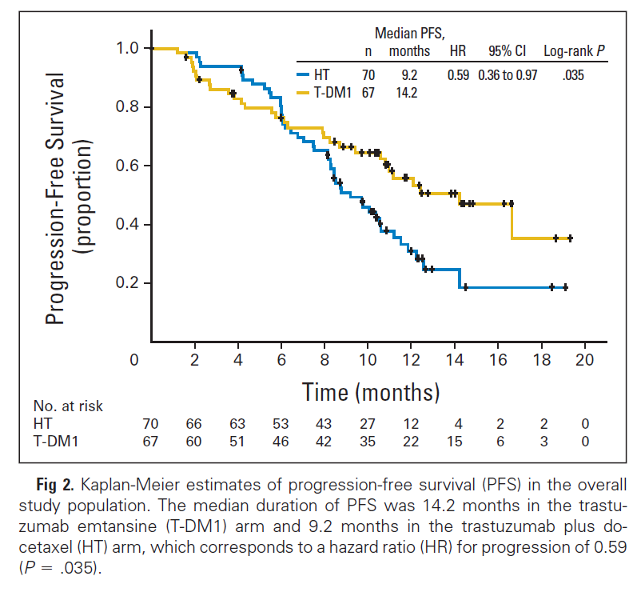
PFS example
San Antonio Breast Cancer Symposium - Cancer Therapy and Research Center at UT Health Science Center – Dec10-14, 2013
Key terms:
median PFS
1 year PFS
p-value
Hurvitz et al., Phase II randomized study of trastuzumab emtansine
versus trastuzumab plus docetaxel in patients with HER2-positive metastatic breast cancer. JCO, Mar 2013 31(9).
This presentation is the intellectual property of the author/presenter. Contact her at garrettm@musc.edu for permission to reprint and/or distribute.

Slide 21
Censoring and Interval Censoring
San Antonio Breast Cancer Symposium - Cancer Therapy and Research Center at UT Health Science Center – Dec10-14, 2013
DFS and PFS are called ‘time to event’ endpoints
Events are disease recurrence or progression
Some patients do not ever have the event and their times are considered ‘censored’ at the last time they were known to be free of disease (or progression).
Progression and recurrence are usually measured by imaging
every 2-4 months (or longer)
actual time of event is not known
This presentation is the intellectual property of the author/presenter. Contact her at garrettm@musc.edu for permission to reprint and/or distribute.

Slide 22
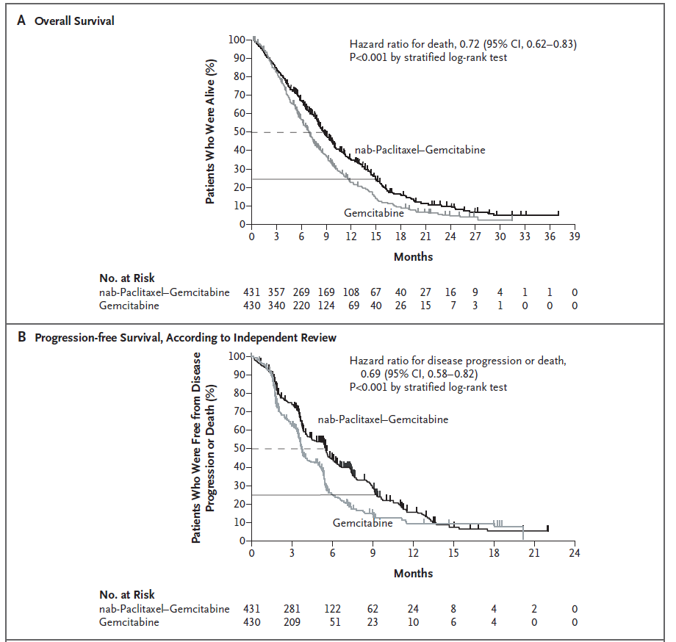
Interval-censoring example
San Antonio Breast Cancer Symposium - Cancer Therapy and Research Center at UT Health Science Center – Dec10-14, 2013
How often were patients evaluated for disease progression?
Tumor response was evaluated every 8 weeks by SCT or MRI
Von Hoff et al. Increased survival in pancreatic cancer with nab-Paclitaxel plus gemcitabine. NEJM, Oct 16, 2013.
This presentation is the intellectual property of the author/presenter. Contact her at garrettm@musc.edu for permission to reprint and/or distribute.

Slide 23
Phase III Trials: Comparative Efficacy
San Antonio Breast Cancer Symposium - Cancer Therapy and Research Center at UT Health Science Center – Dec10-14, 2013
This presentation is the intellectual property of the author/presenter. Contact her at garrettm@musc.edu for permission to reprint and/or distribute.

Slide 24
Comparing efficacy
San Antonio Breast Cancer Symposium - Cancer Therapy and Research Center at UT Health Science Center – Dec10-14, 2013
“Does the new treatment approach extend survival compared to the previous approach?”
Potentially practice changing trial
Defining a new standard of care
Results submitted to FDA for approval
In some breast cancer patient populations, RFS or PFS is an acceptable endpoint when:
overall survival takes a looooong time to evaluate
treatments are already very effective
This presentation is the intellectual property of the author/presenter. Contact her at garrettm@musc.edu for permission to reprint and/or distribute.

Slide 25
Overall survival (OS)
San Antonio Breast Cancer Symposium - Cancer Therapy and Research Center at UT Health Science Center – Dec10-14, 2013
Time from treatment initiation (or randomization) to death.
No interval censoring, but there is still censoring
Common approaches for evaluation
Kaplan-Meier curves
Hazard ratio (HR)
log-rank test
Cox regression model
Graphical display of time to event data
A risk ratio
Test for comparing time to event data between 2 (or more) groups
An approach for estimating the hazard ratio and for testing that the HR=1.
This presentation is the intellectual property of the author/presenter. Contact her at garrettm@musc.edu for permission to reprint and/or distribute.

Slide 26
Hazard ratio for OS
San Antonio Breast Cancer Symposium - Cancer Therapy and Research Center at UT Health Science Center – Dec10-14, 2013
The ratio of the risk of death at any given point in time between patients in the one treatment group compared to the other, conditional on being alive at that time point.
Proportional Hazards Assumption: the ratio is constant over time.
Why ‘hazard’?
hazard function = Prob(die at time t| survival to time t)
hazard ratio = hazard for new treatment/hazard for SOC
Interpretations of HR for PFS and RFS are analogous to that for OS.
This presentation is the intellectual property of the author/presenter. Contact her at garrettm@musc.edu for permission to reprint and/or distribute.

Slide 27
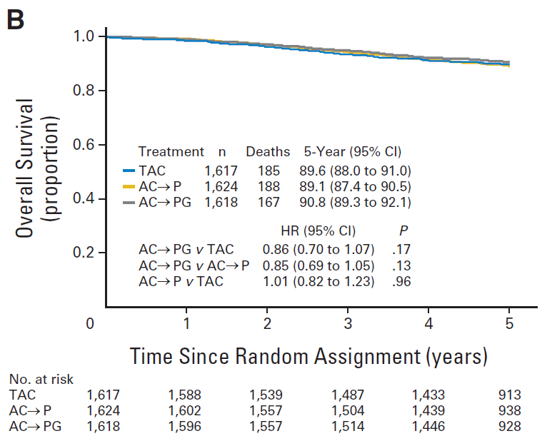
Phase III OS example
San Antonio Breast Cancer Symposium - Cancer Therapy and Research Center at UT Health Science Center – Dec10-14, 2013
Key terms:
hazard ratio (HR)
5 year OS
95% confidence interval (95% CI)
p-value (p)
Swain et al., Definitive results of a phase III adjuvant trial comparing three chemotherapy regimens in women with operable, node-positive breast cancer: The NSABP B-38 trial. JCO, Sep 10 2013.
Figure 2B. Overall survival across all three treatment arms. AC→P: doxorubicin & cyclophosphamide followed by paclitaxel; AC→PG, doxorubicin and cyclophosphamide followed by paclitaxel and gemcitabine;
TAC: docetaxel, doxorubicin, cyclophosphamide.
This presentation is the intellectual property of the author/presenter. Contact her at garrettm@musc.edu for permission to reprint and/or distribute.

Slide 28
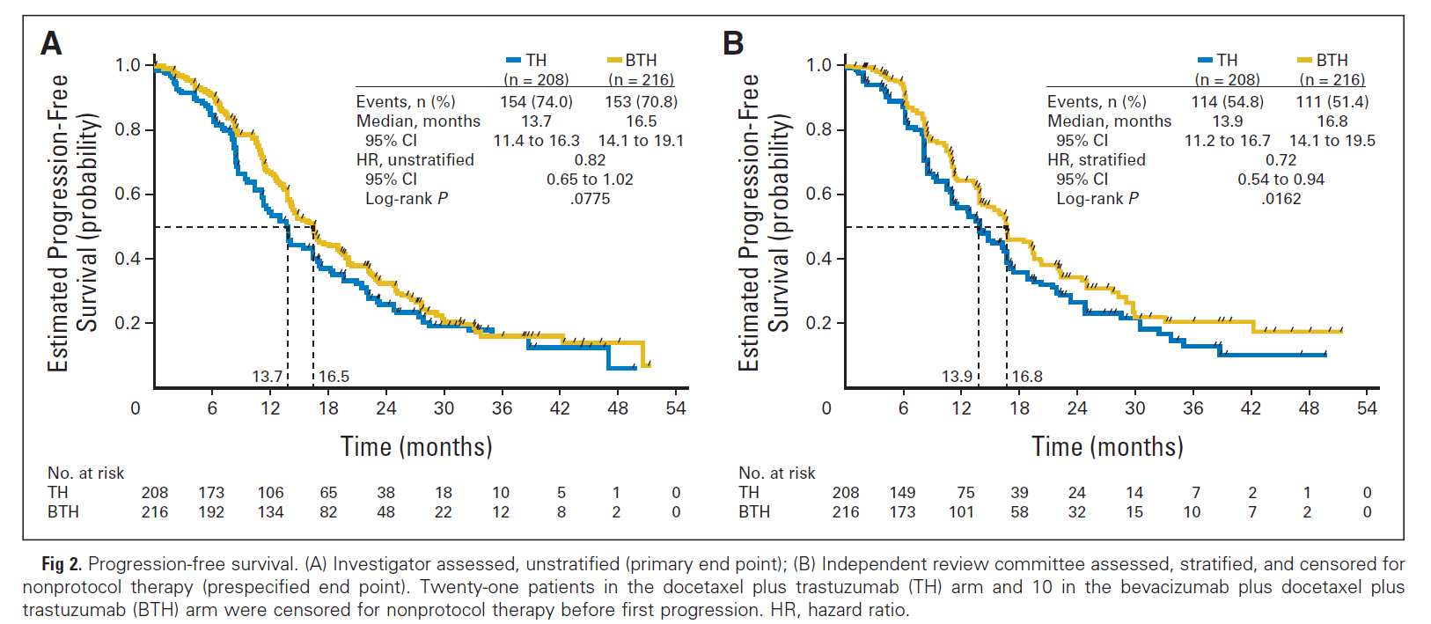
Phase III PFS example
San Antonio Breast Cancer Symposium - Cancer Therapy and Research Center at UT Health Science Center – Dec10-14, 2013
Gianni et al. AVEREL: A randomized phase III trial evaluating bevacizumab in combination with docetaxel and trastuzumab as first-line therapy for HER2-positive locally recurrent/metastatic breast cancer. JCO, 2013 May 10.
This presentation is the intellectual property of the author/presenter. Contact her at garrettm@musc.edu for permission to reprint and/or distribute.

Slide 29
The End
San Antonio Breast Cancer Symposium - Cancer Therapy and Research Center at UT Health Science Center – Dec10-14, 2013
Elizabeth Garrett-Mayer
garrettm@musc.edu
http://people.musc.edu/~elg26
This presentation is the intellectual property of the author/presenter. Contact her at garrettm@musc.edu for permission to reprint and/or distribute.

Slide 30
Proportional hazards assumption
San Antonio Breast Cancer Symposium - Cancer Therapy and Research Center at UT Health Science Center – Dec10-14, 2013
This presentation is the intellectual property of the author/presenter. Contact her at garrettm@musc.edu for permission to reprint and/or distribute.

Slide 31
Ratio of heights is 0.5
San Antonio Breast Cancer Symposium - Cancer Therapy and Research Center at UT Health Science Center – Dec10-14, 2013
This presentation is the intellectual property of the author/presenter. Contact her at garrettm@musc.edu for permission to reprint and/or distribute.

Slide 32
Ratio of heights is always 0.5 (in this case)
San Antonio Breast Cancer Symposium - Cancer Therapy and Research Center at UT Health Science Center – Dec10-14, 2013
This presentation is the intellectual property of the author/presenter. Contact her at garrettm@musc.edu for permission to reprint and/or distribute.

